Slide 1
Self–accelerating universe from nonlinear massive gravity
Chunshan Lin
Kavli IPMU@UT

Slide 2
Outline
Introduction;
Self–accelerating solutions in open FRW universe;
Cosmological perturbations
The nonlinear massive gravity theory
The first workable model !
Scalar sector & vector sector … ?
Tensor sector … !

Slide 3
Introduction
Part I

Slide 4
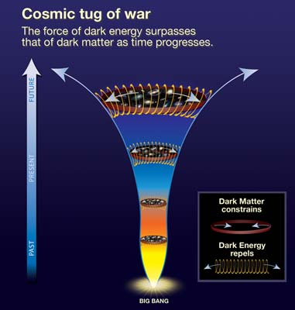

Introduction
Cosmic acceleration

Slide 5


Introdction
Can we give graviton a mass?
  Fierz and Pauli 1939
  Vainshtein 1972 non–linear interactions
  Boulware–Deser (BD) ghost 1972
van Dam–Veltman–Zakharov discontinuity
Lack of Hamiltonian constrain and momentum constrain
6th dof is BD ghost!
6 degrees of freedom
？
Helicity ±2, ±1, 0
5 dof

Slide 6
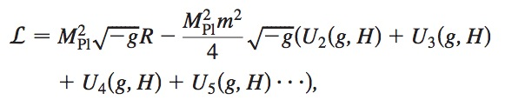

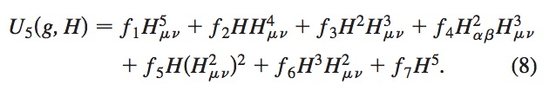





Introduction
Whether there exist a nonlinear model without ghost?
  N. Arkani–Hamed et al 2002
  P. Creminelli et al., ghost free up 4th order, 2005
  C. de Rham and G. Gabadadze 2010
Not protected by symmetry!

Slide 7

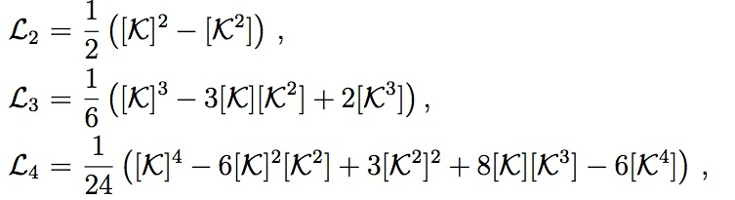




Introduction
  C. de Rham, G. Gabadadze and A. Tolly 2011
Automatically produce the “appropriate coefficients” to eliminate BD ghost!
Or rewrite it as
Stukelberg fields
It is often called fiducial metric

Slide 8
Self–accelerating solutions
A.Emir Gumrukcuoglu, Chunshan Lin, Shinji Mukohyama arXiv:1109.3845
Part II

Slide 9
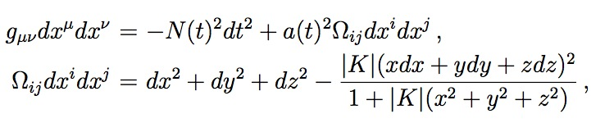
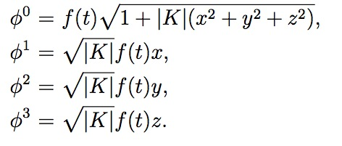
Self–accelerating solutions
No go result for FRW solution (G. D’Amico et al 2011 Aug.)
However… (A.Gumrukcuoglu, C. Lin, S. Mukohyama: 1109.3845)
It does not extend to open FRW universe
The 4 Stukelberg scalars
motivated by…
Minkowski metric
Open FRW chart

Slide 10

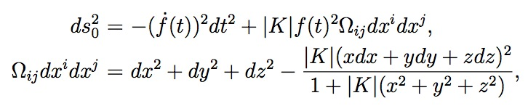
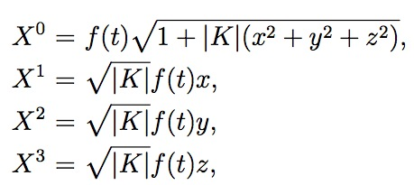
Self–accelerating solutions
Open chart of Minkowski spacetime
The Minkowski metric
can be rewritten in the open FRW form as
by such coordinate transformation

Slide 11


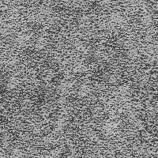

Self–accelerating solutions
Fiducial metric respect FRW symmetry
  (0i) –components of the equation of motion for are trivially satisfied;
  In addition to the identity (Hassan&Rosen 1103.6055)
  Evolution equations for cosmic perturbations fully respect homogeneity and isotropy at any order.
The first workable model !
contain all nontrivial information.

Slide 12
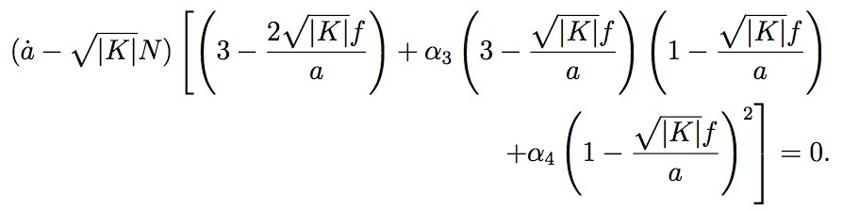


Self–accelerating solutions
reads
  1st solution
  2nd and 3rd solutions
  Please notice that these 2 solutions do not exist when K=0.

Slide 13


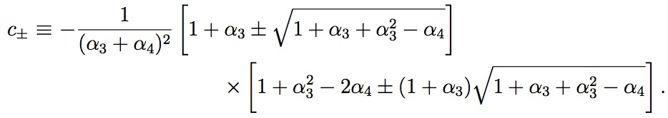

Self–accelerating solutions
Freedmann equation
where
The effective cosmological constant

Slide 14
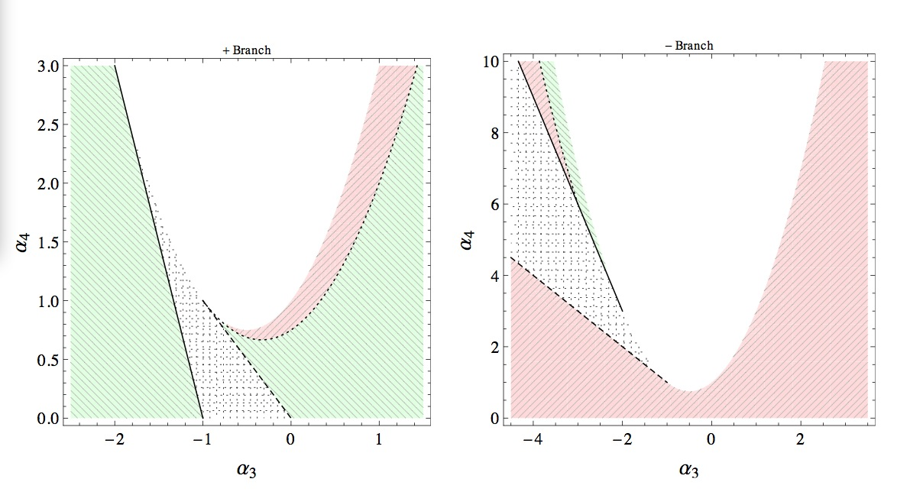
Self–accelerating solutions
Sign of the effective cosmological constant

Slide 15
Cosmological perturbations
Part III
A.Gumrukcuoglu, C. Lin, S. Mukohyama: 1111.4107

Slide 16

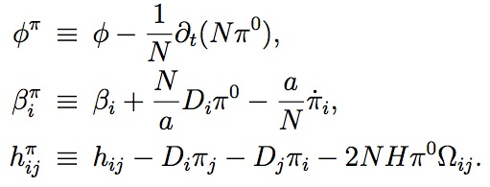
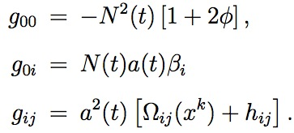
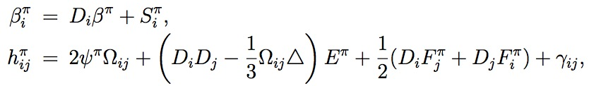
Cosmological perturbations
The total action
Perturb stukelberg fields
Arbitrary fiducial metric
Define the gauge invariant variable
The induced metric perturbation
Decomposition for convinience

Slide 17

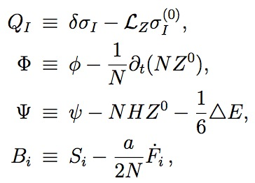


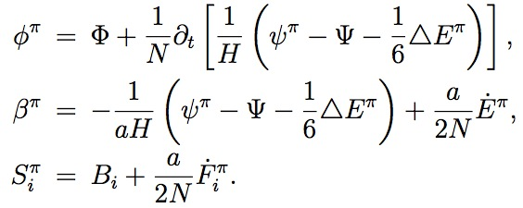

Cosmological perturbations
Then perturb the matter fields
Construct gauge invariant variables as
where
There are such relations between these two sets of perturbations

Slide 18



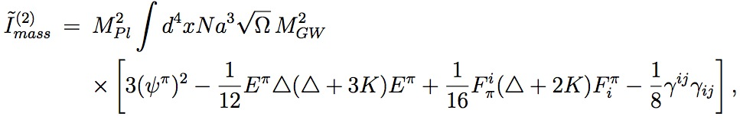
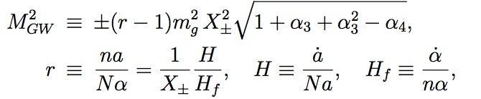
Cosmological perturbations
Rewrite the action for the simplicity of calculation
The gravitational mass terms
and
So
It does not contribute to the eom of
No kinetic terms
where

Slide 19


Cosmological perturbations
  No kinetic terms but non–vanishing mass terms
  Finally we get
    Scalar & vector = GR
    Time dependent mass of gravitational waves
Integrated out
+
Suppression
–
Instability
OR

Slide 20




Cosmological perturbations
An example
  The quadratic order of tensor perturbation is
where
Deviation from scale invariance…
DECIGO, BBO, LISA…
Harmonic expansion
The equation of motion of tensor mode

Slide 21



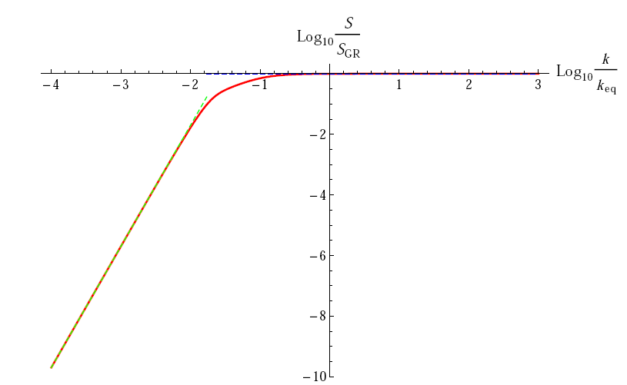
Cosmological perturbations
For the mode we interest nowadays
small scale mode, no differ from GR;
large scale mode, gets extra suppression.
upcoming paper

Slide 22
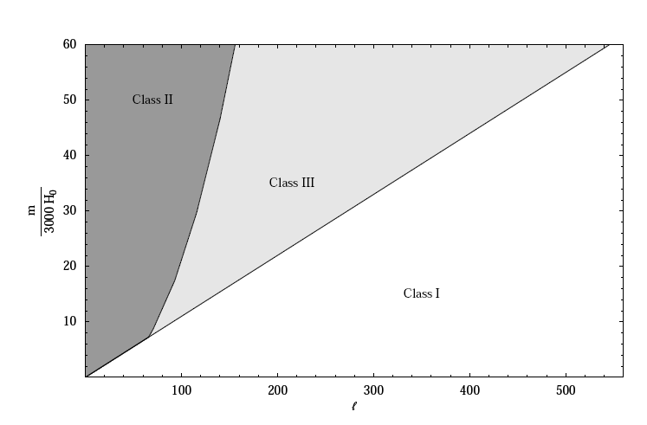
Cosmological perturbations
B mode spectrum on CMB
[0907.1658] S. Dubovsky & A. Starobinsky …..

Slide 23
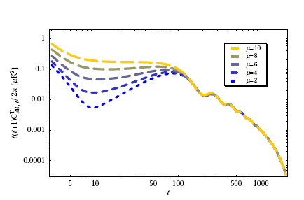

Cosmological perturbations
The plateau?
Combining CMB and late time evolution experiment…
B mode spectrum on CMB

Slide 24
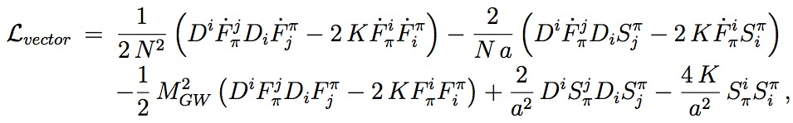



Cosmological perturbations
  Vector perturbations
  Varying this action with respect to
Kinetic term vanishes and

Slide 25
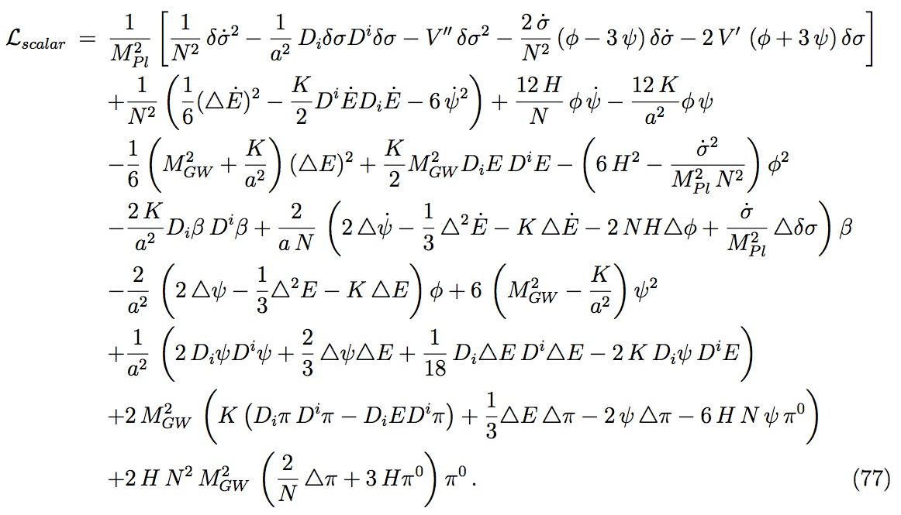

Cosmological perturbations
  Scalar perturbation

Slide 26
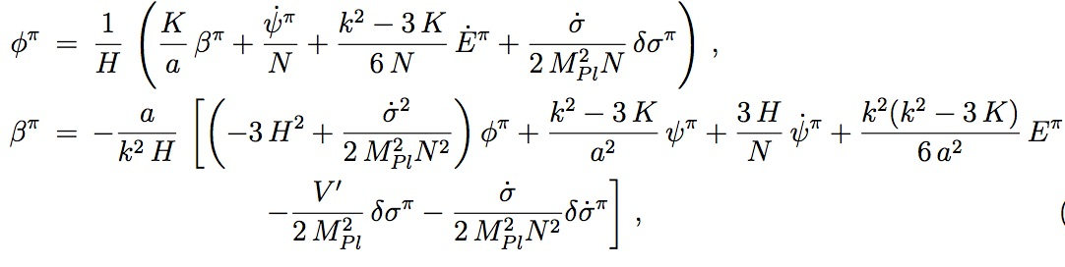


Cosmological perturbations
rewrite it in terms of gauge invariant form, we get EoM
Substitute them into the action, we have
Here Q is Sasaki-Mukhanov variable

Slide 27

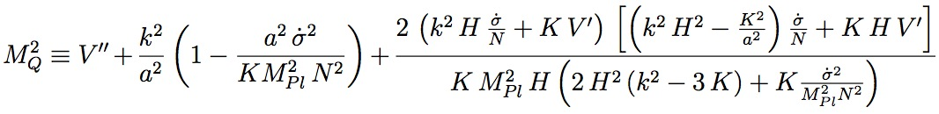


Cosmological perturbations
and
This result agrees with the standard results in GR coupled to the same scalar matter.
Remarks:
  Strong coupling or non dynamical? This is the question!
  lorentz violation
  Higuchi bound is not applicable.

Slide 28
Conclusion and discussion
The nonlinear massive gravity theory
Self accelerating solutions in the open FRW universe
Cosmological perturbations
Upcoming projects
  Late time energy spectrum of gravitational waves;
  Non linear behavior;
  The stability against heavy gravitational source;
  …

Slide 29
Thank You!

