Slide 1
Axion Like Particle and Cosmic Microwave Background Asymmetry
Qiaoli Yang
Jinan University, Guangzhou
06-2018
Hefei

Slide 2
The Standard Model of particle physics explains ALMOST every thing that we CURRENTLY observed...
Expect:
It cannot be the ultimate theory due to theoretical considerations.
We do already have phenomenological hits of BSM NP.

Slide 3
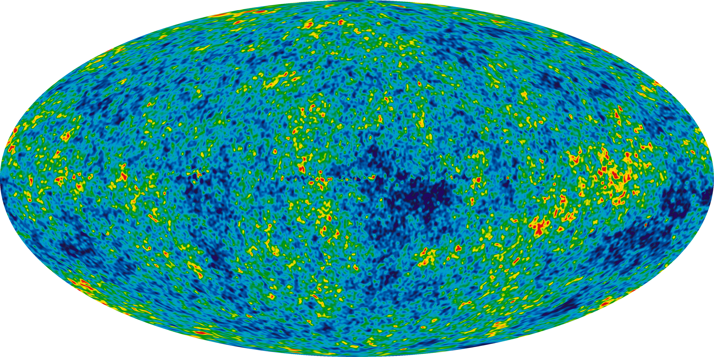
Cosmological observations strongly indicate the existence of Dark matter
CMB anisotropy observations. (Horizon scale)
Structure formation. (Horizon scale)

Slide 4
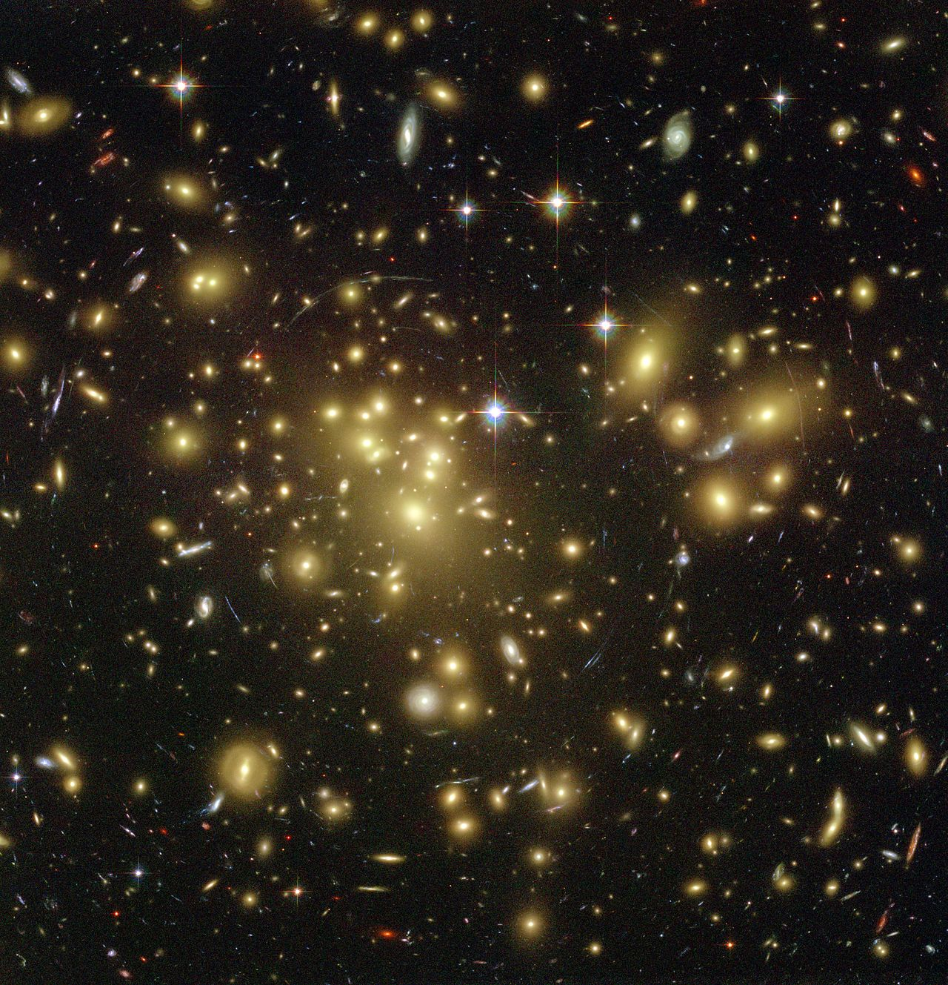
Gravitational lensing. (Cluster scale)
Galaxy clusters velocities. (Cluster scale)

Slide 5
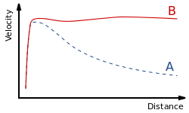
Galaxy rotation curves. (Galaxy scale)
etc.

Slide 6
Possible Solutions:
Modify Gravity:
MOND
entropic gravity
..
Massive compact halo object (small black hole.. )
New fundamental particles

Slide 7
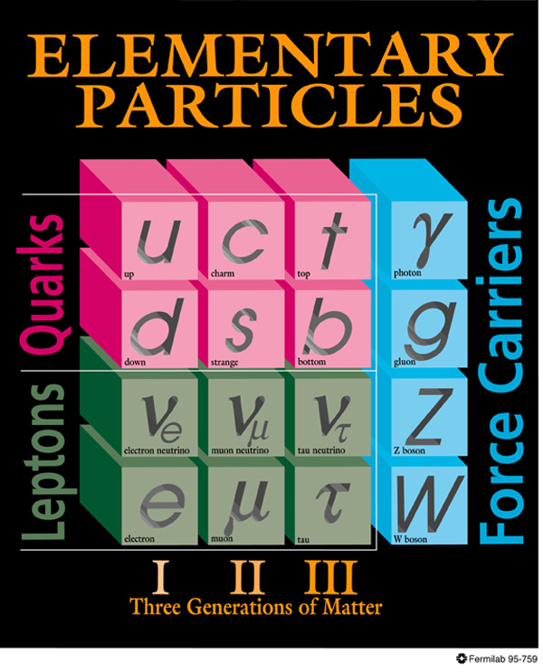
Dark matter
  Properties
  stable
  non-relativistic
  non-baryonic
  BSM NP exist!

Slide 8
leading candidates:
WIMPs
Axions
ALPs
Dark Photons
.....

Slide 9
leading candidates:
Spin 0
Spin 1/2
Spin 1
.....

Slide 10

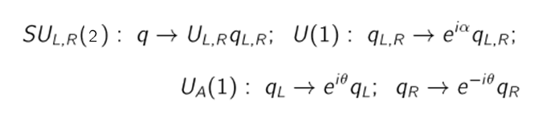
The U(1)_A Problem
The light u-d quark Langrangin in the chiral limit:
It has following symmetries:

Slide 11


The symmetry is broken due to quark pair condensation
The vector symmetry is unbroken so

Slide 12
Three generators are broken so there are three pseudo Nambu-Goldstone bosons.
What happened to the U(1)_A? It should also be broken and give the fourth pseudo Nambu-Goldstone which is not observed.
Solution: U(1)_A is explicitly broken due to QCD instanton effect.

Slide 13


A classical field configuration of QCD vacuum:
with the winding number n
cannot be smoothly deformed into others with a different winding number without passing energy barriers

Slide 14

However these field configurations with different winding numbers can tunnel to each other due to instantons.
So the physical vacuum has to include field configuration with all possible winding numbers thus has the form:

Slide 15
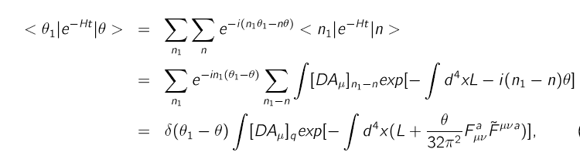
The \theta vacuum gives an additional effective interaction term:

Slide 16


This term violates CP invariance if
The measurement of electric dipole moment of neutron gives a upper limit:

Slide 17
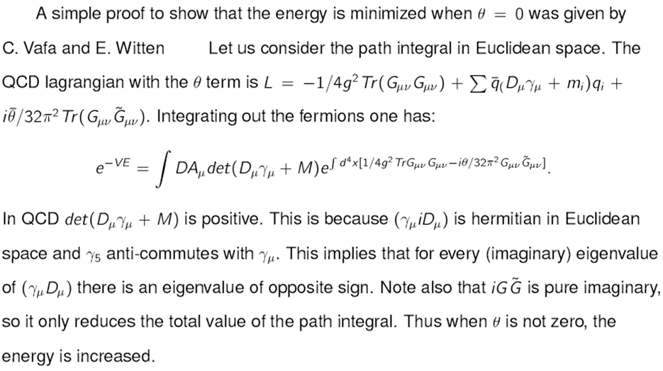

Slide 18
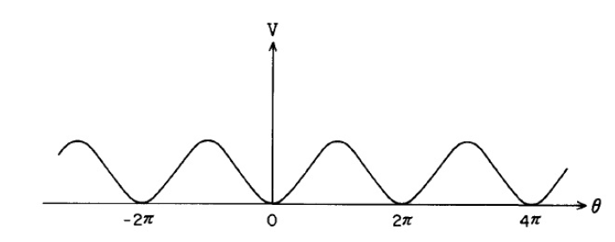


Slide 19

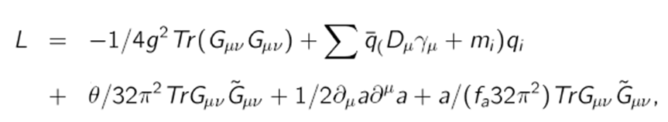

To solve the strong CP problem, one introduces the symmetry which is spontaneously broken
relaxes to zero during QCD phase transition.

Slide 20

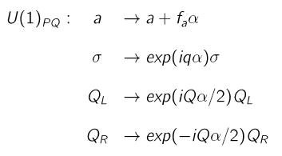

A example: the KSVZ axion
One introduces an new complex scalar and a new heavy quark Q.
=>

Slide 21
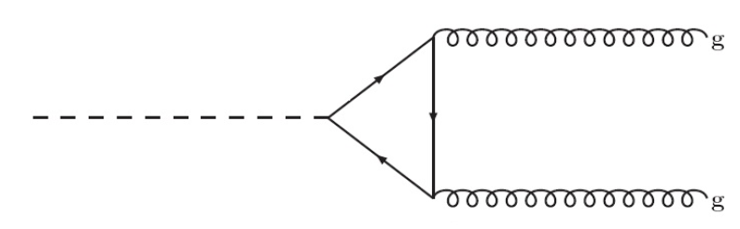
The ABJ anomaly gives the required effective axion-gluon-gluon coupling.

Slide 22
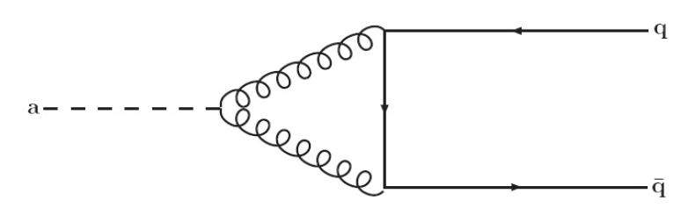
After QCD phase transition, the “PQ” Nambu-Goldstone boson acquires mass due to instanton effects, hence becoming a quasi-Nambu-Goldstone boson, the “axion”.

Slide 23



Axion like particles
interested background fields in string theory:
the metric
the two-form gauge antisymmetric field
dilaton
...

Slide 24
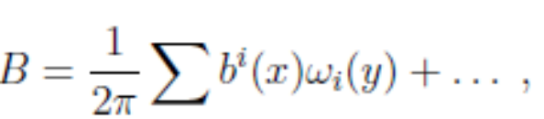
Axion like particles
alps arises due to compactification of the antisymmetric tensor fields
the x are non-compact coordinate, y are compact coordinates.

Slide 25
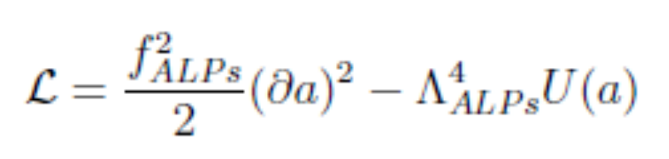
Axion like particles
the zero mode acquires a potential due to non-perturbative effects on the compactifying cycle.
The effective Lagrangian in four dimension:

Slide 26
ALPs
So if the string theory is true, alps exist inevitably.
Question is: what is the mass?

Slide 27
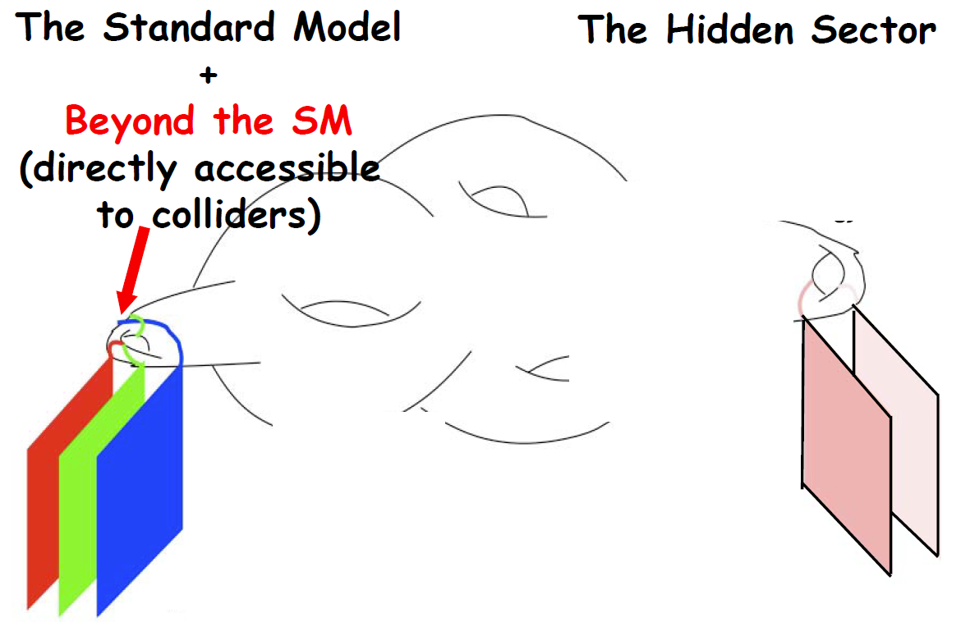
Spin 1, dark photons
A hidden sector particle

Slide 28
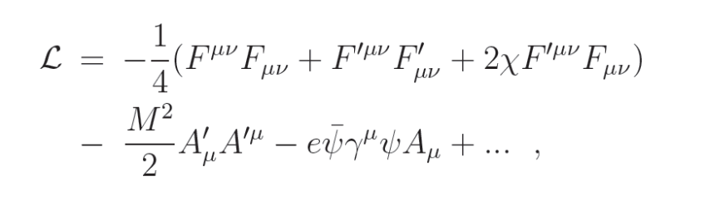
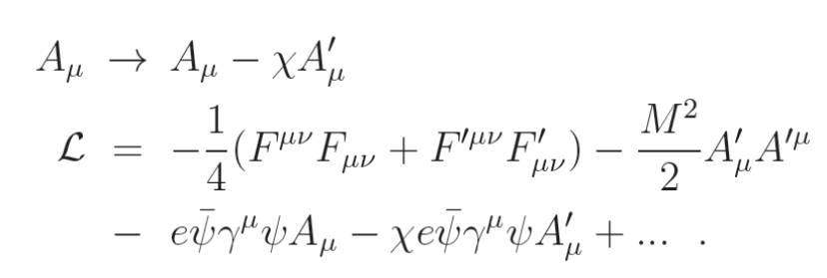
Dark photons

Slide 29
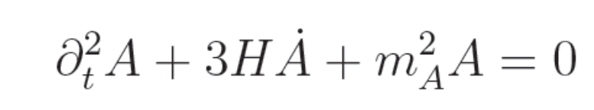
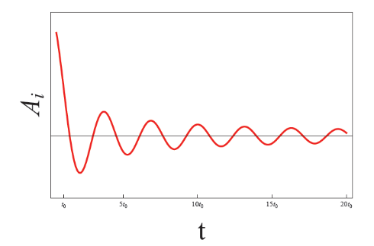
Misalignment mechanism:
during the radiation dominated era:

Slide 30

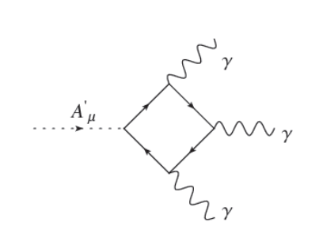
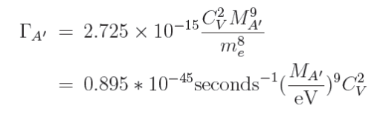
Dark photons
Decay channel
Decay rate:

Slide 31
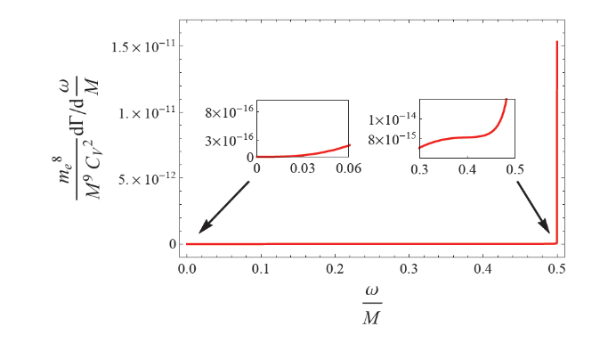
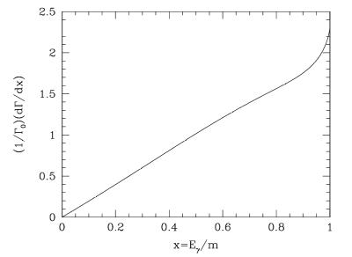
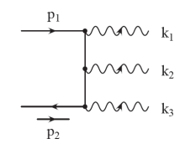
Dark Photons
Spectrum:
orthopositronium：

Slide 32
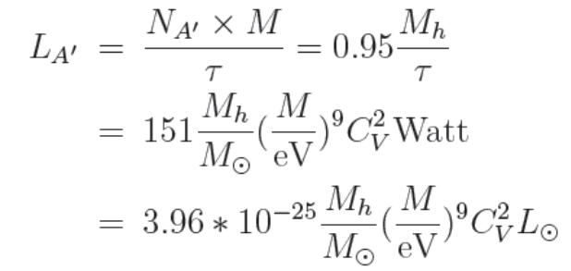
Dark matter halos
up to 95% percent galaxy mass which is of order 10^(12) solar mass.

Slide 33
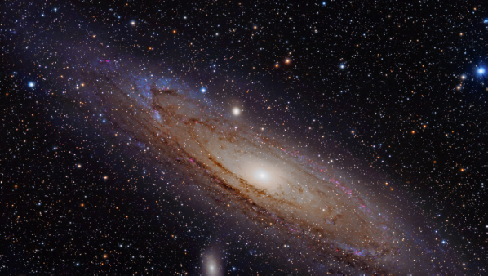

The distortion of spectrum
Cosmology red-shift, Gravitational red-shift, Kinetic red-shift...

Slide 34
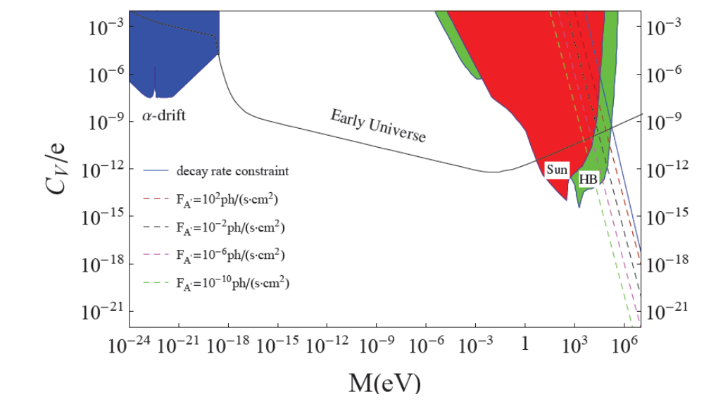
The flux from the M31 received on the earth
Q. Yang, H. Di, PRD 95 (2017), 075032.

Slide 35


Atomic transitions to detect dark photons
Q. Yang, H. Di, Phys.Lett. B780 (2018) 622
small velocity
high energy spectrum density

Slide 36


Dark photon detection
Interactions in non-relativistic limit:
in atomic scale，DP behaves like laser

Slide 37
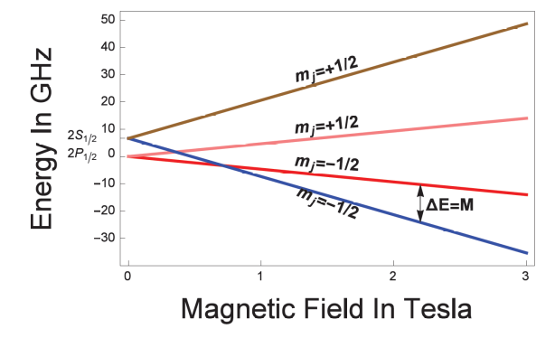
Dark photons
experiment detection:

Slide 38
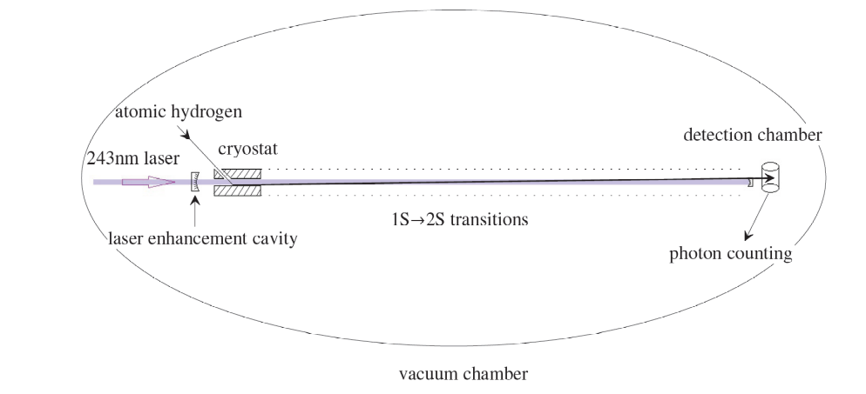

Dark Photon Detection

Slide 39
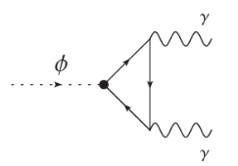
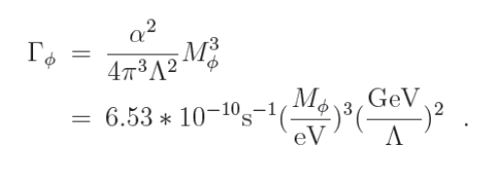
ALPs
decay channel
decay rate:

Slide 40

QCD Axions:
Cosmological density ratio during the matter dominate era:

Slide 41
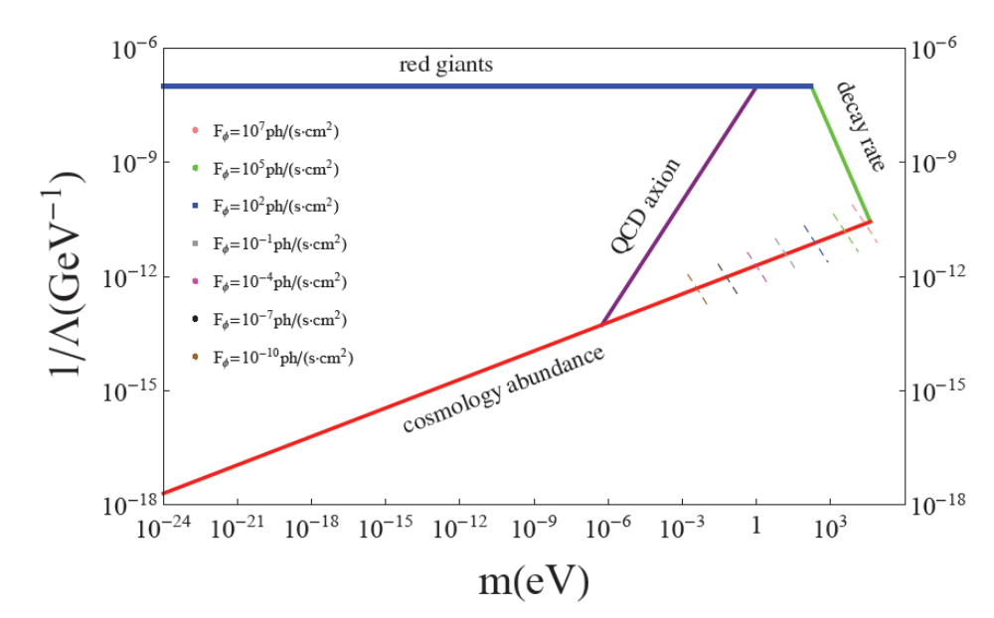
The flux of ALPs
Q. Yang, H. Di, PRD 95 (2017), 075032.

Slide 42
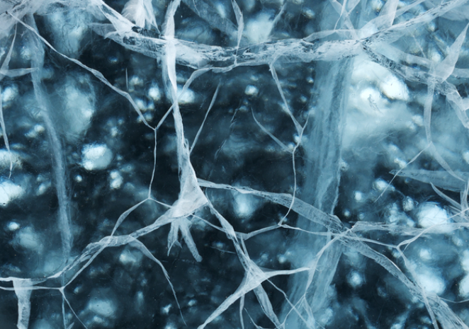
A GUT Scale ALP?
Q. Yang, Y. Liu, H.Di, PRD 96 (2017) 083516
H.Di, Q. Yang, arXiv:1712.09917
topological defect is a very common phenomenon.

Slide 43
Why we have not seen any fundamental field defects?
Axion strings, Axion Domain Walls
Inflated away..
But can we see their remnant?

Slide 44
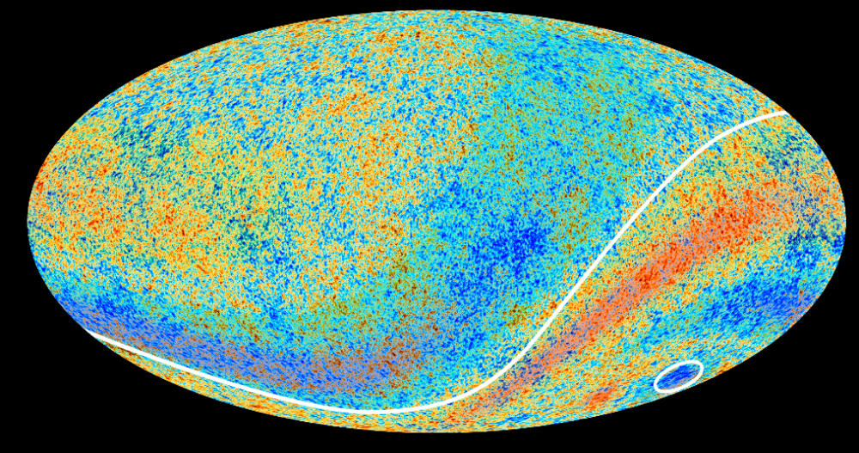
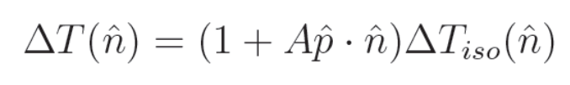

Slide 45

The hemispherical power asymmetry：
Scale dependent:
A\sim0.072 for l<600

Slide 46
Inflation
Cosmological scale correlation length:
Structures should be Inflated away.
Structures formed after inflation:
Correlation length should be much smaller then the horizon

Slide 47
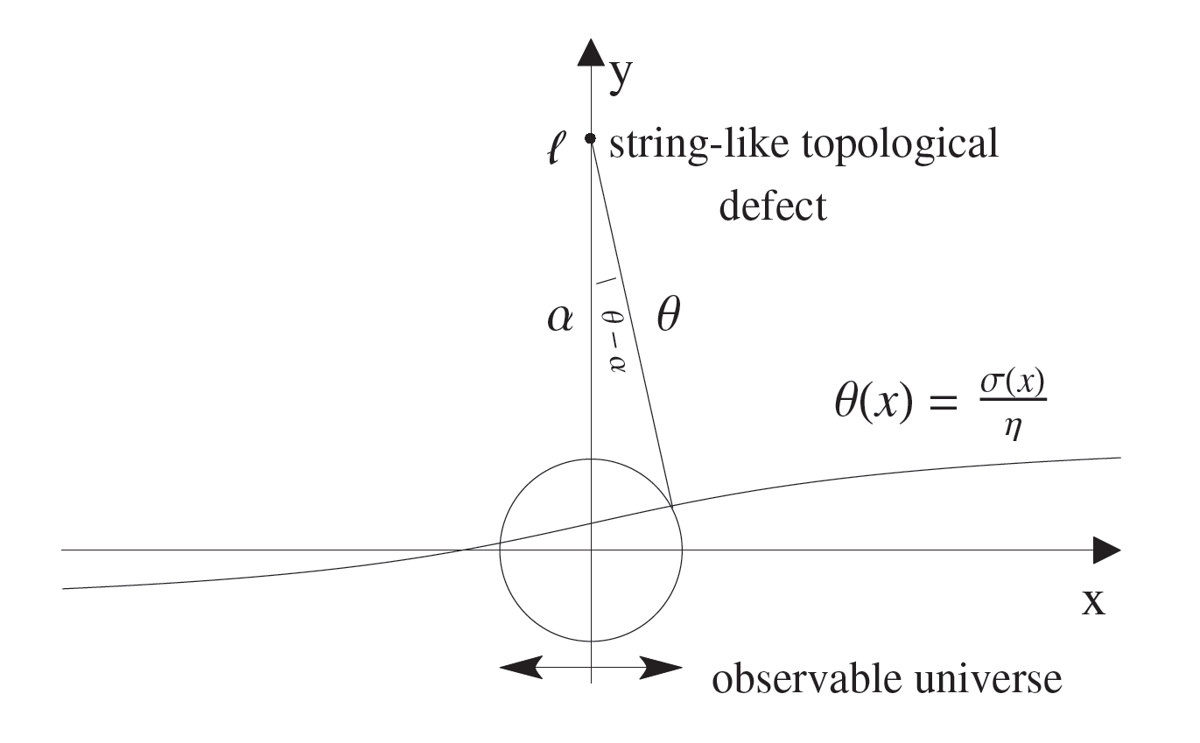


Slide 48
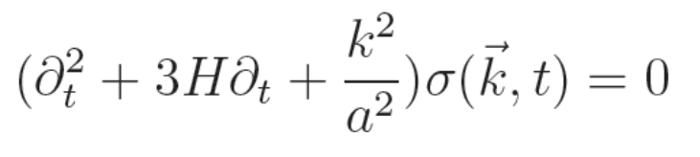
for small k modes, protected by topology.
for large k modes, frozen by causality

Slide 49
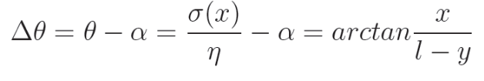
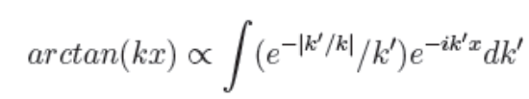
Initial fluctuation:

Slide 50
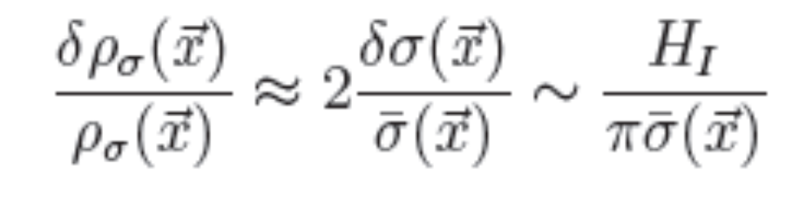
Amplitude fluctuation due to the quantum effects
When the field perturbation is small:

Slide 51
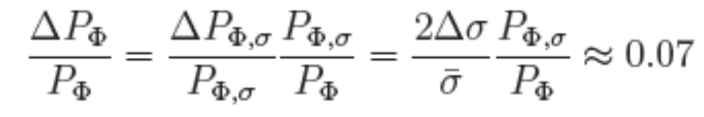
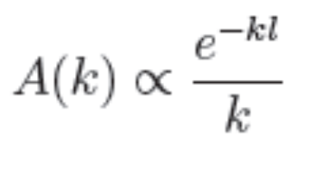
The power asymmetry is:
So the asymmetry is scale dependent:

Slide 52
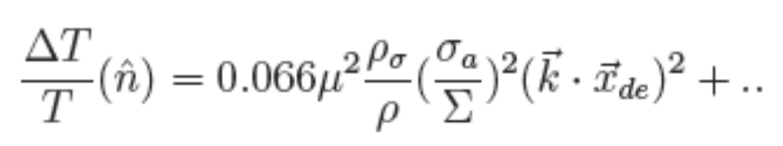
Asymmetry due to the Grishchuk-Zeldovich effect:
Quadrupole is the leading term:

Slide 53
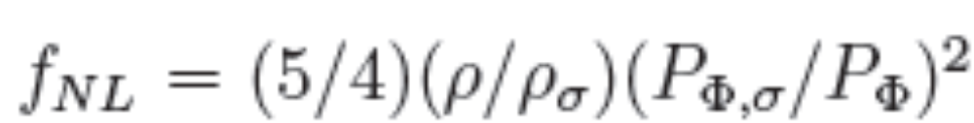
non-Gaussian term:

Slide 54
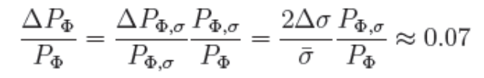
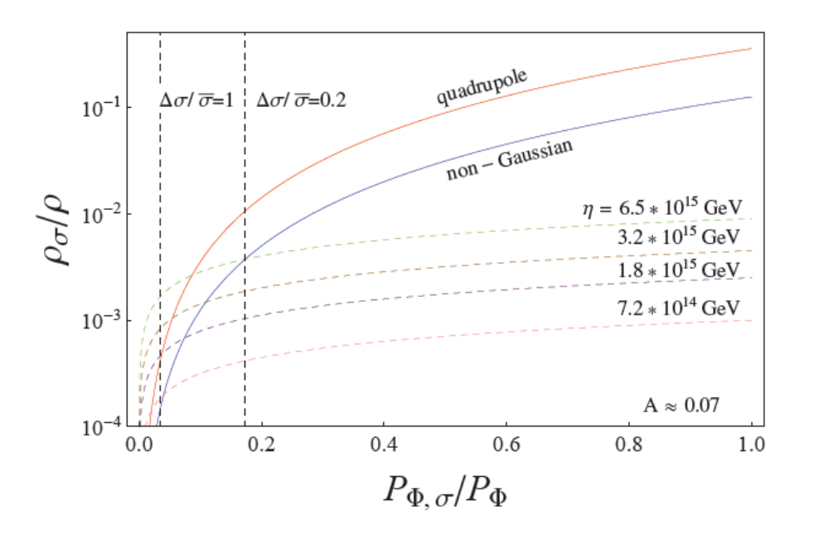
Power asymmetry

Slide 55
Conclusions:
Dark Matter is an elegant solution to explain the observations across many different order of cosmological scales, therefore, is highly likely to be true.
Non-thermal creation of bosonic dark matter is a very interesting mechanism, which leads to a different dark matter behavior comparing to WIMPs.
The dipole CMB anomaly may suggest an ALP with GUT Scale F_a.

