Slide 1
Systematic calculations of alpha decay half-lives and branching ratios of unstable nuclei
Zhongzhou REN (任 中洲)
Department of Physics, Nanjing University, Nanjing, China

Slide 2
Outline
Review: alpha decay and cluster radioactivity
Formulas and models, Density-dependent cluster model (DDCM) and generalized DDCM
Multi-channel cluster model (MCCM):
(1) solve coupled-channel Schrödinger equations for quasi-bound states
(2) both alpha-decay half-lives and branching ratios of deformed nuclei are obtained
Summary

Slide 3
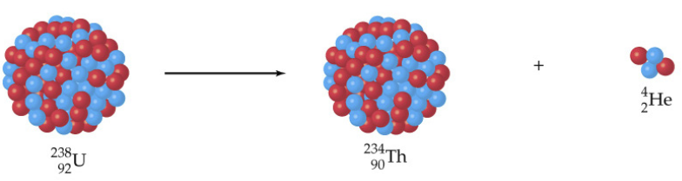
Review on decay (alpha, cluster)
α decay: early days of nuclear physics (1896, Becquerel; Curies…).
Rutherford: three kinds of radioactivity, alpha, beta, gamma; existence of nucleus by alpha scattering.
Proton radioactivity (Z≥51)
Alpha decay (Z≥52)
Cluster radioactivity (Z≥87)
Spontaneous fission (Z ≥90)

Slide 4

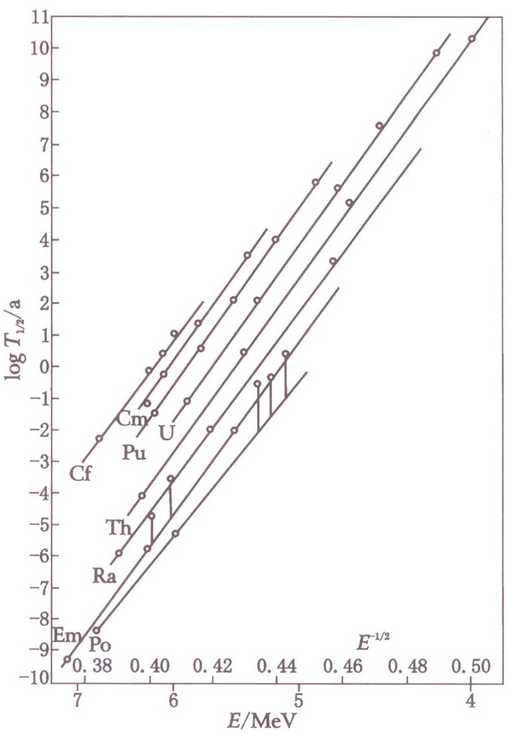
Page 120-125 Geiger-Nuttall law：Relation between alpha-decay energies and alpha-decay half-lives

Slide 5
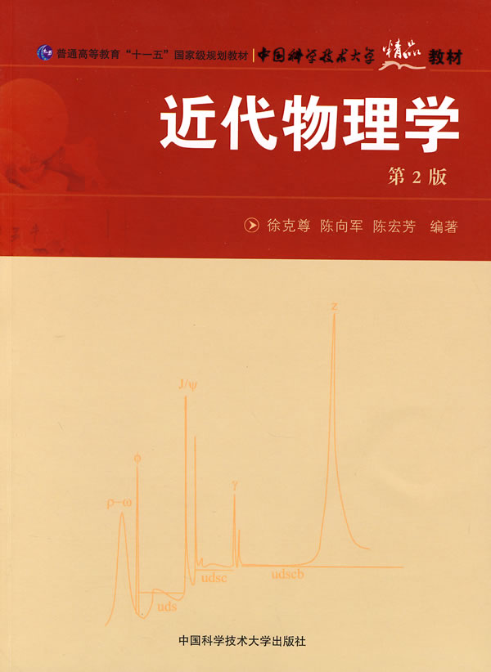
科大的近代物理教科书也有Geiger-Nuttall定律

Slide 6
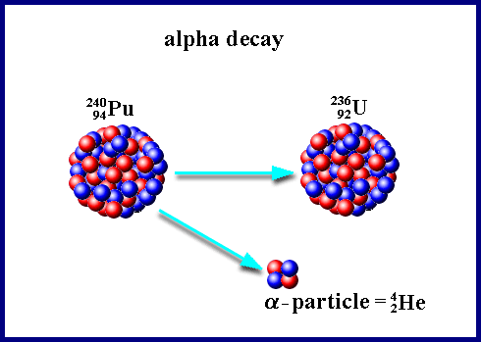
Gamow explanation (1928, ZPA,一下成名):
Geiger-Nuttall law for half-lives of α-decay
H. Geiger and J.M. Nuttall "The ranges of the α particles from various radioactive substances and a relation between range and period of transformation," Philosophical Magazine, Series 6, vol. 22, no. 130, 613-621 (1911).
H. Geiger and J.M. Nuttall "The ranges of α particles from uranium," Philosophical Magazine, Series 6, vol. 23, no. 135, 439-445 (1912).

Slide 7

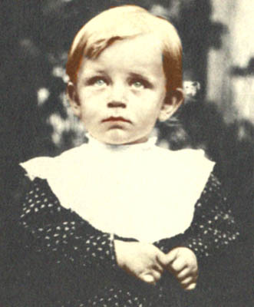
… 1928…
publication his explanation with quantum mechanics
George Gamow in 1909,
two years before
discovery of the G-N law

Slide 8
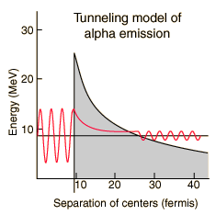
G. Gamow "Zur Quantentheorie des Atomkernes" (On the quantum theory of the atomic nucleus), Zeitschrift für Physik, vol. 51, 204-212 (1928).
1.First: quantum mechanics (Atom) to Nuclear Physics 2. beta decay(GT) 3.Big bang 4.Biophysics 5.play???
R_{ext}
↓
Internal region External region

Slide 9
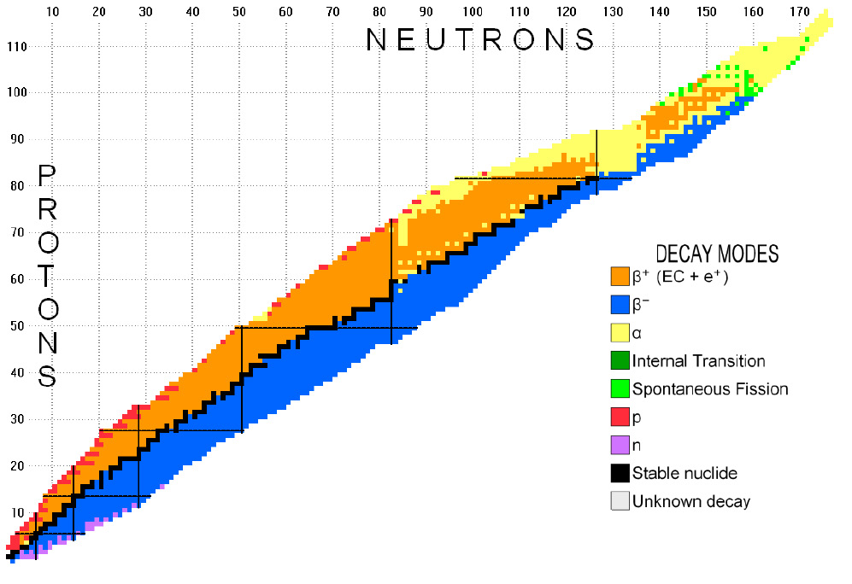
There are more than 400 nuclei that exhibit the alpha-decay phenomenon (yellow one).

Slide 10
It has been used as a reliable way to identify new synthesized elements and isomeric states.

Slide 11
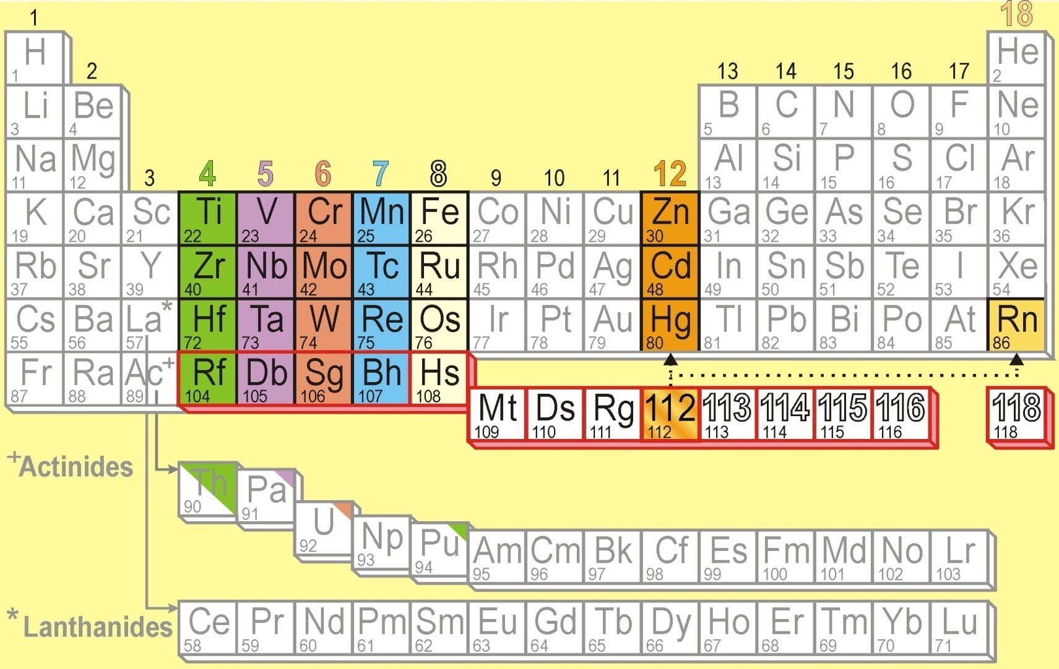
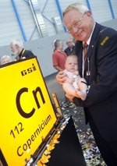
Superheavy: Z=114 (Fl), Z=116 (Lv)
Cn
112
117
117
R. Eichler et al, NATURE, Vol.447(2007)72, Chemical characterization of element 112
Oganessian et al., Phys. Rev. Lett. 104, 142502 (2010)
Synthesis of a New Element with Atomic Number Z=117
Notes:
到目前为止，人们已经知道118个化学元素，而原子序数Z ≥104的元素称为超锕元素或者超重元素， 共计15个。今年俄罗斯杜布纳实验室合成了117号元素。然而，超重元素在元素周期表中的位置不仅取决于它们的原子序数，而且还决定于它们的化学性质。人们已经开展了Rf-Hs的化学性质研究， 并且找到了它们在周期表中的位置。最近IUPAC命名了112号元素为Copernicium （Cn）, 并且进行了化学性质研究，表明Cn的化学性质与易挥发的金属元素汞相似，确定其在周期表中的位置在汞的正下方。从实验上和理论上探索超重元素的化学性质，既可以确定超重元素在元素周期表中的位置，还可以直接检验相对论效应对超重元素化学性质的影响。超重元素的化学性质研究是当前核化学研究领域的基础前沿课题，国际上只有少数几家著名实验室有能力，开展此项研究体现了一个国家综合实力。

Slide 12
Synthesis of Z=112 SHE at SHIP
n
⁷⁰Zn
²⁰⁸Pb
²⁷⁷112
²⁷⁷112
²⁷⁷112
CN
²⁷³110
11.45 MeV
280 μs
²⁶⁹Hs
11.08 MeV
110 μ s
²⁶⁵Sg
9.23 MeV
19.7 s
²⁶¹Rf
4.60 MeV (escape)
7.4 s
known
kinematic separation
in flight
identification
by α-α correlations
to known nuclides
²⁵⁷No
8.52 MeV
4.7 s
Date: 09-Feb-1996
Time: 22:37 h
²⁵³Fm
8.34 MeV
15.0 s

Slide 13


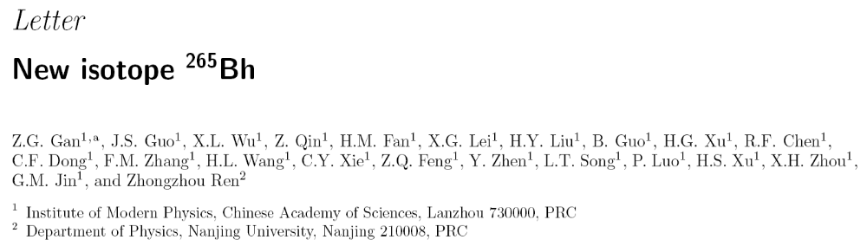
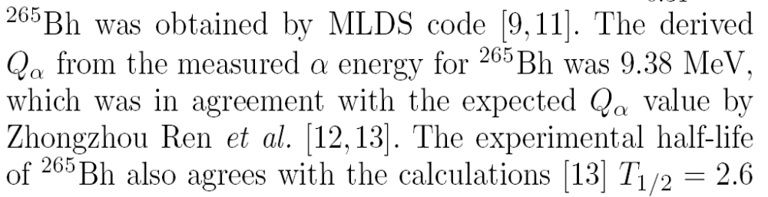
New isotope in China: 265Bh (Z=107)
Data of 265Bh agree with theory [12,13]

Slide 14
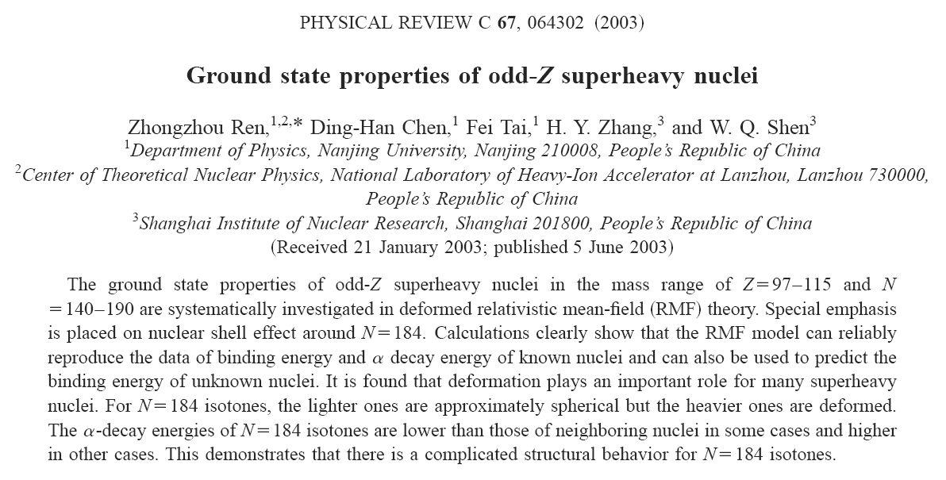
PRC论文: 系统研究奇Z超重核的基态性质,
预言未知超重核衰变能和寿命.

Slide 15
Review on theory for alpha decay
Phenomenological description
(1) Geiger-Nuttall (G-N) law----New G-N Law (2012)
(2) Viola-Seaborg formula
(3) ……
Semiclassical approximation (WKB)
the cluster model
(2) the density-dependent cluster model (DDCM)
(3) the generalized liquid drop model (GLDM)
(4) the super asymmetric fission model (SAFM)
(5) ……

Slide 16
Review on cluster radioactivity
1980 Săndulescu, Poenaru, and Greiner (theoretical prediction) , Sov. J. Part. Nucl. 11 (1980) 528
1984 Rose and Jones (experimental observation ¹⁴C from ²²³Ra), A new kind of natural radioactivity, Nature 307 (1984) 245
1984-2001: from ²²¹Fr to ²⁴²Cm; C, O, F, Ne, Mg, Si radioactivity (¹⁴C—³⁴Si)
2008: radioactivity of ²²³Ac by ¹⁴C and ¹⁵N emissions, J. Phys.: Conf. Ser. (2008) 111012050…

Slide 17
Review on models (alpha and cluster)
Traditional alpha-decay theory:
Buck et al, Gupta et al: Preformed cluster model
Lovas, Liotta, Delion et al: Phys. Rep. 294 (1998) 265
Ren and C. Xu: Density-dependent cluster model…
Denisov and Ikezoe: UMADAC (Cluster model), PRC 72 (2005) 064613…
Fission-like model:
Royer et al: Generalized liquid drop model…
Analytical formula for cluster decay half-lives:
Ren and C. Xu, PRC 70 (2004) 034304;
Ni and Ren…,PRC 78 (2008) 044310…

Slide 18
Focus on researches of my group
Formulas of half-lives:
1. Half-lives of cluster radioactivity (PRC2004)
2. Unified formula of half-lives for alpha decay and cluster radioactivity (PRC2008)
3. New Geiger-Nuttall law of alpha-decay half-lives: effects of quantum numbers (PRC2012)
Theoretical models (PRC2004-2013…):
1. Density-Dependent Cluster Model for spherical nuclei
2. DDCM for deformed nuclei
3. Generalized DDCM
4. Multi-Channel Cluster Model (MCCM) for even-even, odd-A, and odd-odd nuclei

Slide 19
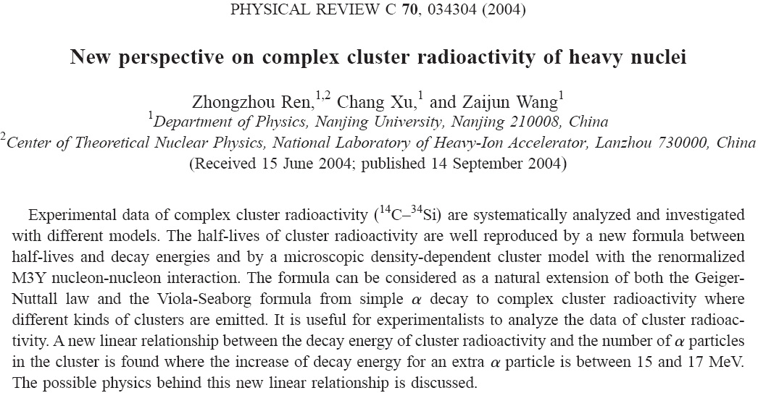
Ren et al., PRC 70 (2004) 034304: New formula and DDCM calculations for cluster radioactivity

Slide 20
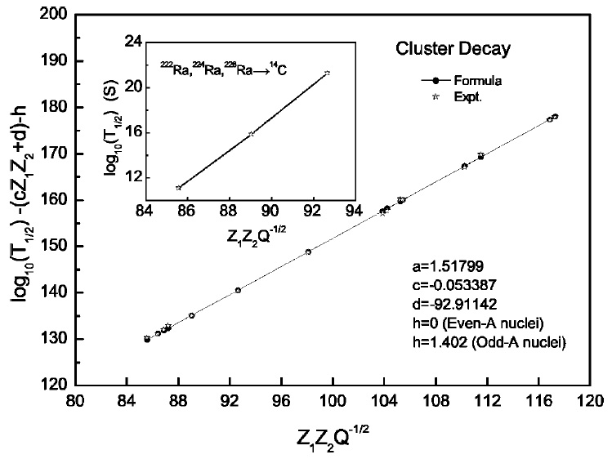
Comparison of the calculated half-lives using the formula with the experimental data for emission of various clusters.

Slide 21
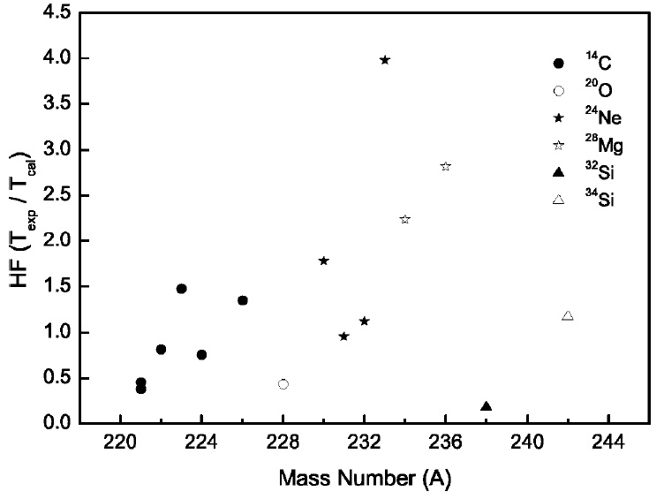
Deviations between experimental half-lives and theoretical one for cluster radioactivity. Calculations are performed within the DDCM.

Slide 22
Half-lives of cluster radioactivity (PRC, 2004)
Decay Q/MeV Log₁₀ T^{expt} Log₁₀ T^{Formula} Log₁₀^{RM3Y}
²²¹Fr—²⁰⁷Tl+¹⁴C 31.29 14.52 14.43 14.86 ²²¹Ra—²⁰⁷Pb+¹⁴C 32.40 13.37 13.43 13.79 ²²²Ra—²⁰⁸Pb+¹⁴C 33.05 11.10 10.73 11.19 ²²³Ra—²⁰⁹Pb+¹⁴C 31.83 15.05 14.60 14.88 ²²⁴Ra—²¹⁰Pb+¹⁴C 30.54 15.90 15.97 16.02 ²²⁶Ra—²¹²Pb+¹⁴C 28.20 21.29 21.46 21.16 ²²⁸Th—²⁰⁸Pb+²⁰O 44.72 20.73 20.98 21.09 ²³⁰Th—²⁰⁶Hg+²⁴Ne 57.76 24.63 24.17 24.38

Slide 23
Half-lives of cluster radioactivity (PRC, 2004)
Decay Q/MeV Log₁₀ T^{expt} Log₁₀ T^{Formula} Log₁₀^{RM3Y}
²³¹Pa—²⁰⁷Tl+²⁴Ne 60.41 22.89 23.44 23.91 ²³²U—²⁰⁸Pb+²⁴Ne 62.31 20.39 21.00 20.34 ²³³U—²⁰⁹Pb+²⁴Ne 60.49 24.84 24.76 24.24 ²³⁴U—²⁰⁶Hg+²⁸Mg 74.11 25.74 25.12 25.39 ²³⁶Pu—²⁰⁸Pb+²⁸Mg 79.67 21.65 21.90 21.20 ²³⁸Pu—²⁰⁶Hg+³²Si 91.19 25.30 25.33 26.04 ²⁴²Cm—²⁰⁸Pb+³⁴Si 96.51 23.11 23.19 23.04

Slide 24
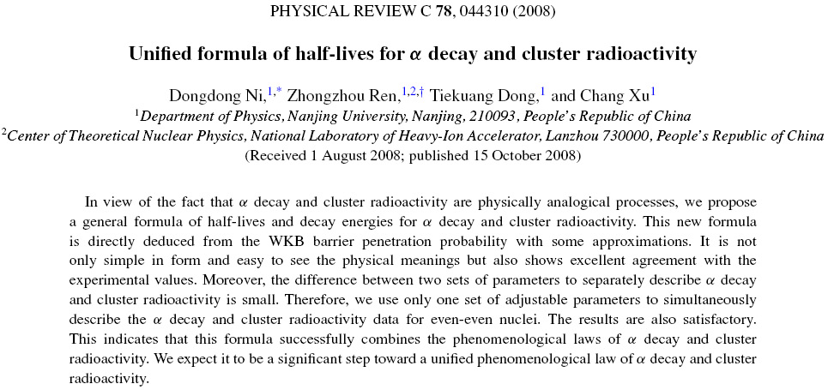
PRC 78 (2008) 044310: Unified description of alpha decay and cluster radioactivity （大学生1作)

Slide 25
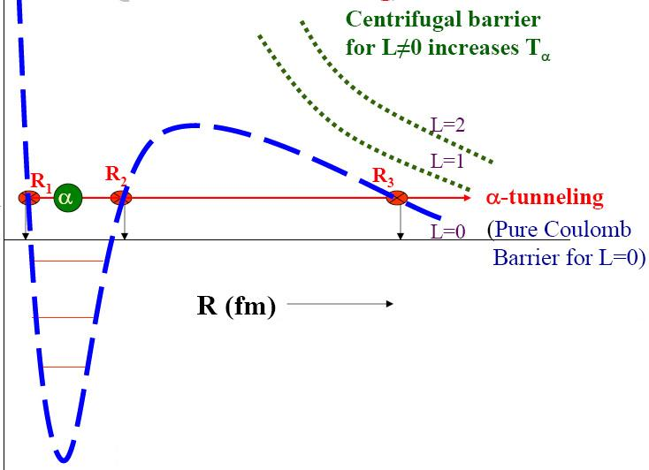

Derivation from quantum tunneling
V(R)
Q

Slide 26
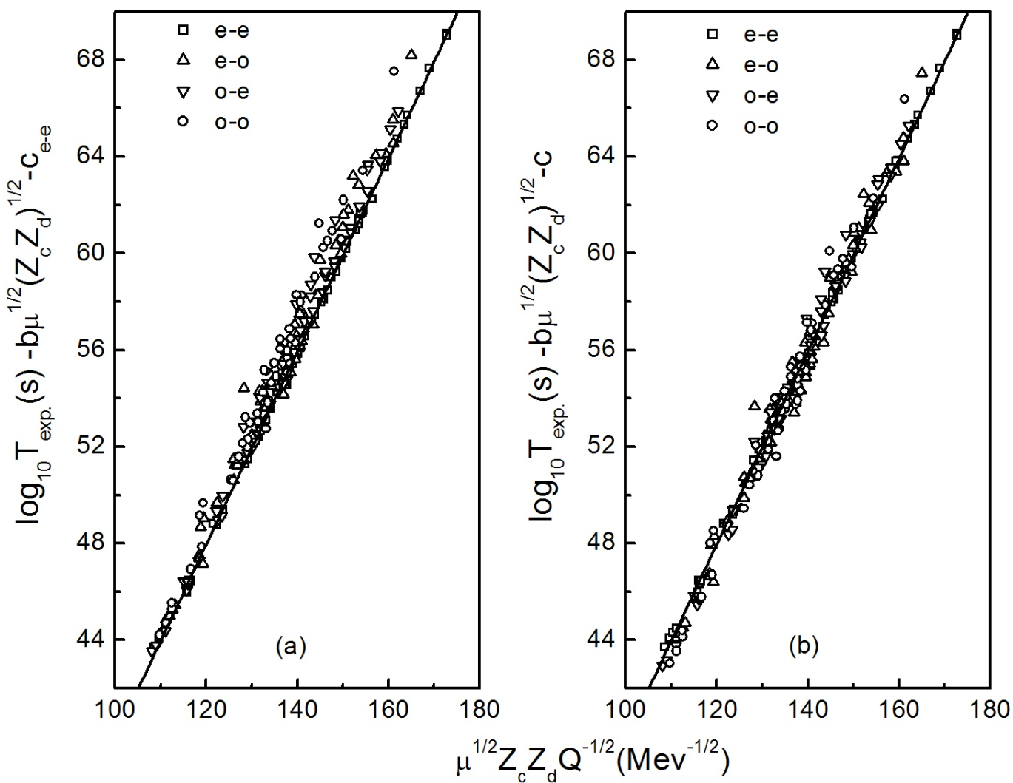
Effect of different hindrance in even-even, odd-A, and odd-odd emitters: values of the parameter c
same c values
various c values
Phys. Rev. C 78 (2008) 044310, Ni, Ren, Dong, and Xu

Slide 27
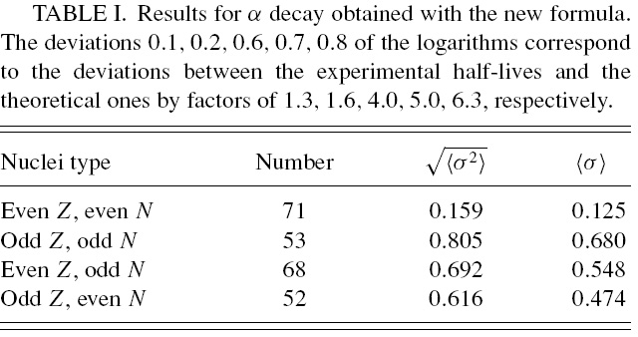
Deviation of the theoretical results from the experimental data for the alpha decay of nuclei with Z>=84 and N>=128
(Ni, Ren…, PRC78, 2008)

Slide 28
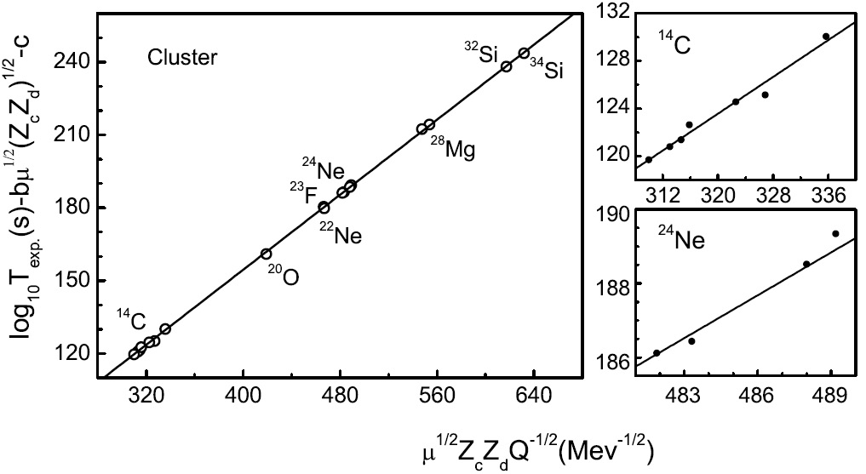
Comparison of the calculated half-lives with the experimental data for cluster radioactivity (PRC, 2008)

Slide 29
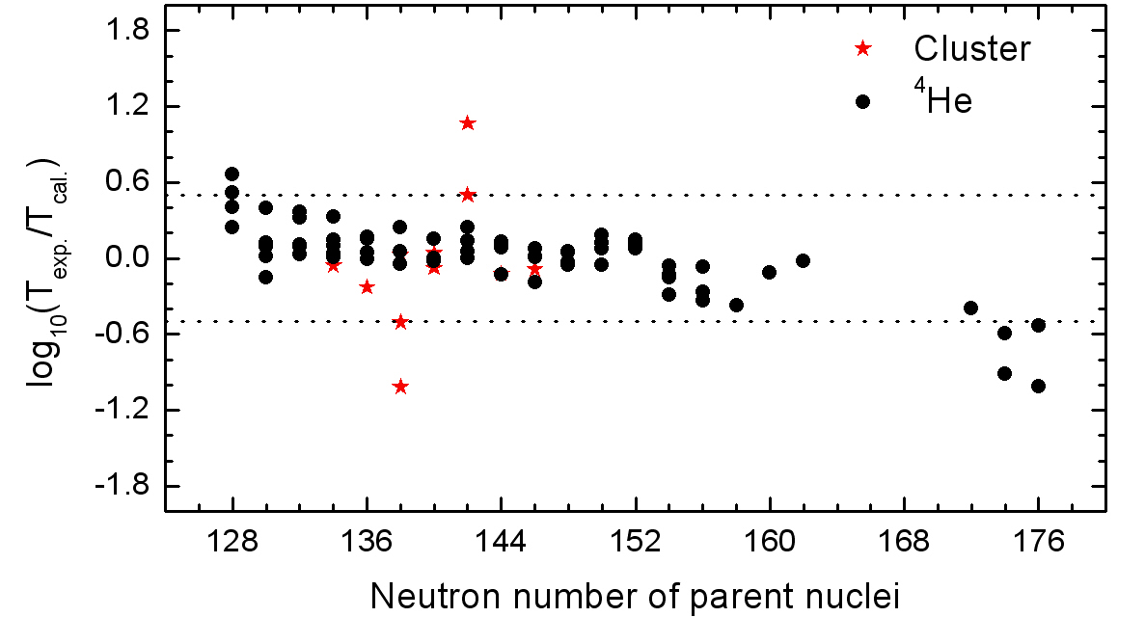
Unified description of alpha decay and cluster radioactivity for even-even nuclei: one set of parameters is used
Phys. Rev. C 78 (2008) 044310, Ni, Ren, Dong, and Xu

Slide 30
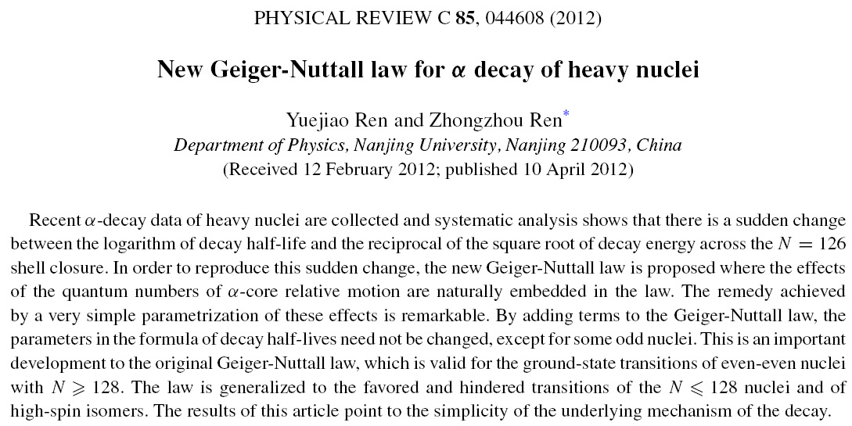
PRC 85 (2012) 044608: Effects of the quantum numbers of quasibound states are included into the formula.

Slide 31
Some basic observables such as quantum numbers can be absorbed in the formula for a better description of alpha-decay data.
Effects of G (or n) quantum number on alpha-decay data: S=0 for N>126 and S=1 for N<=126
Effects of angular momentum and parity of alpha particle

Slide 32
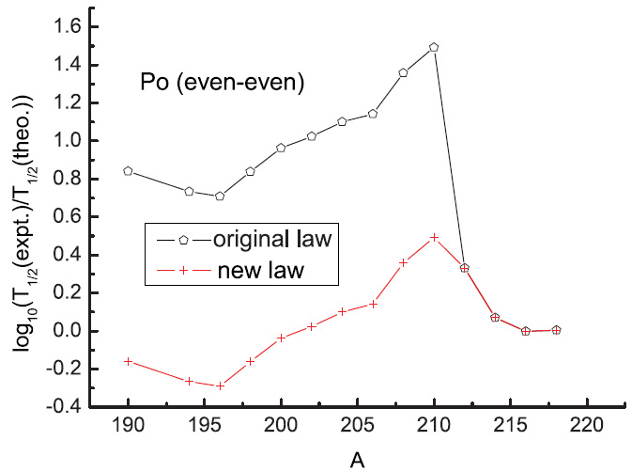
Ratios between experiment and theory for even-even Po nuclei with the original law and with the new law: new law also agrees well with the data for N<=126.

Slide 33
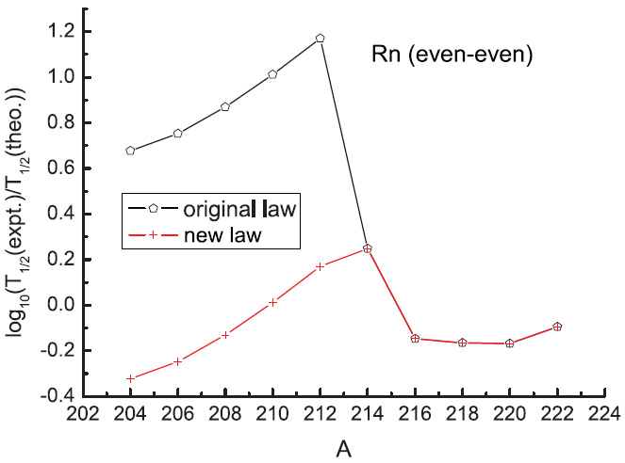
Ratios between experimental data and theoretical results for Rn nuclei with the original law and with the new law (PRC, 2012)

Slide 34
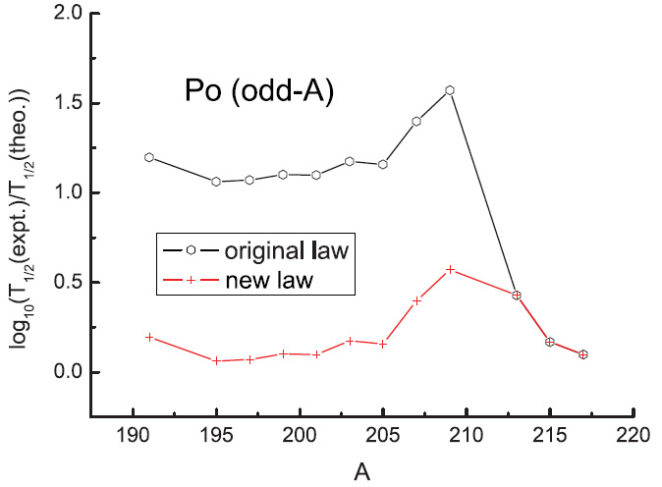
Ratios between experimental data and theoretical results for odd-A Po nuclei with original law and with new law
(PRC, 2012)

Slide 35
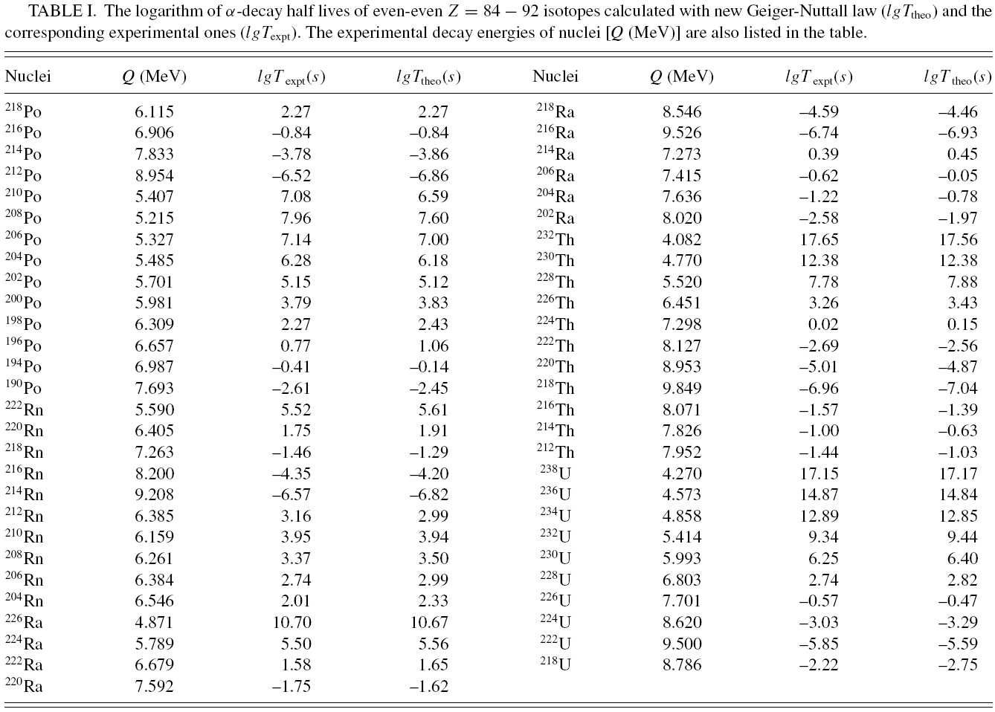

Slide 36
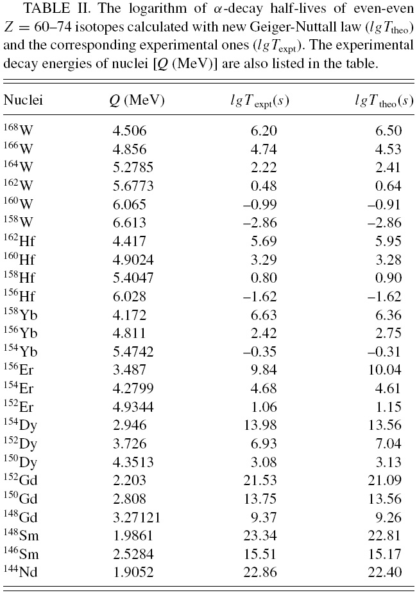

Slide 37
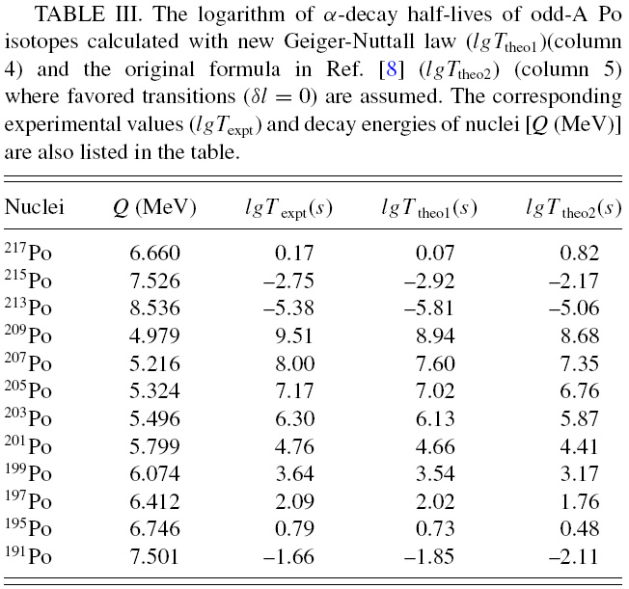

Slide 38
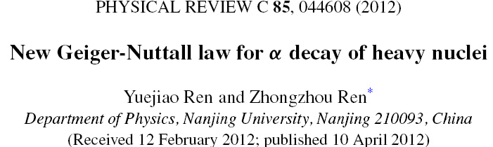
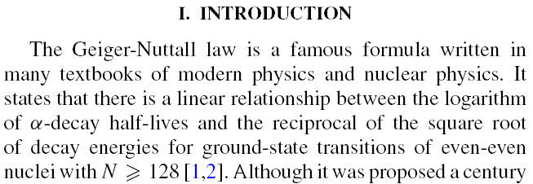
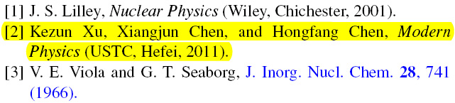

Slide 40
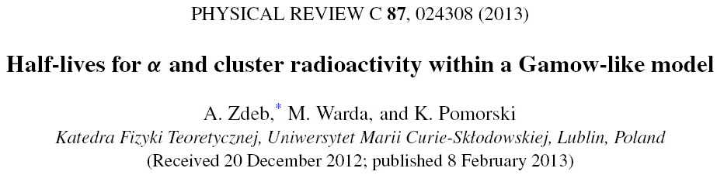

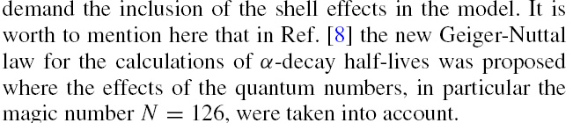


该文多处引用了我们的工作，举例如下
GN定律和VS公式的推广见文献[6-8](其中文献[7,8]为我们工作)。作者特别强调了新GN定律包含了量子数效应 [8]。

Slide 41
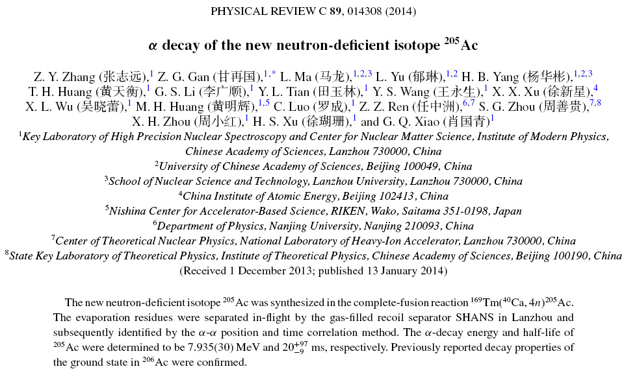

Slide 42
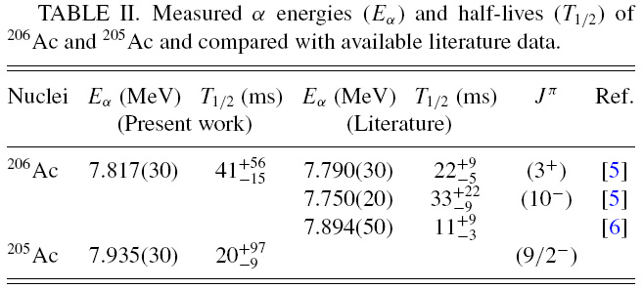
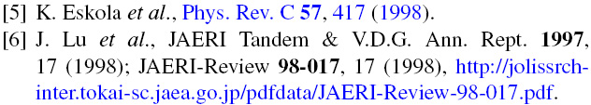

Slide 43
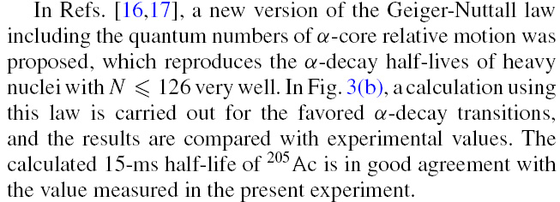
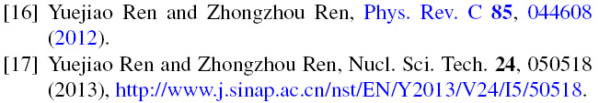
The calculated half-life (15 ms) with the new Geiger-Nuttall law [16,17] agrees well with the measured data (20 ⁺⁹⁷₋₉ms).

Slide 44
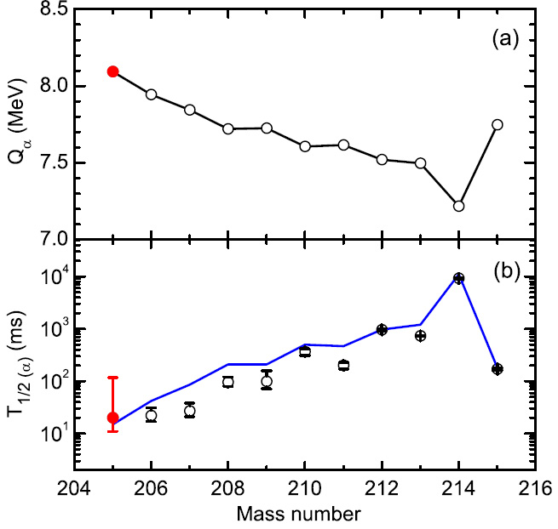
Systematic of (a) Q_{α}-decay energies and (b) α-decay half-lives for favored α transitions of Ac isotopes
Red solid point:
Present measurement
Blue line:
Calculated results
[16,17]
Black open point:
Literature values
[4,5,12-14]

Slide 45
Density-Dependent Cluster Model
DDCM: model of alpha and cluster decay:
1) N-N effective potential: from Reid potential
2) Double folding with density: alpha+nucleus
3) low density behavior--exchange included
4) agree well with experimental half-lives
Z Ren, C Xu, Z Wang, PRC 70: 034304 (2004)
C Xu, Z Ren, NPA 753: 174 ,NPA 760: 303 (2005)
C Xu, Z Ren, PRC 73: 041301(R) (2006)…
D. Ni, Z. Ren, PRC , (2009), (2010), GDDCM…..

Slide 46
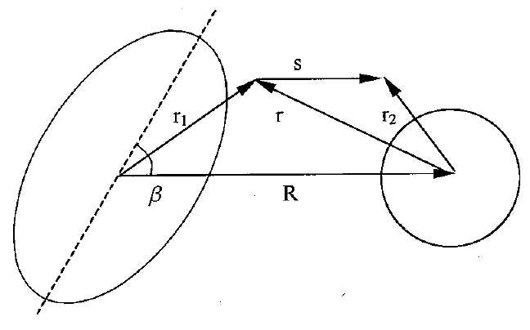
Schematic Fig.: double folding potential or Woods-Saxon potential
We consider a spherical alpha-particle interacts with a deformed core nucleus which has an axially symmetric nuclear shape.
The decay process is described by the tunneling of the alpha particle through a deformed potential barrier, which is approximated by an axially deformed potential.

Slide 47
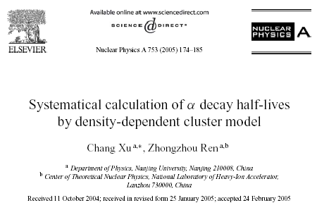
DDCM for alpha decay: agreement is within a factor of three for half-lives although experimental half-lives vary from 10⁻⁶ s to 10¹⁹ year

Slide 48

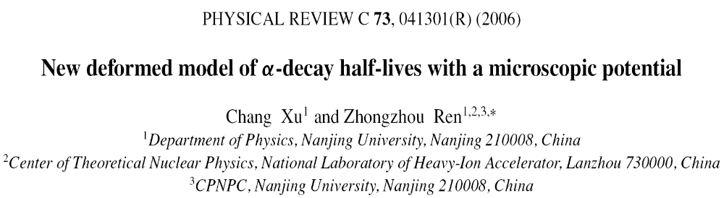
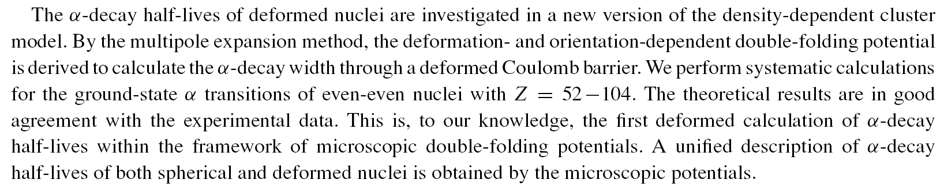

Slide 49
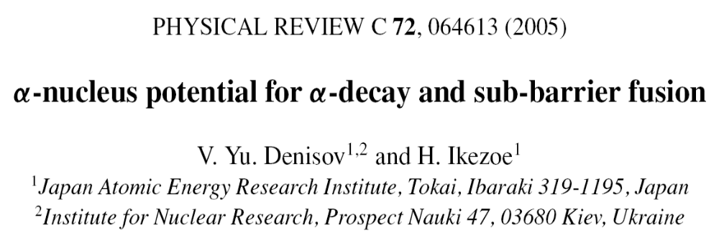
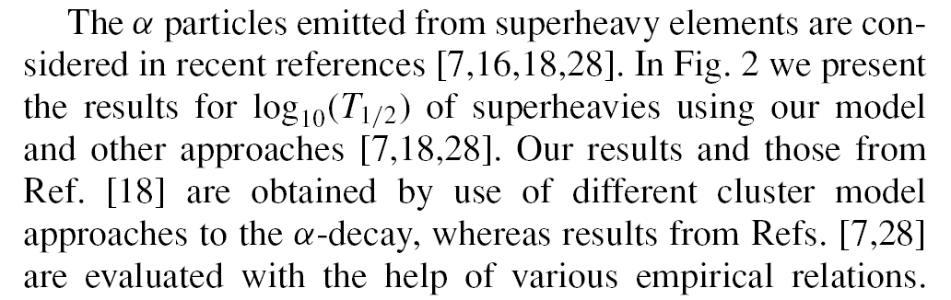
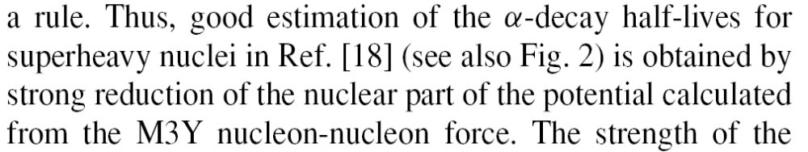
Denisov et al. compared DDCM with their results
Our results and those from
Ref. [18] are …of different cluste model... in Fig. 2.
Good estimation of alpha-decay half-lives is obtained in Ref.[18] for superheavy nuclei...
[18] C. Xu and Z. Ren, Nucl. Phys. A753, 174 (2005)

Slide 50
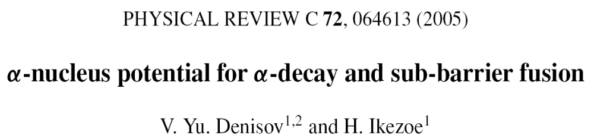
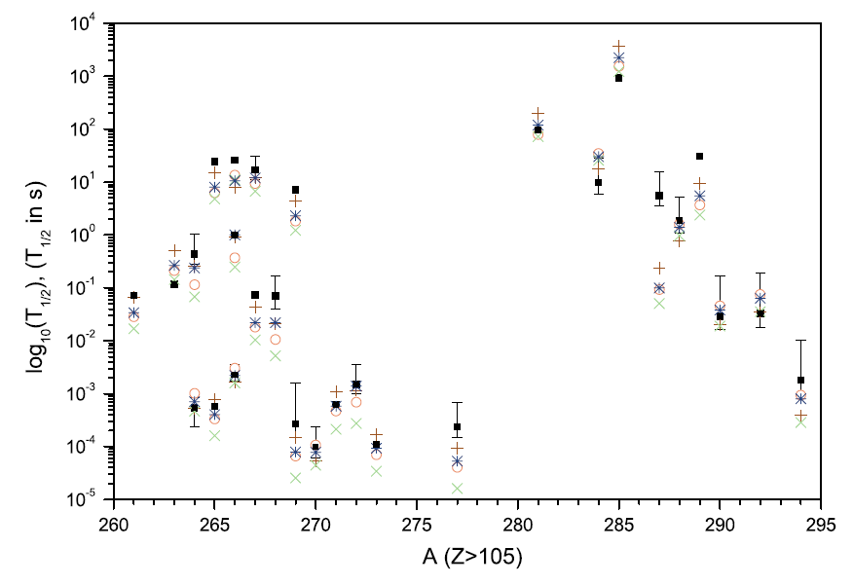
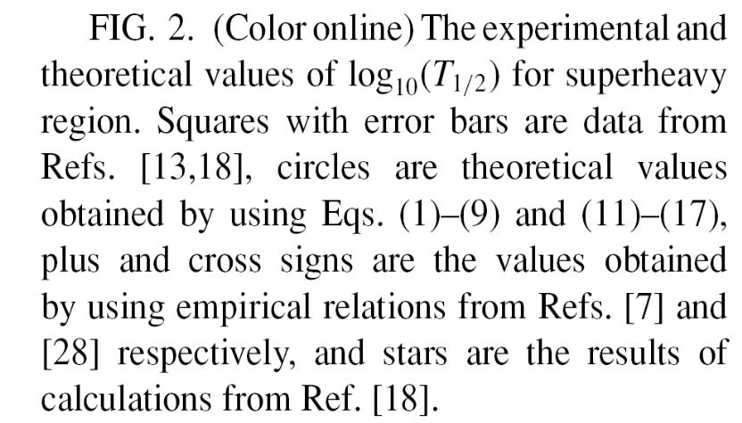
Different cluster models give similarly good results

Slide 51
alpha decay and quantum mechanics
Quantum mechanics: originated from atomic physics. Two kinds of states in textbook: bound, scattering
1928，Gamow: quantum tunnel
Unstable nuclei (²³⁸U): finite lifetime: Quasi-Bound State (QBS)
Our DDCM: WKB, Bohr-Sommerfeld quantization, semi-classical approximation
alpha-decay : quantum effect. To solve Schroedinger-eq. for QBS
Generalized Density-Dependent Cluster Model
Multi-Channel Cluster Model (MCCM)

Slide 52
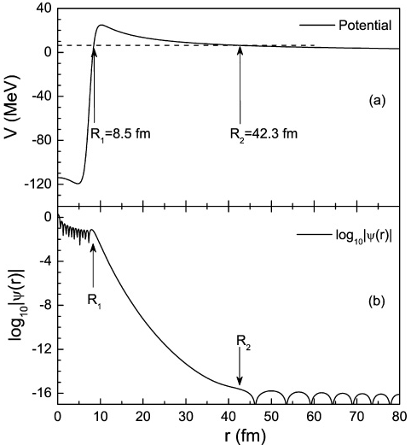

QBS: wave function of Woods-Saxon potential, tail
Woods-Saxon shape nuclear potentials
V₀ is determined by the characteristic of the alpha-cluster quasibound state.

Slide 53
Generalized Density-Dependent Cluster Model
The Reid
nucleon-nucleon potential
Bertsch et al.
Nuclear Matter : G-Matrix
M3Y
Satchler et al.
Hofstadter et al.
Electron Scattering
G-DDCM
1/3₀
Alpha Scattering
RM3Y
Brink et al.
Tonozuka et al.
Nuclear Matter
Alpha Clustering (1/3)
S--Eq. : Q—BS
Alpha Clustering

Slide 54

Generalized Density-Dependent Cluster Model
PRC 80 014314 (2009)

Slide 55



Slide 56


Multi-Channel Cluster Model (MCCM):
alpha-decay of deformed nuclei 2010-2013

Slide 57

Five-channel calculation of fine structure in the alpha decay of well-deformed nuclei

Slide 58

Schematic diagram of the alpha decay of well-deformed even-even nuclei

Slide 59
Key points ( five channels)
The deformed potential V is expanded in spherical multipoles to order 12.
The dynamics of the core is included in evaluating the interaction matrix elements.
The Boltzmann distribution hypothesis is proposed for daughter states to simulate the internal effect of nuclear states on alpha-cluster formation.
A more realistic description of alpha decay has been achieved.

Slide 60
The total wave function of the system
The set of coupled equations for the radial components
The multipole expansion of the interaction potential

Slide 61
The coupling potential between channels α and α’
For rotational nuclei, the reduced matrix elements are assumed as

Slide 62
Coupled-channel wave functions
(1) The potential depth V₀ is adjusted to make all channels reproduce the experimental Q_{Jd} values.
(2) The Wildermuth condition
(3) Boundary conditions for different channels

Slide 63
Alpha-cluster formation
A constant preformation factor is used for all even-even nuclei (P_{α} =0.36).
This value is not only consistent with the experimental data of open-shell nuclei but also supported by the microscopic calculation.
The hypothesis of Boltzmann distributions ρ(E_{I}) is proposed for daughter states, as Einstein did for molecules with a set of discrete states.
This implies that there is a gradual decline in the P_{α} factor with increasing daughter spins.

Slide 64
The total decay width representing the tunneling through the deformed barrier
The partial decay width corresponding to the decay into a core state I
The alpha-decay half-lives and branching ratios (BR) are expressed as

Slide 65

Sensitivity of the calculated half-lives and branching ratios to the decay Q₀ value for the alpha decay of ²⁴⁴Cm, showing the crucial effect on half-lives.

Slide 66

Sensitivity of the calculated branching ratios to the energy spectrum of daughter nuclei
The decrease of BR with increasing the E₂ value is more evident as we proceed to higher-spin states.
There is an increase in the half-life by about 28% as the E₂ value is varied from 40 to 80 keV.

Slide 67

Sensitivity of the calculated branching ratios and half-lives to the deformation β₂ values of daughter nuclei

Slide 68

The comparison of experimental alpha-decay half-lives with theoretical ones for well-deformed emitters

Slide 69
Calculated results for two isotopes of Pu
²⁴⁰Pu
Exp.
(%)
Cal.
(%)
²⁴²Pu
Exp.
(%)
Cal.
(%)
4.6×10⁻⁵
4.6×10⁻⁶
---
2.6×10⁻⁶
8⁺
8⁺
0.00106
0.00147
0.00086
0.00232
6⁺
6⁺
0.084
0.048
0.0307
0.0341
4⁺
4⁺
27.1
27.73
23.48
23.85
2⁺
2⁺
72.8
72.22
76.49
76.12
0⁺
0⁺
T_{1/2}(s) 2.07×10¹¹ 2.74×10¹¹
T_{1/2}(s) 1.18×10¹³ 1.93×10¹³

Slide 70
Calculated results for two isotopes of Cm
²⁴²Cm
Exp.
(%)
Cal.
(%)
²⁴⁴Cm
Exp.
(%)
Cal.
(%)
2.0×10⁻⁵
3.8×10⁻⁵
4.0×10⁻⁵
2.8×10⁻⁵
8⁺
8⁺
0.0046
0.0053
0.00352
0.00733
6⁺
6⁺
0.035
0.077
0.0204
0.0479
4⁺
4⁺
25.92
31.04
23.1
28.60
2⁺
2⁺
74.08
68.87
76.9
71.34
0⁺
0⁺
T_{1/2}(s) 1.41×10⁷ 1.32×10⁷
T_{1/2}(s) 5.72×10⁸ 5.68×10⁸

Slide 71
Calculated results for two isotopes of Cf
²⁵⁰Cf
Exp.
(%)
Cal.
(%)
²⁵²Cf
Exp.
(%)
Cal.
(%)
---
5.8×10⁻⁵
6.0×10⁻⁵
7.9×10⁻⁵
8⁺
8⁺
~0.01
0.010
0.002
0.0089
6⁺
6⁺
0.3
0.66
0.24
0.95
4⁺
4⁺
15.0
22.73
15.7
19.76
2⁺
2⁺
84.7
76.60
84.2
79.29
0⁺
0⁺
T_{1/2}(s) 4.13×10⁸ 3.09×10⁸
T_{1/2}(s) 8.61×10⁷ 8.87×10⁷

Slide 72
Calculated results for two isotopes of Fm
²⁵²Fm
Exp.
(%)
Cal.
(%)
²⁵⁴Fm
Exp.
(%)
Cal.
(%)
---
3.8×10⁻⁴
---
4.8×10⁻⁴
8⁺
8⁺
0.023
0.022
0.0066
0.0126
6⁺
6⁺
0.97
1.45
0.82
1.41
4⁺
4⁺
15.0
21.60
14.2
20.30
2⁺
2⁺
84.0
76.93
85.0
78.28
0⁺
0⁺
T_{1/2}(s) 9.14×10⁴ 4.70×10⁴
T_{1/2}(s) 1.17×10⁴ 7.95×10³

Slide 73

The comparison of experimental branching ratios with theoretical ones for well-deformed emitters

Slide 74



Slide 75


Slide 76


Multichannel calculations for fine structure in odd-A nuclei（maximum 25 channels）
Multichannel calculations for fine structure in odd-odd nuclei（maximum 25 channels）

Slide 77

Experimental observation of fine structure in the alpha decay of odd-mass nuclei: ²⁴⁵Cm
K^{π}=7/2⁺ band
K^{π}=5/2⁺ band

Slide 78

Diagram of the alpha decay of deformed odd-mass nuclei (to favored rotational bands)
The number of decay channels increases greatly in contrast to even-even nuclei

Slide 79

Comparison of calculated alpha-decay half-lives with the experimental data (within a factor of about 1.9)

Slide 80

24 decay channels considered for odd-A Es isotopes
(Ni and Ren, PRC 86, 054608, 2012)

Slide 81

Calculated results for odd-odd Am isotopes
(23 and 25 decay channels considered)
MCCM WKB
MCCM WKB

Slide 82


Charge radii of nuclei: Phys. Rev. C 87 (2013) 024310
result on charge radii from alpha-decay data

Slide 83
Summary
Review on alpha decay and cluster radioactivity
Analytical formulas for half-lives of alpha decay and cluster radioactivity
P G-DDCM and MCCM for calculations of alpha-decay half-lives and branching ratios of deformed nuclei:
S-eq. for quasi-bound states.
By including nuclear deformation, we reach good agreement with experimental half-lives and branching ratios. Odd-A and odd-odd nucei.

Slide 84
Thanks
Thanks for the invitation to visit USTC中国科大.
Thanks for your attention !

Slide 88


Slide 89


The law relates alpha-decay half-lives to decay energies for even-even nuclei with Z≥84 on an isotopic chain
Page 92: Geiger-Nuttall law of alpha decay (Geiger and Nuttall 1911, 1912)

Slide 90
该文多处引用了我们的工作，举例如下
GN定律和VS公式的推广见文献[6-8](其中文献[7,8]为我们工作)。作者特别强调了新GN定律包含了量子数效应 [8]。

Slide 92
Thank you!

