Slide 1
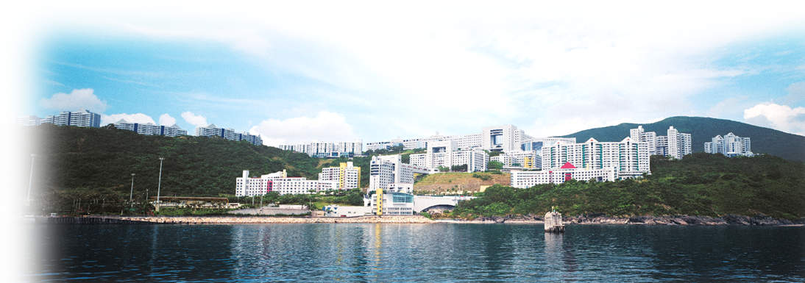
Physics of the Cosmological Collider
-- Non-Gaussianity in the Post-Planck Era
Yi Wang 王一, 2017.03.03
The Hong Kong University of Science and Technology

Slide 2
Collaboration with
X. Chen 0909.0496, 0911.3380, 1205.0160
X. Chen & Z. Z. Xianyu 1604.07841, 1610.06597, 1612.08122
X. Chen & M. H. Namjoo 1509.03930, 1601.06228, 1608.01299

Slide 3
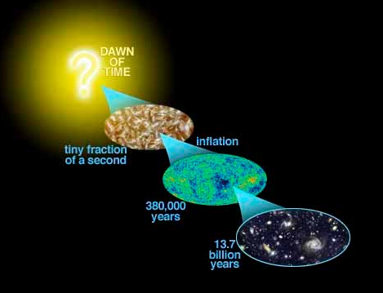

Slide 4
Review of Non-G before Planck

Slide 5
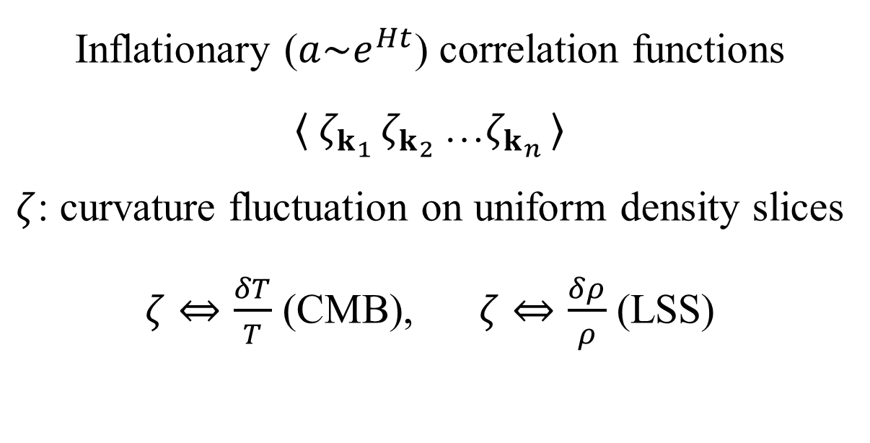
Inflationary ($a\sim e^{Ht}$) correlation functions
$〈 ζ_{k_{1} }ζ_{k_{2} }$…$ζ_{k_{n} }〉$
$ζ$: curvature fluctuation on uniform density slices
$ζ⇔\frac{δT}{T}$ (CMB), $ζ⇔\frac{δρ}{ρ}$ (LSS)

Slide 6
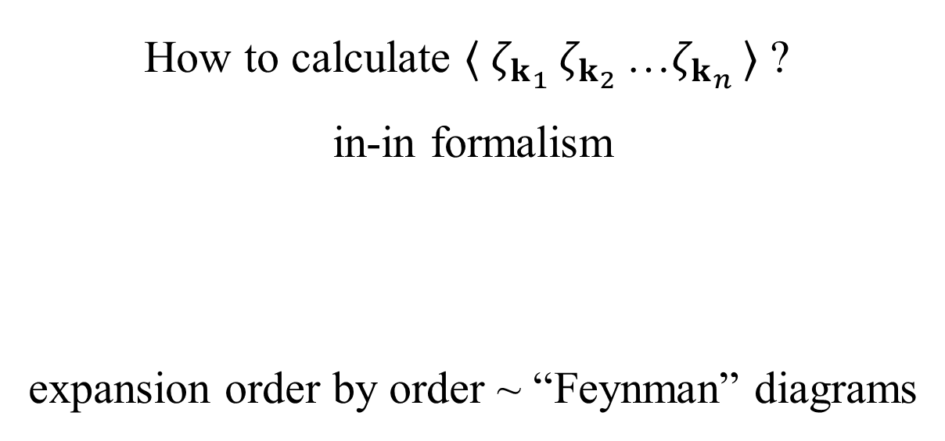
How to calculate $〈 ζ_{k_{1} }ζ_{k_{2} }$…$ζ_{k_{n} }〉$ ?
in-in formalism
expansion order by order ~ “Feynman” diagrams

Slide 7
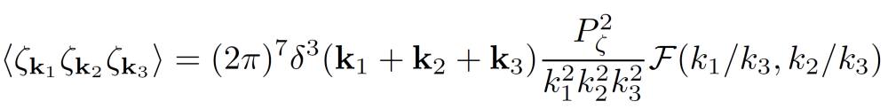
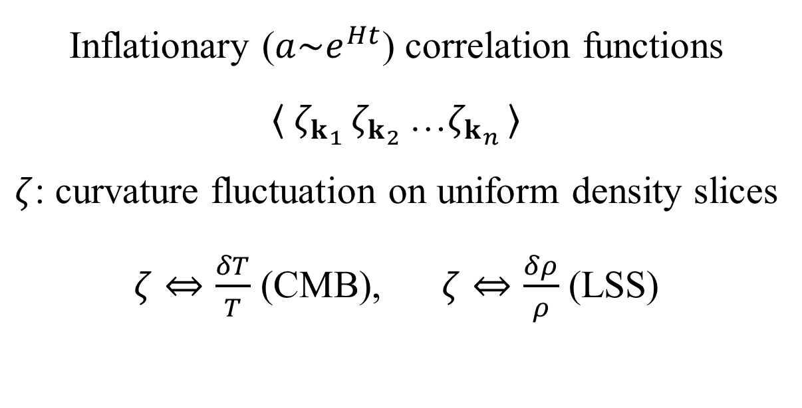
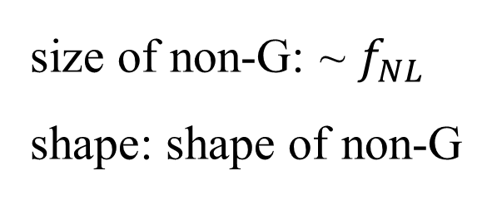
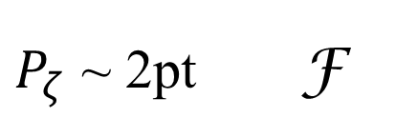
Inflationary ($a\sim e^{Ht}$) correlation functions
$〈 ζ_{k_{1} }ζ_{k_{2} }$…$ζ_{k_{n} }〉$
$ζ$: curvature fluctuation on uniform density slices
$ζ⇔\frac{δT}{T}$ (CMB), $ζ⇔\frac{δρ}{ρ}$ (LSS)
{
size of non-G: ~ $f_{NL}$
shape: shape of non-G
$P_{ζ}$ ~ 2pt F

Slide 8
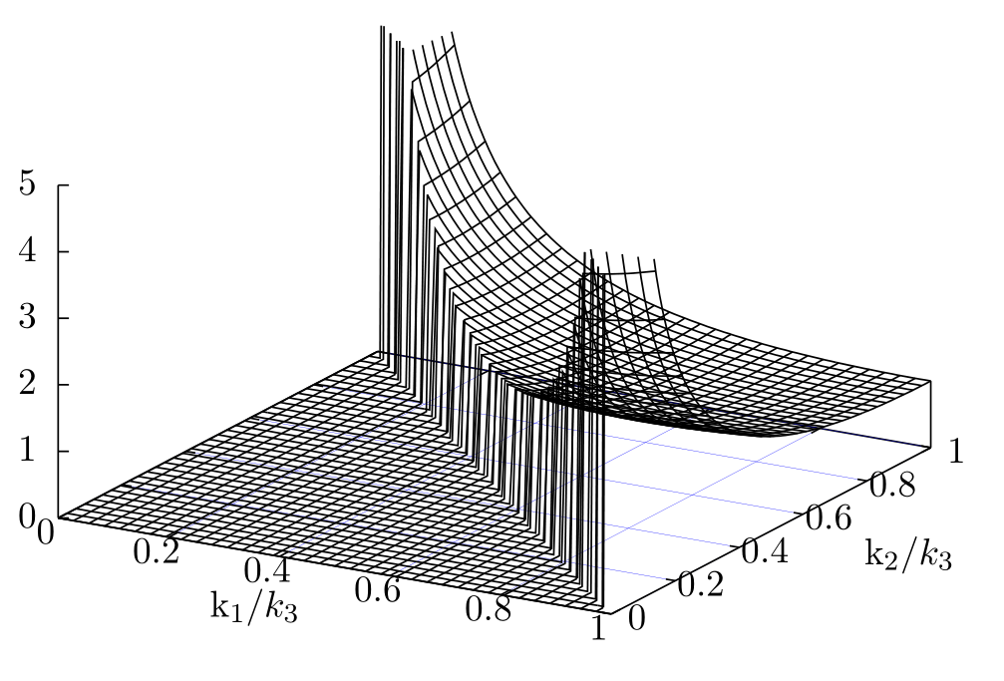
Local shape non-G:

Slide 9
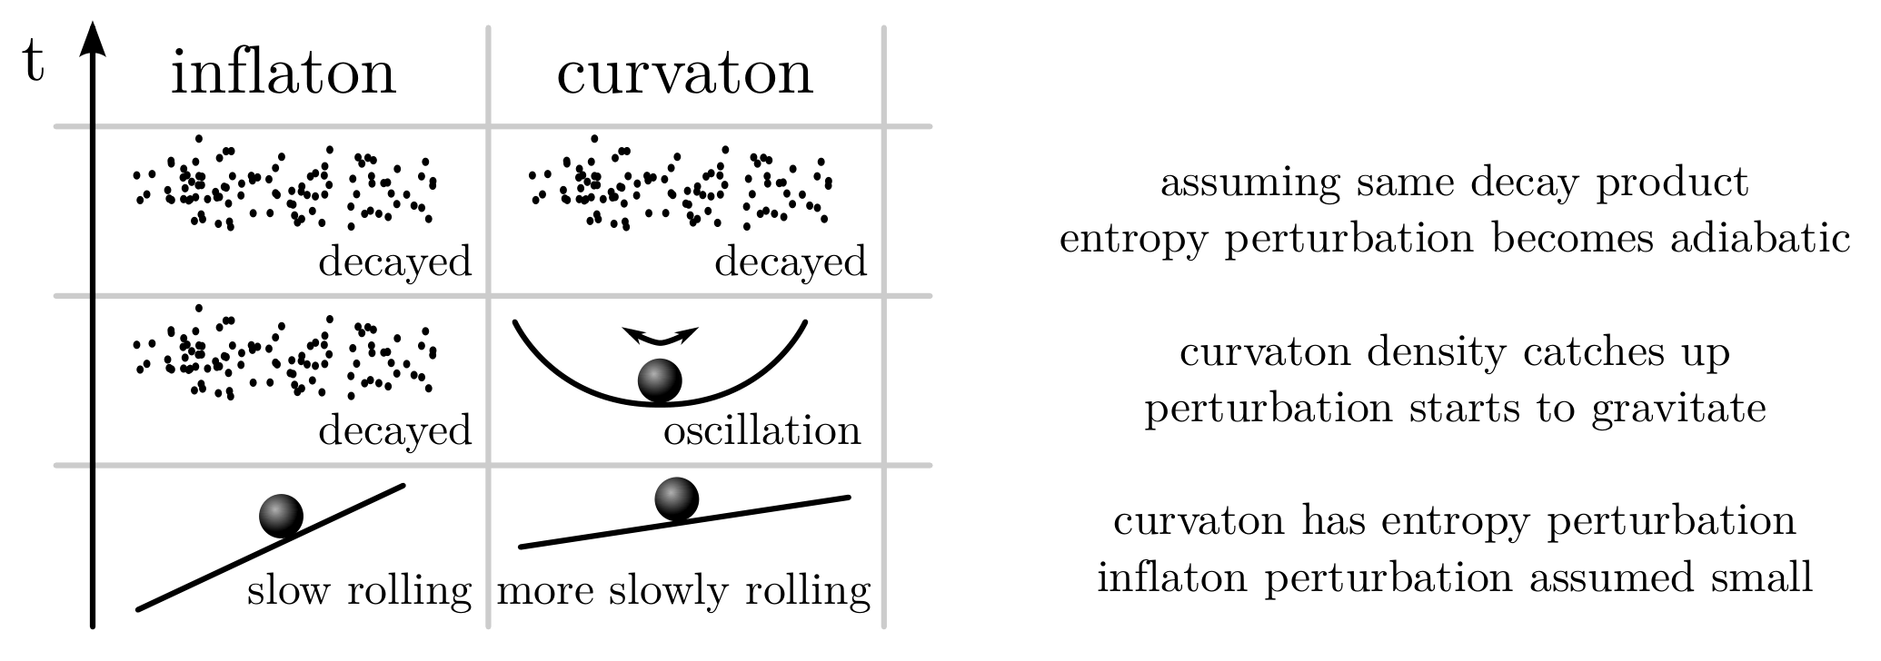
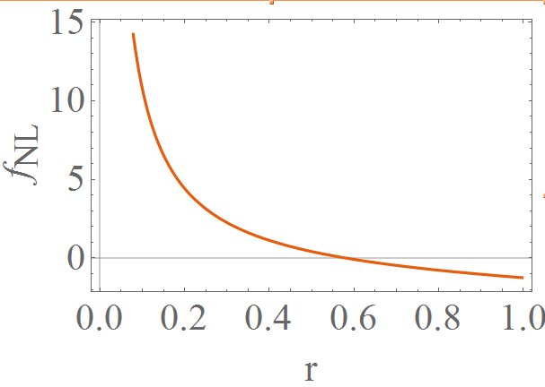
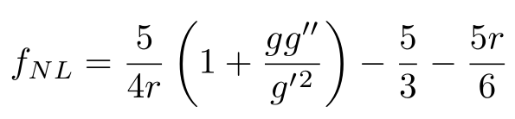
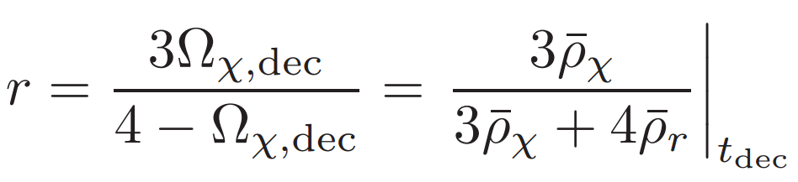
Example of local non-G: the curvaton scenario:
Sasaki, Valiviita, Wands 2006

Slide 10
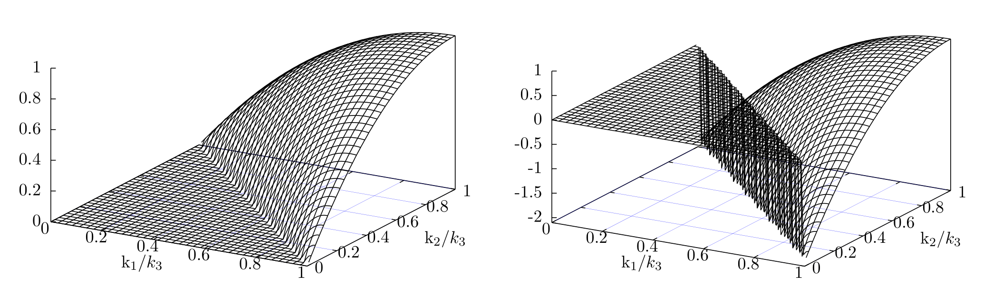
Equilateral and orthogonal shapes of non-G:

Slide 11
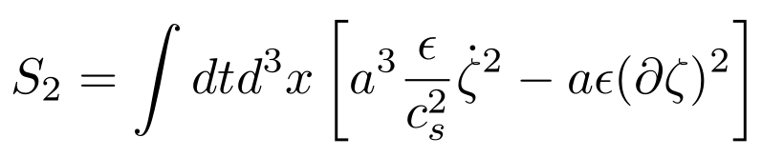

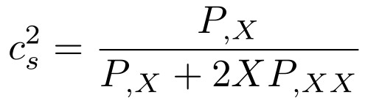
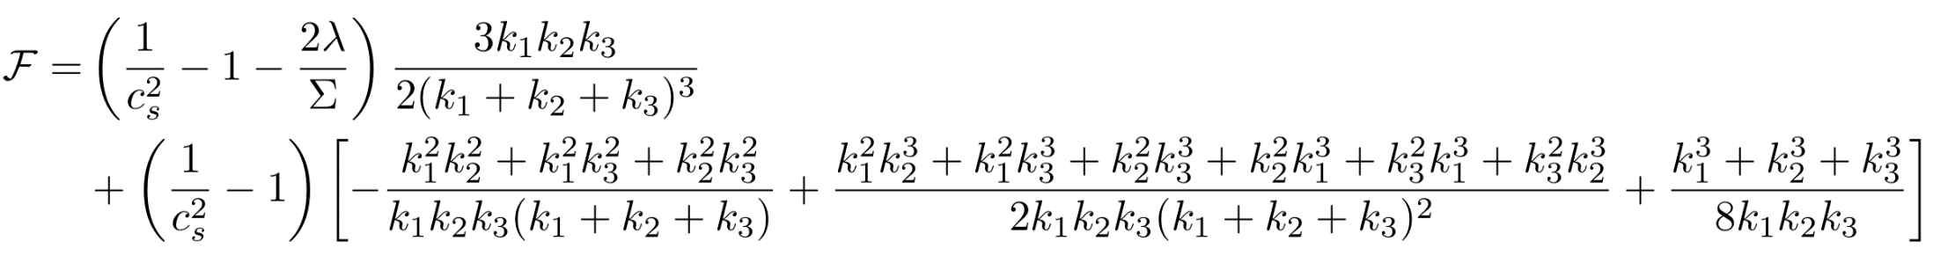
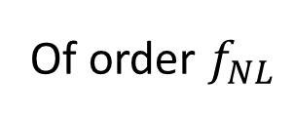
Example of equilateral non-G: modified sound speed
Of order $f_{NL}$
Chen, Huang, Kachru, Shiu 2006

Slide 12
Many many many similar stories 2000s – 2013.

Slide 13
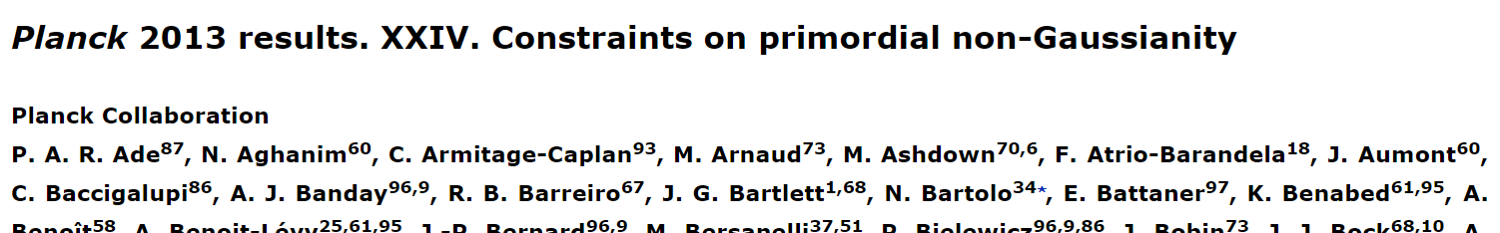
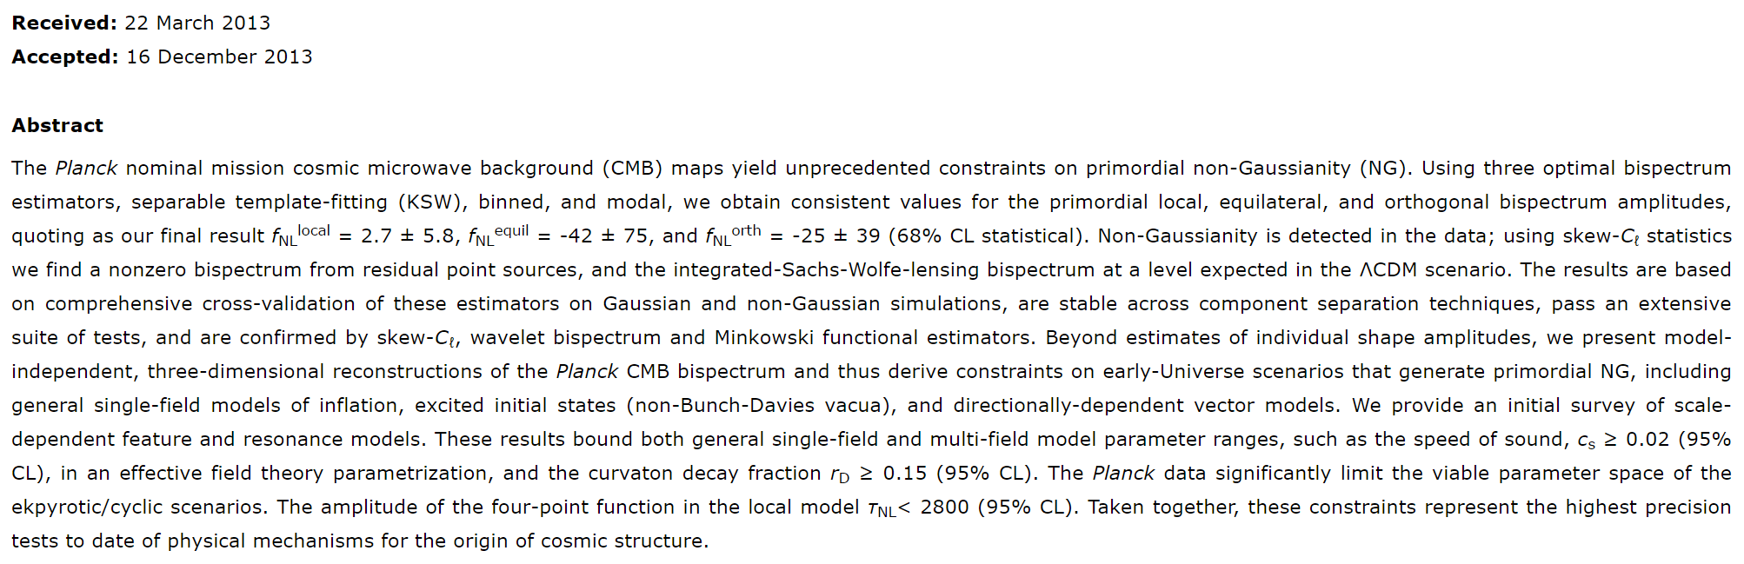

Slide 14
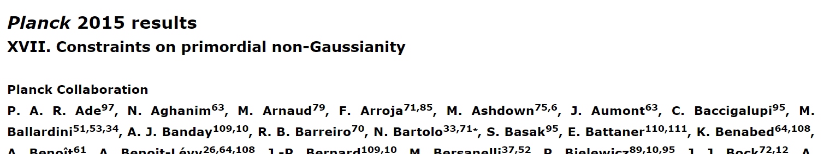
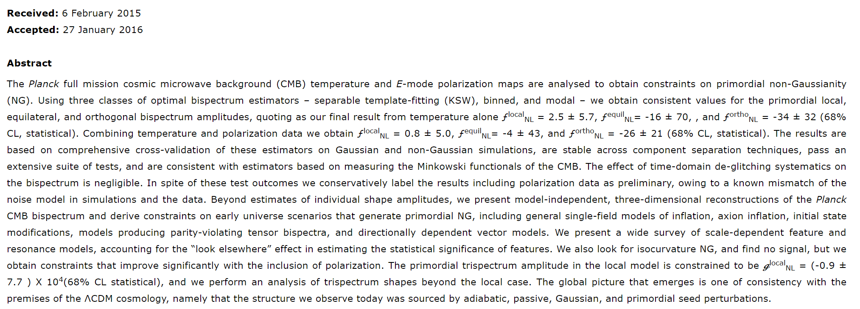

Slide 15
COBE
(1990s)
$$∆f_{NL}\sim 2000$$
COBE
(1990s)
∆𝑓_𝑁𝐿~2000
Planck
(2013)
$$∆f_{NL}\sim 5$$
Planck
(2013)
∆𝑓_𝑁𝐿~5
LSS
$$∆f_{NL}\sim 0.5$$
LSS
∆𝑓_𝑁𝐿~ 0.5
21cm:
$${∆f_{NL}\sim 10}^{−3}$$
CMB distortion:
$${∆f_{NL}\sim 10}^{−3}$$
21cm:
〖∆𝑓_𝑁𝐿~ 10〗^(−3)
CMB distortion:
〖∆𝑓_𝑁𝐿~ 10〗^(−3)
WMAP
1yr (2003)
$$∆f_{NL}\sim 100$$
7yr (2010)
$$∆f_{NL}\sim 20$$
WMAP
1yr (2003)
∆𝑓_𝑁𝐿~100
7yr (2010)
∆𝑓_𝑁𝐿~20

Slide 16
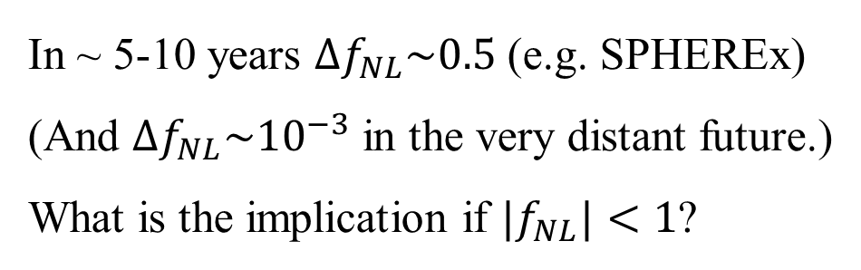
In ~ 5-10 years $Δf_{NL}\sim 0.5$ (e.g. SPHEREx)
(And $Δf_{NL}\sim {10}^{−3}$ in the very distant future.)
What is the implication if ${|f}_{NL}|<1$?

Slide 17
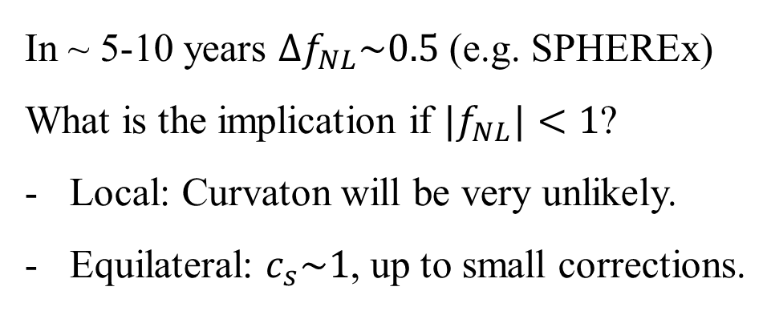
In ~ 5-10 years $Δf_{NL}\sim 0.5$ (e.g. SPHEREx)
What is the implication if ${|f}_{NL}|<1$?
Local: Curvaton will be very unlikely.
Equilateral: $c_{s}\sim 1$, up to small corrections.

Slide 18
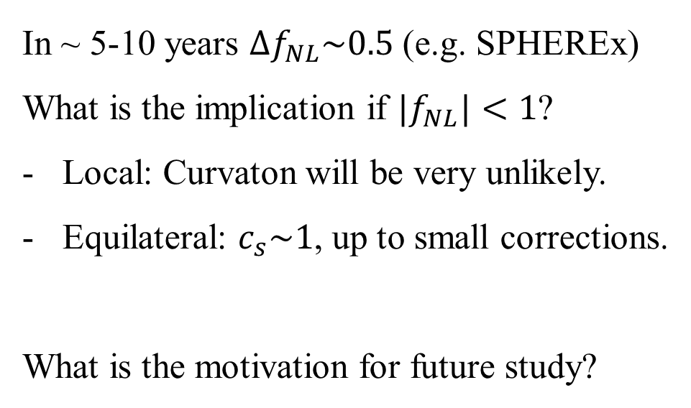
In ~ 5-10 years $Δf_{NL}\sim 0.5$ (e.g. SPHEREx)
What is the implication if ${|f}_{NL}|<1$?
Local: Curvaton will be very unlikely.
Equilateral: $c_{s}\sim 1$, up to small corrections.
What is the motivation for future study?

Slide 19
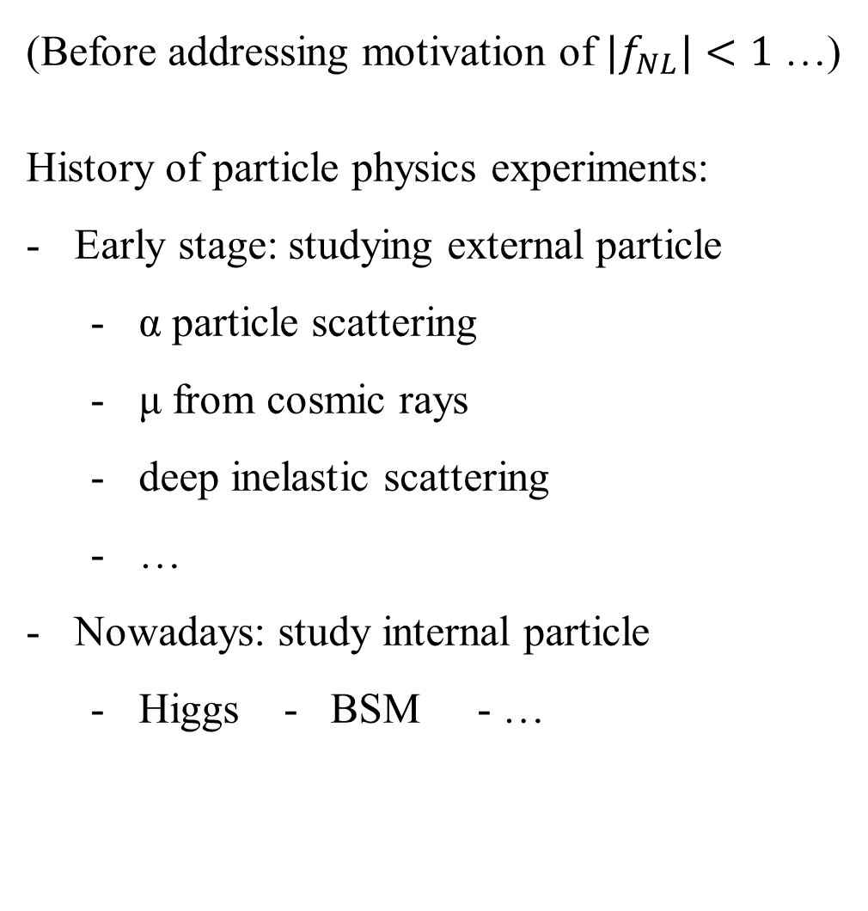
(Before addressing motivation of ${|f}_{NL}|<1$ …)
History of particle physics experiments:
Early stage: studying external particle
  α particle scattering
  μ from cosmic rays
  deep inelastic scattering
  …
Nowadays: study internal particle
  Higgs - BSM - …

Slide 20
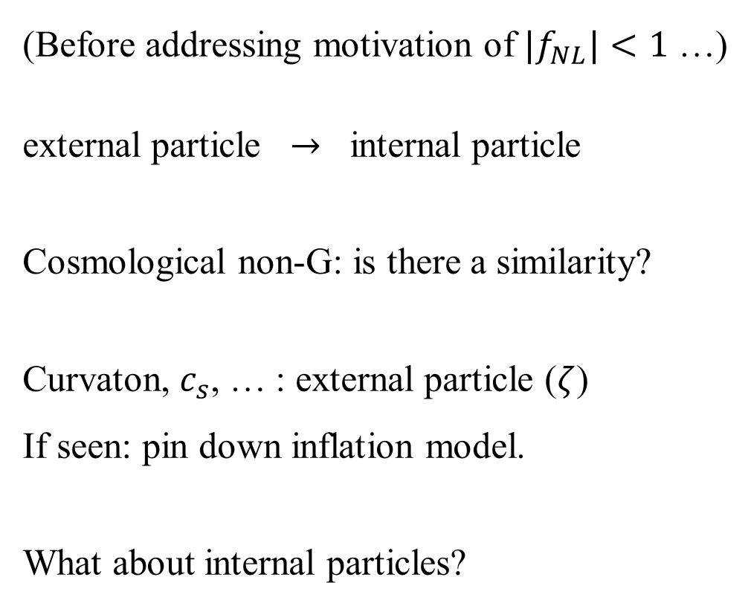
(Before addressing motivation of ${|f}_{NL}|<1$ …)
external particle $→$ internal particle
Cosmological non-G: is there a similarity?
Curvaton, $c_{s}$, … : external particle ($ζ$)
If seen: pin down inflation model.
What about internal particles?

Slide 21
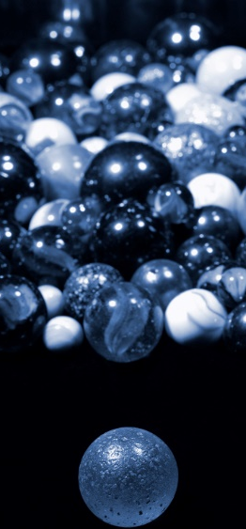
Internal particles:
Quasi-single field inflation
Xingang Chen & YW 2009
m ~ H fields

Slide 22
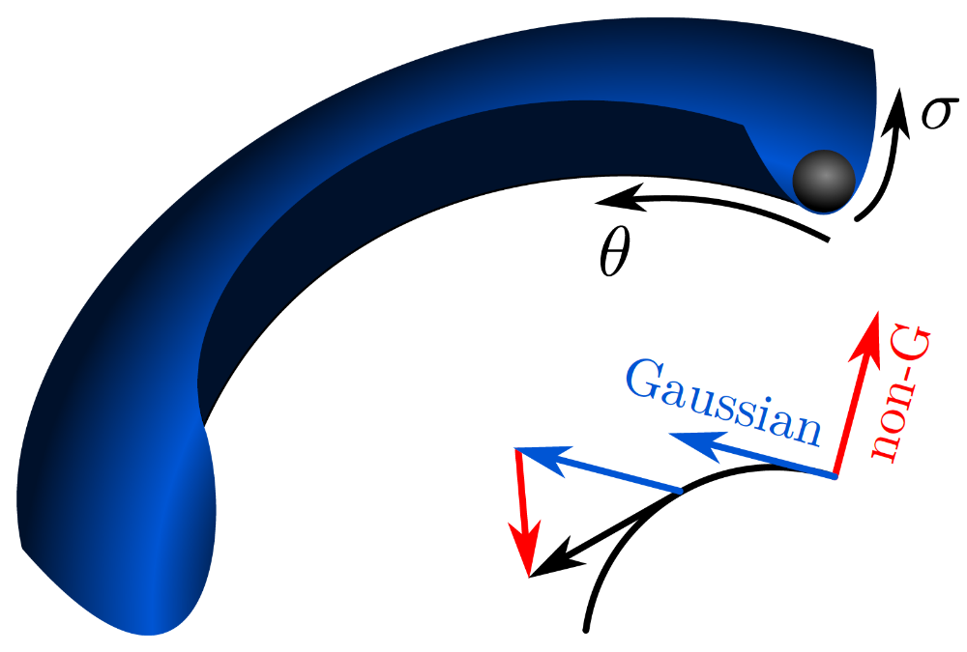
Example: quasi-single field inflation
X. Chen, YW 2009

Slide 23
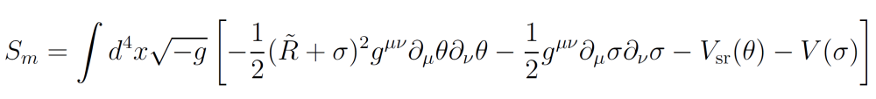

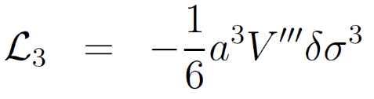

Slide 24
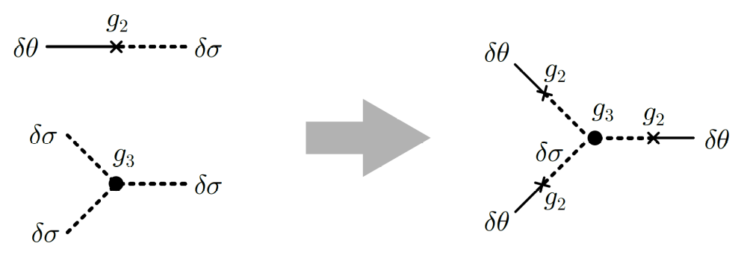

Slide 25
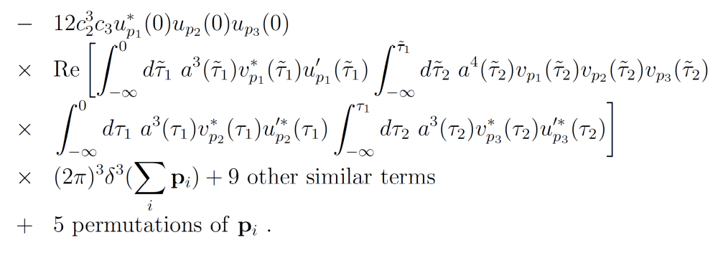

Slide 27
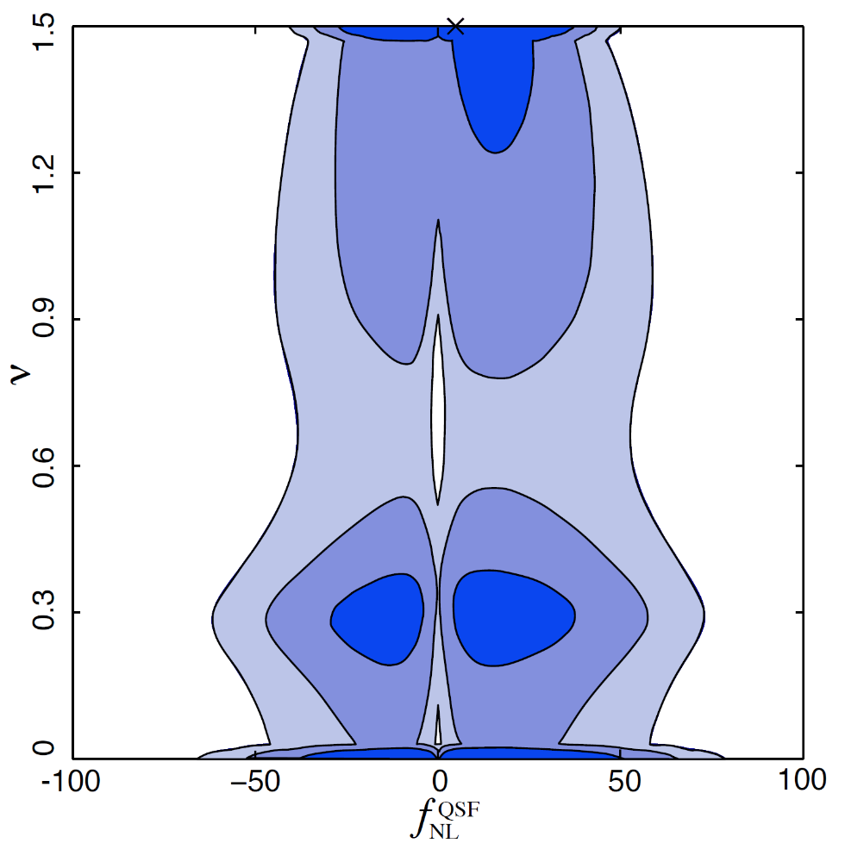
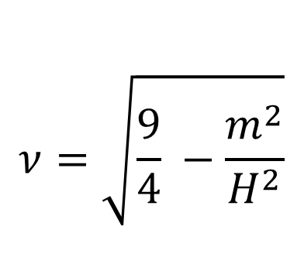
$$ν=\sqrt{\frac{9}{4} −\frac{m^{2}}{H^{2}}}$$
Planck collaboration 2013

Slide 28
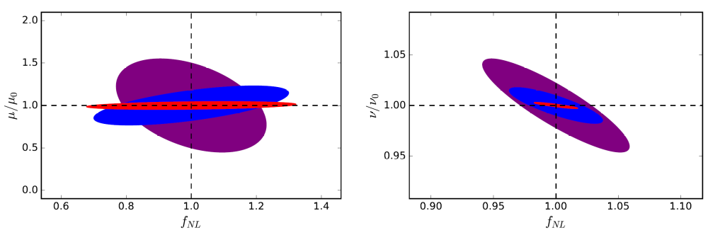
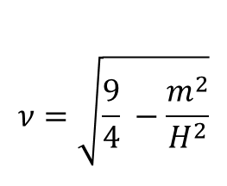
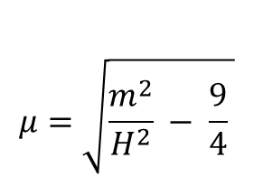
Distant future 21cm forecast
$$μ=\sqrt{\frac{m^{2}}{H^{2}} − \frac{9}{4} }$$
$$ν=\sqrt{\frac{9}{4} −\frac{m^{2}}{H^{2}}}$$
µ = 0.7 (purple), µ = 1.0 (blue), µ = 3.0 (red)
ν = 0.8 (purple), ν = 1.0 (blue), ν = 1.4 (red)
Meerburg, Munchmeyer, Munoz, Chen 2016

Slide 29

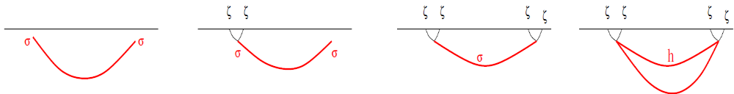
Cosmological double slit experiment
Arkani-Hamed, Maldacena 2015

Slide 30
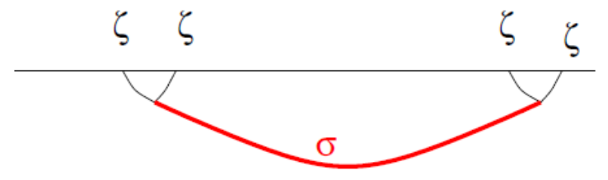
X. Chen, YW 09, 12, Pi, Sasaki 12, Gong, Pi, Sasaki 13
Arkani-Hamed, Maldacena 15
Contributions to correlation functions:
type | meaning | analytic in k? | integrate out? | suppression at large μ | suppression at large x
local | vacuum correlation | Yes | Yes | 1/μ² | vanish outside lightcone
non-local | thermal particle production | No | No | e^{-πμ} | non-vanishing

Slide 31
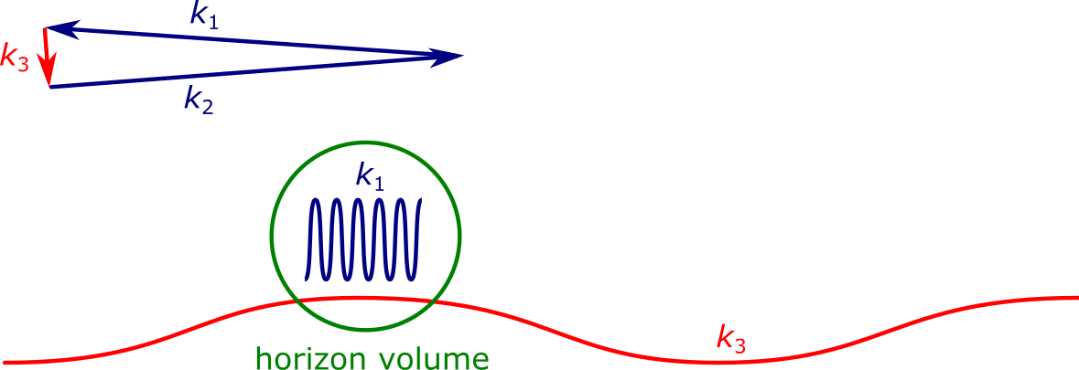

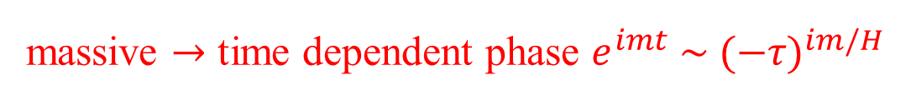

$$\left\langle ζ^{3}\right\rangle$$
massive $→$ time dependent phase $e^{imt} \sim {(−τ)}^{im/H}$
curvature mode $\sim e^{ikτ}$, at resonance record the phase

Slide 32
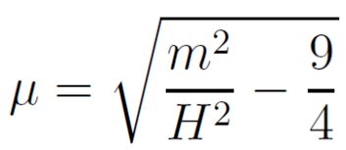
Arkani-Hamed, Maldacena 15

Slide 33
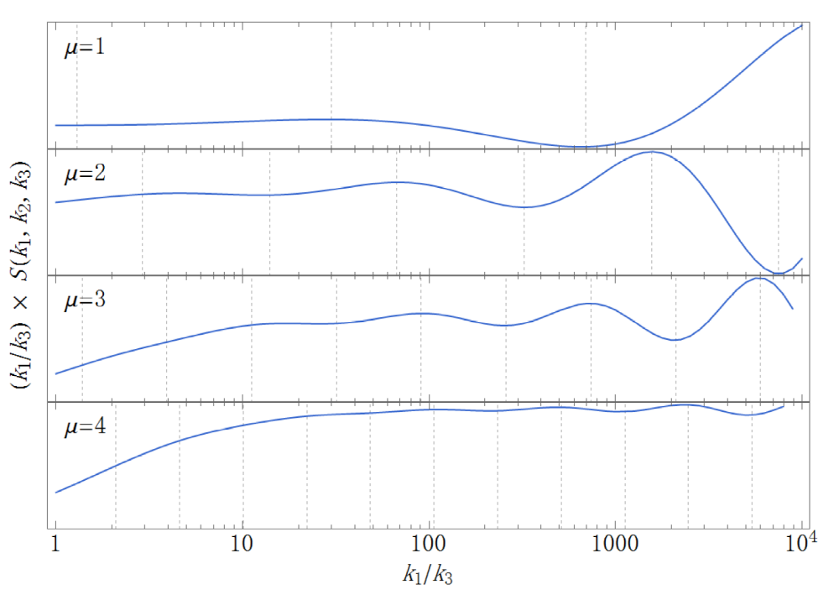

Slide 34

Correlation between the density fluctuation and a clock

Slide 35
Observational consequence:
scale-independent
shape-dependent
oscillations on shape of non-Gaussianities

Slide 36
The Precision Era of Non-Gaussianity

Slide 37
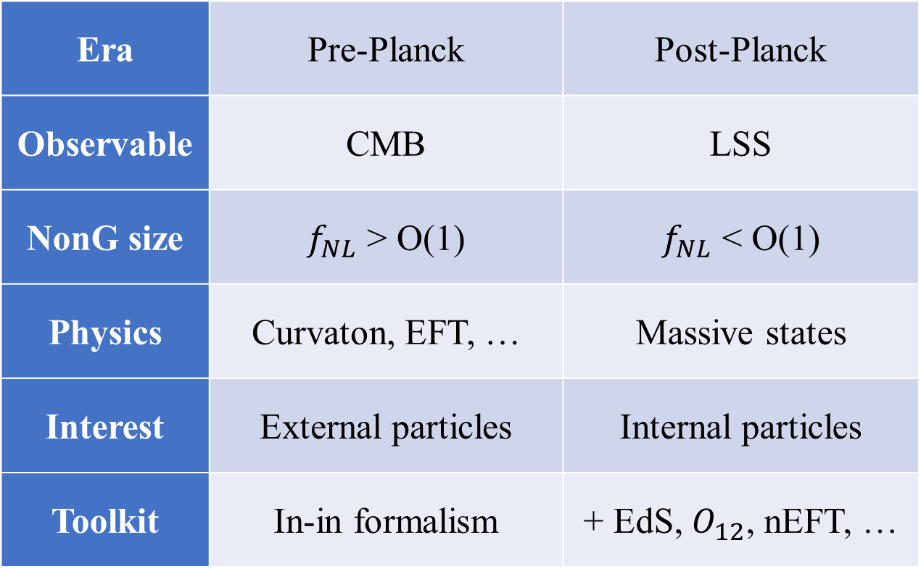
Era | Pre-Planck | Post-Planck
Observable | CMB | LSS
NonG size | $f_{NL}$ > O(1) | $f_{NL}$ < O(1)
Physics | Curvaton, EFT, … | Massive states
Interest | External particles | Internal particles
Toolkit | In-in formalism | + EdS, $O_{12}$, nEFT, …

Slide 38

Standard Model background of the
X. Chen, YW, Z. Z. Xianyu

Slide 39
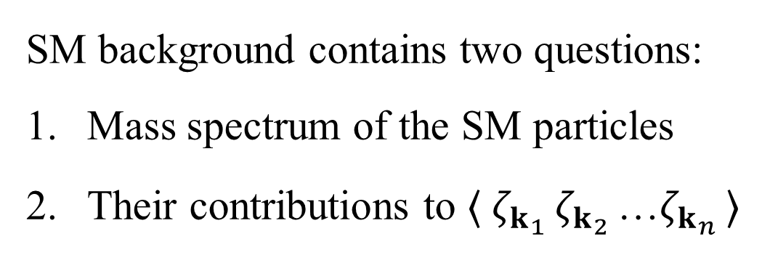
SM background contains two questions:
Mass spectrum of the SM particles
Their contributions to $〈 ζ_{k_{1} }ζ_{k_{2} }$…$ζ_{k_{n} }〉$

Slide 40
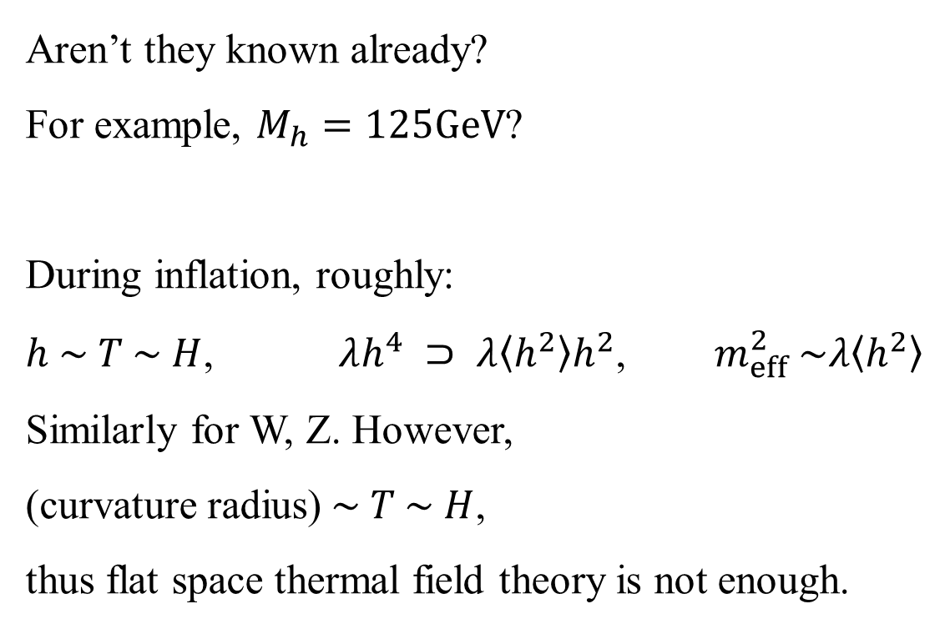
How to extract mass of SM particles?
Aren’t they known already?
For example, $M_{h}=125GeV$?
During inflation, roughly:
$h \sim T \sim H$, $λh^{4} ⊃ λ〈h^{2}〉h^{2}$, $m_{eff}^{2} \sim λ〈h^{2}〉$
Similarly for W, Z. However,
(curvature radius)$\sim T \sim H$,
thus flat space thermal field theory is not enough.

Slide 41
How to extract mass of SM particles?
We extract the SM mass spectrum
from cosmological correlation functions,
calculated using in-in formalism.

Slide 42
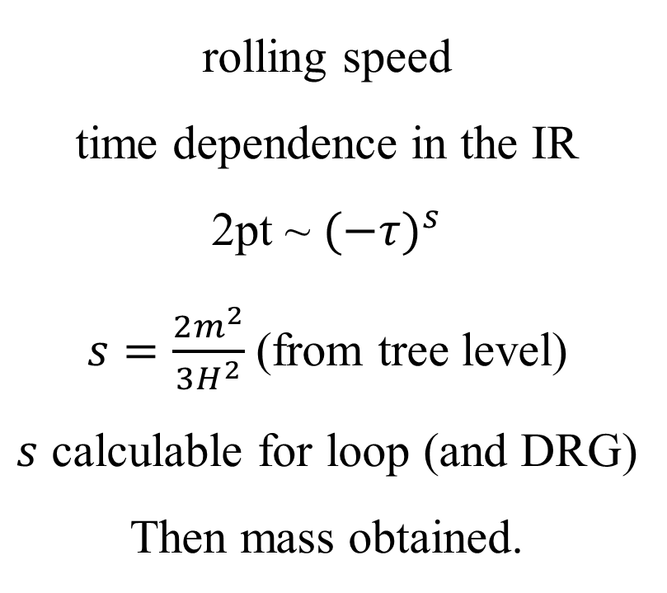
How to extract mass of SM particles?
rolling speed
time dependence in the IR
2pt ~ ${(−τ)}^{s}$
$s=\frac{2m^{2}}{3H^{2}}$(from tree level)
$s$ calculable for loop (and DRG)
Then mass obtained.
Method 1:
calculate IR growth
+ DRG resummation

Slide 43
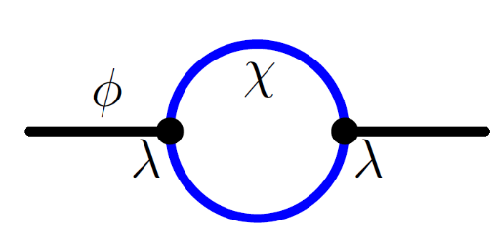
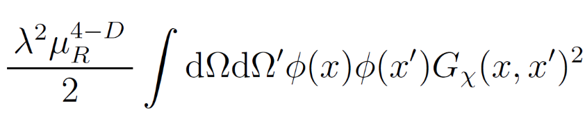
How to extract mass of SM particles?
Method 2: mass renormalization on a sphere
Example:
on a sphere (EdS)
mass renormalization ~

Slide 44





can set $φ=$ constant

Slide 45


Thus

Slide 46








How to extract mass of SM particles?
Method 3: for Higgs only – non-perturbative PI
For $z=0$:

Slide 47

The Higgs mass: tree vs quantum-corrected

Slide 48

The full SM spectrum depending on inflation models

Slide 49


3pt based on the SM mass spectrum
No UV divergence in the non-local part of loop.

Slide 50


Slide 51


SM spectra is affected by coupling to inflaton.
e.g. gauge sector is affected by the following:

Slide 52

SM spectra is affected by coupling to inflaton.
But still we can make predictions:

Slide 53





case of EWSB during inflation
if tree-level $M_{H0}^{2}<0$ from $ξh^{2}R$

Slide 54
Predictions for BSM physics on the cosmological collider?

Slide 55

Expansion History of the Primordial Universe
X. Chen, M. H. Namjoo, YW 2015/16

Slide 56

Possibilities:

Slide 57
Inflation is the most natural paradigm.
But alternative scenarios are also being studied.
Nice to distinguish those scenarios observationally.
The question is equivalent to --

Slide 58
How to measure the evolution history of the primordial universe?

Slide 59

It is a difficult job.
There is no structure in the primordial universe.
Only ${10}^{−5}$ fluctuations, quantum to classical.

Slide 60
How to measure the evolution history of the primordial universe?
Primordial gravitational waves (GWs)
Quantum Primordial Standard Clocks (massive fields)

Slide 61
Quantum Primordial Standard Clock

Slide 62



$$\left\langle ζ^{3}\right\rangle$$
massive $→$ curvature, tells physical time
curvature mode, tells conformal time at $kτ=\frac{M}{H}$

Slide 63


Slide 64
Summary: massive fields during inflation
Cosmological collider:
SM studied
BSM? Strings? Black holes?
Quantum primordial standard clock
Probing the expansion history

Slide 65

Thank you!

