Slide 1
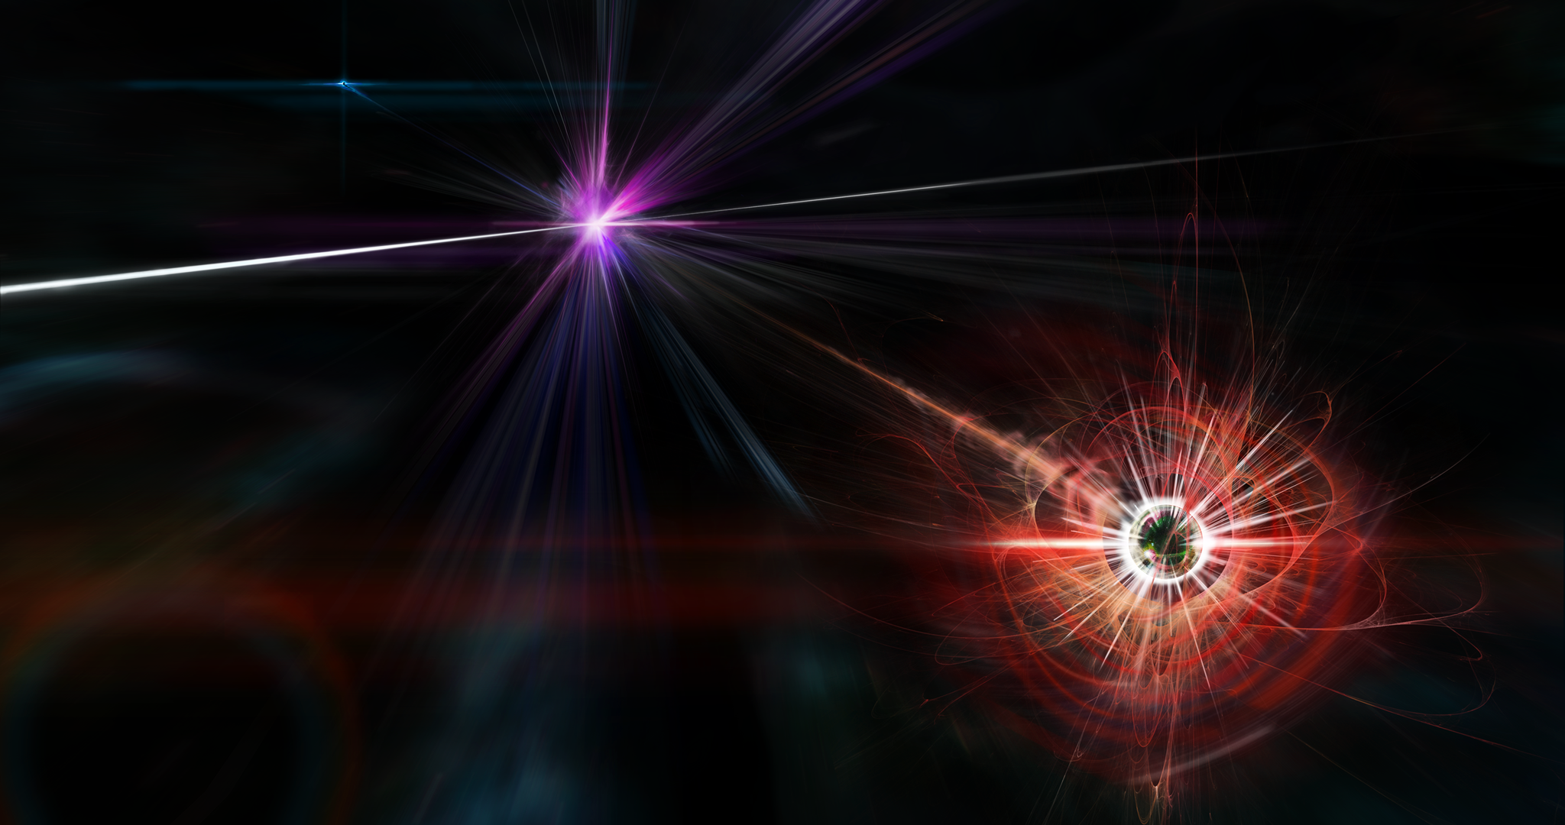


Magnetic Monopoles
Theory and Experiment
Arttu Rajantie
Imperial College London
USTC, Hefei, China 13 April 2018

Slide 2
Literature
A. Rajantie, Physics Today 69 (2016) 40.
A. Rajantie, Contemporary Physics 53 (2012) 195.
MoEDAL Collaboration, arXiv:1712.09849.
MoEDAL Collaboration, PRL 118 (2017) 061801.
MoEDAL Collaboration, IJMPA29 (2014) 1430050.
O. Gould and A. Rajantie, PRL119 (2017) 241601.
O. Gould and A. Rajantie, PRD96 (2017) 076002.

Slide 3
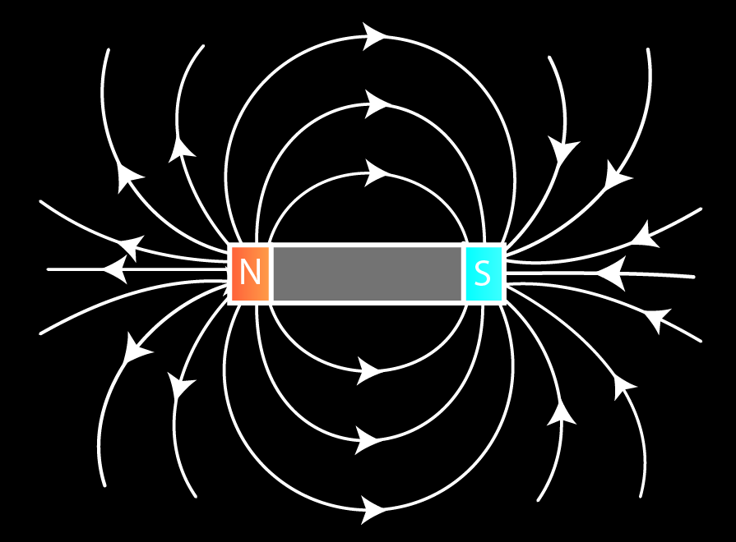
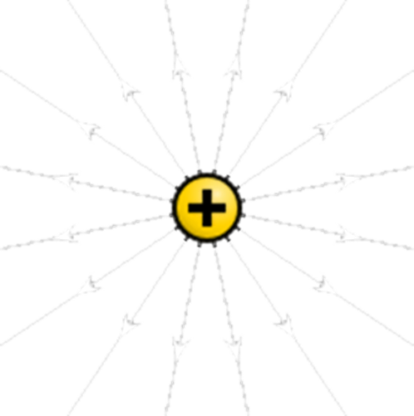
Electricity vs Magnetism
Magnetic dipole
Electric charges +/-
N
S

Slide 4
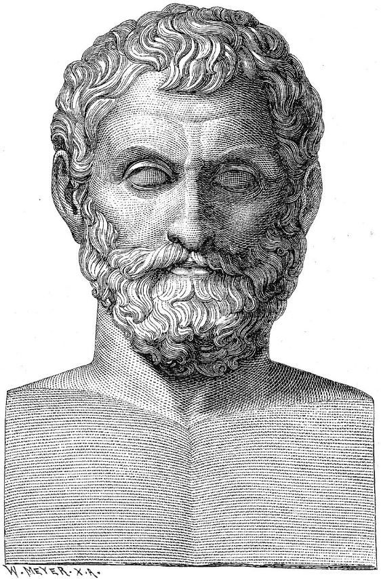
History of Magnetism
Thales of Miletus 625-545 BC:
Lodestone attracts iron
because it has a soul

Slide 5
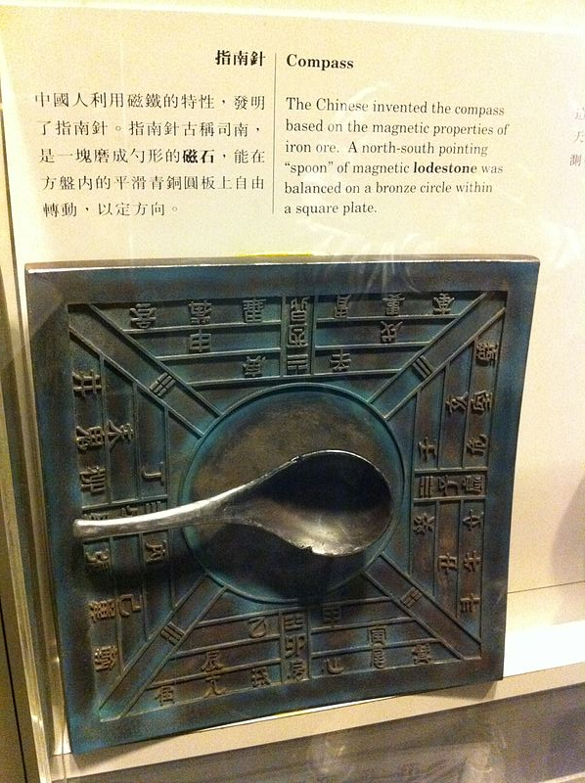
History of Magnetism
Thales of Miletus 625-545 BC:
Gui Guzi (鬼谷子) 4th century BC
Hong Kong Space Museum

Slide 6
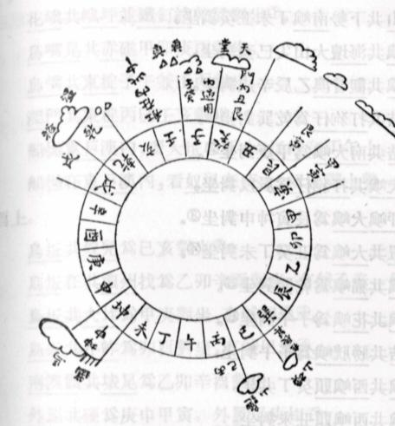
History of Magnetism
Thales of Miletus 625-545 BC:
Gui Guzi (鬼谷子) 4th century BC
Navigational compass:
  China 9th-11th century
  Europe 1190:
  Use mentioned by Alexander Neckam

Slide 7
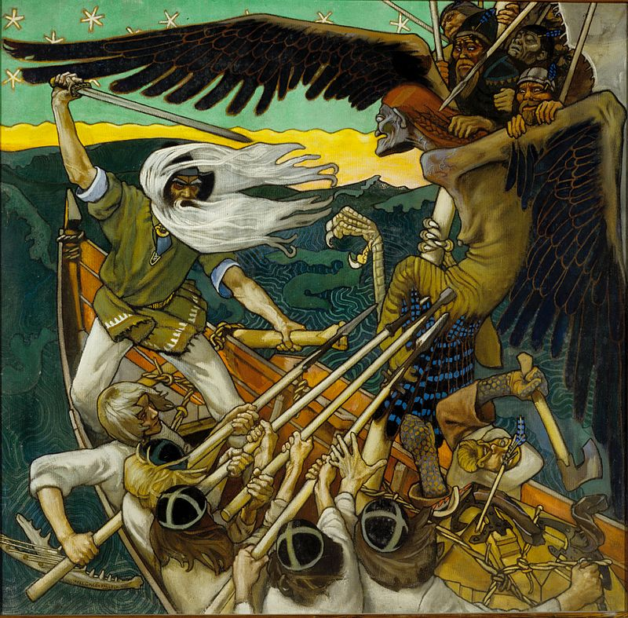
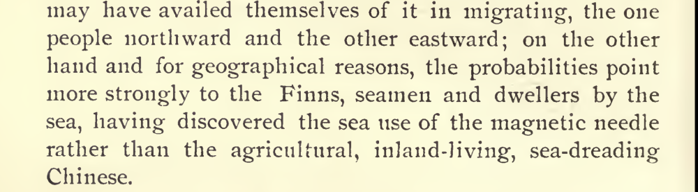
History of Magnetism
Thales of Miletus 625-545 BC:
Gui Guzi (鬼谷子) 4th century BC
Navigational compass:
  China 9th-11th century
  Europe 1190
  Park Benjamin Jr., The History of Electricity, 1895:

Slide 8
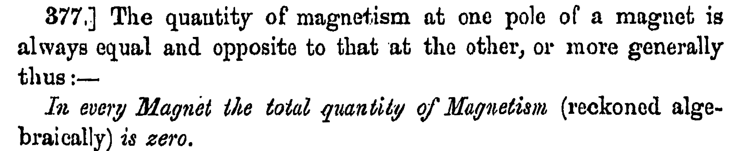

Maxwell Equations
No magnetic
charges
$$\vec{∇}⋅\vec{E}=ρ_{E} \\ \vec{∇}⋅\vec{B}=0 \\ \vec{∇}×\vec{E}=−\frac{∂\vec{B}}{∂t} \\ \vec{∇}×\vec{B}=−\frac{∂\vec{B}}{∂t}+{\vec{j}}_{E}$$
(Maxwell, Treatise on Electricity and Magnetism, 1873)

Slide 9
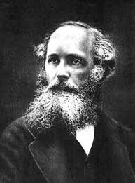
Maxwell Equations
Maxwell 1873:
Experimental reason for not
including magnetic charges
Floating magnet feels no net force
Magnetising an object does not
change its weight
When a long magnet is broken
into short pieces, each piece has
two poles
James Clerk Maxwell

Slide 10
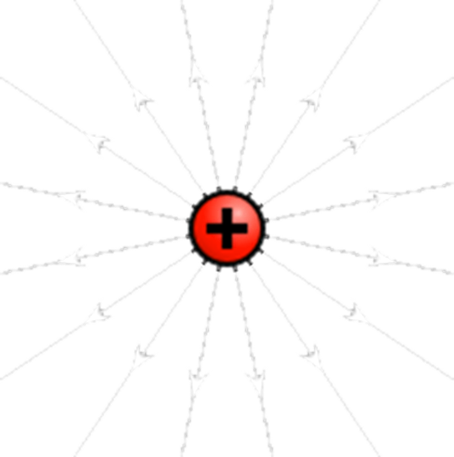


Magnetic Charges
Duality $\vec{E}+i\vec{B}→e^{iθ}\left(\vec{E}+i\vec{B}\right)$
$$\vec{∇}⋅\vec{E}=ρ_{E} \\ \vec{∇}⋅\vec{B}=ρ_{M} \\ \vec{∇}×\vec{E}=−\frac{∂\vec{B}}{∂t}+{\vec{j}}_{M} \\ \vec{∇}×\vec{B}=−\frac{∂\vec{B}}{∂t}+{\vec{j}}_{E}$$
N

Slide 11

Electromagnetic Potentials
$$\vec{E}=−\vec{∇}φ−\frac{∂\vec{A}}{∂t}, \vec{B}=\vec{∇}×\vec{A}$$
Quantum Mechanics:
Complex phase of the wave function couples to $\vec{A}$
$$iℏ\frac{∂}{∂t}ψ=−\frac{{\left(ℏ\vec{∇}+ie\vec{A}\right)}^{2}}{2m}ψ+eφψ$$
Sourceless magnetic field: No monopoles?
$$\vec{∇}∙\vec{B}=\vec{∇}∙\left(\vec{∇}×\vec{A}\right)=0$$

Slide 12
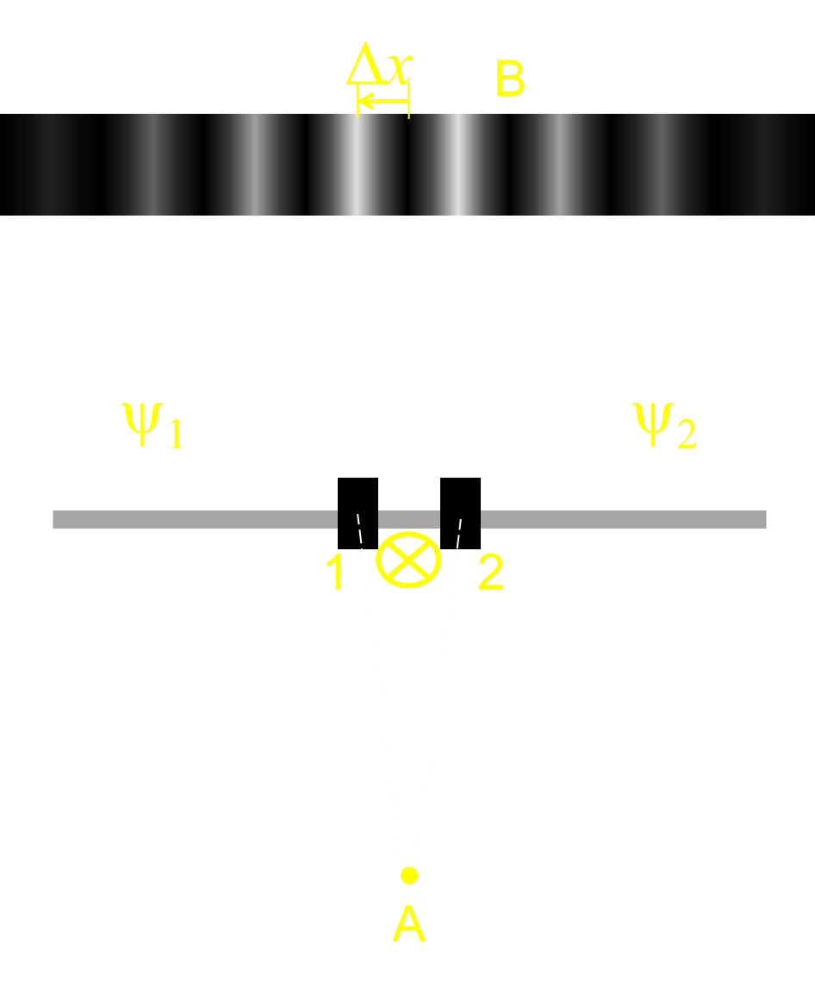
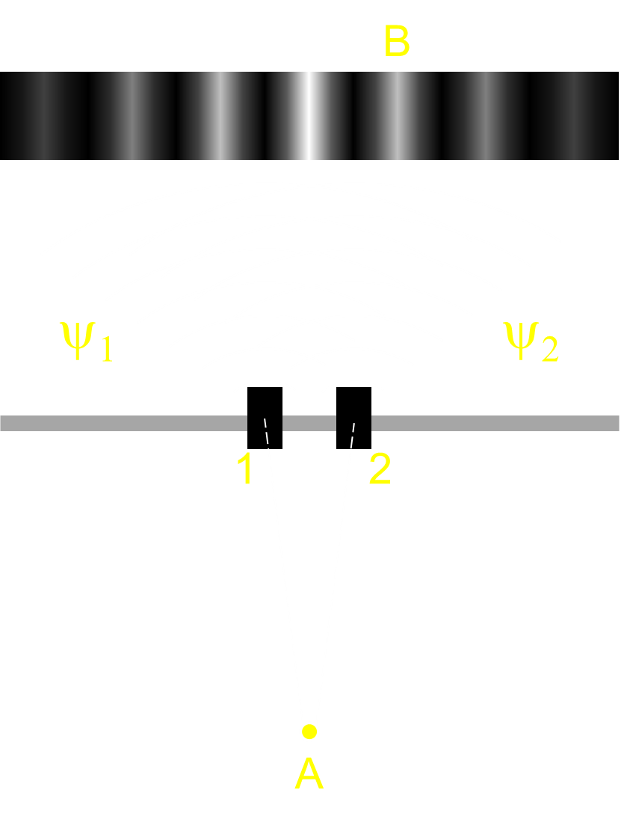


Dirac Monopole (1931)
N
Vector potential
Singularity along $\vec{n}$ (Dirac string):
  Carries magnetic flux $Φ=g$
  QM: No effect if $g=g_{D}=2π/e$

Slide 13
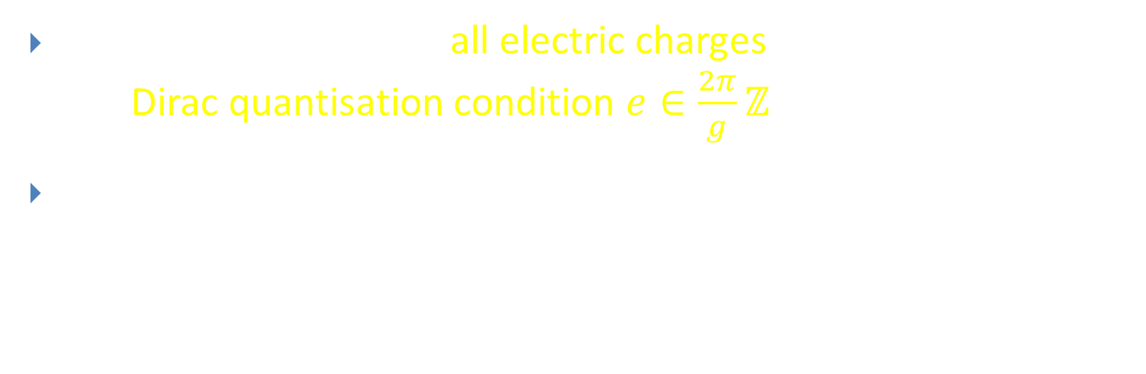
Dirac Monopole (1931)
N
String unobservable if all electric charges satisfy
the Dirac quantisation condition $e∈\frac{2π}{g}ℤ$
Conversely $g$ must be an integer multiple of $g_{D}=\frac{2π}{e_{0}}$,
where $e_{0}$ is the elementary electric charge

Slide 14
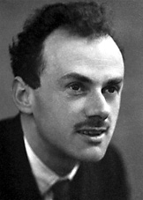
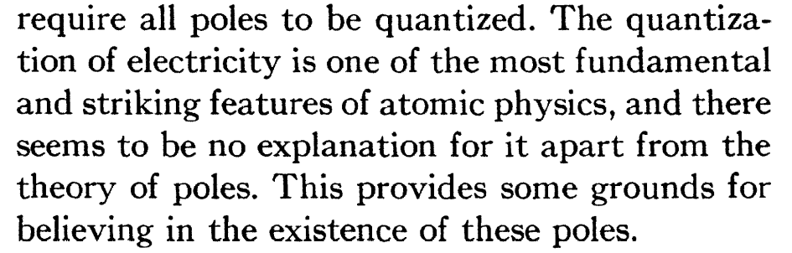
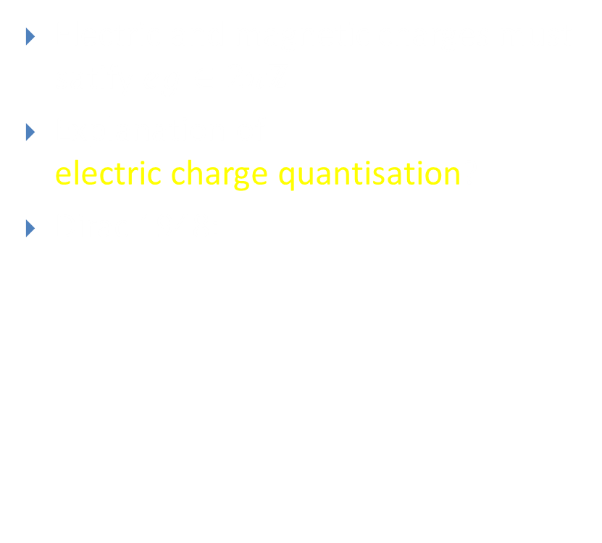
Dirac Quantisation Condition
Electric and magnetic charges must satify $eg∈2πℤ$
Explanation of
electric charge quantisation?
Dirac 1948:
Paul Dirac

Slide 15

Dyons
Particles with electric charge $e$ and magnetic charge $g$
Any two particles have to satisfy the quantisation condition (Schwinger 1966):
$$e_{1}g_{2}−e_{2}g_{1}∈2πℤ$$

Slide 16


‘t Hooft-Polyakov Monopole (1974)
Monopole in renormalisable quantum field theory
Georgi-Glashow model: SU(2)+adjoint Higgs
$Φ≠0$ ⇒ Symmetry breaking $SU(2)→U(1)$
Electrodynamics with magnetic field given by
$$B_{i}=\frac{1}{2}ε_{ijk}\text{Tr}\hat{Φ}\left(F_{jk}^{}−\frac{i}{2e}\left[D_{j},\hat{Φ}\right]\left[D_{k},\hat{Φ}\right]\right)$$

Slide 17
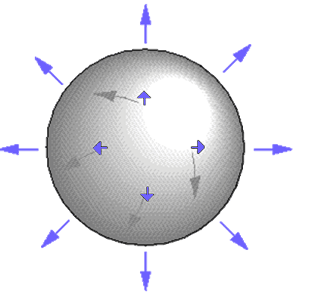
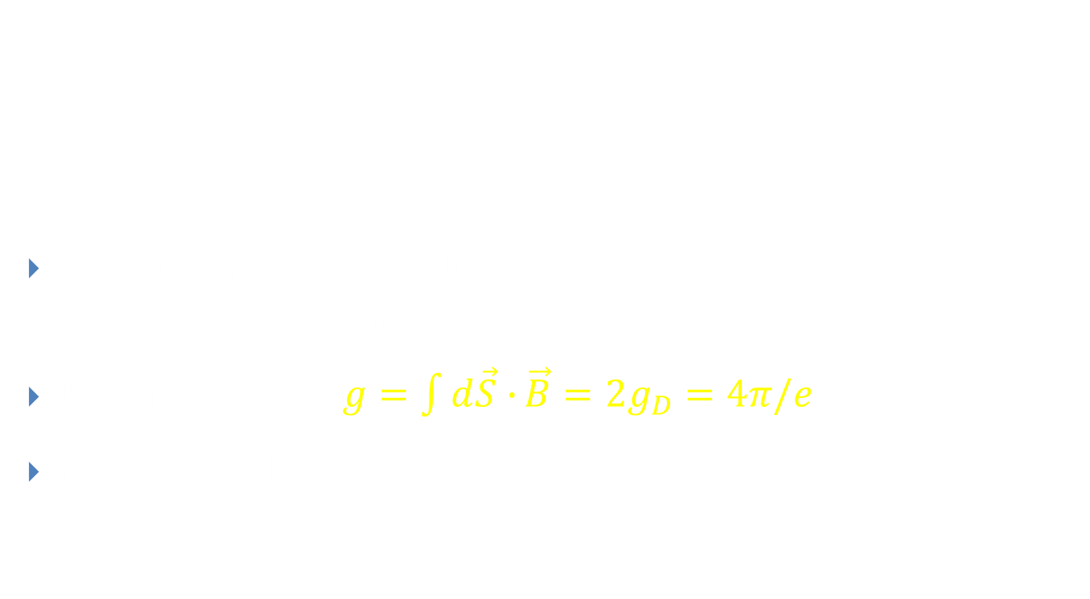
‘t Hooft-Polyakov Monopole (1974)
Smooth “hedgehog” solution:
$Φ^{a}∝x_{a}$, $A_{i}^{a}∝ε_{iaj}x_{j}$
Magnetic charge $g=\int{d\vec{S}∙}\vec{B}=2g_{D}=4π/e$
Finite, semiclassically calculable mass $M≈\frac{4πv}{e}\sim \frac{m}{e^{2}}$

Slide 18
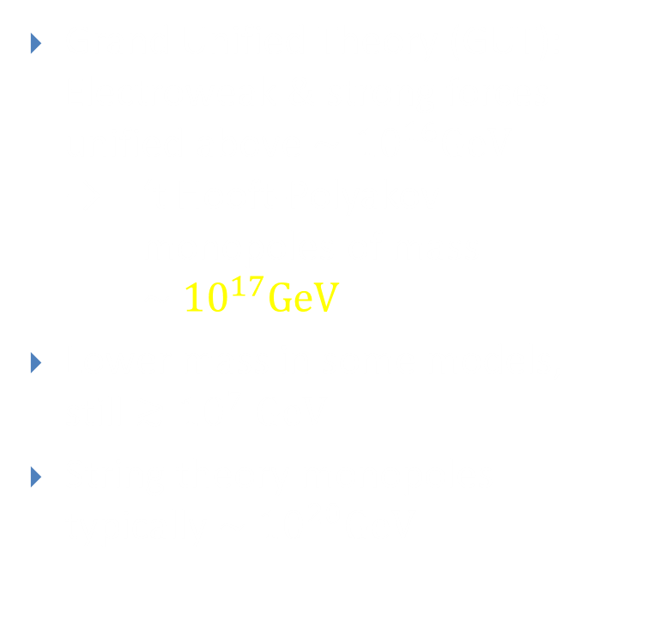
GUT Monopoles
Grand Unified Theory (GUT):
Electroweak & strong forces unified above $∼{10}^{16}GeV$
→ ‘t Hooft-Polyakov monopoles of mass $\sim {10}^{17}GeV$
Lower mass in some models,
still $≳{10}^{7} GeV$
String theory monopoles typically $\sim {10}^{20}GeV$
energy
Theory of Everything
10¹⁹ GeV
Grand Unified Theory
10¹⁶ GeV
Electro- weak Theory
gravity
strong
weak
electromagnetic
10² GeV

Slide 19


Elementary Monopoles
N
Magnetic Coulomb field:
Magnetic charge localised at a point
Divergent energy:
Cutoff-scale mass?

Slide 20

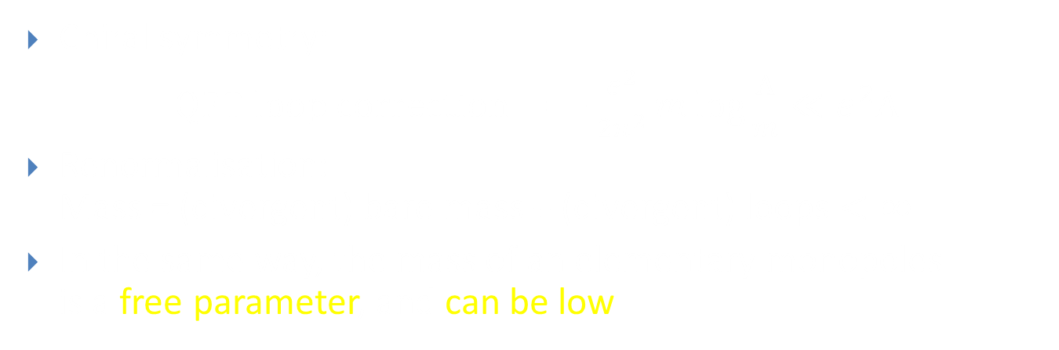
Compare: Electron Mass
Chiral symmetry:
$\text{QFT} \text{loop} \text{correction}=−\frac{e^{2}}{2π^{2}}m\log{\frac{Λ}{m}}≪e^{2}Λ$
Renormalisation:
Mass = (divergent) bare mass + (divergent) loops $<∞$
In the same way, the mass of an elementary monopoles
is a free parameter, and can be low

Slide 21
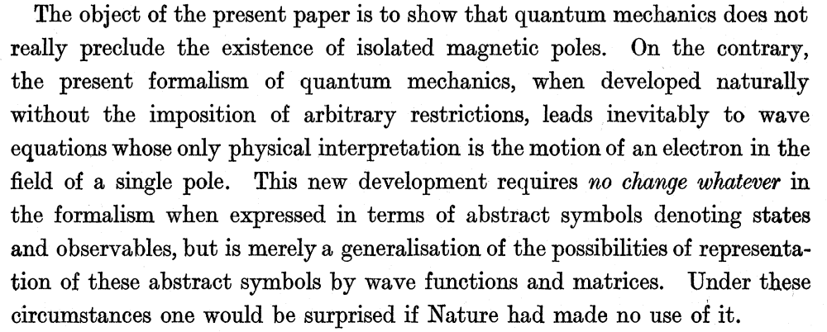
Summary: Why monopoles?
Compatible with quantum field theory
Would not require any modification of the Standard Model:
The theory ”knows about” magnetic charge,
but none of the known particles carry it
Dirac 1931:

Slide 22
Probes of New Physics
Strong, precisely known EM interactions
Electrodynamics ⇒ Stable particles
Interaction with charged fermions depends on core structure (Rubakov, Callan 1981)
  Cross section not suppressed by monopole mass
  Some GUT monopole catalyse proton decay
Properties related to beyond the SM physics:
  Unification of forces
  Fundamental properties of electromagnetism

Slide 23
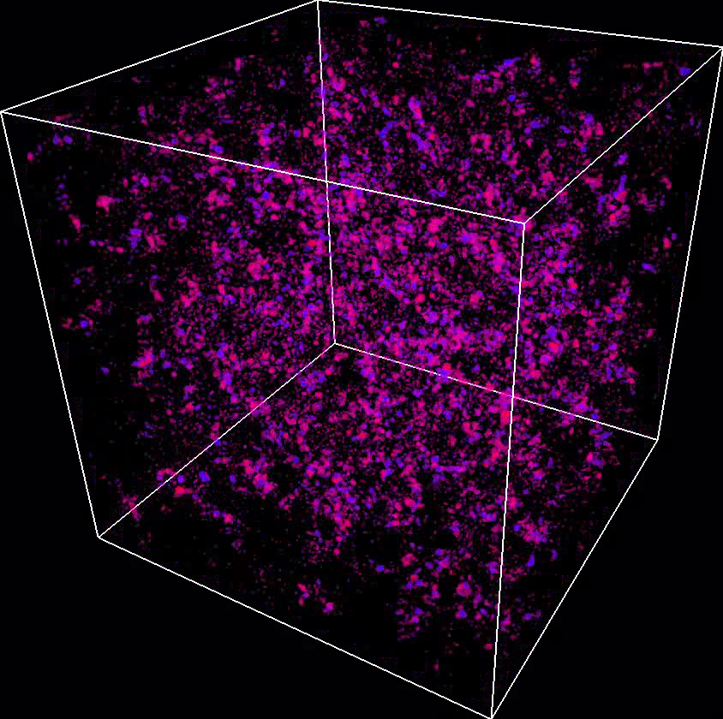
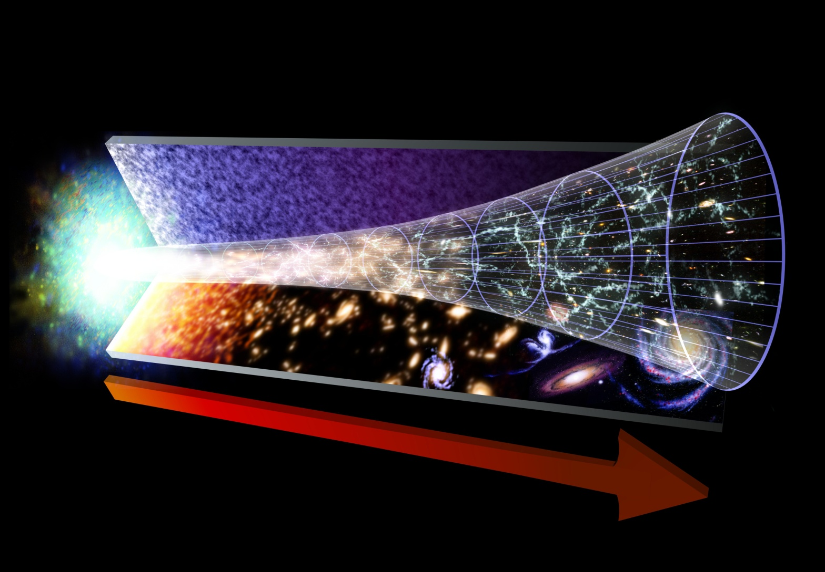

Cosmic Monopoles
Hot Big Bang:
GUT symmetry breaks
in a phase transition
The Higgs field chooses
a direction randomly
Kibble (1976):
Monopoles form,
at least one per horizon volume
→ $n_{mon}\sim H^{−3}$
Simulation: AR & D.J.Weir
Visualisation: www.vapor.ucar.edu
ξ

Slide 24
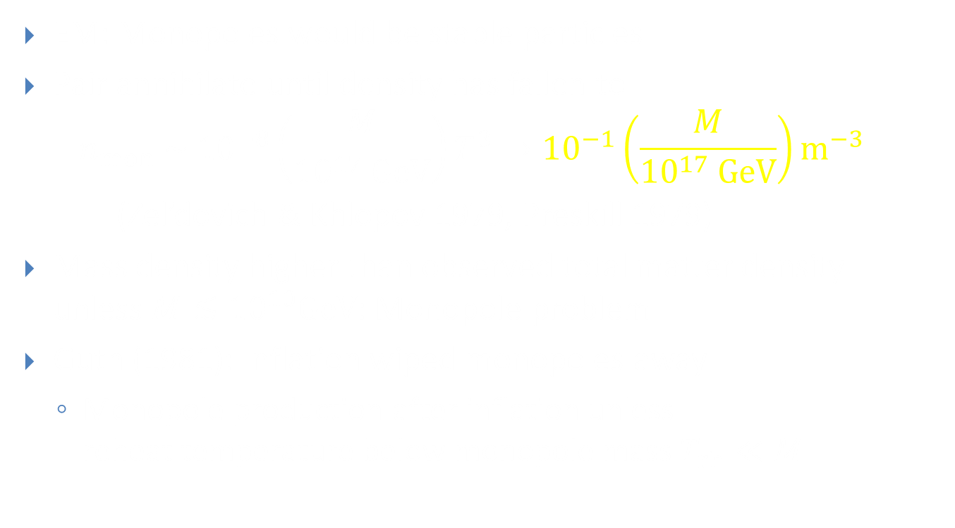
Cosmic Monopoles
EM: Monopoles would be stable particles
Pair annihilate until density has fallen to
$$n_{mon} \sim {10}^{−8}\left(\frac{M}{{10}^{17} GeV}\right)T^{3}→{10}^{−1}\left(\frac{M}{{10}^{17} GeV}\right)m^{−3}$$
(Zel’dovich & Khlopov 1979, Preskill 1979)
Mass density higher than observed total matter density
unless $M≲{10}^{10}GeV$: Monopole problem
Guth (1981): Inflation wiped monopoles away
  Monopole production after inflation unless
  reheat temperature below monopole mass $T_{rh}≪M$

Slide 25
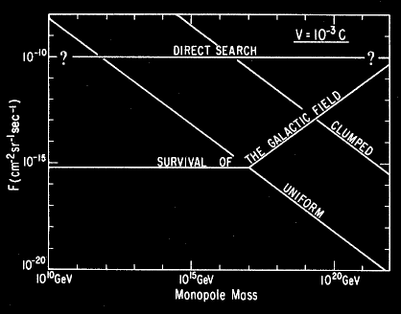
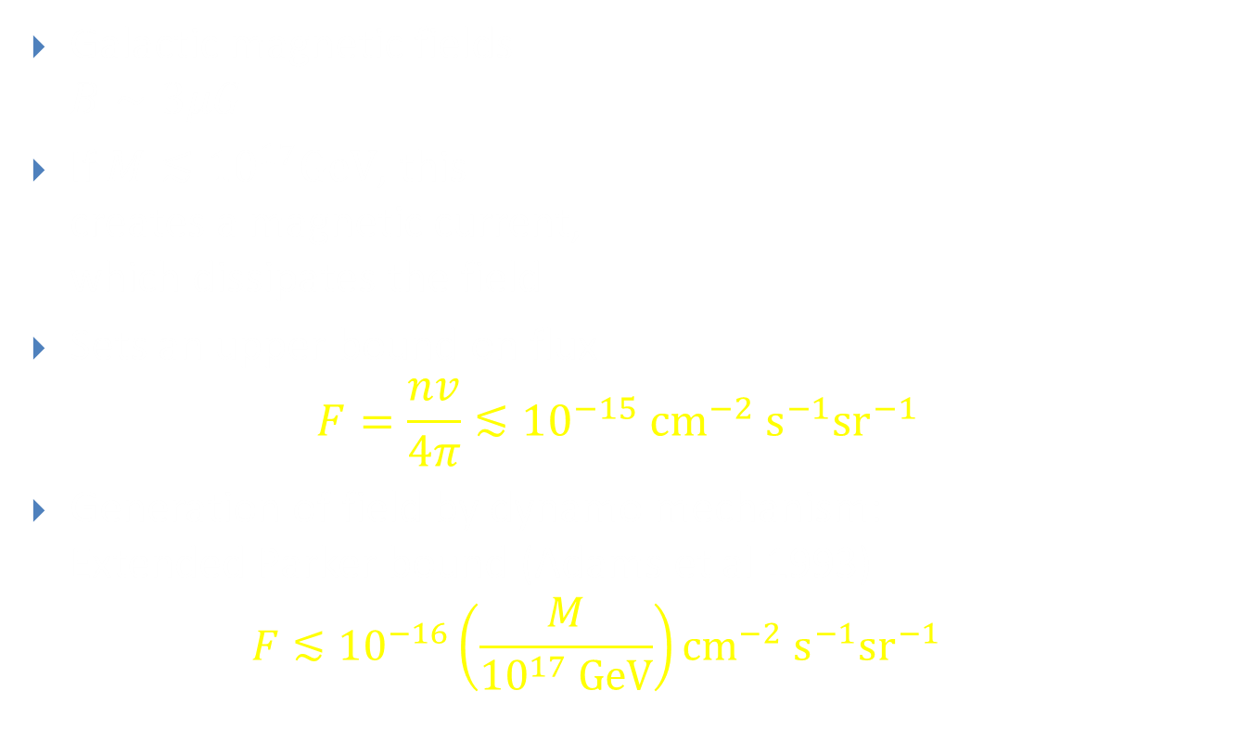
Parker Bound (1970)
Galactic magnetic fields
$B∼3μG$
If $M≲{10}^{17}GeV$, this
creates a magnetic current,
which dissipates the field
Sets an upper bound on flux
$F=\frac{nv}{4π}≲{10}^{−15} {\text{cm}}^{−2} {\text{s}}^{−1}{\text{sr}}^{−1}$
Generation of field by dynamo mechanism:
Extended Parker bound (Adams et al 1993)
  $$F≲{10}^{−16}\left(\frac{M}{{10}^{17} GeV}\right){\text{cm}}^{−2} {\text{s}}^{−1}{\text{sr}}^{−1}$$
(Turner et al 1982)

Slide 26
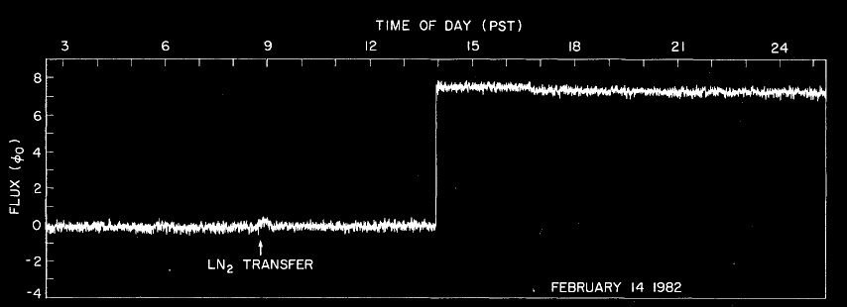
Cosmic Rays
(Cabrera 1982)
Early “detections”:
  Berkeley 1975, Stanford 1982, Imperial 1986
  All turned out to be false

Slide 27
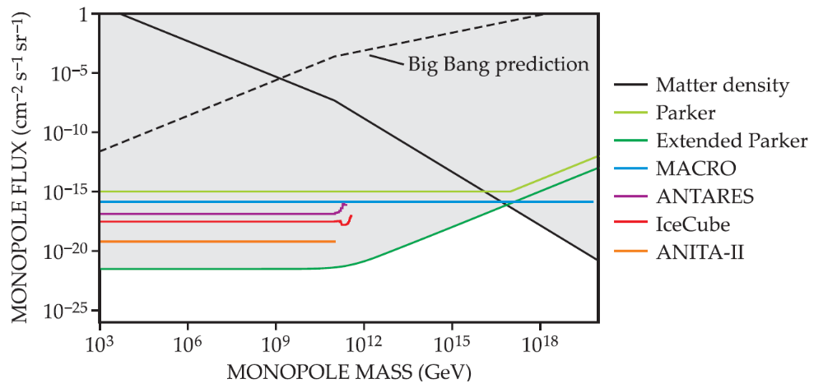
Cosmic Rays
Note: Varying kinematic assumptions
AR, Physics Today 2016

Slide 28
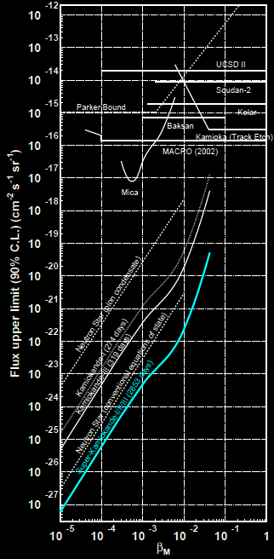
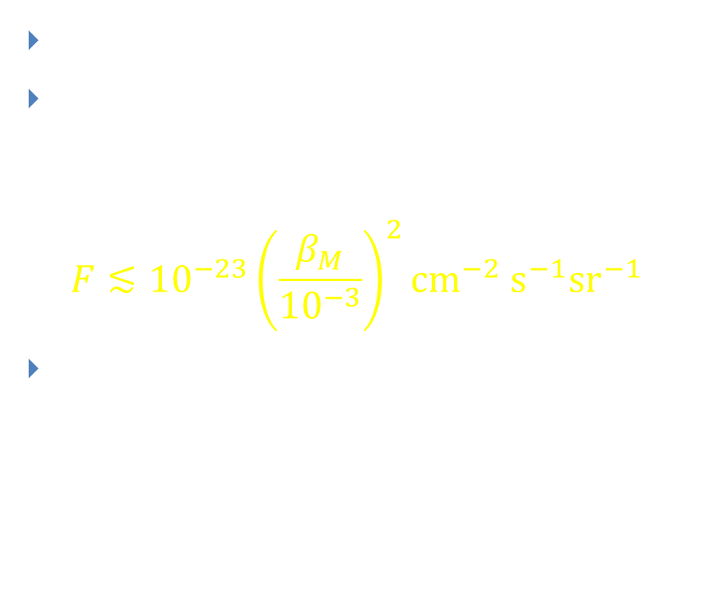
Monopole-Induced Neutrinos
Monopoles accumulate in the Sun
GUT monopoles catalyse p decay:
Produces neutrinos (Rubakov 1981) Super-Kamiokande bound (2012):
$$F≲{10}^{−23}{\left(\frac{β_{M}}{{10}^{−3}}\right)}^{2}{\text{cm}}^{−2} {\text{s}}^{−1}{\text{sr}}^{−1}$$
Model-dependent

Slide 29
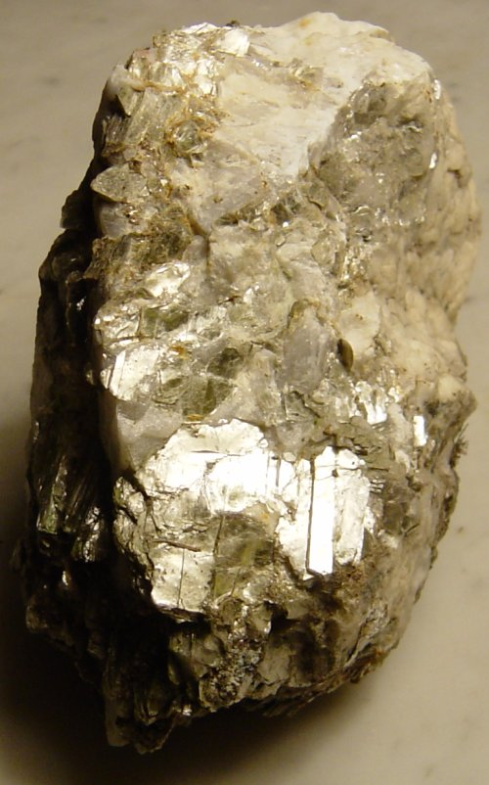
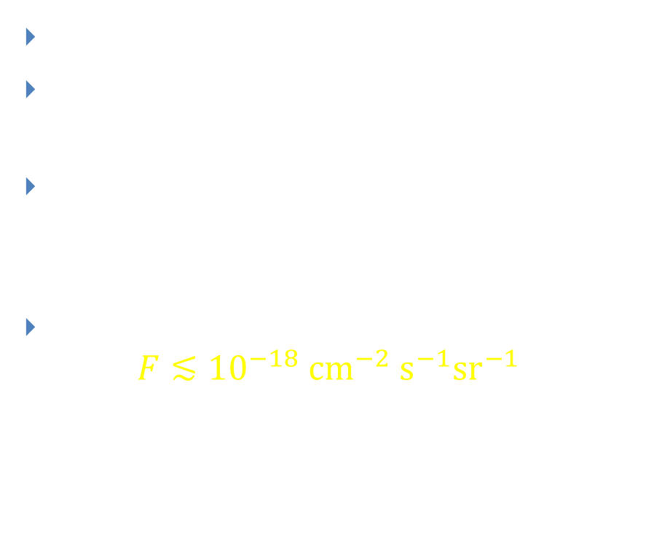
Tracks in Mica
$\sim 1 Gyr$old silicate crystals
Monopole would ionise,
leave a track
Price&Salamon (1986):
Analysed mica samples from
museums, cross section $\sim 1200 cm^{2}$
For $β\sim {10}^{−3}$, sets bound on flux
$F≲{10}^{−18} {\text{cm}}^{−2} {\text{s}}^{−1}{\text{sr}}^{−1}$

Slide 30
Searches for Trapped Monopoles
Moon rocks (Alvarez et al. 1970)
Sea water (Carrigan et al 1976)
Monopole-antimonopole annihilations in Earth’s core (Carrigan 1980)
Deeply buried rocks (Kovalik&Kirschvink1986)
Meteorites (Jeon&Longo 1995)
Polar volcanic rocks (Bendtz et al. 2013)
No monopoles found

Slide 31

No Cosmic Monopoles?
Bounds from searches many orders of magnitude lower than prediction (though with caveats)
Maximum temperature after inflation $T_{rh}$ has to be below monopoles mass to avoid monopole formation
Even if monopoles don’t exist in the Universe today,
could we still produce them in particle colliders?
Baryogenesis needs $T_{rh}≫100 GeV$,
so monopoles with masses $M\sim 1..10 TeV$
may be OK and accessible with the LHC

Slide 32
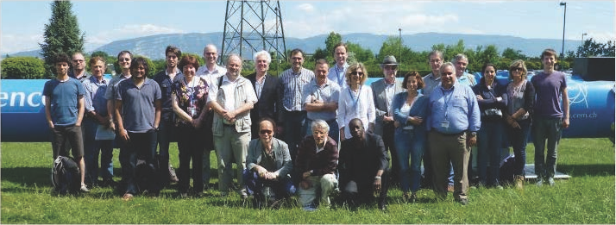
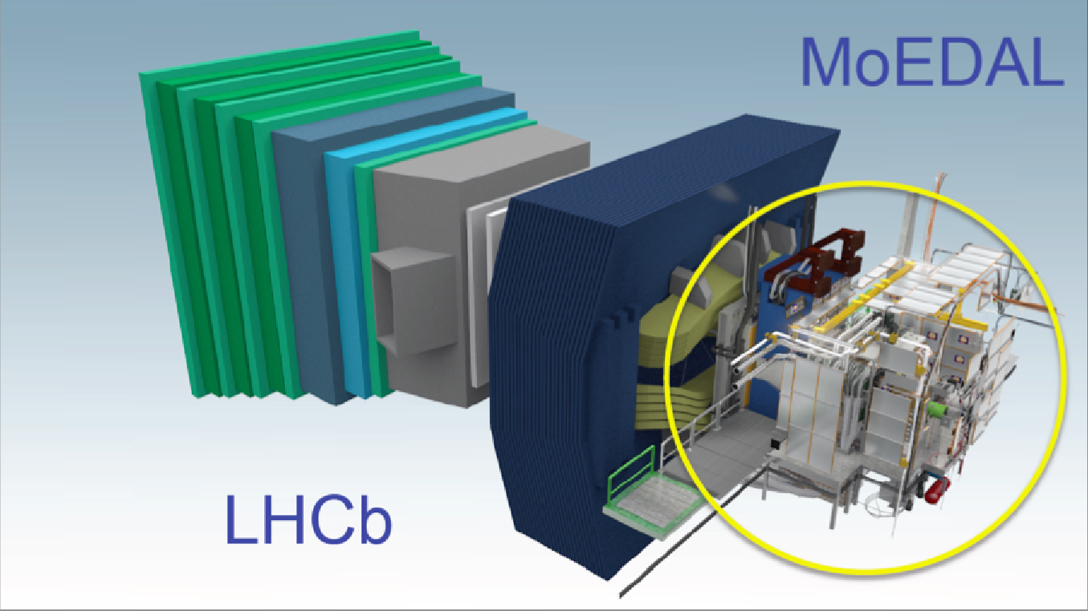
MoEDAL
Monopole and Exotics Detector at the LHC
25 institutions from 14 countries
Started operation in 2015
Shares LHC intersection point 8
with LHCb

Slide 33
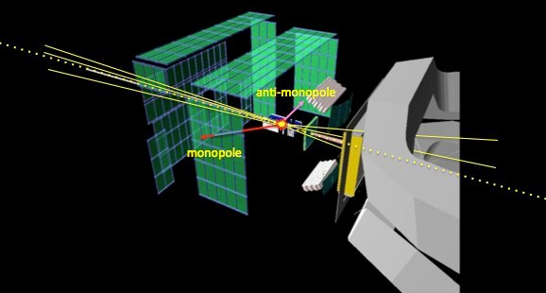

MoEDAL
Nuclear Track Detectors
  Stacks of 9 plastic sheets (CR39, Makrofol and Lexan)
  Total surface area ${\sim 100 m}^{2}$
  Removed and etched, analysed for particle tracks with
  optical microscope
Ionisation threshold $Z/β≳5$
  Standard Model particles $Z/β≈1$
  → In principle no background

Slide 34
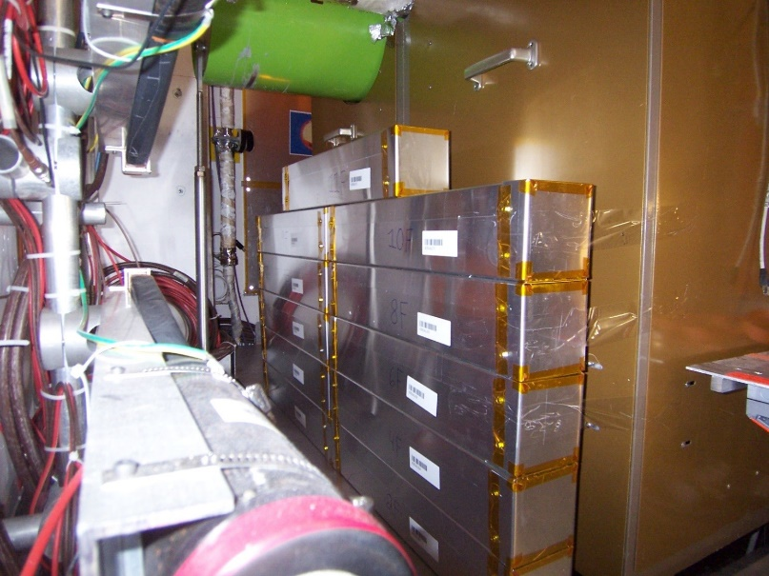
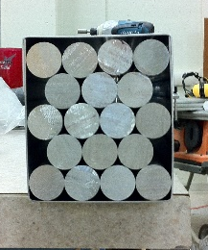

MoEDAL
Trapping Detectors (MMT)
  800kg of aluminium bars
  Monopoles lose energy,
  gets bound to nucleus
  with binding energy
  $E_{b}≈2.6 MeV$ (Malkus 1951)
Removed and analysed by SQUID magnetometer
  Signal: Jump in current
  Repeat arbitrarily many times to confirm

Slide 35
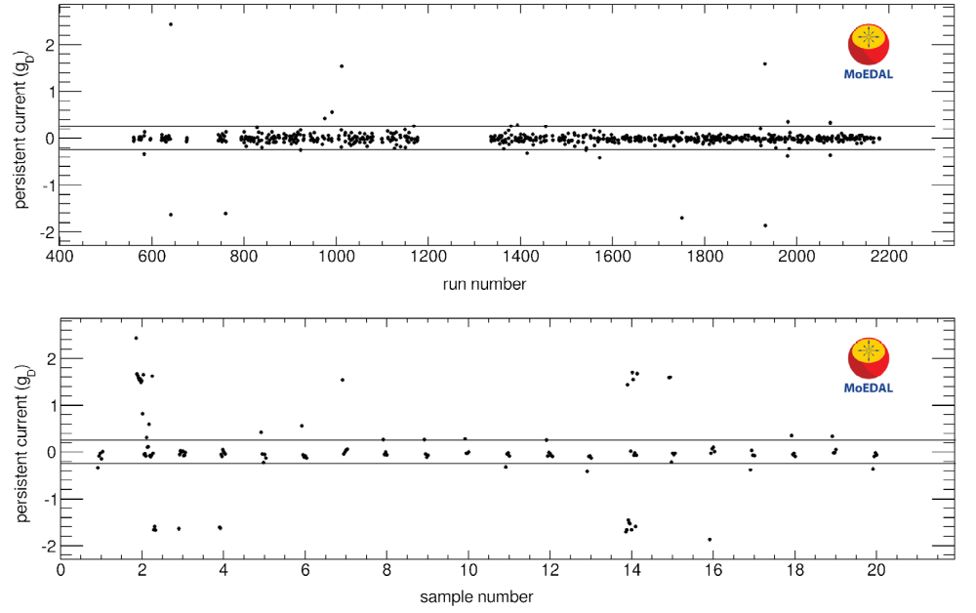
MMT Scans
MoEDAL Collaboration, PRL 2017

Slide 36
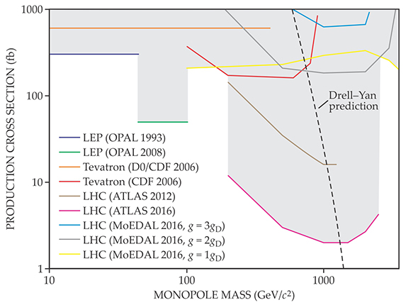
Collider Searches
AR, Physics Today 2016

Slide 37
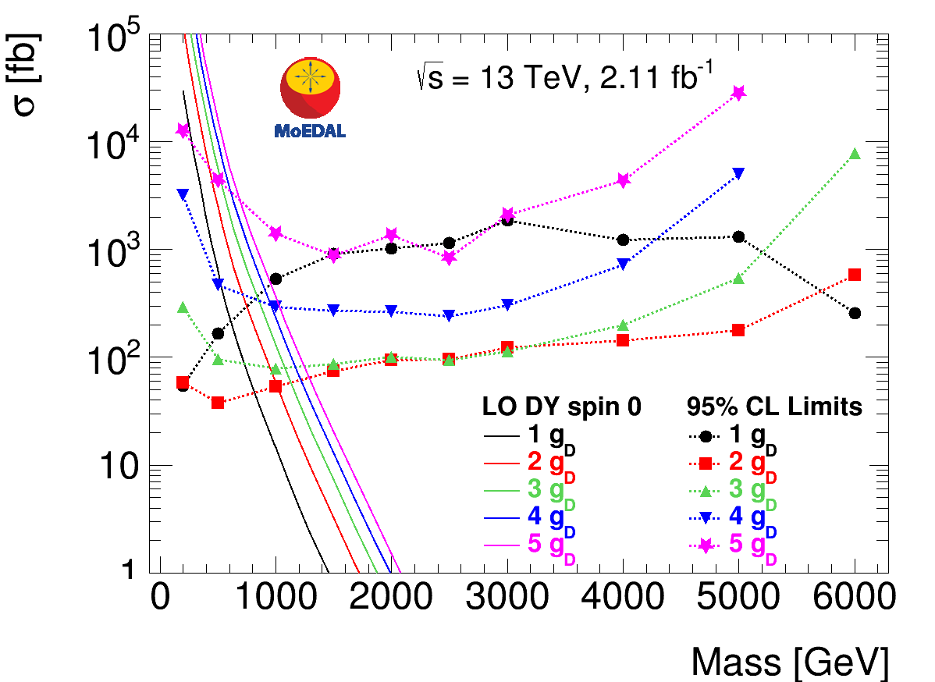
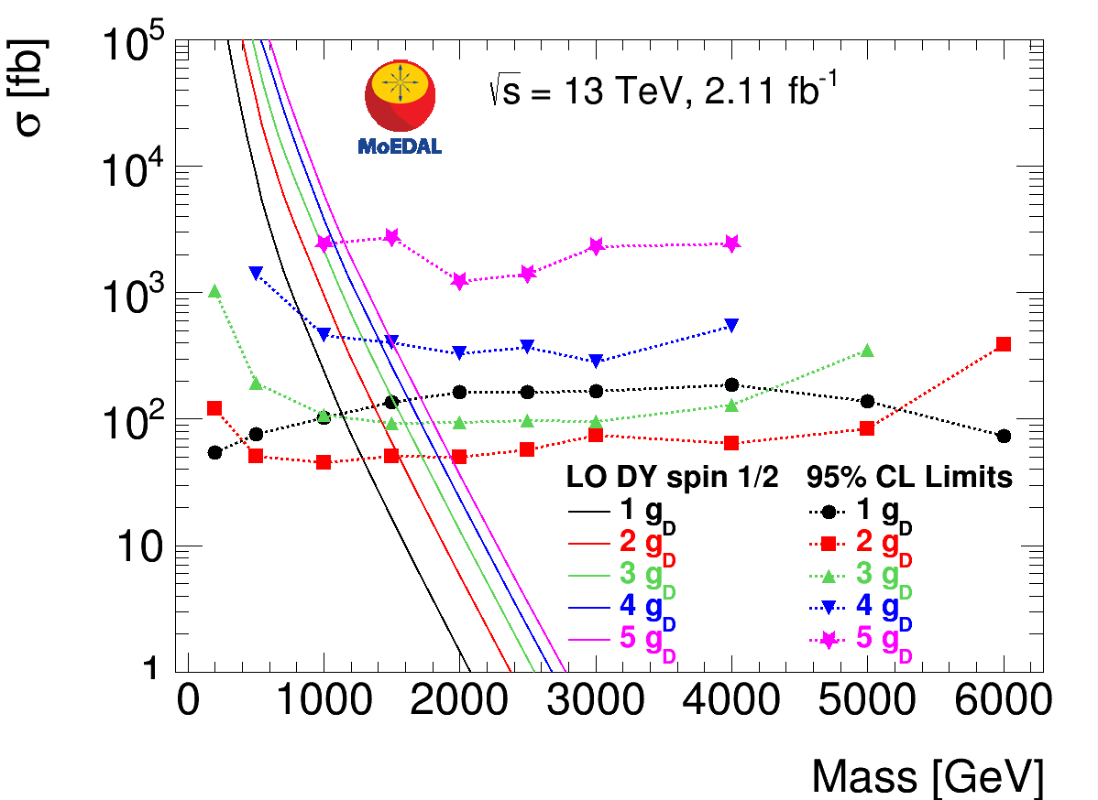

MoEDAL 13 TeV Results
222kg of Al exposed to $2.11 fb^{−1}$ of $13 TeV pp$
Best current bounds for $g≥2g_{D}$
Note: Constraints on cross section, not mass
MoEDAL Collaboration, arXiv:1712.09849

Slide 38
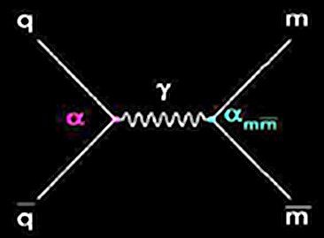

Production Amplitude
Collider searches generally assume tree-level
Drell-Yan with $e→g=2π/e$
  $g≫1$ ⇒ Not reliable!
Need (non-perturbative) QFT calculations
but tools don’t exist yet
Semiclassical calculations:
  ‘t Hooft-Polyakov pair production
  amplitude suppressed by $\sim e^{−4/α}∼{10}^{−236}$
  (Drukier&Nussinov, Demidov&Levkov,…)
  Practically impossible in two-particle collisions

Slide 39
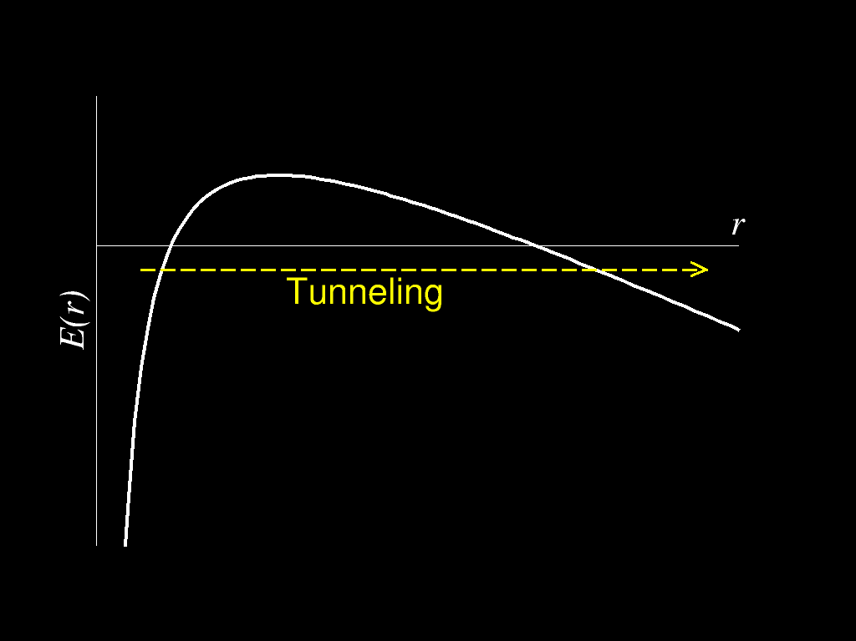


Schwinger Pair Production
Consider instead pair production from a strong magnetic field
EM dual to usual Schwinger pair production:
(Sauter 1931, Heisenberg&Euler 1936, Schwinger 1951)
Tunneling through Coulomb potential barrier
No direct experimental
confirmation yet:
  $e^{+}e^{−}$ pairs need
  $\left|\vec{E}\right|≫\frac{m^{2}}{e}∼{10}^{18} V/m$
  1000 x stronger than the
  most powerful lasers
$$E\left(r\right)=2m−\frac{e^{2}}{4πr}−e\vec{E}⋅\vec{r}$$

Slide 40
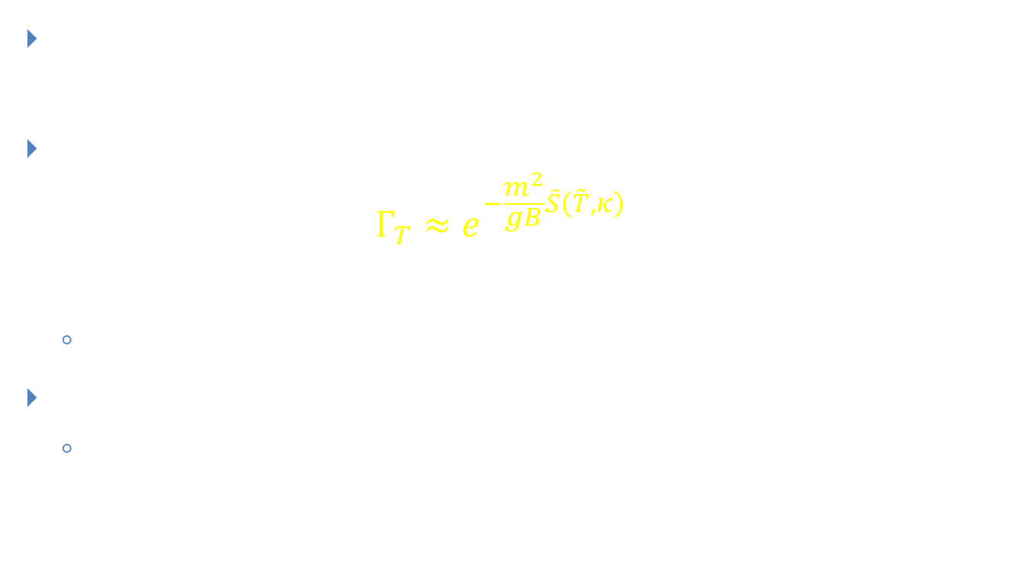
Thermal Schwinger Pair Production
Magnetic monopole pair production at temperature $T$ and in magnetic field $B=\left|\vec{B}\right|$
Production rate per unit time and volume (AR&Gould 2017):
$$Γ_{T}≈e^{−\frac{m^{2}}{gB}\tilde{S}\left(\tilde{T},κ\right)},$$
where $\tilde{S}\left(\tilde{T},κ\right)$ is a function of $\tilde{T}=mT/gB$ and $κ=g^{3}B/m^{2}$
  Calculated numerically
Non-perturbative: Does not require $g≪1$
  Works for magnetic monopoles

Slide 41



Numerical Results for $\tilde{S}$
(AR&Gould, 2017)
$$=mT/gB$$
$$=g^{3}B/m^{2}$$

Slide 42
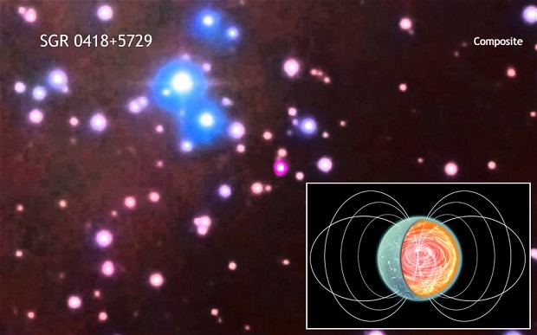
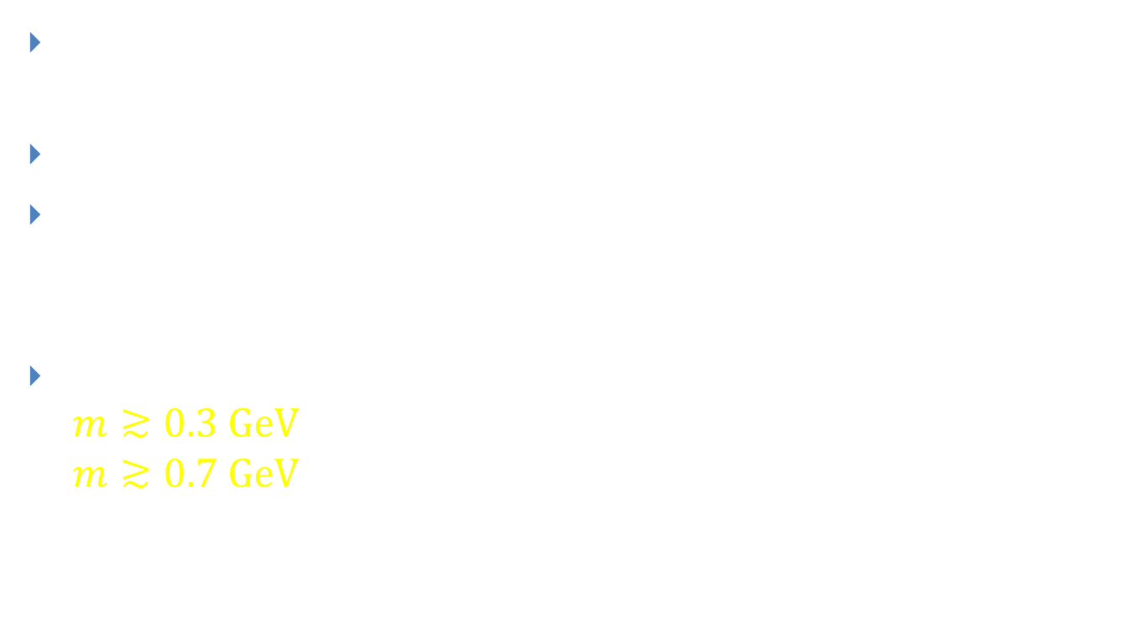
Magnetars
Neutron stars with very strong magnetic fields (23 known),
up to $B \sim {10}^{−4} GeV^{2}$
Temperature $T≈{10}^{−6}…{10}^{−8} GeV$
Monopole pair
production would
dissipate the field
Bound
$m≳0.3 GeV$ for $g=g_{D}$
$m≳0.7 GeV$ for $g={2g}_{D}$

Slide 43
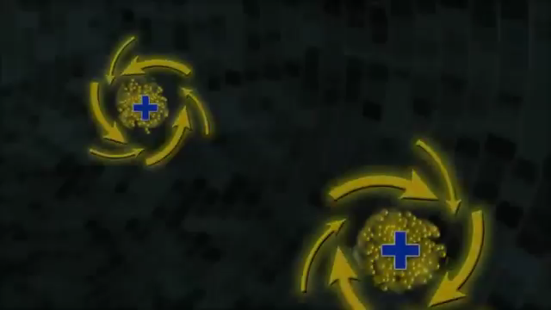
Heavy Ion Collisions
(Video: Brookhaven National Laboratory)

Slide 44
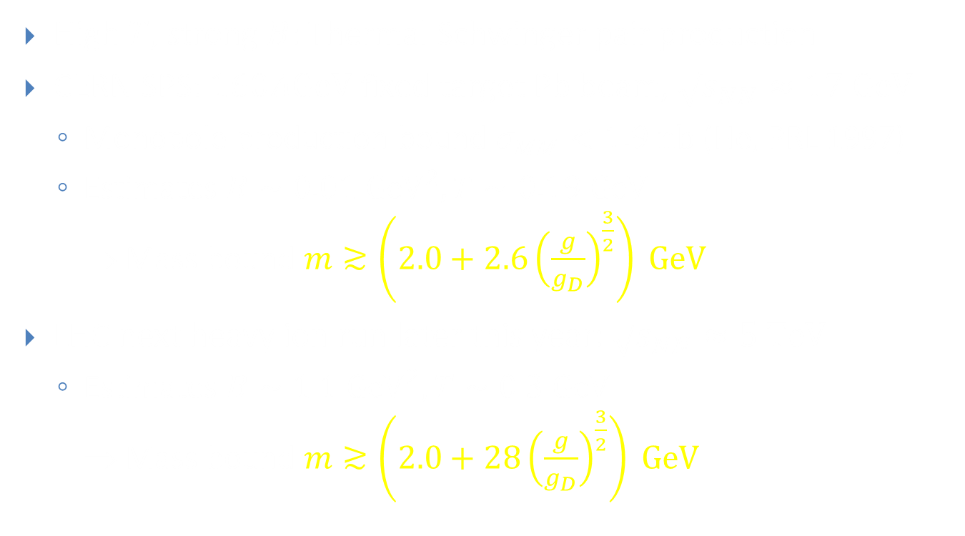
Heavy Ion Collisions
High $T$, strong $B$: Thermal Schwinger pair production
CERN SPS: $160AGeV$ fixed target Pb beam, $\sqrt{s_{NN}}≈17 GeV$
  Monopole production bound $σ_{MM}<1.9 nb$ (He, PRL 1997)
  Estimates $B∼0.01 {GeV}^{2}, T∼0.19 GeV$
  ⇒ Mass bound $m≳\left(2.0+2.6{\left(\frac{g}{g_{D}}\right)}^{\frac{3}{2}}\right) GeV$
LHC next heavy ion run later this year: $\sqrt{s_{NN}}≈5 TeV$
  Estimates $B∼1.1 {GeV}^{2}, T∼0.3 GeV$
  ⇒ Mass bound $m≳\left(2.0+28{\left(\frac{g}{g_{D}}\right)}^{\frac{3}{2}}\right) GeV$

Slide 45
Monopole Mass Bounds
Gould & AR, 2017

Slide 46
Summary
Magnetic monopoles can exist
EM duality, Dirac quantisation condition, Grand Unification suggest they should exist
GUT monopoles would be heavy,
but elementary monopoles could be light
Astrophysics and cosmic rays constrain monopole flux
Colliders constrain monopole production cross section
Heavy ion collisions can constrain mass directly
- or find them!

