Slide 1

Recent developments on quantum integrable systems
Yupeng Wang
Institute of Physics, CAS
2018-09-28, 科大

Slide 2
Outline
I. Overview
The Quantum Moebius Strip
Twisted Spin Chain
IV. Concluding Remarks & Perspective

Slide 3
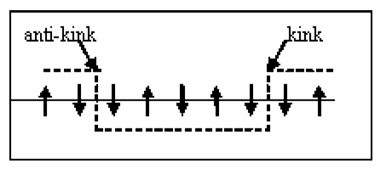
I. Overview: important applications
Why exactly solvable models?
Provide important benchmarks!
Hydrogen atom
2D Ising model thermodynamic phase transition
1D Hubbard model Mott insulator
Heisenberg chain Spinon （fractional charge）
Recent applications：Cold atoms、Yang-Mills and
AdS/CFT、Stochastic process、
Topological states of matter、
Quantum information

Slide 4
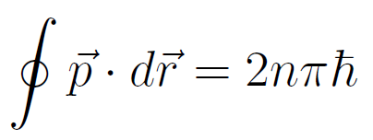
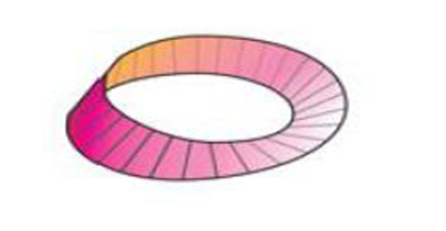
I. Overview: motivation
A long history for topology in physics:
Topological field theory, AdS/CFT, fractional charges etc
Quantum Hall, topological insulator, topological order,
Weyl/Majorana fermion etc.
Two issues:
Topological states of matter;
Quantization in topological space
Sommerfield quantization:
How to quantize in topological space?
Calabi-Yau manifold
Seiberg-Witten conjecture etc.
The present topic: from integrable models to understand…

Slide 5

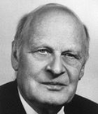

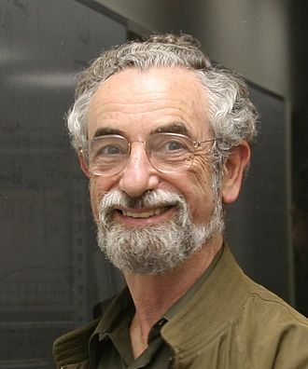


Masters
H. Bethe
L. Onsager
C. N. Yang
E. H. Lieb
R. J. Baxter
L. D. Faddeev

Slide 6
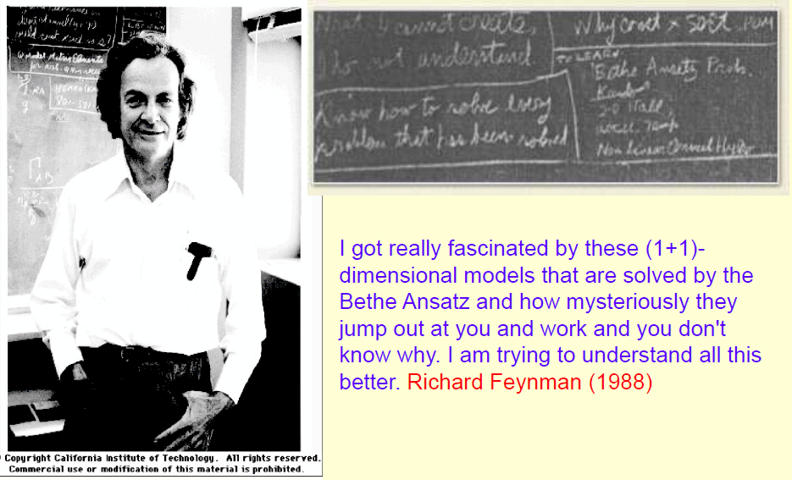
I. Motivation
II. The off-diagonal Bethe Ansatz
1. Operator product identities
2. Inhomogeneous T-Q relations
III. XXX spin chain with non-diagonal boundaries
1. The solutions
2. The completeness and Bethe eigenvectors
IV. Concluding remarks & perspective

Slide 7
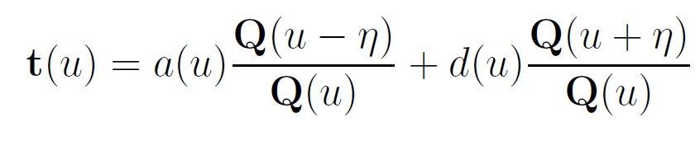
I. Overview
The history of quantum integrable models:
1931, H. Bethe (coordinate Bethe Ansatz)
1967, C.N. Yang (Yang-Baxter equation)
1971, R.J. Baxter (T-Q equation)
1979, L.D. Faddeev(algebraic Bethe Ansatz)

Slide 8
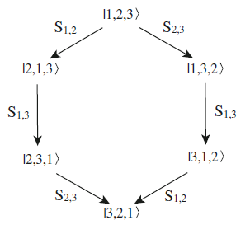

Liouville theorem and Yang-Baxter Equation
Liouville theorem : Variables are separable!
Yang-Baxter Equation: Factorizable!

Slide 9

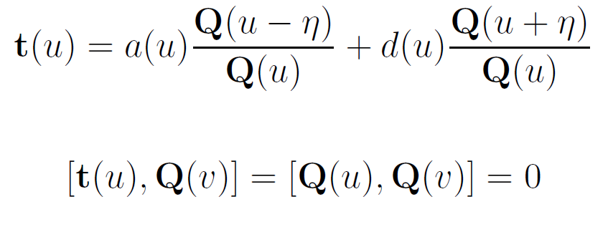
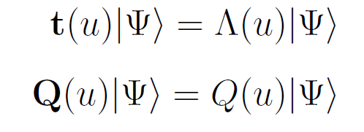
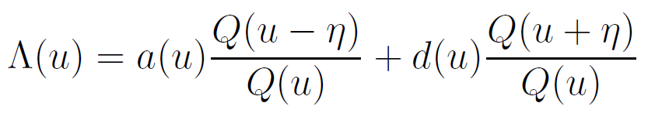
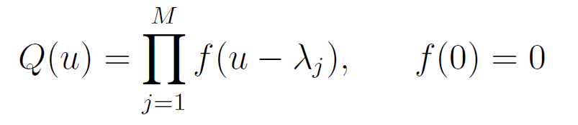
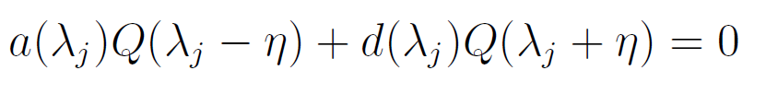
I. Overview
Baxter’s T-Q relation
Regularity

Slide 10
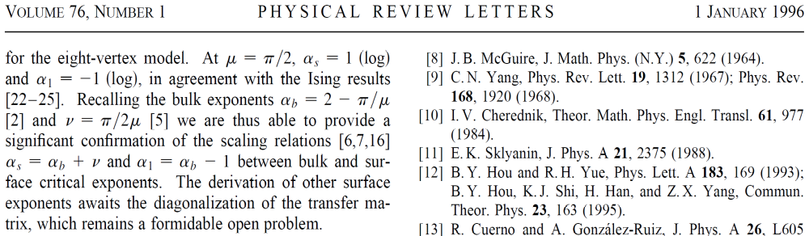
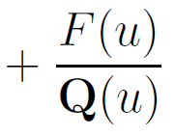
The first topological quantum integrable model (odd N XYZ) was discovered in 1972 but resisted solution for 40 years!
Baxter’s T-Q equation encounters a big problem!
2013, off-diagonal Bethe Ansatz(ODBA) was proposed:

Slide 11



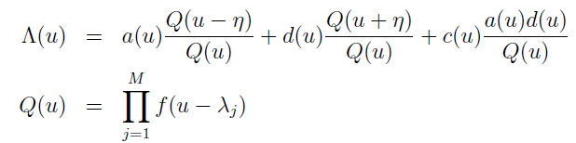



The inhomogeneous T-Q equation Cao et al, PRL 111,137201(13)
C(u) is nonsingular and matches asymptotic behavior or periodicity
CYSW term
Why?
Regularity

Slide 12
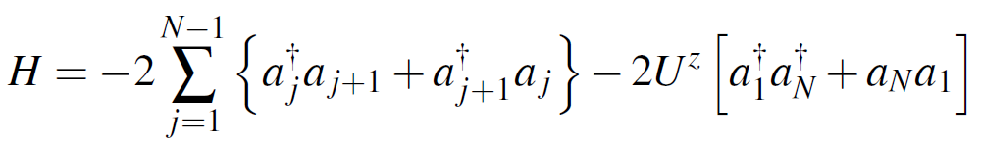
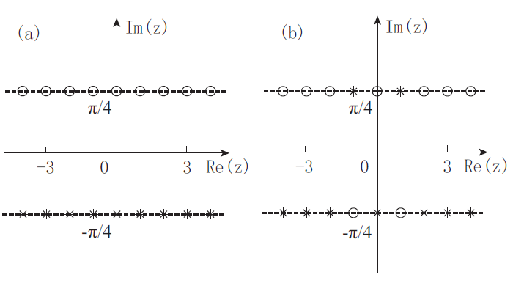
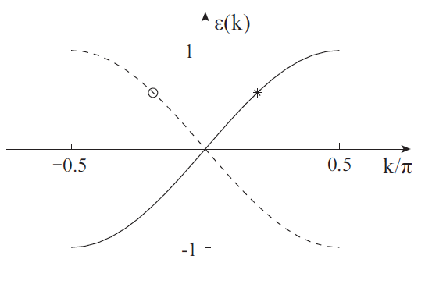
II. The quantum Moebius strip
A superconducting quantum dot embedded in a metallic ring
chiral particle-hole excitations
Cao et al, PRL 111,137201(2013)

Slide 13


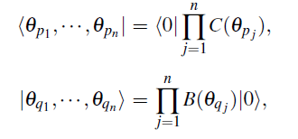
Zhang et al, J. Stat. Mech. (2015) P05014
II. The quantum Moebius strip
How to retrieve the eigenstates?
Monodromy matrix
Transfer matrix
An orthogonal basis:

Slide 14

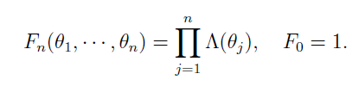
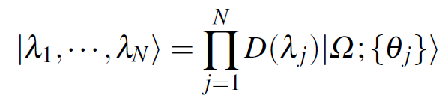
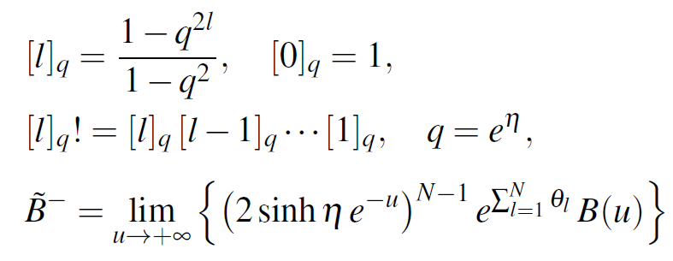
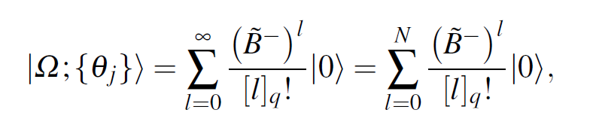
Bethe states
Scalar product
Compact form: (q-coherent states)

Slide 15
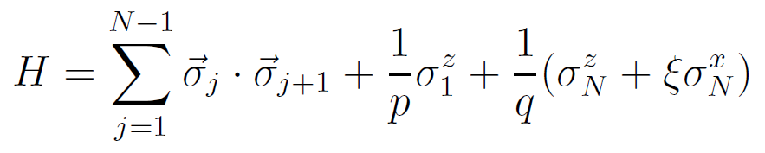
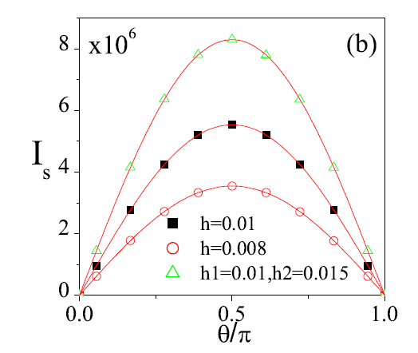

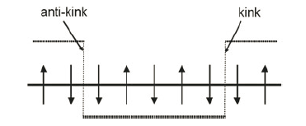
III. Twisted spin chain
Cao et al, Nucl. Phys. B 875, 152 (2013)
Unparallel boundary fields
Spin current
Spinons carry spin half?
We found spiral spinons!

Slide 16

IV. Concluding Remarks & Perspective
The ODBA indeed works well!
Multi-component :
JHEP 04, 143 (2014)
JHEP 06, 128 (2014)
JHEP 02, 036 (2015)
JHEP 05, 119 (2016)
High-genus manifold:
JHEP 09, 212 (2015)
AdS/CFT:
JHEP 10, 133(2015)
Relativistic quantum Toda chain：
JPA 50(2017)124003

Slide 17

Collaborators : J. Cao, W.L. Yang, K. Shi
X. Zhang, Y.Y. Li & S. Cui
Thanks!

