Slide 1
Notes on non-minimally derivative coupling
Yungui Gong （龚云贵）
School of Physics
Huazhong University of Science and Technology

Slide 2
Outline
Motivation: Higgs inflation
Non-minimally derivative coupling
Inflation with non-minimally derivative coupling
PPN parameters and Dynamical analysis
Conclusion
Based on arXiv: 1412.8152, 1504.01271, 1504.05839

Slide 3
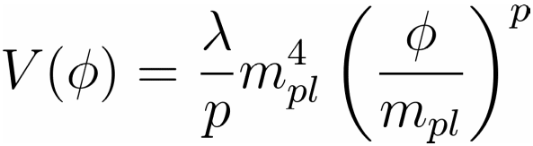
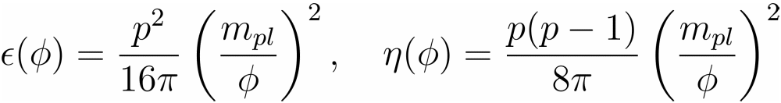
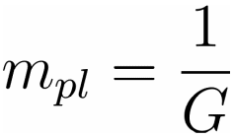



Higgs Inflation
Review of power law potential
Coupling constant problem
Curvature
To avoid quantum gravity

Slide 4
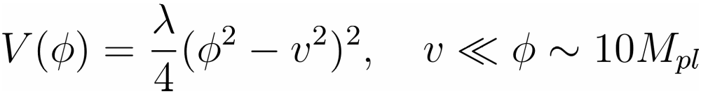

Higgs inflation
Coupling constant problem
Coupling constant is too small
Higgs field
Particle Data Group 2014, Chin. Phys. C

Slide 5
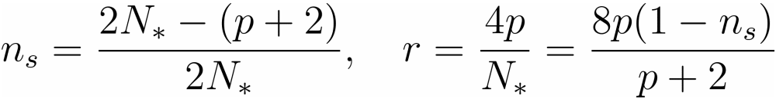
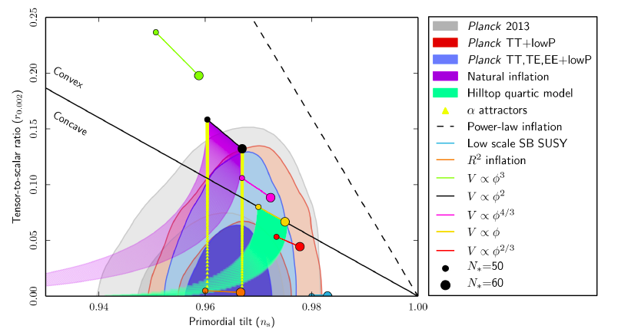


Higgs inflation
observational constraint (Planck 2015)
Higgs inflation Excluded

Slide 6

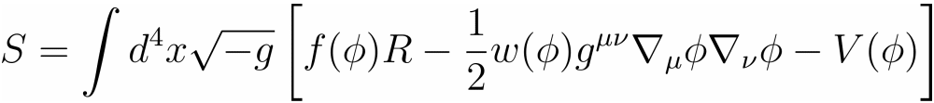

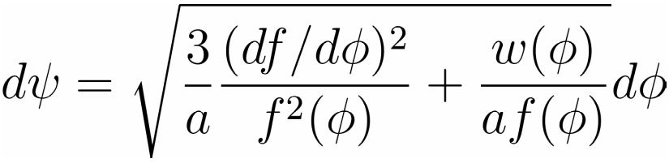
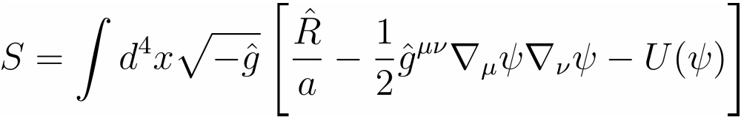
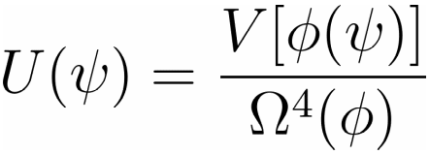

Non-minimal coupling
Non-minimal coupling
Jordan Frame
Einstein Frame

Slide 7
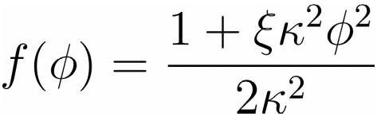

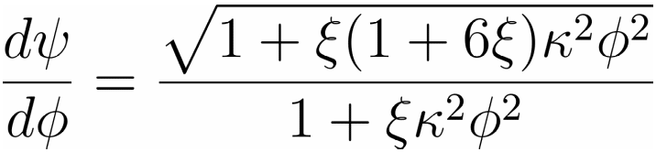

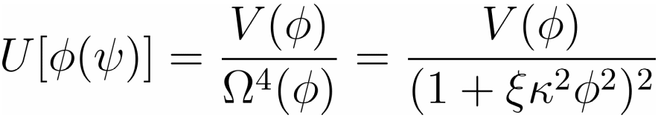
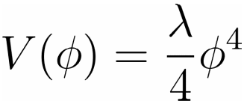
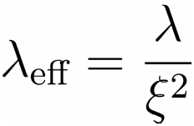
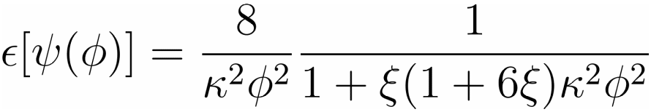
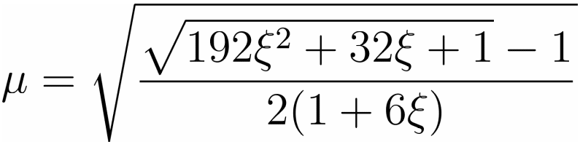



Non-minimal Coupling
non-minimal case
Kaiser, PRD 52 (95) 4295

Slide 8
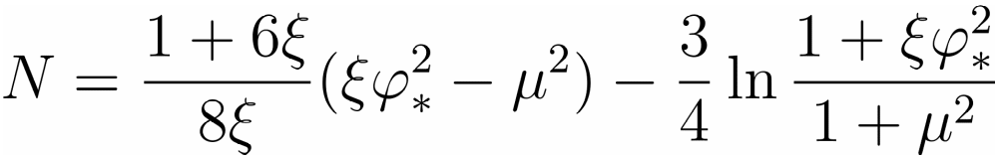

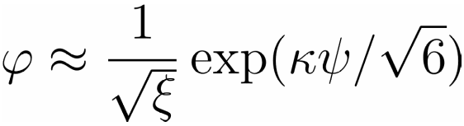

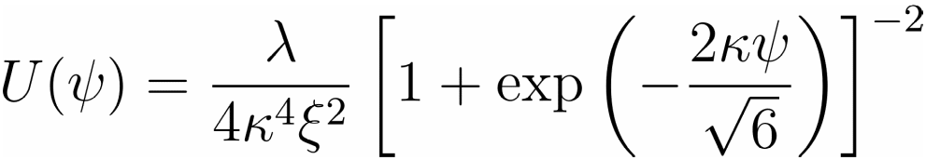
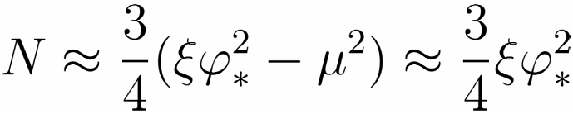
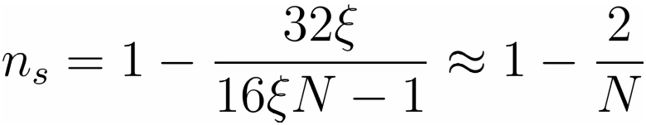
Non-minimal coupling
e-folds
Strong coupling
PLB 659 (08) 703
Kaiser, PRD 52 (95) 4295

Slide 9
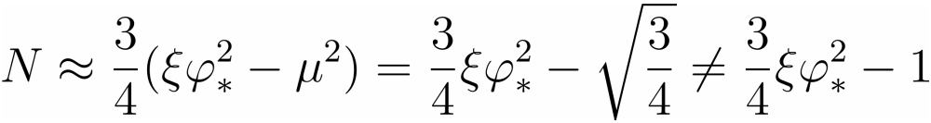

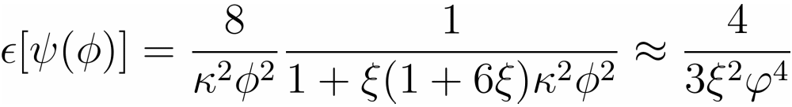

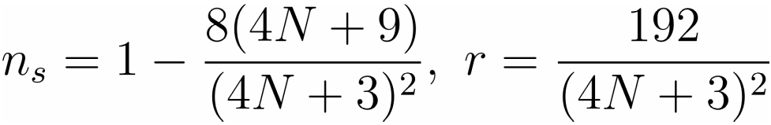
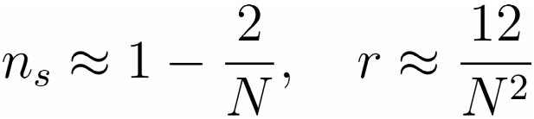

Non-minimal coupling
Strong coupling
Bezrukov and Shaposhnikov, PLB 659 (08) 703
same result as

Slide 10
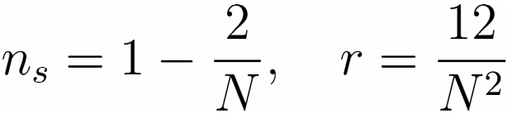
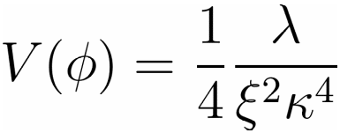
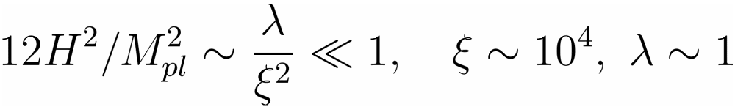
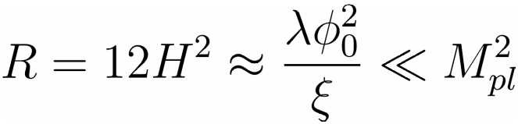
Non-minimal Higgs inflation
non-minimal coupling with strong coupling
Kaiser, PRD 52 (95) 4295
Bezrukov and Shaposhnikov, PLB 659 (08) 703
Einstein frame:

Slide 11
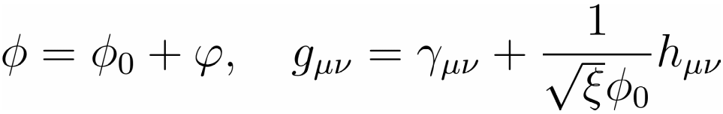
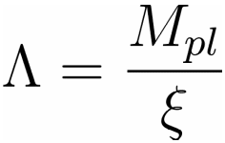
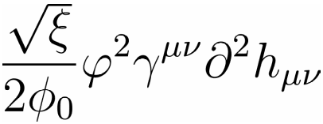
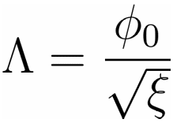
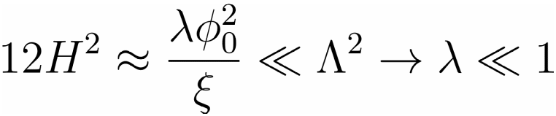
Higgs inflation
violation of unitarity bound
Nonrenormalizable operator
Burges etal,
JHEP 0909, 103
Barbon & Espinosa,
PRD 79 (09) 081302
Unitarity violation scale
Germani and A. Kehagias, Phys. Rev. Lett. 105, 011302 (2010)

Slide 12



Higgs inflation
chaotic inflation: excluded by Planck15 result, the coupling constant is too small to be consistent with Higgs observation
Non-minimal coupling : coupling constant is ok, consistent with Planck15 result at strong coupling limit violation of unitarity bound
New Higgs inflation with more general non-minimal coupling

Slide 13



General non-minimal coupling
derivative coupling: quadratic in and linear in
Divergence
Independent
Horndeski, Int. J. Theor. Phys. 10 (1974) 363
L. Amendola, PLB 301 (1993) 175

Slide 14
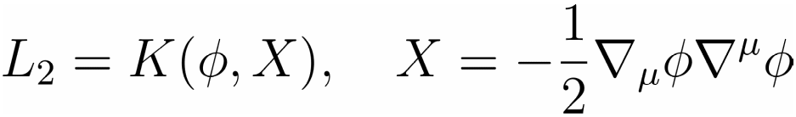

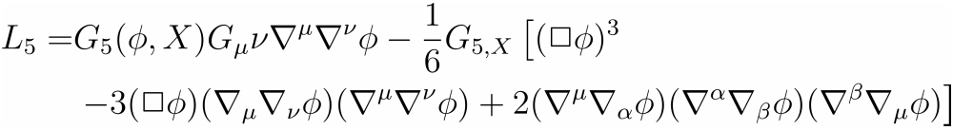
Horndeski Theory
The most general scalar-tensor theory with 2nd order of EOMs

Slide 15
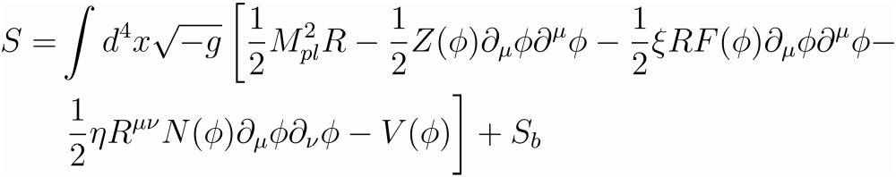
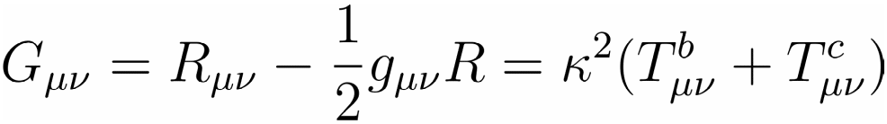

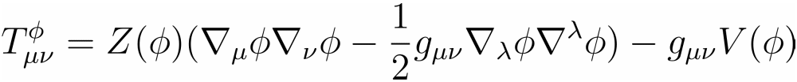
Derivative coupling
General action

Slide 16
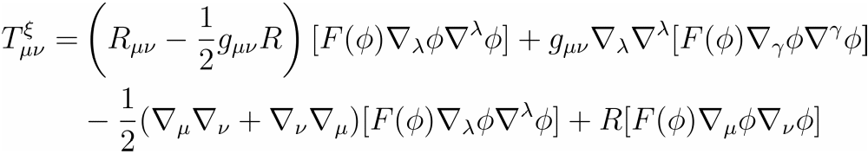
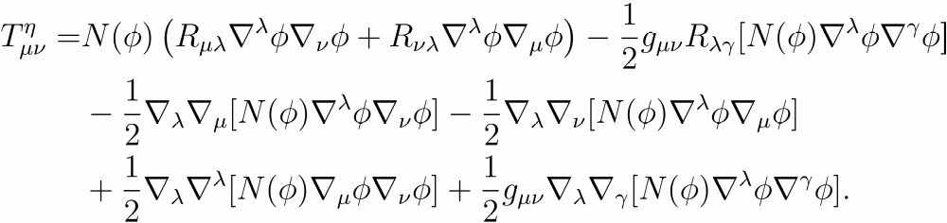
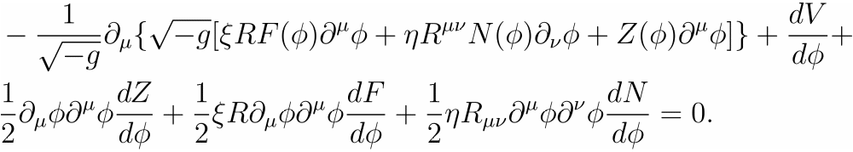
Derivative coupling
general EOM

Slide 17

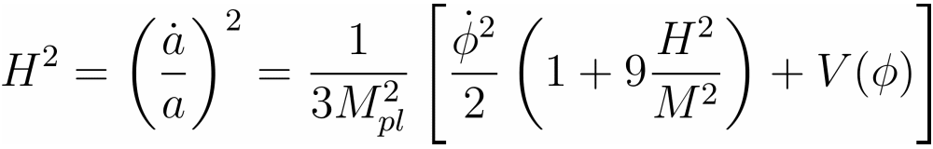
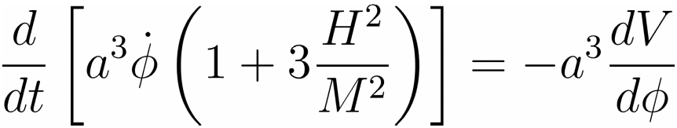
Derivative coupling
second order equation
the action
Sushkov, PRD 80 (2009) 103505

Slide 18

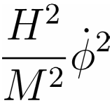
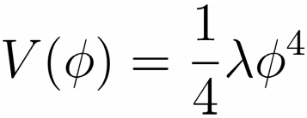
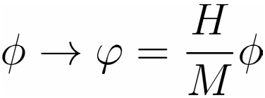
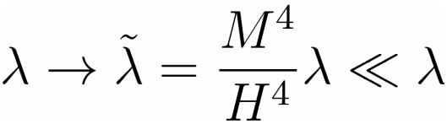
Derivative coupling
High friction
effective coupling constant
Germani & Kehagias, PRL 105 (2010) 011302

Slide 19


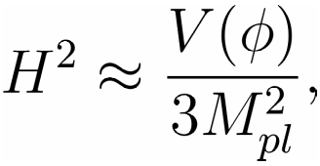



Slow-roll inflation
Slow-roll
High friction limit
Slow-roll parameters
More potentials possible

Slide 20




Lyth Bound
Number of e-folds
Upper bound
Sub-Planckian excursion is possible
It is possible
Yang, Gao and Gong, arXiv: 1504.05839

Slide 21





Lyth bound
Lower bound
Modified Lyth bound
Yang, Gao and Gong, arXiv: 1504.05839
If the slow roll parameter is not a monotonic function, then
If decreases during inflation
Gao, Gong and Li, PRD 91 (2015) 063509

Slide 22


Cosmological Perturbations
ADM formula
Uniform field gauge
Germani & Kehagias, JCAP 1005 (2010) 019
Germani & Watanabe, JCAP 1107 (2011) 031

Slide 23







Scalar perturbations
canonical quantization
Germani & Kehagias, JCAP 1005 (2010) 019
Germani & Watanabe, JCAP 1107 (2011) 031
Yang, Gao and Gong, arXiv: 1504.05839

Slide 24




Scalar power spectrum
scalar mode function
Long wavelength limit

Slide 25





Tensor perturbations
gravitational waves

Slide 26







Gravitational waves
tensor spectrum

Slide 27

Derivative coupling
Planck 2015 constraints

Slide 28




Unitarity
Strong coupling scale
Germani etal, JCAP 1412, 009

Slide 29





PPN parameters
PPN

Slide 30

Observational constraints on PPN

Slide 31




Phase analysis
Friedmann equations
Dynamical variables

Slide 32






Phase analysis
Dynamical equations

Slide 33

Fixed points
Critical points

Slide 34




Fixed points
The properties of the fixed points
At late time, the effect of the non-minimally kinetic coupling is negligible

Slide 35
Conclusions
scalar and tensor spectral indices up to second order in slow-roll parameters
Inflationary models with non-minimally derivative coupling is more consistent with the observations (smaller tensor perturbation)
Higgs inflation with quartic potential is consistent with Planck15 results at 95% CL
sub-Planckian excursion is possible for power-law potential (chaotic inflation)

Slide 36
Thank You

