Slide 1
Emergent Topology in Condensed Matter Physics
翁征宇 清华大学高等研究院
2016.12.6. ICTS -USTC

Slide 3
他们揭示了新奇物质的秘密
… Kosterlitz-Thouless phase transition （拓扑相变）
… topological nature of integer quantum Hall effect
… topology in spin chains
… hope for topological materials: new generations of
electronics and superconductors, or future quantum
computers

Slide 4
2017年APS Oliver E. Buckley 凝聚态物理奖
Alexei Kitaev California Institute of Technology. …. the idea of topological quantum computation … in a many-body system with nontrivial topological properties. … the use of Majorana modes. He devised and studied a few exactly solvable quantum models, including the Majorana chain and a system of spins on the honeycomb lattice. …the mathematical classification of topological insulators and superconductors.
Xiao-Gang Wen Massachusetts Institute of Technology … concentrates on highly entangled many-body systems, in particular, the phases of quantum matter beyond Landau symmetry breaking theory, which include topological order, the associated holographic boundary theory, as well as non-Abelian statistics and non-Abelian edge state in topological order….
Citation:
“For theories of topological order and its consequences in a broad range of physical systems.”
拓扑序与长程纠缠

Slide 5
2012年APS Oliver E. Buckley 凝聚态物理奖
Charles L. Kane University of Pennsylvania
Laurens W. Molenkamp University of Wuerzburg
Shoucheng Zhang Stanford University
Citation:
"For the theoretical prediction and experimental observation of the quantum spin Hall effect, opening the field of topological insulators."

Slide 6
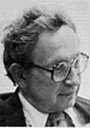
拓扑与凝聚态物理
凝聚态物理： 多体量子理论 + 量子统计物理
粒子数 ~10²³ （三维材料）>>>>> 热力学极限
1950-1970 凝聚态物理经历了革命性的发展
“More is different”
--- P.W. Anderson, Science 177 (1972)

Slide 7
凝聚态物理的基本组织原则 organizational principles in an emergent world
Sign structure （e.g. 波函数的对称性)
Adiabatic continuity （复杂性的统一）
Spontaneous symmetry breaking （e.g. 宏观量子效应）
自发对称性破缺在实际凝聚态材料中无处不在
无自发对称性破缺反而是例外

Slide 8
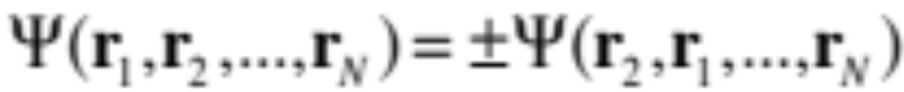

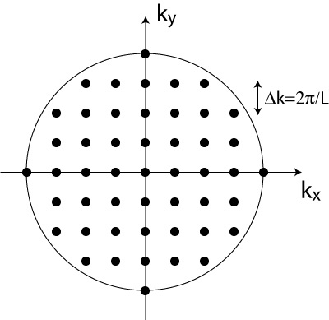
Sign structure: 波函数的结构
Bose statistics and Fermi statistics
Bose statistics Bose-Einstein condensation
Fermi statistics Pauli exclusion principle
Basis for the Landau‘s Fermi-liquid
one-to-one correspondence principle continuity principle

Slide 9
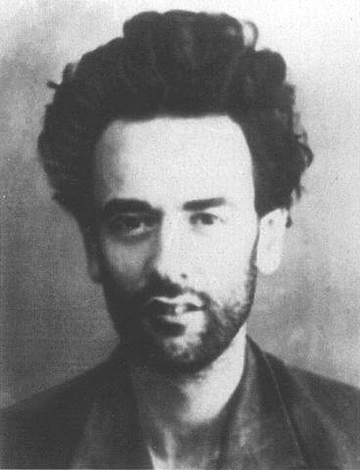
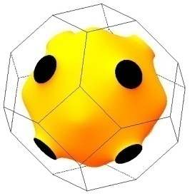




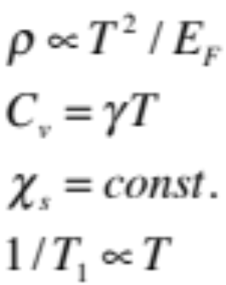

Adiabatic continuity principle
Landau paradigm：Fermi Liquid
Fermion signs
Fermi surface of copper
Fermi sea
Fermi degenerate temperature
typical Fermi liquid behavior:
Quasiparticle
Sommerfeld constant
Pauli susceptibility
Korringa behavior

Slide 10
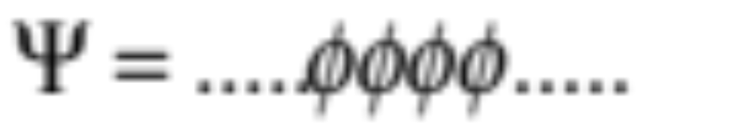
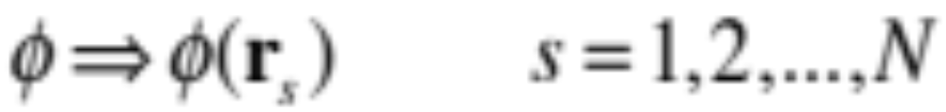
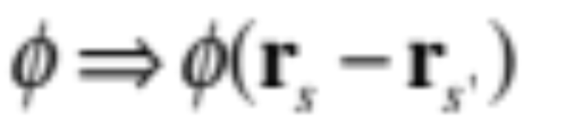
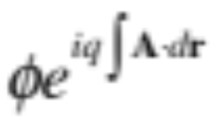
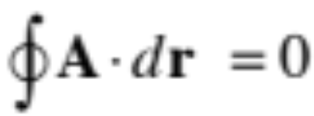
Spontaneous symmetry breaking (SSB)
Superfluidity
or superconductivity
宏观量子效应！
测量下没有波函数坍缩
保持了量子纠缠
没有长程纠缠！
Meissner effect
General rigidity

Slide 11
凝聚态物理的三大基本组织原则 organizational principles
Sign structure （e.g. 波函数的对称性)
Adiabatic continuity （多样性的统一）
Spontaneous symmetry breaking （e.g. 宏观量子效应）
拓扑如何改变这些基本原则，它的位置？

Slide 12
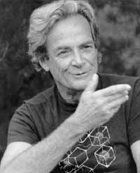
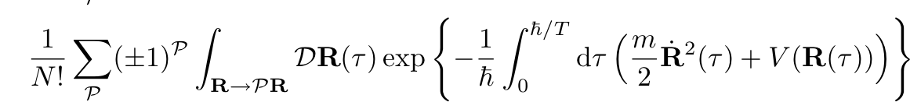

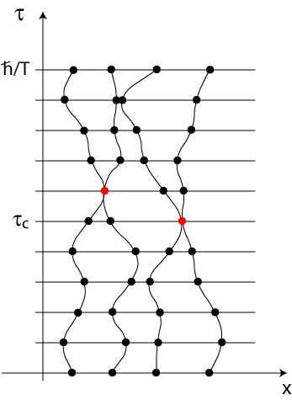
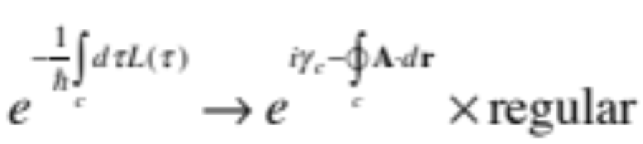
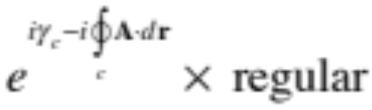
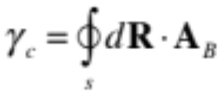


Sign structure in Feynman’s path integral expression
Partition function
Homotopy classes
2d: anyon statistics Y.S. Wu, PRL (1984)
相位干涉将起决定性作用
Berry phase
“准经典对应”
Berry connection
adiabatic condition

Slide 13
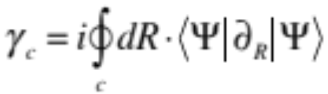
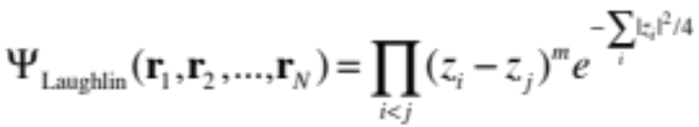

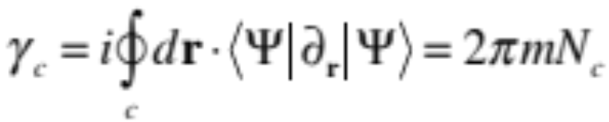
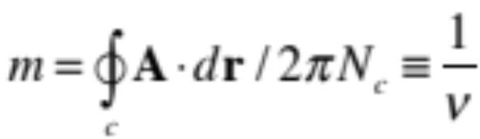


Berry phase
Laughlin wavefunction
Fractional quantum Hall state
The sign structure of the wave function is crucial for strongly correlated electrons

Slide 14
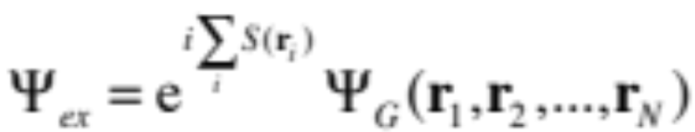

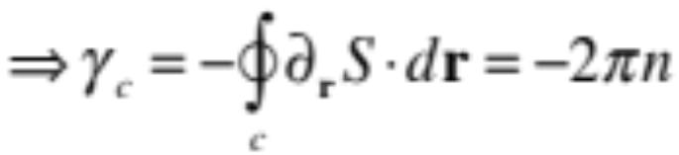
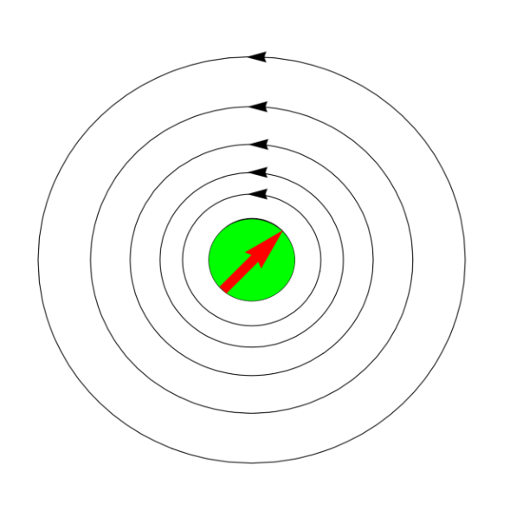
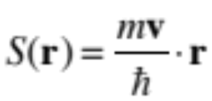
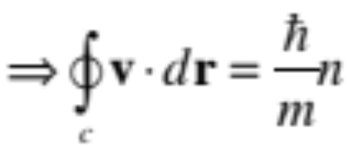
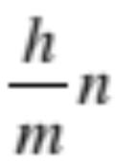
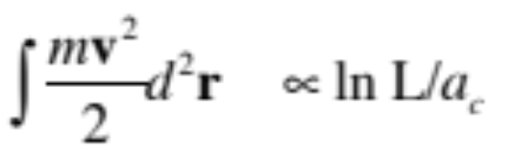
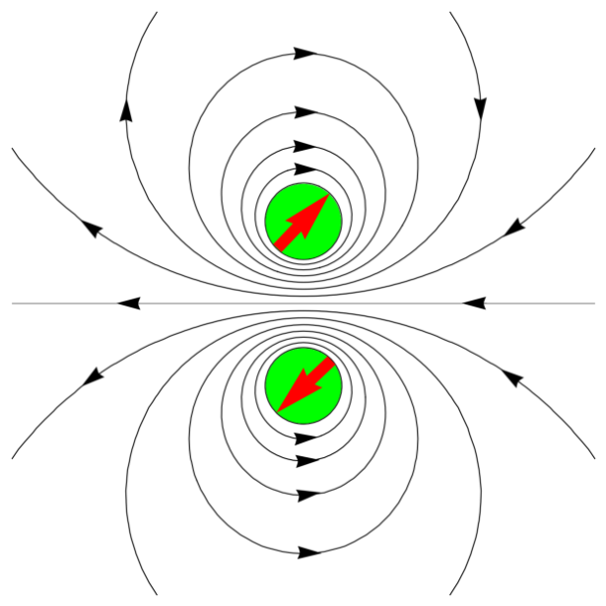
Superfluidity
Feynman’s construction
Berry phase
Vortex quantization
Energy cost
Vortex-antivortex binding
V.L. Berezinskii, JETP, 1971, 1972
J. M. Kosterlitz and D. J. Thouless
J. Phys. C 1972, 1973, 1974
Topological defects of SSB!

Slide 15
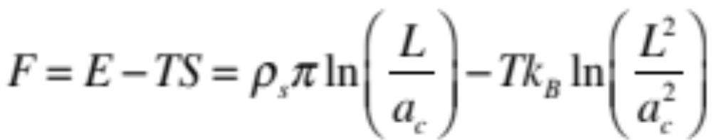
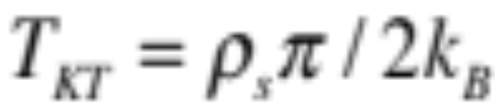
Kosterlitz-Thouless (KT) transition: 拓扑相变
Entropy driven critical temperature:
J. M. Kosterlitz and D. J. Thouless
J. Phys. C 1972, 1973, 1974
helium films

Slide 16
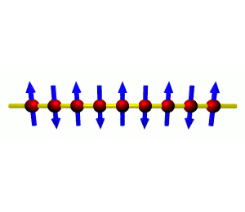
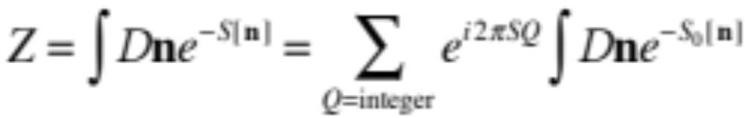
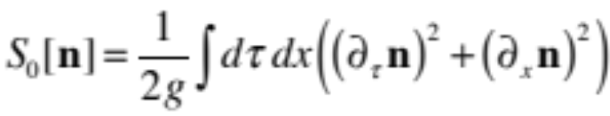
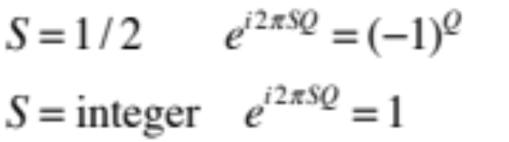

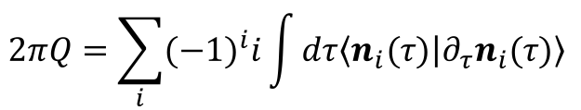
Haldane 自旋链猜想 -- spin chains: topological term
F.D.M. Haldane, Phys. Lett A, PRL, 1983
nonlinear $σ−model$
topological term
$$2πQ=\sum_{i}{{(−1)}^{i}i\int{dτ\left\langle n_{i}(τ) | {∂_{τ}n}_{i}(τ)\right\rangle } }$$
Berry phase
gapless spinon excitation
Haldane conjecture
gapped spin excitation

Slide 17
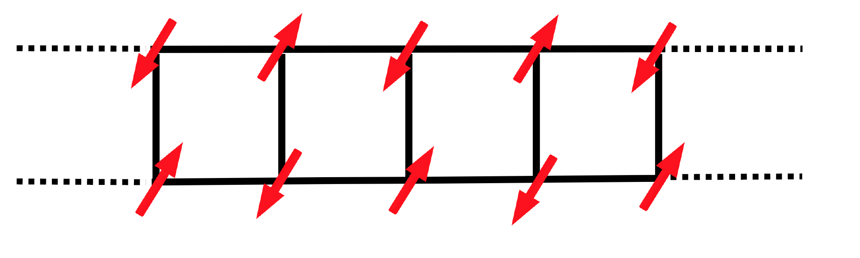



gapless spinon excitation
Haldane conjecture
gapped spin excitation
AKLT/topological state (symmetry protected
toplogical state)
spin-1 chain CsNiCl₃ M. Kenzelmann, et al. PRB (2002)

Slide 18
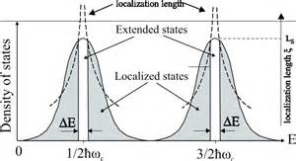
整数量子霍尔效应 (1980 K.von Klitzing et al.)
Berry connection
First Chern number
D. J. Thouless, M. Kohmoto, M.P. Nightingage, M. Den Nijs, (1982)
Q. Niu, D. J. Thouless, Y.S. Wu, (1985)

Slide 19
无序杂质中量子Hall效应的拓扑描述
Graphene
Q. Niu, D. J. Thouless, Y.S. Wu, (1985)
square lattice
D.N. Sheng, ZYW (1997)

Slide 20
Rashba model
+ disorder
+ disorder+ magnetic field
只有边缘态才能避免
散射!
(2005)
拓扑绝缘体的基本原理

Slide 21
凝聚态物理的基本组织原则 organizational principles
Sign structure （e.g. 波函数的对称性)
Adiabatic continuity （多样性的统一）
Spontaneous symmetry breaking （e.g. 宏观量子效应）
Long-range entanglement/topological order? (X.G.Wen, …)
Berry phase topology novel quantum effect

Slide 22
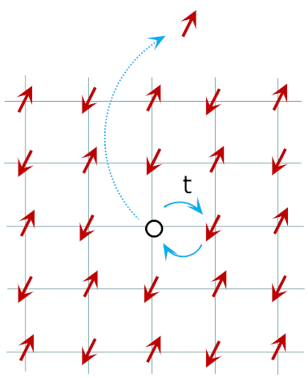
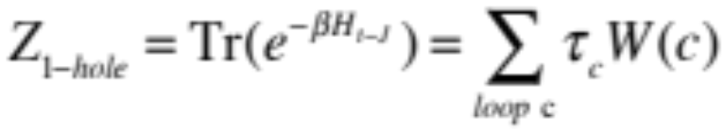
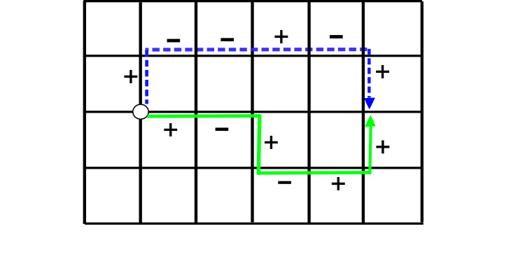
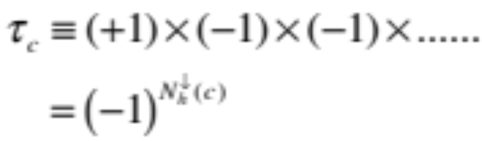
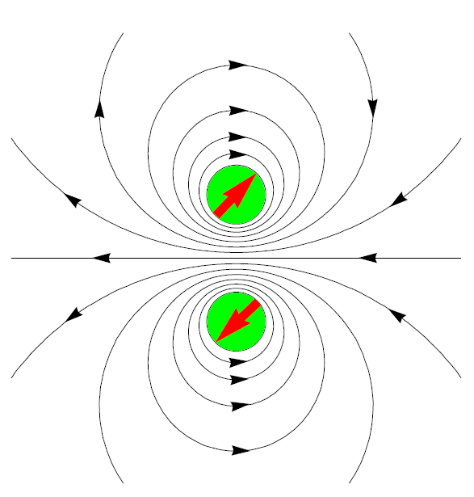
t-J model: A standard model for strong correlation
Non-trivial Berry phase: Phase string effect
duality
Quantum memory protected by the Mott gap !
量子相位干涉与长程纠缠
Novel and complex phenomenon in high-Tc cuprates？
D.N. Sheng, Y.C. Chen, ZYW, PRL (1996); K. Wu, ZYW, J. Zaanen, PRB (2008); ........

Slide 23
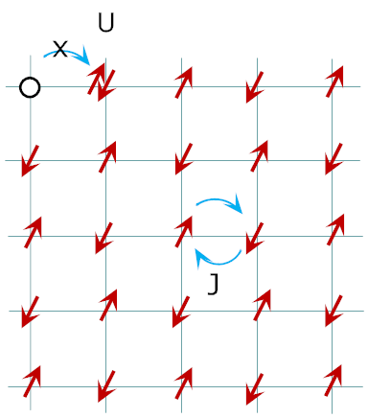
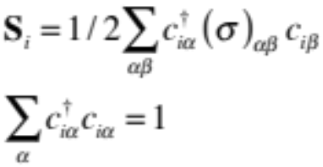
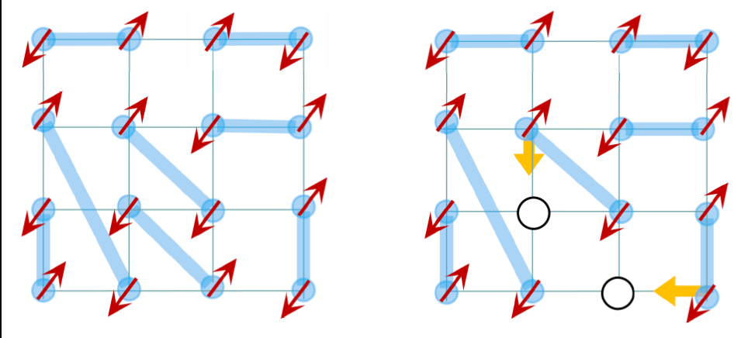

local moment
t-J model
Heisenberg model
doped Mott insulator
Anderson’s RVB theory: no pairing glue
Science, 235, 1196 (1987)
Half-filling:
Mott-RVB insulator
doping:
Superconductor

Slide 24
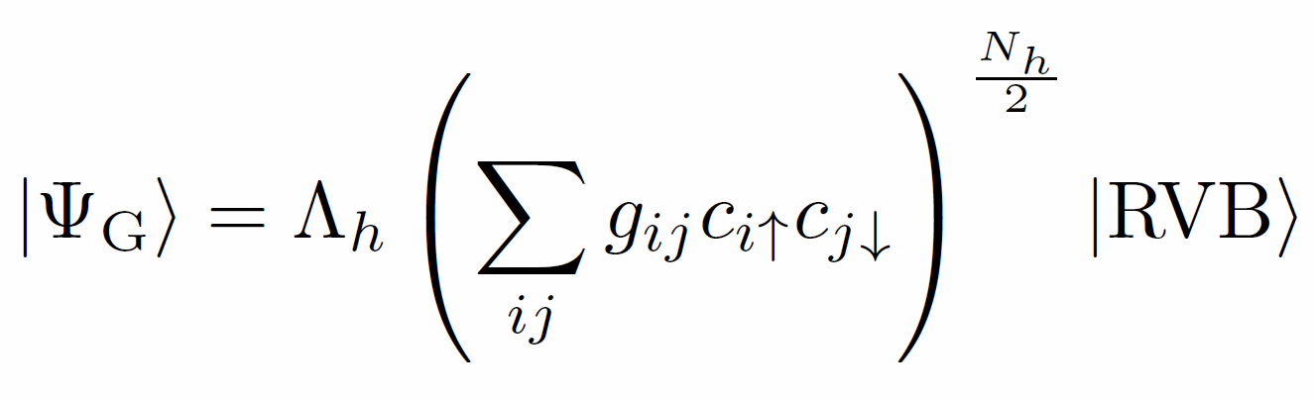
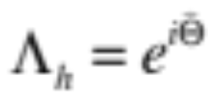
Anderson’s RVB theory
Science, 235, 1196 (1987)
Half-filling:
Mott-RVB insulator
doping:
Superconductor
New ground-state: Two-component RVB
New sign structure
ZYW, NJP (2011), Y. Ma, ZYW, NJP (2014)

Slide 25
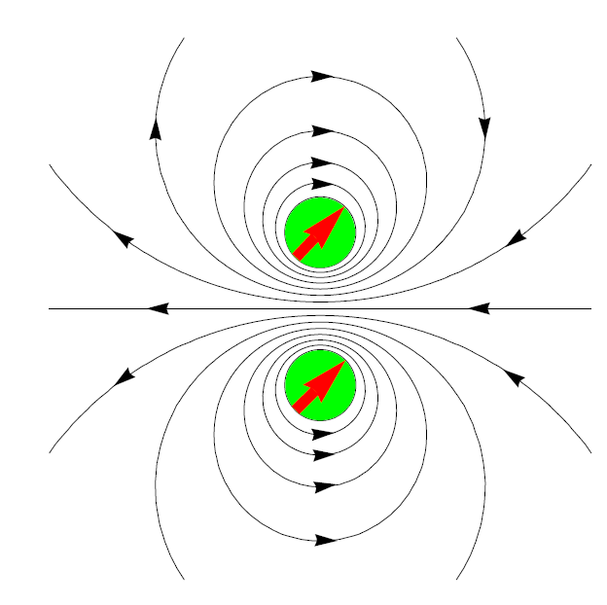
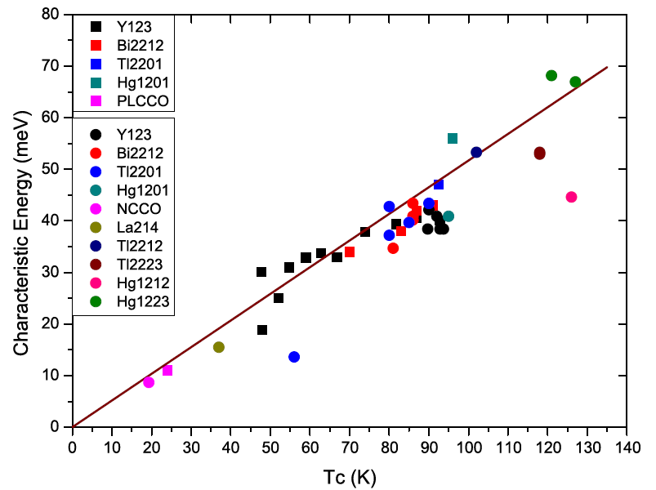



Spin-rotons new elementary excitations in SC phase
S=1
S=0
Four-fold degenerate topological excitations
neutron
Raman A_{1g}
“resonant mode” in
neutron scattering
Raman scattering in A_{1g} channel
J.W. Mei & ZYW, PRB (2010)
P. Ye, C.S. Tian, X.L. Qi, ZYW, PRL (2011)

Slide 26




Slide 27






＋
－
Berry-like phase
The precise property of the t-J model
topological Berry phase:
Phase string effect
D.N. Sheng, Y.C. Chen, ZYW, PRL (1996); K.Wu, ZYW, J. Zaanen, PRB (2008), L. Zhang, ZYW, PRB (2014)

Slide 28









String Berry phase
t/J=3
No string Berry phase
DMRG comparative study
Two hole binding energy
Momentum distribution
Density distribution

Slide 29





Q.R. Wang, Z. Zhu, et al. (2015), Z. Zhu, H.C. Jiang, et al. (2014), Z. Zhu, D. N. Sheng, ZYW, (2016)

Slide 30


t-J /Hubbard model
T
Two-component fluid
strange metal behavior at T>T*
Quantum memory of Mott physics!
“intertwined orders”
AFLRO
SC
FL
p

Slide 31
凝聚态物理的三大基本组织原则 organizational principles
Sign structure (novel quantum effect) 波函数结构
Adiabatic continuity （多样性的统一）
Spontaneous symmetry breaking （e.g. 宏观量子效应）
topology 拓扑
long-range entanglement 长程纠缠
fractionalization 分数化

Slide 32
谢谢！

