Slide 1
Constraining Dark Matter
Hai-Bo Yu
University of Michigan, Ann Arbor
USTC, 06/17/2011

Slide 2
Outline
Introduction and motivation
  Evidences for dark matter
  Theory: Weakly-interacting dark matter particle (WIMP) and Asymmetric dark matter (ADM)
  Experiments
Constraining dark matter
  Tevatron/LHC
  Neutron Stars
Conclusions

Slide 3
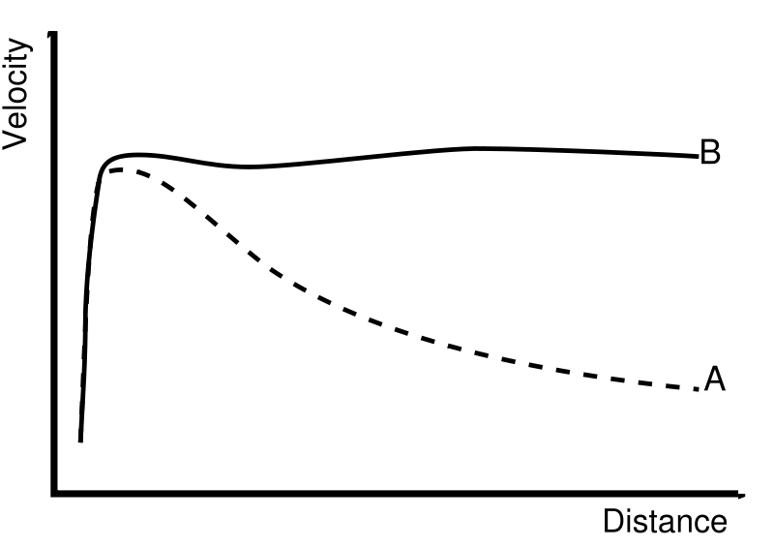
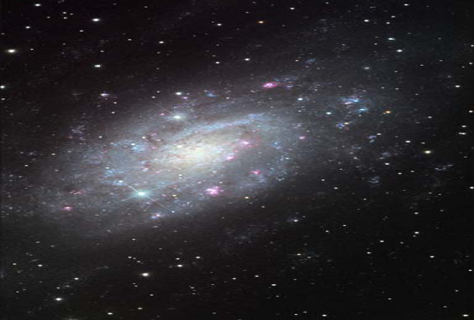
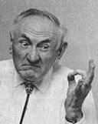
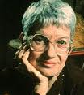
EVIDENCES FOR DARK MATTER
Rotation curves of galaxies
Expect v~R^(-1/2) beyond luminous region
Find v~constant
The discrepancy is resolved by dark matter
Fritz Zwicky (1933)
Vera Rubin (1970)
with Kent Ford

Slide 4
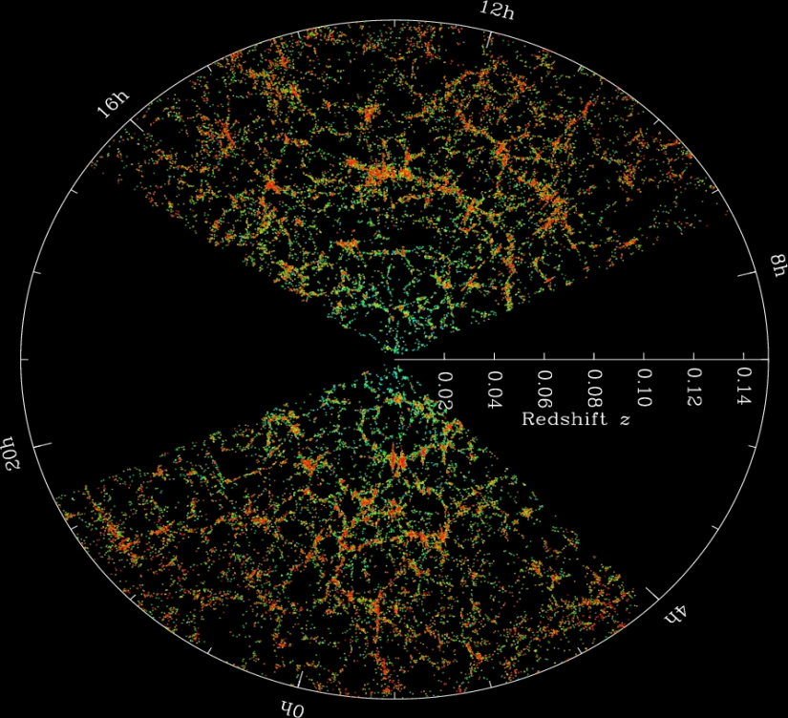

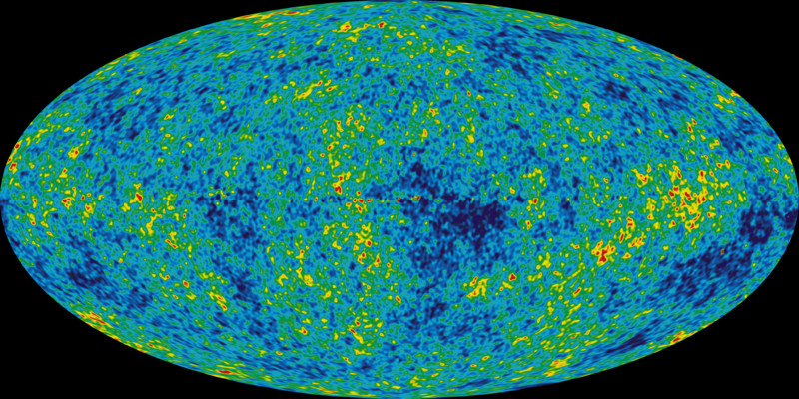
WE NEED DARK MATTER
Large structure formation
Galaxy formation
Anisotropy of the CMBR
Gravitational lensing…
Dark Matter Halo
Galactic Disk
*
We are here!

Slide 5
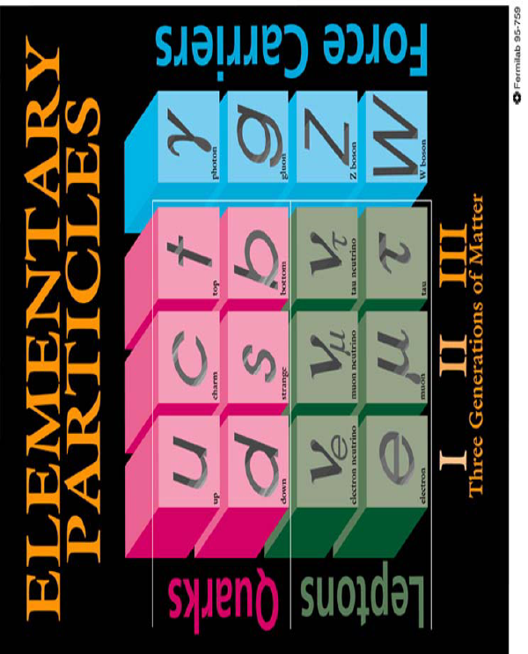
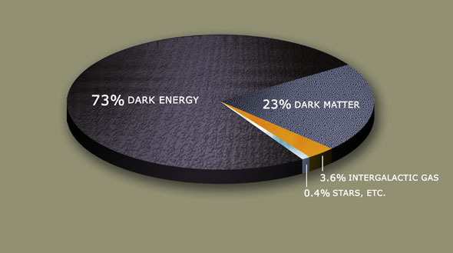

WHAT DO WE KNOW ABOUT DM?
Known properties:
Cold (Warm)
Stable
Non-baryonic
Dark
Relic density
XX XX
X XXX
We do not know
Mass
Spin
Quantum number
We need new physics beyond the Standard Model!

Slide 6
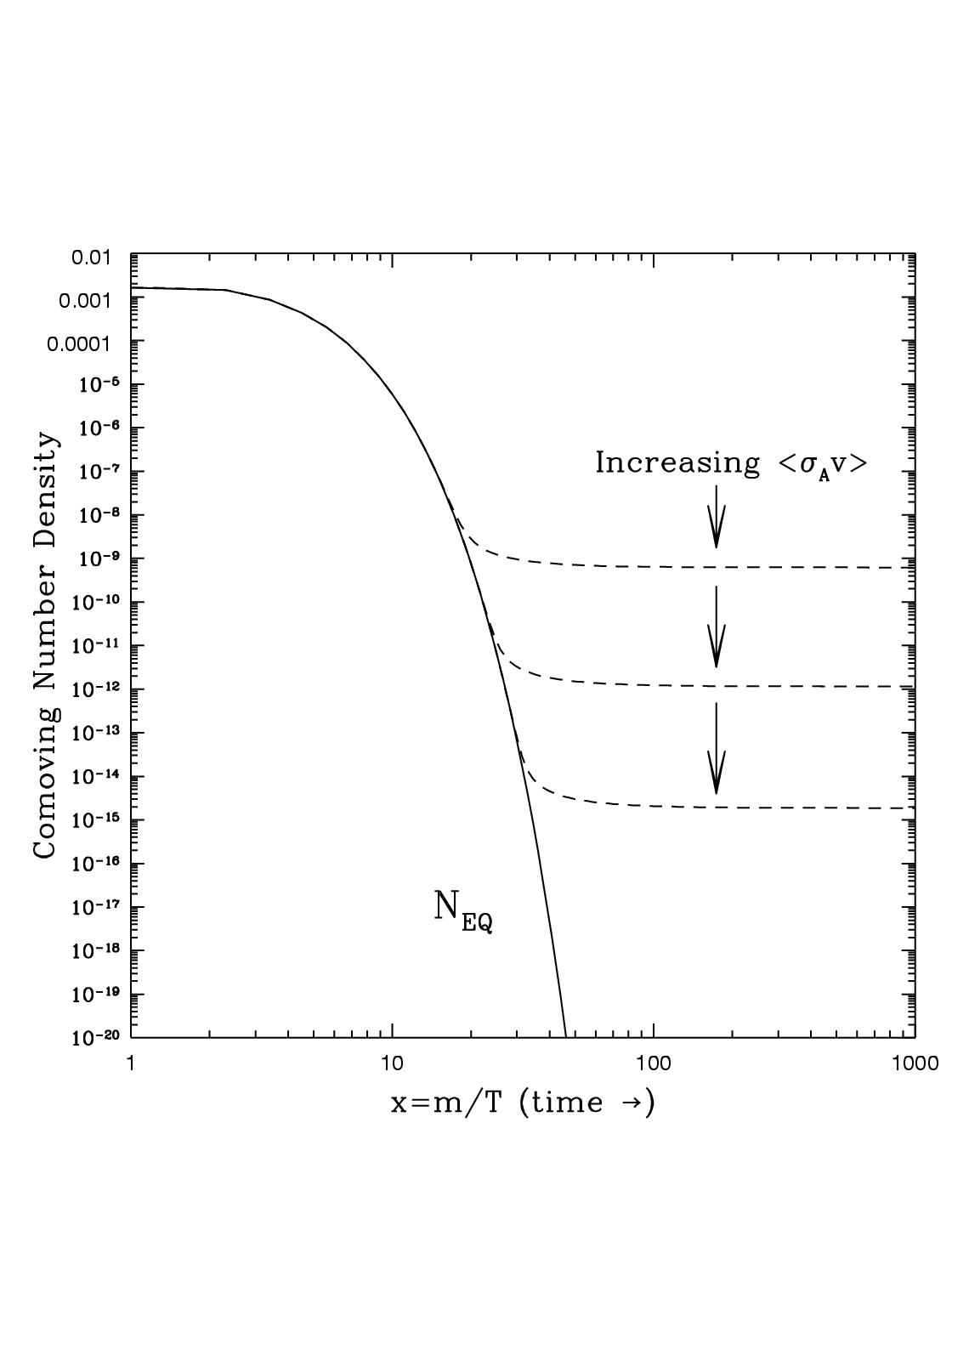
THERMAL WIMP
X
SM
WIMP: Weakly-Interacting Massive Particle
X
SM
Assume a new heavy particle X in thermal equilibrium in the early Universe.
Three stages:
X+X→SM+SM; SM+SM→X+X
X+X→SM+SM; SM+SM→X+X
X+X→SM+SM; SM+SM→X+X
(Universe is expanding.)
(1)
(2)
(3)

Slide 7
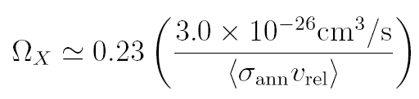

WIMP & THE WIMP MIRACLE
X
SM
X
SM
thermal relic density
A remarkable coincidence:
Dark matter and weak scale new physics.
m_{X} ≈100 GeV, g_{X} ≈0.23 → Ω_{X}≈0.2
Weak scale new physics→ connect to the gauge hierarchy problem?

Slide 8

ASYMMETRIC DARK MATTER (ADM)
Dark matter particles are Dirac fermions or complex scalar fields.
Dark matter particles are more than anti dark matter particles.
This model prefers dark matter mass ~ 1-10 GeV.

Slide 9
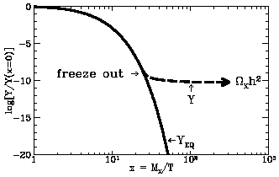
DARK MATTER SEARCH
ADM
WIMP
Collider
Collider
X
SM
X
SM
Direct
Direct
_
X
SM
X (X)
SM
Look for DM accumulation!
Relic density, Indirect
Negligible now!

Slide 10
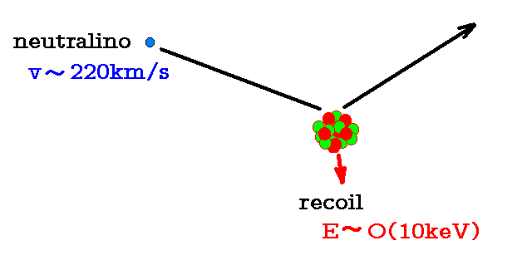

DIRECT DETECTION
Basic parameters of WIMP
mass ~100 GeV;
local density ~3×10³/m³
velocity~ 10⁻³ speed of light
~1 event/kg/year
DM
Image credit: Jonathan L Feng

Slide 11
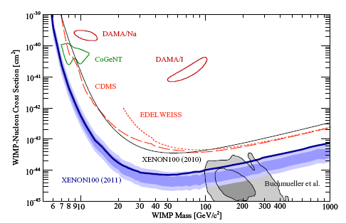
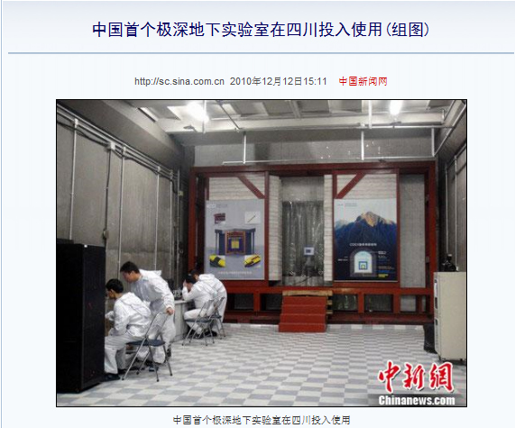
CURRENT STATUS
XENON Collaboration, 1104.2549 [astro-ph.CO]
DAMA and CoGeNT claim dark matter events.
They are not confirmed by other direct detection experiments.
Low mass, high scattering cross section
High mass, low scattering cross section

Slide 12
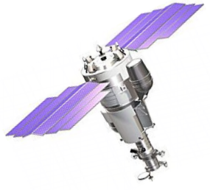
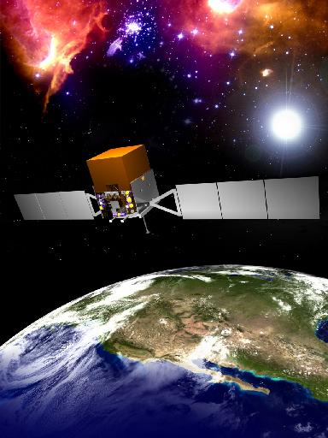
INDIRECT DETECTION OF WIMP
WIMP: X+X→SM+SM
*
*
PAMELA
Fermi

Slide 13
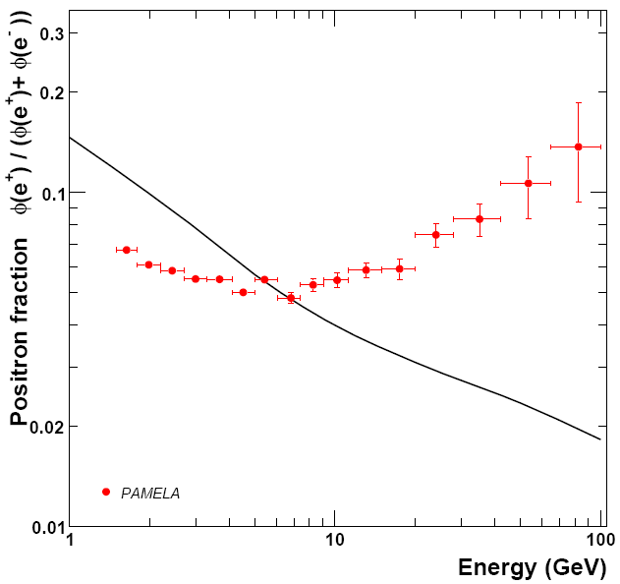
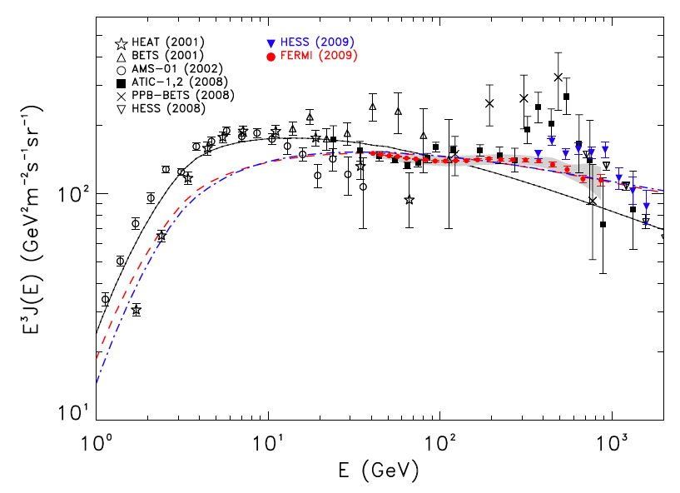
PAMELA AND FERMI RESULTS
PAMELA Fermi

Slide 14
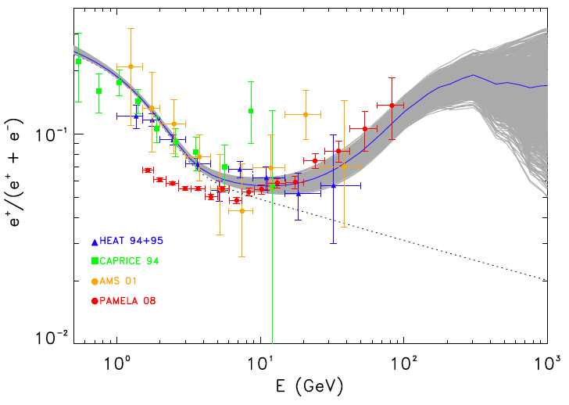
DARK MATTER ANNIHILATION?
Challenges: Observed flux is ~100-1000 bigger than what we expected from the WIMP annihilation. One requires boosted WIMP. Cirelli, Kadastik, Raidal, Strumia (2008); Arkani-Hamed, Finkbeiner, Slatyer, Weiner (2008).
These models have strong tensions between a large boost factor and correct thermal relic density. Feng, Kaplinghat, HBY (2009); Feng, Kaplinghat, HBY (2010)
Conventional physics can
  explain it. Pulsars
  Hooper, Blasi, Serpico (2008)
  Profumo (2008)
Fermi-LAT Collaboration (2009)

Slide 15
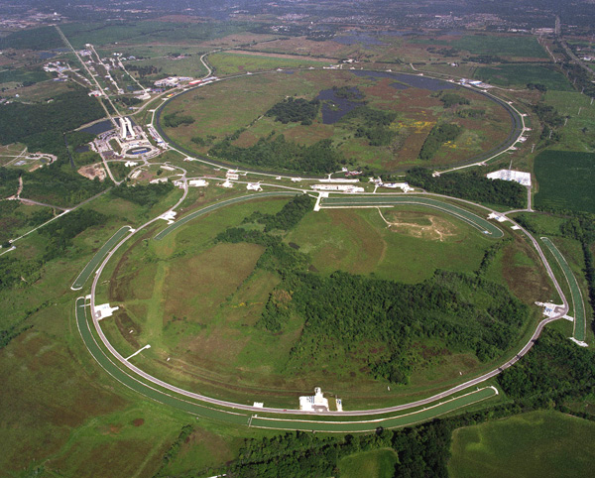
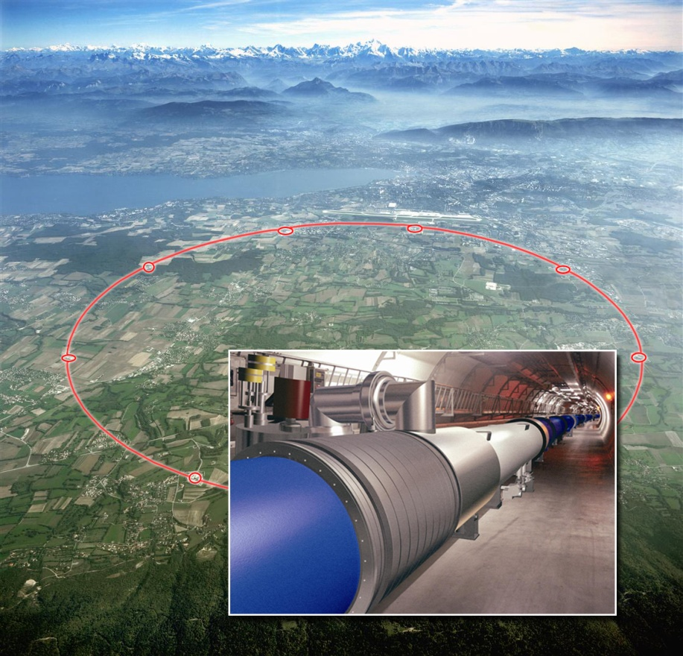
PARTICLE COLLIDERS
Tevatron: 2 TeV
10²-10⁴ top quarks/year
LHC: 7-14 TeV
10⁵-10⁸ top quarks/year

Slide 16
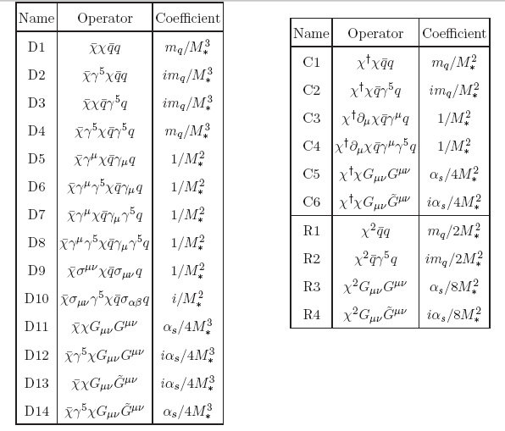
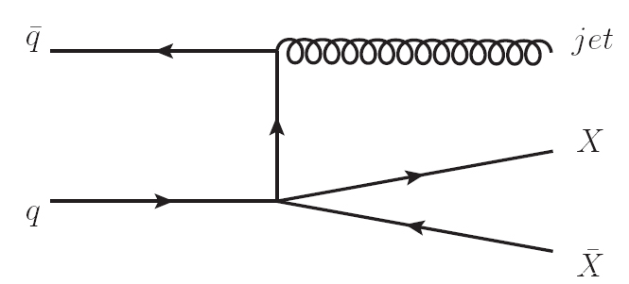
AN EFFECTIVE THEORY APPROACH
Use effective field theory
SM
X
SM
X
Goodman, Ibe, Rajaraman, Shepherd, Tait, BHY (2010) PLB
Goodman, Ibe, Rajaraman, Shepherd, Tait, BHY (2010) PRD
Goodman, Ibe, Rajaraman, Shepherd, Tait, BHY (2010) NPB

Slide 17
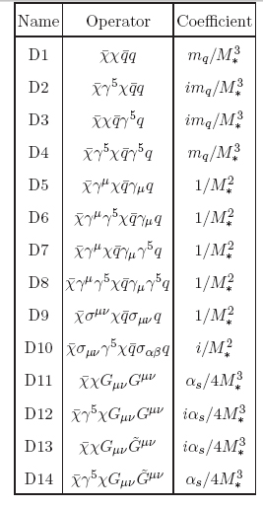
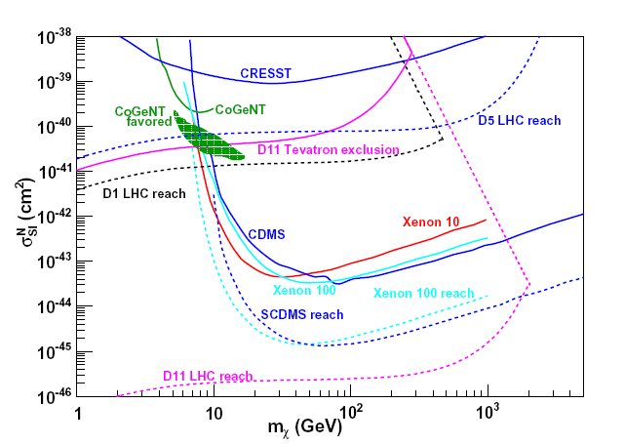
COLLIDER CONSTRAINTS ON SI OPERATORS

Slide 18
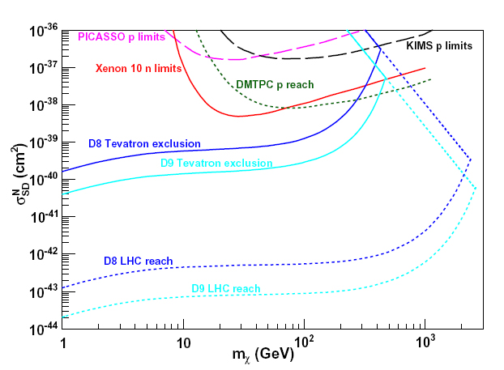
COLLIDER CONSTRAINTS ON SD OPERATORS
Particle colliders provide complementary constraints on DM-SM interaction.

Slide 19
STARS AS DARK MATTER PROBES
Capture
Thermalize
WIMP: WIMP annihilation can produce energetic neutrons which can be detected by IceCube in South pole and SuperK in Japan.
ADM: No anti dark matter, no annihilation. Accumulated dark matter particles may form black holes at the center of stars and destroy the host stars!
Sink to the center
McDermott, HBY, Zurek (2011)

Slide 20


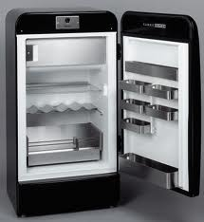
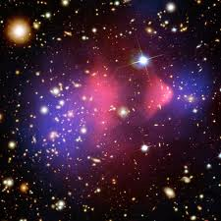
WHY NEUTRON STARS?
Mass: Msun~10⁵⁷ p
Density: 1408 kg/m³
Ve: 0.002c
T: 1.57×10⁷ K
Mass: ~1.44 Msun
Density: 1×10¹⁸ kg/m³
Ve: 0.6-0.7c
T: 10⁵-10⁶ K
Higher Ve → higher capture rate
Higher density→ deeper gravitational potential
Higher density→ quicker thermalization
We focus on scalar asymmetric dark matter particles.

Slide 21


CAPTURE AND THERMALIZATION
STEP 1
Capture
Thermalize
It is a cooling process. 1 GeV=1.2*10^{13} K
Drift to the center

Slide 22






BOSE-EINSTEIN CONDENSATION
DM in the thermal state
DM in the BEC ground state
STEP 2
Self-gravitation
Without a BEC
DM particles collapse. But we need to check another condition.
With a BEC

Slide 23




CHANDRASEKHAR LIMIT
Bosons: gravity VS. zero point energy
Above this limit, the system collapses to a black hole.
Fermions: gravity VS. Fermi pressure
Fermi pressure
Bosons are more ready to collapse.

Slide 24

GRAVITATIONAL COLLAPSE AND BLACK HOLE FORMAION
STEP 3

Slide 25
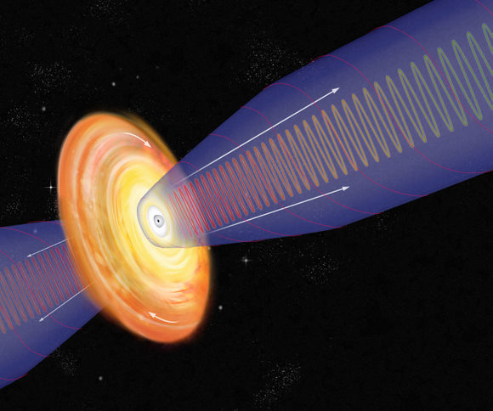

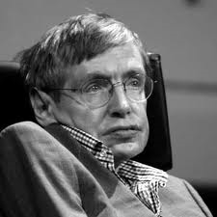

BARYON ACCRETION AND HAWKING RADIATION
Baryon accretion
Hawking radiation
Hawking wins if the BH
initial mass is less than

Slide 26


DESTRUCTION OF THE HOST STAR
The formation of the mini black hole can destroy the host neutron star with the following time scale.
Observations of old neutron stars put constraints on the DM-neutron scattering cross section.
STEP 4
Without a BEC
With a BEC

Slide 27
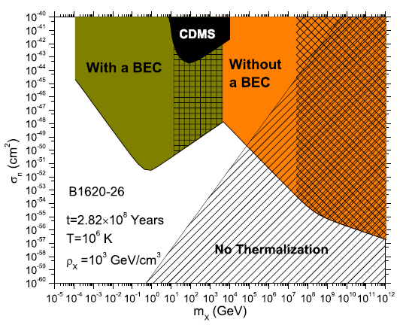
CONSTRAINTS FROM PULSARS IN M4
The initial black hole mass is too small and it evaporates due to Hawking radiation.
Valid only if Hawking radiation does not heat DM and destroy the BEC.
McDermott, HBY, Zurek (2011)
Hawking radiation is not important.
Excluded by observations of the neutron star.

Slide 28
CONCLUSIONS
Particle Dark Matter
  Compelling evidences from astrophysical observations
  No confirmed direct/indirect detection signal yet
  Theory: WIMP, ADM
Constraints
  Tevatron/LHC
  Neutron stars
LHC, direct/indirect detection and astrophysical probes are running. This field will evolve soon!

