Slide 1



Spin-orbit coupled Bose-Einstein condensates of chromium atoms
易俗
中国科学院理论物理所
2014.12.26@USTC

Slide 2
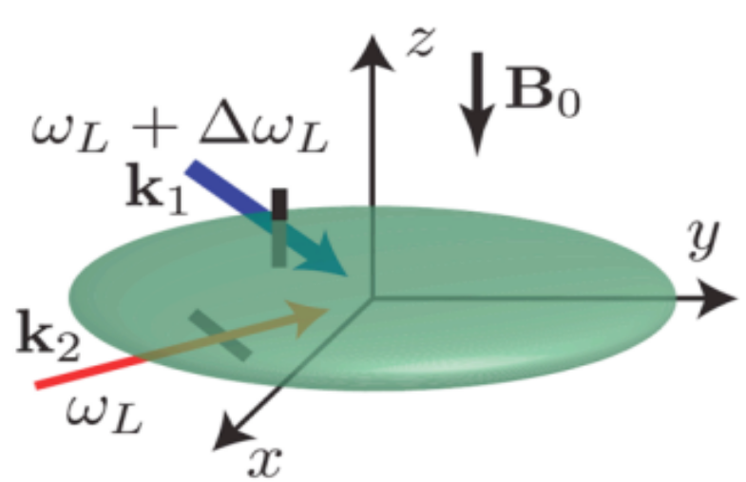
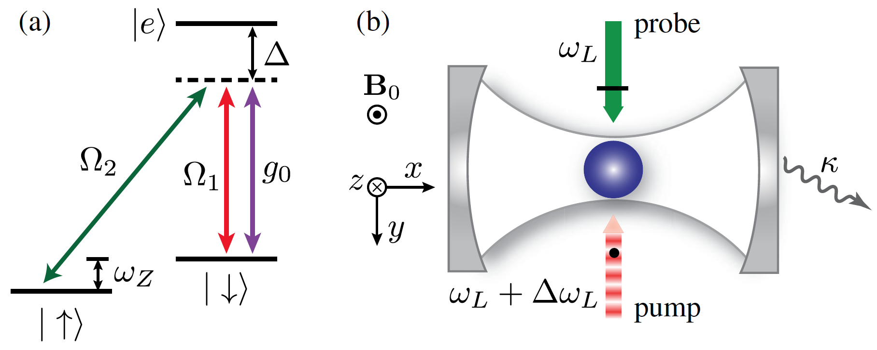
Outline
Introduction
  Spin-orbit couplings in atomic gases
Spin-orbit-coupled BEC with dipolar interaction
  Generating SOC in chromium gas
  Quantum phases
BEC with cavity-mediated spin-orbit coupling
  Generating SOC in cavity
  Quantum phases
Summary

Slide 3














How cold is ultracold?
T
Surface of sun
Boiling water
Liquid Nitrogen
Ice
Liquid ⁴He, superfluidity, superconductivity
³He superfluidity
evaporative cooling, BEC!!!

Slide 4
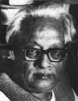
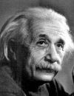
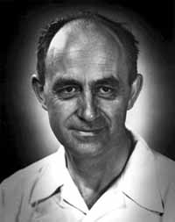
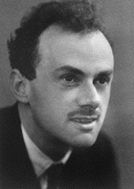
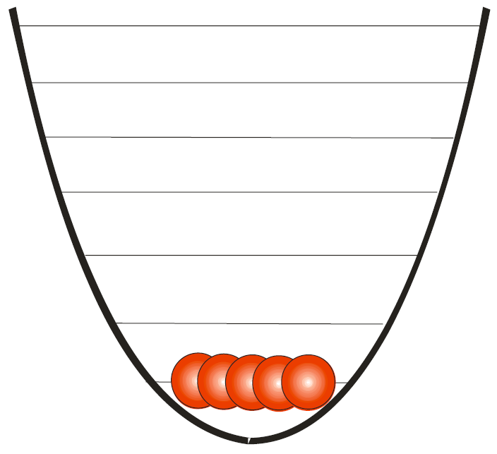
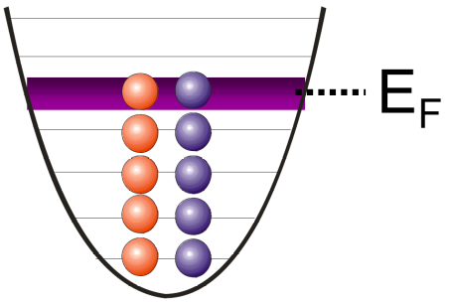
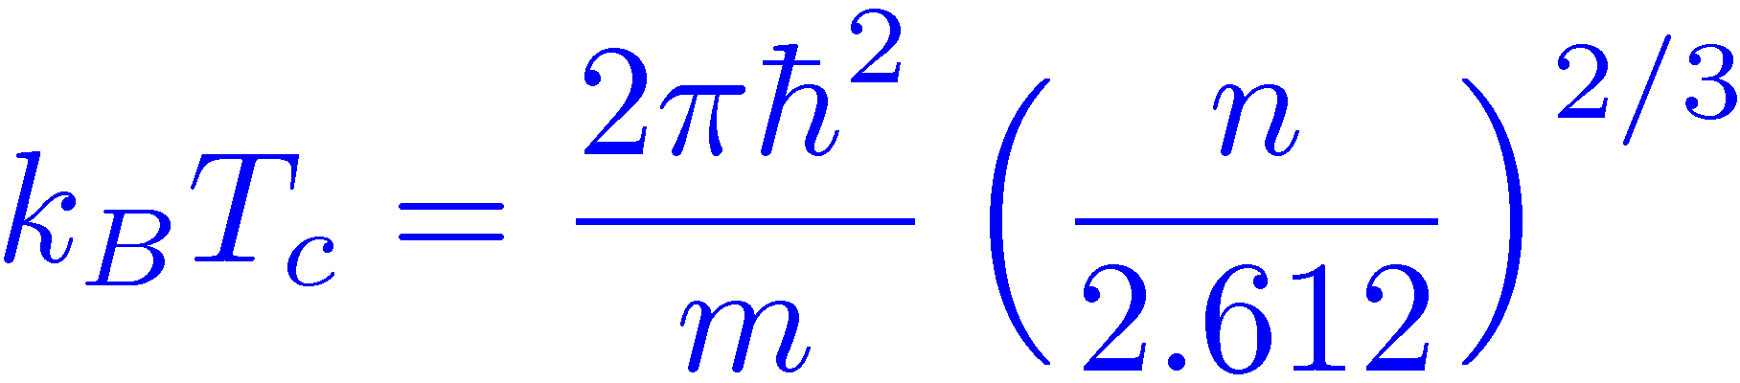
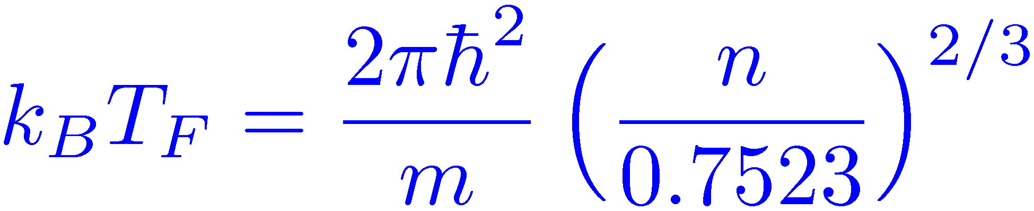
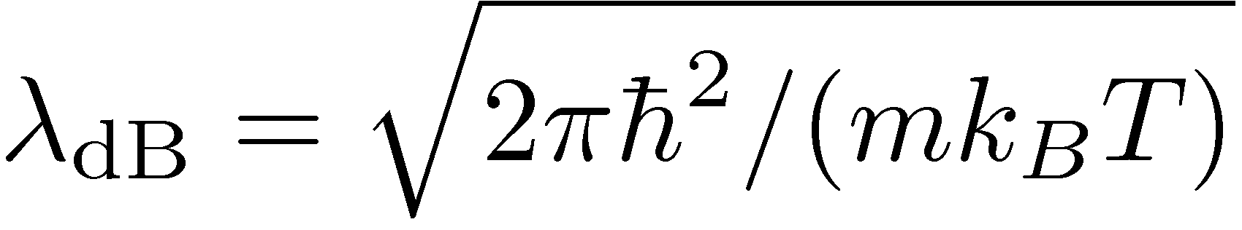
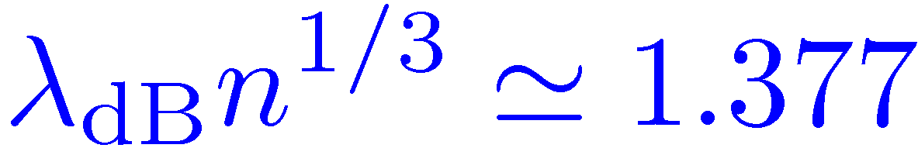
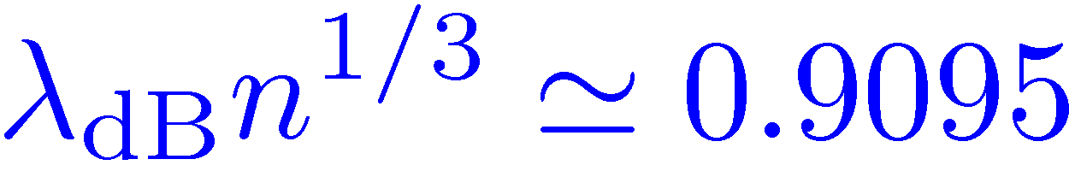
Quantum degeneracy
Bose-Einstein statistics
Fermi-Dirac statistics
Transition temperature:
Fermi temperature:
Thermal de Broglie wavelength:
Phase space density f (r,p) ~ 1

Slide 5
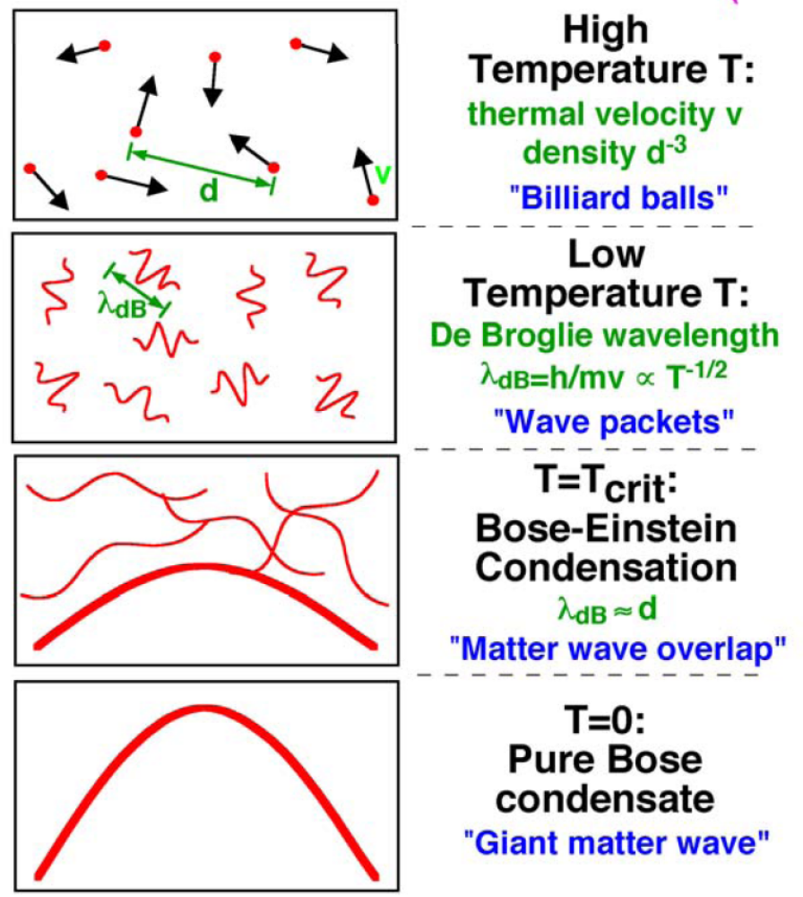
Known quantum gases
Quantum statistics
becomes important when
λ_{dB} ~ interatomic spacing.
Atom nuclei: T_{q} ~ 10¹¹K
Electron gas: T_{q} ~ 10⁴K
Phonon: T_{q} ~ 10²K
Liquid Helium: T_{q} ~ 1K
Atomic gas: T_{q} ~ 10⁻⁵K

Slide 6
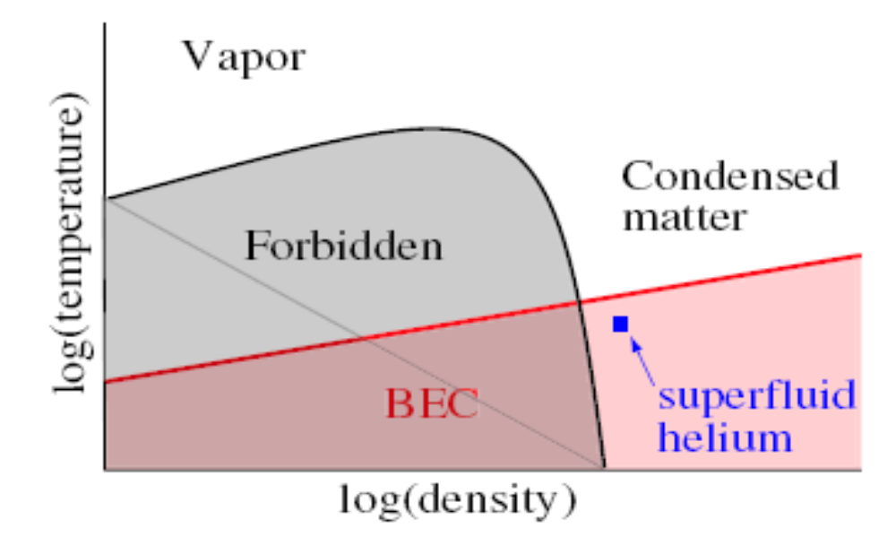
Quantum dilute gas
For a long time, it was thought that quantum degenerate gas is impossible …
Search for gaseous BEC started in spin-polarized hydrogen, first succeeded in alkali atomic vapors in 1995. First quantum degenerate Fermi gas realized in 1999. Superfluid Fermi gas in 2003.
Density of dilute atomic gas 10¹³-10¹⁵cm⁻³ as compared to the density of molecules in air 10¹⁹cm⁻³.
Diluteness of the quantum gas guarantees its (meta)stability.

Slide 7
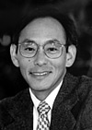
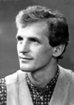
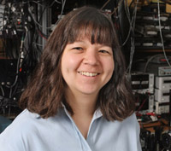
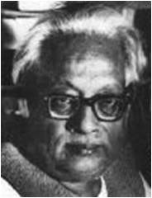


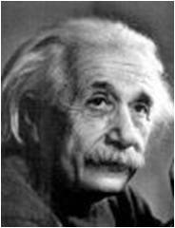
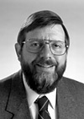
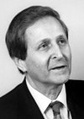

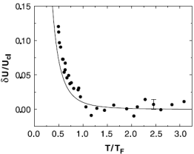
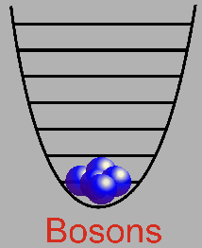
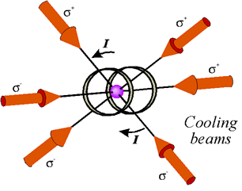
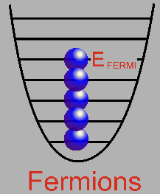
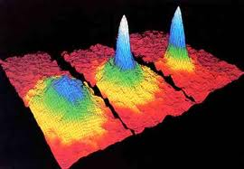
超冷原子研究的经典里程碑
玻色-爱因斯坦凝聚预言
玻色-爱因斯坦凝聚实现
激光冷却
费米简并
1924
1987
1995
1999
7
Notes:
7

Slide 8
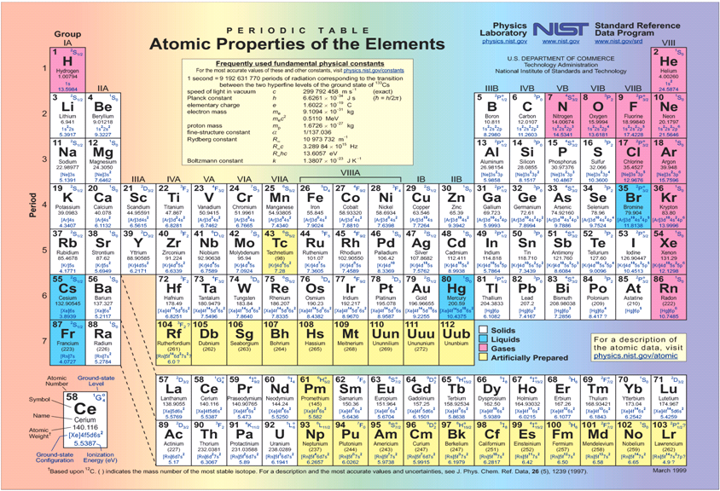
Laser cooling: demonstrated species

Slide 9
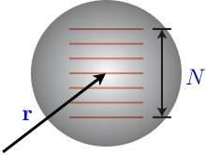
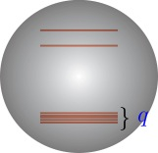
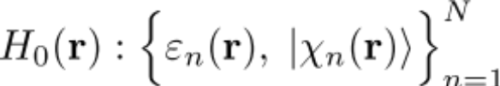
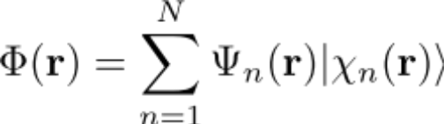
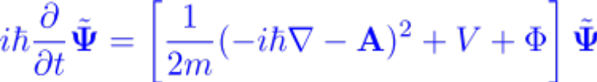
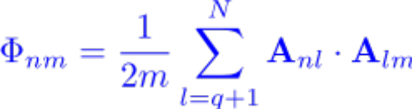
Synthetic gauge field
System:
Wave functions:
Schrodinger equations:
Vector potential:
Scalar potential:
The gauge field is non-Abelian if the matrices
{A_{x}, A_{y}, A_{z}, Φ}
do not commute

Slide 10
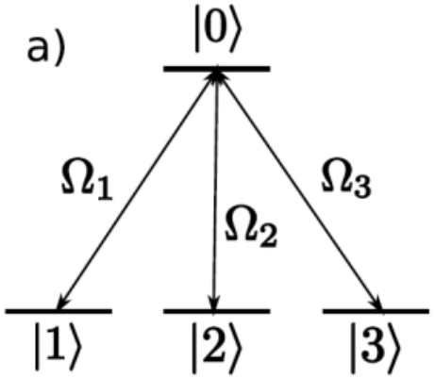
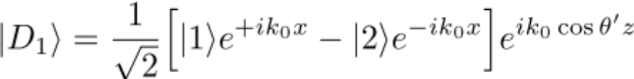
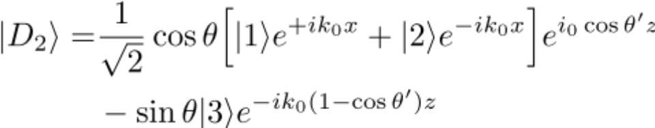
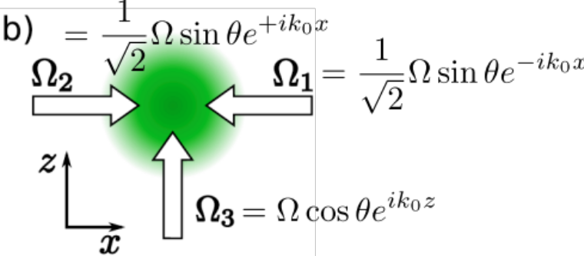
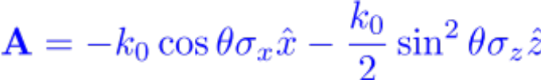
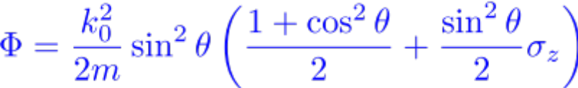
Dark-state-based scheme
Atom-light interaction Hamiltonian:
Degenerate dark states:
|1〉, |2〉, and |3〉 are
(almost) degenerate
Gauge fields:
Puseckas et al., PRL 95, 010404 (2005)

Slide 11
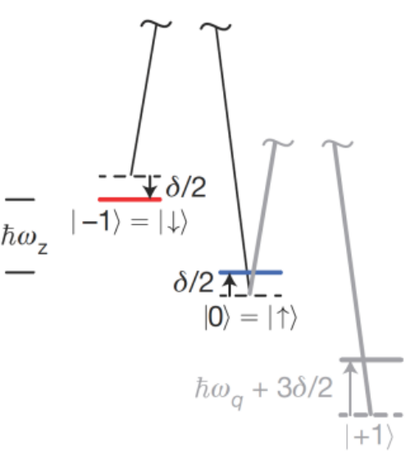
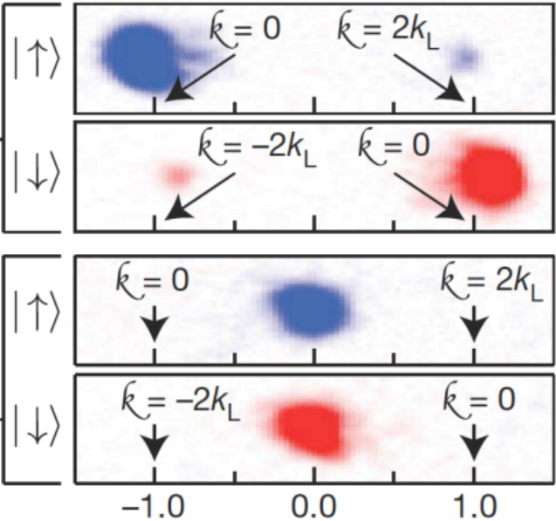
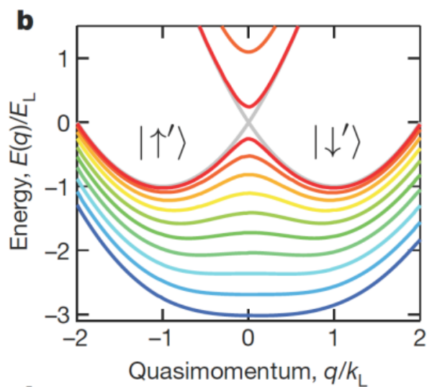
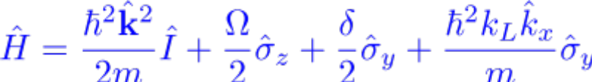
Experimental realization of spin-orbit coupling
Spin-1 Rb atoms are exposed to a pair of Raman beams and a B-field;
Linear Zeeman shift is compensated by Raman beams;
Quadratic Zeeman shift is employed to isolated the desired energy levels;
Single-particle Hamiltonian:
Lin et al., Nature 471, 83 (2011)

Slide 12
Outline
Introduction
  Spin-orbit couplings in atomic gases
Spin-orbit-coupled BEC with dipolar interaction
  Generating SOC in chromium gas
  Quantum phases
BEC with cavity-mediated spin-orbit coupling
  Generating SOC in cavity
  Quantum phases
Summary

Slide 13
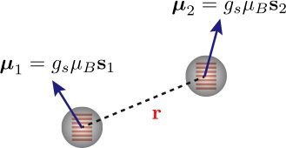
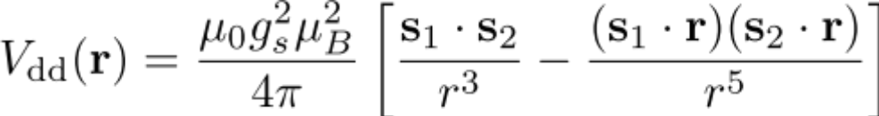
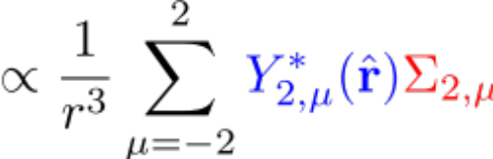
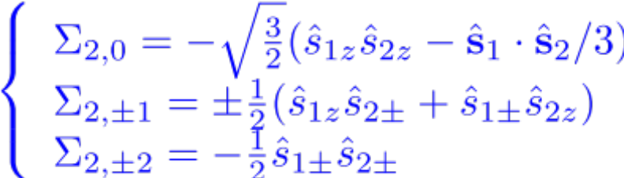
Dipolar interaction between free dipoles
s is a spin operator
Σ_{2,𝜇} are spherical tensor of rank 2
Magnetic dipole-dipole interaction (MDDI) between free dipoles couples the spin and orbital angular momenta.

Slide 14
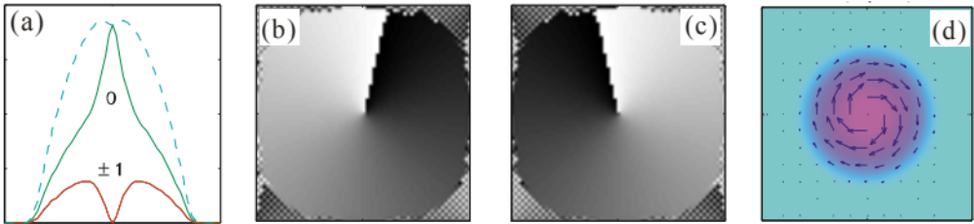
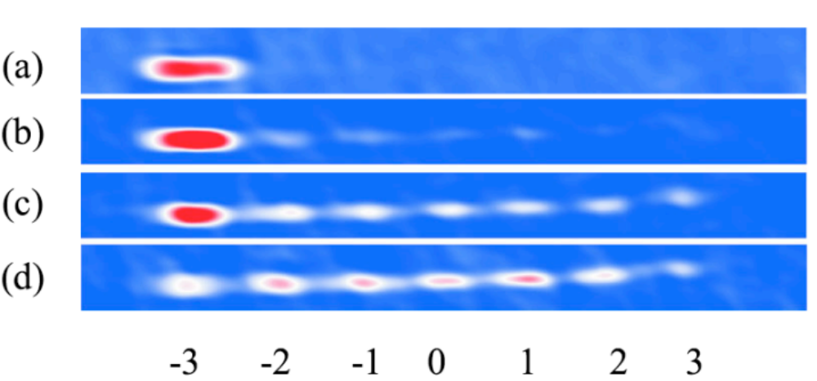
Spin related dipolar effects
Spontaneous spin vortex in dipolar spin-1 condensates
Yi and Pu, PRL 97, 020401 (2006)
Spontaneous demagnetization: Einstein-de Haas effects
Pasquiou et al., PRL 106, 255303 (2011)

Slide 15




Dipolar atomic gases

Slide 16





Facts about ⁵²Cr atoms
Electronic ground state:
Without nuclear spin, the quadratic Zeeman shift is zero.
Excited states:

Slide 17






Ingredient for the scheme
An ultracold gas of Cr atoms:
A bias magnetic field:
A pair of laser beams:
  wave vectors
  frequencies (far-detuned from resonance)
  Rabi couplings:
Deng, Cheng, Jing, Sun, and Yi, PRL 108, 125301 (2012)

Slide 18





Effective two-level model
Hamiltonian
Atom-light interaction
Parameters Δω_{L}, Ω_{R}, and k_{L} of the light field can be tuned independently
Raman coupling ↔ transverse field
Detuning ↔ longitudinal field

Slide 19




Dressed spin states
Single-particle Hamiltonian along the x-axis:
Dispersion relation:
The SO coupling strength k_{L} is tunable by varying the relative angle of the Raman beams

Slide 20




Many-body Hamiltonian
Field operator in bare spin states:
Single-particle part:
Trapping potential

Slide 21






Contact interactions
Scattering lengths:
Immiscibility

Slide 22




Magnetic dipole-dipole interaction
MDDI between polarized dipoles:
Spin-orbit coupling part:

Slide 23





Mean-field description
Condensate wave function:
Gross-Pitaevskii equations:
Single-particle:
CI induced mean-field:
MDDI induced mean-field:

Slide 24



Numerical simulation
Recoil energy:
Number of atoms:
Trapping potential:
Raman coupling:
Free parameter:

Slide 25





Small axial field:

Slide 26

Spin structure of the polarized phase

Slide 27




Large axial field

Slide 28




Intermediate axial field

Slide 29



Spin vortex in the intermediate regime

Slide 30
Outline
Introduction
  Spin-orbit couplings in atomic gases
Spin-orbit-coupled BEC with dipolar interaction
  Generating SOC in chromium gas
  Quantum phases:
BEC with cavity-mediated spin-orbit coupling
  Generating SOC in cavity
  Quantum phases:
Summary

Slide 31





Observation of Dicke quantum phase transition in BEC
Baumann et al., Nature 464, 1301 (2010)

Slide 32





Condensates in cavity
Nagy, Szirmai, and Domokos, EPJD 48, 127 (2008)

Slide 33






Self-organization
Cavity amplitude:
Effective potential
Self-organization is a transition from
homogeneous to λ-periodic distribution
Nagy et al., EPJD 48, 127 (2008)

Slide 34


Specifications of the system
3-level Λ-type atoms:
  Ground states: |↑〉 and |↓〉
  Excited state: |e〉
  m|↑〉−m|↓〉=1 & m_{|e〉}=m|↓〉
  External B field: B₀ ↔ ω_{Z}
Atom-light (cavity) couplings:
  atom-pump: Ω₁ ↔ ω_{L}+Δω_{L}
  atom-probe: Ω₂ ↔ ω_{L}
  atom-cavity: g₀ ↔ ω_{c}≃ω_{L}+Δω_{L}
Cavity decay: κ
Hilbert space: {|↑〉, |↓〉}
Deng, Cheng, Jing, and Yi, PRL 112, 143007 (2014)

Slide 35







Single-particle effective Hamiltonian
(two-photon detuning)
(Raman coupling strength)
(pumping strength)

Slide 36



Many-body system
Hamiltonian:
Dynamical equations:

Slide 37






Mean-field equations
Mean-field approx.:
Steady-state cavity amplitude:
Bunching parameter:
Order parameters:
(superradiance)
Dynamical eqs. for condensates:

Slide 38



Experimentally accessible parameters:
Wavelength:
Atom-light detuning:
Cavity decay:
Harmonic trap:
Atom number:
Scattering lengths:

Slide 39




Phase diagram

Slide 40



Cavity amplitude & order parameters
α vanishes in stripe phase;
Θ dominates in the checkerboard phase;
Ξ dominates in the LVAP phase;

Slide 41








Checkerboard phase: small Ω
2D optical lattice
density holes:
density holes locate at:

Slide 42



Intermediate Ω
Off-diagonal term:
y-lattice enhanced

Slide 43





Stripe phase
Pseudo-spin:
immiscible
miscible
increasing Ω
Transversal field:
Raman coupling energy:

Slide 44




Large Ω
Miscible
Density holes locate at
Raman coupling energy:
No self-organization?

Slide 45





Lattice of vortex-antivortex pairs
planar spin:
quadrupole
hedgehog
antivortex at
(even sites)
Effective transversal magnetic field:
vortex at
(odd sites)
Positions of vortices and antivortices
is switched by negating α
Still has self-organization!

Slide 46




Synthetic magnetic field
Eigenvalues
Ground state:
Synthetic magnetic field:

Slide 47
Summary
Schemes for generating spin-orbit coupling in both free space and cavity
Rich quantum phases
Strong synthetic magnetic field

Slide 48
Thank you for your attention

