Slide 1
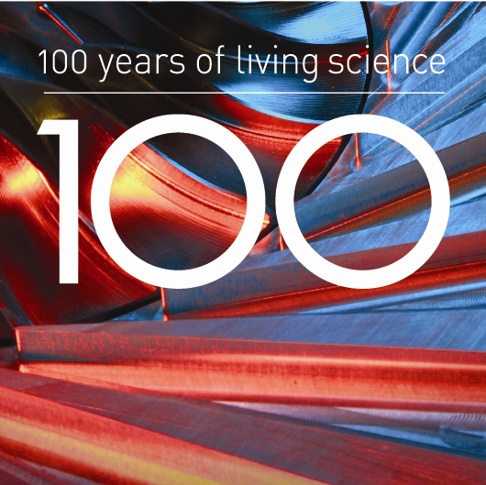
The World in Eleven Dimensions
Michael Duff
University of Science and Technology of China, Hefei
June 2014

Slide 2
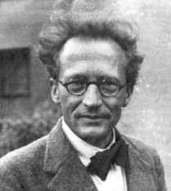
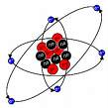

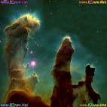
Two Pillars of XX Century Physics
Quantum Mechanics: applies to the very small; atoms, subatomic particles and the forces between them.
General Relativity: applies to the very large; stars, galaxies and gravity, the driving force of the cosmos as a whole.

Slide 3
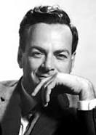

Central Quandary of XXI Century Physics
Quantum mechanics and general relativity are
mutually incompatible!
Microscopic scale: Einstein’s theory
fails to comply with the quantum rules
that govern the subatomic particles.
Macroscopic scale: black holes are
threatening the very foundations of
quantum mechanics.
New scientific revolution? M-theory?

Slide 4
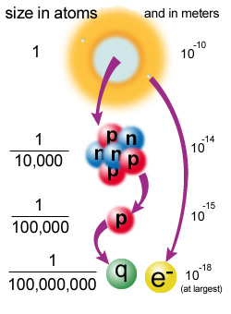
When is a particle ``elementary’’?
Page 4
© Imperial College London

Slide 5
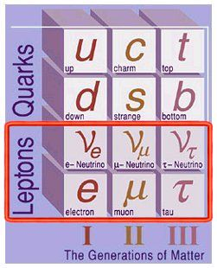
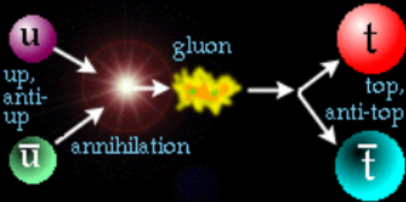
The building blocks : quarks and leptons
plus their antiparticles:

Slide 6
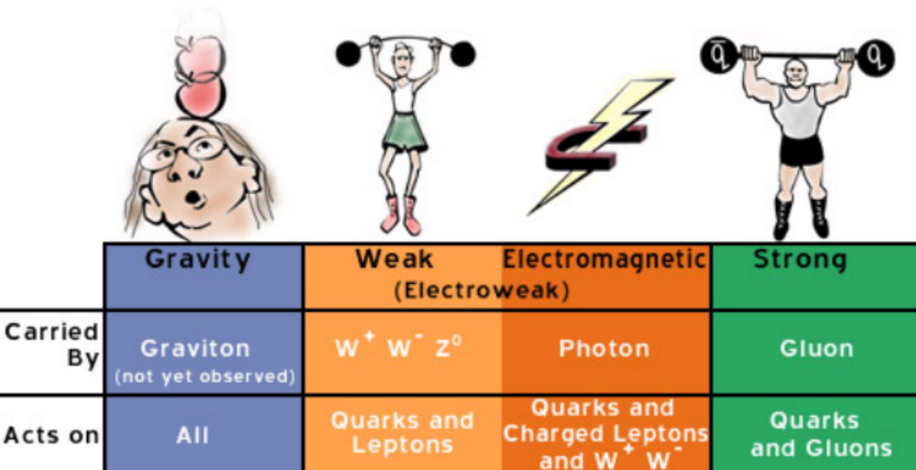
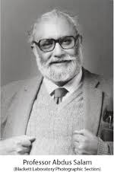
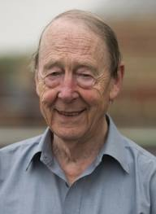
Four fundamental forces
Imperial’s
Abdus Salam
‘’Electro-weak’’
1979 Nobel Prize
Plus the Higgs Boson* to give mass to the W, Z,
quarks and leptons = ``The Standard Model’’

Slide 7

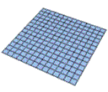
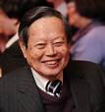
What exactly is a force?
The particle view of nature is a
description that works exceedingly
well to describe three of the four
observed forces of nature
The geometric view of nature
works very well for describing
gravity at astronomical distance scales
C. N. YANG
A. EINSTEIN

Slide 8
All-embracing theory?
If current ideas are correct, will require three
radical ingredients:
Extra dimensions
Supersymmetry
Extended objects (strings, branes..)

Slide 9


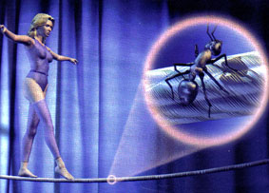

Fifth dimension
Kaluza and Klein imagined a small circle at each point of 4D spacetime
D=4 perspective:
Einstein’s gravity PLUS Maxwell’s electromagnetism!
*

Slide 10
Supersymmetry
Unifies bosons (force-carrying particles) with fermions
(building block particles)
2) Implies gravity!
3) Places an upper limit on the dimension of spacetime:
D=11

Slide 11
Early 1980s: D=11 supergravity:
Admits solutions in which seven dimensions are curled
up a la Kaluza-Klein.
Different geometries yield different theories in 4D.
Some choices gave the right bosons (graviton,photon,
gluons, W, Z, Higgs) but none gave the right fermions
(no left-right asymmetry).
Moreover, gave infinite probabilities for quantum processes.

Slide 12
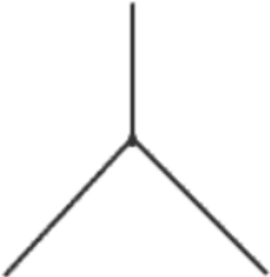

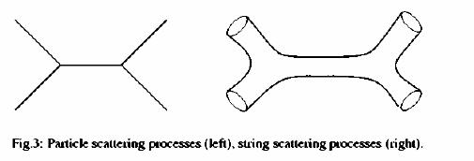
Particles versus strings
Particle physics interactions can occur
at zero distance -- but Einstein's theory
of gravity makes no sense at zero distance.
String interactions don't occur at one point but are
spread out in a way that leads to more sensible
quantum behavior.

Slide 13
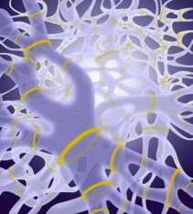
1984 superstring revolution:
Replace particles by strings:
gravity and quantum theory are reconciled.

Slide 14


String theories:
String vibration modes correspond to particles
Crucially, they include the ``graviton’’
Strings require ten space-time dimensions; six must be ``curled-up’’. Solves left-right problem.
Heterotic SO(32) : closed superstrings
Heterotic E8 x E8 : closed superstrings
Type I : open and closed superstrings
Type IIA : closed superstrings
Type IIB : closed superstrings
PUZZLES:
Why five different ten-dimensional string theories?
What about eleven dimensions?
If strings, why not ``branes’’?

Slide 15
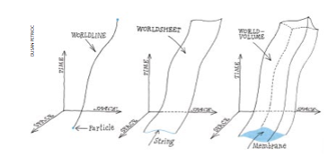
0-branes, 1-branes, 2-branes,...p-branes.
Particle String Membrane
p=0,d=1
p=1,d=2
p=2,d=3

Slide 16
OXFORD ENGLISH DICTIONARY
BRANE
Physics.
Brit. /bren/, U.S. /bren/ [Shortened < MEMBRANE n.]
I. Simple uses.
1. An extended object with any given number of dimensions, of which strings in string theory are examples with one dimension. Also with prefixed numbers, or symbols representing numbers, as 2-brane, p-brane.
1988
M. DUFF et al. in Nucl. Physics B. 297 516: We shall be concerned only with extended objects of one time and two space dimensions, i.e. ‘2-branes’... Possible ‘p-brane’ theories exist whenever there is a closed p + 2 form in superspace.
1996
Sci. Amer. Jan. 75/2 He [sc. M. J. Duff] found that a five-dimensional membrane, or a ‘five-brane’, that moved through a 10-dimensional space could serve as an alternative description of string theory.
II. Compounds.
2. BRANE-WORLD, a world model in which our space-time is the result of a three-brane moving through a space-time of higher dimension, with all interactions except gravity being confined to the three-brane.

Slide 17
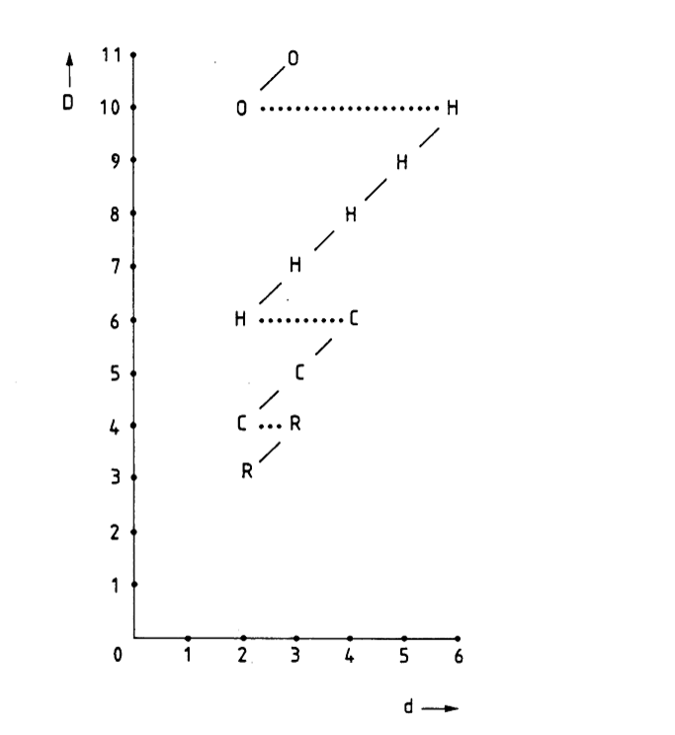
The Brane Scan:
D=spacetime dimension
d=p+1=worldvolume dimension
R=real
C=complex
H=quaternion
O=octonion
String in D=10 but
Membrane in D=11

Slide 18
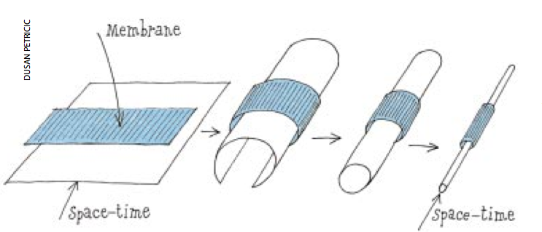
Strings in D=10 from membranes in D=11
Copyright 1998 Scientific American, Inc.
As the underlying space, shown here as a two-dimensional sheet, curls into a cylinder, the membrane wraps around it.
The curled dimension becomes a circle so small that the two-dimensional space ends up looking one-dimensional, like a line. The tightly wrapped membrane then resembles a string.
In fact it is the Type IIA string.

Slide 19
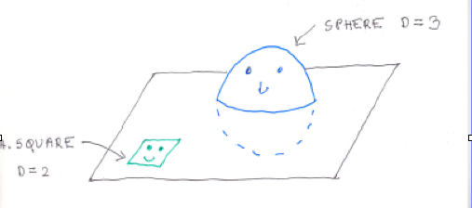
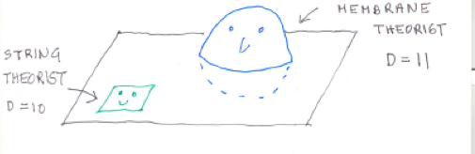
EDWIN ABBOTT:
FLATLAND 1884
STRINGLAND 1987

Slide 20
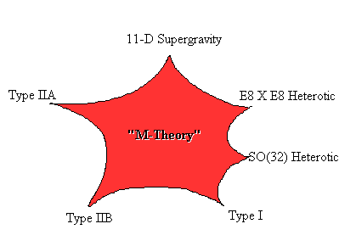
1995 M-theory revolution
Five different string theories and D=11 supergravity unified by eleven-dimensional M-theory: strings plus branes

Slide 21
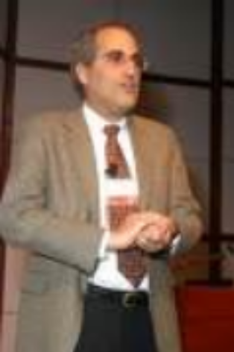
Edward Witten,
Fields Medalist and string theorist
``M stands for magic, mystery or membrane,
according to taste’’
“Understanding what M- theory really
is would transform our understanding of
nature at least as radically as occurred
in any of the major scientific upheavals
in the past”
*

Slide 22
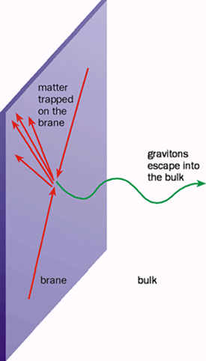
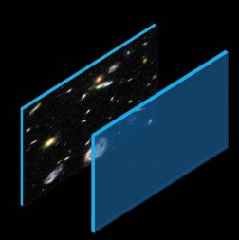
The braneworld Parallel universes?

Slide 23

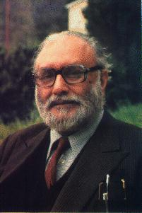


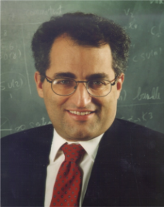
Story so far: Unification
Faraday Glashow,Weinberg,Salam Georgi,Glashow Green,Schwarz Witten
1831 1967 1974 1984 1995
Electricity }
}
} Electromagnetic force }
} }
Magnetism} } Electro-weak force }
} }
Weak nuclear force} } Grand unified force }
} } 5 Different }
Strong nuclear force} } D=10 String } M-theory
} Theories }
Gravitational force}
?
+branes in D=11

Slide 24
M theory is an ambitious attempt to answer all the Big Questions (A Theory of Everything):
How did the universe begin?
What are its fundamental constituents?
What are the laws of Nature that govern these constituents ?
Victim of its own success?
*

Slide 25

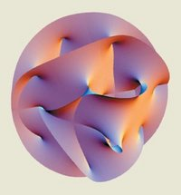
Curling up the extra dimensions on a
`` Calabi-Yau manifold’’
Different choices of Calabi-Yau lead to different four-dimensional universes
S. T. Yau
BUT
There are billions (possibly infinitely many) of them!
This is the ``STRING LANDSCAPE’’

Slide 26
What does this mean?
Theorists are divided:
THE UNIVERSE: there is one universe with a unique set of fundamental laws.
OR
THE MULTIVERSE: there are many universes each with different laws: We just happen to be living in one of them!
Bio-friendliness explained?

Slide 27
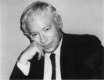
Steven Weinberg,
Nobel laureate and string theorist
``Most advances in the history of science have been marked by discoveries about nature, but at certain turning points we have made discoveries about science itself. These discoveries lead to changes in how we score our work, in what we consider to be an acceptable theory.’’
``Now we may be at a new turning point, a radical change in what we accept as a legitimate foundation for a physical theory. The current excitement is of course a consequence of the discovery of a vast number of solutions of string theory.’’

Slide 28

David Gross,
Nobel laureate
and string theorist
``The landscape idea? I hate it ”
“Never, never, never, never give up!”

Slide 29

Lord Rees, cosmologist
``The universe in which we‘ve emerged belongs to the unusual subset that
permits complexity and consciousness to develop. Once we accept this,
various apparently special features of our universe -- those that some
theologians once adduced as evidence for Providence or design --
occasion no surprise.’’
*

Slide 30
A unique universe?
The multiverse idea is, in fact, bucking an historical trend towards
uniqueness of physical laws. For example, mathematical consistency
demands that the fundamental building blocks of matter must come
in complete families:
A universe the same as ours, but without the top quark, for example, is theoretically forbidden (even in string/M-theory).
Sure enough, the top quark (the final missing piece of the jigsaw) was discovered experimentally in 1995.

Slide 31
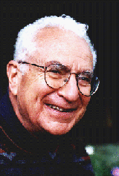
Murray Gell-Mann,
Nobel laureate
and string theorist
``If we really live in a multiverse, Physics will have been
reduced to an environmental science like Botany.’’

Slide 32
Is M-theory testable?
Generic features:
Supersymmetric particles
Extra dimensions
Microscopic black holes
Cosmic strings
If we are lucky, some might be seen at the next generation
of accelerators and/or astrophysical observations

Slide 33
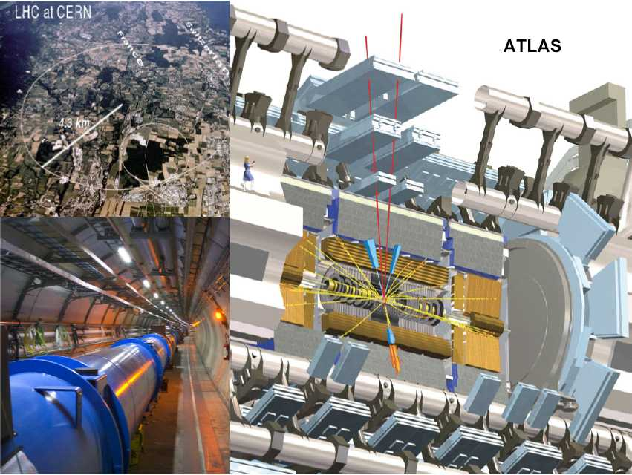
CERN’s Large Hadron Collider
2012 Higgs but no supersymmetry (yet)

Slide 34
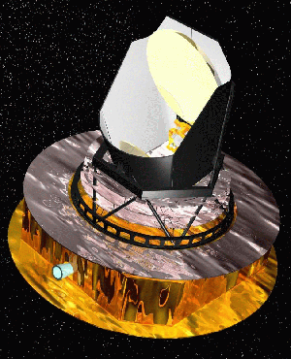
Planck surveyor
2013 Business as usual

Slide 35
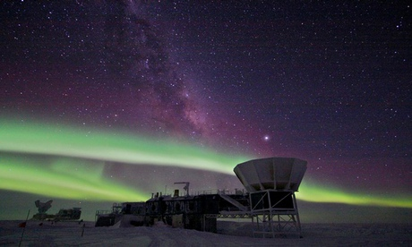
BICEP 2014: Gravitational waves
Evidence for cosmic inflation

Slide 36
BUT
Landscape problem means there is no definitive ``smoking-gun’’ experimentally falsifiable prediction.
This has lead to accusations that string and M-theory are not SCIENCE
Yet even if we stopped doing M-theory tomorrow, the
landscape problem (why one physical universe out of
many mathematical possibilities) is one that will have to be
confronted by any attempt at a final theory.

Slide 37


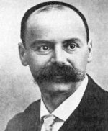
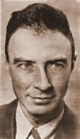
BLACK HOLES
`` all light emitted from such a body would be made to return towards it by its own proper gravity ’’ John Michell in 1784 on the concept of black hole
Laplace 1786
Schwarzschild 1916
Oppenheimer 1939

Slide 38

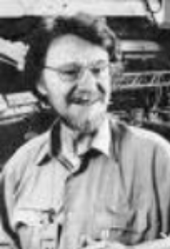

Quantum entanglement
Einstein, Podolsky, Rosen: paradox 1935
John Bell : falsifiable prediction 1964
Alain Aspect: empirical confirmation 1982

Slide 39
Time-lags between Theory and Experiment
Examples:
Black holes: predicted 1784, confirmed 1970s
Bose-Einstein condensate: predicted 1925, confirmed 1995
Yang-Mills bosons: predicted 1954, discovered 1982
Quantum entanglement: predicted1935, discovered 1982
The Higgs boson: predicted1964, discovered 2012
Gravitational waves: predicted 1916, discovered 2014
Predicted but not yet confirmed:
The cosmological constant (1917) (May be dark energy?)
Extra dimensions (1926)
Supersymmetry (1971)
M-theory (1995)

Slide 40
Repurposing string theory
1970s Strong nuclear interactions
1980s Quantum gravity; ``theory of everything'’
1990s AdS/CFT: QCD (revival of 1970s); quark-gluon plasmas
2000s AdS/CFT: superconductors
2000s Cosmic strings
2000s Fluid mechanics
2010s Black hole/qubit correspondence:: entanglement in Quantum Information Theory

Slide 41
½ BPS and non-BPS
+ - +
-
+
-
+
SO(4,4)
__________________
SO(2;3;R) x [(5+1)^2]
Borsten, Dahanayake,Duff, Marrani, Rubens
Phys. Rev. Lett. 105.100507
``Four qubit entanglement from string theory’’
IMPLICATIONS FOR BIG BANG THEORY?

Slide 42
½ BPS and non-BPS
+ - +
-
+
-
+
S0(4,4)
__________________
SO(2;3;R) x [(5+1)^2]

Slide 43
So is M the Final Theory?

Slide 44
So is M the Final Theory?
It is too early to tell

Slide 46
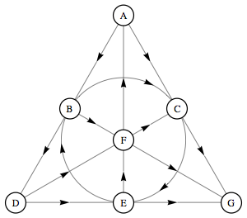
Black holes, qubits and octonions
M-theory black holes involve the mathematics of octonions
(discovered in 1845 by Cayley, but regarded as a ‘lost cause’ in physics).
Can apply same mathematics
to quantum information theory:
7 qubits: Alice, Bob, Charlie,Daisy,
Emma, Fred and George.
Hawking black hole entropy provides
measure of quantum entanglement.
Fano Plane
Can we now detect octonions in the lab?

Slide 47
Falsifiable predictions
Early result 2006:
STU black holes imply 5 ways to entangle three qubits
Already known in QI; verified experimentally
Later result 2010:
STU black holes imply 31 ways to entangle four qubits
Not already known in QI: in principle testable in the laboratory

Slide 48
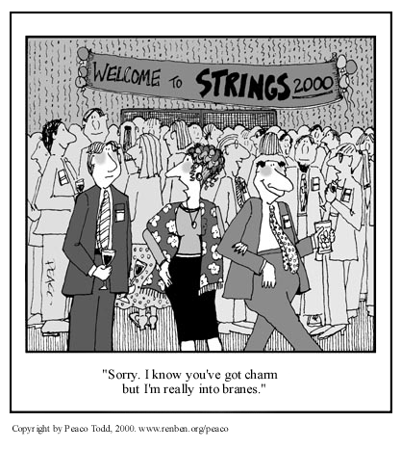
Branes

Slide 49
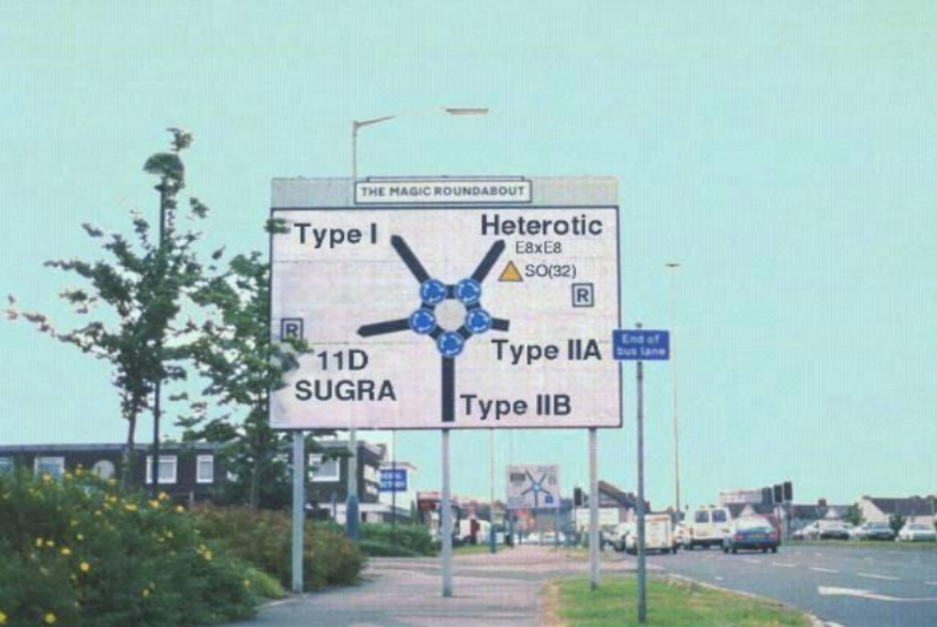
M-theory: the theory formerly known as strings

Slide 50
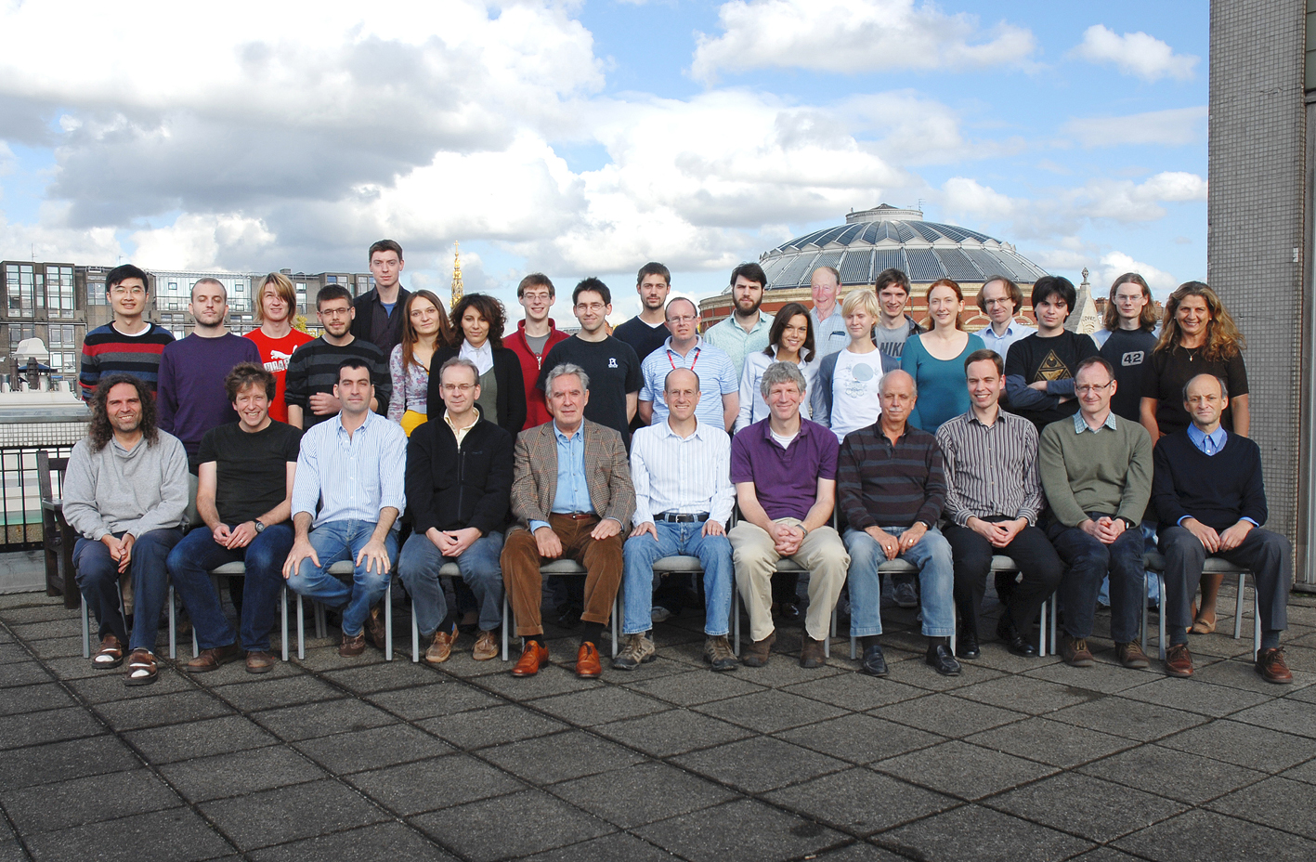
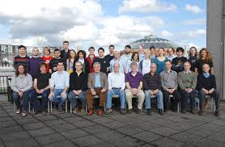
Imperial College Theory Group
Imperial College Theory Group

