Slide 1
Axion/ALP Dark Matter Detections

Slide 2

CDM
Accounts 23% of total energy density of universe while baryonic matter accounts 4%.
Properties:
a. Pressureless
  Primordial velocity is very small , at most
  ~ today .
  b.Collisionless
Cold dark matter is weakly interacting (so dark), except for gravity.

Slide 3
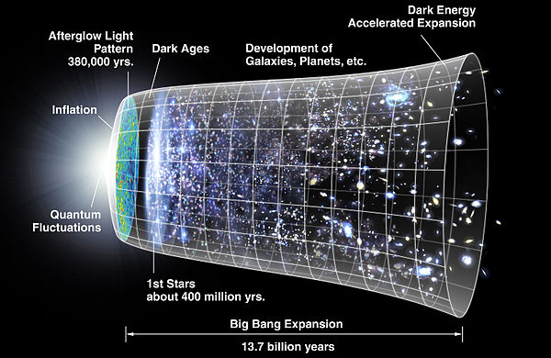
History of the Universe
picture by NASA

Slide 4
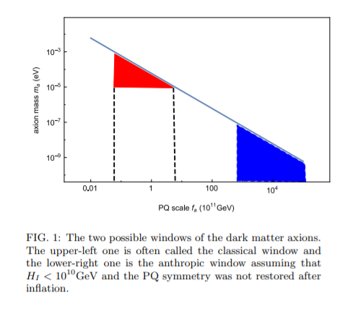


Slide 5

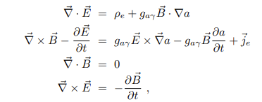
The axion electrodynamics
The Maxwell equations are modified:

Slide 6
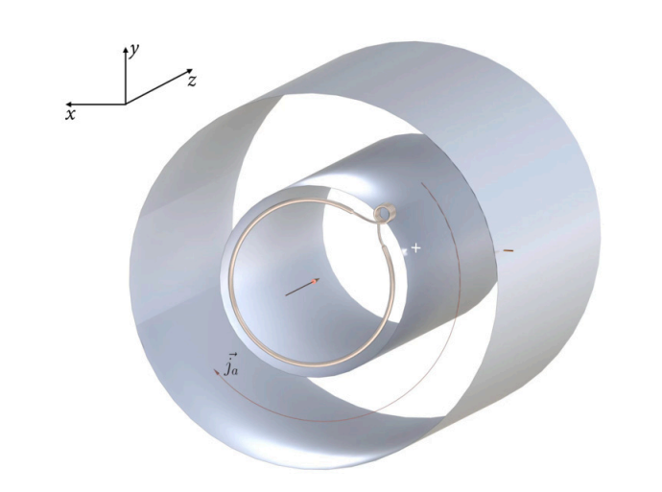
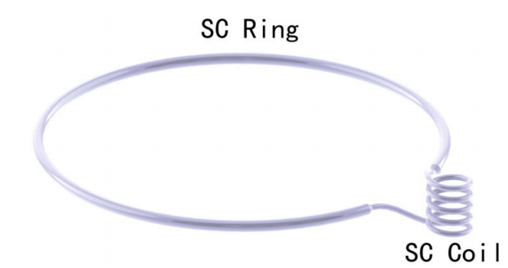
Electric Capacitors
npb 1005 (2024) 116602

Slide 7
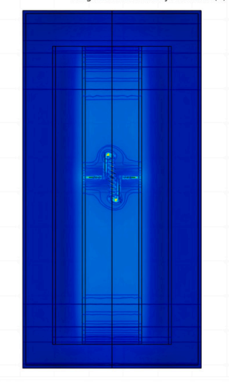
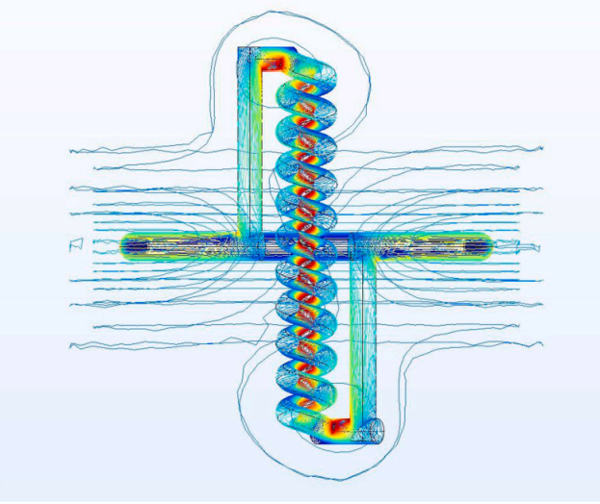
Electric Capacitors

Slide 8
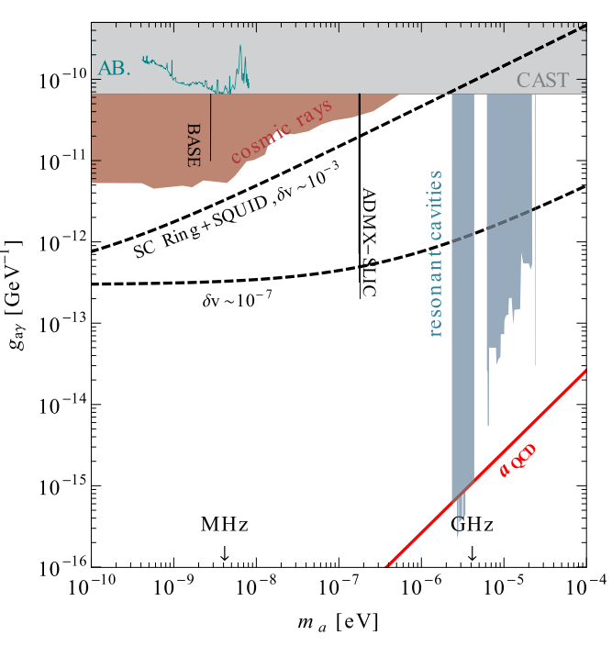
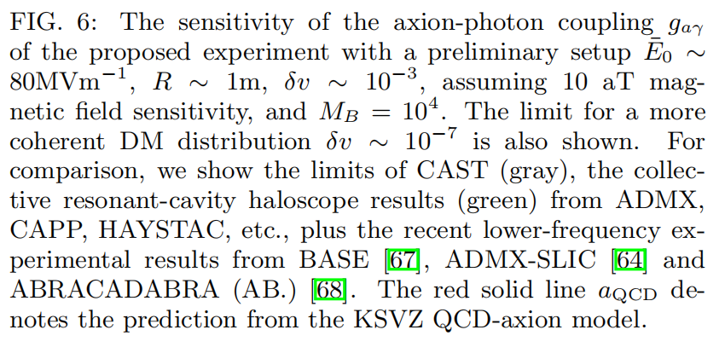

Slide 9
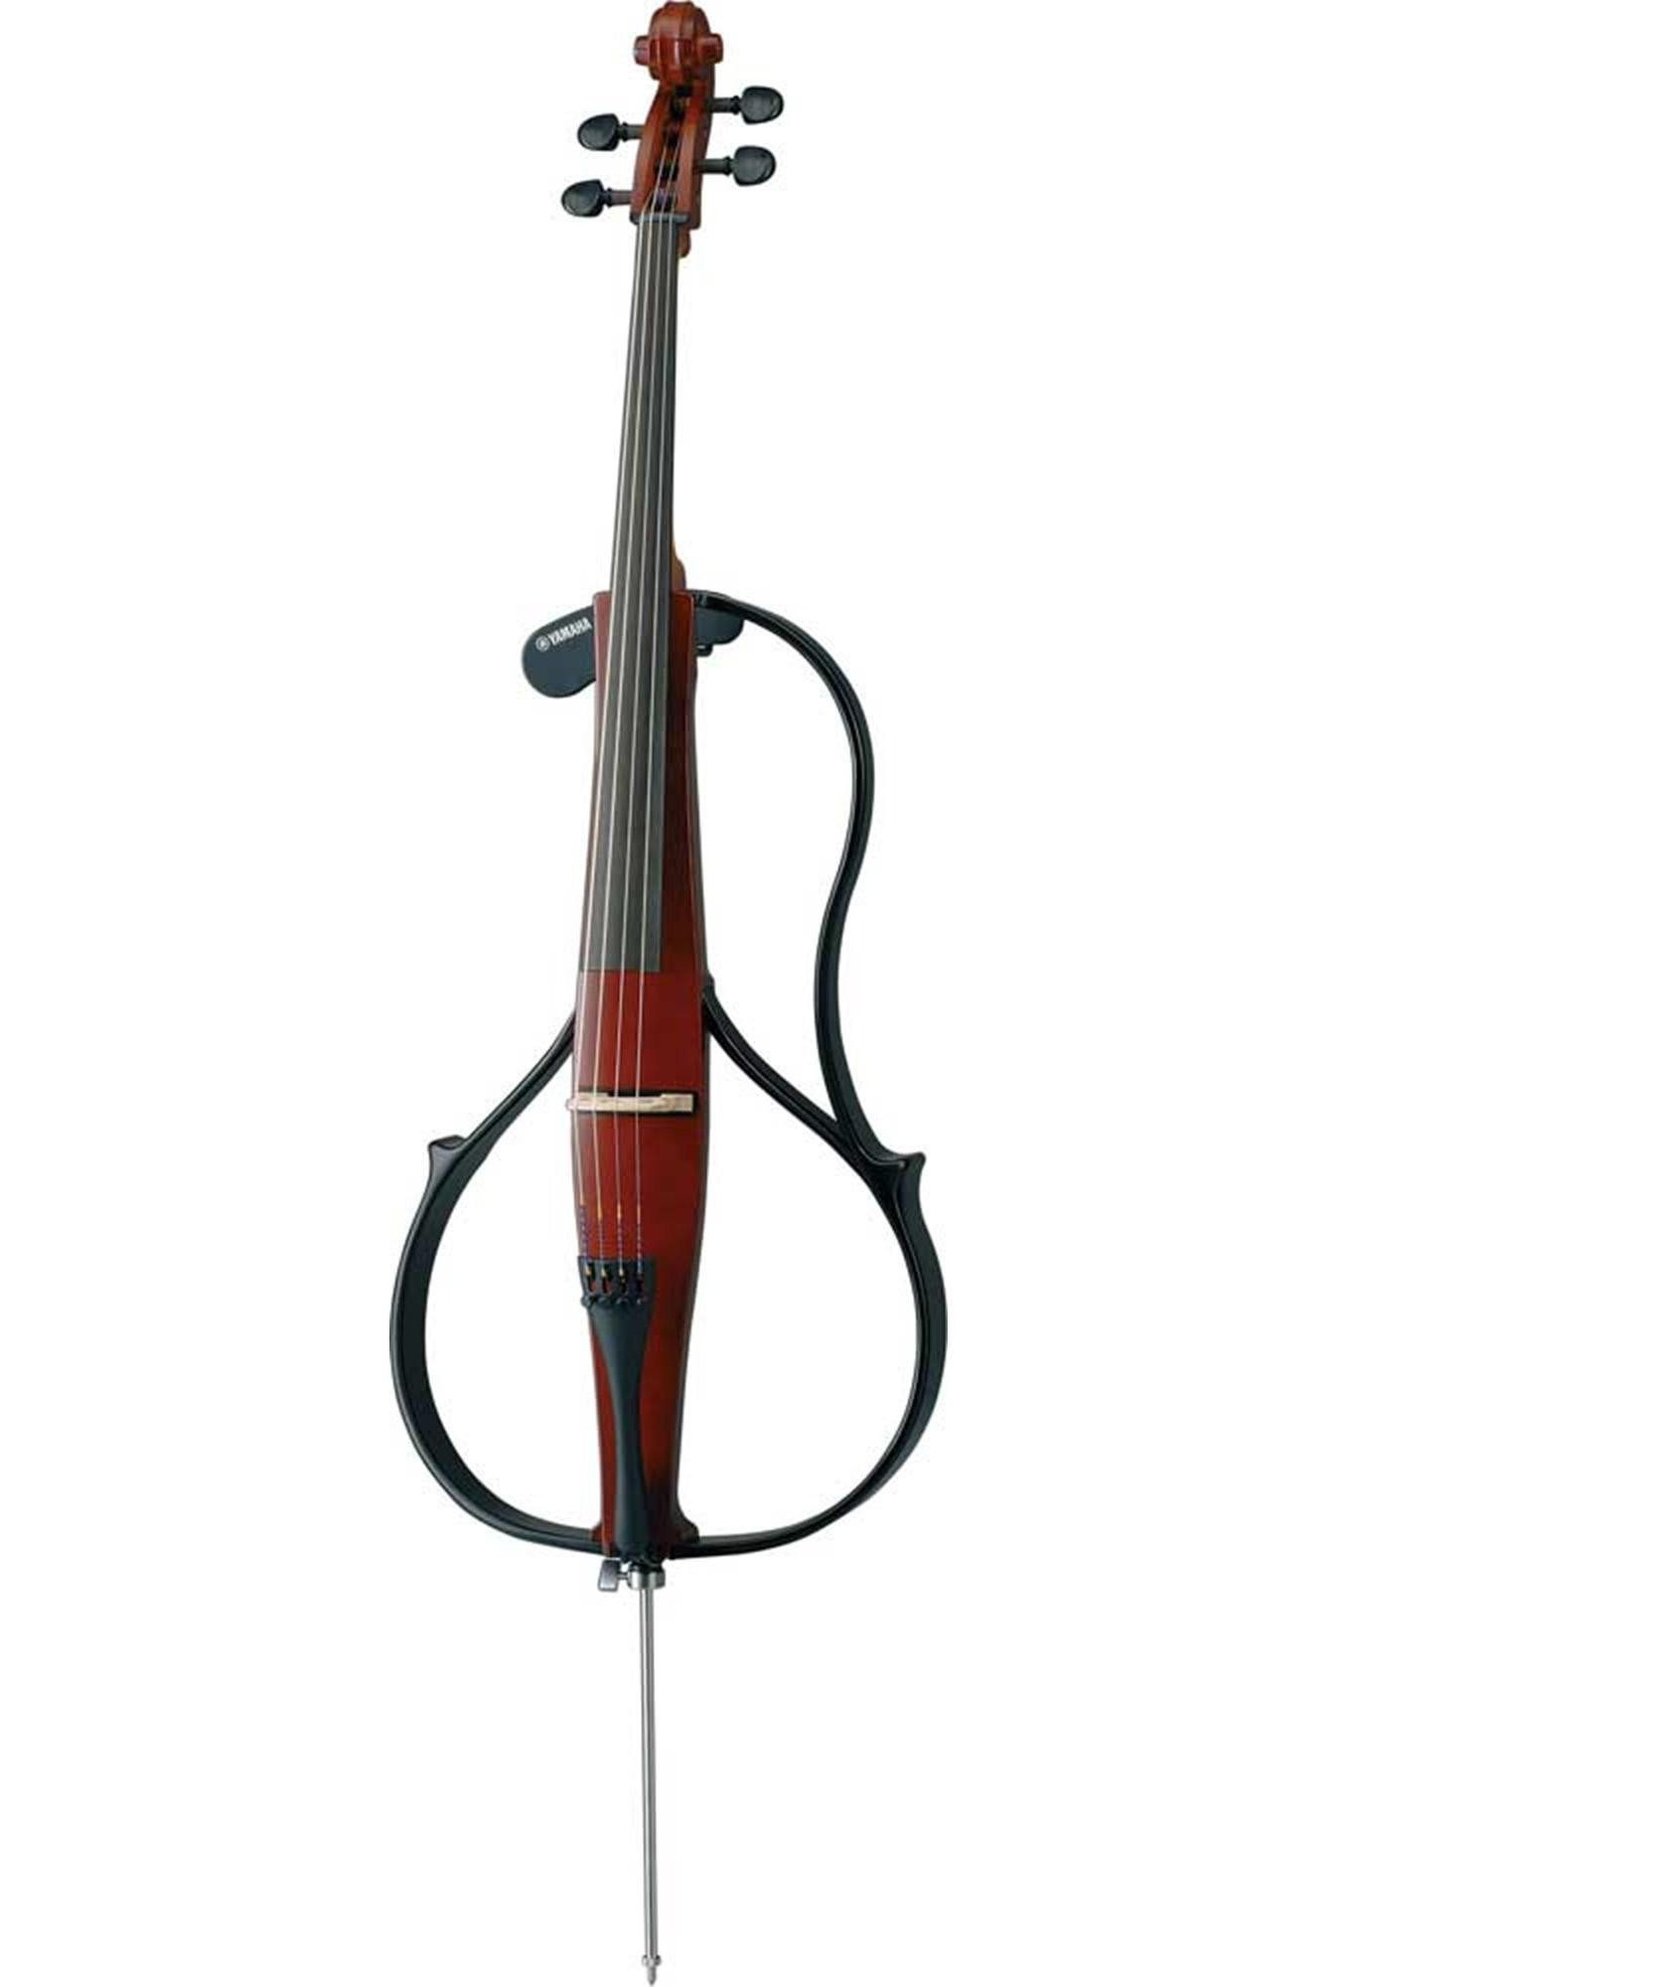
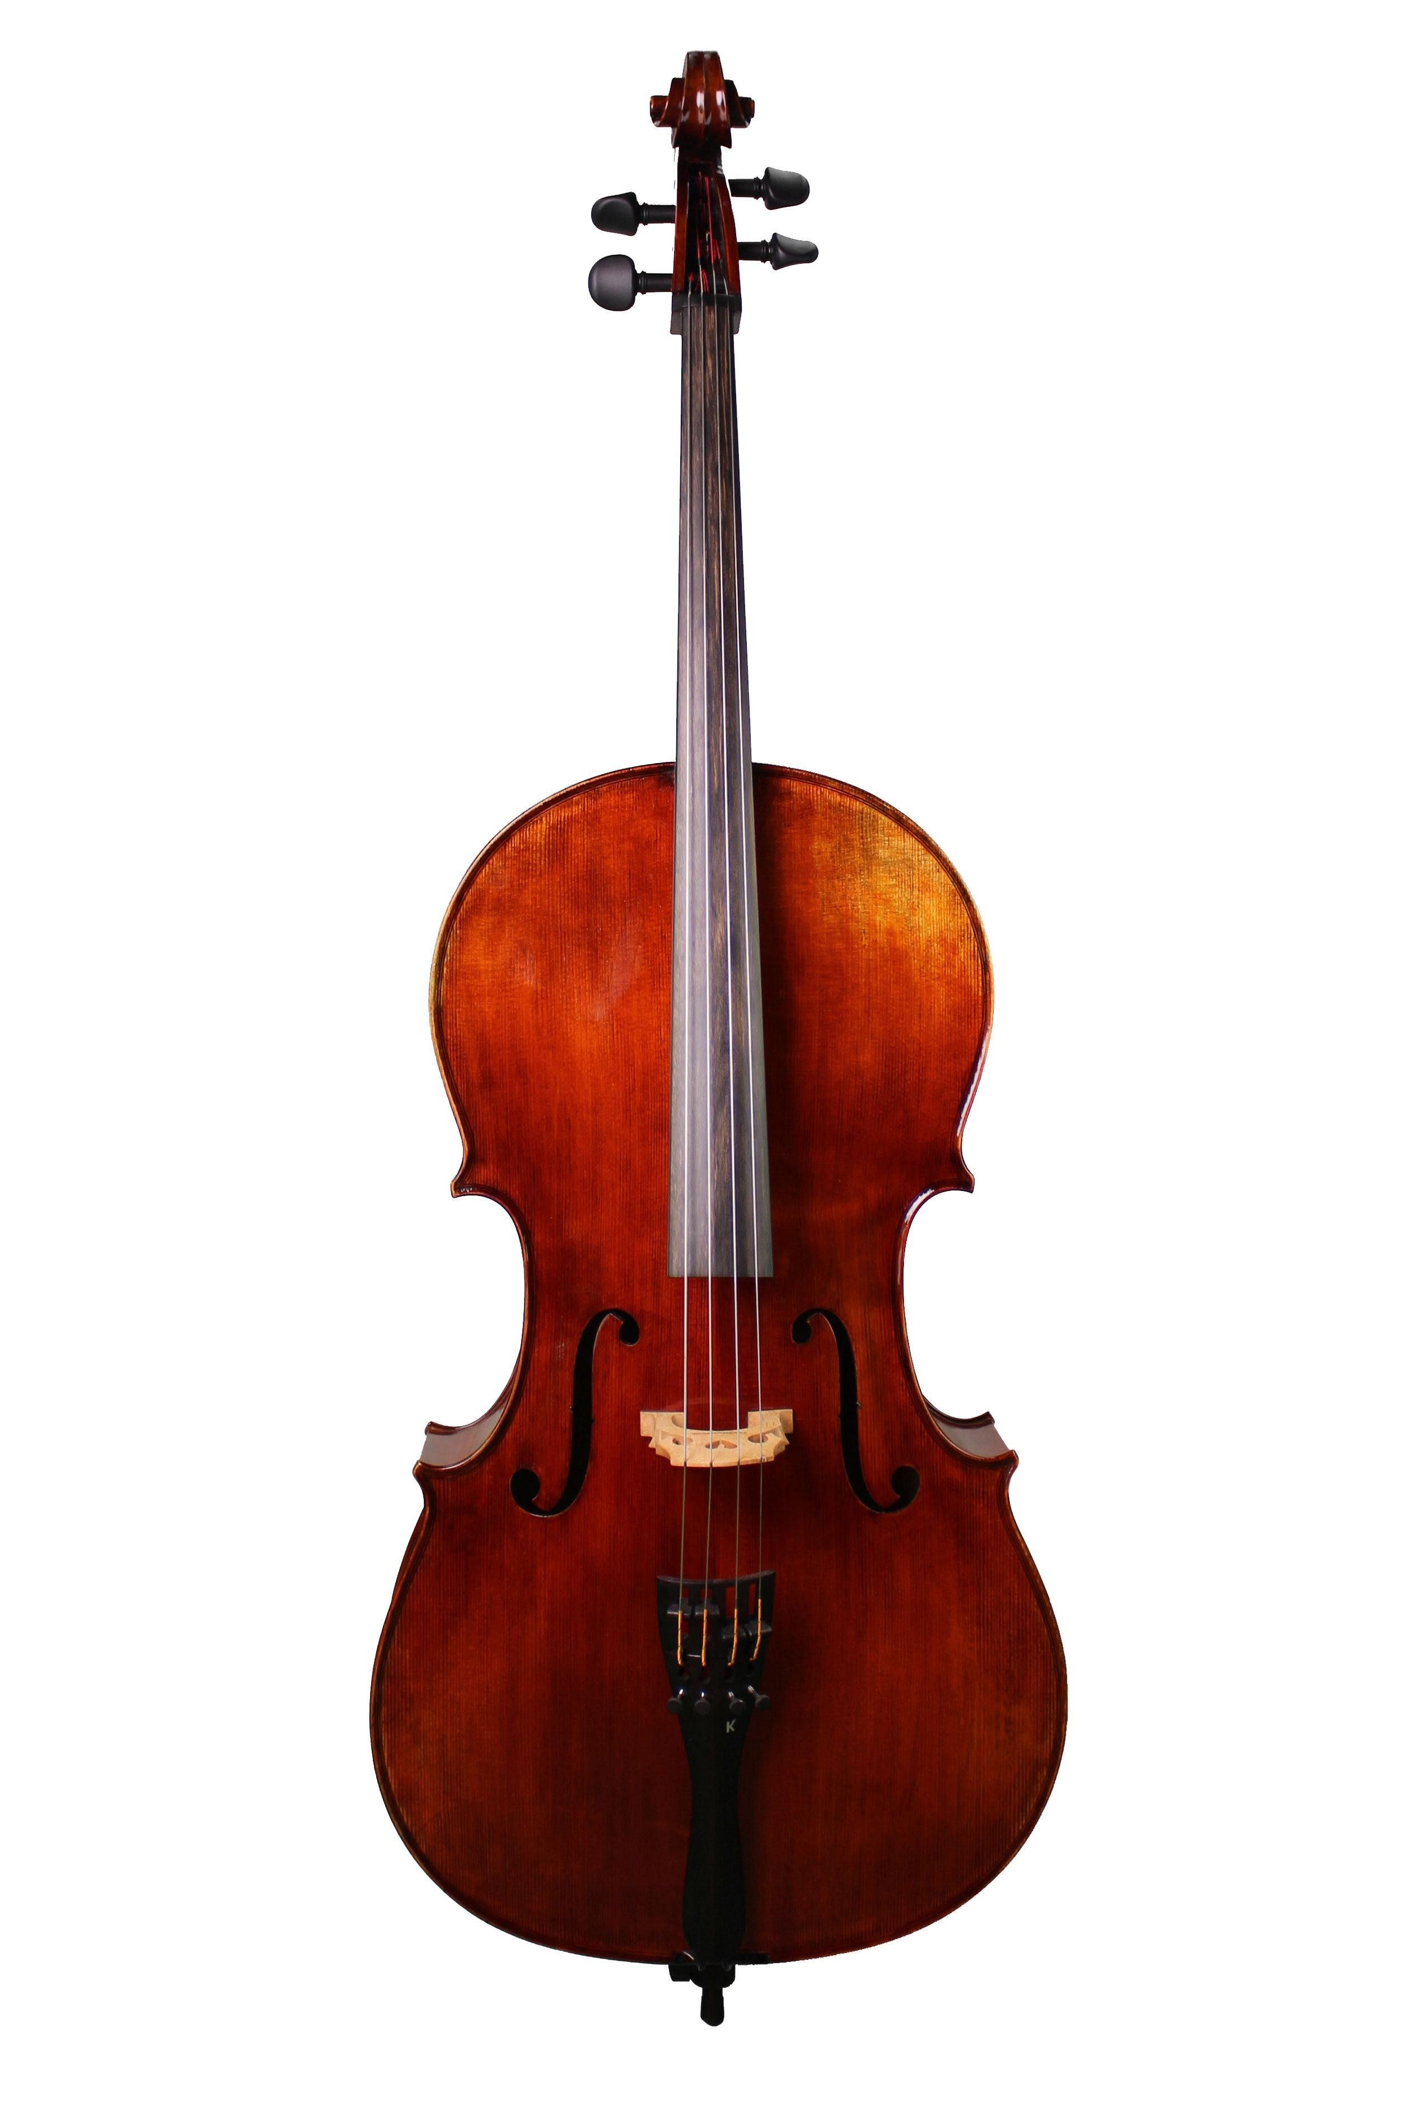
Why resonant cavity?
If the resonance is tuned to the axion mass, the cavity acts like a forced oscillator and on resonance achieves a large axion-induced excitation.

Slide 10


The signal power:

Slide 11
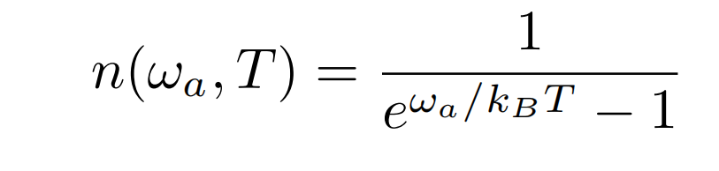
The quantum properties of the Cavity
Modern cryogenic technology can sustain ~20mK or lower temperature
The thermal photons have a very low occupation number n<<1 .
Thus it is useful to consider the quantum picture.

Slide 12
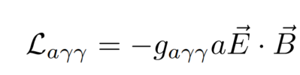
The Quantum picture of the Cavity
(Feynman diagram method could not be used here)
The axion photon coupling is

Slide 13
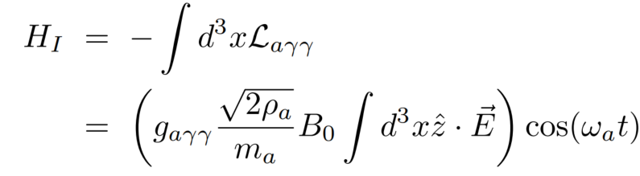
The Quantum picture of the Cavity
The interaction Hamiltonian is

Slide 14
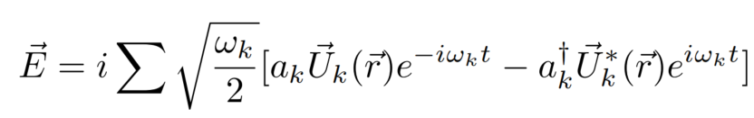

The Quantum picture of the Cavity
The electric field operator in the cavity can be expanded
where is the cavity modes

Slide 15
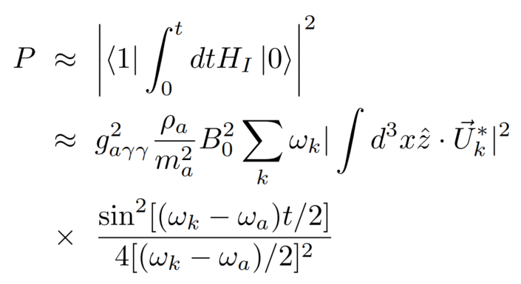
The Quantum picture of the Cavity
The transition probability is

Slide 16
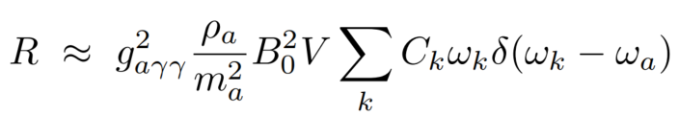
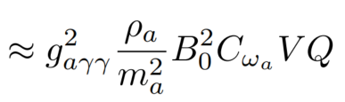
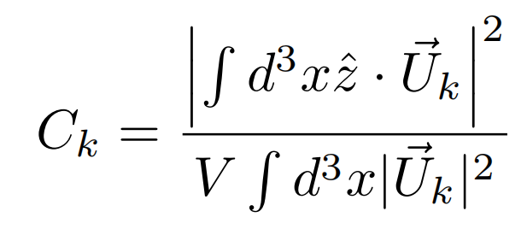
The Quantum picture of the Cavity
The transition rate is
where

Slide 17
The Quantum picture of the Cavity
The transition rate is enhanced by the cavity quality factor Q even for a single transition. Also, it is larger than the classical picture by a factor pi/2
Typical photon emitting rate of the cavity is order of 10Hz.

Slide 18
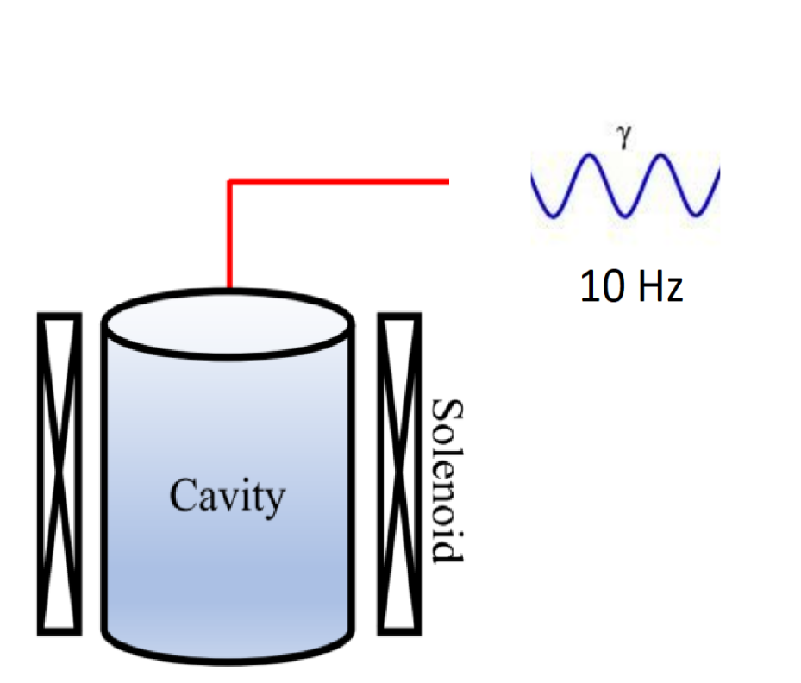
A cavity at quantum level can be regarded as a single photon emitter with a slow rate~ 10Hz.

Slide 19
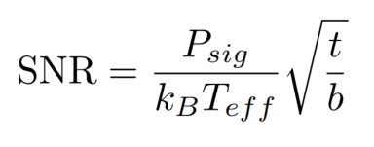
The bottleneck of the haloscope
The linear amplifier with a moderate bandwidth adds noise temperature order of T_eff=10K

Slide 20
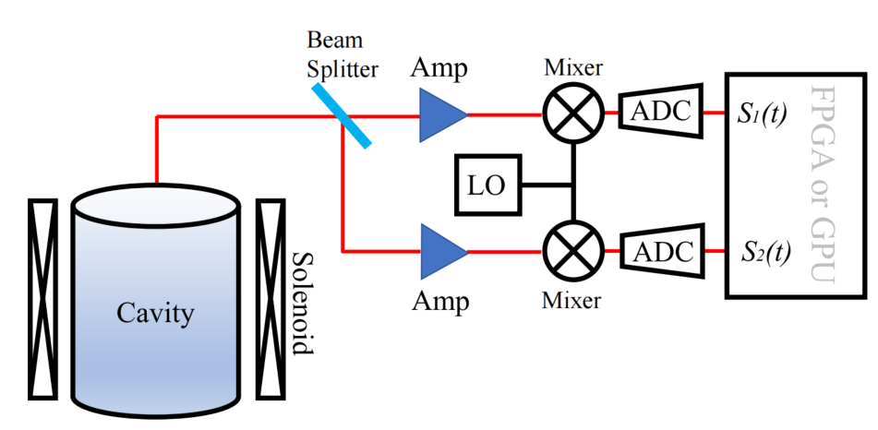
The quantum interferometry

Slide 21


The quantum interferometry
The beam splitter gives two output fields in channel 1 and 2
denotes the signal and denotes the noises.

Slide 22



The quantum interferometry
Then one measures
and
as the real and imaginary part of the field envelopes.

Slide 23

The quantum interferometry
The two path instantaneous power function is
where N₁₂ is the power of correlated noise in channel 1 and 2

Slide 24
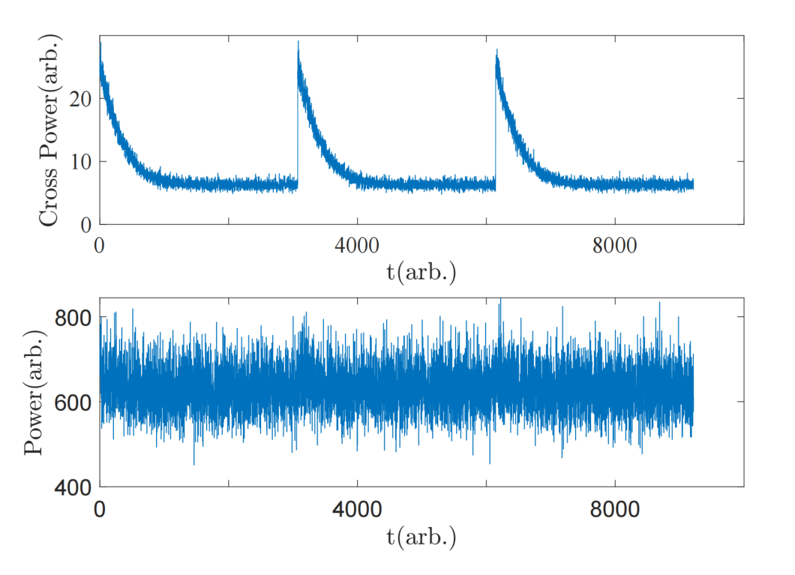
Simulated signal

Slide 25


Dark matter axions induce Quantum transitions

Slide 26



The axion spectrum density I_{a} is high
The interaction term in non-relativistic limit is:
The transition rate is

Slide 27
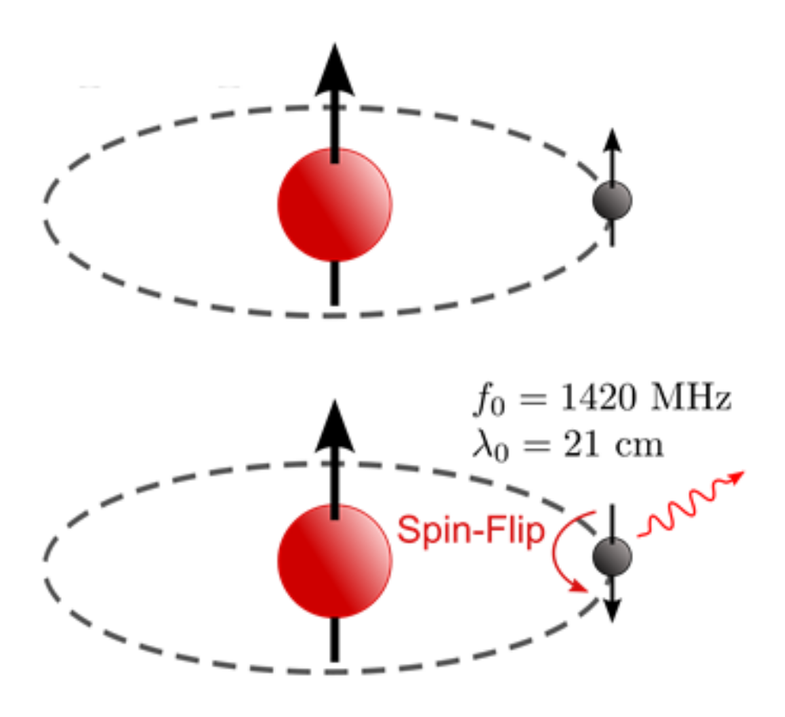
Hydrogen 1S state transitions
arxiv:1912.11472

Slide 28
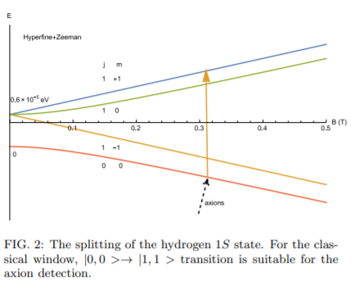
Hydrogen atoms are ideal targets for the classical window

Slide 29
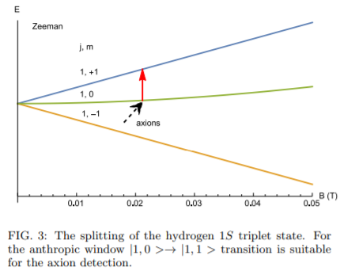
Hydrogen atoms are also ideal targets for the anthropic window

Slide 30
