Slide 1

核物质的对称能
陈列文
上海交通大学 物理与天文系/粒子与核物理研究所(INPAC)
lwchen@sjtu.edu.cn
对称能
对称能的确定
对称能与核素图上原子核的数目
对称能与暗物质
总结和展望
交叉学科理论研究中心，中国科学技术大学，合肥，
2016年11月18日

Slide 2
目录
对称能
对称能的确定
对称能与核素图上原子核的数目
对称能与暗物质
总结和展望

Slide 3
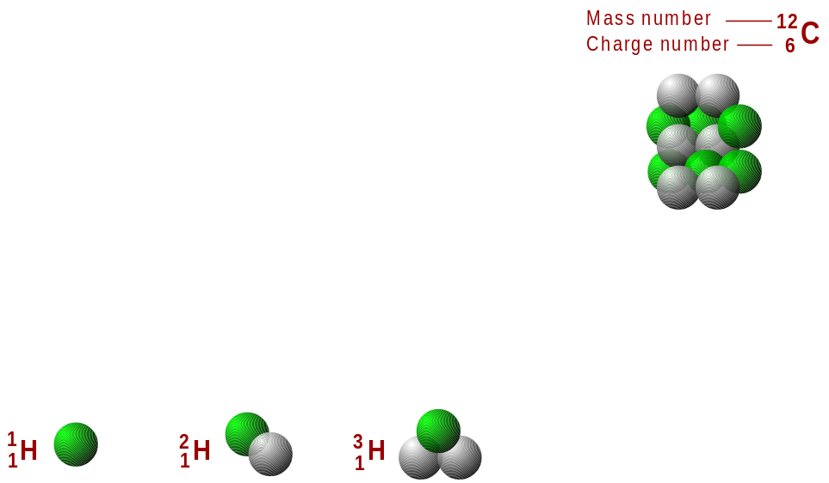
原子核的组成
原子核由质子和中子组成
核素: 给定中子数和质子数的原子核
元素: 给定质子数的原子核
同位素: 相同质子数但不同中子数的原子核
重离子：质量数大于4的离子，亦即比α粒子(⁴He)重的离子
同位旋：就核力的性质而言，质子与中子之间没有明显区别，因此把质子和中子看成同一种粒子(统称为核子)的两种不同状态，类比自旋的概念引入抽象的同位旋(isospin)空间，质子和中子是同位旋I相同，同位旋第3分量I₃不同的两种状态 ，由此可确定它们的同位旋I ＝ 1／2，质子的 I₃ ＝1／2 ，中子的I₃＝－1／2，它们组成同位旋二重态 … (海森堡，1932年)。在强相互作用，同位旋是一个好量子数。
p. 1

Slide 4
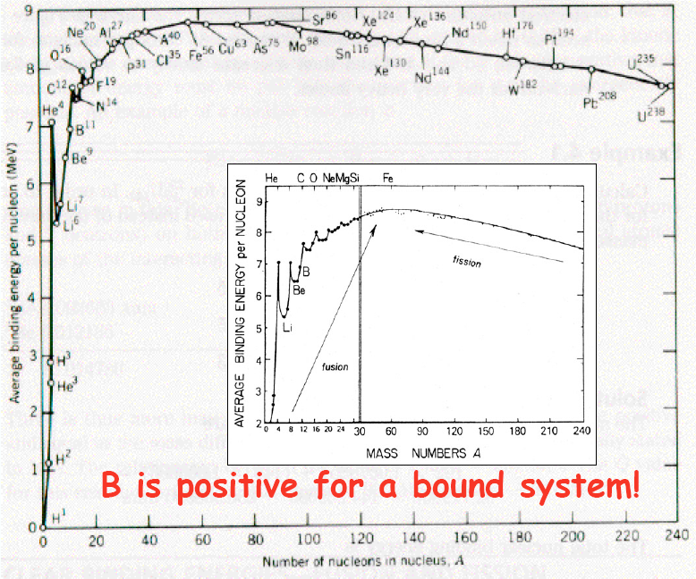
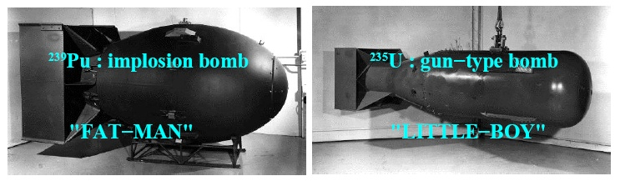
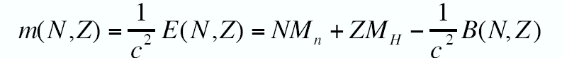
原子核的质量和结合能
1945.8.9(长崎)
1945.8.6(广岛)
Atomic Bomb
H-Bomb
Power of Sun
p. 2

Slide 5
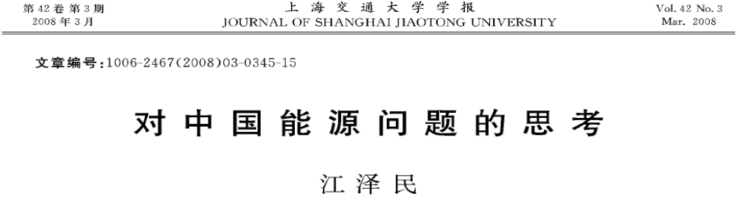
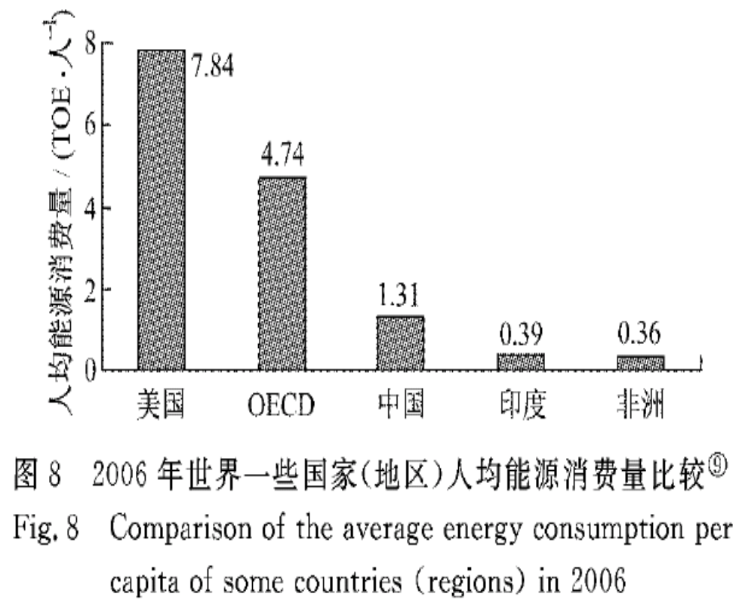
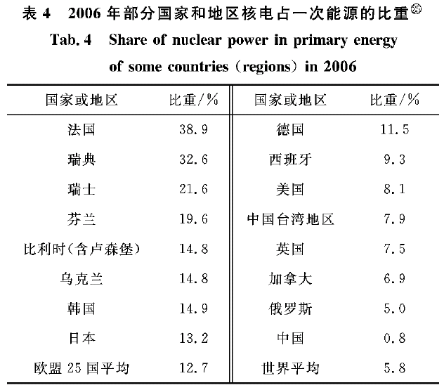
重核的裂变
中国：
2016：~2%
2020：~7%
2030：~15%
2050：~22%
p. 3

Slide 6


有限核的对称能
原子核的结合能 - 液滴模型
(Liquid-drop model:Bethe-Weizsäcker mass formula-1935)
Symmetry energy term
(对称能项)
Symmetry energy including surface diffusion effects (y_{s}=S_{v}/S_{s})
W. D. Myers, W.J. Swiatecki, P. Danielewicz, P. Van Isacker, A. E. L. Dieperink,……
p. 4

Slide 7
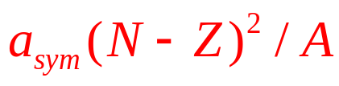

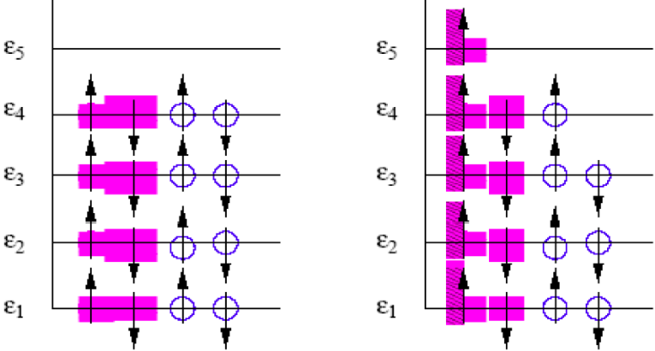
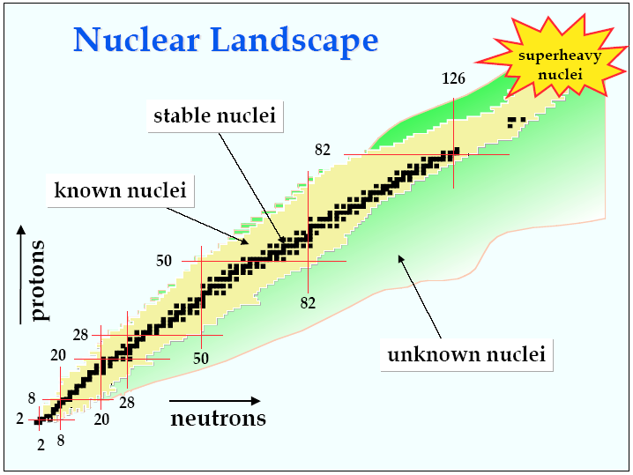
有限核的对称能
质子
中子
¹⁶O
¹⁶N
泡利不相容原理
对称能：
使中子数和质子数
趋于对称
库仑能：
使中子数和质子数
偏离对称
N > Z
N = Z
p. 5

Slide 8
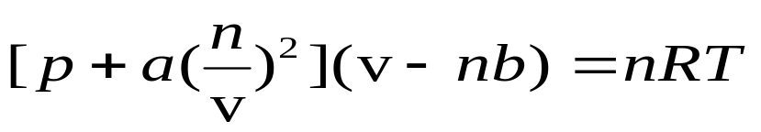
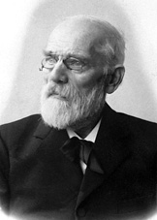
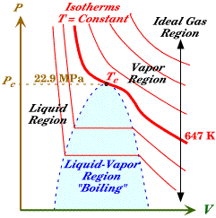
物质的状态方程
状态方程(EOS-Equation of State): a relationship among several state variables
van der Waals EOS:
The Nobel Prize in Physics 1910 was awarded to Johannes Diderik van der Waals "for his work on the equation of state for gases and liquids".
The EOS depends on the interactions
and properties of the particles in the matter.
It describes how the state of the matter
changes under different conditions
p. 6

Slide 9
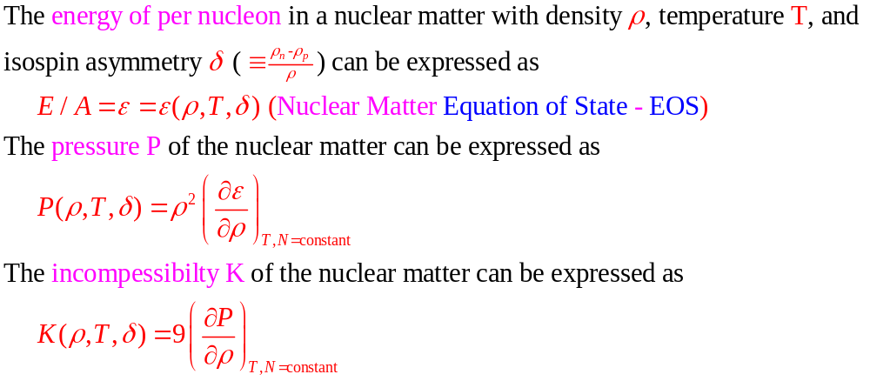
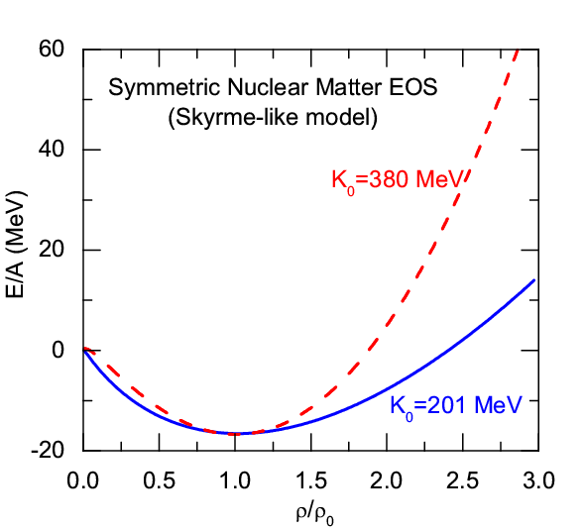

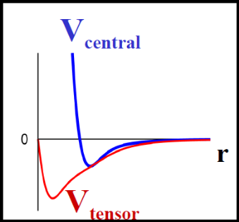
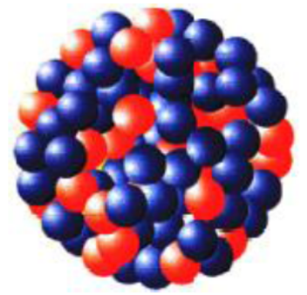
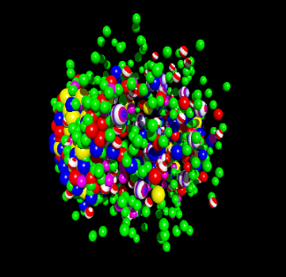
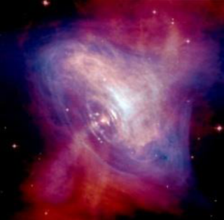
核物质的状态方程
Nature of the nuclear
force?
Structure and stability
of nuclei?
Dynamics of heavy
ion collisions?
Nature of compact stars
and dense nuclear matter?
p. 7

Slide 10
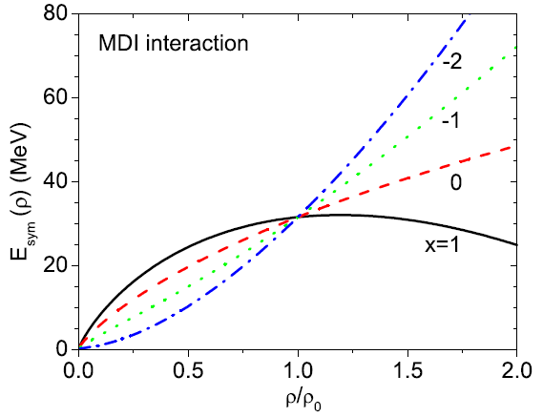
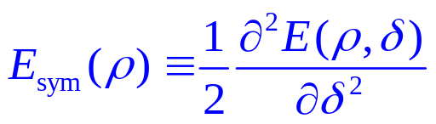
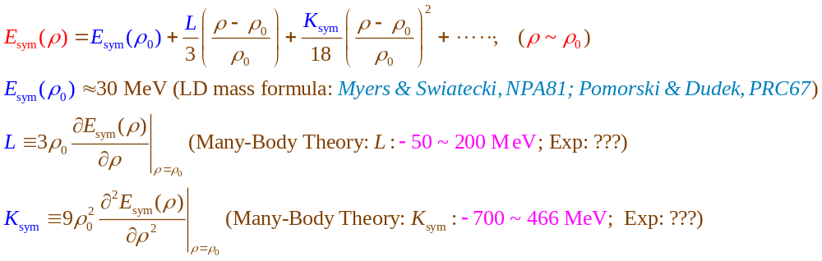
核物质的对称能
EOS of Isospin Asymmetric Nuclear Matter
(Parabolic law)
Symmetric Nuclear Matter
(relatively well-determined)
Isospin asymmetry
Symmetry energy term
(poorly known)
Nuclear Matter Symmetry Energy
p. 8

Slide 11

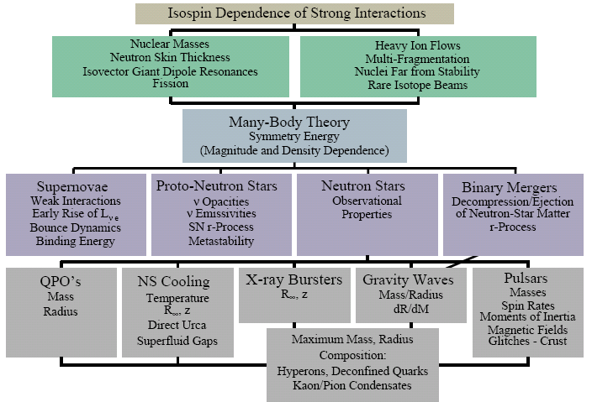
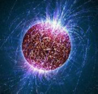
为什么研究对称能？
The multifaceted influence of the nuclear symmetry energy
A.W. Steiner, M. Prakash, J.M. Lattimer and P.J. Ellis, Phys. Rep. 411, 325 (2005).
Nuclear Physics
on the Earth
Physics at fm scale
Symmetry Energy
Astrophysics and Cosmology
in Heaven
Physics at km scale
The symmetry energy is also related to some issues of fundamental physics:
1. The precision tests of the SM through atomic parity violation observables (Sil et al., PRC2005)
2. Possible time variation of the gravitational constant (Jofre et al. PRL2006; Krastev/Li, PRC2007)
3. Non-Newtonian gravity proposed in the grand unified theories (Wen/Li/Chen, PRL2009)
4. Dark Matter (Zheng/Zhang/Chen, JCAP2014; Zheng/Sun/Chen, ApJ2015)
p. 9

Slide 12
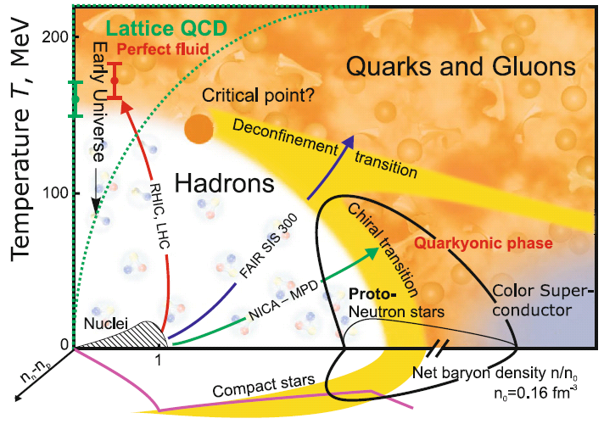
QCD相图
QCD Phase Diagram in 3D: density, temperature, and isospin
V.E. Fortov, Extreme States of Matter – on Earth and in the Cosmos, Springer-Verlag Berlin Heidelberg 2011
Esym: Important for understanding the EOS of strong interaction matter and QCD phase transitions at extreme isospin conditions
Heavy Ion Collisions (Terrestrial Lab);
Compact Stars(In Heaven); …
Quark Matter
Symmetry Energy ?
M. Di Toro et al., NPA775 (2006);
Pagliara/Schaffner-Bielich, PRD81,
(2010); Shao et al., PRD85,(2012); Chu/Chen, ApJ780 (2014); H. Liu et a., PRD94 (2016); Xia/Xu/Zong, (2016)
At extremely high baryon density, the main degree of freedom could be the deconfined
quark matter rather than confined baryon matter, and there we should consider quark
matter symmetry energy (isospin symmetry is still satisfied). The isopsin asymmetric quark
matter could be produced/exist in HIC/Compact Stars
p. 10

Slide 13
目录
对称能
对称能的确定
对称能与核素图上原子核的数目
对称能与暗物质
总结和展望

Slide 14
核物质状态方程: 多体理论方法
The nuclear matter EOS cannot be measured experimentally, its determination thus depends on theoretical approaches
Microscopic Many-Body Approaches
Non-relativistic Brueckner-Bethe-Goldstone (BBG) Theory
Relativistic Dirac-Brueckner-Hartree-Fock (DBHF) approach
Self-Consistent Green’s Function (SCGF) Theory
Variational Many-Body (VMB) approach
Green’s Function Monte Carlo Calculation
V_{lowk} + Renormalization Group
Nuclear Lattice Approach
Effective Field Theory
Density Functional Theory (DFT)
Chiral Perturbation Theory (ChPT)
QCD-based theory
Phenomenological Approaches
Relativistic mean-field (RMF) theory
Quark Meson Coupling (QMC) Model
Relativistic Hartree-Fock (RHF)
Non-relativistic Hartree-Fock (Skyrme-Hartree-Fock)
Thomas-Fermi (TF) approximations
p. 11

Slide 15
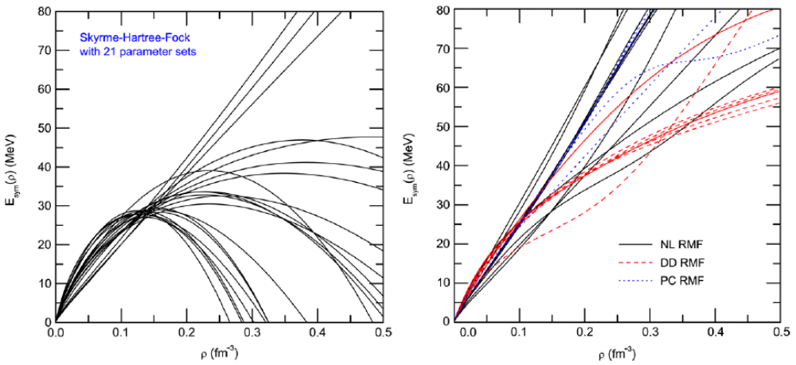
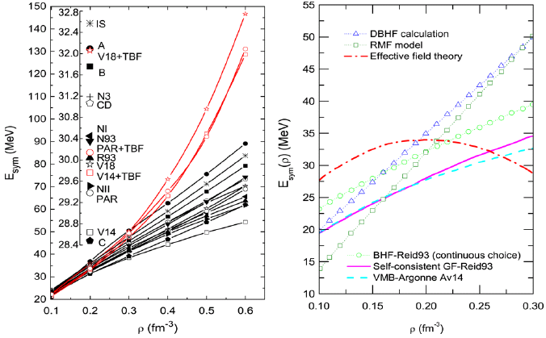
核物质状态方程: 多体理论方法
Chen/Ko/Li, PRC72, 064309(2005)
Chen/Ko/Li, PRC76, 054316(2007)
Z.H. Li et al., PRC74, 047304(2006)
Dieperink et al., PRC68, 064307(2003)
BHF
p. 12
Notes:
15

Slide 16
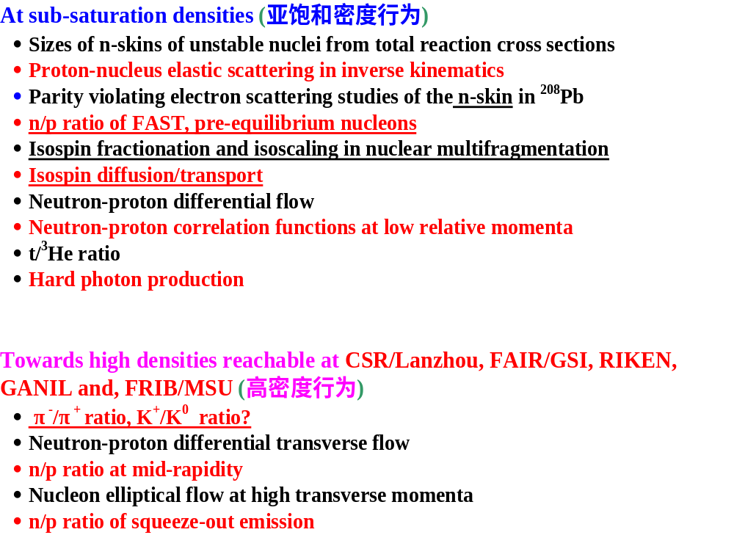
核物质对称能: 实验探针
Promising Probes of the E_{sym}(ρ)
(an incomplete list !)
Pigmy/Giant resonances
Nucleon optical potential
B.A. Li, L.W. Chen, C.M. Ko
Phys. Rep. 464, 113(2008)
p. 13

Slide 17
放射性束流装置
Cooling Storage Ring (CSR) Facility at HIRFL/Lanzhou in China (2008)
up to 500 MeV/A for ²³⁸U
http://www.impcas.ac.cn/zhuye/en/htm/247.htm
Beijing Radioactive Ion Facility (BRIF-II) at CIAE in China (2012)
http://www.ciae.ac.cn/
Radioactive Ion Beam Factory (RIBF) at RIKEN in Japan (2007)
http://www.riken.jp/engn/index.html
Texas A&M Facility for Rare Exotic Beams -T-REX (2013)
http://cyclotron.tamu.edu
Facility for Antiproton and Ion Research (FAIR)/GSI in Germany (2022)
up to 2 GeV/A for ¹³²Sn (NUSTAR - NUclear STructure, Astrophysics and Reactions )
http://www.gsi.de/fair/index_e.html
SPIRAL2/GANIL in France (2013)
http://pro.ganil-spiral2.eu/spiral2
Selective Production of Exotic Species (SPES)/INFN in Italy (2015)
http://web.infn.it/spes
Facility for Rare Isotope Beams (FRIB)/MSU in USA (2018)
up to 400(200) MeV/A for ¹³²Sn
http://www.frib.msu.edu/
The Korean Rare Isotope Accelerator (KoRIA-RAON(RISP Accelerator Complex) (Planning)
up to 250 MeV/A for ¹³²Sn, up to 109 pps
……
p. 14

Slide 18
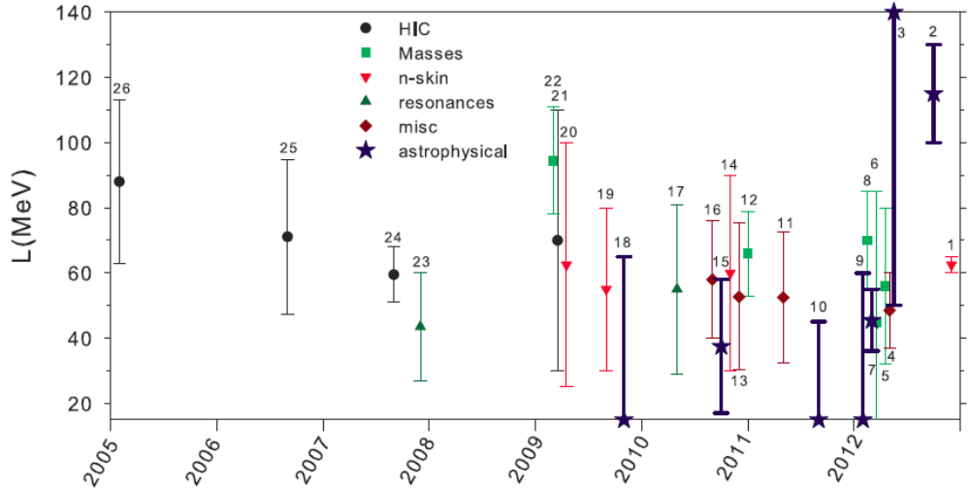
核物质对称能：饱和密度附近
Current constraints (An incomplete list) on E_{sym} (ρ₀) and L from
terrestrial experiments and astrophysical observations
Chen/Ko/Li, PRL94,032701 (2005)
饱和密度处对称能的斜率
“misc”: miscellaneous
W.G. Newton et al., Journal of Physics: Conf. Series 420 (2013) 012145
p. 15

Slide 19
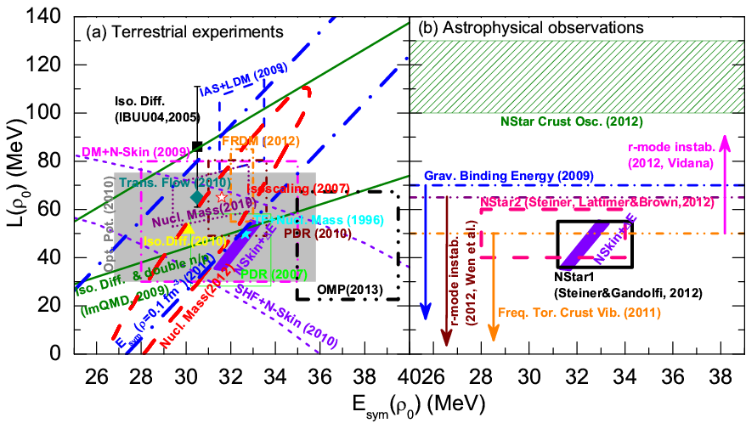
核物质对称能：饱和密度附近
Current constraints (An incomplete list) on E_{sym} (ρ₀) and L from
terrestrial experiments and astrophysical observations
E_{sym}(ρ₀) = 32.5±2.5 MeV, L = 55±25 MeV
L.W. Chen, Nucl. Phys. Rev. (原子核物理评论) 31, 273 (2014) [arXiv:1212.0284]
B.A. Li, L.W. Chen, F.J. Fattoyev, W.G. Newton, and C. Xu, arXiv:1212.1178
p. 16

Slide 20
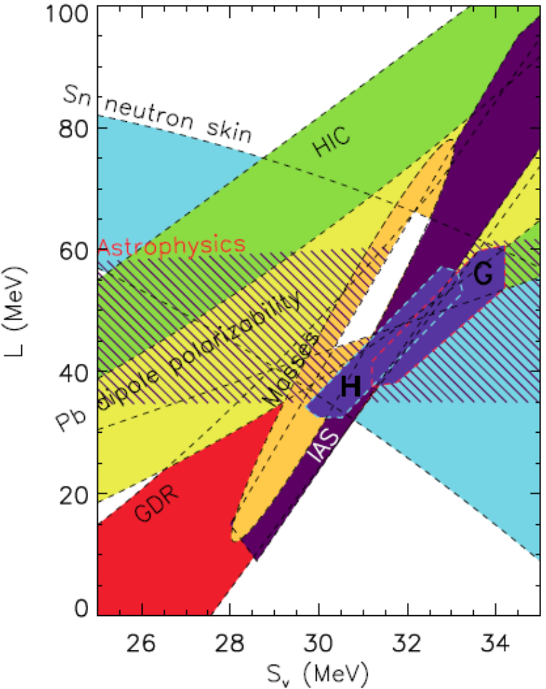
核物质对称能：饱和密度附近
Jim Lattimer and Andrew Steiner using 6 out of approximately 30 available constraints
J.M. Lattimer and A.W. Steiner,
EPJA50, (2014) 40
饱和密度处对称能的斜率
The centroid is around
S_{v}=31 MeV and L=50 MeV
Microscopic calculations (H/G) do not include higher-order contribution?
EOS of SNM?
Chen/Ko/Li/Xu, PRC82, 024321 (2010)
Why? Zhang/Chen, PLB726, 234 (2013)
Neutron skin is actually determined by
L(0.11 fm⁻³) rather than L(0.16 fm⁻³)
饱和密度处对称能的大小
0.11 fm⁻³ ~ Average density of Heavy Nuclei
p. 17

Slide 21
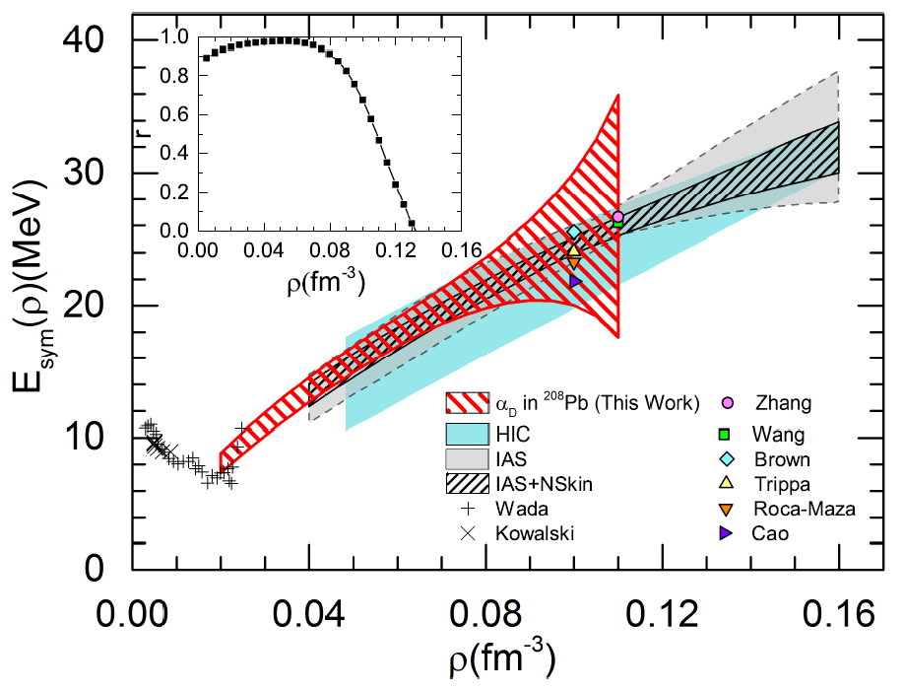
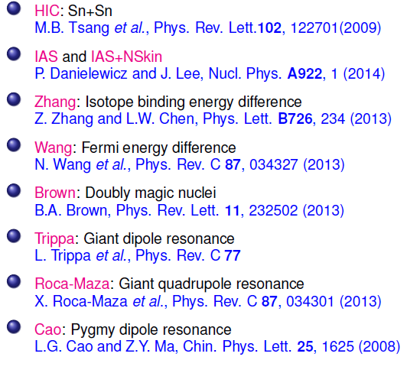
核物质对称能：亚饱和密度行为
Z. Zhang and LWC, PRC92, 031301(R) (2015)
Wada and Kowalski: experimental results of the symmetry energies at densities below 0.2$ρ_{0}$ and temperatures in the range 3 ~11 MeV from the analysis of cluster formation in heavy ion collisions.
Wada et al., Phys. Rev. C85, (2012) 064618; Kowlski et al., Phys. Rev. C75, (2007) 014601.
Natowitz et al., Phys. Rev. Lett. 104, (2010) 202501.
p. 18

Slide 22
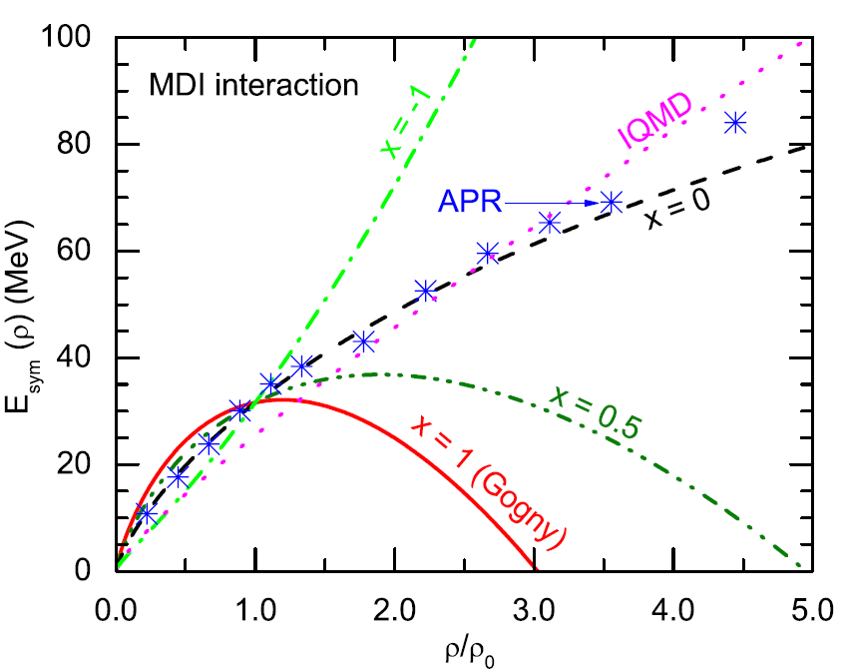


核物质对称能：超饱和密度行为
A Soft or Stiff Esym at supra-saturation densities ???
pion ratio (FOPI): ImIQMD, Feng/Jin, PLB683, 140(2010)
n/p v2 (FOPI):
Russotto/Trauntmann/Li et al., (UrQMD)
PLB697, 471(2011)
PRC94, 034608 (2016)
Stiffer
Pion Medium Effects?
Threshold effects?
Δ resonances? ……
Xu/Ko/Oh
PRC81, 024910(2010)
Xu/Chen/Ko/Li/Ma
PRC87, 067601(2013)
Hong/Danielewicz,
PRC90, 024605 (2014)
Song/Ko,
PRC91, 014901 (2015)
Softer
pion ratio (FOPI):
IBUU04, Xiao/Li/Chen/Yong/Zhang, PRL102,062502(2009)
ImIBLE, Xie/Su/Zhu/Zhang, PLB718,1510(2013)
p. 19

Slide 23
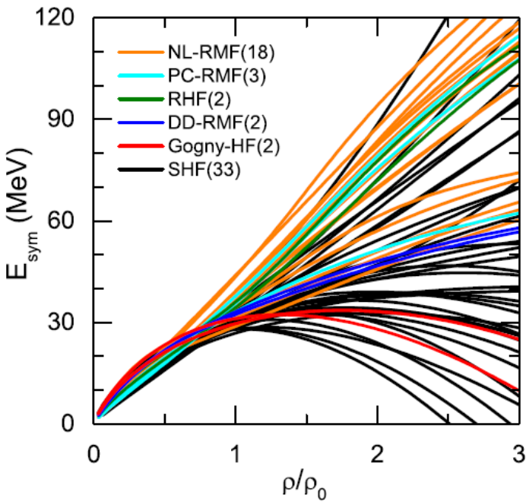
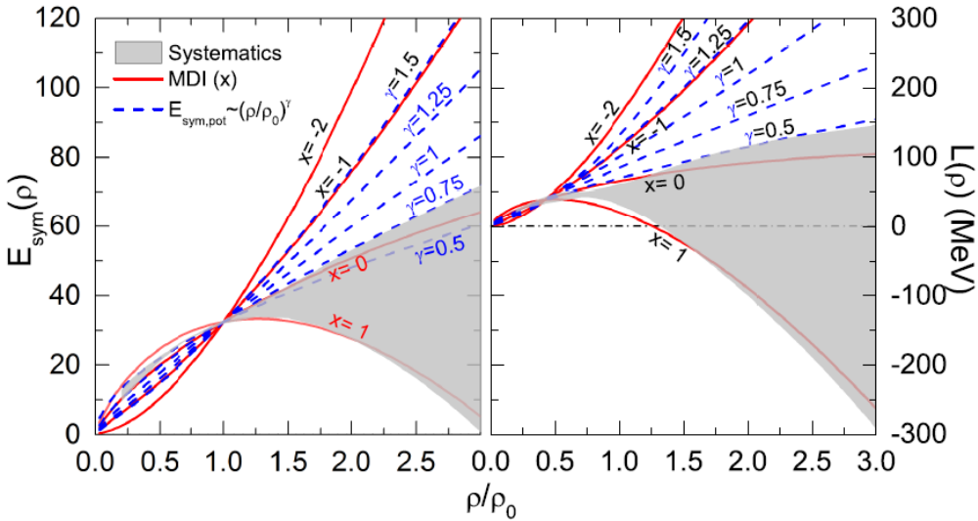
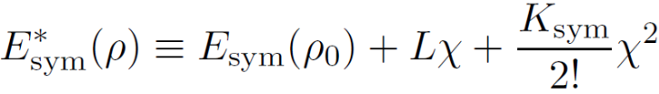
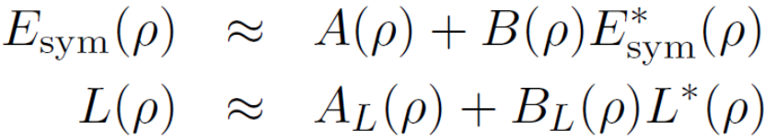
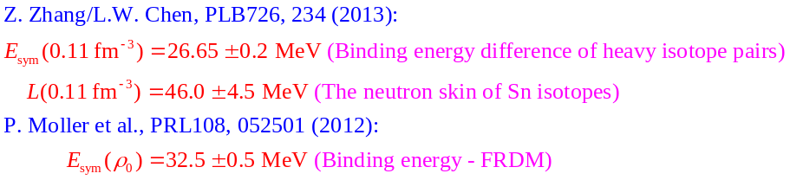
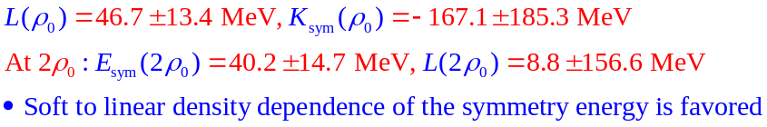
核物质对称能：超饱和密度行为
Esym systematics: A Soft Esym at supra-saturation densities ???
60 EDFs
Chen, EPJ Web of Conf. 88, 00017 (2015)
p. 20

Slide 24
核物质对称能：现状
Cannot be that all the constraints on E_{sym} (ρ₀) and L are equivalently reliable since some of them don’t have any overlap. However, essentially all the constraints seem to agree with:
E_{sym}(ρ₀) = 32.5±2.5 MeV
L = 55±25 MeV
The symmetry energy at subsaturation densities have been relatively well-constrained. But at very low densities, the clustering could be important and how does it affect the symmetry energy?
All the constraints on the high density Esym come from HIC’s (FOPI), and all of them are based on transport models. The constraints on the high density Esym are elusive and controversial for the moment !!!
(A new window from Esym systematics? Softer high density Esym?
– L.W. Chen, EPJ Web of Conferences 88, 00017 (2015))
p. 21

Slide 25
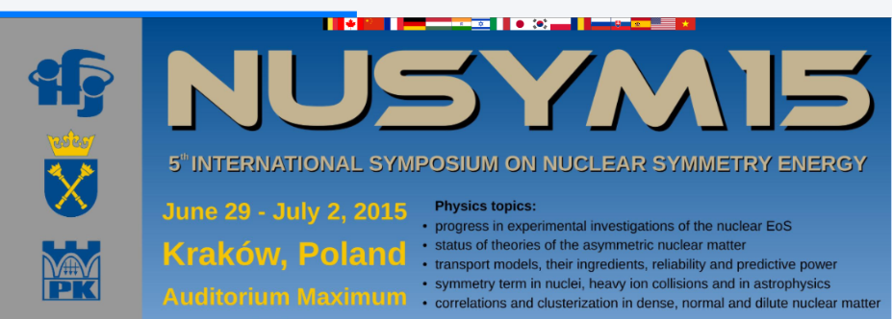
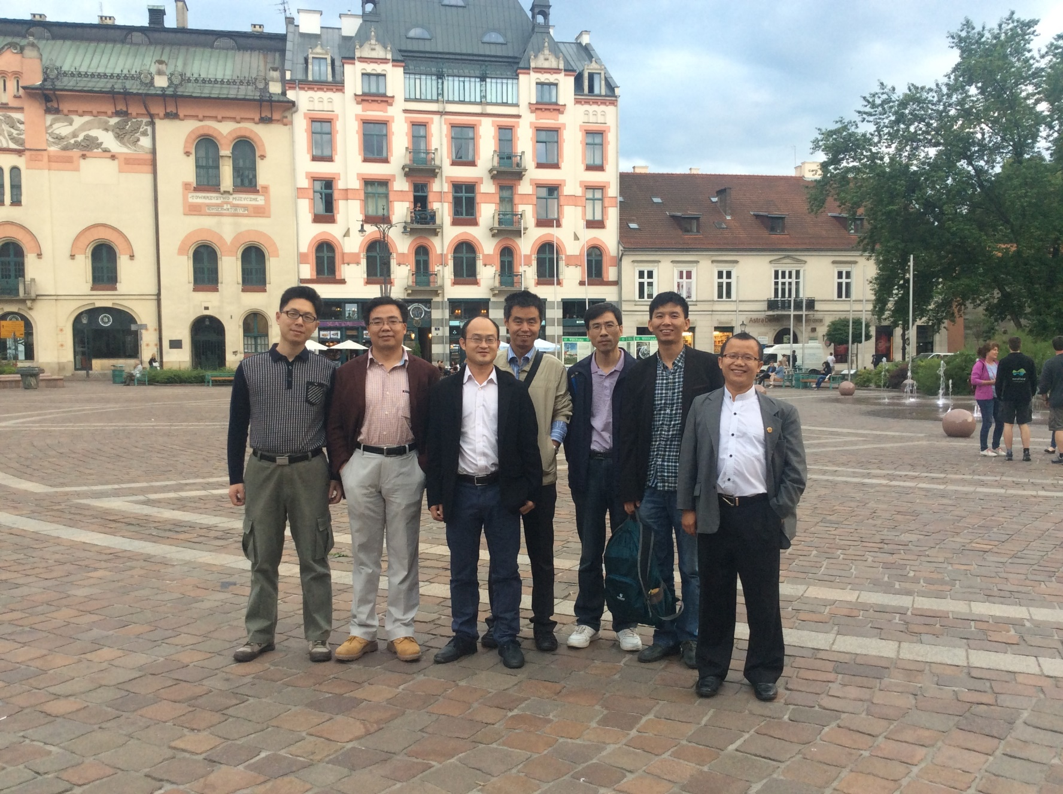
Chinese@NuSYM15 (Krakow, Poland)
p. 22

Slide 26

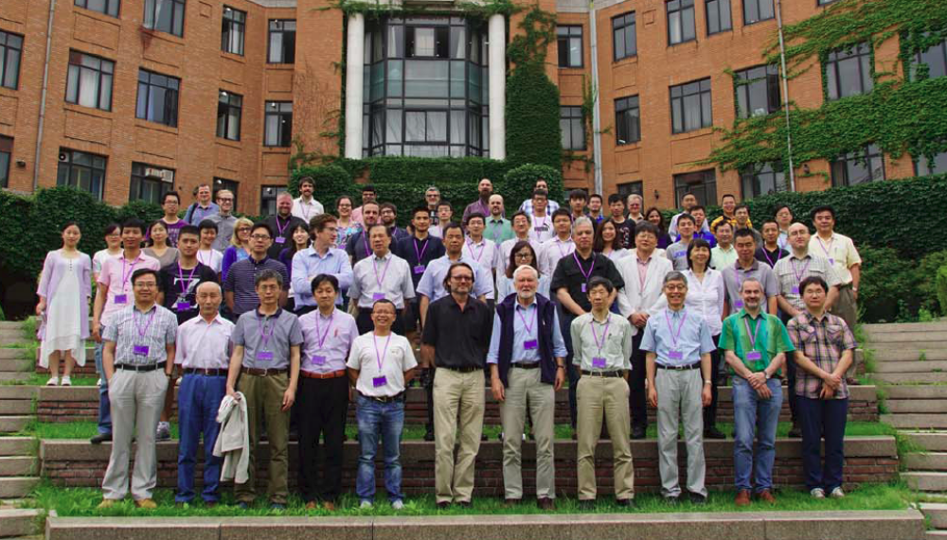

NuSYM16 (Tsinghua, Beijing,China)
p. 23

Slide 27
目录
对称能
对称能的确定
对称能与核素图上原子核的数目
对称能与暗物质
总结和展望

Slide 28
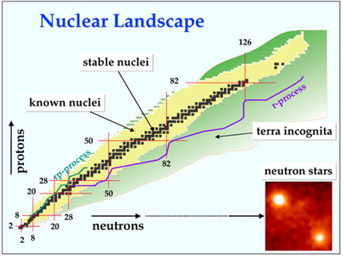
核素示意图
已知大约118种元素(包括近年来新发现的、还未命名的)
只有不到300个稳定核(对此我们有一定认识)
对大部份不稳定核有所知,但知之不多
对其余几千个远离稳定区的核则一无所知
这些核素为人们提供了丰富的重离子源
SHE
(~270)
(~3000)
(~4000)
核素图上原子核能有多少个？
丰中子核的边界在哪儿？
p. 24

Slide 29
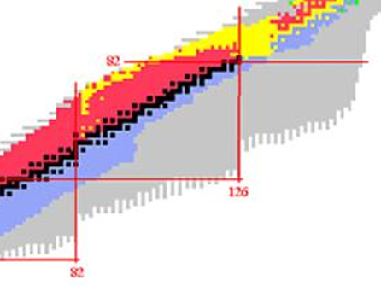
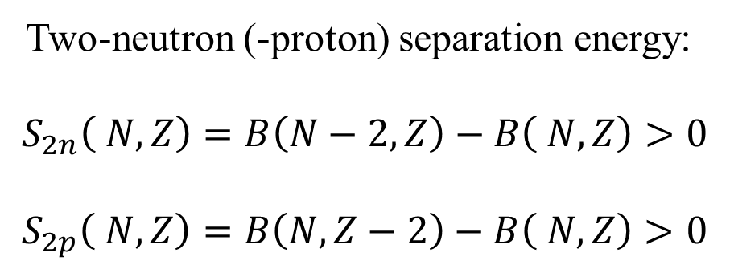
原子核的存在极限：滴线的位置
Dripline: Named by John Wheeler
Two-neutron (-proton) separation energy:
$$S_{2n}\left( N,Z\right)=B\left(N−2,Z\right)−B\left( N,Z\right)>0$$
$$S_{2p}\left( N,Z\right)=B\left(N,Z−2\right)−B\left( N,Z\right)>0$$
Same neutron number
The two-neutron (-proton) drip line nuclei is recognized as the last (or heaviest) even-even nuclei in an isotope (isotone) chain which satisfies the criteria given above.
Same proton number
p. 25

Slide 30
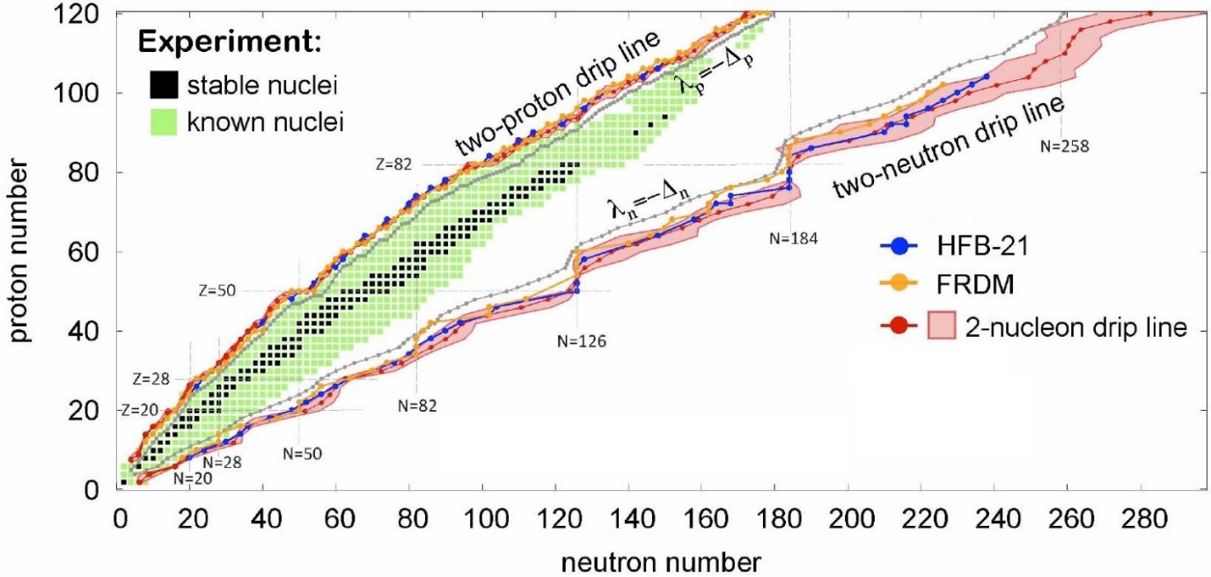
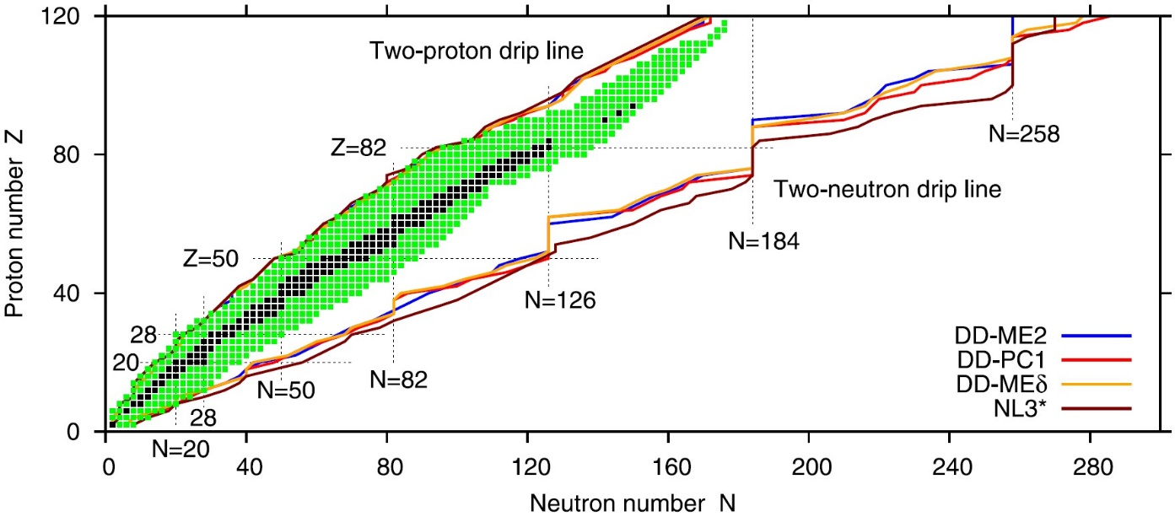
原子核的存在极限：滴线的位置
Obtained two-neutron (-proton) drip line in SHF approach and RMF theory
J. Erler et al., Nature 486, 509 (2012)
Theoretically, although various mean-field models predict similar proton drip line, the predicted neutron drip line exhibit significant variations.
Why？
A.V. Afanasjev et al., PLB726, 680 (2013)
p. 26

Slide 31
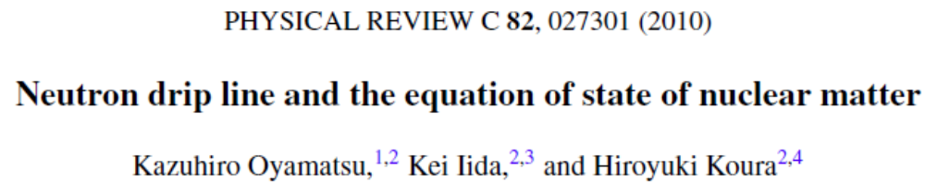
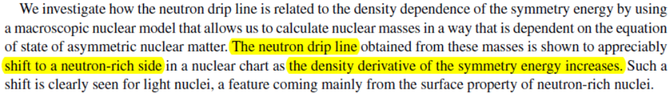



滴线与对称能
Neutron dripline is sensitive to L.
Calculations from microscopic
density functionals provide no
evidence for the strong correlation between neutron dripline and L.
p. 27

Slide 32


滴线与对称能-液滴模型估算
Semi-empirical mass formula can provide us a good preview of how the EoS affects the nuclear drip lines
$$B\left(N,Z\right)=a_{vol}A+a_{surf}A^{2/3}+a_{sym}\left(A\right)\frac{{\left(N−Z\right)}^{2}}{A}+a_{Coul}\frac{Z\left(Z+1\right)}{A^{1/3}}+E_{pair}$$
If we assume $a_{sym}\left(A\right)≈a_{sym}\left(A+2\right)$,
for a typical neutron drip line nuclei ${}_{68}^{222}{Er}$ (Z=68)
$$S_{2n}\left(N,Z\right)≈−2a_{vol}−0.22a_{surf}−1.24a_{sym}\left(A\right)+2.27a_{Coul}$$
for a typical proton drip line nuclei ${}_{96}^{222}{Cm}$ (Z=96)
$$S_{2p}\left(N,Z\right)≈−2a_{vol}−0.22a_{surf}+0.60a_{sym}\left(A\right)−58.07a_{Coul}$$
$$a_{vol} \sim −16 MeV$$
$$a_{surf} \sim 18 MeV$$
$$a_{Coul} \sim 0.7 MeV$$
P. Danielewicz, NPA 727, 233 (2003)
$a_{sym}\left(A\right)$ corresponds to $E_{sym}\left(ρ_{c}\right)$, where $ρ_{c}$~0.11 fm⁻³ for heavy nuclei
M. Centelles et al., PRL102, 122502 (2009); L.W. Chen, PRC83, 044308 (2011);
P. Danielewicz and J. Lee, NPA922, 1 (2014)
p. 28

Slide 33





滴线与对称能-平均场理论计算
Z. Zhang/LWC PLB726, 234 (2013)
$$E_{sym}\left(ρ_{sc}\right)=26.65±0.20 MeV$$
4 Skyrme interaction
MSL1 $E_{sym}\left(ρ_{c}\right)=26.67 MeV$
KDE $E_{sym}\left(ρ_{c}\right)=26.39 MeV$
SLy9 $E_{sym}\left(ρ_{c}\right)=26.72 MeV$
SLy4 $E_{sym}\left(ρ_{c}\right)=26.49 MeV$
1 relativistic mean field
DD-ME$δ$ $E_{sym}\left(ρ_{sc}\right)=26.86 MeV$
A strong correlation exists between the two-neutron drip line and $E_{sym}\left(ρ_{c}\right)$ !!!
p. 29

Slide 34

滴线与对称能-平均场理论计算
R. Wang and L.W. Chen, PRC92, 031303(R)(2015)
J. Erler et al., Nature 486, 509 (2012)
The candidate interactions with similar Esym(rho_c) predict similar neutron dripline
Next rare isotope (FRIB) facility can cover the dirpline up to Z=30 and around Z~40
Up to Z=120, the number of even-even nuclei is 1941+/-31 (only 800 have been discovered experimentally) and the total number of bound nuclei is 6866+/-166 (only 3191 have been discovered experiment ally) Exp:M. Thoennessen, Rep. Prog. Phys. 76, 056301(2013); Int. J. Mod. Phys. E 23, 1430002 (2014); arXiv:1501.06761.
p. 30

Slide 35
目录
对称能
对称能的确定
对称能与核素图上原子核的数目
对称能与暗物质
总结和展望

Slide 36





Planck (A&A571(2014) A16):
Baryon Matter: ~5%
Dark Matter: ~27%
Dark Energy: ~68%
Dark Matter Search
Candidates:
-WIMP
-Axion
-SuperWIMPs
-Sterile Neutrinos
-Gravitino
-……
Compact
Objects
Direct
Detection
f
f’
χ
χ’
Collider
AMS
XMM-Newton
p. 31

Slide 37



暗物质的直接探测
Nuclear Form Factor
DM
Nuclear
Recoil
$$v≈220 \text{km}\text{/}\text{s}$$
$$\left.\begin{aligned}E_{R}≈ \\ Ο(10 keV\end{aligned}\right)$$
They use the empirical form factors proposed by Helm as
And they usually set the isospin-violating parameter equal to 1
Detectable
Signal
R. H. Helm, Phys. Rev. (1956) 1466
Helm —— Charge distributions
—— Matter distributions
✔
?
Neutralino couples to proton
and neutron differently
J. Ellis et al., Eur. Phys. J. C 24 (2002) 311
R.C. Cotta et al., New J. Phys. 11 (2009) 105026
!
p. 32

Slide 38



同位旋破缺的暗物质
$g_{np}$ = 1.0
Is not consistent with each other
Consistent with each other
$g_{np}$ = -0.7
J. L. Feng et al. Phys. Lett. B , 124-127 (2011)
X.G. He, B. Ren, and J. Tandean, PRD85, 093019 (2012)
p. 33

Slide 39








原子核内中子和质子的分布
Zheng/Zhang/Chen, JCAP08(2014)011
We investigate how the Nuclear Symmetry Energy affects the matter distributions under the constraints of Neutron skin thickness of ${}_{}^{208}{Pb}$ given by PREX/JLab
${}_{}^{208}{Pb}$: fm
MeV
${}_{}^{132}{Xe}$: fm
Huge uncertainties of neutron distributions are given which are strongly related to symmetry energy!
p. 34

Slide 40




核的形状因子:对称能效应
Zheng/Zhang/Chen, JCAP08(2014)011
Little symmetry
energy effect
Significant
symmerty energy effect
p. 35

Slide 41


核的形状因子:对称能效应
Zheng/Zhang/Chen, JCAP08(2014)011
Sensitivities of LUX and XENON100 are sufficiently reduced to be consistent with CDMS
Little effect ($\sim$1%) compared with the empirical values
Significant improvement in the sensitivity of Xe-based detectors compared with the empirical values due to Nuclear Symmetry Energy effect
p. 36

Slide 42






中子星吸积暗物质
Traveling path (Geodesic equation)
$$r_{p}$$
Capture condition
Neutron
star
$r_{p}$: the perihelion radius
Total accretion rate
Ms: mass of neutron stars (per solar mass); Rs: radius of neutron stars (km)
p. 37

Slide 43

中子星吸积暗物质
Fraction of the capturable dark matter
Scattering inside neutron star matter
Baryon density:
Proton fraction:
Neutron star EOS
Pauli blocking factor:
Travelling path:
Isospin-violating factor:
Scattering cross-section in the free space:
What we are interested in
C. Kouvaris, Phys. Rev. D 77 (2008) 023006
p. 38

Slide 44


中子星吸积暗物质
Zheng/Sun/Chen, ApJ800, 141 (2015)
EOS of neutron star matters
TOV
Neutron stars consist of β-equilibrium
npeμ matter with charge neutrality
proton fraction
baryon density
Varying with Symmetry Energy !
p. 39

Slide 45

中子星吸积暗物质
Total mass
t: the living age of the neutron star
f: contains all the effects caused by different neutron star strutures
For old neutron stars around the earth:
So small !
or
p. 40

Slide 46


黑洞的形成
Black hole formation
Captured DM will go on scattering with
star matters and accumulate within a
small radius at the star core
When the mass of the DM exceed the
Chandrasekhar limit (for non-interacting ADM)
too large
Planck mass:
Black hole forms and it will eventually destroy the whole neutron star
So we require to ensure the existence of the old neutron stars
p. 41

Slide 47

中子星作为暗物质的探针
Zheng/Sun/Chen, ApJ800, 141 (2015)
Constraints from old neutron stars
Much more
sensitive than the
sensitivity of the
traditional detectors
(~10⁻⁴² cm²)
Isospin-violating
effects affect the
constraints
significantly
Isospin-violating
effects vary with
the nuclear inter
-action we used
p. 42

Slide 48

中子星作为暗物质的探针
Constraints from the realistic PSR B1257+12
Zheng/Sun/Chen, ApJ800, 141 (2015)
The pulsar PSR B1257+12 is a planetary system with one solitary neutron star being orbited by three planets located 0.6 kpc (kiloparsec千秒差距=3262 light year) away from the solar system. Its age is about 0.862 Gyr (Ts=10^5 K and M=1.4Msun)
For low mass DM (<20 GeV), the constraint from NS is much stronger than that from direct detection experiments !
p. 43

Slide 49
目录
对称能
对称能的确定
对称能与核素图上原子核的数目
对称能与暗物质
总结和展望

Slide 50
总结和展望
通过重离子碰撞，原子核结构性质(mass, neutron skin, GR/PG…),
以及核子光学势的研究，我们已经对亚饱和密度以及饱和密度附近
核物质对称能有了比较好的认识：
    亚饱和密度区的核物质对称能 – 比较精确
    饱和密度附近的核物质对称能:
E_{sym}(ρ₀) =32.5±2.5 MeV and L=55±25 MeV
更精确的约束需要更精确的实验数据和更可靠的理论方法!
决定核物质对称能的高密行为依然是一个巨大的挑战 (Many-body
forces, Short range tensor forces, Short range NN correlations, Model
cross check, more data,……).丰中子核引起的高能重离子碰撞的实验
数据将非常重要!
对称能的确定对于理解一些基本的科学问题(比如核素图上原子核的
数目和暗物质等)有重要意义
p. 44

Slide 51
Acknowledgements
Collaborators：
Peng-Cheng Chu (QTU, Qingdao)
Wei-Zhou Jiang (SEU. Nanjing)
Che Ming Ko, Zhen Zhang (TAMU. Texas)
Bao-An Li, Bao-Jun Cai (TAMU-Commerce, Texas)
Xiao-Hua Li (USC, Hengyang)
De-Hua Wen (SCUT, Guanzhou)
Zhi-Gang Xiao (Tsinghua, Beijing)
Chang Xu (NJU, Nanjing)
Jun Xu (SINAP, CAS, Shanghai)
Gao-Chan Yong (IMP, Lanzhou)
Xin Wang, Zhao-Wen Zhang, Kai-Jia Sun, Hao Zheng, Rui Wang, Ying Zhou, Jie Pu (SJTU, Shanghai)
Funding：
National Natural Science Foundation of China
Major State Basic Research Development Program (973 Program) in China
Shanghai Rising-Stars Program
Shanghai “Shu-Guang” Project
Shanghai “Eastern Scholar”
Science and Technology Commission of Shanghai Municipality

Slide 52
谢 谢！
Thanks!

