Slide 1
Hidden spin currents in doped Mott antiferromagnets
Zheng-Yu Weng
Institute for Advanced Study, Tsinghua University
Collaborators: Wayne Zheng (ED), Shuai Chen (VMC), Tsinghua University
Donna Sheng (DMRG), Cal. State Univ., Zheng Zhu (DMRG), MIT
中国科大 交叉学科理论研究中心（ICTS） Colloquium， Oct. 12, 2018
Notes:
Quantum Magnetism: Frustration, Low-Dimensionality, Toplogy Aug. 27- Sept. 14, 2018, KITS

Slide 2
Outline
Introduction:
Complex phase diagram of the high-Tc cuprates
Basic organizing principles of Mott physics
Sign structure, Mutual duality, and the ground state wave function
Single hole in 2D: hidden spin currents (ED/DMRG/VMC)
Two-hole ground state: non-BCS pairing (VMC/DMRG)
Discussion

Slide 3
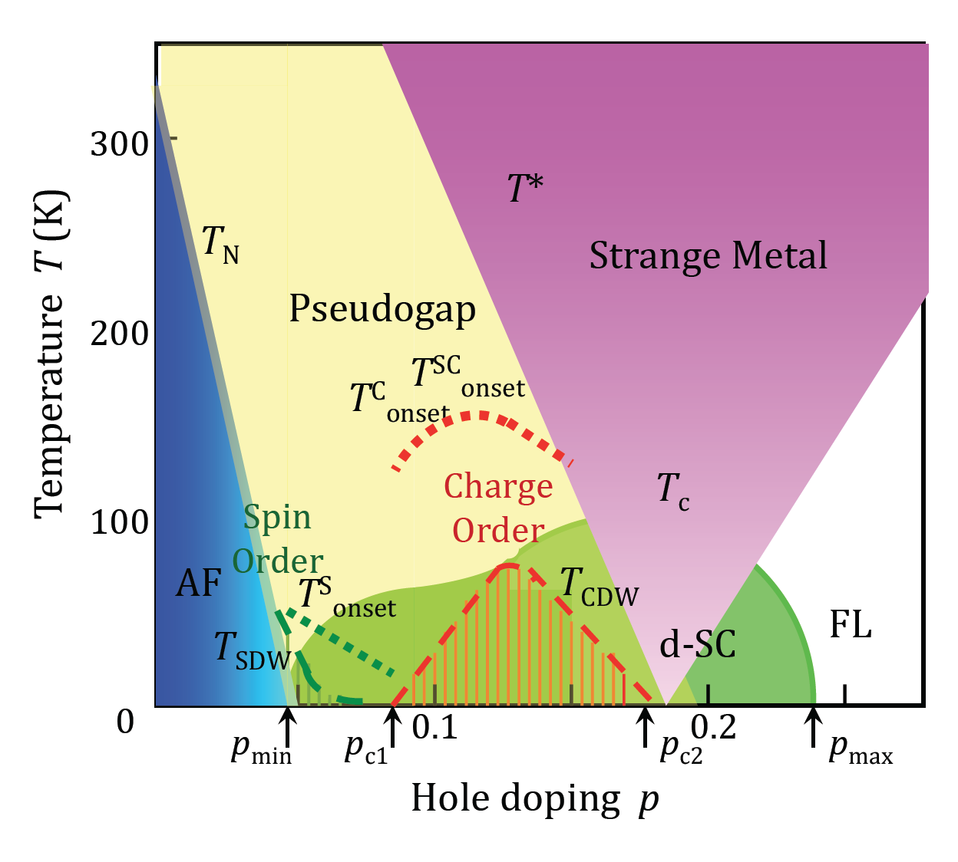
What is the most essential issue in the high-Tc cuprates?
(30 years later .....)
richness and complexity in the cuprate
intertwined orders, “democracy”
smoking gun?
single band electrons:
strongly correlated and self-organized
into exotic states as a function of doping?
Underlying organizing principle
of Mottness?
Keimer, Kivelson, Norman, Uchida, Zaanen, Nature (2015)
Notes:
A veritable zoo of new subatomic particles began to emerge in the 1930s, when physicists started to study cosmic rays. "Who ordered that?" asked the Nobel Prize-winning Columbia University physicist I.I. Rabi. the next particle to be discovered, the muon, really came out of left field.

Slide 4
Organizing principles in condensed matter physics
Spontaneous symmetry breaking
Adiabatic continuity
Sign structure （e.g. wave function symmetry)
Long-range entanglement (topological order... )
Berry phase; Many-body version; emergent gauge field

Slide 6
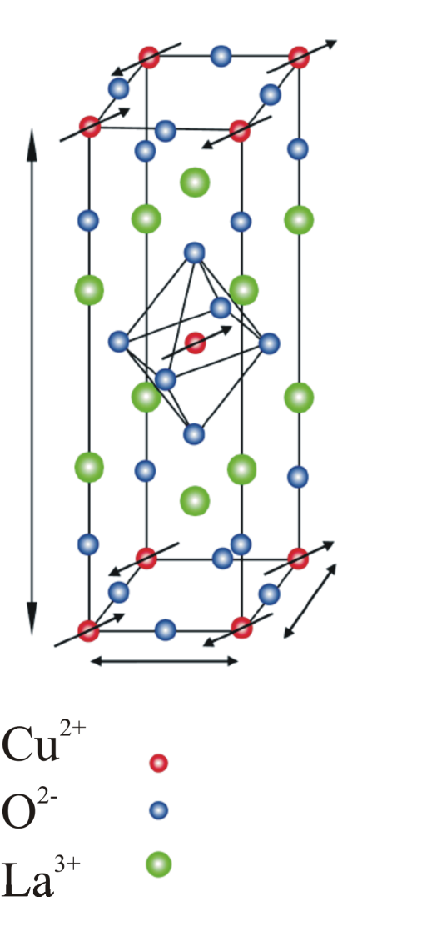
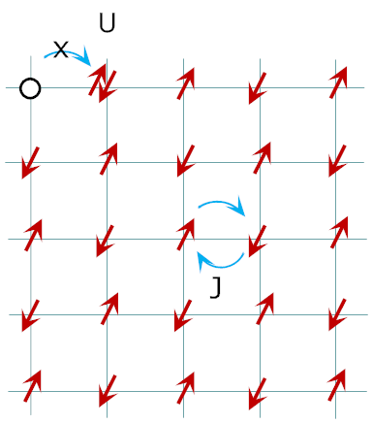
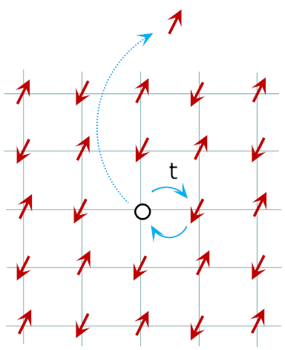
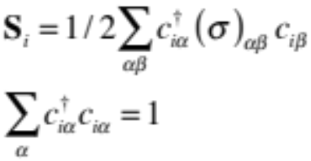
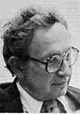
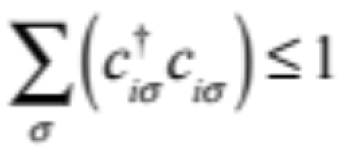
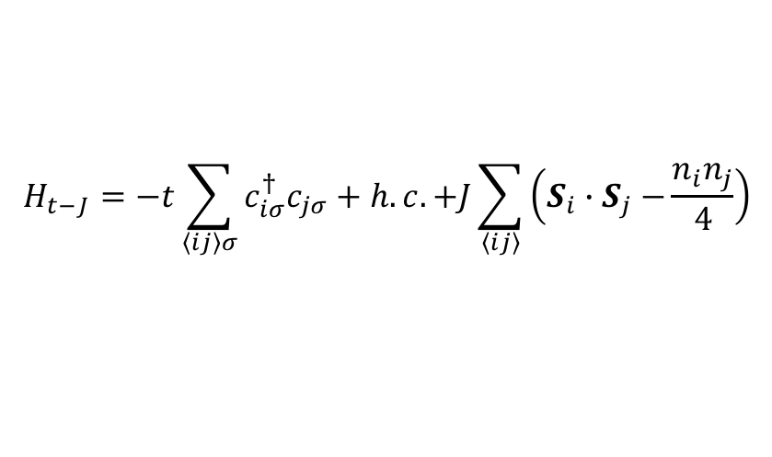
Mott insulator
Heisenberg model
local moment
doped Mott insulator
t-J model
Anderson:
Cuprate =
Doped Mott insulator
$$H_{t−J}=−t\sum_{\left\langle ij\right\rangle σ}{c_{iσ}^{†}c_{jσ}}+h.c.+J\sum_{\left\langle ij\right\rangle }{\left(S_{i}{∙S}_{j}−\frac{n_{i}n_{j}}{4}\right)}$$
No double occupancy constraint
Science, 235, 1196 (1987)

Slide 7
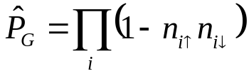
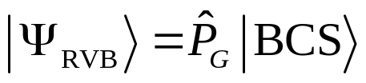



What are the essential characterizations of a (doped) Mott insulator?
“Plain vanilla” picture:
no-double-occupancy constraint
Gutzwiller projection
Anderson’s RVB state
Science, 235, 1196 (1987)
Mean-field ansatz of a local effective Hamiltonian
Emergent U(1) and SU(2) gauge theories
Lee, Nagaosa, Wen, RMP, 78, 17 (2006)
$$I_{h}=−I_{s}$$

Slide 8
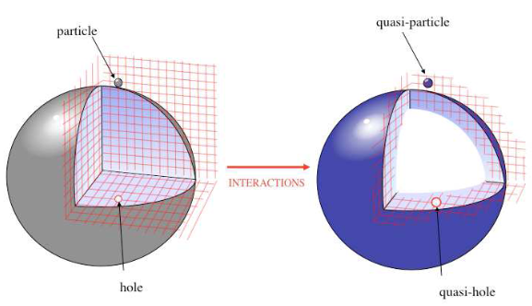
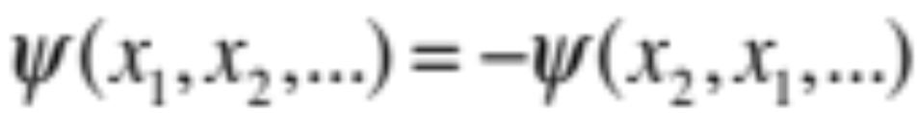
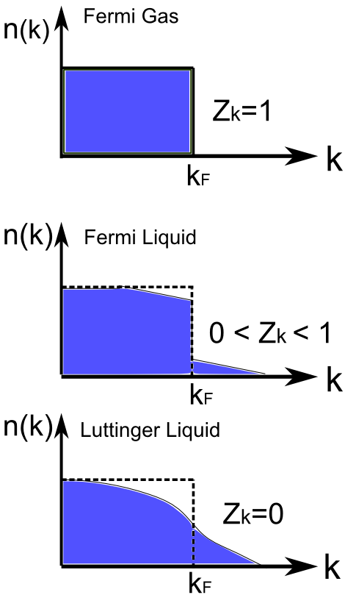
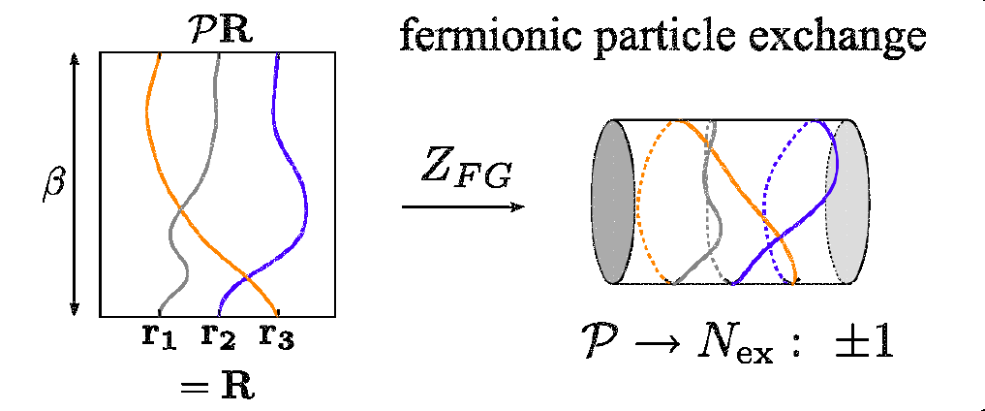
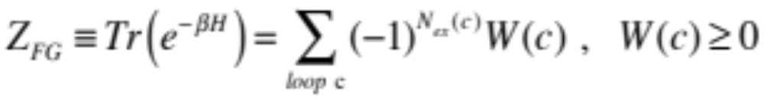
Statistical sign structure for Fermion systems
Fermion signs
Landau Fermi Liquid

Slide 9
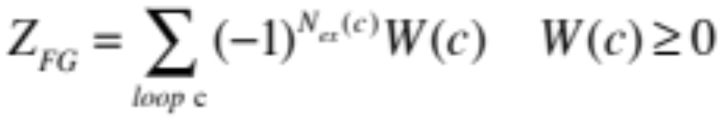
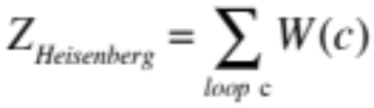
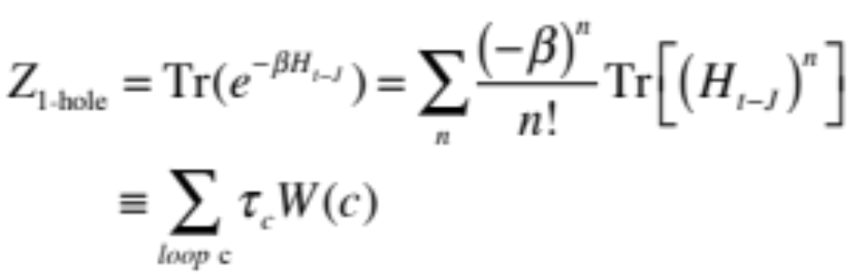
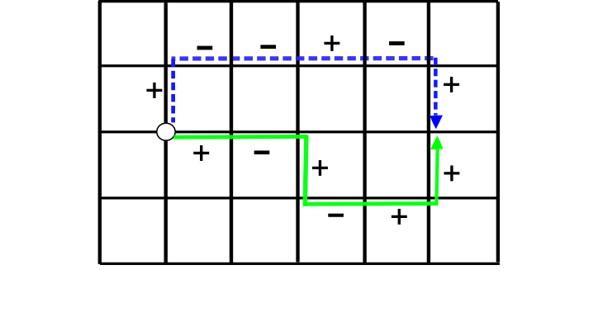

                Nontrivial sign structure of Mottness: Fermi signs are changed by the
                no-double-occupancy constraint
half-filling
(2) one-hole:
Phase string effect
＋
－
Sheng, Chen, ZYW, PRL (1996); Wu, ZYW, Zaanen, PRB (2008)

Slide 10
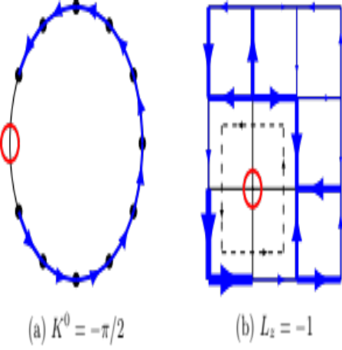
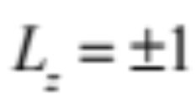


Emergent U(1) and SU(2) gauge theories
Lee, Nagaosa, Wen, RMP, 78, 17 (2006)
$$I_{h}=−I_{s}$$
＋
－
$I_{s} → J_{spin}^{z}$
backflow: neutral spin current
Spin current
2D example: (4X4) ED
1D example: ED
Zheng, Zhu, Sheng, ZYW, arXiv:1802.05977

Slide 11
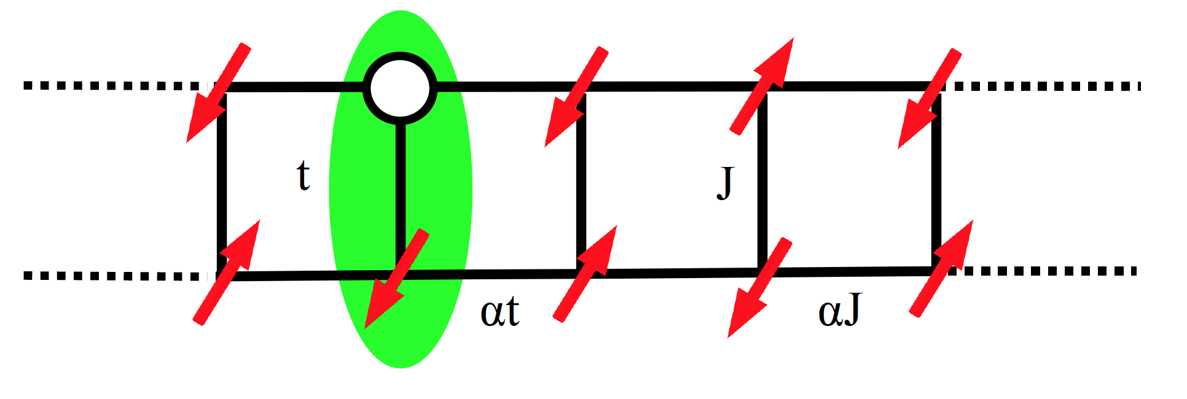
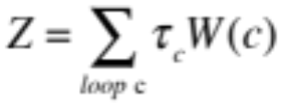
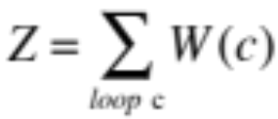
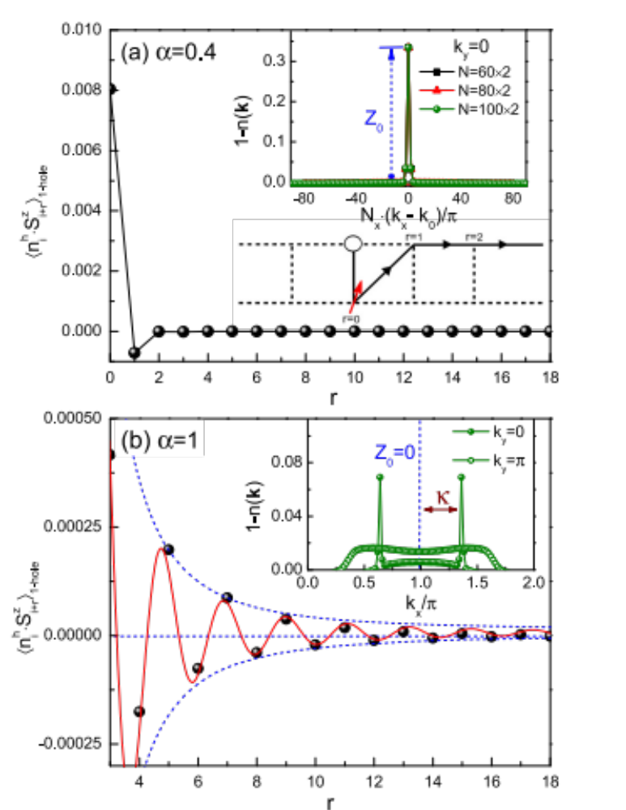

Example: 2-leg ladder
Zheng Zhu, ZYW, PRB (2016)
DMRG calculation
t-J model
$σ$t-J model
only differing by sign structure
Landau’s quasiparticle
S=1/2, k, m*, e
rigid spin cloud

Slide 12
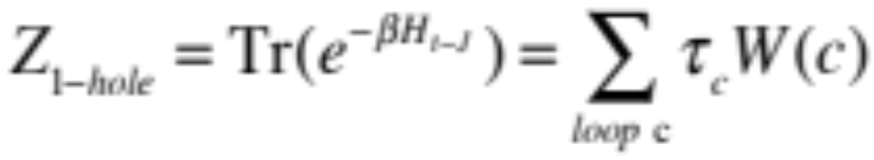
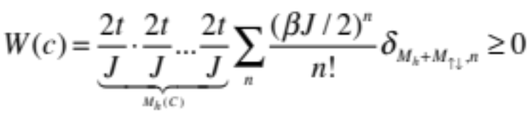
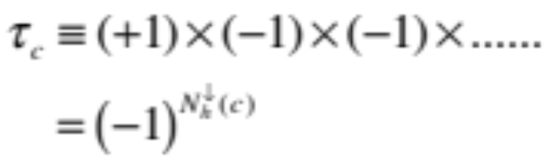


t-J model: a ‘standard’ model for high-Tc cuprates
＋
－
Non-trivial Berry phase:
Phase string effect
Finite doping:
$τ_{c}→$ $τ_{c}×{(−1)}^{N_{ex}^{h}(c)}$
$$N_{ex}^{h}\left(c\right):$$
exchange number between holes
Kai Wu, ZYW, Jan. Zaanen, PRB (2008）

Slide 13
Basic organizing principles for doped Mott insulators
1) no double occupancy constraint
2) (statistic) sign free at half-filling; antiferromagnetic long-range order
3) emergent phase string sign structure upon doping
mutual long-range entanglement between
charge and spin degrees of freedom;
Quantum memory protected by the Mott gap (Hubbard model)!
Long Zhang, ZYW, PRB (2014)

Slide 14


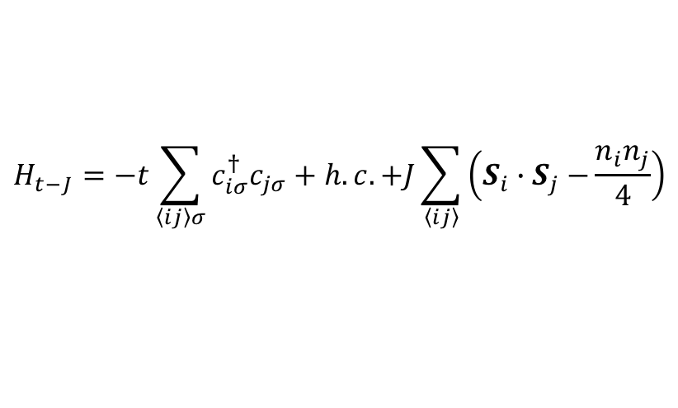

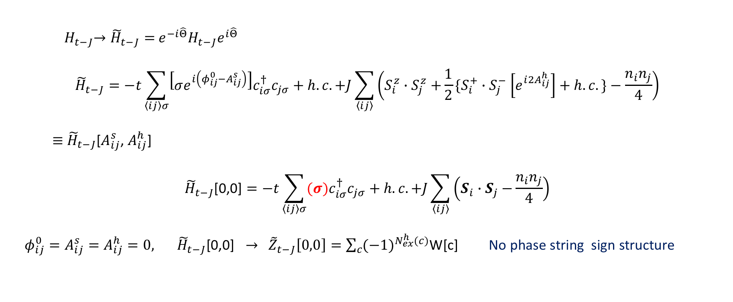

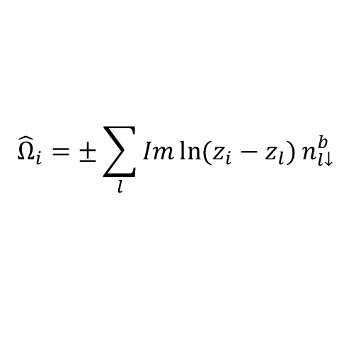
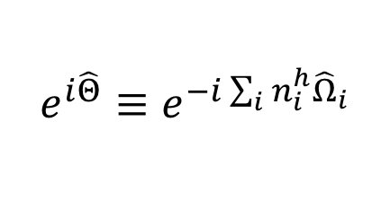
General structure of the wave function with phase string sign structure
$$H_{t−J}=−t\sum_{\left\langle ij\right\rangle σ}{c_{iσ}^{†}c_{jσ}}+h.c.+J\sum_{\left\langle ij\right\rangle }{\left(S_{i}{∙S}_{j}−\frac{n_{i}n_{j}}{4}\right)}$$
Mutual duality transformation
$$e^{i\hat{Θ}}≡e^{−i\sum_{i}{n_{i}^{h}}{\hat{Ω}}_{i}}$$
$${\hat{Ω}}_{i}=±\sum_{l}{Im\ln{(z_{i}−z_{l})}n_{l↓}^{b}}$$
${ H}_{t−J}→{\tilde{H}}_{t−J}=$ $e^{−i\hat{Θ}}H_{t−J}e^{i\hat{Θ}}$
$${\tilde{H}}_{t−J}=−t\sum_{\left\langle ij\right\rangle σ}{{\left[σe^{i\left(φ_{ij}^{0}−A_{ij}^{s}\right)}\right]c}_{iσ}^{†}c_{jσ}}+h.c.+J\sum_{\left\langle ij\right\rangle }{\left(S_{i}^{z}{∙S}_{j}^{z}{+\frac{1}{2}\{S}_{i}^{+}{∙S}_{j}^{−}\left[e^{i{2A}_{ij}^{h}}\right]+h.c.\}−\frac{n_{i}n_{j}}{4}\right)}$$
$≡$ ${\tilde{H}}_{t−J}$[$A_{ij}^{s}$, $A_{ij}^{h}$]
$${\tilde{H}}_{t−J}\text{[0,0]}=−t\sum_{\left\langle ij\right\rangle σ}{(σ)c_{iσ}^{†}c_{jσ}}+h.c.+J\sum_{\left\langle ij\right\rangle }{\left(S_{i}{∙S}_{j}−\frac{n_{i}n_{j}}{4}\right)}$$
$φ_{ij}^{0}=A_{ij}^{s}=A_{ij}^{h}=0, { \tilde{H}}_{t−J}\text{[}\text{0}\text{,}\text{0}\text{]} →$ ${ \tilde{Z}}_{t−J}\left[0,0\right]=\sum_{c}{{(−1)}^{N_{ex}^{h}(c)}\text{W}\text{[}\text{c}\text{]}}$ No phase string sign structure
$∴{ A}_{ij}^{s}{, A}_{ij}^{h}$, $φ_{ij}^{0}$
$$τ_{c}$$
$σ$t-J model

Slide 15
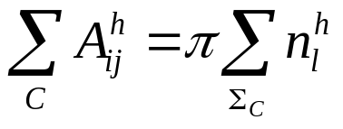
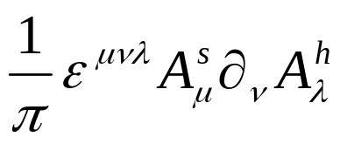
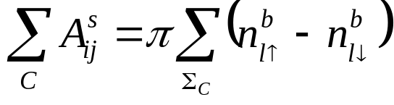

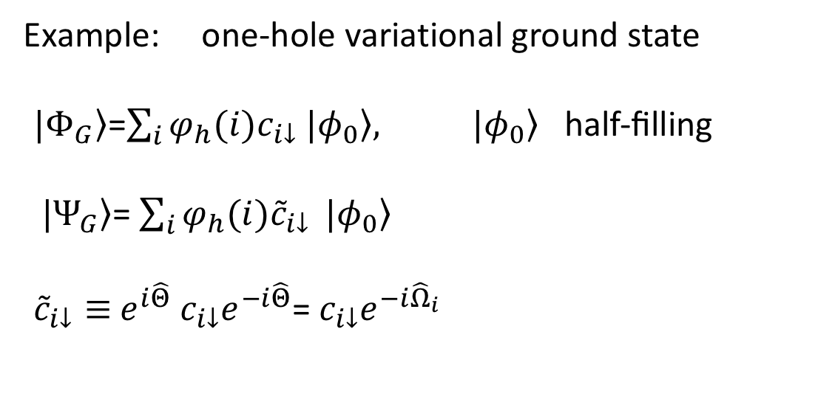
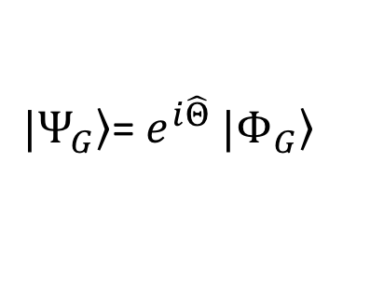

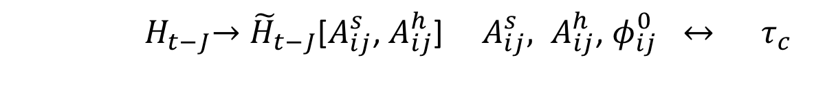

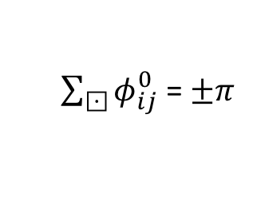
Emergent gauge structure
due to the phase string sign structure
Z.Y. Weng, et al. (1997);
S.P. Kou, X.L. Qi, ZYW
PRB (2005)
${ H}_{t−J}→{\tilde{H}}_{t−J}\text{[}A_{ij}^{s}\text{, }A_{ij}^{h}\text{]}$ ${ A}_{ij}^{s}{, A}_{ij}^{h}$, $φ_{ij}^{0} ↔ τ_{c}$
P. Ye, C.S. Tian, X.L. Qi, ZYW,
PRL. (2011); NPB (2012)
mutual duality/mutual Chern-Simons gauge structure
$|\left.Ψ_{G}\right\rangle$= $e^{i\hat{Θ}} |\left.Φ_{G}\right\rangle$
Z.Y. Weng, (2011)
$\sum_{⊡}{φ_{ij}^{0}}$ =$±π$
Mutual semions!
Example: one-hole variational ground state
$|\left.Φ_{G}\right\rangle$=$\sum_{i}{φ_{h}(i)c_{i↓}}$ $|\left.φ_{0}\right\rangle , |\left.φ_{0}\right\rangle \text{half}\text{−}\text{filling}$
$|\left.Ψ_{G}\right\rangle$= $\sum_{i}{φ_{h}(i){\tilde{c}}_{i↓}} |\left.φ_{0}\right\rangle$
${\tilde{c}}_{i↓}≡$ $e^{i\hat{Θ}}$ $c_{i↓}e^{−i\hat{Θ}}$= $c_{i↓}e^{−i{\hat{Ω}}_{i}}$
$$A_{ij}^{h}$$
$$A_{ij}^{s}$$

Slide 16

One-hole ground state of the t-J model in 2D
Landau’s quasiparticle
One-hole in an AF background
S=1/2, k, m*, e
($\frac{π}{2},$ $\frac{π}{2}$)
rigid cloud
Exact diagonalization
Self-consistent Born approx. (Kane, Lee, Read (1989),…)
ARPES (ZX Shen’s group, 1998)
….
Finite-doping: emergent Fermi arc

Slide 17
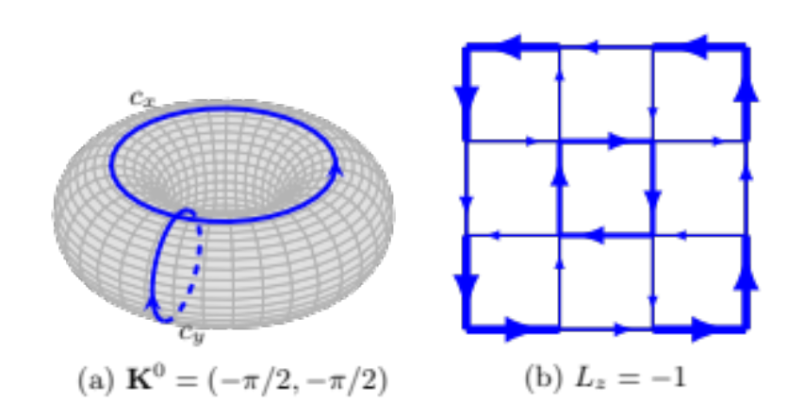
Exact diagonalization, 4 by 4, one hole, S=S^{z}=1/2
periodic boundary condition
spin currents in the ground states!
W. Zheng, Z. Zhu, D. N. Sheng, ZYW, arXiv:1802.05977

Slide 18
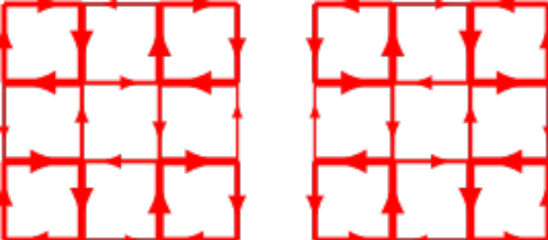
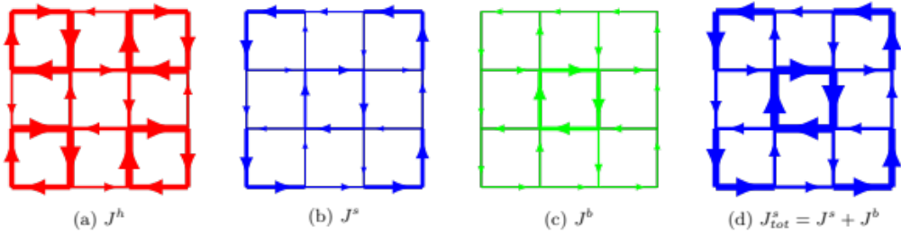
Open boundary with C4 symmetry: Exact two-fold degeneracy
Total angular momentum
Spin currents
charge currents
Exact diagonalization
Total currents at L_{z}=-1: Conservation of charge and spin currents

Slide 19
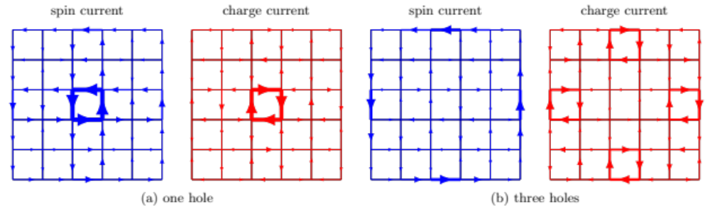
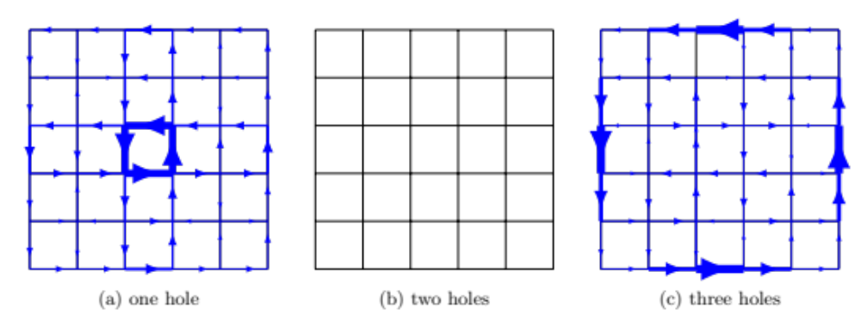
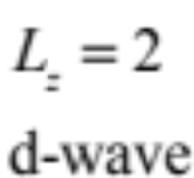
4 x 4
e
6 x 6
8 x 8

Slide 20
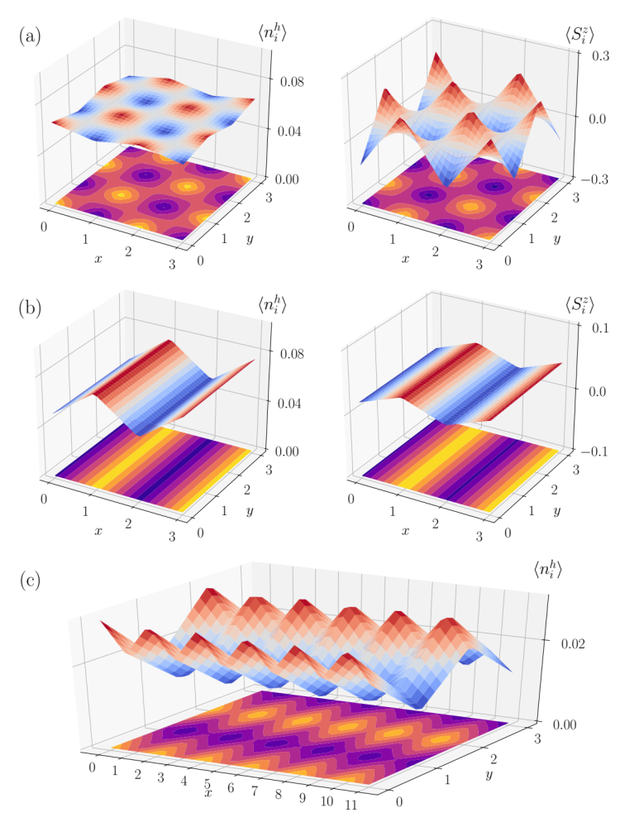
Degenerate ground states
with zero spin current states:
charge/spin modulations
stripe/nematicity
Incepient “intertwined orders”!
Spin/charge currents are dual to charge/spin modulations

Slide 21
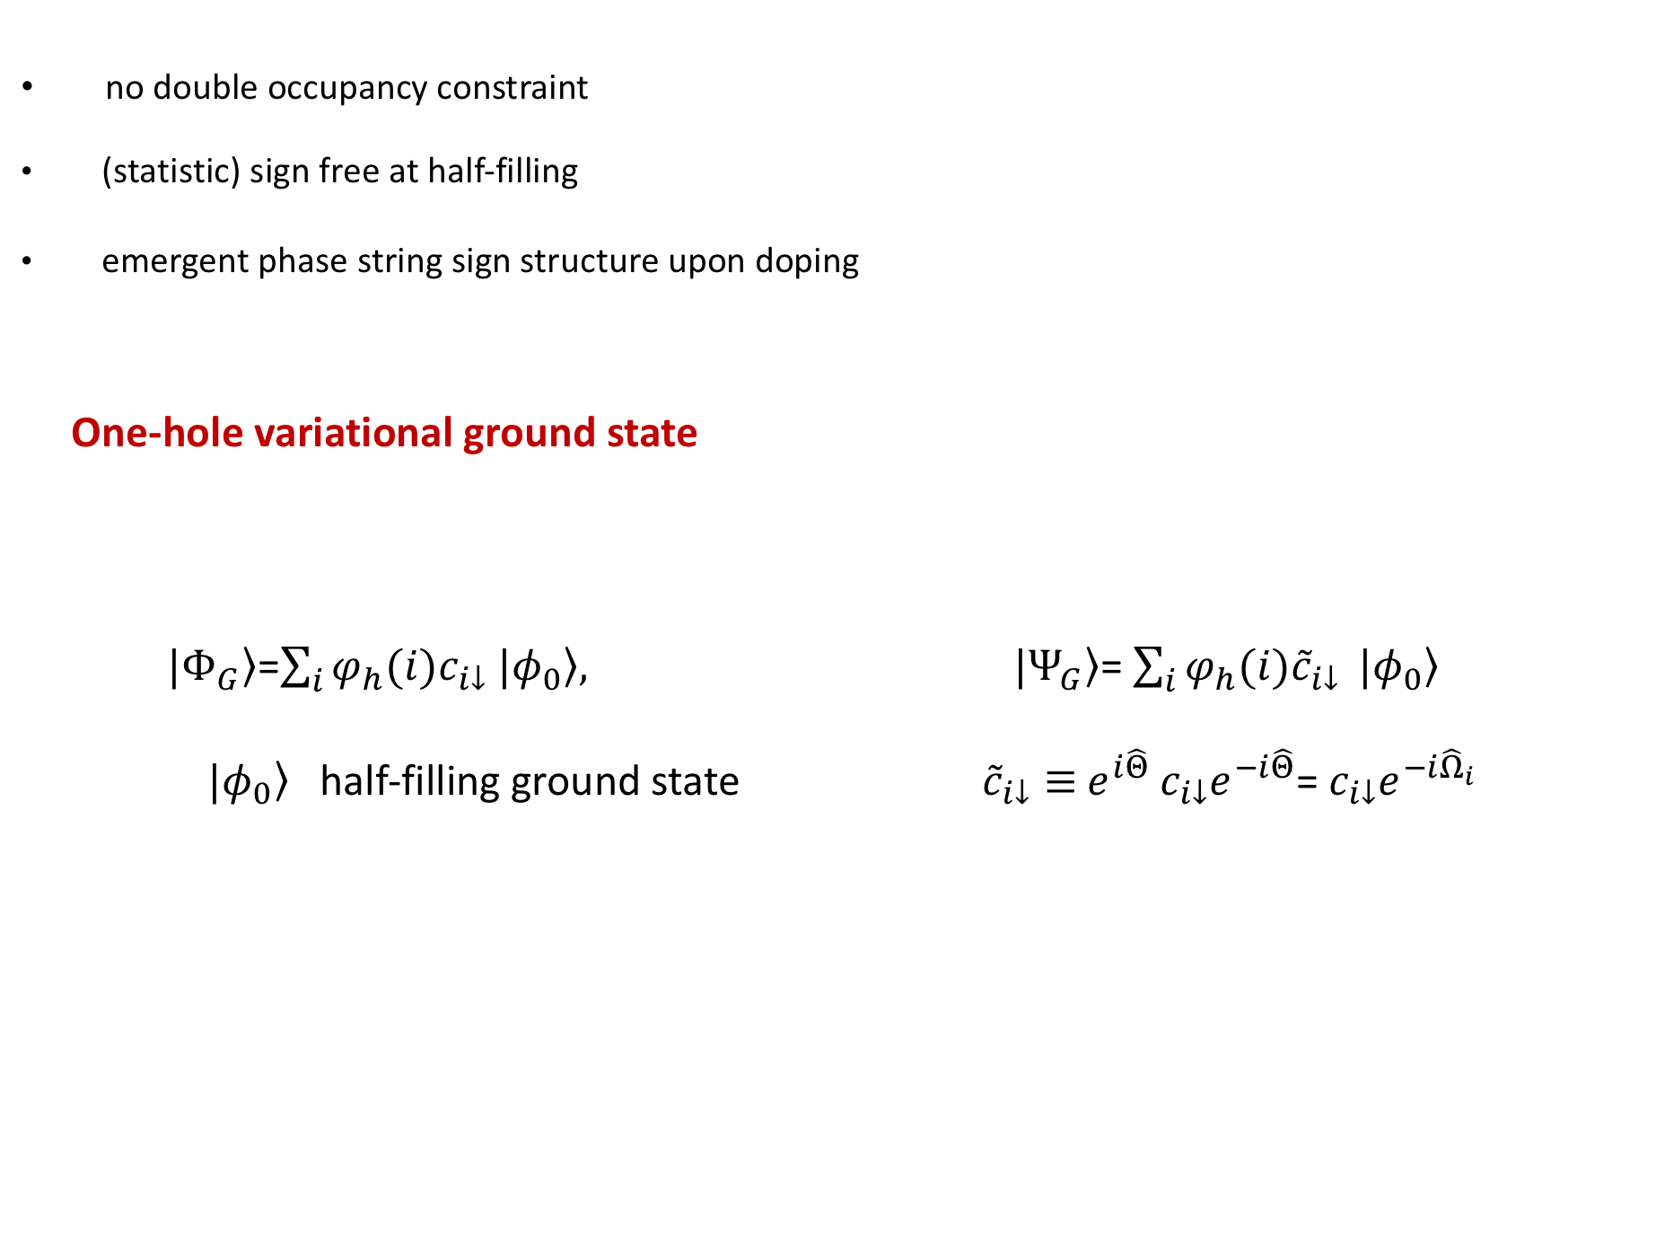
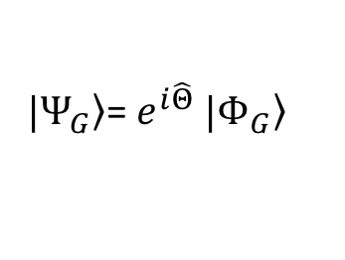
no double occupancy constraint
(statistic) sign free at half-filling
emergent phase string sign structure upon doping
One-hole variational ground state
$|\left.Φ_{G}\right\rangle$=$\sum_{i}{φ_{h}(i)c_{i↓}}$ $|\left.φ_{0}\right\rangle , |\left.Ψ_{G}\right\rangle$= $\sum_{i}{φ_{h}(i){\tilde{c}}_{i↓}} |\left.φ_{0}\right\rangle$
$|\left.φ_{0}\right\rangle$ half-filling ground state ${\tilde{c}}_{i↓}≡$ $e^{i\hat{Θ}}$ $c_{i↓}e^{−i\hat{Θ}}$= $c_{i↓}e^{−i{\hat{Ω}}_{i}}$
$|\left.Ψ_{G}\right\rangle$= $e^{i\hat{Θ}} |\left.Φ_{G}\right\rangle$

Slide 22
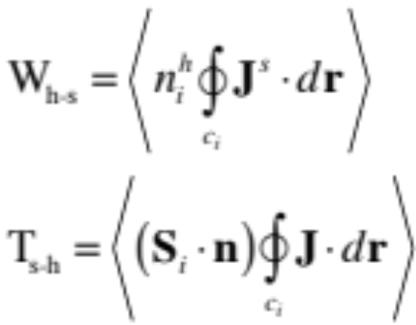



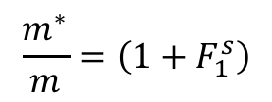

Bloch state (quasiparticle)
New hole state (t-J model)
Shuai Chen, Qingrui Wang, Donna Sheng, ZYW (2018)
$${\hat{Ω}}_{i}=±\sum_{l}{Im\ln{(z_{i}−z_{l})}n_{l↓}^{b}}$$
Landau’s Fermi liquid theory
Variational
Monte Carlo
calculation
rigid cloud
quasiparticle:
+e, s=1/2, k, m*
$$=±C$$
charge current
$$J=\frac{m}{m^{∗}}\left(1+F_{1}^{s}\right)J^{0}$$
Galilean invariance
$$\frac{m^{∗}}{m}=\left(1+F_{1}^{s}\right)$$
$$J=J^{0}$$

Slide 23
New quasiparticle
VMC vs. DMRG
Shuai Chen, et al (2018)

Slide 24
4 x 4
6 x 6
8 x 8

Slide 25

no double occupancy constraint
(statistic) sign free at half-filling
emergent phase string sign structure upon doping
1) one-hole variational ground state
$|\left.Φ_{G}\right\rangle$=$\sum_{i}{φ_{h}(i)c_{i↓}}$ $|\left.φ_{0}\right\rangle , |\left.Ψ_{G}\right\rangle$= $\sum_{i}{φ_{h}(i){\tilde{c}}_{i↓}} |\left.φ_{0}\right\rangle$
$|\left.φ_{0}\right\rangle$ half-filling ground state ${\tilde{c}}_{i↓}≡$ $e^{i\hat{Θ}}$ $c_{i↓}e^{−i\hat{Θ}}$= $c_{i↓}e^{−i{\hat{Ω}}_{i}}$
2) two-hole variational ground state
$|\left.Ψ_{G}\right\rangle$= $\left(\sum_{ij}{g_{ij}{\tilde{c}}_{i↑}{\tilde{c}}_{j↓}}\right) |\left.φ_{0}\right\rangle$， $|\left.Φ_{G}\right\rangle$=$\left(\sum_{ij}{g_{ij}c_{i↑}c_{j↓}}\right)|\left.φ_{0}\right\rangle$
$|\left.Ψ_{G}\right\rangle$= $e^{i\hat{Θ}} |\left.Φ_{G}\right\rangle$

Slide 26




Two-hole ground state of the t-J model
RVB-like variational wave function
The present two-hole state with sign structure
$$|\left.φ_{0}\right\rangle$$
${c_{iσ}→\tilde{c}}_{iσ}=c_{iσ}$ $e^{−i{\hat{Ω}}_{i}}$
$t_{⊥}$=0
$${\hat{Ω}}_{i}=±\sum_{l>i}{πn_{l↓}^{b}}$$
DMRG: Zheng Zhu, Donna Sheng, ZYW, PRB (2018)
VMC: Shuai Chen, Zheng Zhu ,ZYW (2018)

Slide 27
Variational Monte Carlo vs. DMRG
Shuai Chen, Zheng Zhu ,ZYW (2018)
Absence of pairing
in the RVB wavefunction
RVB
RVB
RVB
RVB
Kinetic energy driven
DMRG: Zheng Zhu, Donna Sheng, ZYW, PRB (2018)

Slide 28




${c_{iσ}→\tilde{c}}_{iσ}=c_{iσ}$ $e^{−i{\hat{Ω}}_{i}}$
$$A_{ij}^{h}$$
$A_{ij}^{s}$=0
$σ$t-J model
Linear pairing potential
new pairing force:
string-like
Non-BCS type
Amperean pairing: P. A. Lee (2014)

Slide 29
Summary
Complex phase diagram in the cuprates may indicate an emergent phenomenon of strongly correlated electrons
Underlying organizing principle: Sign structure of Mottness
Odd number of holes: ED/DMRG vs. VMC，composite structure in the ground states, spin currents, novel degeneracy
Spin/charge currents and charge/spin modulations: dual to each other！
Even number of holes: Cooper pairs are formed，with d-wave symmetry，and spin currents disappear！
Variational wavefunction reproduces the DMRG result very well
- one hole case： New quasiparticle
- two hole pairing ground state

Slide 30


Basic organizing principle of Mott physics:
phase string sign structure
Intrinsic translational symmetry breaking for
doped charge!
＋
－
＋
－
D. N. Sheng, Y-C. Chen, ZYW, PRL (1996)
Kai Wu, ZYW, Zaanen, PRB (2008)
Long Zhang, ZYW, PRB (2014)
Notes:
Summation over all possible hole-spin loops

Slide 31

Third organizational principle of Mott physics
partition function (single-hole-doped t-J model )
＋
－
Novel quantum memory effect: phase string
Notes:
Summation over all possible hole-spin loops

Slide 32











General sign structure at arbitrary doping, dimensions, temperature for the t-J model/Hubbard model
fermion signs
= total steps of hole hoppings
= total number of spin exchange processes
= total number of opposite spin encounters
Sheng, Chen, Weng, PRL (1996); Wu, Weng, Zaanen, PRB (2008)

Slide 33



Exact sign structure for the Hubbard model
Hilbert space:
spinons holon (h) doublon (d)
-
+
-
+
+
+
+
+
+
-
-
Long Zhang & ZYW, PRB（2014）

Slide 34



long-range/nonlocal charge-spin entanglement (ED)
$$=±C$$
nontrivial ground state degeneracy
concomitant with spin currents

Slide 35



Breakdown of Landau’s one-to-one correspondence principle:
neutral spin currents carry away
partial momentum!

