Slide 1
Entanglement Entropy in
Holographic Superconductor Phase Transitions
Rong-Gen Cai
Institute of Theoretical Physics
Chinese Academy of Sciences
(April 17, 2013)
JHEP 1207 (2012) 088 ; JHEP 1207 (2012) 027
JHEP 1210 (2012) 107 ; arXiv: 1303.4828

Slide 2
Contents:
Introduction
Holographic superconductors
(metal/sc, insulator/sc)
3. Holographic Entanglement Entropy
(p-wave metal/sc, s/p-wave insulator/sc)
4. Conclusions

Slide 3
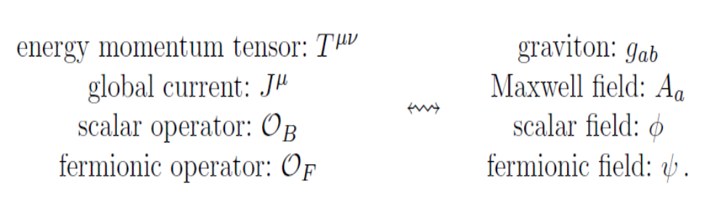
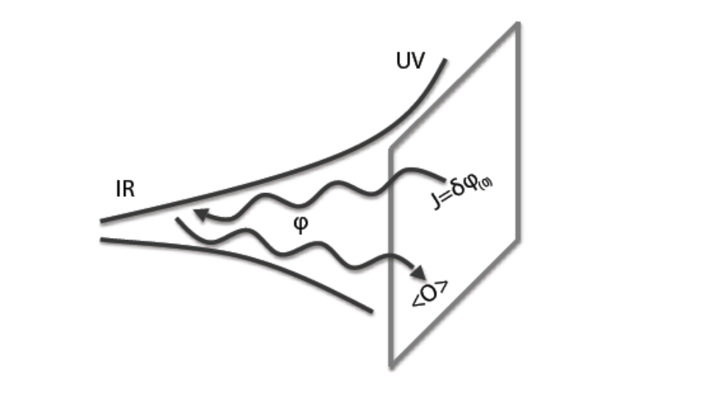
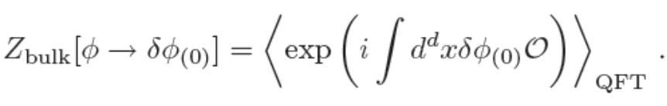
1. Introduction: AdS/CFT Correspondence
quantum field theory
d-spacetime dimensions
operator Ο
(quantum field theory)
quantum gravitational theory
(d+1)-spacetime dimenions
dynamical field φ
(bulk)

Slide 4
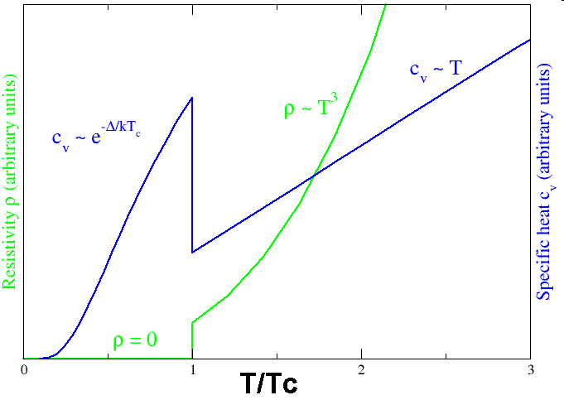
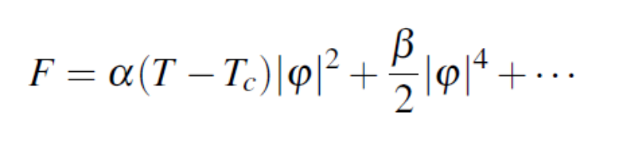
AdS/CMT:
Superconductor：
Vanishing resistivity (H. Onnes, 1911)
Meissner effect (1933)
1950, Landau-Ginzburg theory
1957, BCS theory: interactions with phonons
1980’s: cuprate superconductor
2000’s: Fe-based superconductor

Slide 5
How to build a holographic superconductor model？
CFT AdS/CFT Gravity
global symmetry abelian gauge field
scalar operator scalar field
temperature black hole
phase transition high T/no hair；
low T/ hairy BH

Slide 6
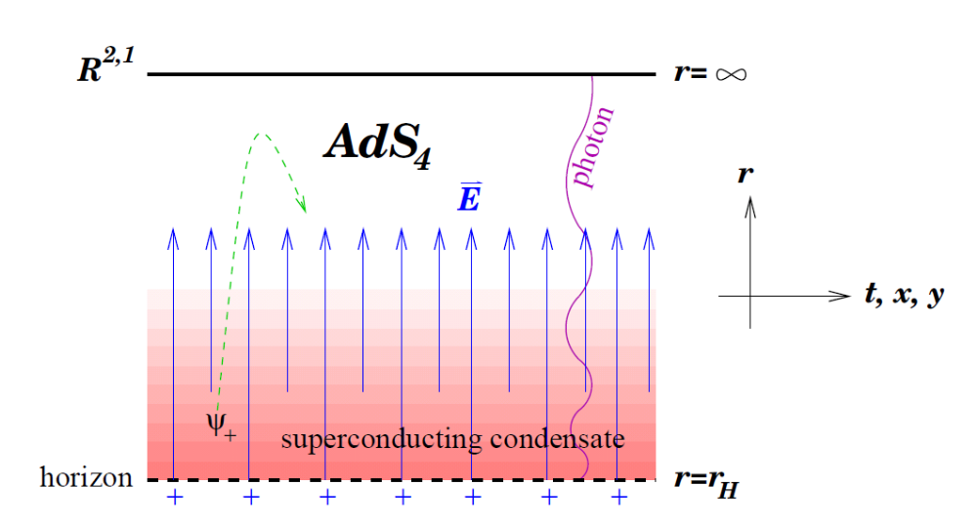
No-hair theorem?
S. Gubser, 0801.2977

Slide 7
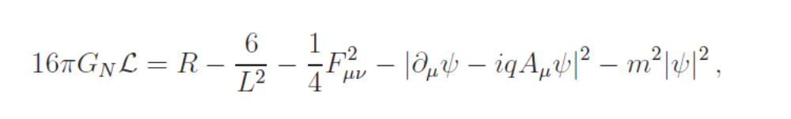
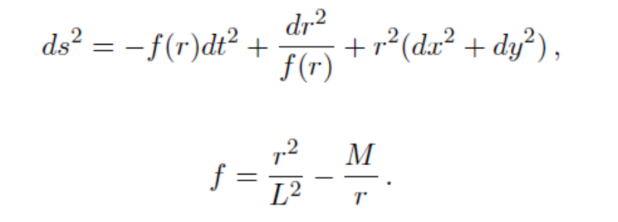
2. Holographic superconductors
Building a holographic superconductor
S. Hartnoll, C.P. Herzog and G. Horowitz, arXiv: 0803.3295
PRL 101, 031601 (2008)
High Temperature (black hole without hair):

Slide 8
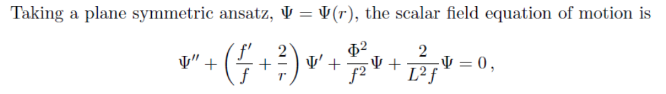
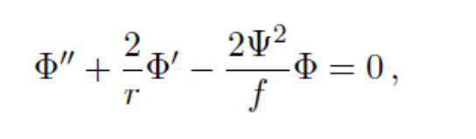
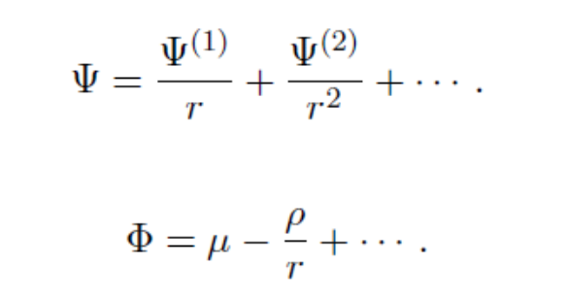
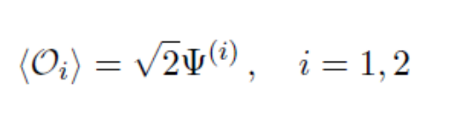
Consider the case of m^2L^2=-2，like a conformal scalar field.
In the probe limit and A_t= Phi
At the large r boundary:
Scalar operator condensate
O_i:

Slide 9
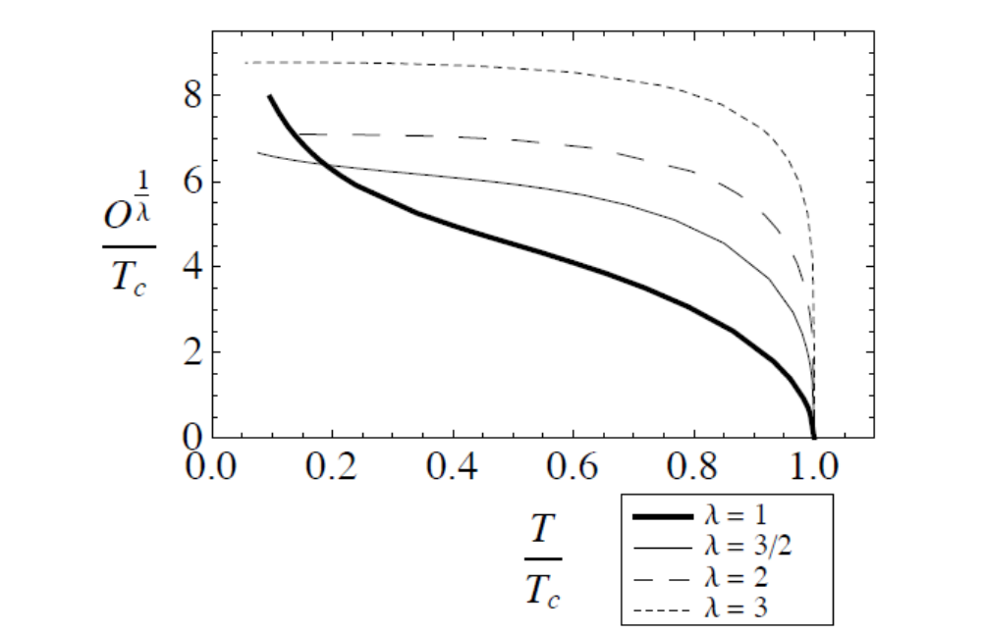
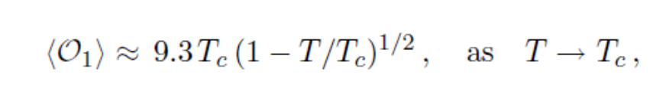
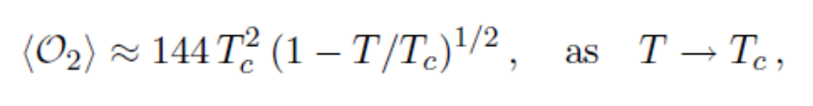

Slide 10
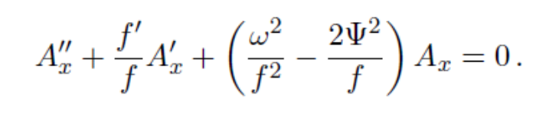


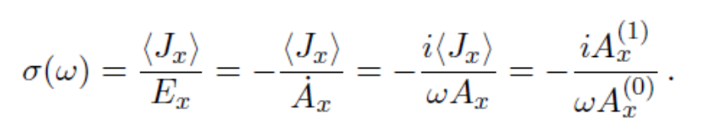
Conductivity
Maxwell equation with zero momentum :
Boundary conduction:
at the horizon: ingoing mode
at the infinity:
AdS/CFT
source:
current
Conductivity:

Slide 11
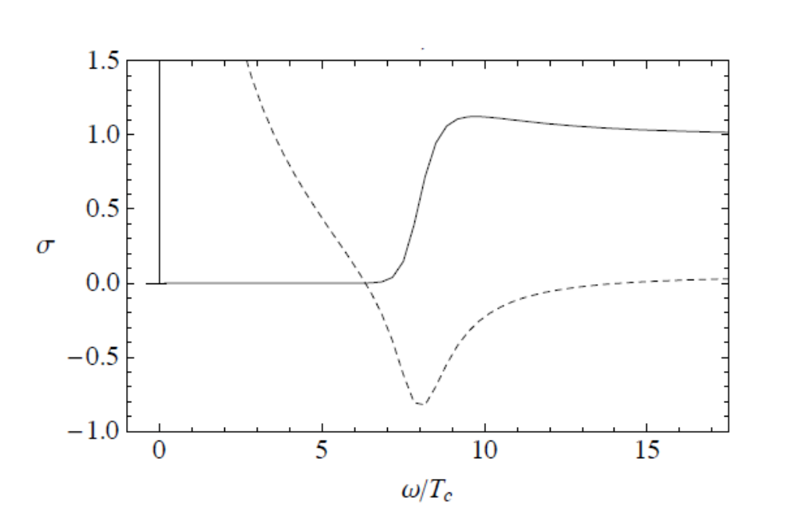


A universal energy gap: ~ 10%
BCS theory: 3.5
K. Gomes et al, Nature 447, 569 (2007)

Slide 12
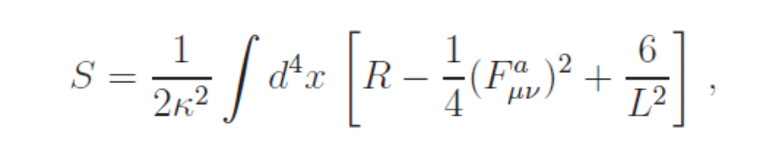
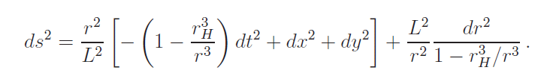
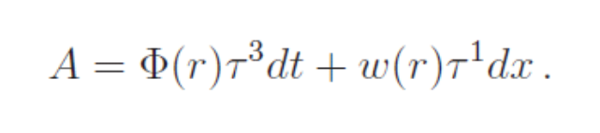

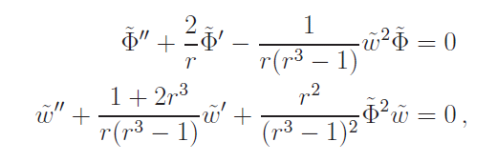
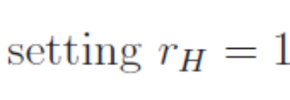
P-wave superconductors
S. Gubser and S. Pufu, arXiv: 0805.2960
M. Ammon, et al., arXiv: 0912.3515
The order parameter is a vector! The model is

Slide 13
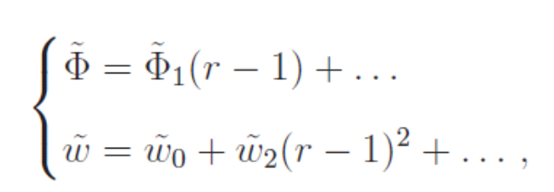
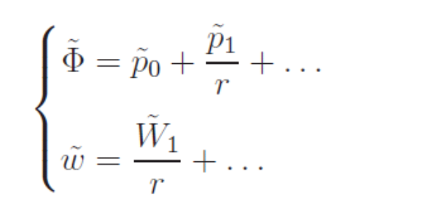
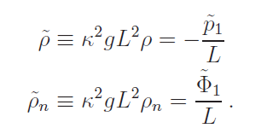

Near horizon:
Far field:
The total and normal component charge density:
Defining superconducting charge density:

Slide 14
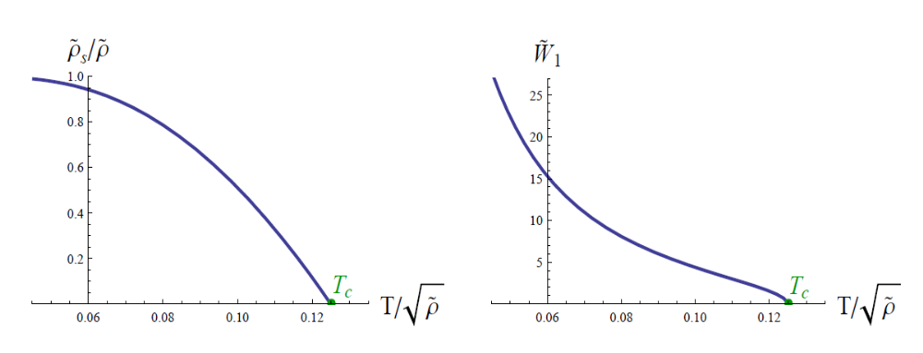

Vector operator
condensate
The ratio of the superconducting
charge density to the total charge density.

Slide 15
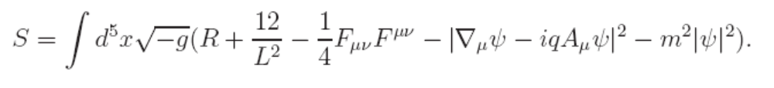
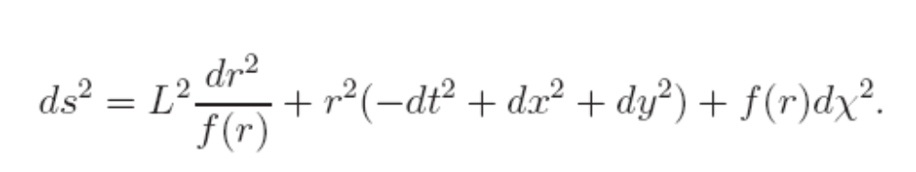
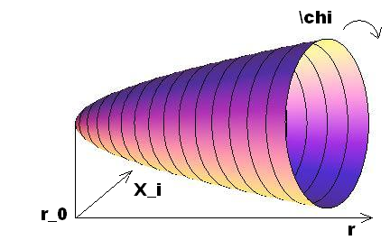
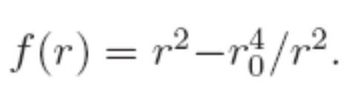

Holographic insulator/superconductor transition
The model:
T. Nishioka et al, JHEP 1003,131 (2010)
The AdS soliton solution

Slide 16

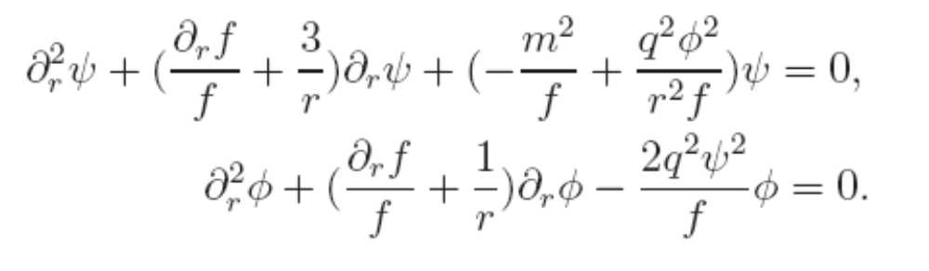
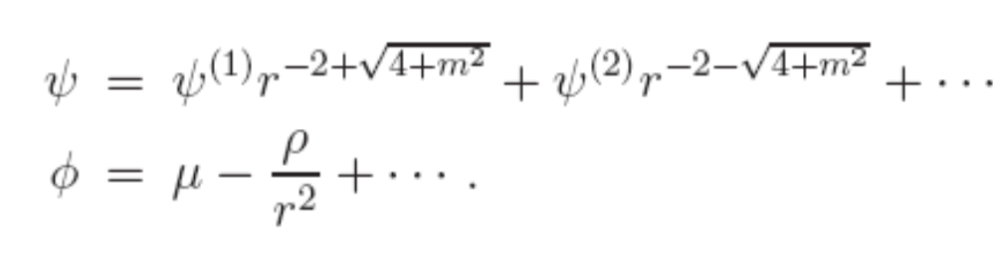
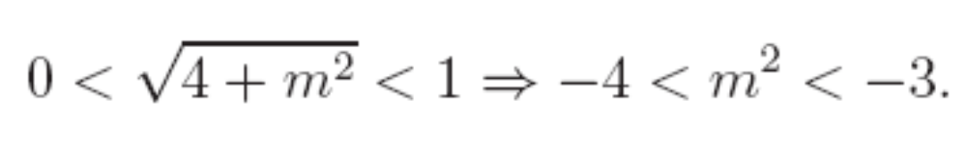
The ansatz:
The equations of motion:
The boundary:
both operators
normalizable if

Slide 17
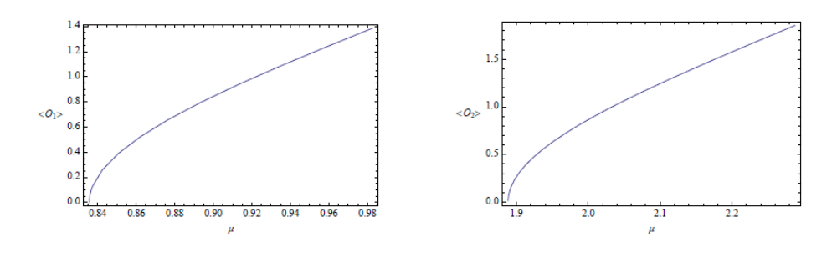
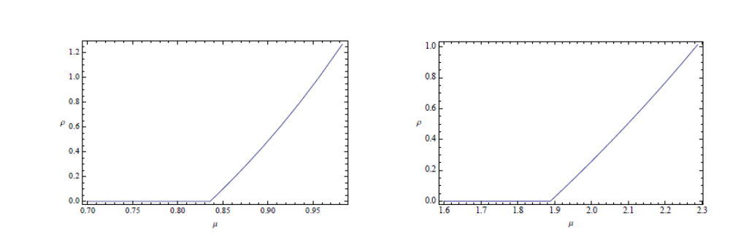
soliton superconductor

Slide 18
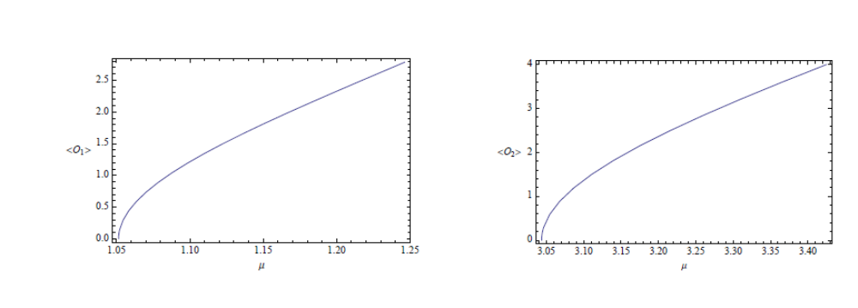
black hole superconductor

Slide 19
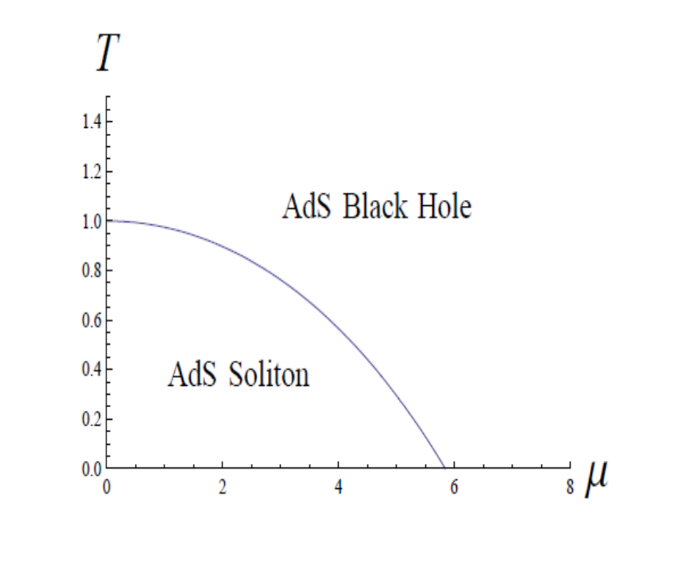
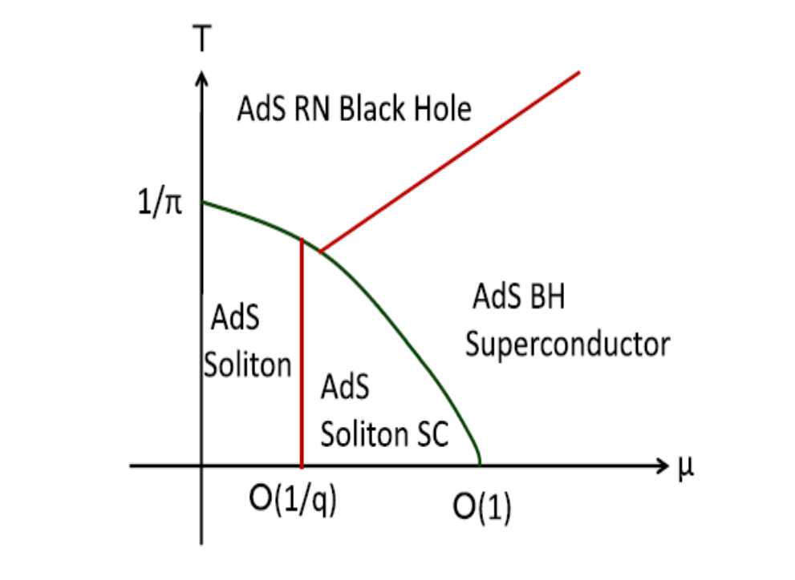
phase diagram
without scalar hair
with scalar hair

Slide 20
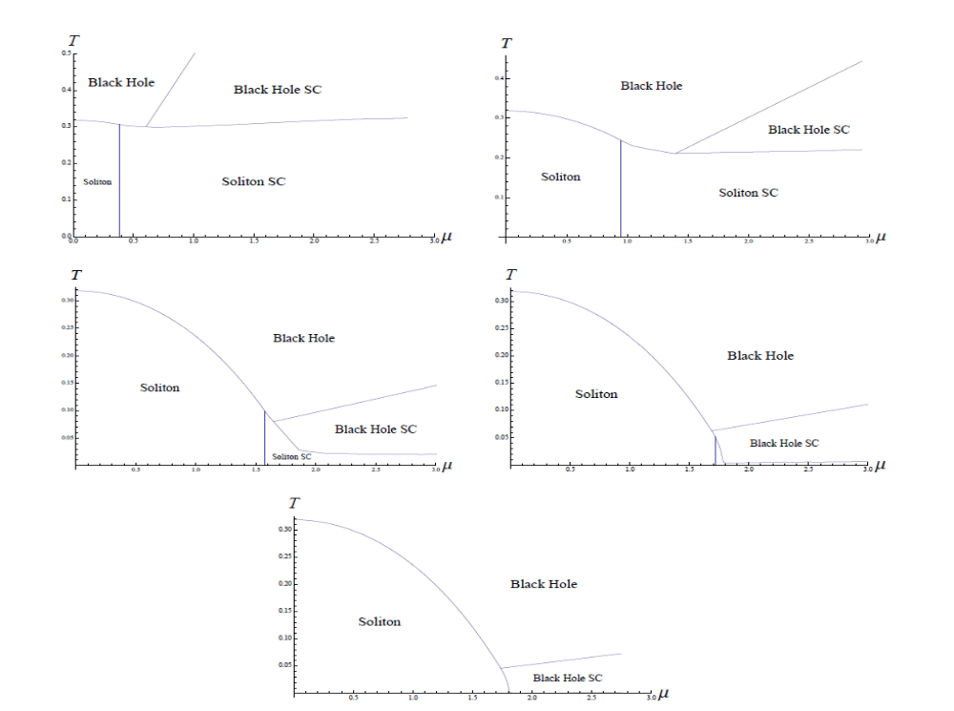
Complete phase diagram (arXiv:1007.3714)
q=5
q=2
q=1.2
q=1.1
q=1

Slide 21
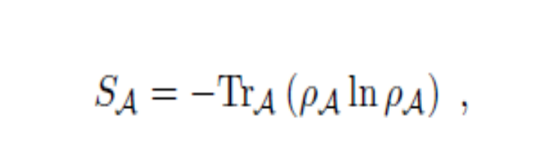



3. Holohraphic entanglement entropy
Given a quantum system, the
entanglement entropy of a
subsystem A and its complement B
is defined as follows
A
B
where is the reduced density matrix of A given by tracing
over the degree of freedom of B,
where is the density matrix of the system.

Slide 22
The entanglement entropy of the subsystem measures how
the subsystem and its complement are correlated each other.
The entanglement entropy is directly related to the degrees
of freedom of the system.
In quantum many-body physics, the entanglement entropy
is a good quantity to characterize different phases and phase
transitions.
However, the calculation is quite difficult except for the case
in 1+1 dimensions.

Slide 23
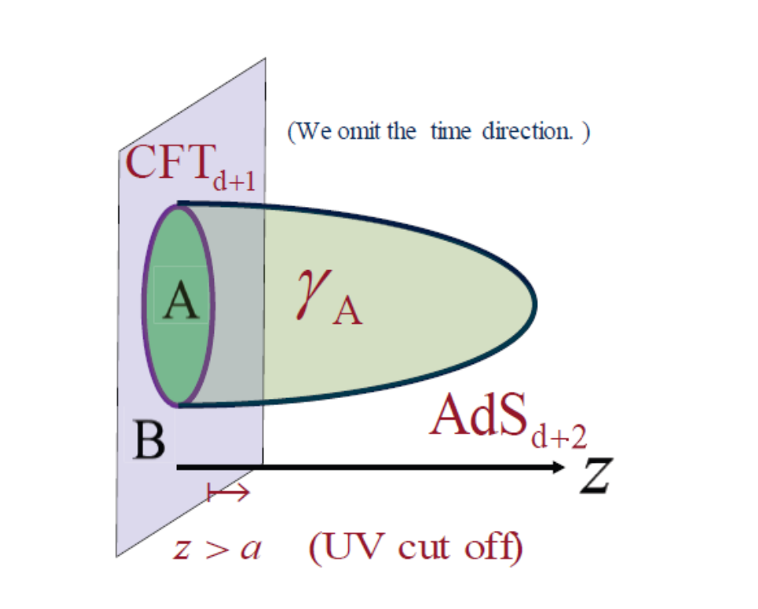
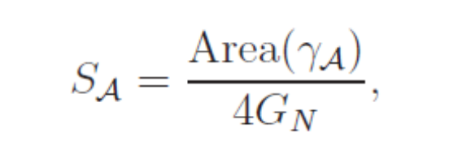


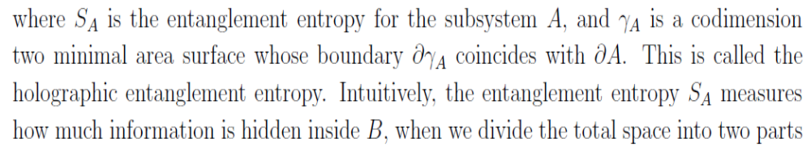
A holohraphic proposal (S. Rye and T. Takayanagi, hep-th/0603001)
Search for the minimal area surface
in the bulk with the same
boundary of a region A.

Slide 24
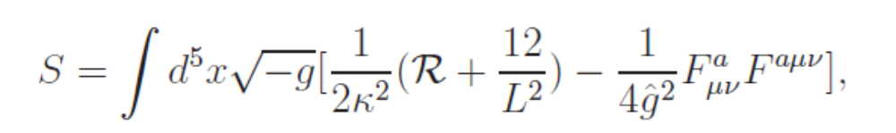
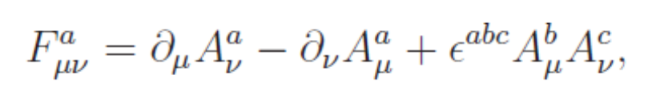
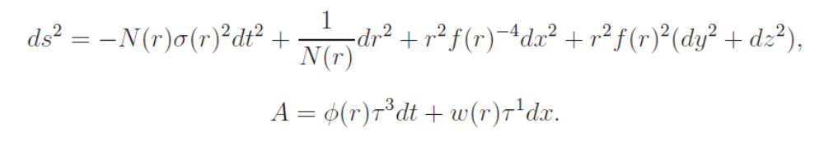
EE in holographic p-wave superconductor
(R. G. Cai et al, arXiv:1204.5962)
Consider the model:
The ansatz:

Slide 25
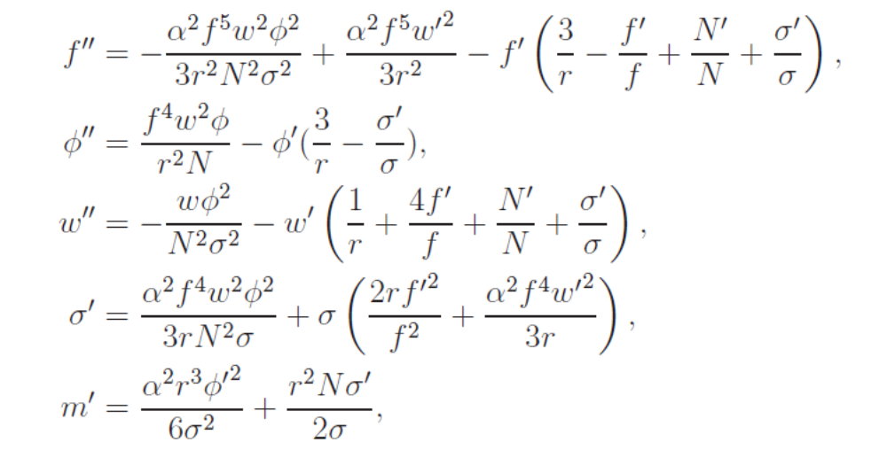

Equations of motion:

Slide 26
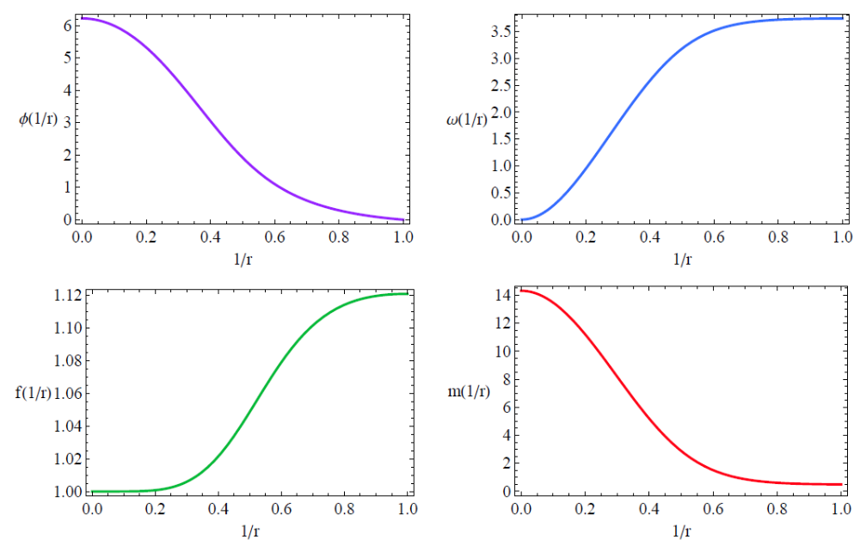


Slide 27
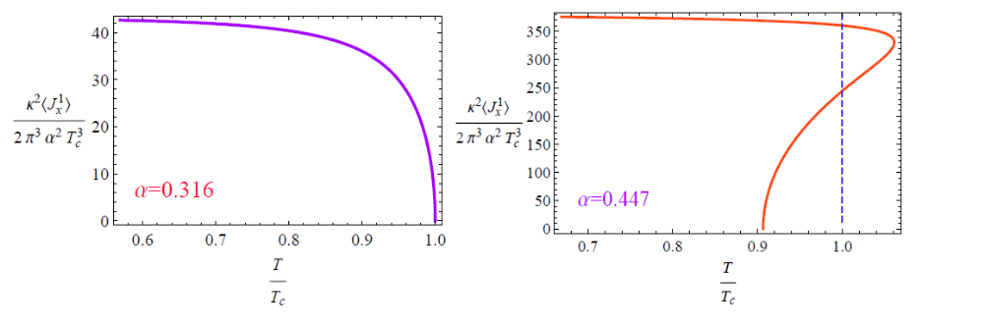

The condensate of the vector operator
second order trasnition
first order transition

Slide 28


Free energy and entropy

Slide 29


superconducting charge density and normal charge density

Slide 30



Minimal area surfaces:
z =1/r

Slide 31





“Equation of motion"
The belt width along x direction
The holographic entanglement entropy
area theorem

Slide 32





EE for a fixed temperature

Slide 33




EE for a fixed width

Slide 34




Holograhic EE in the insultor/superconductor transition
(R.G. Cai et al, arXiv:1203.6620)
The model:
AdS soliton:

Slide 35



Condensate of the order parameter

Slide 36



pure ads soliton

Slide 37

Non-monotonic behavior

Slide 38




Holographic EE for a belt geoemtry
The induced metric

Slide 39


connected
disconnected
"confinement/deconfinement transition"
(Takayanag et al, hep-th/0611035
Klebanov et al, hep-th/0709.2140)

Slide 40

We find that the phase transition always exists

Slide 41


c-function:
Non-monotonic behavior

Slide 42

“ Phase diagram”

Slide 43




EE and Wilson loop in Stuckelberg Holographic
Insulator/superconductor Model
R.G. Cai, et al, arXiv:1209.1019
The Stuckelberg Insulator/superconductor model:
The local U(1) gauge symmetry is given by

Slide 44






The soliton solution
We set:

Slide 45



Slide 46

Gibbs Free Energy:

Slide 47

Confinement/deconfinement transition:

Slide 48

Non-monotonic behavior of EE versus chemical potential:

Slide 49

A first-order transition in superconducting phase:

Slide 50

Insulator/superconducting transition as a first order one:

Slide 51



The entanglement entropy in p-wave holographic
insulator/superconductor phase transition
R.G. Cai, et al, arXiv: 1303.4828
Consider the model:

Slide 52


The behavior near the boundary:
The free energy:

Slide 53





Slide 54




The charge density:
The critical back reaction:

Slide 55

1) Strip along x direction

Slide 56




Entanglement entropy:

Slide 57



Slide 58




2) Strip along y direction:

Slide 59


The critical width versus chemical potential:

Slide 60
4. Conclusions
The entanglement entropy is a good probe to the
superconducting phase transition: It can indicate not
only the appearance of the phase transition, but also
the order of the phase transition.
The entanglement entropy versus chemical potential
is always non-monotonic in the superconducting
phase of the insulator/superconducting transition.

Slide 61
Thanks !

Slide 62

HEE in s-wave metal/sc phase transition
(T. Albash and C. Johnson, arXiv:1202.2605)
The model: as an SO(3) x SO(3) invariant truncation of four
dimensional N=8 supergravity

Slide 63


Depending on the boundary condition: second order
or first order transition

Slide 64


Slide 65

HEE for a fixed belt width

Slide 66


Slide 67


Slide 68


