Slide 1


PLANCK: implication for cosmology
黄 庆 国
暗能量及基本理论研讨班，岳阳
SKLTP-ITP, CAS
2013.04.08
2009.5.14

Slide 2
From pre-Planck to Planck

Slide 3
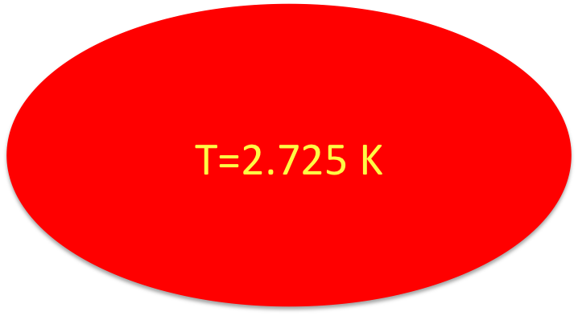
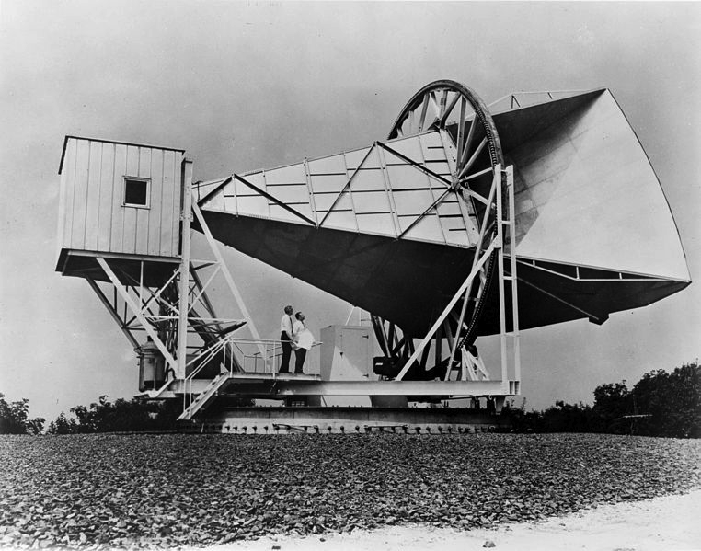

Echo from Big Bang
1978, Arno A. Penzias and Robert W. Wilson

Slide 4

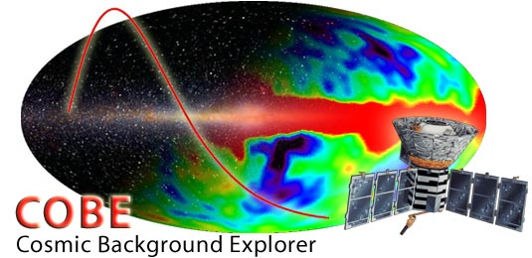

2006, G. Smoot and J. Mather

Slide 5
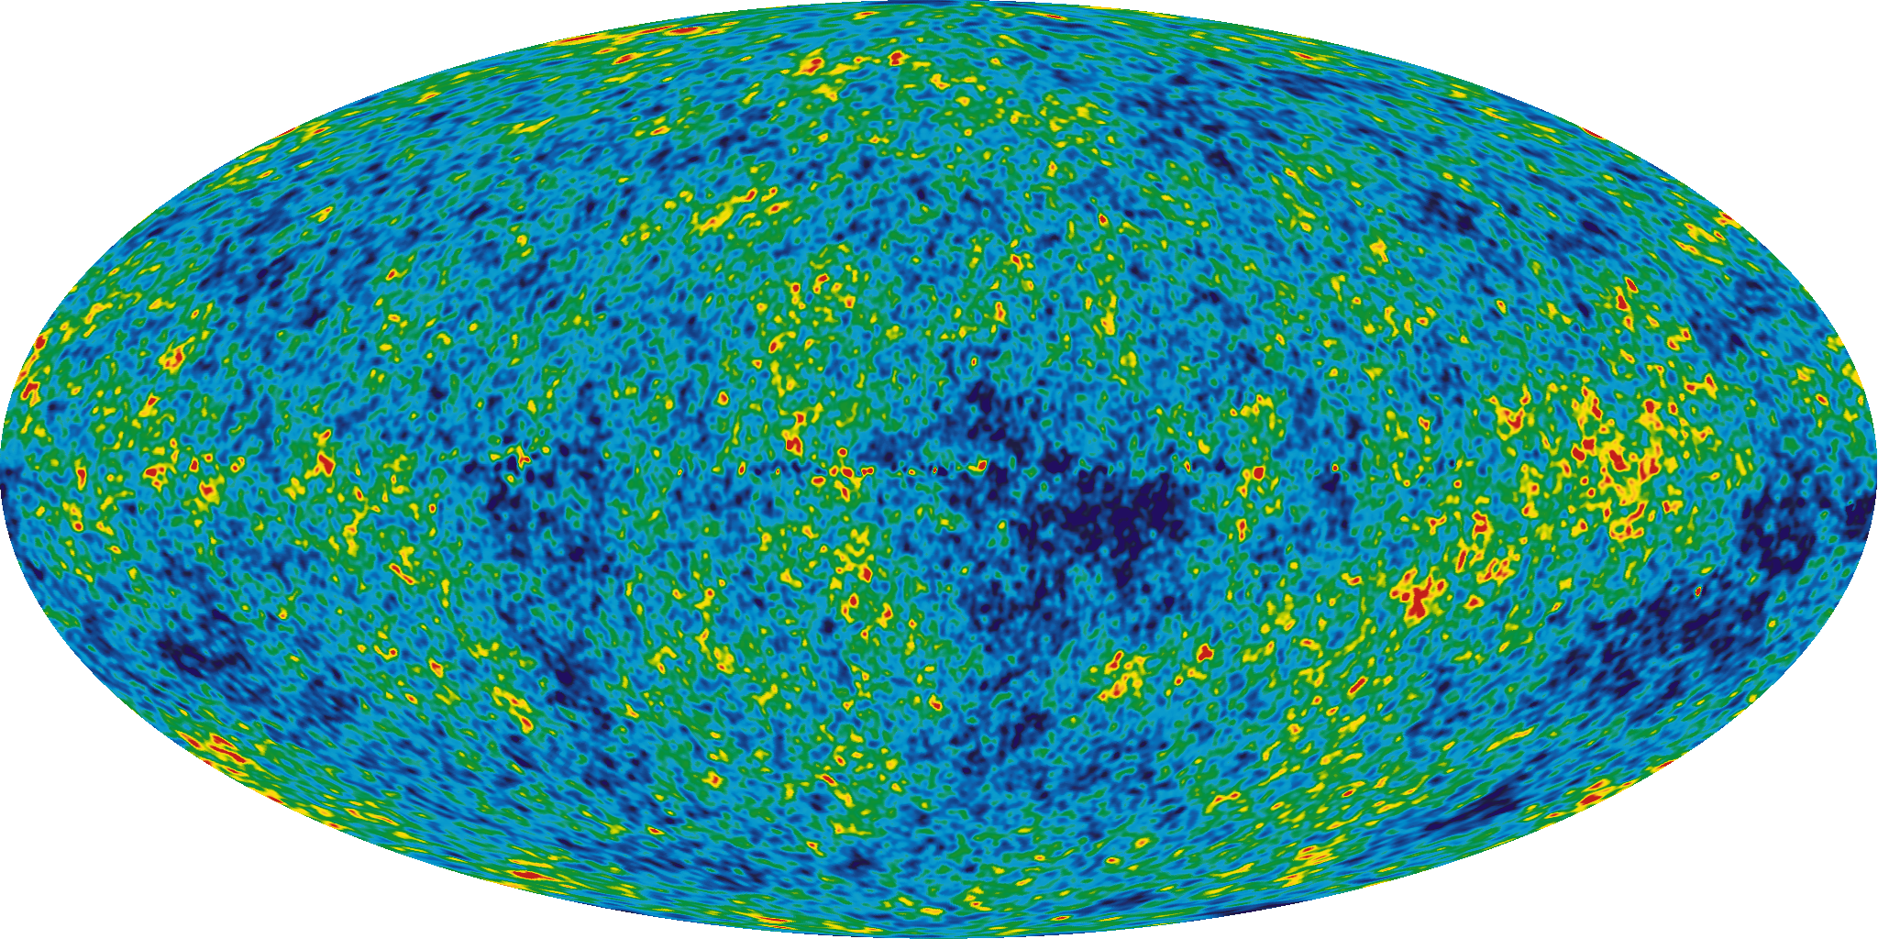
WMAP
SPT
ACT

Slide 6
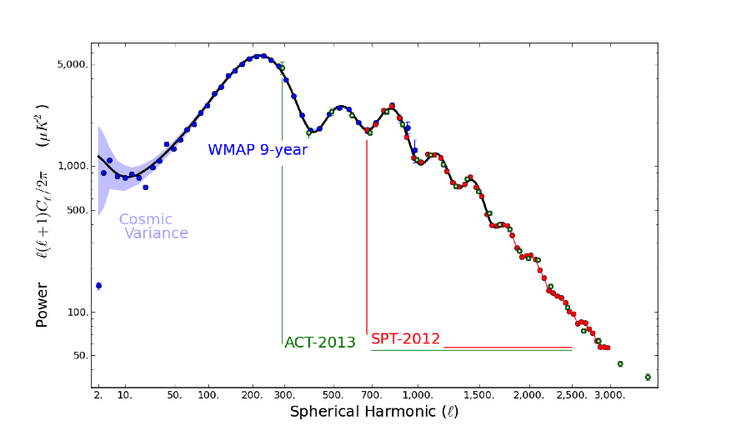
Cheng, QGH, Ma, 1303.4497

Slide 7
WMAP+SPT+ACT+BAO+H0
Cheng, QGH, Ma, 1303.4497

Slide 8
The deviation from scale-invariant power spectrum is significantly favored at around 5.6 σ.
The tensor-to-scalar ratio is upper bounded by 0.12 at 95%CL.
The joint constraints on r-n_{s} give very tight constraints on single field inflation models, and the models with power law potential ϕ^{p} can only survive if 0.9<p<2.1, so a large class of inflation models have already been ruled out before Planck data.
The running of spectral index is preferred at around 95% CL.
The running of spectral index does not change very much even if we switch to different pivot scales.
Cheng, QGH, Ma, 1303.4497

Slide 9
Calabrese et al., 1302.1841

Slide 10
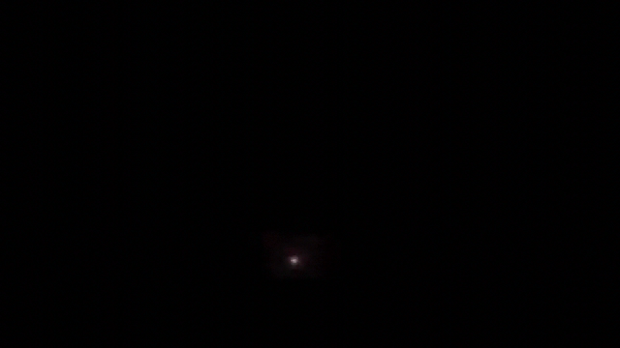
PLANCK
Copyright @ European Space Agency

Slide 11
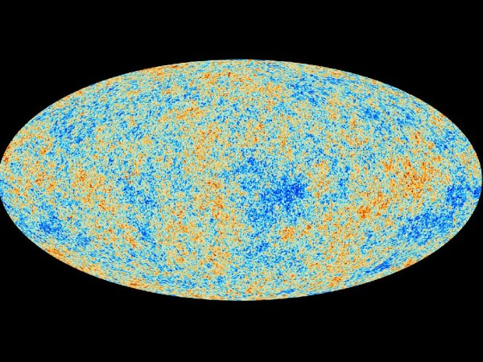

Slide 12
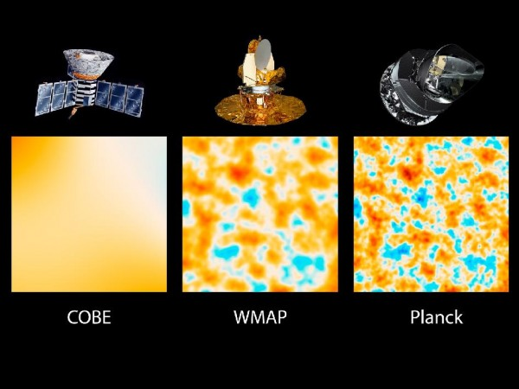

Slide 13
Planck collaboration

Slide 15
March 27, 2013

Slide 16
Overview
“Scientific results include robust support for the standard, six parameter ΛCDM model of cosmology and improved measurements for the parameters that define this model, including a highly significant deviation from scale-invariance of the primordial power spectrum.”
“The Planck values for some of these parameters and others derived from them are significantly different from those previously determined.”
“Several large scale anomalies in the CMB temperature distribution detected earlier by WMAP are confirmed with higher confidence.”
Planck collaboration

Slide 17
Overview
“The excellent agreement between the Planck temperature spectrum at high l and the prediction of the ΛCDM model.”
“From an analysis of an extensive grid of models, we find no strong evidence to favor any extension to the base ΛCDM cosmology, either from the CMB temperature power spectrum and other astrophysical datasets. ”
“When the Planck likelihood does provide marginal evidence for extensions to the base ΛCDM model, this comes predominantly from a deficit of power (compared to the base model) in data at l<30.”
Planck collaboration

Slide 18
6-parameter ΛCDM model

Slide 19
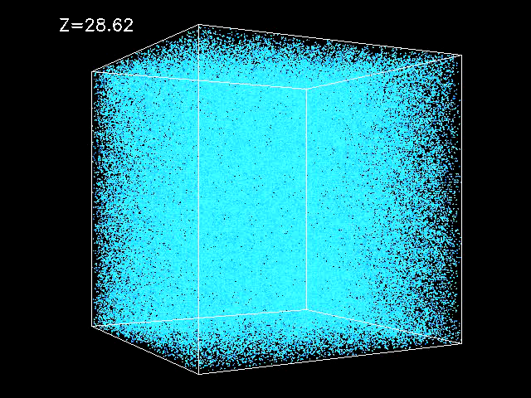

Primordial curvature perturbation
optical depth to re-ionization
θ=r_{s}/D_{A}, angular scale of the sound horizon at last-scattering

Slide 20
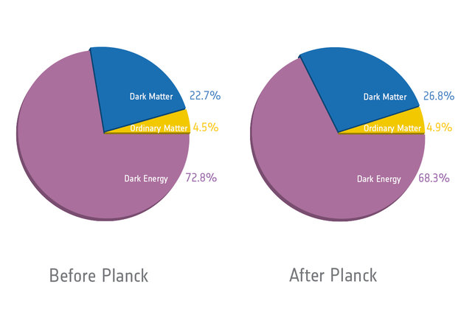
Energy Budget

Slide 21
Hubble constant
Planck+lensing+WP

Slide 22
Acoustic-scale distance ratio (compared to BAO)

Slide 23
Riess et al. (2011)
Freedman et al. (2012)
“The tension between the CMB based estimates and the astrophysical measurements of H0 is intriguing and merits further discussion.”

Slide 24
Planck+WP+highL is consistent with the Union2.1 and SNLS SALT2, but is in tension with the distributions from the SNLS combined and SNLS SiFTO samples.

Slide 25
Optical depth
A detection of lensing helps Planck to break parameter degeneracies, in particular to constrain the re-ionization optical depth without help of polarization data.
lensing

Slide 26
Spectral index
Cheng, QGH, Ma, 1303.4497

Slide 27
Extensions to the base ΛCDM model

Slide 28

Spatial curvature

Slide 29
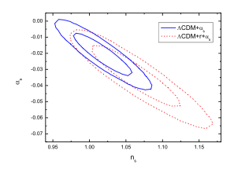
Running spectral index
Running spectral index is one of the examples with marginal evidence for extensions to the base ΛCDM model are favored by the TT spectrum at low multipoles.
pre-Planck
Planck+WP+highL
Cheng, QGH, Ma, 1303.4497
Planck collaboration

Slide 30
Tensor-to-scalar ratio
pre-Planck
Planck+WP+highL
Cheng, QGH, Ma, 1303.4497
Planck collaboration

Slide 31
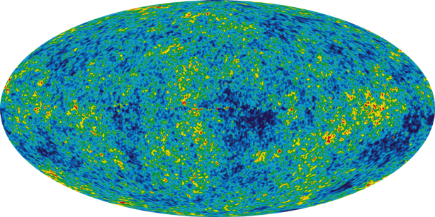
Non-Gaussianity
BISPECTRUM
TRISPECTRUM

Slide 32
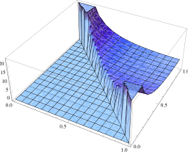
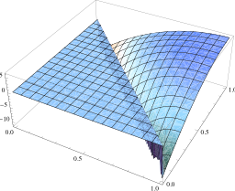
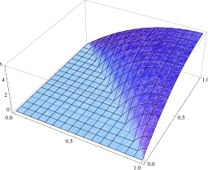
local
equilateral
orthogonal
No evidence for non-zero bispectrum.

Slide 33
Total mass of active neutrinos

Slide 34
Number of relativistic species
No evidence for extra relativistic species, beyond the three species of neutrino in SM and photons.

Slide 35
Equation of state of dark energy
in physics 2011

Slide 37
Planck+WP+BAO

Slide 38
“The fact that the Planck results for the base ΛCDM model are in such good agreement with BAO data, which are based on a simple geometrical measurement.”
“We find no evidence at the current level of analysis for a dynamical form of dark energy.”
“Unlike CMB data, traditional astrophysical data sets – e.g., measurements of the Hubble parameter, SNe Ia, and galaxy redshift surveys – involve complex physical systems that are not understood at a fundamental level.”
Planck collaboration

Slide 39
Anomalies

Slide 40
The glitches at low multipoles

Slide 41
Quadruple-octopole alignment

Slide 43
Power asymmetry

Slide 45
Point-parity asymmetry

Slide 46
The cold spot

Slide 48
“These are the real features of the CMB anisotropies.”
“We know so little about the physics of the early Universe that we should be open to the possibility that there is new physics beyond that assumed in the base ΛCDM model.”
Planck collaboration

Slide 49
“Another possibility is that the anomalies have their origin in the local Universe.”
“According to Francis & Peacock (2009), the removal of the ISW signal originating within the volume at z<0.3 from WMAP data reduces the significance of the apparent alignment between the CMB quadrupole and octopole and the Cold Spot.”
Planck collaboration

Slide 50
Implications for inflation

Slide 51
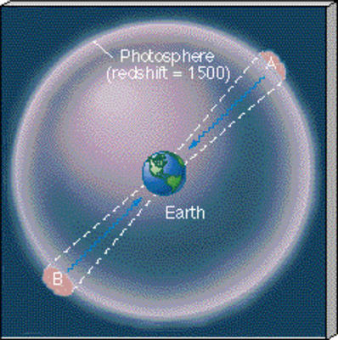
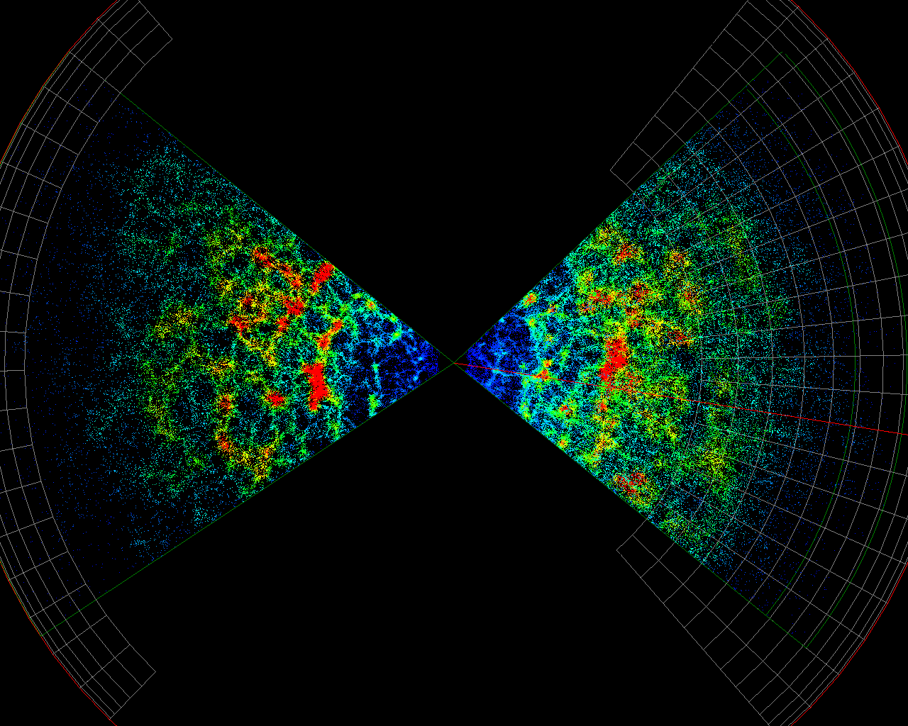
Changes for hot big bang model
Flatness problem
Horizon problem
Monopole problem
Origin of cosmic structure
……

Slide 52

Inflation

Slide 53





Dynamics of inflation
reheating
single-field slow-roll inflation

Slide 54
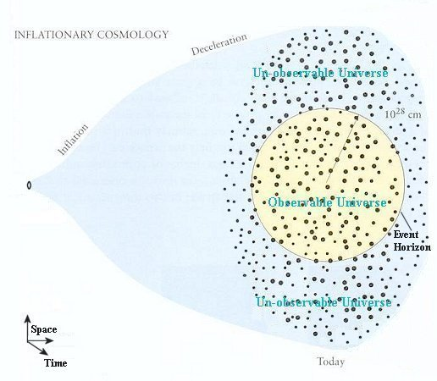

Flatness problem：
Monopole problem：
Horizon problem：

Slide 55


Origin of cosmic structure

Slide 56
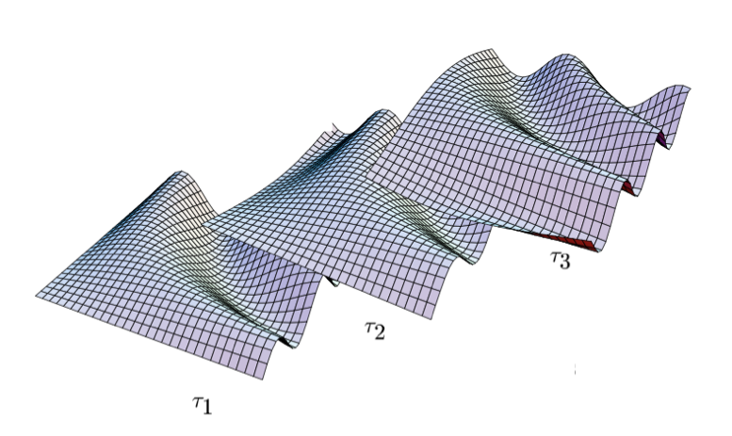


time
General Relativity

Slide 57

Reheating
Reheating
depends on the dynamics of inflation

Slide 58





consistency relation

Slide 59
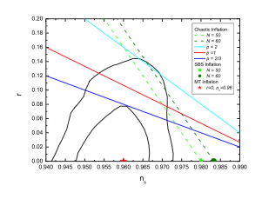
Cheng, QGH, Ma, 1303.4497
Planck collaboration

Slide 60
Features in primordial curvature perturbation
Wiggles model from non-BD vacuum
Step-inflation model
Cutoff model

Slide 62


Local non-Gaussianity
canonical single-field slow-roll inflation:
Maldacena, 2003
Sensitivity to f_{NL} from LSS:
Hamaus, Seljak, Desjacques, 2011
Suyama-Yamaguchi inequality:
Constraint on g_{NL} by pre-Planck:

Slide 63
Models with large g_{NL}, but small f_{NL}:
General single-file ultra-slow-roll inflation (QGH, Wang, 1303.4526)
Curvaton mode (Enqvist, Sloth, 2002; Lyth, Wands, 2002; Moroi, Takahashi, 2001)
Multi-field slow-roll inflation (Byrnes, Choi, Hall, 2008)
Non-trivial ending geometry in Multi-field inflation (QGH, 2009)

Slide 64




Curvaton model:

Slide 65
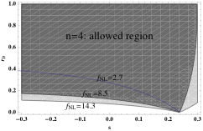
QGH, 1303.6084

Slide 66
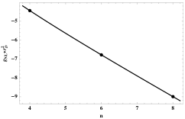
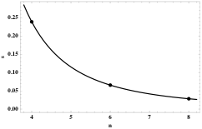
QGH, 1303.6084

Slide 67
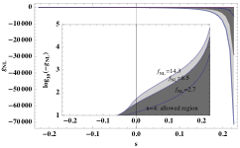
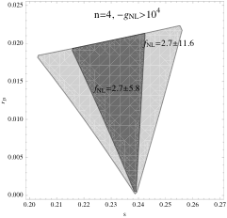
There is a big room for producing a large negative g_{NL}, but not positive g_{NL}.
QGH, 1303.6084

Slide 68
large ε
> 0
Considering inflation dominated by U(ϕ)~ϕ^{p}, ε=p/4N.
For N=50, ε=0.005p. If p=4, ε=0.02.
For m/H* <<0.1, n_{s}=0.96.
Some inflation models tightly constrained by Planck can be relaxed in curvaton scenario.
QGH, 1303.6084

Slide 69



General single-field ultra-slow-roll inflation:
QGH, Wang, 1303.4526

Slide 70





Slide 71




Slide 72









Slide 73
Non-BD vacuum:

Slide 74
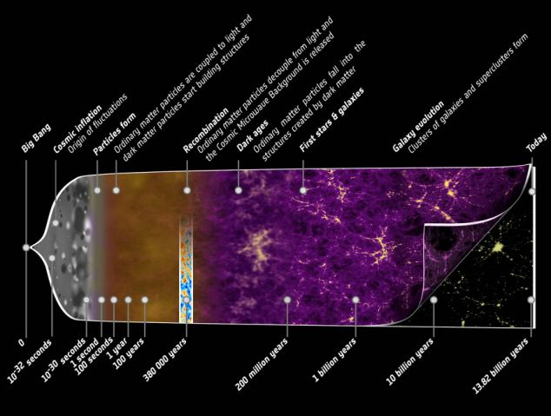

Slide 75
尽信书则不如无书！

Slide 76
Enjoy Yourself !

