Slide 1





Successes and challenges
in quantum field theory
H. Itoyama
Osaka City Univ. &
Nambu Yoichiro Institute of
Theoretical and Experimental Physics
(NITEP)
I) Introduction
basic variables in classical physics are
both “a system point particles” & “fields”
Newtonian (classical) mechanics
Maxwell’s (classical) electromagnetism (EM)
modify i) → Einstein’s special (theory of) relativity
eq. of motion inv. under the Galilei transf.
eq. of motion inv. under the Lorentz transf.
theory of fluids & elastic body is of this kind
classical field theory
iii) → i) as v/c << 1

Slide 2
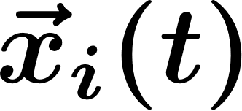
the law for ; provides trajectories
the law for fields ; provides temporal & spacial distributions
leading to wave propagations,
medium not always required (Michelson-Morley)

Slide 3

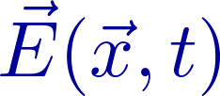
Two roads leading to particles= waves
(quantum theory)
start from particles
start from waves
mechanics
fields ,
also electron, positrons & Higgs are fields
quantization
quantum mechanics
quantization of fields
statistics
(2nd quantization)
quantum manybody problem
quantum field theory
“equivalent”
vacuum:
lowest energy level
of single (several) particle states
lowest energy level with
no particle, but dynamically determined
 | time | space
Q.M. | parameter | d.v.
Q.F.T. | parameter | parameter

Slide 4
Contents
Introduction
Stage 1 ~ 1960
Stage 2 ~ 1978
Stage 3 ~ 2010
Some current challenges
Words of caution
historical in part
mixed undergraduate &graduate level and not uniform
SUSY related challenges only

Slide 5

II)
From Heisenberg-Pauli to Yukawa
“Microscopic forces are derived by the exchange of a quantum mechanical particle (quantum)”
π
Ｎ
Ｎ
applied to the force exerted btn nucleons successfully
predicted the existence of π meson as well as its mass by the range of the force
$m_{π} ≪ M_{N}$ not explained.

Slide 6
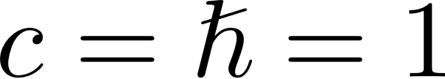
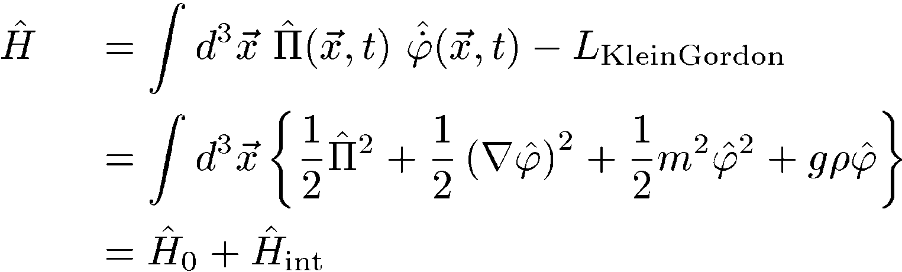
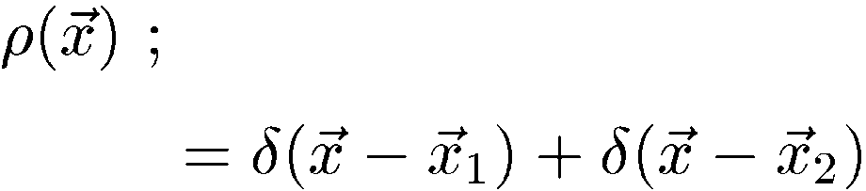
“Textbook” calculation leading to
the “Yukawa potential”
canonical quantization
Yukawa
density field of static nucleon distribution
taken as
compute energy shift of the ground state to the lowest order in perturbation theory

Slide 7
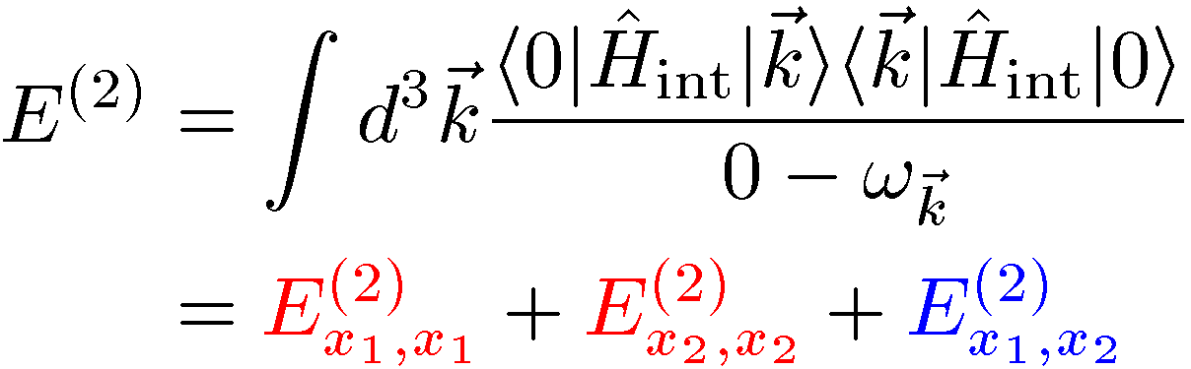
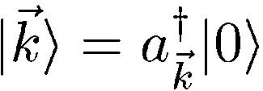
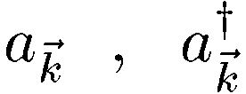

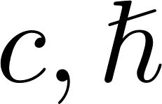
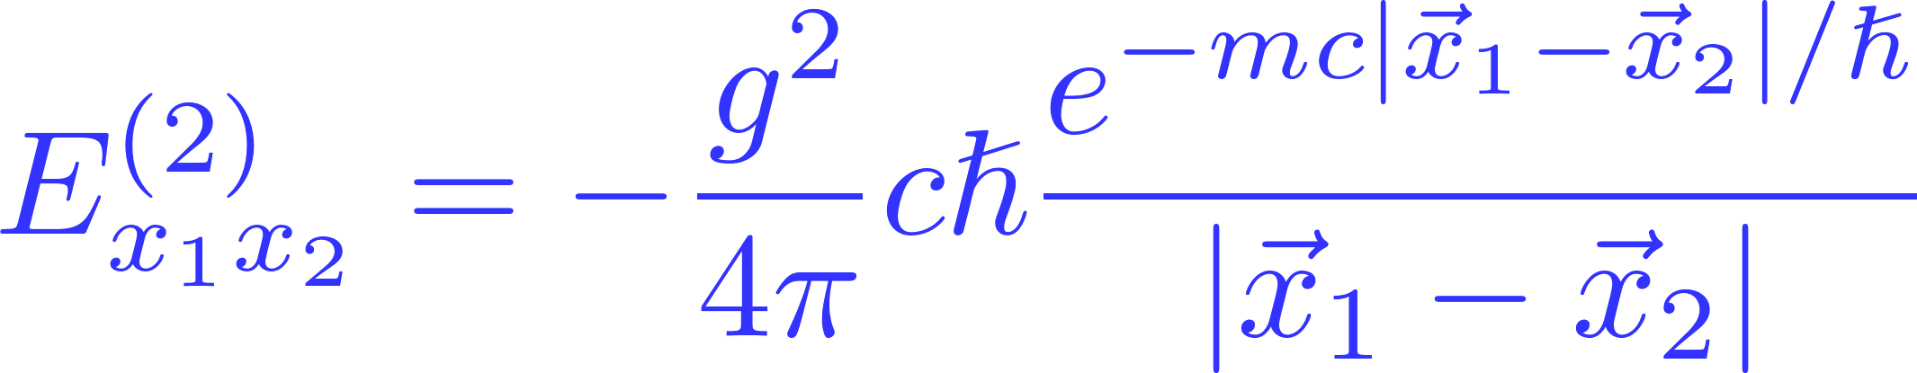
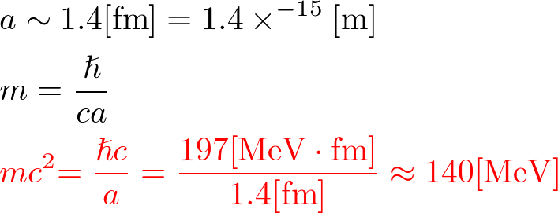
Here and : Fourier coeff’s of the operator
result ; ( retrieved )
prediction ; from the interaction range of the nuclear force

Slide 8
Problem of self-energy and UV divergences: Quantum electrodynamics
electrons & positrons are described by (spinor) fields
an interaction takes place at a definite point in spacetime
⇒ exchange of a quantum with arbitrarily large frequencies possible
photon
electron

Slide 9



Suppose that initial & final energy and momenta of the electron are definite.
Possible to represent the spacetime process of the electron as a figure based on and classify by the number of emissions and absorptions of photons (Feynman diagrams)
final
final
final
photon
・・・
initial
initial
initial
UV $∞$ present
electron selt-energy part
1PI

Slide 10

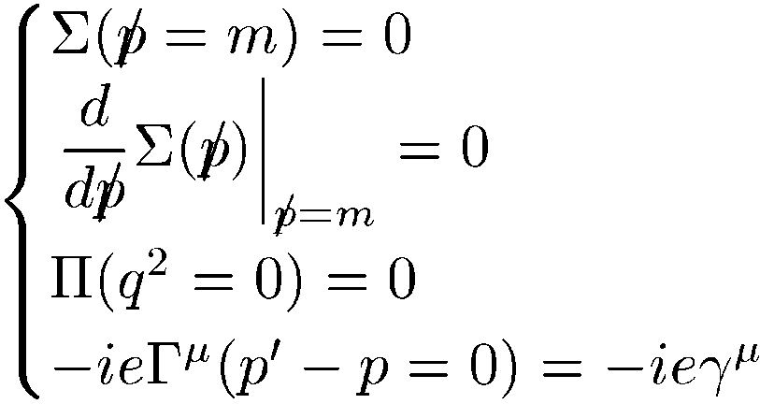
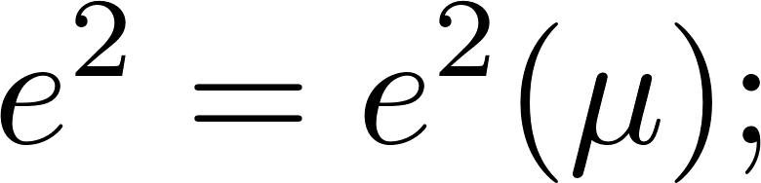


Renormalization prescription and the interpretation
perform (renormalized) perturbation theory
the separation is not unique
⇔ $∃$counter terms
consisting of 4 terms $∴$ 4 (originally physical) conditions
1PI
e.g.
1PI
Tomonaga, Schwinger, Feynman, Dyson
need not be directly related to observables
predict only the ratio of experimental values at two energy scales
⇒ renormalized c. c. dependent on

Slide 11
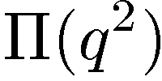


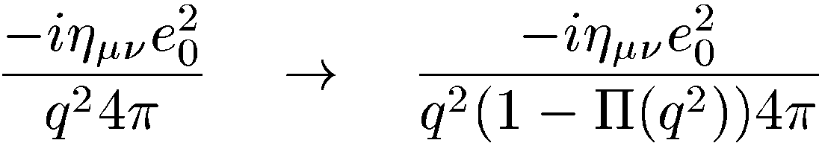
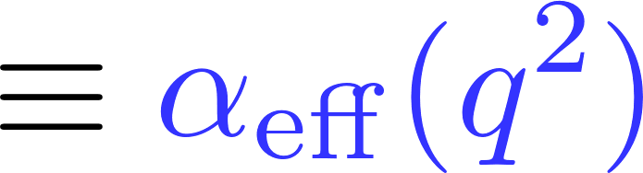
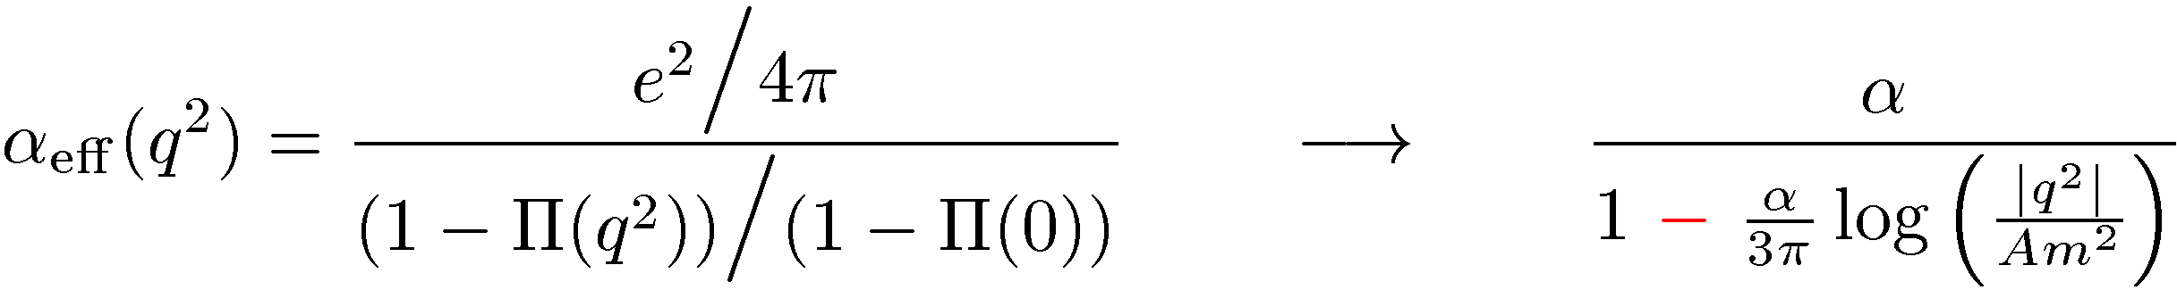

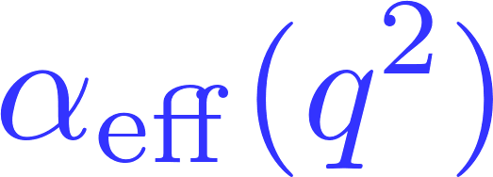
Vacuum polarization and charge screening in QED
meaning of :
correction to external photon fields
become strong as q² large (in short distances) and perturbation theory breaks down
test charge placed on a vacuum is subject to a dynamical generalization of (static) charge screening
; q²-dependent
effective coupling
constant
One-loop

Slide 12








III)
Force as a catch of a quantum again
By 1978,
quanta exchanged are gauge bosons
vacuum: while no particle present, not at all empty
$$γ$$
$$W±, Z$$
gluon
e.m.
(electric charge)
weak force
strong force
(color)
$$e+$$
$$e−$$
$$ν$$
$$\overline{ν}$$
$$q$$
$$\overline{q}$$
properties of vac.
dynamical generalization of static screening
magnetic flux squeezed
spontaneously broken symmetry
color electric flux squeezed
antiscreening, i.e. asymptotic freedom

Slide 13

Spontaneously broken symmetry
from our daily life
round table at dinner
reflection symmetry no longer holds at the time smbdy takes up a napkin at either side
Def： While symmetric in the original configuration,
not so in the final output.

Slide 14


Known before in macroscopic (condensed matter) physics
ferromagnetic material
the stable ground states are the ones with
all arrows (microscopic magnets $≈$ atomic circular currents) aligned
30°
35°
・・・・・・
all equally fine
gr. state #1
village 1
gr. state #2
village 2
・・・・・・
small motion of called fluctuation
#( ) = $∞$, $∴$ infinitely high wall separating any two of villages
#(villages) = $∞$, we must choose one to live

Slide 15
1st excited state
30°
35°
one arrow of village 2 in village 1
(＊) energy → 0 as 35°→ 30°, excitation with
arbitrarily small energy
abstraction
can take place in the vacuum of quantum field theory
dictionary:
arrows in the ground state ⇔ vacuum expectation value
excitation of (＊) ⇔ massless particle
Th massless particles (Nambu-Goldstone bosons) appear
when the symmetry becomes spontaneously
broken in the vacuum.

Slide 16

gauge theory
of electroweak interactions
spontaneously broken symmetry essential as well
mass
photon γ
massless
quanta mediating forces
weak bosons Ｗ$±$, Ｚ
become massive
(Higgs mechanism)
NG bosons
actors
in NJL model
Higgs
massive
matter
quarks, leptons
massive
(due to Higgs v.e.v.)

Slide 17
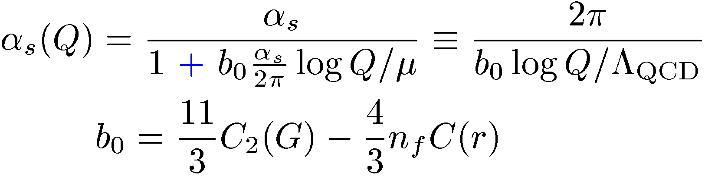

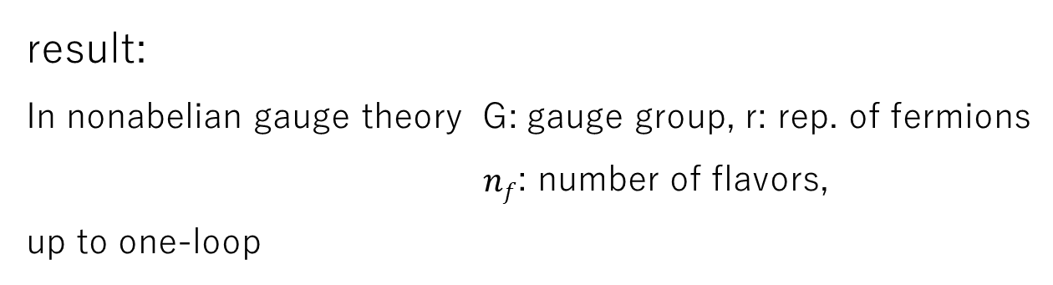
Q: Anti-screening possible ? A: Yes
result:
In nonabelian gauge theory G: gauge group, r: rep. of fermions
$nf$: number of flavors,
up to one-loop
Gross, Wilczek,
Politzer
becomes small as Q² large
⇒ free gas picture to our early universe

Slide 18
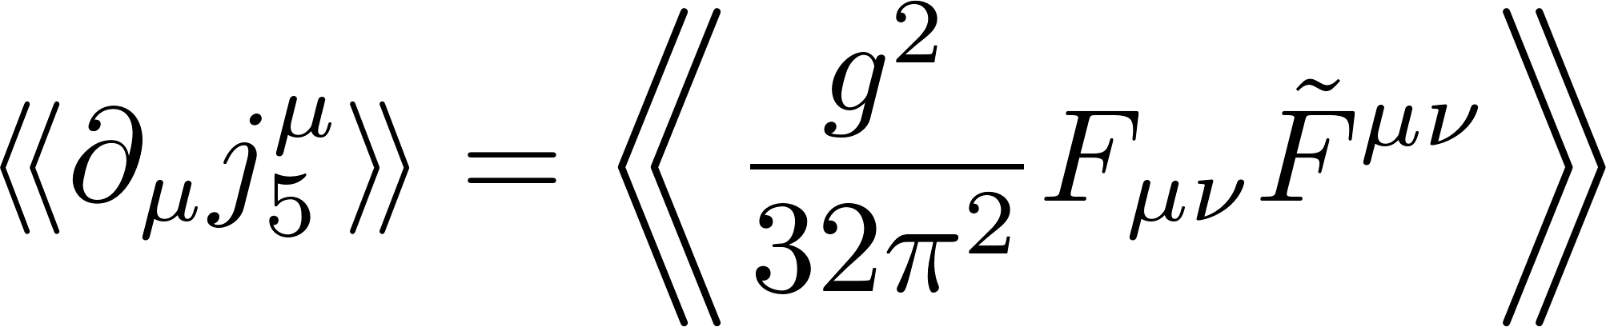
IV)
Gravitational anomaly and its cancellation
anomaly: quantum violation to conservation law,
typically
In the electroweak gauge theory, gauge anomalies cancel btn quarks &leptons
exact result in QFT, topological &
do not receive temperature corrections
gauge & grav. anomalies cancel
in 10d SO(32) & E8×E8 gauge theory + supergravity
⇒ road to superstrings
S. Adler ’64
axial current in QED
H. I. ’82
A. Mueller
Green-Schwarz ’84
18

Slide 19
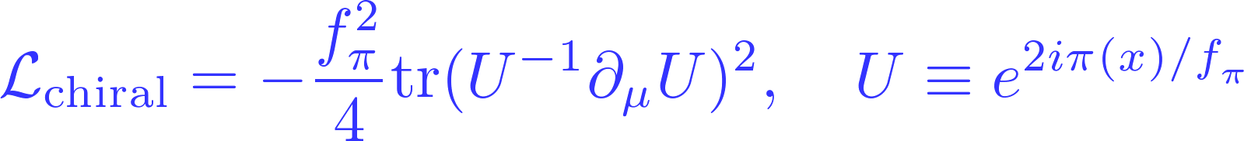
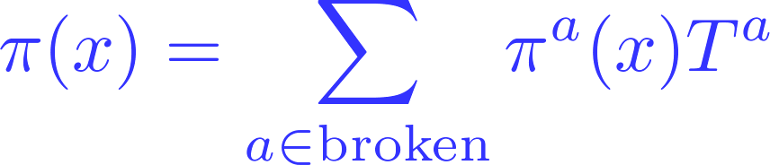

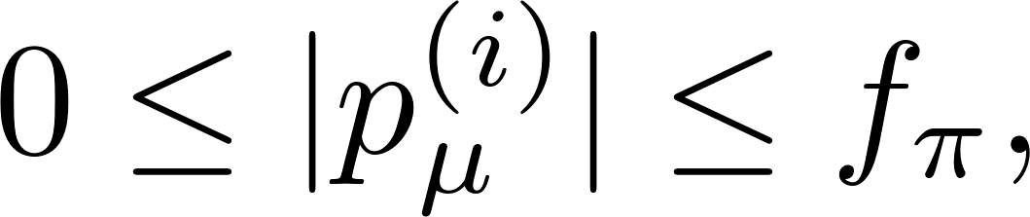
Low energy effective theories
largely due to K. Wilson
e.g.: chiral Lagrangian for π, K, η (N-G bosons)
all scat. amp. OK for but not beyond this
low energy theorem can be derived
ironically, superstrings have engineered a wealth of such theories

Slide 20
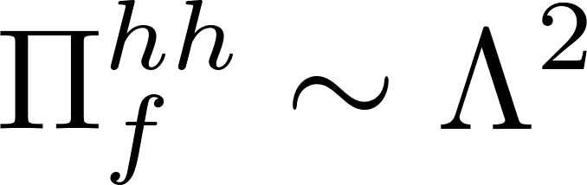

3 motivations to supersymmetry (SUSY)
technical solution to the naturalness prob:
superstrings require unification of all massless particles up to spin 2 graviton
ideal gas to QFT : weaken the force at low energy
uneasy $∴$ cancel this & forget
⇒ by now, very unlikely LHC exp.
Representation of SUSY
on-shell (particle) rep
off-shell (field) rep
object called superpotential
massive
massless
b f b
(mass)²
b f
encodes both the potential & Yukawa coupling

Slide 21

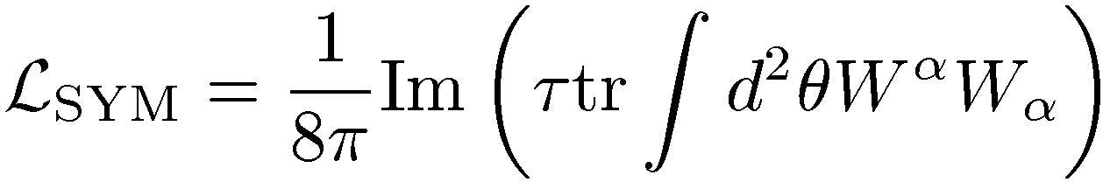
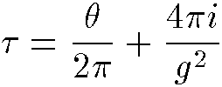

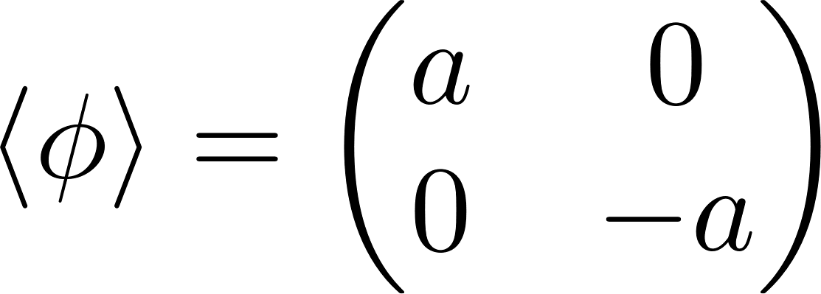
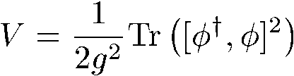
SUSY continued
zero point oscillations cancel btn b & f
yields holomorphy to complexified coupling constant
no correction to the superpotential
e.g.
extended SUSY
massless rep
massive rep
massive BPS rep
1 4 6 4 1
flat direction undermined, called moduli
local SU(2) spontaneously broken to U(1)

Slide 22
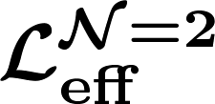



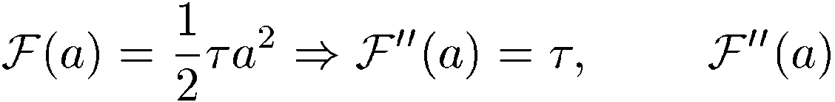
SUSY and the exact determination
(e.g. SU(2) SYM)
BPS states (W± multiplet)
mass
U(1) multiplet
(spin)_{z}
effective theory at
= holomorphic fn in 1/a
4k-2 th coeff = contribution from multi-instanton with
instanton number k
If ∴ is coupling function
22

Slide 23



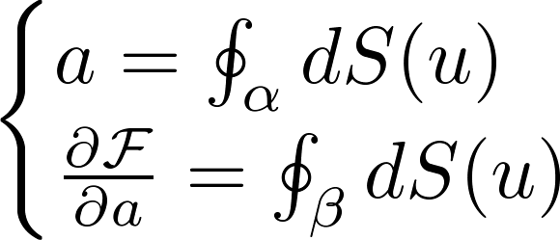



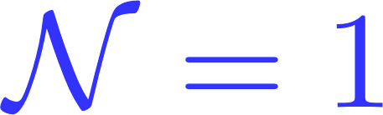




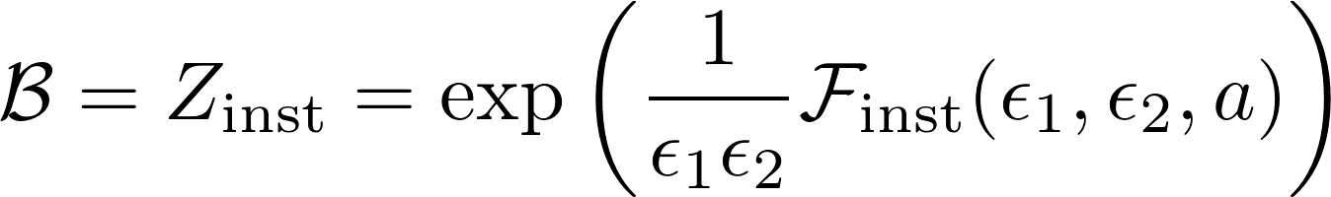
From S-W to matrix model: highlights
・Seiberg-Witten(1994): can be determined exactly by a proper curve
(Riemann surface) and the differential through period integrals
・H.I.-Morozov(1995):
The above can be regarded as an algebraic integrable system.
Donagi-Witten, Nakatsu-Takasaki(1995), …
, of integrable system of particles complete the guess
deformation theory:
・Similar development in gluino condensate ($Si$) prepotential
(Dijkgraaf-Vafa, H.I.-Morozov, 2002)
skipping details,
Free energy of a one-matrix model.
・AGT conjecture (2009)
: Vir. representation theor. part pf 2d scalar correl. fn
can be generated directly by a matrix model
H.I.-T. Oota (2010)

Slide 24
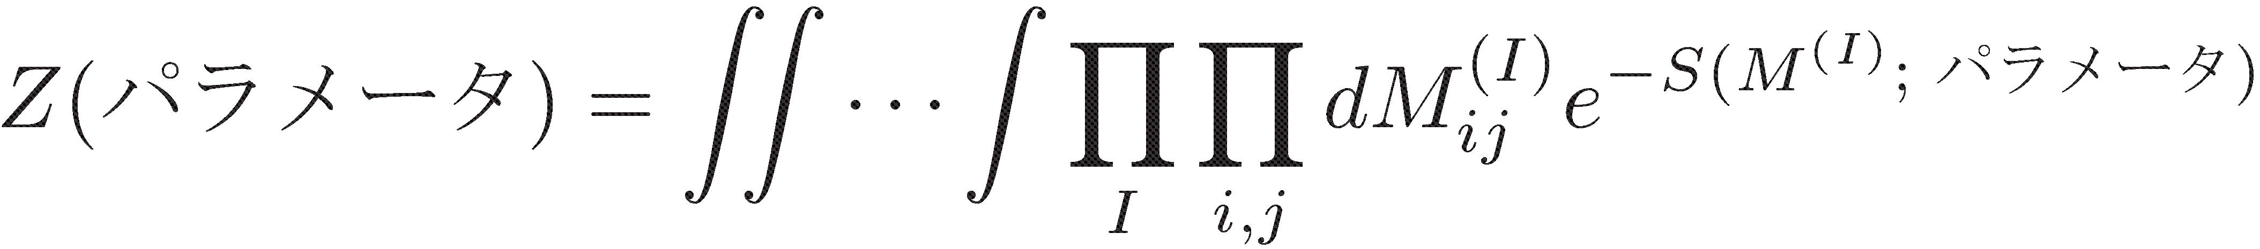
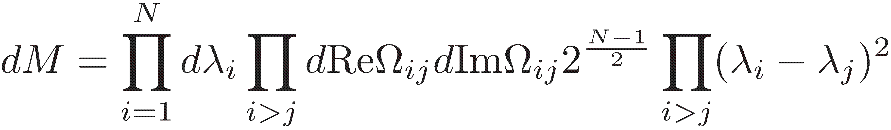
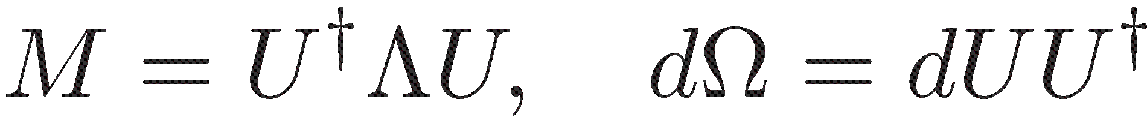

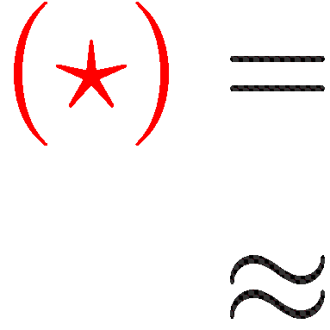
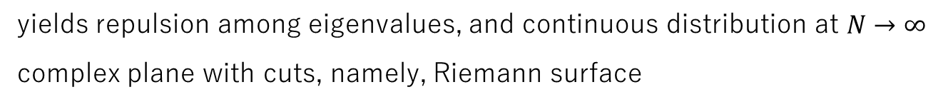
What is matrix model?
Definition
just multiple integrals, QFT defined on a point
Here, one-matrix model (and its extension)
eigenvalues are integration variables
N ×N hermitian
yields repulsion among eigenvalues, and continuous distribution at $N→∞$
complex plane with cuts, namely, Riemann surface
H. I.-Matsuo,… 1990
Eq. for correlators takes the form of Virasoro conditions

Slide 25
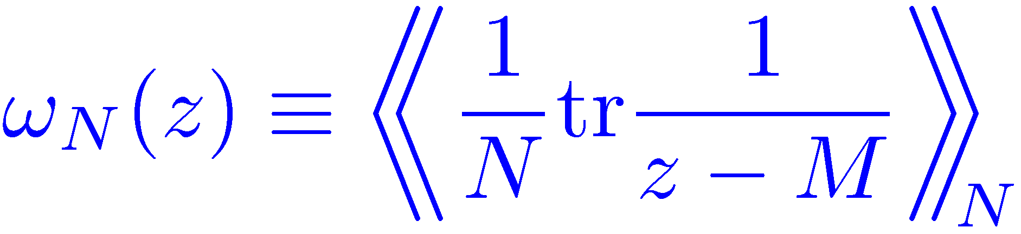
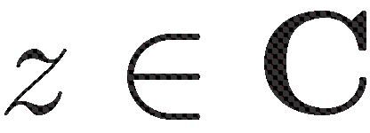
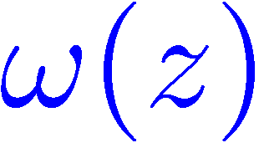
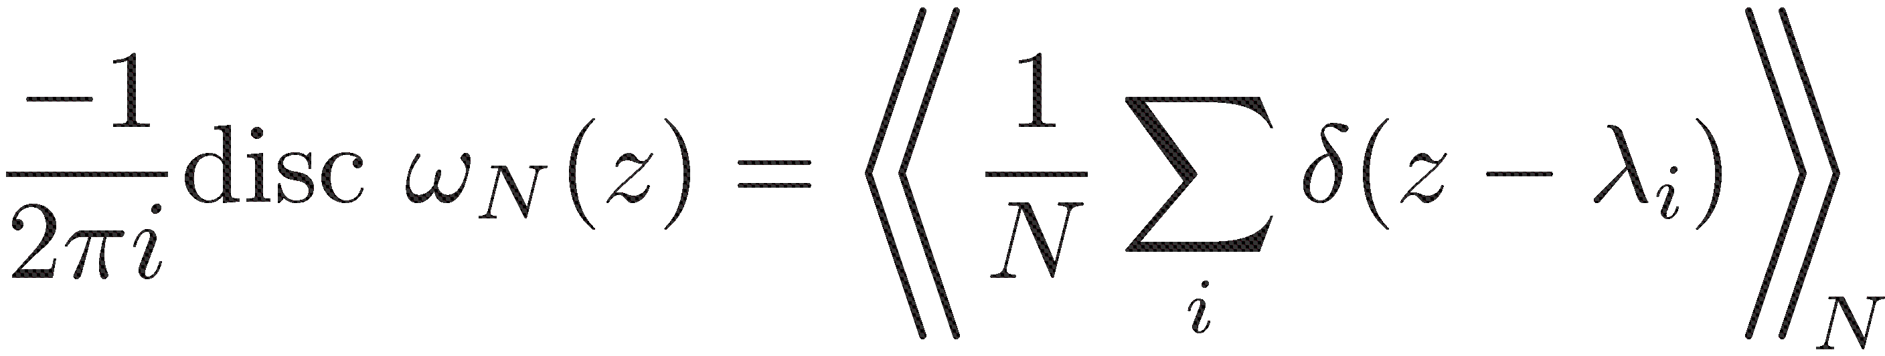
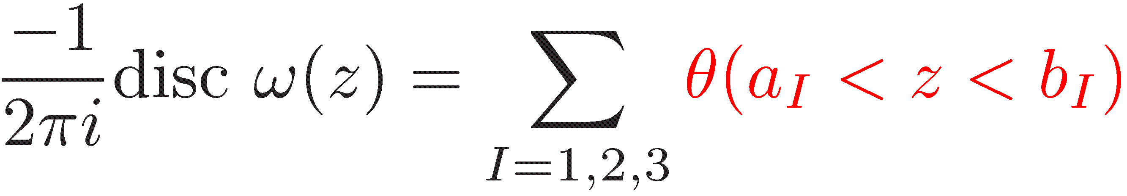
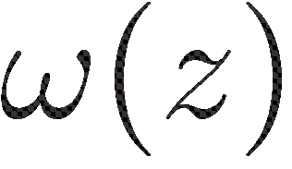
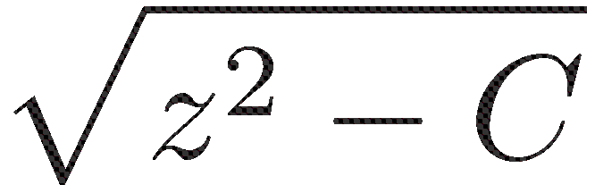
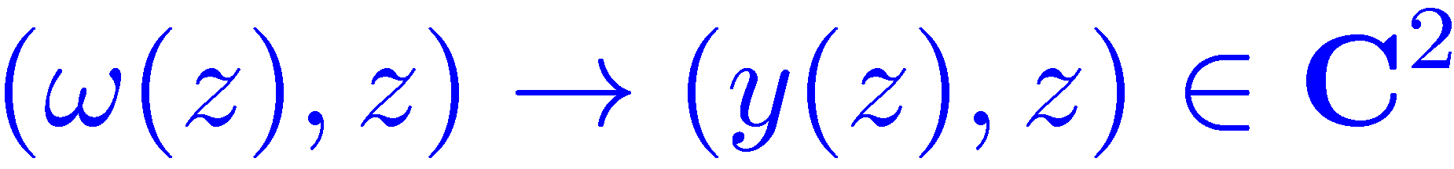



To put this into mathematics
resolvent
averaging by the action
$N→∞$ limit is denoted by
For a generalized function f(x) on a real axis,
$$N→∞$$
typically contains
change of variables and Vir. give
, which is a Riemann surface

Slide 26


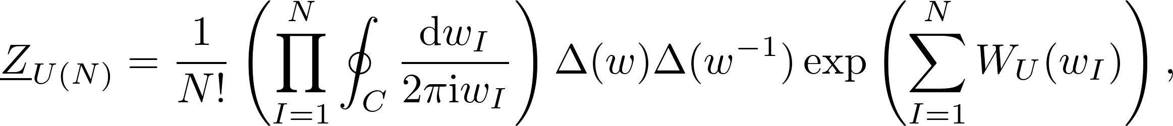


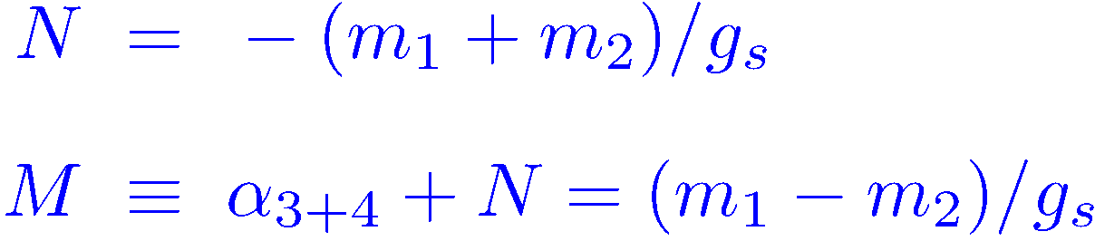
V)
1)
Latest development on aa
Discrete Painlevé system and the double scaling limit of the matrix model for irregular conformal block and gauge theory
H.I., T. Oota, Katsuya Yano, arXiv:1805.05057, PLB and arXiv:1812.00811
IO5: I-Oota, arXiv:1003.2929, Nucl. Phys. B
IOYone: I-Oota-Yonezawa, arXiv:1008.1861, Phys. Rev. D
also
v.s. case
and from to with log potential
From to unitary m. m. with log potential
parameter counting & dictionary
2d or m. m. 4d gauge
2 parameters aside from or

Slide 27
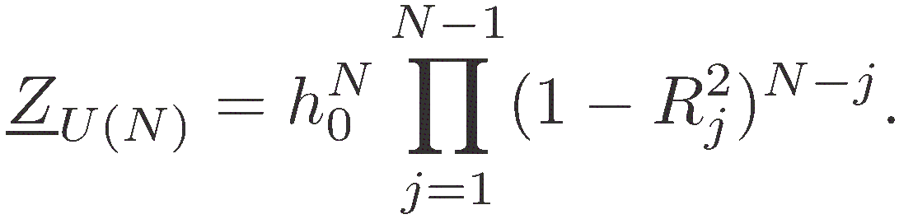




Results
・recursion relations (string equations)
where
・the double scaling limit and derived PII :
Approach to Argyres-Douglas type non-Lagrangian theory

Slide 28











2)
D-term Triggered Dynamical Supersymmetry Breaking
with N. Maru (Osaka City University)
based on
IJMPA 27 (2012) 1250159, arXiv:1109.2276
PRD 88 (2013) 025012, arXiv:1301.7548
most desirable to break SUSY dynamically (DSB)
two auxiliary fields F & D are the parameters of supersymmetry.
We have accomplished
D-term DSB (DDSB)
in a self-consistent
Hartree-Fock approximation
based on the nonrenormalizable D-gaugino-matter fermion term
which is present in generic SUSY (effective) U(N) gauge action
the vac. is metastable, can be made long lived
compare this with
the NJL ptl.
determined as the point of intersection of the two real curves
in the plane. Schematically,
DSB HAS BEEN REALIZED

Slide 29

3)
Large SUSY breaking from 10d nonsupersymmetric heterotic string
superstring is a UV finite quantum mechanics (rather than QFT) living in 10d.
unique 10d tachyon free nonsupersymmetric string.
how to compactify down to 4dim, giving a very small cosmological constant
formula for one-loop vac energy upon circle compactification
we have recently, found a case with and enhanced gauge symmetry in the two parameter extension of the problem (yesterday’s seminar)
( : # of massless fermions, bosons)
H.Itoyama, T.R.Taylor, Phys. Lett. B186 (1987)
H.I.-S.Nakajima

Slide 30
Current puzzles
Neutrino masses, large mixing angles, CP violation
Is dark matter from a particle physics origin?
Any mean field other than the Higgs?
Why is the top quark so heavy?
Is dark energy from a microscopic origin?
Is broken SUSY successful?

