Slide 1
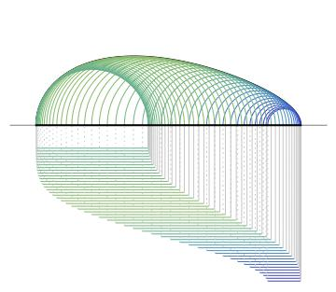
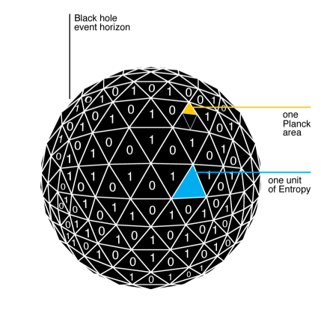
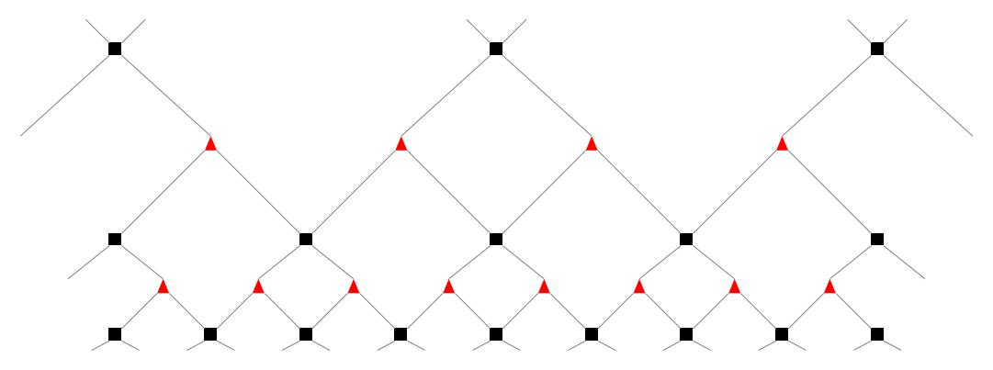
A Holographic
Formalism for Quantum
Gravity
Bartłomiej Czech
Institute for Advanced Study, Tsinghua University
中国科学技术大学, 13 December 2019

Slide 2
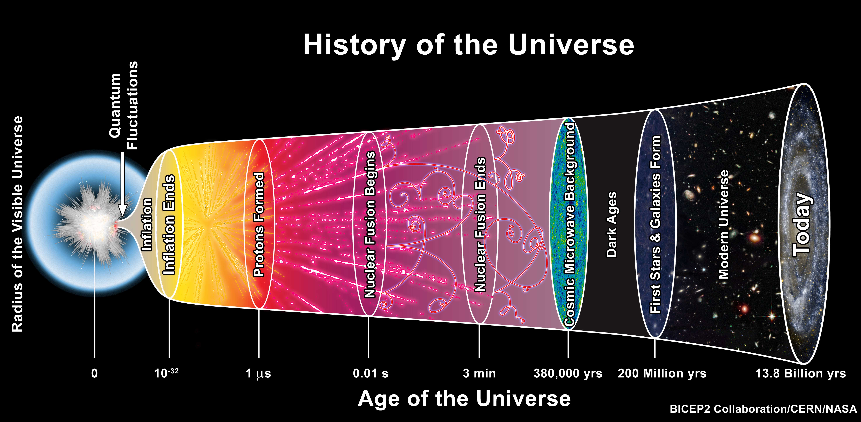
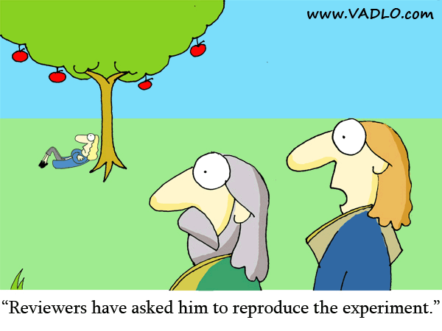
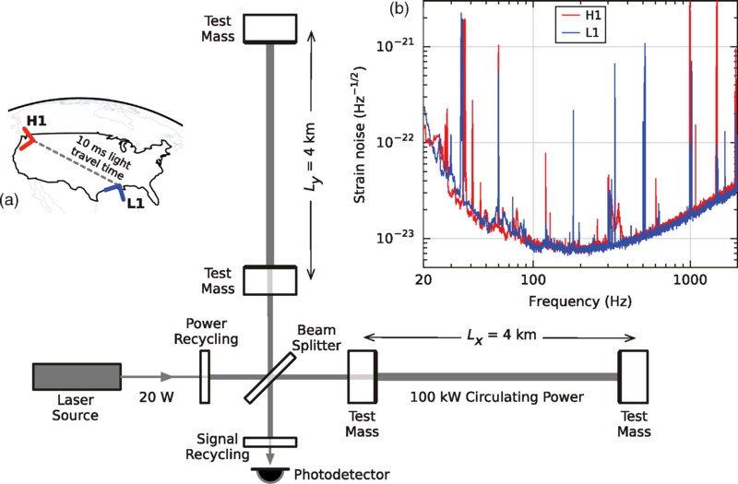
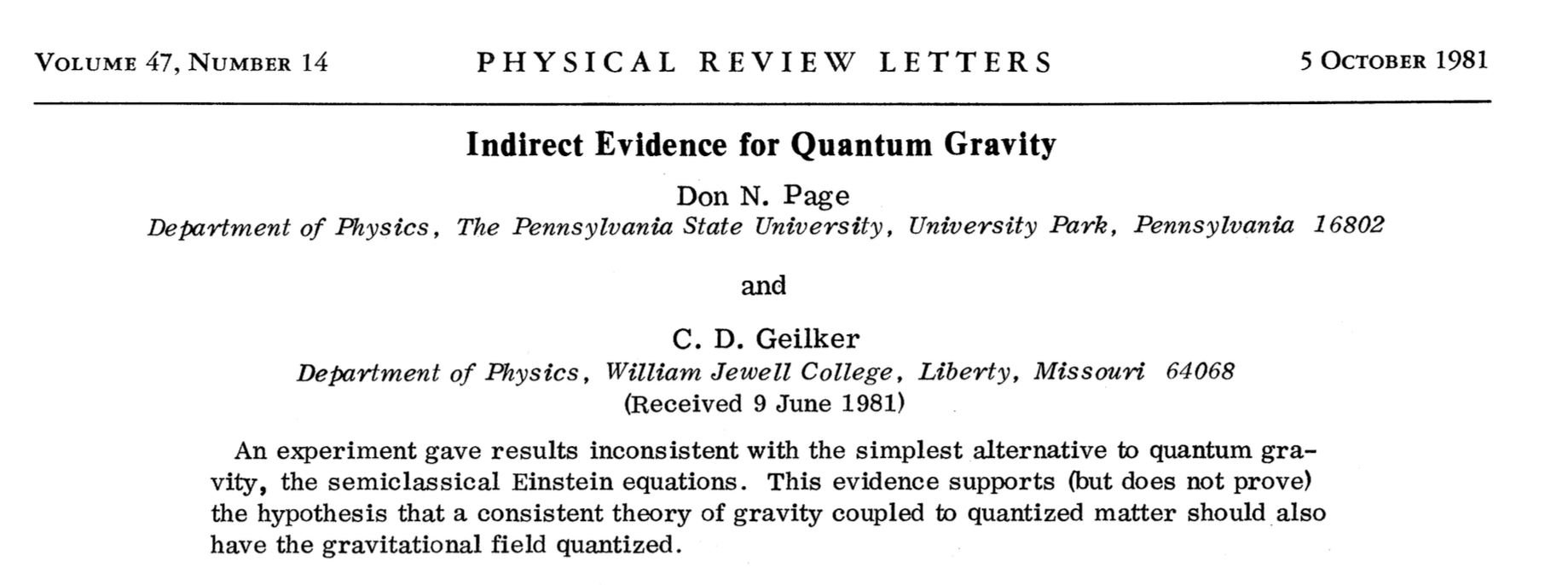
Why Quantum Gravity?
Quantum Gravity was important
in the Early Universe:
We have entered an era of
Gravitational Wave Spectroscopy
  with testable Quantum Gravity predictions
There is empirical evidence against
Standard Model + General Relativity:
  PRL 47, 979 (1981)
I think it’s our duty as a civilization
to gain a fundamental understanding
of why apples fall…
…especially when preliminary results reveal such unexpected connections and counter-intuitive conclusions:
  The World is a Hologram
  Condensed Matter Theory
  Information Theory,
  including Quantum Computing
  and Complexity Theory
Source: Abbott et al. (LIGO and Virgo Collaborations), PRL (2016).

Slide 3
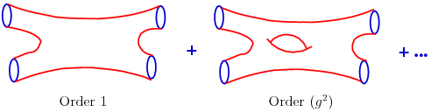


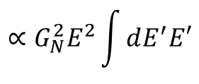
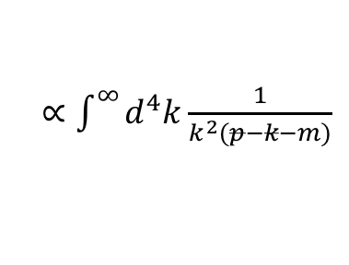
Quantum Gravity is an Ultraviolet Problem
In quantum field theory it is standard
to generate infinities in the ultraviolet,
but it is also standard to tame them
by renormalization.
Alas, gravity is non-renormalizable!
  is the only dimensionless combination
  of the constants of Quantum Gravity.
  G_{N} has a negative mass dimension.
  Gravitational corrections increase with higher energy.
  Every loop order in perturbation theory exacerbates the problem,
  e.g. at tree level and one loop we have:
  c.f. Polchinski, String Theory
Quantum Gravity must look radically different
from the quantizations of the Standard Model forces.
This motivates replacing point particles with strings,
which have tamer ultraviolet properties.
p
k
$∝\int^{∞}{d^{4}k\frac{1}{k^{2}(p−k−m)}}$
$$G_{N}E^{2}h^{−1}c^{−5}$$
$$∝G_{N}^{2}E^{2}\int{dE^{′}E′}$$
$$∝G_{N}E^{2}$$

Slide 4


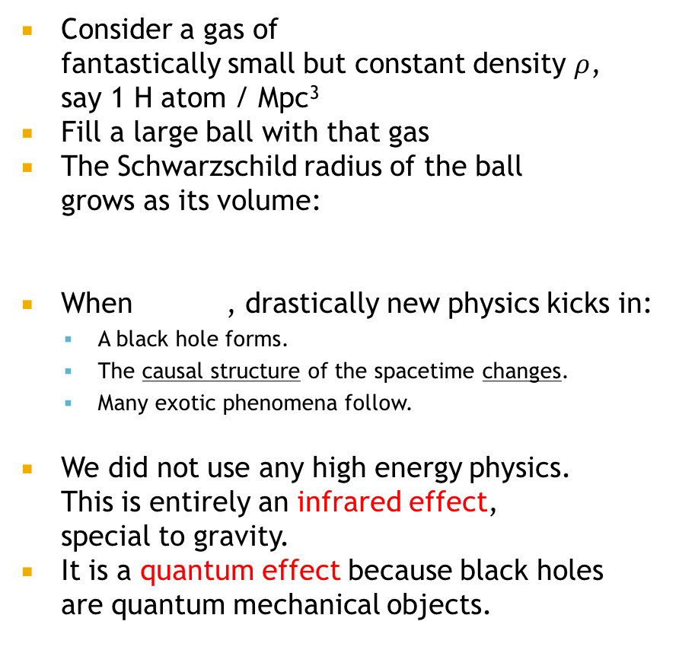
Quantum Gravity is (also) an Infrared Problem
Consider a gas of
fantastically small but constant density $ρ$,
say 1 H atom / Mpc³
Fill a large ball with that gas
The Schwarzschild radius of the ball
grows as its volume:
When , drastically new physics kicks in:
  A black hole forms.
  The causal structure of the spacetime changes.
  Many exotic phenomena follow.
We did not use any high energy physics.
This is entirely an infrared effect,
special to gravity.
It is a quantum effect because black holes
are quantum mechanical objects.
H
H
Mpc
H
$${R_{S}=2GM∝2GρL}^{3}$$
L
$$R_{S}=L$$
Schwarzschild radius R_{S}
L

Slide 5






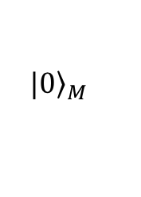
Why Black Holes Are Quantum Mechanical:
Detour to Quantum Field Theory
Unruh, 1976
t
accelerating trajectories
x
Consider the vacuum in Minkowski space
Accelerating observers span a subspace of Minkowski called Rindler,
which has a horizon:
is the accelerating observer’s distance from the horizon
In Rindler modes ,
so the accelerating observer sees a thermal state
The Unruh temperature is:
$${|\left.0\right\rangle }_{M}$$
$$ds^{2}=−dt^{2}+dx^{2}$$
$$ds^{2}=−r^{2}dτ^{2}+dr^{2}$$
$$r=c^{2}/a$$
$$|{\left.0\right\rangle }_{M}=\sum_{n}{e^{−{πE}_{n}}|{\left.E_{n}\right\rangle }_{L}|{\left.E_{n}\right\rangle }_{R}}$$
$$ρ=\sum_{n}{e^{−{2πE}_{n}}|{\left.E_{n}\right\rangle }_{RR}\left\langle E_{n}\right.|}$$
$$T={ha}/{2πk_{B}c=}{hc}/{2πk_{B}r=4}∗{10}^{−21}\left(\frac{a}{g}\right)K$$

Slide 6


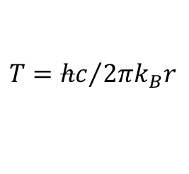
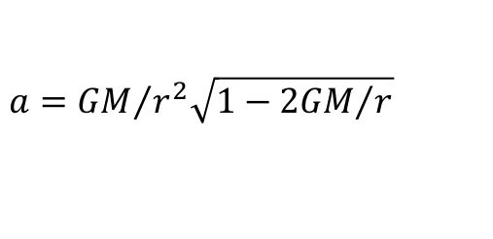
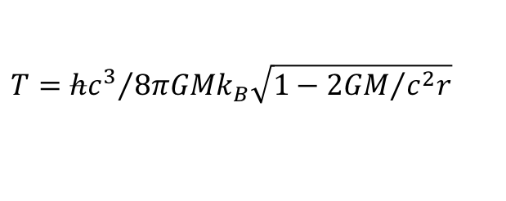
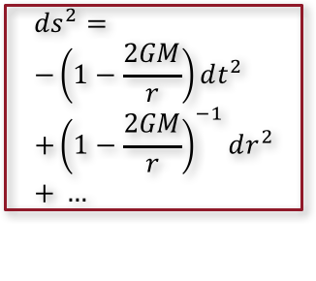
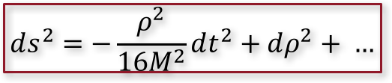
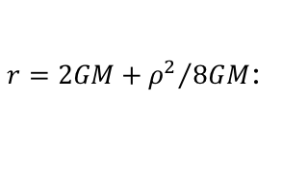

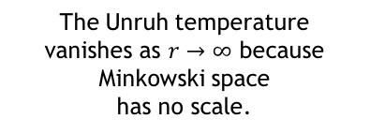
Why Black Holes Are Quantum Mechanical
Hawking, 1974
t
coordinate time
accelerating trajectories
$$ds^{2}=−r^{2}dτ^{2}+dr^{2}$$
$$ds^{2}= \\ −\left(1−\frac{2GM}{r}\right)dt^{2} \\ +{\left(1−\frac{2GM}{r}\right)}^{−1}dr^{2} \\ + …$$
accelerating
trajectories
x
Observers accelerate
to stay at constant r:
Near the horizon, the metric is Rindler, so we can read off the local temperature.
Temperature elsewhere is determined by the redshift, depends on distance
from horizon:
$$a=c^{2}/r$$
$$a={GM}/{r^{2}\sqrt{1−{2GM}/r}}$$
$r=2GM+{ρ^{2}}/{8GM}$:
$$ds^{2}=−r^{2}dτ^{2}+dr^{2}$$
$$ds^{2}=−\frac{ρ^{2}}{16M^{2}}dt^{2}+dρ^{2}+ …$$
$$T={hc}/{2πk_{B}r}$$
$$T={hc^{3}}/{8πGMk_{B}\sqrt{1−{2GM}/{c^{2}r}}}$$
The Unruh temperature
vanishes as $r→∞$ because Minkowski space
has no scale.
This temperature doesn’t vanish
at infinity because the black hole has a scale set by M.
The Hawking Temperature of a Black Hole.

Slide 7

Thermodynamics: Black Holes carry Entropy
If BHs have energy E = Mc²
and temperature, then using
dE = TdS we can define an entropy…
We get S = Area/4hG_{N}
  This is the Bekenstein-Hawking Entropy (1971).
  It is the simplest thing we could
  have gotten with the right units!
  Surely we’re on to something.
What else can we say about this “entropy”?
  With ingenious arrangements of ropes and conducting
  plates, we can extract energy from a black hole
  (“mining,” Unruh-Wald 1982.)
  But no classical process
  decreases the horizon area
  of a black hole:
These are the Laws of Black Hole Thermodynamics.
  Bardeen-Carter-Hawking, 1973.
The First Law
of Thermodynamics
  1870’s: Gibbs reasons that phase space should admit a notion of dimensionless volume (entropy) and postulates a new constant of Nature: h_{Planck}
  1920’s: New physics controlled by that constant
  is discovered: Quantum Mechanics
  1970’s: Bekenstein and Hawking discover
  black hole entropy (in units of G_{N} h_{Planck}),
  a harbinger of Quantum Gravity
  2020’s: If we follow the same schedule…
$$dA≥0$$
The Second Law
of Thermodynamics

Slide 8

The Holographic Principle
Susskind, Maldacena, Bousso, …
Black holes are the densest objects in Nature.
  We could postulate the existence of denser objects (“remnants”), but the consensus is they do not exist.
If Black Holes have S ~ A then any system has S ≤ A.
If we attempt to exceed this bound,
the system collapses and forms a black hole.
  This is why we couldn’t fill our large sphere with Mpc-diluted Hydrogen gas: it would imply a volumetric growth of entropy
  at all scales.
  As Quantum Gravity kicks in, the accessible entropy interpolates between volume and area growth (in the infrared).
Any gravitational system is a hologram!
  This is a crucial ingredient of Quantum Gravity.
H
H
Mpc
H

Slide 9
Summary so far
Quantum Gravity is (also) an Infrared Problem.
Quantum Gravity is holographic:
  # degrees of freedom scales as area, not volume.
I will tell you today about a new formalism
my collaborators and I invented, which
automatically captures these two facts about gravity.
But before that:
Quantum Gravity involves entanglement…
…and how to use this fact in practice.

Slide 10

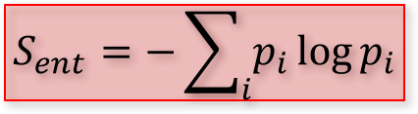

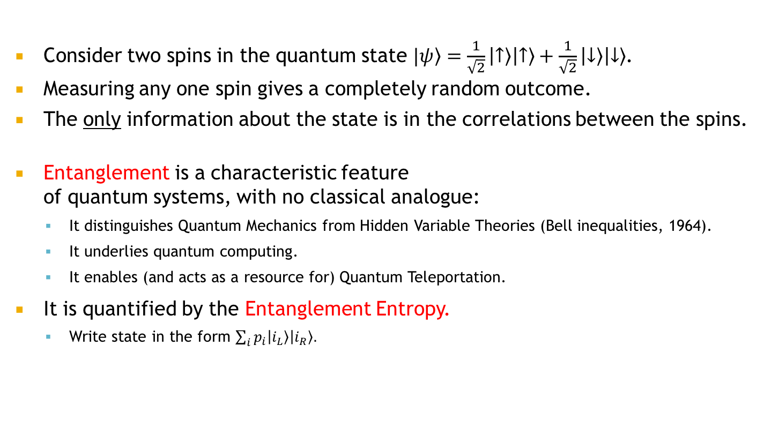
Entanglement:
What Makes Quantum Theories Quantum
Consider two spins in the quantum state $\left.|ψ\right\rangle =\frac{1}{\sqrt{2}}\left|\left.↑\right\rangle \right|\left.↑\right\rangle +\frac{1}{\sqrt{2}}\left|\left.↓\right\rangle \right|\left.↓\right\rangle$.
Measuring any one spin gives a completely random outcome.
The only information about the state is in the correlations between the spins.
Entanglement is a characteristic feature
of quantum systems, with no classical analogue:
  It distinguishes Quantum Mechanics from Hidden Variable Theories (Bell inequalities, 1964).
  It underlies quantum computing.
  It enables (and acts as a resource for) Quantum Teleportation.
It is quantified by the Entanglement Entropy.
  Write state in the form $\sum_{i}{p_{i}\left|\left.i_{L}\right\rangle \right|\left.i_{R}\right\rangle .}$
This is quantum entanglement.
$$S_{ent}=−\sum_{i}{p_{i}\log{p_{i}}}$$
$$\left.|ψ\right\rangle =\frac{1}{\sqrt{2}}\left|\left.↑\right\rangle \right|\left.↑\right\rangle +\frac{1}{\sqrt{2}}\left|\left.↓\right\rangle \right|\left.↓\right\rangle$$
$$\left.|ψ\right\rangle =\frac{1}{\sqrt{5}}\left|\left.↑\right\rangle \right|\left.↑\right\rangle +\frac{2}{\sqrt{5}}\left|\left.↓\right\rangle \right|\left.↓\right\rangle$$
  No local information.
  All information about the state
  is in the correlations between spins.
  Maximal entanglement.
  Some local information (more down than up).
  Some but not all information about the state
  is in the correlations between spins.
  Less than maximal entanglement.

Slide 11

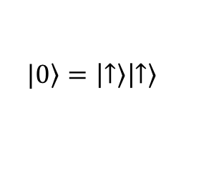





Entanglement for Quantum Gravity?
If entanglement is an essential feature of Quantum Mechanics,
it should be important in Quantum Gravity.
  Is gravitational entropy (black hole entropy, the Holographic Principle) entanglement entropy?
A better reason to study entanglement in Quantum Gravity:
  In quantum field theory, entanglement is a marker of locality.
NEIGHBORING
degrees of freedom are MORE ENTANGLED.
Toy Model:
$$H={−h(σ}_{z}^{L}+σ_{z}^{R})$$
$$H={−h(σ}_{z}^{L}+σ_{z}^{R})−Jσ_{x}^{L}σ_{x}^{R}$$
with $J≪h$
local interaction
$$|\left.0\right\rangle =\left|\left.↑\right\rangle \right|\left.↑\right\rangle$$
$$|\left.0\right\rangle =\left|\left.↑\right\rangle \right|\left.↑\right\rangle +\frac{J}{4h}\left|\left.↓\right\rangle \right|\left.↓\right\rangle$$
$$S_{ent}=0$$
$$S_{ent}=−\frac{J}{4h}\log{\frac{J}{4h}}$$
  Interactions produce entanglement. Local interactions produce local entanglement.
  Lattice field theories (kinetic and potential terms) are built from such local interactions,
  so their ground states are strongly entangled in position space.
  The conclusion extends to local quantum field theories in the continuum.

Slide 12
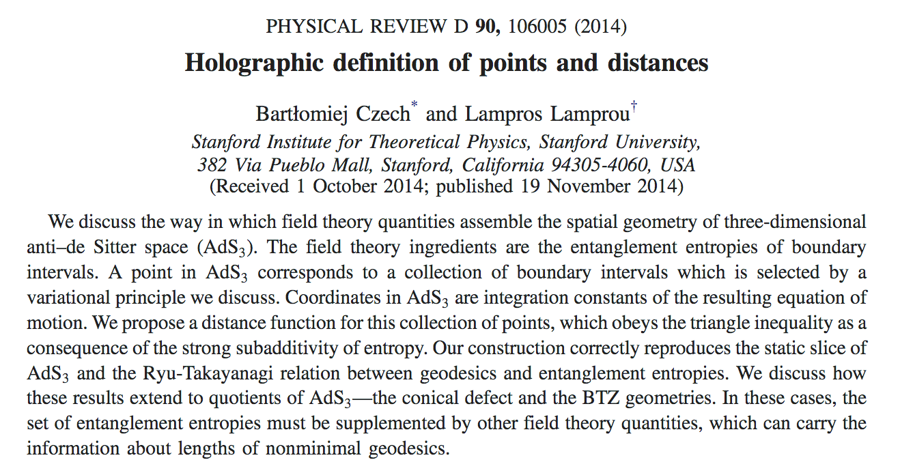
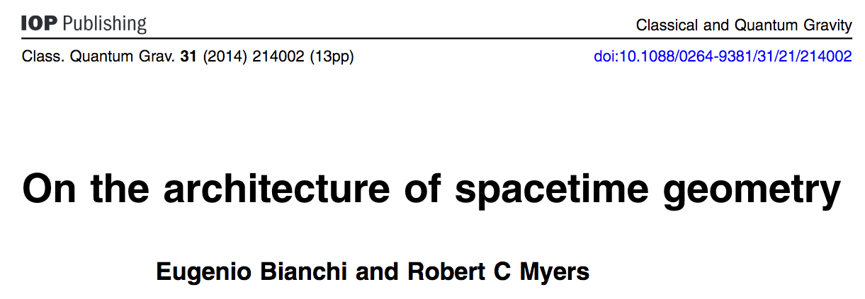
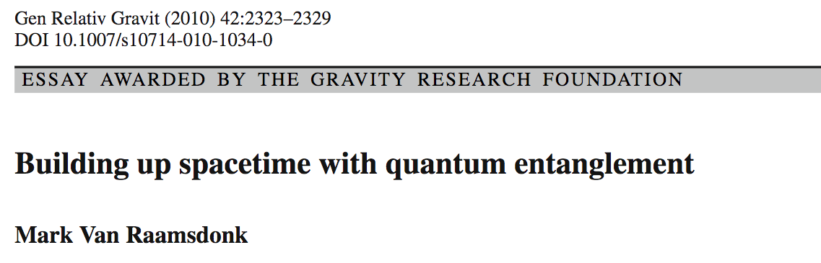
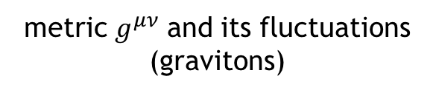
Does Entanglement Define Locality?
NEIGHBORING degrees of freedom are MORE ENTANGLED.
locations of degrees of freedom
pattern of entanglement
This is the exact opposite of what we would want to do in Quantum Gravity:
wavefunction of a quantum state
metric $g^{μν}$ and its fluctuations (gravitons)
pattern of entanglement
locations of degrees of freedom
Are MORE ENTANGLED degrees of freedom NEIGHBORING?
Apply this method
to an example.
Discover the AdS/CFT correspondence.

Slide 13
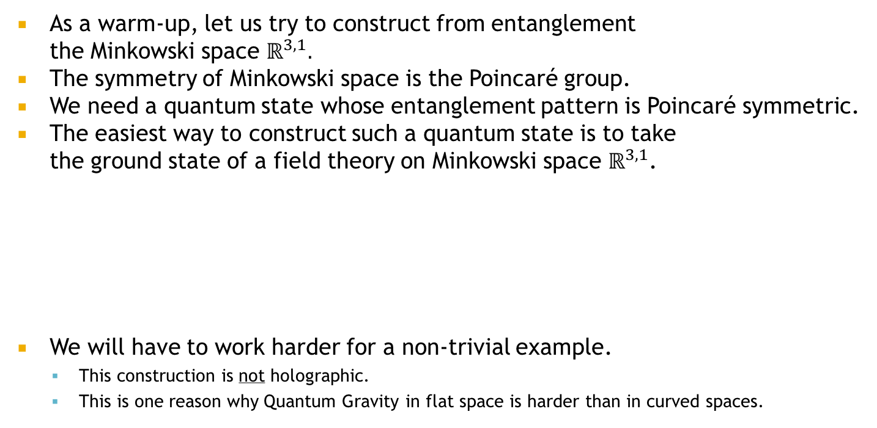

Spacetime from entanglement:
A naive attempt
Are MORE ENTANGLED degrees of freedom NEIGHBORING?
pattern of entanglement
locations of degrees of freedom
As a warm-up, let us try to construct from entanglement
the Minkowski space $ℝ^{3,1}.$
The symmetry of Minkowski space is the Poincaré group.
We need a quantum state whose entanglement pattern is Poincaré symmetric.
The easiest way to construct such a quantum state is to take
the ground state of a field theory on Minkowski space $ℝ^{3,1}$.
We will have to work harder for a non-trivial example.
  This construction is not holographic.
  This is one reason why Quantum Gravity in flat space is harder than in curved spaces.
Minkowski space
$$|\left.φ\right\rangle$$

Slide 14
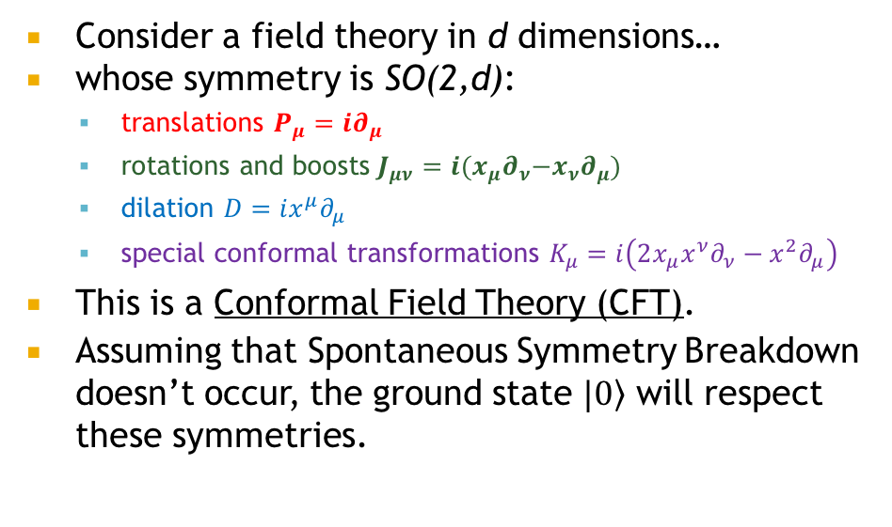


Spacetime from entanglement:
A more sophisticated (and successful) attempt
$$|\left.0\right\rangle$$
$$ℝ^{d−1,1}$$
anti-de Sitter space AdS_{d+1}
Consider a field theory in d dimensions…
whose symmetry is SO(2,d):
  translations $P_{μ}=i∂_{μ}$
  rotations and boosts $J_{μν}=i{(x_{μ}∂}_{ν}−{x_{ν}∂}_{μ})$
  dilation $D=ix^{μ}∂_{μ}$
  special conformal transformations $K_{μ}=i\left(2x_{μ}x^{ν}∂_{ν}−x^{2}∂_{μ}\right)$
This is a Conformal Field Theory (CFT).
Assuming that Spontaneous Symmetry Breakdown
doesn’t occur, the ground state $|\left.0\right\rangle$ will respect these symmetries.
  This theory is holographic:
  We got a d+1-dimensional spacetime
  from the wavefunction of a d-dimensional theory.
  This is not how AdS/CFT was discovered
  (Maldacena 1997).
  Our “derivation” leaves out some issues.
pattern of entanglement
locations of degrees of freedom

Slide 15
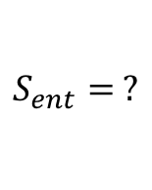




AdS from CFT entanglement
1+1-dim CFT
2+1-dim AdS
CFT scale
$$S_{ent}=\frac{c}{3}\log{\frac{l}{μ}}$$
$$= \frac{R}{2G_{N}}log{\frac{l}{z_{0}}}$$
$$S_{ent}∝\log{\frac{l}{μ}}$$
geodesic length
$$∝ log{\frac{l}{z_{0}}}$$
$$S_{ent}= ?$$
S_{ent} =
Ryu-Takayanagi, 2006
minimal area
(d-1)+1-dim CFT
4 h G_{N}
d+1-dim AdS
CFT scale

Slide 16
Questions about AdS from CFT
How to systematize
this procedure?
Can we derive
Einstein’s Equations
from entanglement?
What new things can we learn from an entanglement-based approach?
What lessons should we draw from this toy model?
Quantum Gravity is an infrared problem. What are the right infrared probes?
Quantum Gravity is holographic.
Can we see a path to other
holographic theories of gravity?
pattern of entanglement
spatial locations of dof’s
We should treat AdS/CFT as a toy model.
Entanglement Entropy

Slide 17
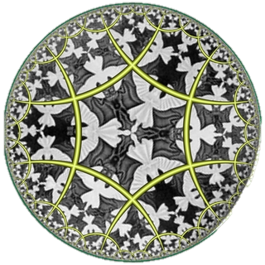
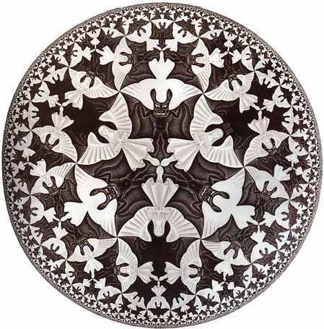
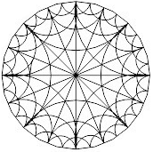
The Kinematic Program
BC et al., 2014-16
A conceptual shift:
Think of spacetime not
as a collection of points,
but as a network of geodesics:
KINEMATIC SPACE is the geometric space whose elements are geodesics.
We will want to think
of Quantum Gravity degrees of freedom
as living not on points but on geodesics.
Our goal is to formulate gravity
in Kinematic Space.
Kinematic Space
Because geodesics are extended objects, they are good candidates for solving the infrared problems of Quantum Gravity.

Slide 18

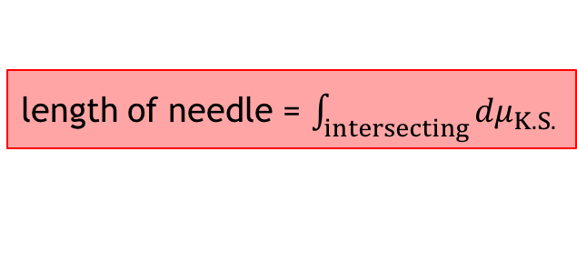
Weaving manifolds from geodesics
Go back to 1733 and meet Comte de Buffon.
(Wikipedia: French naturalist, mathematician and cosmologist…)
“If I drop a needle in my bathroom,
on how many tiles does it land?”
This motivated the Irish mathematician
Morgan Crofton to invent
the Kinematic Space of the Euclidean plane
and prove the following formula (1868):
length of needle = $\int_{intersecting}{dμ_{K.S.}}$
length =
number (measure)
of intersecting lines
This is one of the most robust ways of DEFINING lengths.
Kinematic Space

Slide 19
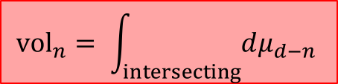
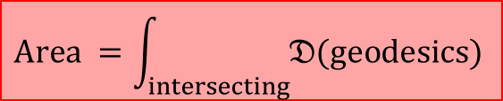
Geodesic Variables are Holographic
BC et al., 2015
Crofton: length = number (measure) of intersecting lines
In homogeneous metric spaces of any curvature, signature and dimension d:
Apply this to areas and geodesics:
Geodesic variables are automatically holographic!
Area of a hypersurface counts
how many homogeneous objects
of complementary dimension intersect it.
$${vol}_{n}= \int_{intersecting}{dμ_{d−n} }$$
$$Area =\int_{intersecting}{𝔇(geodesics) }$$
Entropy
Number of geodesic degrees of freedom

Slide 20

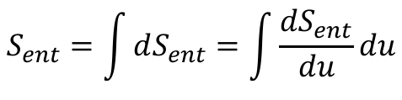
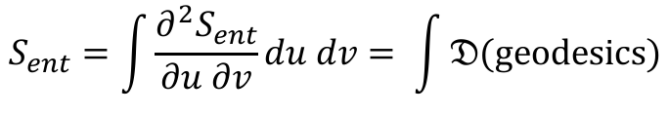


Revisiting Entanglement Entropy in CFT₂
BC et al., 2015
Every “entangled pair” we counted
was associated to a geodesic.
Let’s differentiate this equation:
We can relate it to Crofton’s formula:
$$Area =\int_{intersecting}{𝔇(geodesics) }$$
$$S_{ent}∝\log{\frac{l}{μ}}$$
$$S_{ent}=\int{dS_{ent}}=\int{\frac{dS_{ent}}{du}}du$$
$$S_{ent}=\int{\frac{∂^{2}S_{ent}}{∂u ∂v}}du dv= \int{𝔇(geodesics)}$$
right endpoint v
A density of geodesics!
$$\frac{∂^{2}S_{ent}}{∂u ∂v} du dv=𝔇(geodesics)$$
left endpoint u
  This measure is guaranteed to be positive by the
  Strong Subadditivity of Entanglement Entropy (1973):
  there are no ”negative weight” geodesics!
Kinematic Space

Slide 21
Kinematic Formalism in AdS/CFT
Our strategy is to think about
gravitational spacetimes
as networks of geodesics.
Eventually, we will apply this strategy
more broadly.
But as a first test, let us examine
its usefulness in AdS/CFT.
  If it is a good formalism, it should teach us new things
  (or clarify confusing old things) about AdS/CFT.

Slide 22
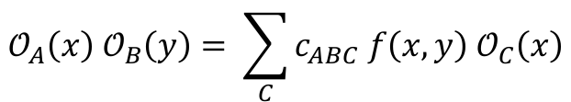
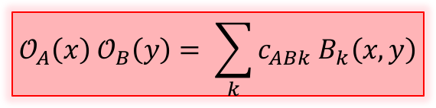
Geodesic degrees of freedom
—a CFT perspective
BC et al., 2016
Kinematic space consists of AdS geodesics.
Each geodesic reaches the boundary at two points.
What operation applies to pairs of CFT pts?
  In a CFT, the OPE has a finite radius of convergence.
  All correlation functions can be calculated using the OPE.
  The OPE coefficients form the complete set of dynamical data.
What symmetries preserve a pair of points?
  Translation along geodesics is come combination of conformal generators.
  This symmetry must transform the OPE expansion to itself.
OPE expansion is built up
of multiplets of this symmetry:
Kinematic Space consists of pairs of CFT points.
time
  Operator Product Expansion (OPE):
many terms:
all operators in the CFT
$$𝒪_{A}\left(x\right){ 𝒪}_{B}\left(y\right)= \sum_{C}{c_{ABC}{ f\left(x,y\right) 𝒪}_{C}\left(x\right)}$$
O_{B}
O_{A}
OPE blocks:
  irreducible building blocks of the OPE
  (many fewer terms)
  OPE blocks live in Kinematic Space!
$$𝒪_{A}\left(x\right){ 𝒪}_{B}\left(y\right)= \sum_{k}{c_{ABk}{ B}_{k}\left(x,y\right)}$$

Slide 23

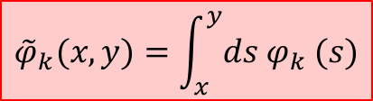
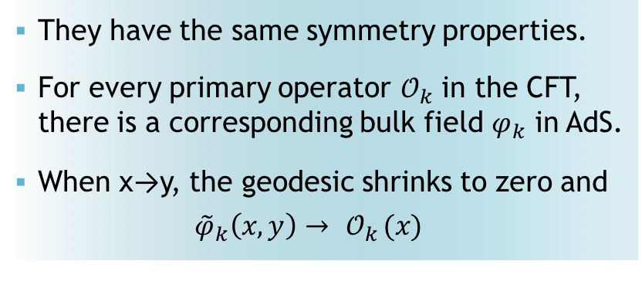
Geodesic operators in AdS are OPE blocks in CFT!
BC et al., 2016
OPE expansion in OPE blocks:
$$𝒪_{A}\left(x\right){ 𝒪}_{B}\left(y\right)= \sum_{k}{c_{ABk}{ B}_{k}\left(x,y\right)}$$
time
$${\tilde{φ}}_{k}(x,y)=\int_{x}^{y}{ds φ_{k} (s)}$$
O_{A}
O_{B}
geodesic operators in AdS
  They have the same symmetry properties.
  For every primary operator ${ 𝒪}_{k}$ in the CFT,
  there is a corresponding bulk field $φ_{k}$ in AdS.
  When x→y, the geodesic shrinks to zero and
  ${\tilde{φ}}_{k}\left(x,y\right)→ { 𝒪}_{k}(x)$
A new entry in the holographic dictionary!

Slide 24

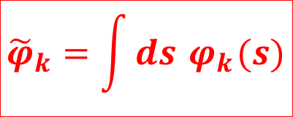
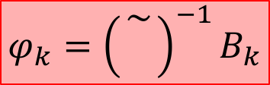
Recovering the point-wise description
BC et al., 2016
Radon transform ~
time
time
$$φ_{k}$$
$${\tilde{φ}}_{k}=\int{ds}{ φ}_{k}(s)$$
(~)^{—1}
inverse transform
  Local operators in AdS are inverse Radon transforms of OPE blocks in the CFT.
  They take the form of CFT operators smeared all around the boundary.
  Operators constructed this way automatically obey
  the Klein-Gordon equation in AdS.
$$φ_{k}={\left({\sim \atop }\right)}^{−1}B_{k}$$

Slide 25


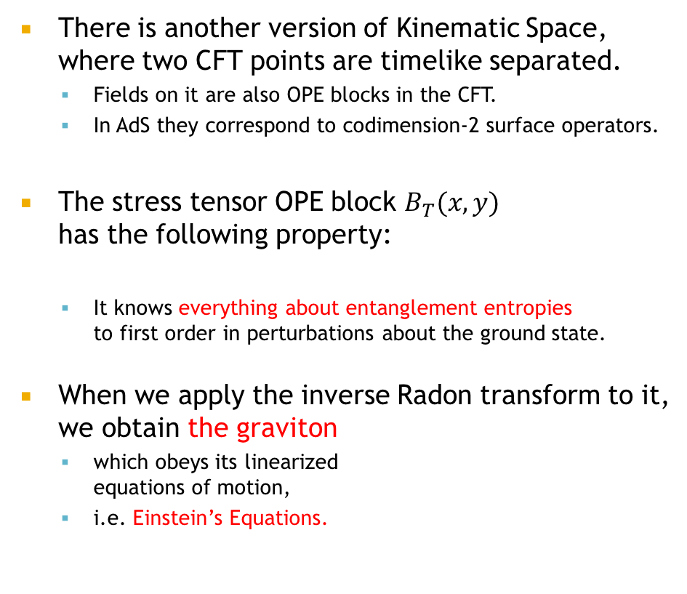
Einstein Equations from Entanglement
BC et al., 2016
There is another version of Kinematic Space,
where two CFT points are timelike separated.
  Fields on it are also OPE blocks in the CFT.
  In AdS they correspond to codimension-2 surface operators.
The stress tensor OPE block $B_{T}(x,y)$
has the following property:
  It knows everything about entanglement entropies
  to first order in perturbations about the ground state.
When we apply the inverse Radon transform to it,
we obtain the graviton
  which obeys its linearized
  equations of motion,
  i.e. Einstein’s Equations.
time
localized on areas!
$$δS_{ent}=δ\left\langle B_{T}\right\rangle$$
$${δg}_{μν}={\left({\sim \atop }\right)}^{−1}B_{T_{μν}}$$
  “Entanglement Dynamics” is just one facet
  of the Kinematic Program
We derived linearized Einstein’s Equations from entanglement!

Slide 26
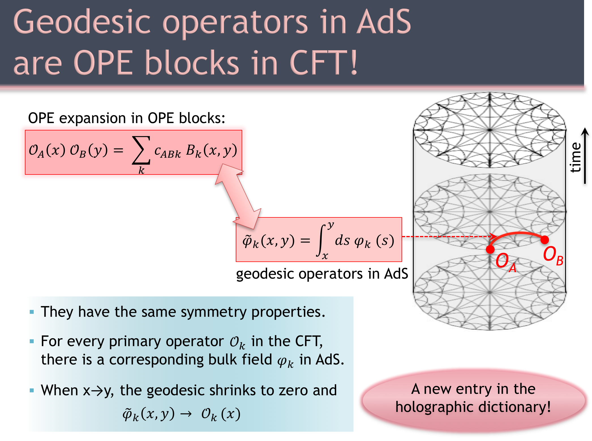
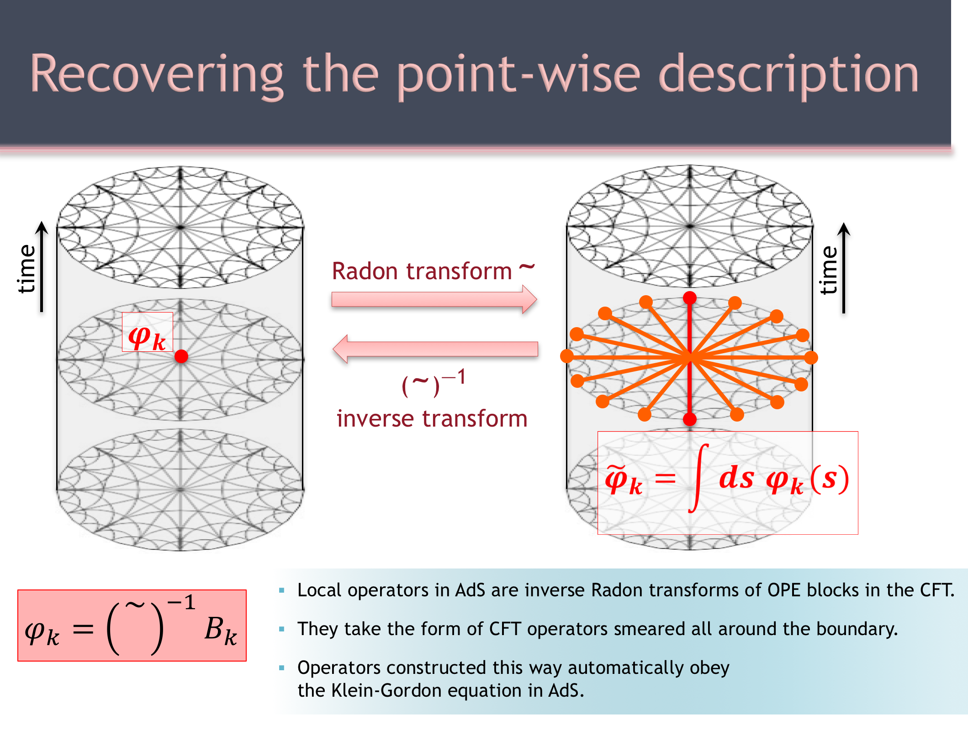
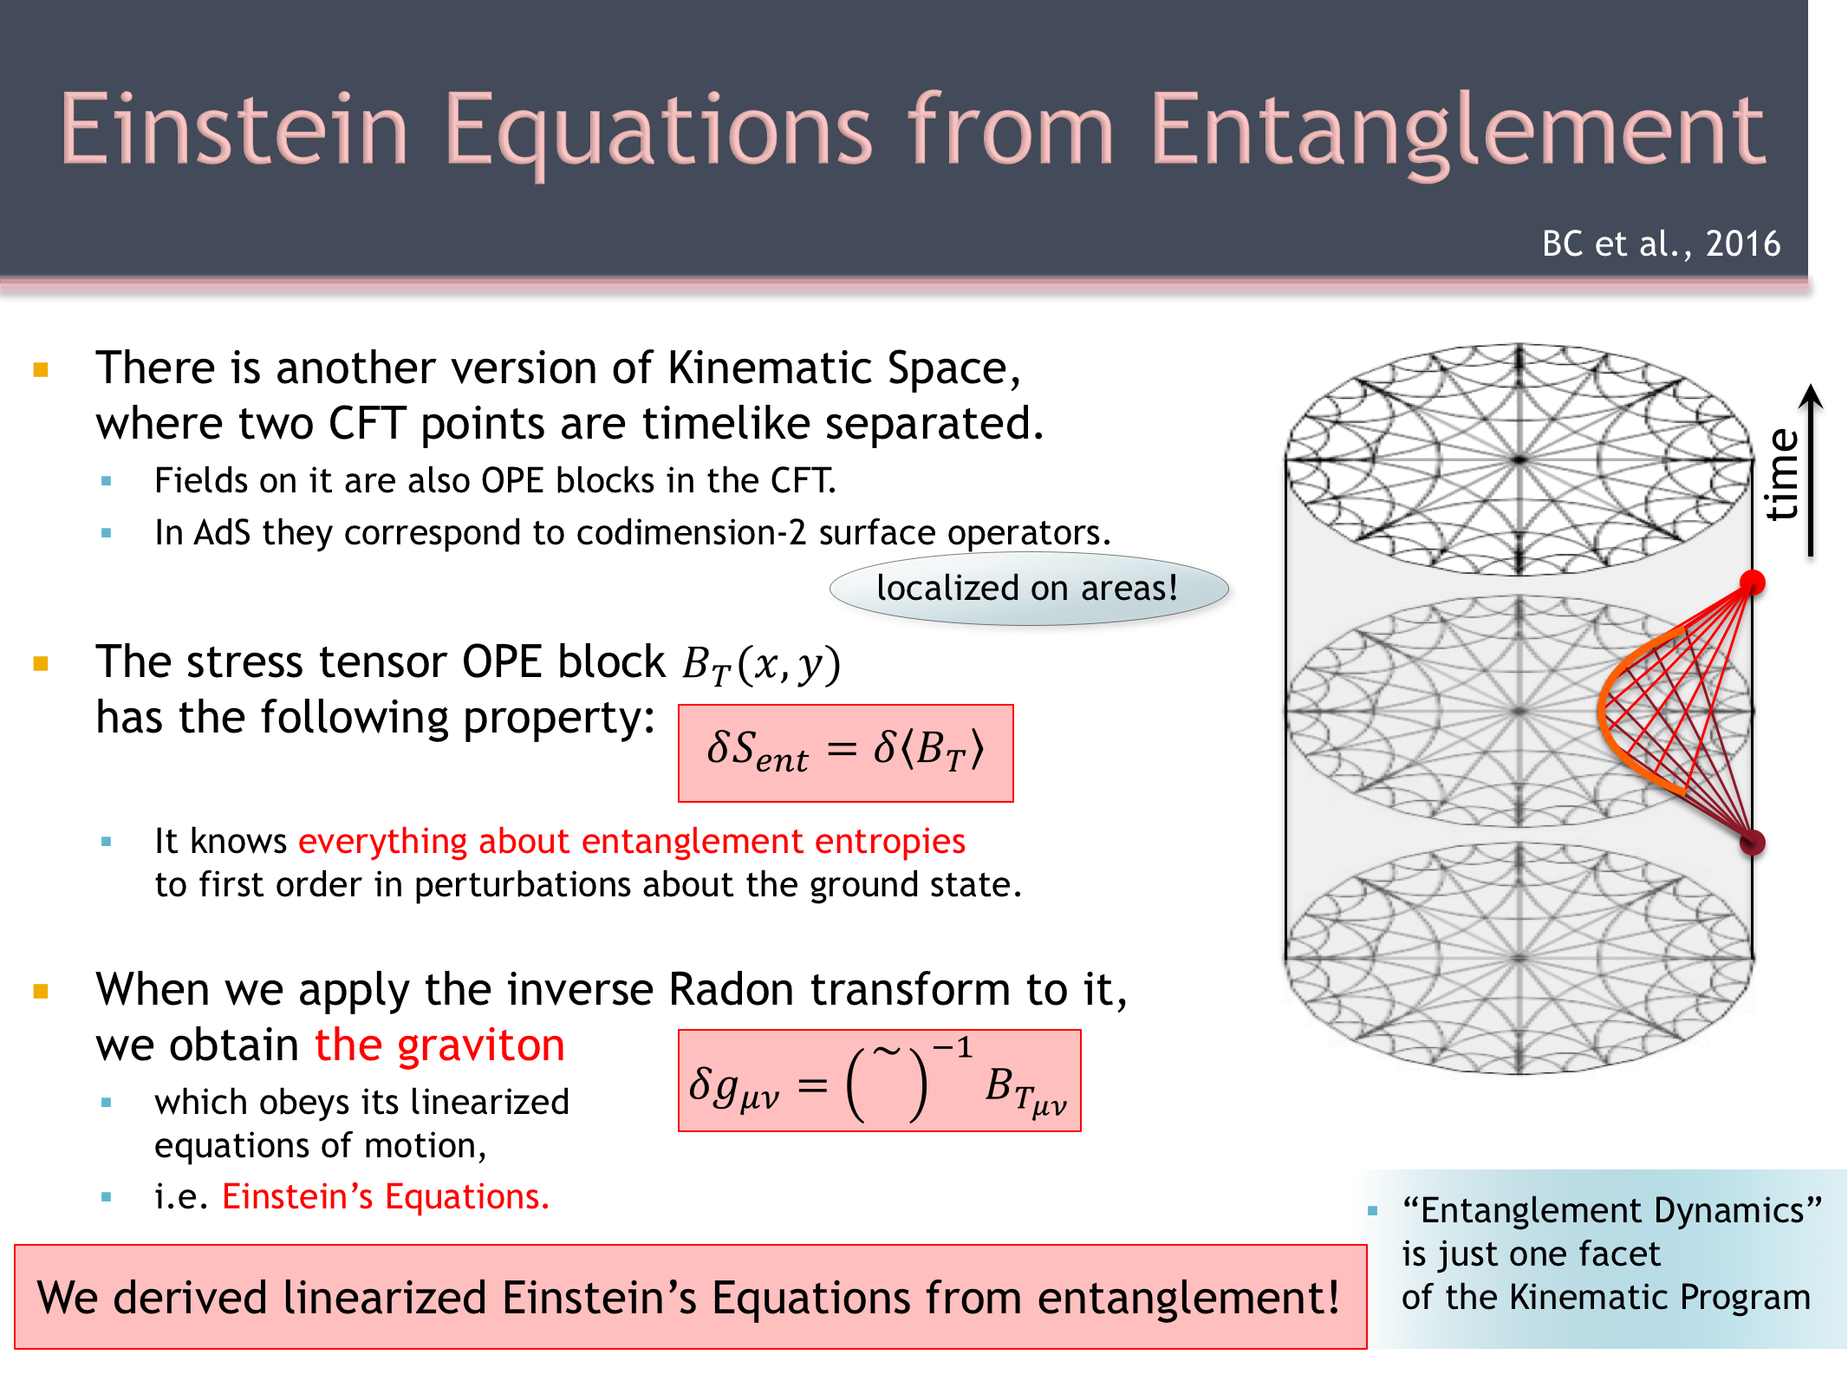
The kinematic formalism in AdS/CFT
We know
how to map back and forth between the geodesic-wise
and the old point-wise formalism.
We found a new entry in the holographic AdS ↔ CFT dictionary.
We recognized properties of entanglement
as a special case of the formalism.
We derived linearized Einstein’s Equations
in AdS from CFT entanglement.

Slide 27
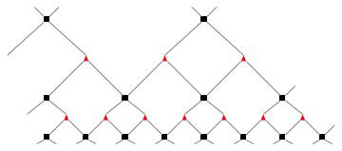
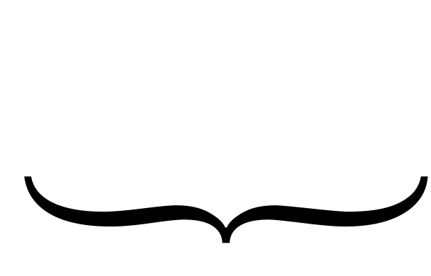

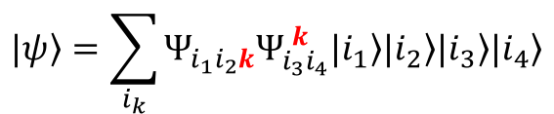


Other Application 1: Tensor Networks
BC et al., 2015
Consider the task of simulating a CFT on a computer:
Wavefunction components
form a tensor.
Tensor Networks represent it
as a contraction
of smaller tensors:
The network for
a CFT ground state is MERA: Vidal, 2005
$$|\left.ψ\right\rangle =\sum_{i_{1}…i_{n}}{Ψ_{i_{1}…i_{n}} |\left.i_{1}\right\rangle …|\left.i_{n}\right\rangle }$$
$$…$$
n legs
k
$$|\left.ψ\right\rangle =\sum_{i_{k}}{Ψ_{i_{1}i_{2}k}Ψ_{i_{3}i_{4}}^{ k}|\left.i_{1}\right\rangle |\left.i_{2}\right\rangle |\left.i_{3}\right\rangle |\left.i_{4}\right\rangle }$$
This fact
has allowed G. Vidal
and me to discover previously unknown properties of MERA: (i) apply local conformal transformations,
(ii) construct a thermal
state MERA, (iii) take quotients…
  The two-to-one structure mimics the OPE.
  The red tensors essentially encode OPE coefficients.
  They map operators
  to OPE blocks.
$${|\left.ψ\right\rangle }_{CFT}=$$

Slide 28



Other Application 2: Streaming Protocol
BC et al., 2014
AdS₃/CFT₂ :
Geodesic length computes the entanglement entropy.
A general curve’s length computes the “differential entropy.”
The shape of the curve determines the parameters of the streaming.
This is the cost of “teleporting” the state in compressed form,
all in one go
A new protocol in
Quantum Information Theory!
This is the cost of “streaming” the state piecemeal.

Slide 29





Other Application 3: modular Berry phase
BC et al., 2017-19
Study a system with a time- dependent Hamiltonian, initially in the ground state:
Say the time dependence is ADIABATICALLY SLOW:
  System remains in ground state
  Time reversibility means:
This is a differential equation
for the phase of $\left.|φ\right\rangle$!
The solution (phase)
is the famous Berry phase.
  very important in
  Condensed Matter Theory
  never previously related to entanglement or AdS/CFT
IDEA:
Let the time-dependent Hamiltonians be Rindler (modular) Hamiltonians!
odd under time reversal
Modular Berry Phase:
“time”-dependence
is region dependence!
“Berry phase”
is Rindler boost
Generated by parallel
transport of surfaces
in spacetime
(a path in kinematic space)
$$|{\left.0\right\rangle }_{M}=\sum_{n}{e^{−{πE}_{n}}|{\left.E_{n}\right\rangle }_{L}|{\left.E_{n}\right\rangle }_{R}}$$
$$|{\left.0\right\rangle }_{M}=\sum_{n}{e^{−{πE}_{n}}|{\left.E_{n}\right\rangle }_{L}|{\left.E_{n}\right\rangle }_{R}}$$
  This is the origin of spacetime curvature
  in holographic duality
  It is a recipe for how to glue up
  a spacetime out of entangled subregions
  A completely novel way to characterize
  or classify entanglement in many-body systems!

Slide 30
Next task: de Sitter space
Thus far, we used Kinematic Space
as an auxiliary construct
for AdS and CFT:
The Kinematic Space of balls in
a Euclidean CFT
is an expanding geometry:
de Sitter space!
time
Kinematic Space
Can we use
Kinematic Space
to get new insights about an expanding Universe?
Its properties reproduce many facts about
a conjectured dS/CFT Correspondence.
(Strominger 2001)

Slide 31
Future directions
Adding depth:
Other kinematic spaces
  Triples of CFT points—interactions?
Beyond entanglement
  Entwinement
What is TIME?
Adding breadth:
de Sitter space
Flat space?
  BMS symmetry (Hawking-Perry-Strominger, 2016)
Side applications:
Better Tensor Networks?
Information Theory? Complexity?
Kinematic Space
Thank you!

