Slide 1
Physics Opportunities with
Supernova Neutrinos
周 顺
中科院高能所理论室
中国科学技术大学交叉学科理论研究中心
合肥，2015-3-26

Slide 2
Outline
Supernova Neutrinos
Physics Opportunities
Neutrino Mass Scale
WDM Sterile Neutrinos
Summary and Outlook

Slide 3
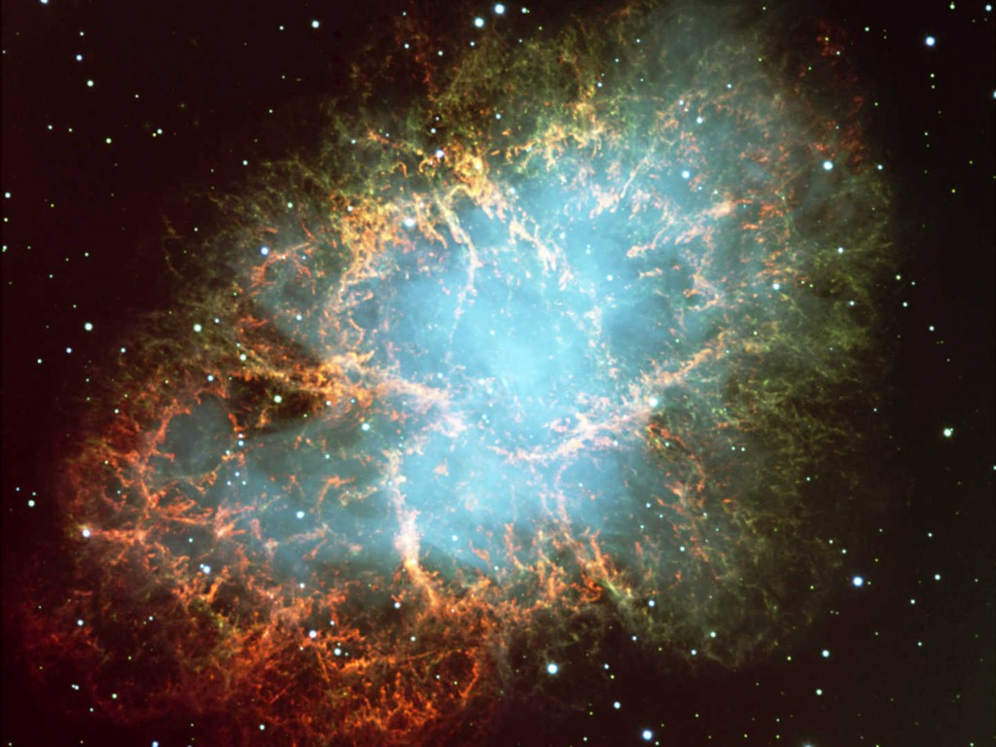
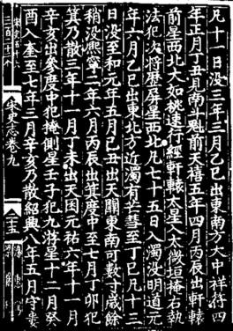
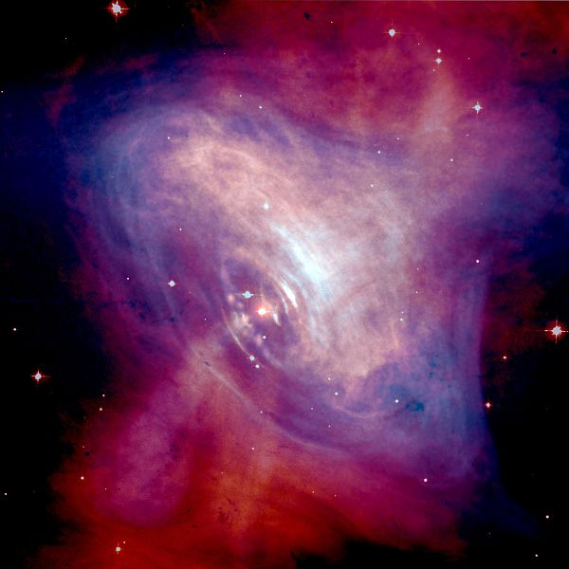
Galactic SN 1054
Distance: 6500 light years (2 kpc)
Center: Neutron Star ( R~30 km)
Progenitor : M ~ 10 solar masses
Red：Optical (Hubble)
Blue：X-Ray (Chandra)

Slide 4
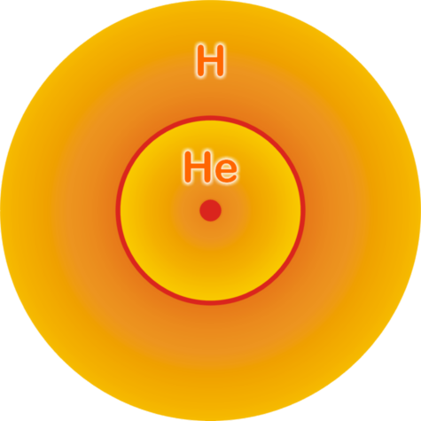

Stellar Collapse and SN Explosion
© Raffelt
Main-sequence star
Helium-burning star
Hydrogen Burning
Helium
Burning
Hydrogen
Burning

Slide 5
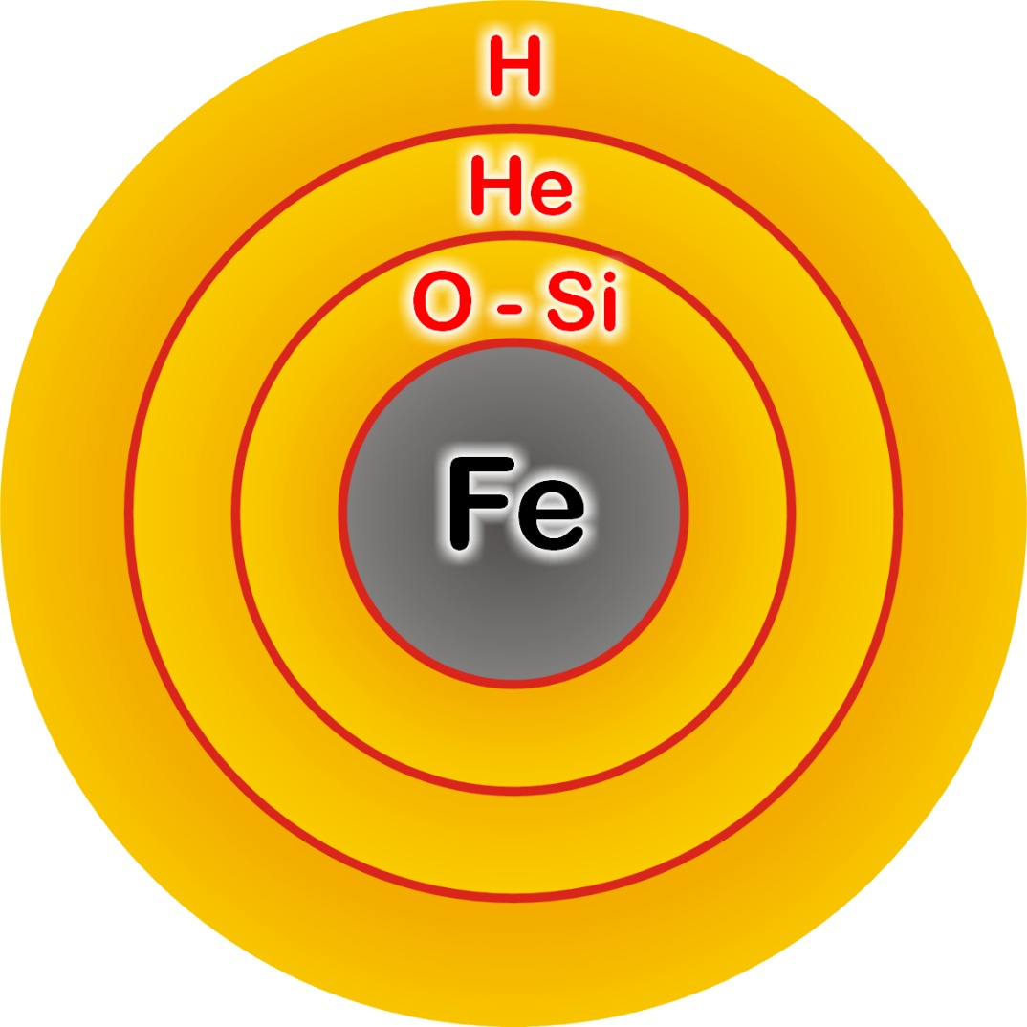

Stellar Collapse and SN Explosion
© Raffelt
Onion structure
Collapse (implosion)
Degenerate iron core:
ρ ≈ 10⁹ g cm⁻³
T ≈ 10¹⁰ K
M_{Fe} ≈ 1.5 M_{sun}
R_{Fe} ≈ 8000 km

Slide 6



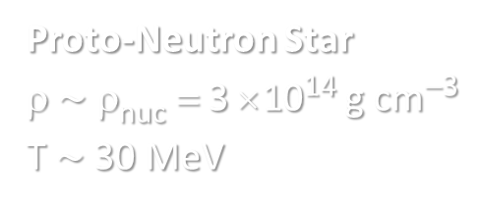

Stellar Collapse and SN Explosion
© Raffelt
Newborn Neutron Star
Neutrino-driven Explosion
$\sim$ 50 km
Proto-Neutron Star
ρ $\sim$ ρ_{nuc} = 3 × 10¹⁴ g cm⁻³
T $\sim$ 30 MeV

Slide 7

Stellar Collapse and SN Explosion
© Raffelt
Newborn Neutron Star
Gravitational binding energy
E_{b} ≈ 3 × 10⁵³ erg ≈ 17% M_{SUN} c²
$\sim$ 50 km
This shows up as
99% Neutrinos
1% Kinetic energy of explosion
(1% of this into cosmic rays)
0.01% Photons, outshine host galaxy
Neutrino cooling
by diffusion
Neutrino luminosity
L_{ν} ≈ 3 × 10⁵³ erg / 3 sec
≈ 3 × 10¹⁹ L_{SUN}
While it lasts, outshines the entire
visible universe
Proto-Neutron Star
ρ $\sim$ ρ_{nuc} = 3 × 10¹⁴ g cm⁻³
T $\sim$ 30 MeV

Slide 8
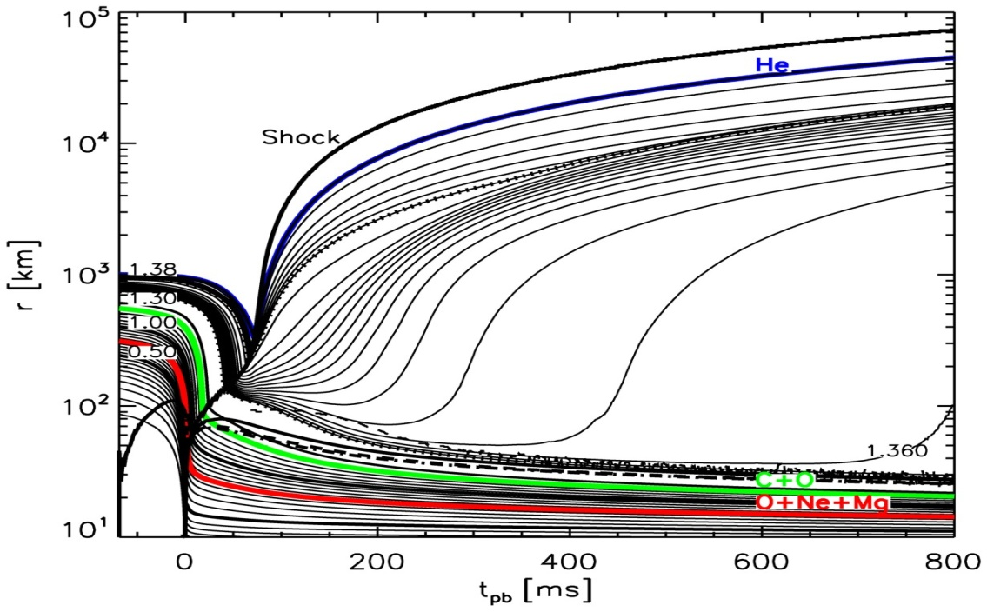
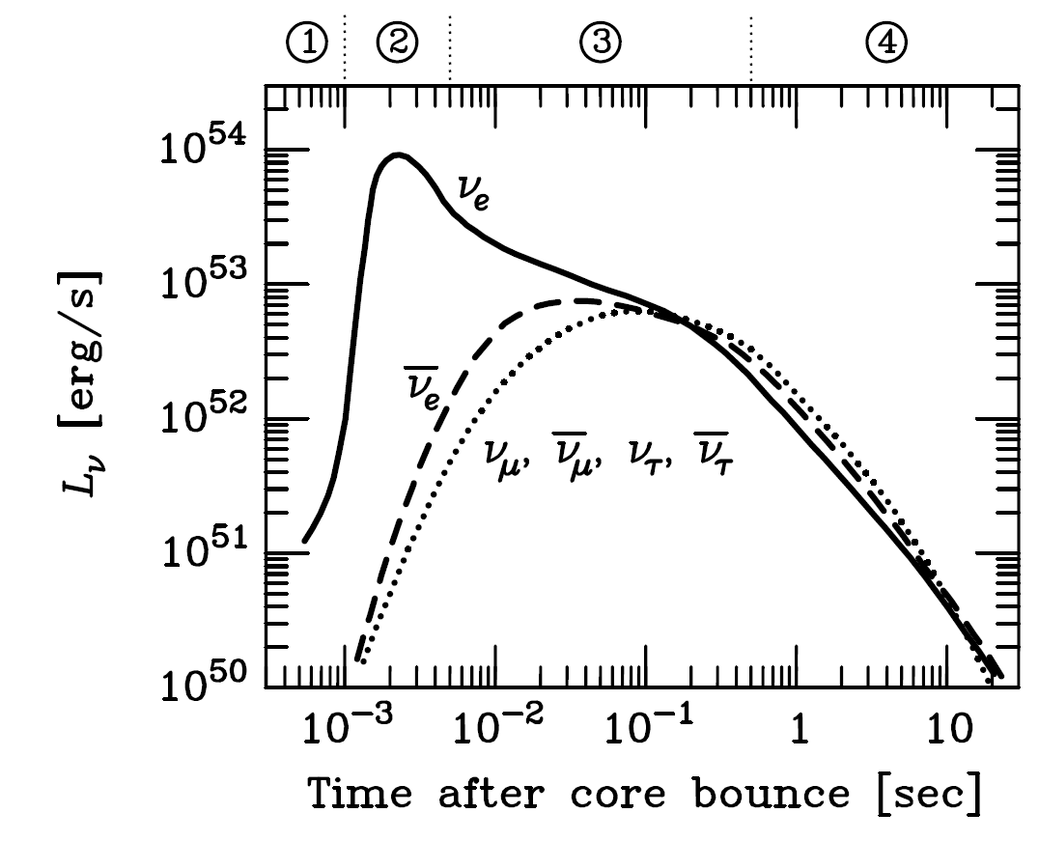
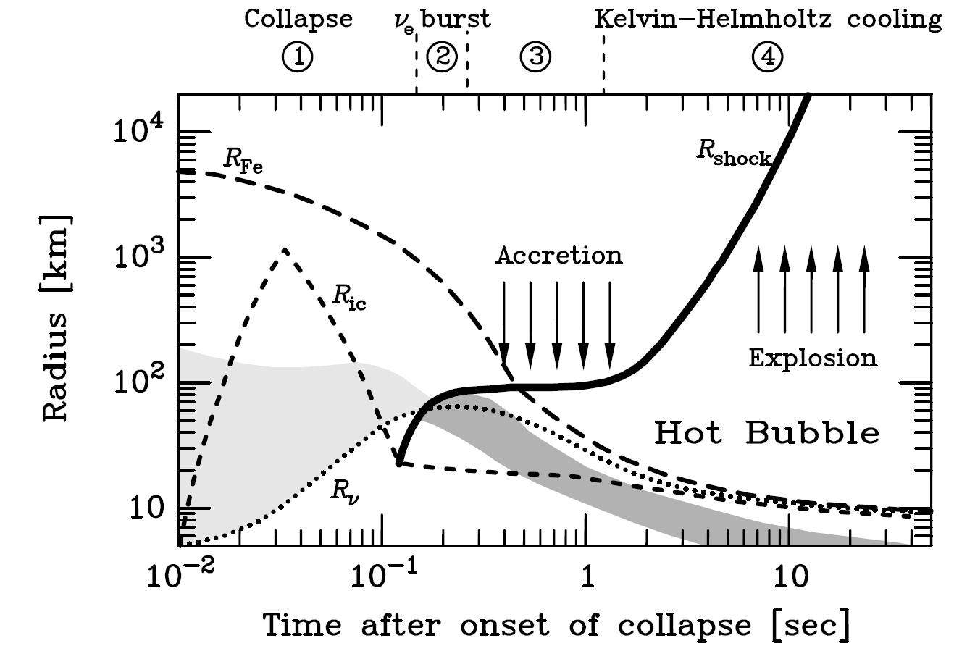
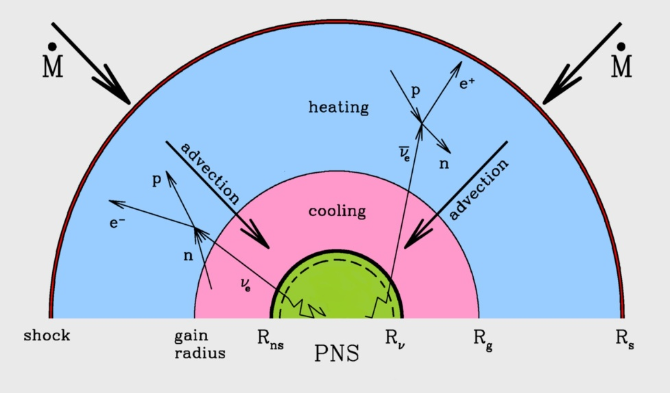
Supernova Neutrinos: Theoretical Prediction
Kitaura, Janka & Hillebrandt
astro-ph/0512065
Raffelt, 1996

Slide 9
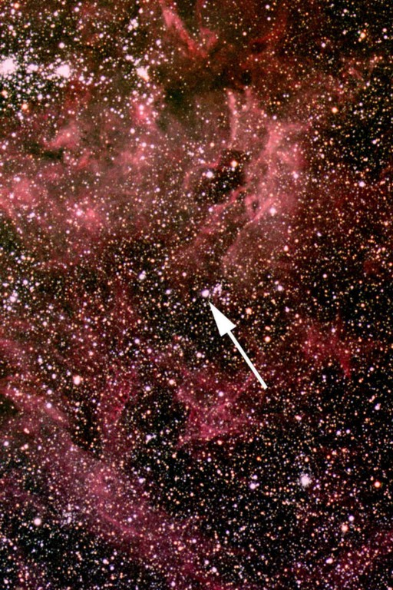
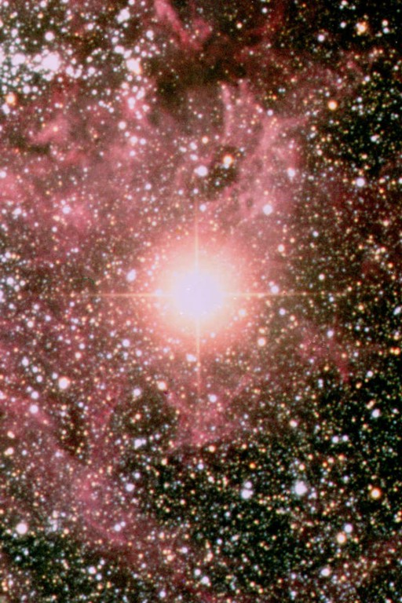
Large Magellanic Cloud SN 1987A
Sanduleak - 69 202
Supernova 1987A
23 February 1987
Distance：165 000 light yrs (50 kpc)
Center：Neutron Star
(expected, but not found)
Progenitor： M ~ 18 solar masses

Slide 10
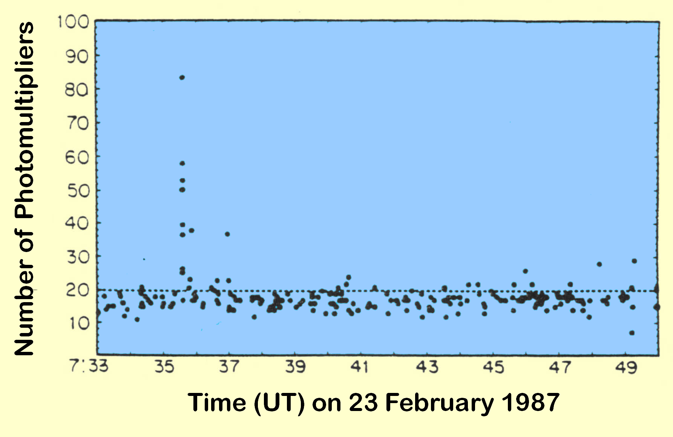
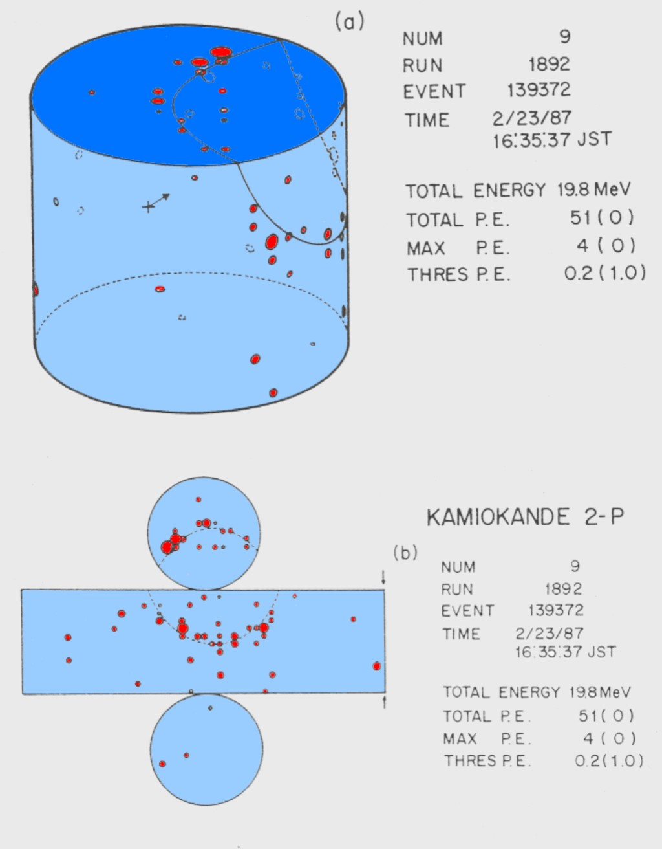
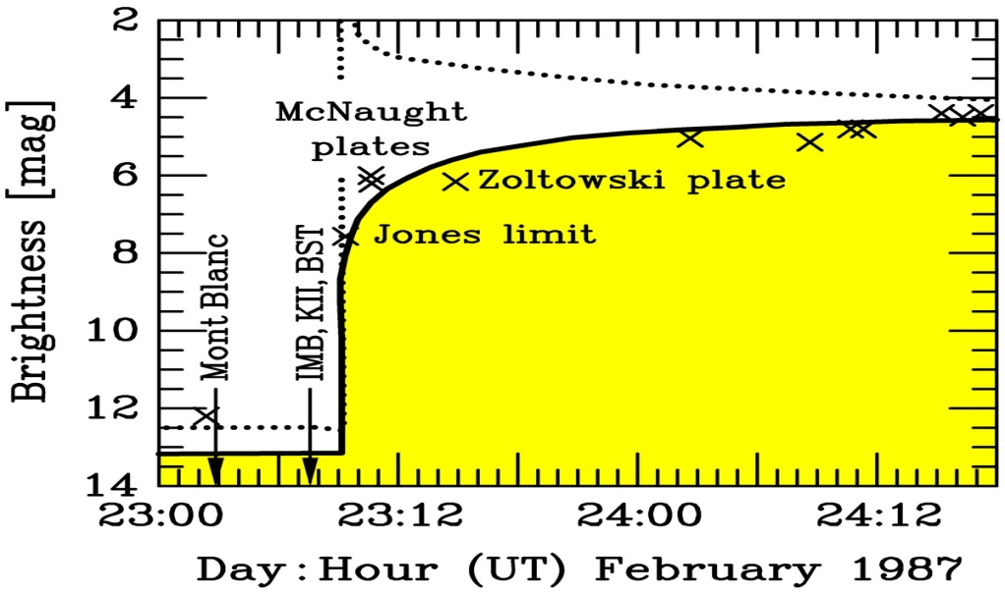
Supernova Neutrinos: SN 1987A
Arnett et al.,
ARAA 27 (1989)
Hirata et al., PRD 38 (1988) 448

Slide 11
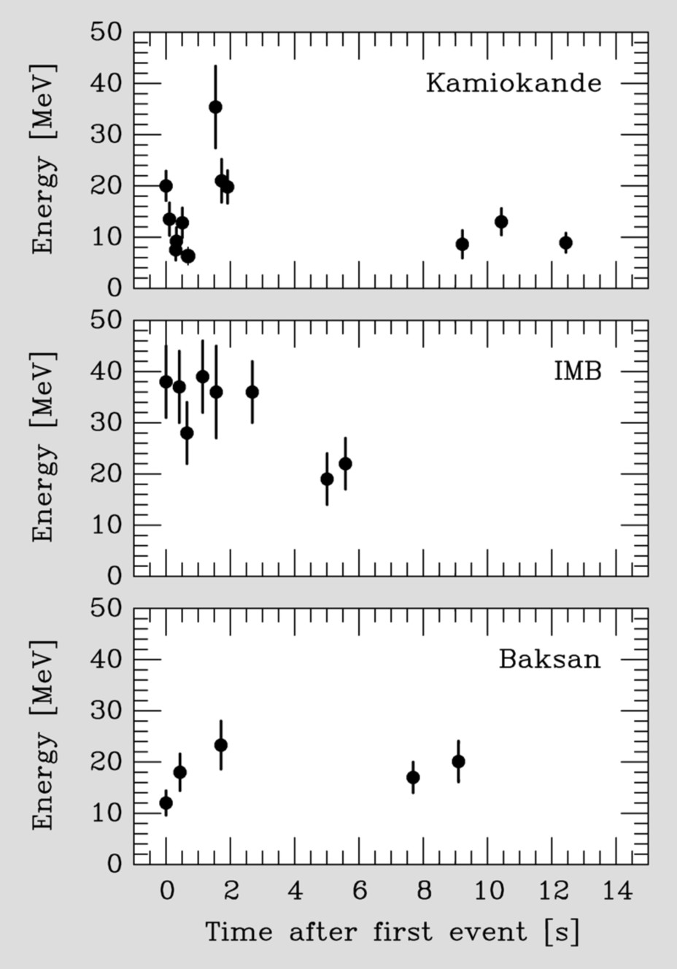
Supernova Neutrinos: SN 1987A
Kamiokande-II (Japan):
Water Cherenkov (2,140 ton)
Clock Uncertainty ± 1 min
Irvine-Michigan-Brookhaven (US):
Water Cherenkov (6,800 ton)
Clock Uncertainty ±50 ms
Baksan LST (Soviet Union):
Liquid Scintillator (200 ton)
Clock Uncertainty +2/-54 s
Mont Blanc: 5 events, 5 h earlier

Slide 12
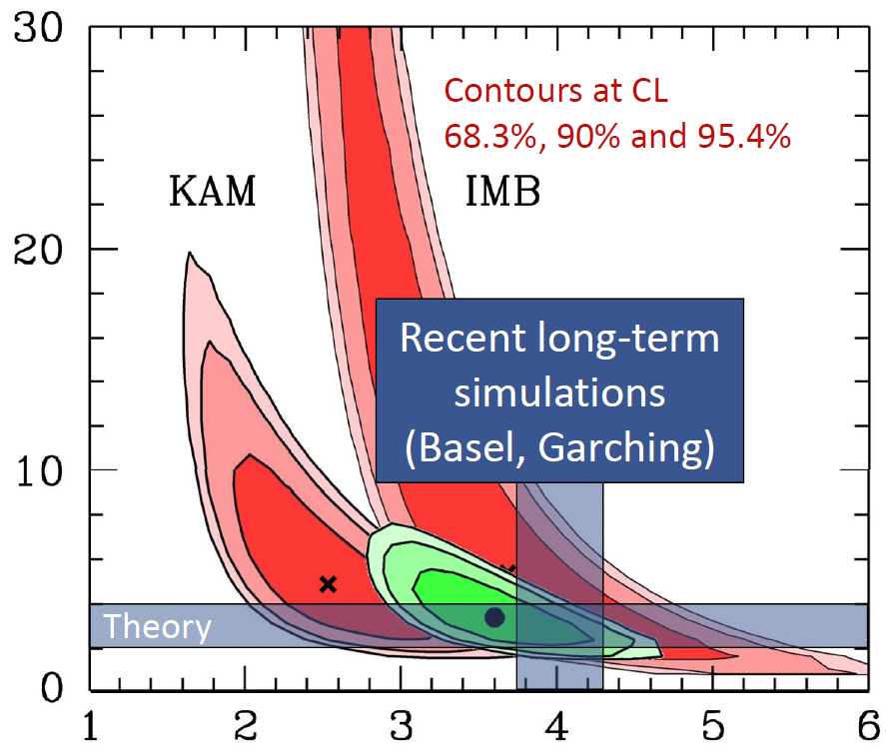
Supernova Neutrinos: SN 1987A
Assumptions:
Thermal
Equipart.
Jegerlehner, Neubig & Raffelt
astro-ph/9601111
Conclusions:
Collapse
Ave.Ener.
Duration
E_{b} [10⁵³ ergs]
Problems：
24 events
by chance
Spectral anti-ν_{e} Temperature [MeV]

Slide 13
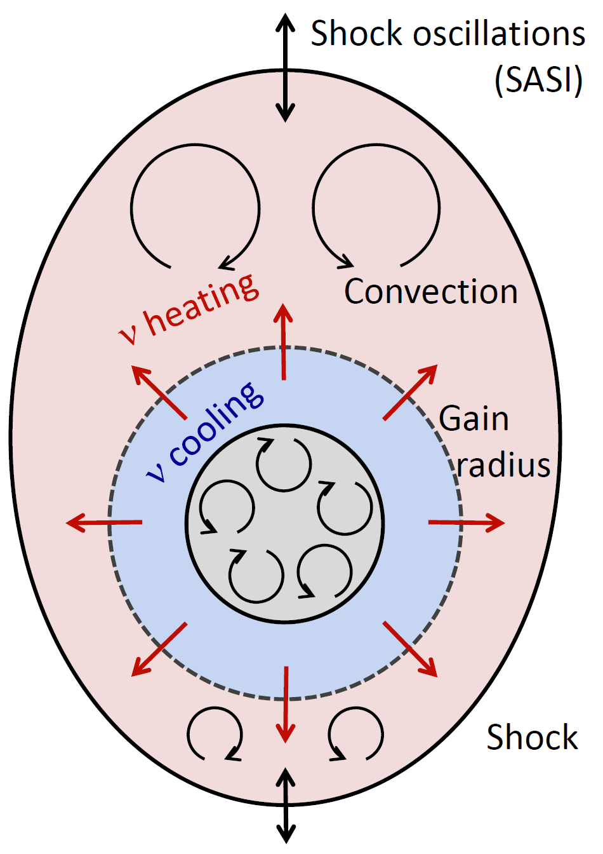
Supernova Neutrinos: Astrophysics & Astronomy
Explosion Mechanism：Neutrino-driven Explosion
The prompt shock halted at 150 km,
by disintegrating heavy nuclei
Neutrinos deposit their energies via
interaction with matter; 1 % neutrino
energy leads to successful explosion
Simulations in 1D & 2D for different
progenitor masses observe explosions
3D simulation has just begun; but no
clear picture (resolution, progenitors)
for a review, Janka, 1211.1378

Slide 14

Supernova Neutrinos: Astrophysics & Astronomy
For Optical Observations：SuperNova Early Warning System (SNEWS)
Arnett et al.,
ARAA 27 (1989)
http://snews.bnl.gov/
Super-K
IceCube
LVD
Borexino
Neutrinos arrive several hours before photons
To alert astronomers several hours in advance
Alert @BNL

Slide 15
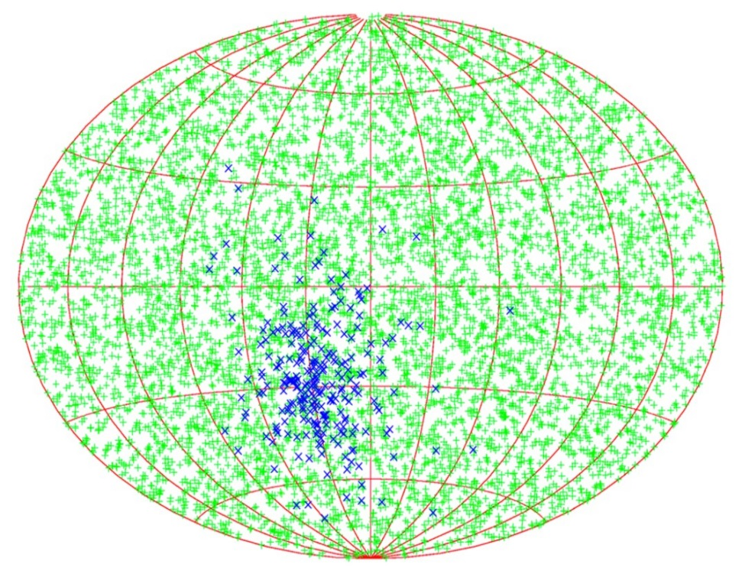
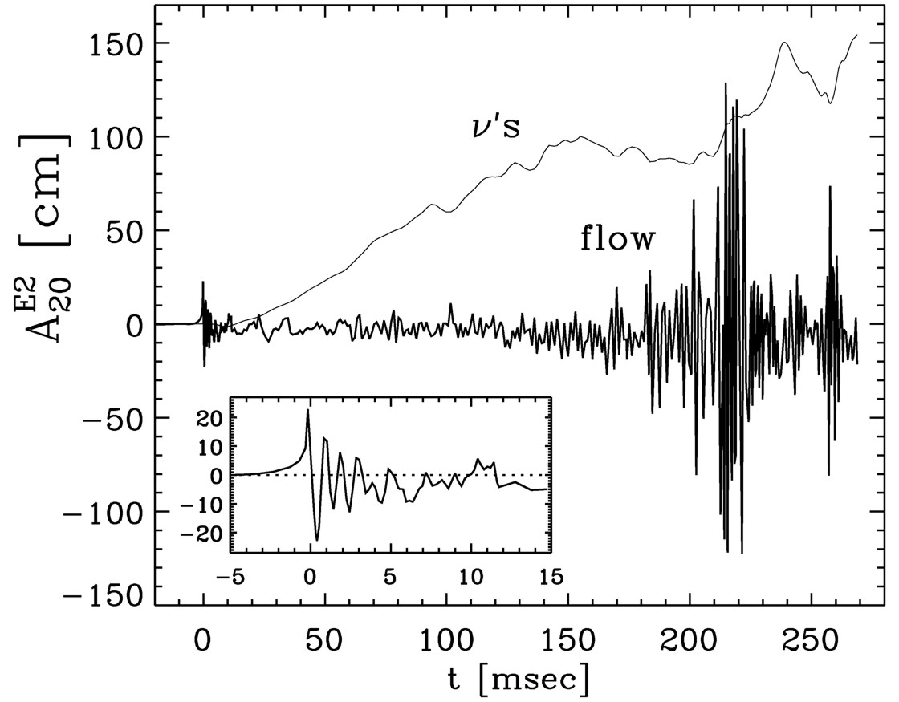
Supernova Neutrinos: Astrophysics & Astronomy
Gravitational waves from SN Explosions
Locate the SN via neutrinos
Tomàs et al., hep-ph/0307050
Müller, Rampp, Buras, Janka,& Shoemaker,
astro-ph/0309833
“Towards gravitational wave signals from
realistic core collapse supernova models”
GWs from asymmetric
neutrino emission
Beacom & Vogel, astro-ph/9811350
n-tagging efficiency
95% CL half-cone
opening angle
None
90 %
GWs from convective mass flows
7.8°
3.2°
SK
Bounce
1.4°
0.6°
SK × 30

Slide 16
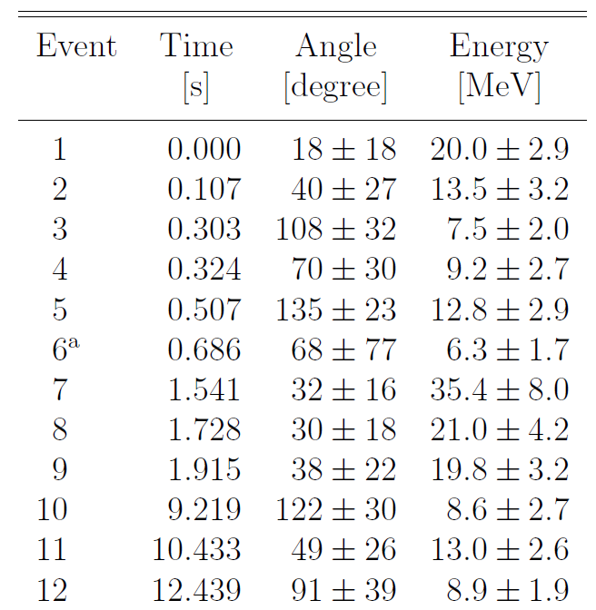
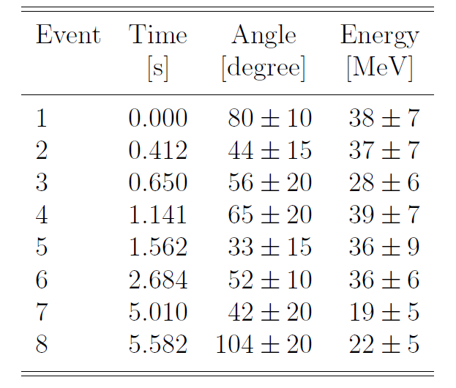
Supernova Neutrinos: Elementary Particle Physics
Neutrino Mass Bound：Time delay of massive particles
G. Zatsepin, 1968
Kamiokande-II data
Estimate:
Take the first event A: (t_{A}, E_{A})
Take the last event B: (t_{B}, E_{B})
IMB data
Assumptions:
Instant. emission
Diff. only from m
Schramm, CNPP 17 (1987) 239

Slide 17
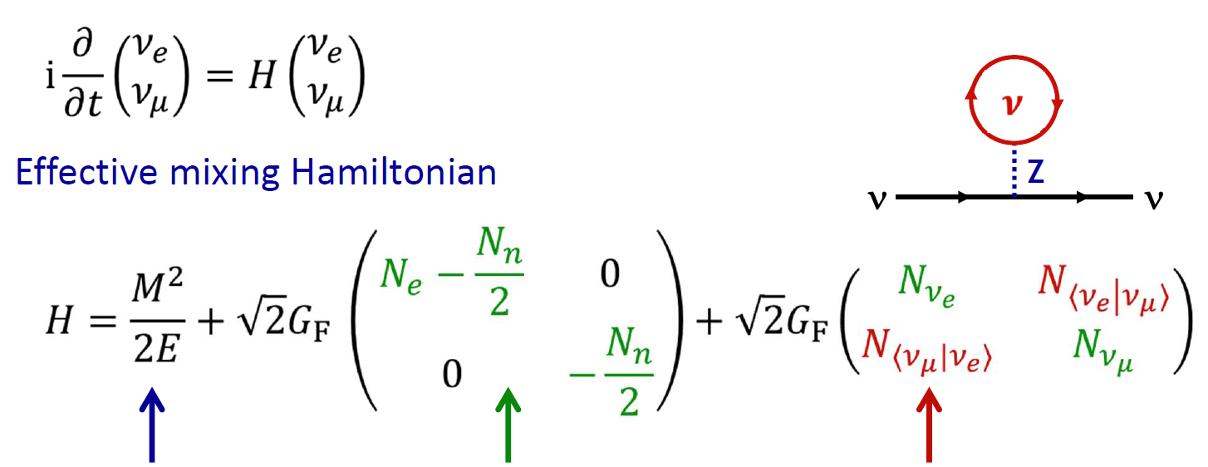
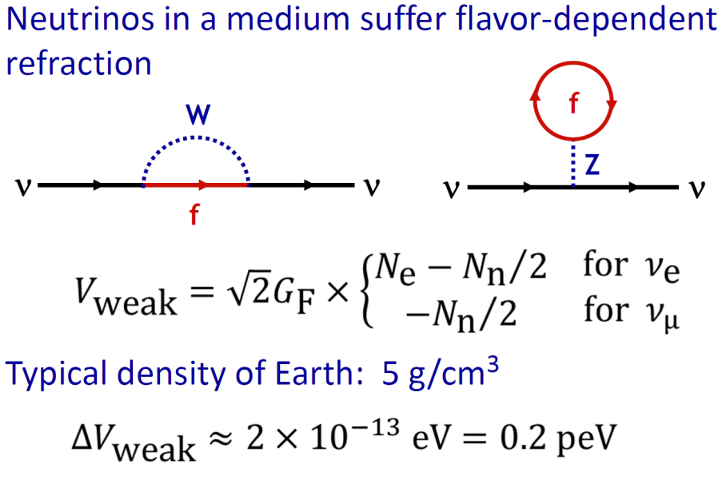
Supernova Neutrinos: Elementary Particle Physics
Flavor Conversion & Matter Effects: Source ─ Prop. ─ Detector
Wolfenstein, 78
Mikheyev&Smirnov, 85
Pantaleone, 92
Neutrino sphere
Vacuum
MSW
Collective
Matter Effects:
Envelope
Shock wave
Earth matter
Mass ordering
High Matter Density:
High interaction rate
Flavors conserved

Slide 18
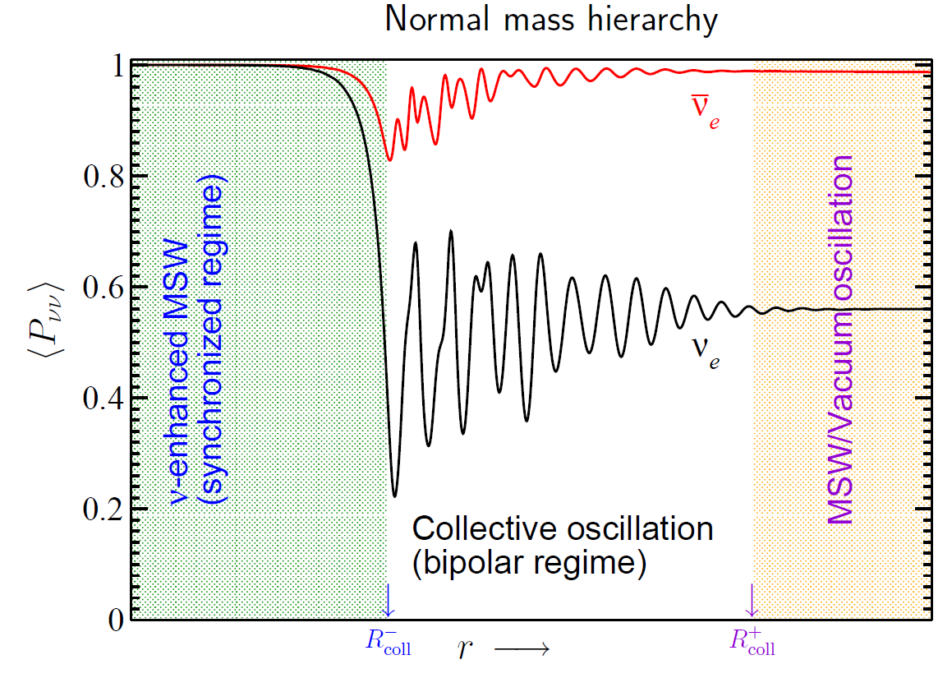
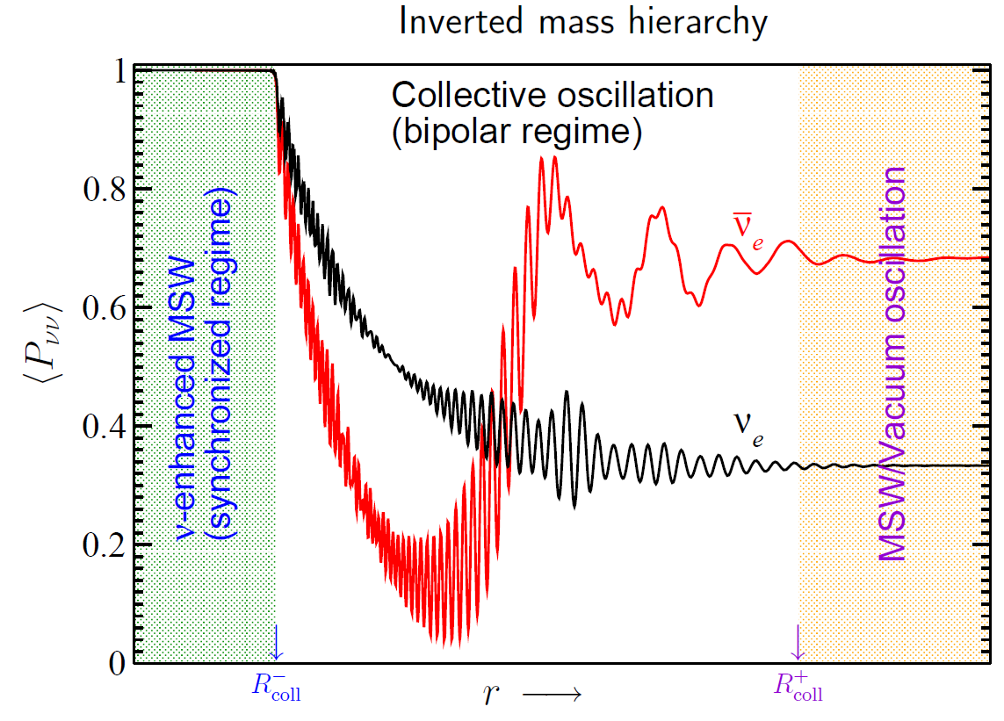
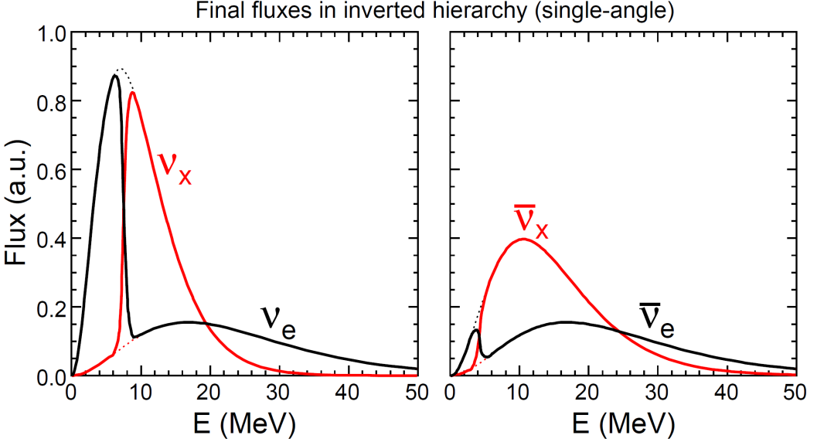
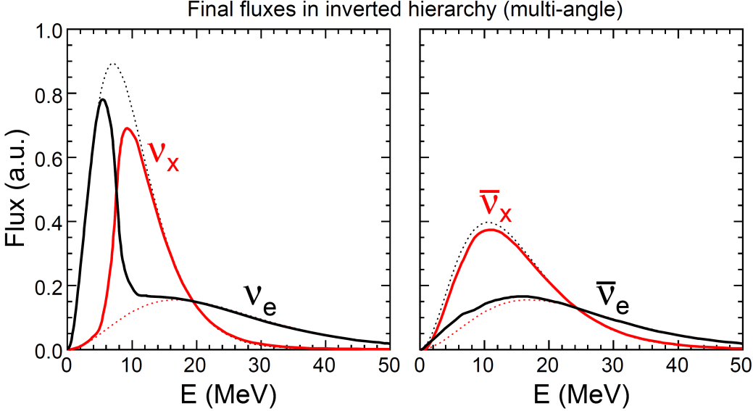
Supernova Neutrinos: Elementary Particle Physics
Flavor Conversion: collective effects (accretion phase)
Left:
Sketch of
Collective
effects
Bottom:
Inverted
+ Accretion
Duan, Fuller&Qian, 1011.2799
Fogli, Lisi, Marrone&Mirizzi, 0707.1998

Slide 19
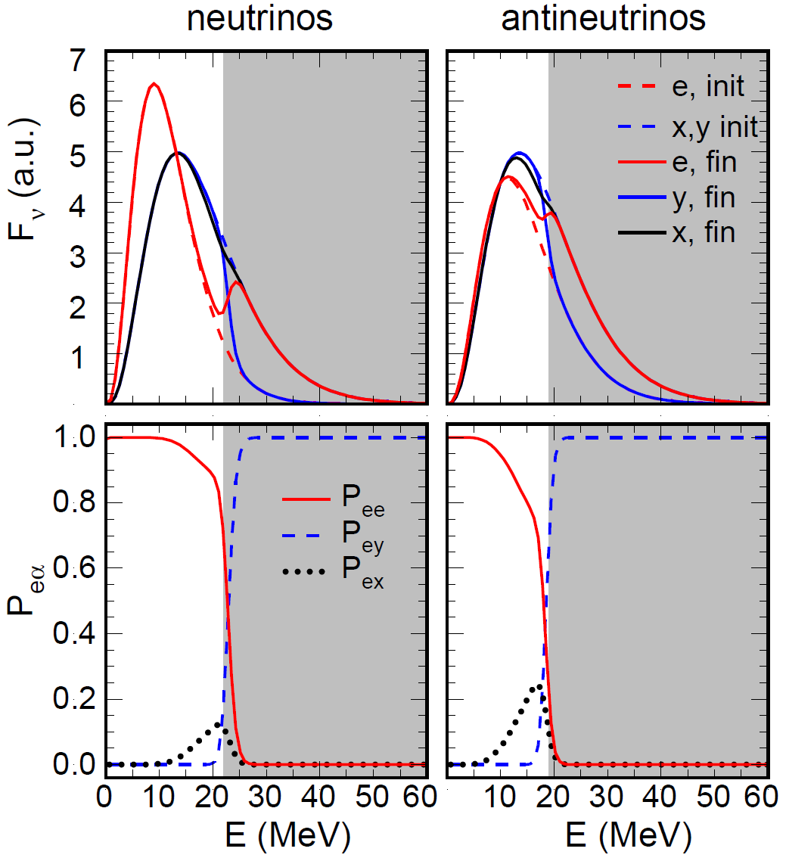
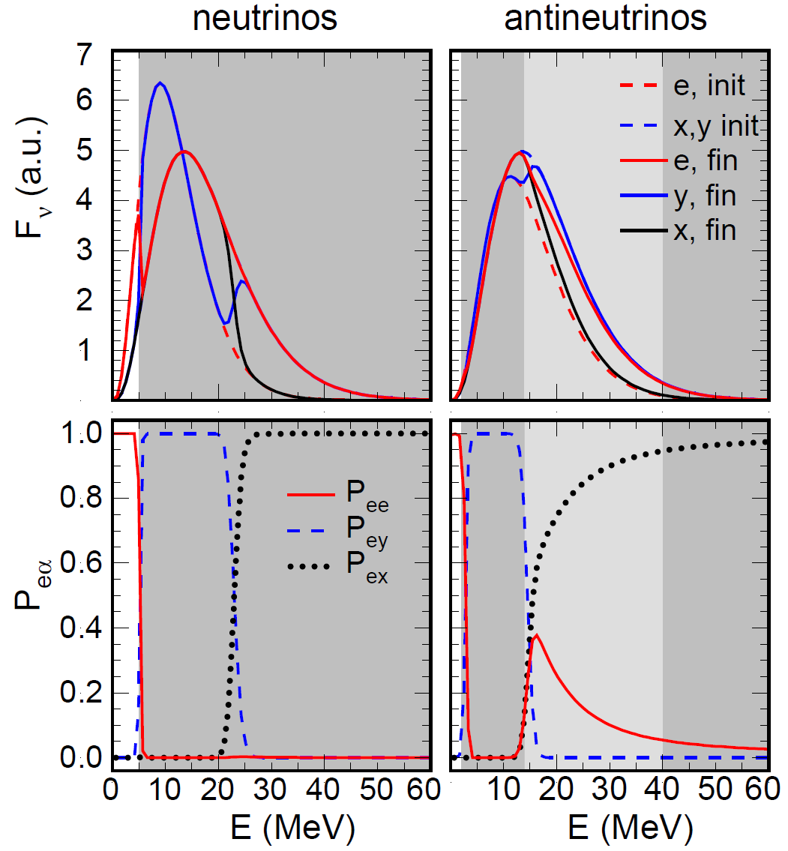
Supernova Neutrinos: Elementary Particle Physics
Flavor Conversion: collective effects (cooling phase)
NH
IH
Dasgupta, Mirizzi, Tamborra&Tomàs,
1002.2943
Note: compare between accretion
and cooling results

Slide 20
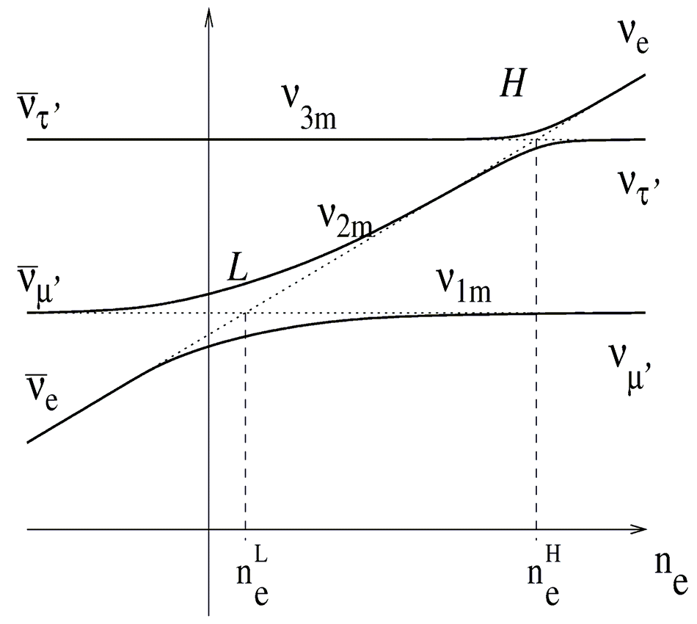
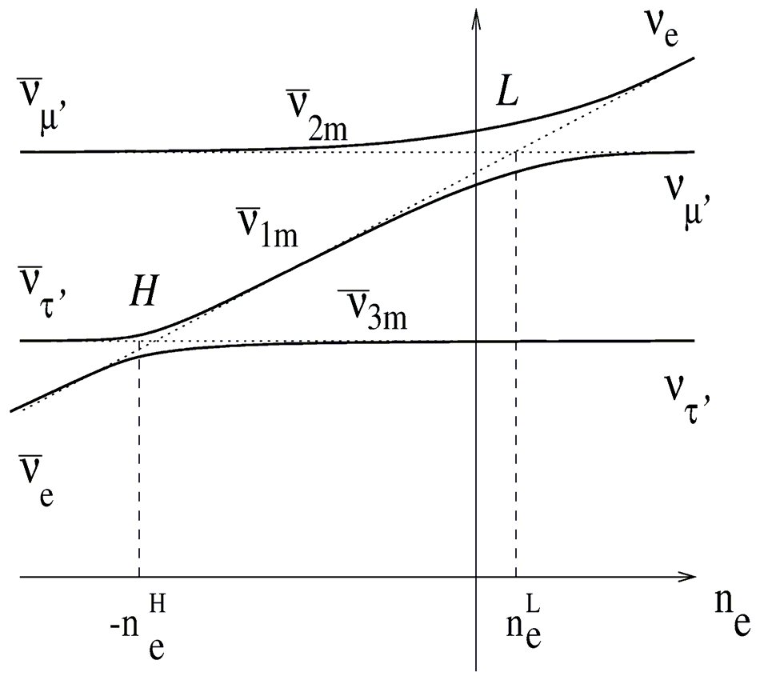
Supernova Neutrinos: Elementary Particle Physics
Flavor Conversion: MSW effects in the SN envelope
Dighe & Smirnov, hep-ph/9907423
Adiabatic for
a ‘large’ θ₁₃
NH
IH
L – Resonance
Res. for neutrinos
Always adiabatic
H – Resonance
Res. for neutrinos (NH)
Res. for antineutrinos (IH)

Slide 21


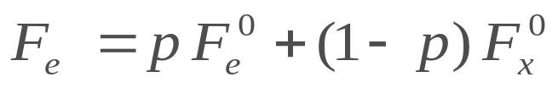

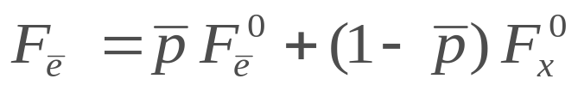

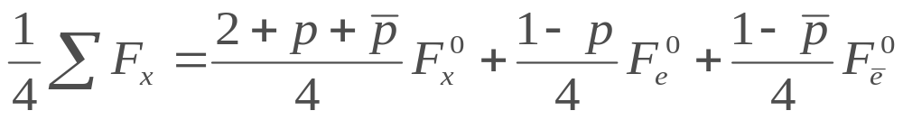

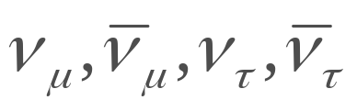
Supernova Neutrinos: Elementary Particle Physics
Flavor Conversion: MSW effects in the SN envelope
for
for
for
Primary fluxes (+ collective)
Leaving the SN (+ Collective & MSW effects)
Dighe & Smirnov, hep-ph/9907423
Dighe, Kachelriess, Raffelt & Tomàs, hep-ph/0311172
Case
Mass ordering
sin²(2θ₁₃)
Survival probabilities
A
Normal
≳ 10⁻³
0
cos²(θ₁₂)
B
Inverted
sin²(θ₁₂)
0

Slide 22


Supernova Neutrinos: Elementary Particle Physics
Flavor Conversion: including Earth Matter Effects
Dighe&Smirnov, hep-ph/9907423
Lunardini & Smirnov, hep-ph/0106149
for a ‘large’ θ₁₃
If IH is determined from oscillation experiments，Earth matter effects indicate collective effects.
NH:
Matter Effects
-antineutrinos
IH:
Matter Effects
- neutrinos
Collective Neutrino Oscillations (accretion phase)
No
Yes
Mass Ordering
sin² θ₁₃
survival
Earth matter
survival
Earth matter
NH
≳ 10⁻³
cos² θ₁₂
Yes
cos² θ₁₂
Yes
IH
0
No

Slide 23
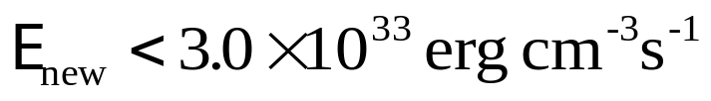

Supernova Neutrinos: Elementary Particle Physics
Extra energy-loss channels: Bound on particle physics models
$\sim$ 50 km
If exotic particles can be produced and escape
from the SN core, then the energy carried away
by them should be at least smaller than that by
neutrinos. Otherwise, the SN neutrino signal
would be significantly reduced.
Cooling via
Neutrino Emission
Exotic weakly-interacting particles
The energy-loss argument has been applied to the SN 1987A, and restrictive bounds on particle physics models have been obtained: Axion，Majoron，keV sterile neutrino，……
Proto-Neutron Star
ρ $\sim$ ρ_{nuc} = 3 × 10¹⁴ g cm⁻³
T $\sim$ 30 MeV

Slide 24

SN ν Detection: present and future experiments
MiniBooNE
(200)
LVD (400)
Borexino (100)
Baksan
(100)
Super-Kamiokande (10⁴)
KamLAND (400)
SN @10 kpc
JUNO (10⁴)
Water / Ice
Cherenkov
Liquid
Scintillator
IceCube (10⁶)

Slide 25
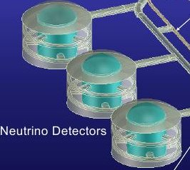
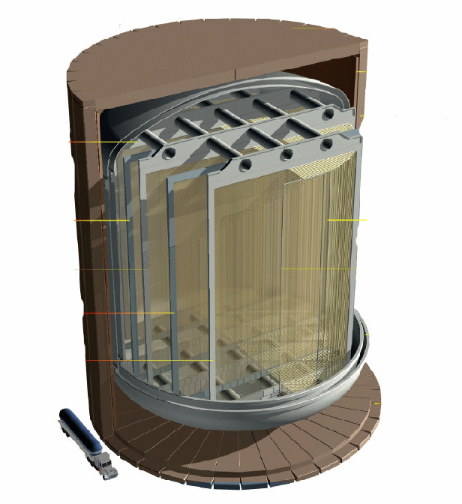
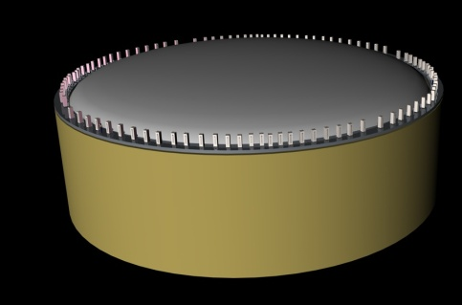
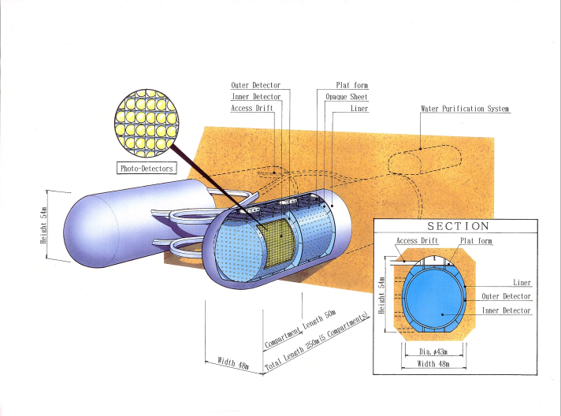
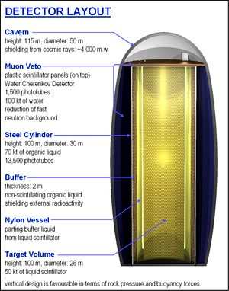
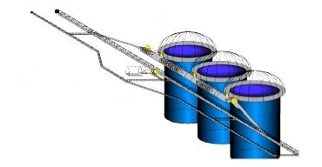
SN ν Detection: present and future experiments
5−100 kton
liquid Argon
DUSEL
LBNE
100 kton scale
scintillator
Hyper-K
Memphys
LENA
JUNO
HanoHano
Megaton-scale
water Cherenkov

Slide 26
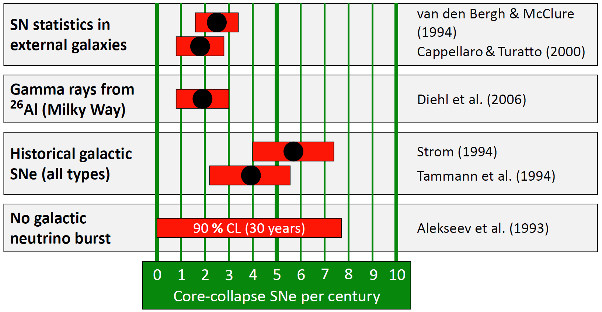
Key Problem: where and When?
© Raffelt
(1) Estimate from SN statistics in other galaxies; (2) Only massive stars produce ²⁶Al (with a half-life 7.2 × 10⁵ years); (3) Historical SNe in the Milky Way; (4) No neutrino bursts observed by Baksan since June 1980

Slide 27
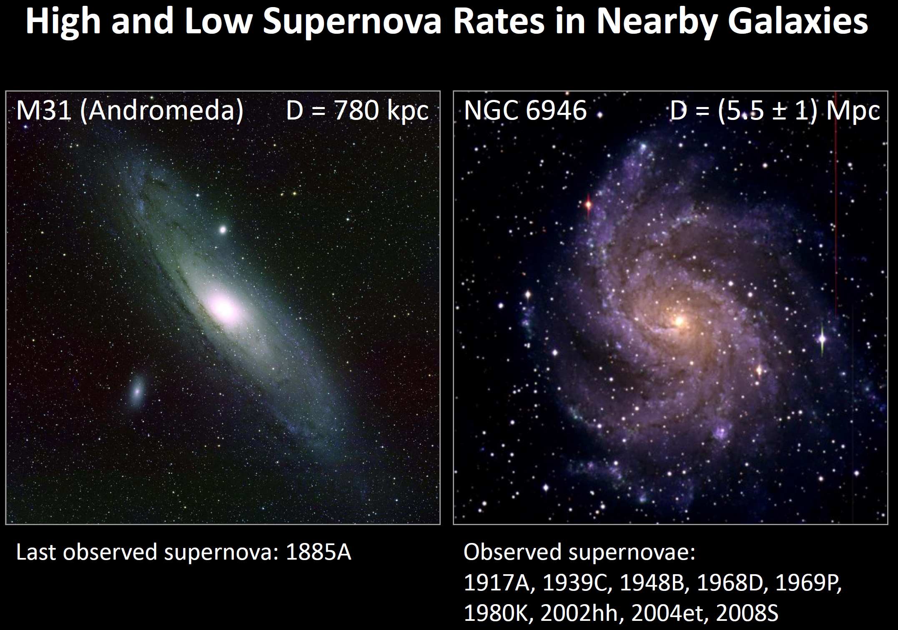
Key Problem: where and When?

Slide 28
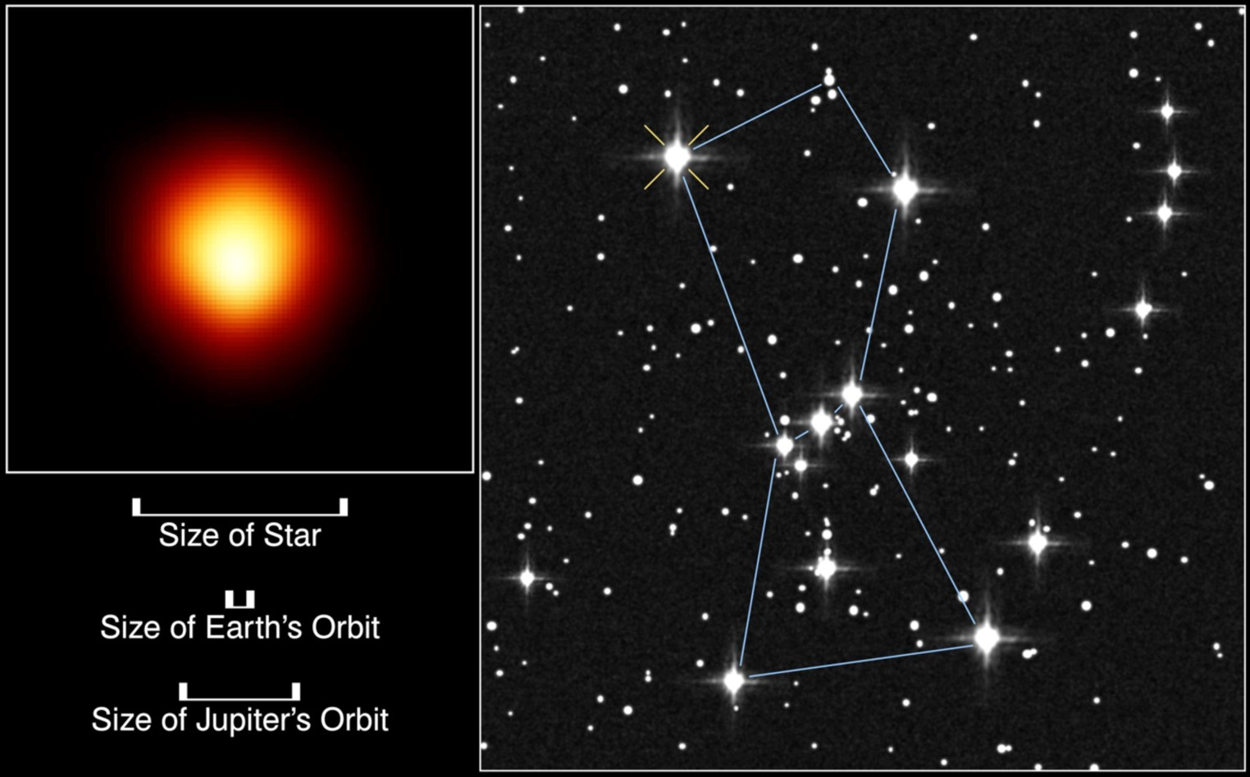
SN Candidate: The Red Supergiant Betelgeuse (Alpha Orionis）
Distance: 425 ly (130 pc)
Type：Red Supergiant
Mass：~ 18 solar masses
Expected to end its life as SN explosion
@ Super-K: 6 ×10⁷ events

Slide 29
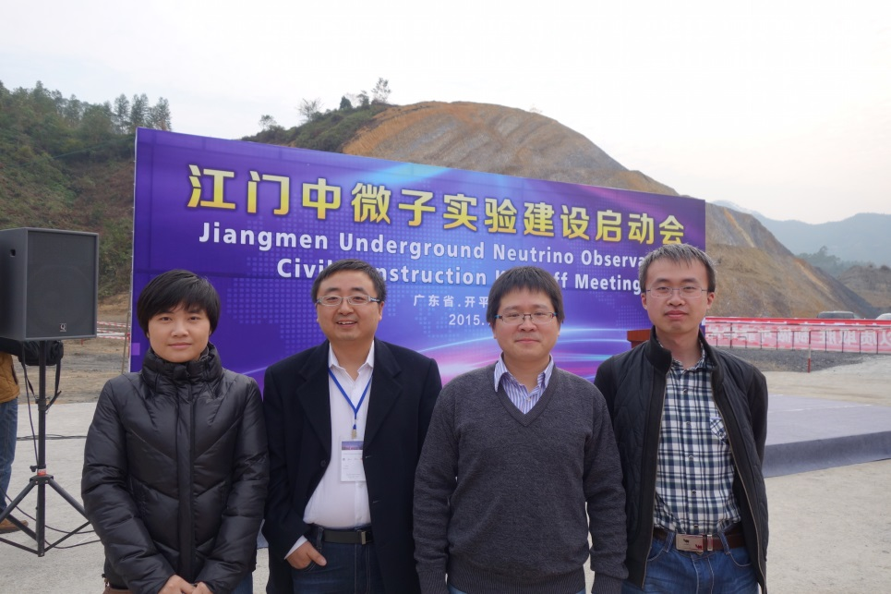
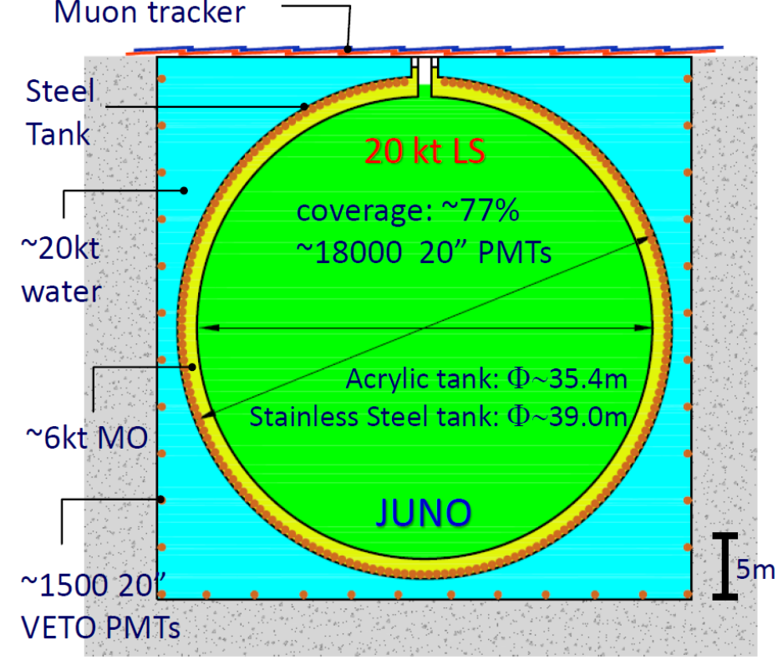
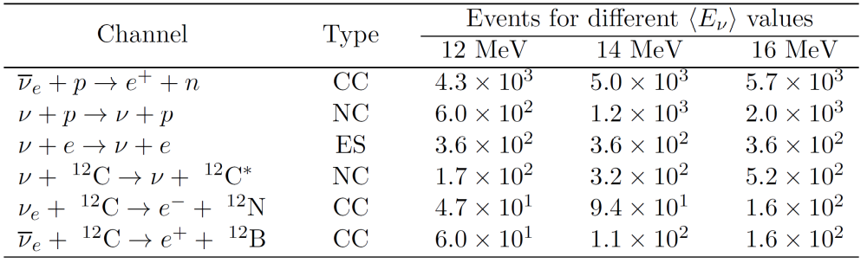

Detection of SN Neutrinos @JUNO
2015/1/10, Jiangmen, Guangdong
Goal: to pin down ν mass ordering
Main Channels in LSD
A typical SN
@ 10 kpc

Slide 30
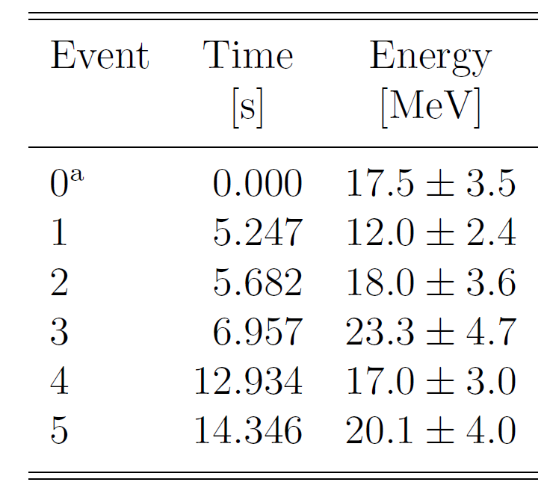
Neutrino Mass Bound: SN Model
Kamiokande-II Data
IMB Data
Baksan Data
Use the SN 1987A observations to extract the SN model param.
Use all the information (t_{i} E_{i} θ_{i} )
Maximum likelihood
Kam, IMB & Baksan
Every Event
Loredo & Lamb, astro-ph/0107260
Pagliaroli, Vissani, Costantini & Ianni, 0810.0466

Slide 31
Neutrino Mass Bound: SN Model
Signal Events
Pagliaroli, Vissani, Costantini & Ianni, 0810.0466
Neutrino Flux Parametrization
Fit SN Model Parameters
Accretion Phase
M_{a} : initial mass
T_{a} : initial e⁺ temp.
τ_{a} : accretion time
Cooling Phase
R_{c} : ν-sphere rad.
T_{c} : initial temp.
τ_{c} : cooling time
Cooling: Thermal distr. of anti-ν_{e}，and exp. decay of luminosity;
Accretion: Anti-ν_{e} only from e⁺ +n，and thermal distr. of positrons

Slide 32



Neutrino Mass Bound: Events @JUNO
JUNO: 20 kt (12% p) liquid scintillator
IBD events @JUNO: N = 4300
Best-fit values for SN model & τ_{r}=100 ms

Slide 33


Neutrino Mass Bound: Simulations
1. Generate n pairs of (t ^{i} , E_{ν} ^{i}) according to R (t , E_{ν})
Pagliaroli, Rossi-Torres &Vissani
1002.3349
@Super-K
2. Denote e⁺ as (t ^{i} , E_{e}^{i}) corresponding to (t ^{i} , E_{ν} ^{i})
Better ? @JUNO
3. Label event by a relative time δt ^{i} and energy E_{e}^{i}
4. Extract SN model parameters and m_{ν} from data

Slide 34



Neutrino Mass Bound @ JUNO
Fit for one single experiment
3000 simulations
for JUNO
Include numerical models, - systematic errors;
Simulate a large number of experiments - stat. errors;
Low-E, Early-t events help
3000 simulations
for Super-K
Jia-Shu Lu, Jun Cao, Yu-Feng Li,
S.Z., 1412.7418

Slide 35






Robust evidence for Dark Matter
Cold or Warm DM ?
Abundance of Cosmic Substructure
Moore et al., 99’

Slide 36





Sterile Neutrinos of keV Masses
Production of sterile neutrinos:
Low matter density: neutrino flavor oscillations with matter effects
High matter density: production & absorption via scattering processes
Occupation-number formalism:
Diagonal terms: just the usual occupation numbers
Non-diagonal terms: encode the phase information
Equations of motion:
Mass terms and matter potentials

Slide 37






Sterile Neutrinos in a SN Core
Two-flavor mixing case
Flavor polarization vectors rotate around magnetic fields
z
P_{p}
B_{p}
Matter Effects
Wolfenstein, 78’; Mikheyev, Smirnov, 85’
y
where the resonant energy is
x
maximal mixing if E ~ E_{r} cos 2θ

Slide 38



Sterile Neutrinos in a SN Core
Weak-damping limit
Oscillation length
Mean free path
Neutrinos oscillate many times before a subsequent collision with nucleons
z
z
P_{p}
B_{p}
B_{p}
P_{p}
y
y
x
x

Slide 39





Sterile Neutrinos in a SN Core
In the weak-damping limit
averaged over a period of oscillation
Two independent parameters:
occupation numbers f^{α}_{p} & f^{s}_{p}
Simplified equations of motion:
further simplification if sterile neutrinos escape from the SN core
set f^{s}_{p} = 0
Lepton-number-loss rate
Energy-loss rate

Slide 40





Sterile Neutrinos in a SN Core
Tau-sterile neutrino mixing
Initial conditions:
Y_{e} = 0.3, Y_{νe} = 0.07, Y_{νμ}=Y_{ντ}=0
the MSW resonance occurs in the antineutrino channel;
asymmetry between tau neutrinos and antineutrinos.
Simple bound in the ‘vacuum limit’: E_{r} >> E
Energy-loss rate
Supernova Bound

Slide 41



Energy-loss Rate and SN Bound
Follow the time evolution of η and calculate the energy loss
G. Raffelt, S.Z., 1102.5124

Slide 42
Summary and Outlook
Neutrinos from next nearby supernova cannot be missed (a once-in-a-lifetime opportunity!)
Physics opportunities with SN neutrinos: stellar collapse, explosion mechanism, collective flavor conversion, matter effects, neutrino mass ordering, absolute neutrino mass,…
10⁴ neutrino events @ JUNO for a typical galactic SN; to improve neutrino mass bound, & other possibilities; A lot of theoretical works to do while waiting for a real SN

