Slide 1

GWs from the early Universe
Zong-Kuan Guo
ICTS, USTC
2018.3.8

Slide 2
暴胀宇宙学相关研究
提出了具有高阶曲率耦合的暴胀模型
  PRD 75 (2007) 023520; PRD 80 (2009) 063523; PRD 81 (2010) 123520; PRD 88 (2013) 123508
提出了解释宇宙微波背景在大尺度上反常的暴胀模型
  PRD 88 (2013) 063539; EPJC 74 (2014) 3006
提出了暴胀期间产生原初磁场的机制
  PRD 93 (2016) 043541; PRD 94 (2016) 083524
研究发现暴胀结束后的重加热过程能产生强的引力波信号
  PRL 120 (2018) 031301; PRD (2018)

Slide 3
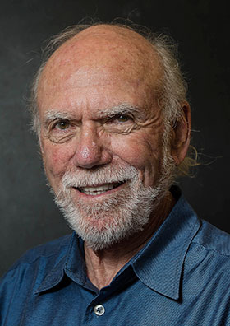
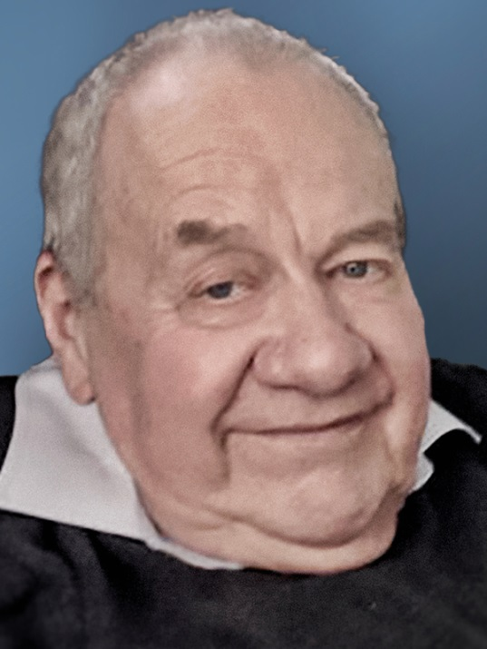
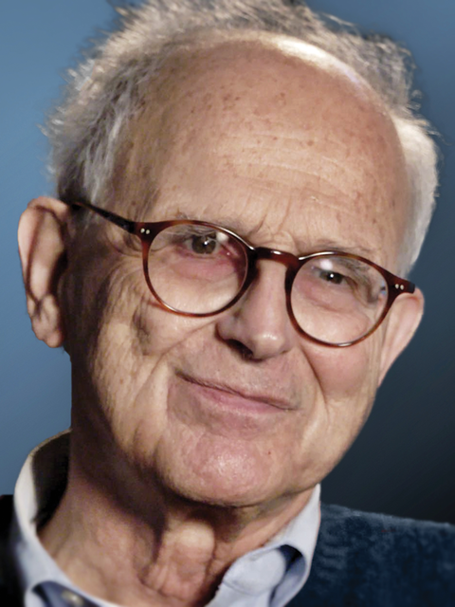
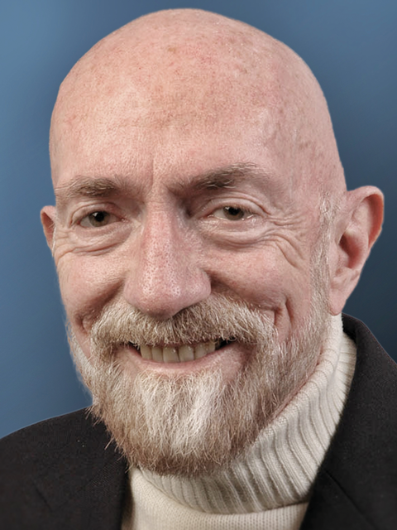
Barry C. Barish
Ron Drever, died 2017.3.7
Rainer Weiss
Kip S. Thorne
GW150914 PRL 116 (2016) 061102
LVT151012 PRX 6 (2016) 041015
GW151226 PRL 116 (2016) 241103
GW170104 PRL 118 (2017) 221101
GW170608 ApJ 851 (2017) L35
GW170814 PRL 119 (2017) 141101
GW170817 PRL 119 (2017) 161101
2016 Breakthrough Prize in Fundamental Physics
2016 Gruber Foundation Cosmology Prize
2016 Shaw Prize
2016 Kavli Prize in Astrophysics
2016 Harvey Prize
2017 Nobel Prize in physics
2017 Fudan-Zhongzhi Science Award

Slide 4
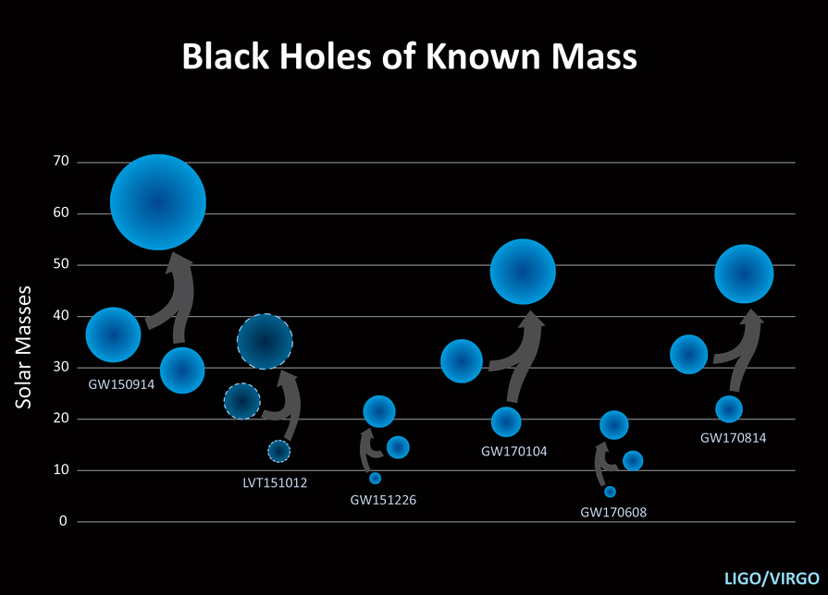
Credit: LSC

Slide 5
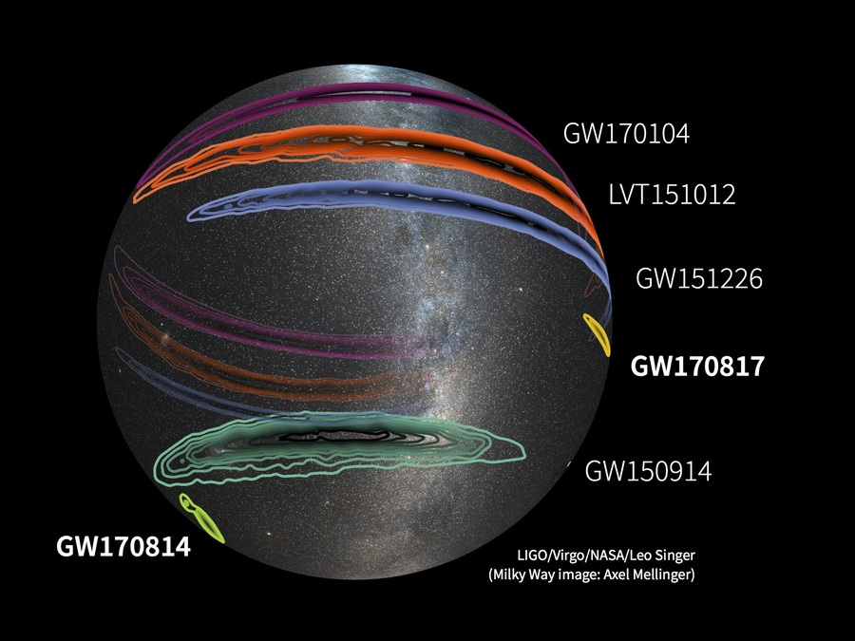
Credit: LSC

Slide 6
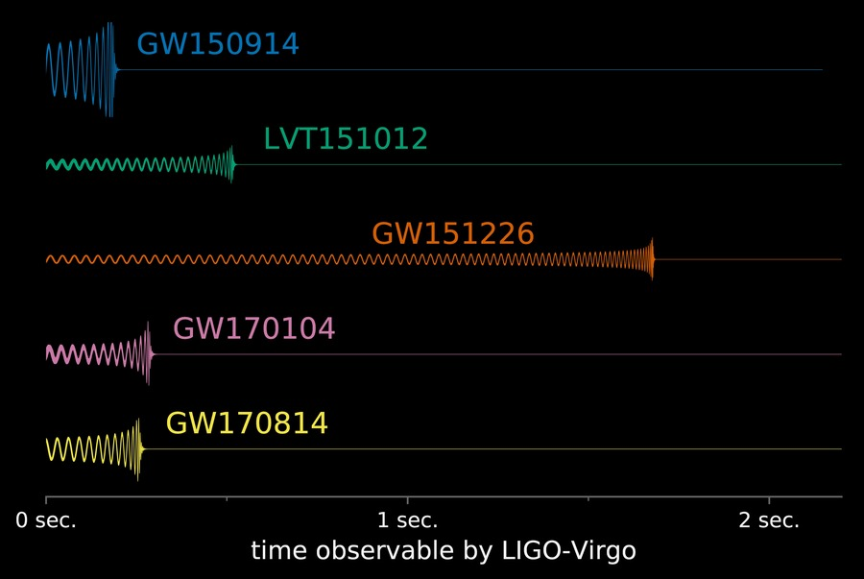
Credit: LSC

Slide 7
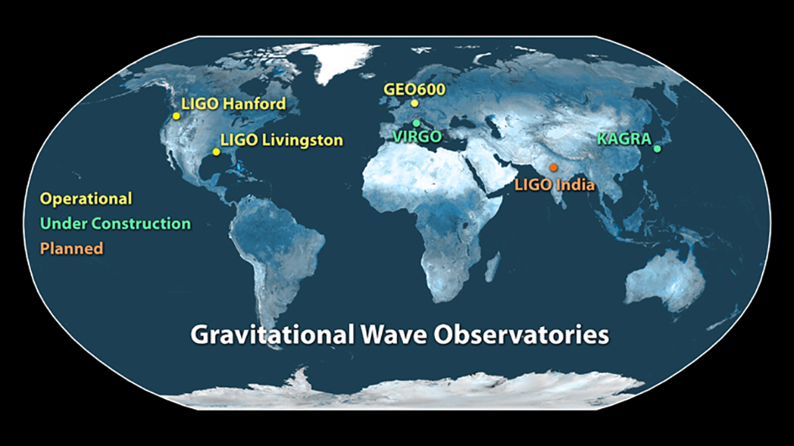
Taiji/Tianqin
LISA
Credit: LSC

Slide 8

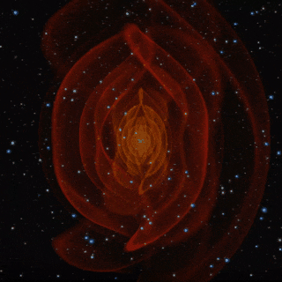
Cosmological Probes
GWs
the Universe
Sources & Background

Slide 9
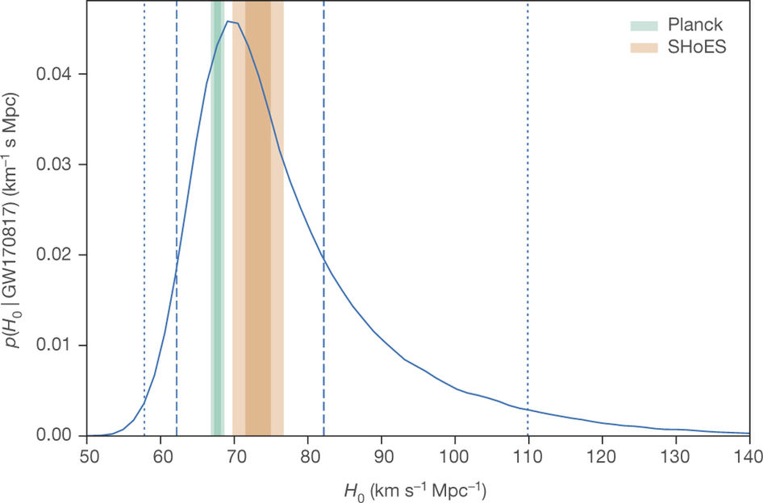
GW standard sirens as cosmological probes
Credit: Nature 551 (2017) 85

Slide 10
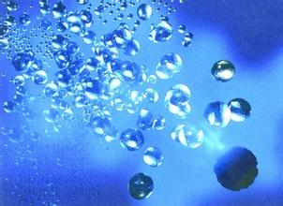
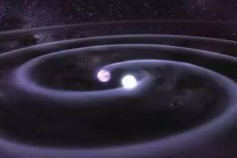
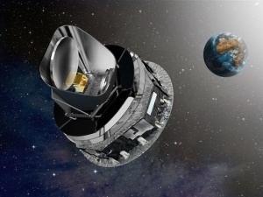
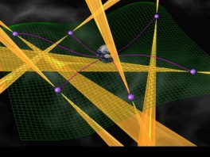
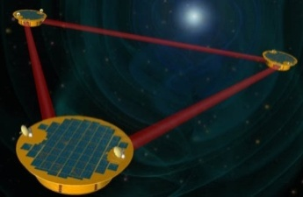
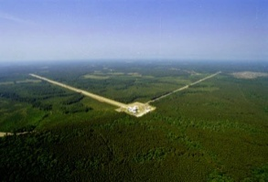
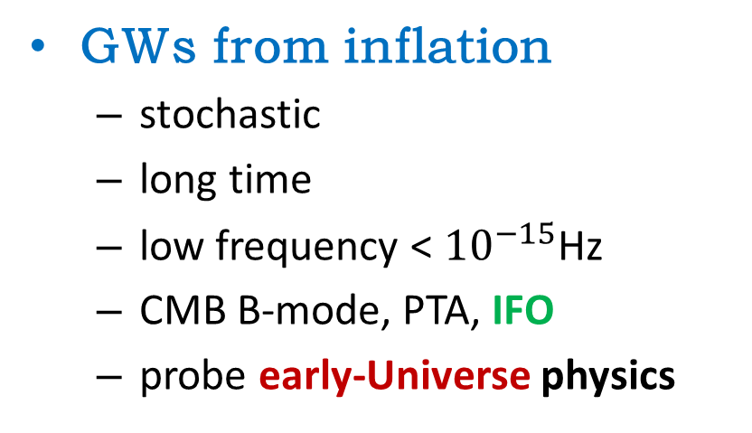
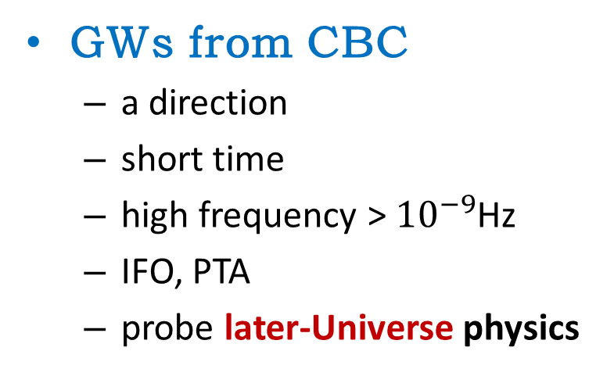
GWs from inflation
  stochastic
  long time
  low frequency < ${10}^{−15}$Hz
  CMB B-mode, PTA, IFO
  probe early-Universe physics
GWs from CBC
  a direction
  short time
  high frequency > ${10}^{−9}$Hz
  IFO, PTA
  probe later-Universe physics
Log(f)
−16
−14
−12
−10
−8
−6
−4
−2
0
+2
Planck 2009

Slide 11
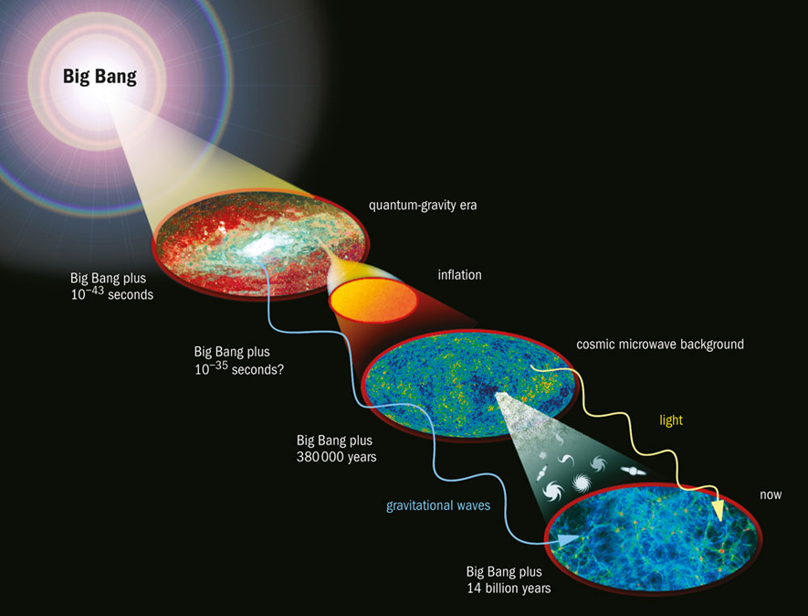

Slide 12
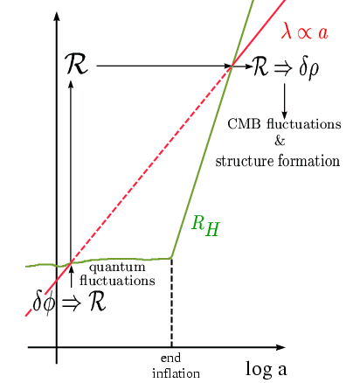
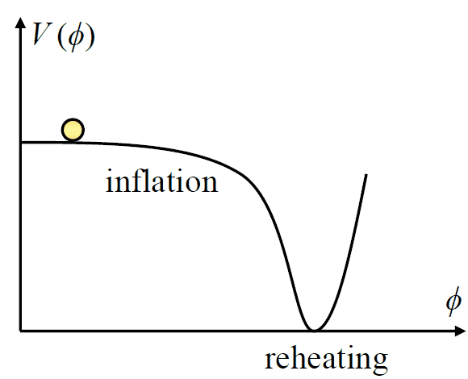

$$\sim 7σ$$
GWs produced during inflaiton
GWs produced during reheating/preheating

Slide 13
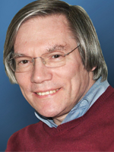
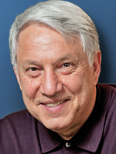
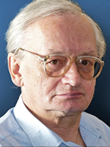
Alan H. Guth
Andrei D. Linde
Alexei A. Starobinsky
Spectrum Of Relict Gravitational Radiation And The Early State Of The Universe,
Alexei A. Starobinsky, JETPL 30 (1979) 682.
Inflationary universe: A possible solution to the horizon and flatness problems,
Alan H. Guth, Phys. Rev. D 23 (1981) 347.
A New Inflationary Universe Scenario: A Possible Solution of the Horizon, Flatness, Homogeneity, Isotropy, and Primordial Monopole Problems,
Andrei D. Linde, Phys. Lett. B 108 (1982) 389.
2002 Dirac Prize (Guth, Linde, Steinhardt)
2004 Gruber Prize in Cosmology (Guth, Linde)
2012 Fundamental Physics Prize (Guth, Linde)
2013 Gruber Prize in Cosmology (Starobinsky, Mukhanov)
2014 Kavli Prize in Astrophysics (Guth, Linde, Starobinsky)
20xx Nobel Prize in physics?

Slide 14
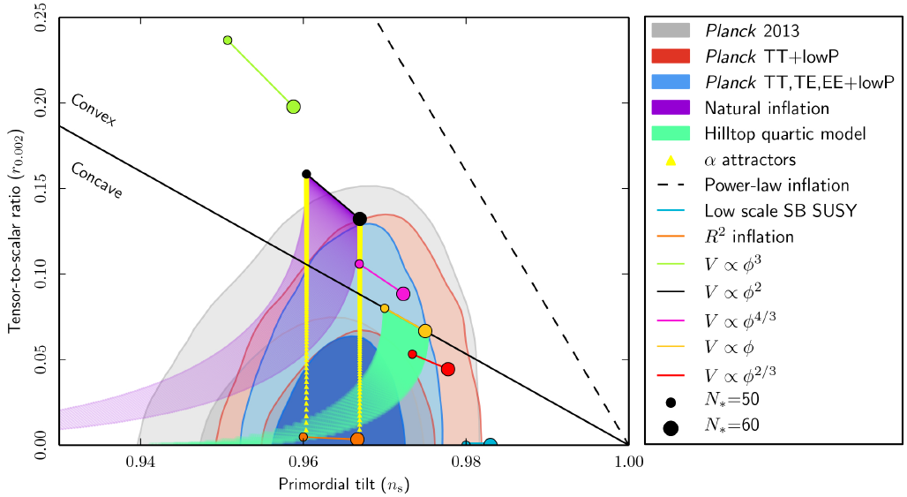
[Planck Collaboration, arXiv:1502.02114]

Slide 15
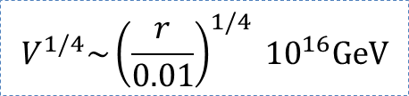
GWs produced during inflation
  to distinguish inflationary models
  to determine the energy scale of inflation
GWs produced during reheating/preheating
  to constrain inflationary models
  to determine the reheating temperature
$$V^{1/4}\sim {\left(\frac{r}{0.01}\right)}^{1/4} {10}^{16}\text{GeV}$$
Reheating Constraints to Inflationary Models, L. Dai, et al., PRL 2014
Reheating Phase Diagram for Higgs Inflation, R.G. Cai, Z.K. Guo, S.J. Wang, PRD 2015

Slide 16
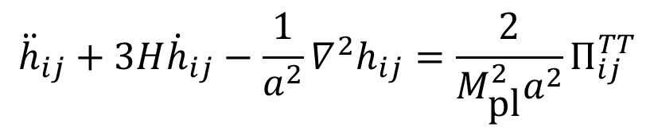
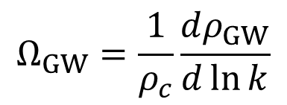
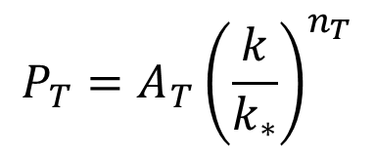
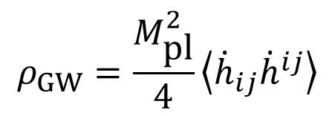
0
$${\ddot{h}}_{ij}+3H{\dot{h}}_{ij}−\frac{1}{a^{2}}∇^{2}h_{ij}=\frac{2}{M_{\text{pl}}^{2}a^{2}}Π_{ij}^{TT}$$
$$P_{T}=A_{T}{\left(\frac{k}{k_{∗}}\right)}^{n_{T}}$$
$$ρ_{GW}=\frac{M_{\text{pl}}^{2}}{4}\left\langle {\dot{h}}_{ij}{\dot{h}}^{ij}\right\rangle$$
$$Ω_{GW}=\frac{1}{ρ_{c}}\frac{dρ_{GW}}{d\ln{k}}$$
During inflation (with/without sources)
During reheating/preheating

Slide 17
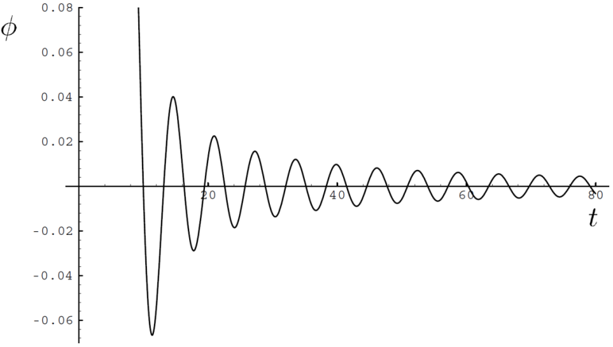
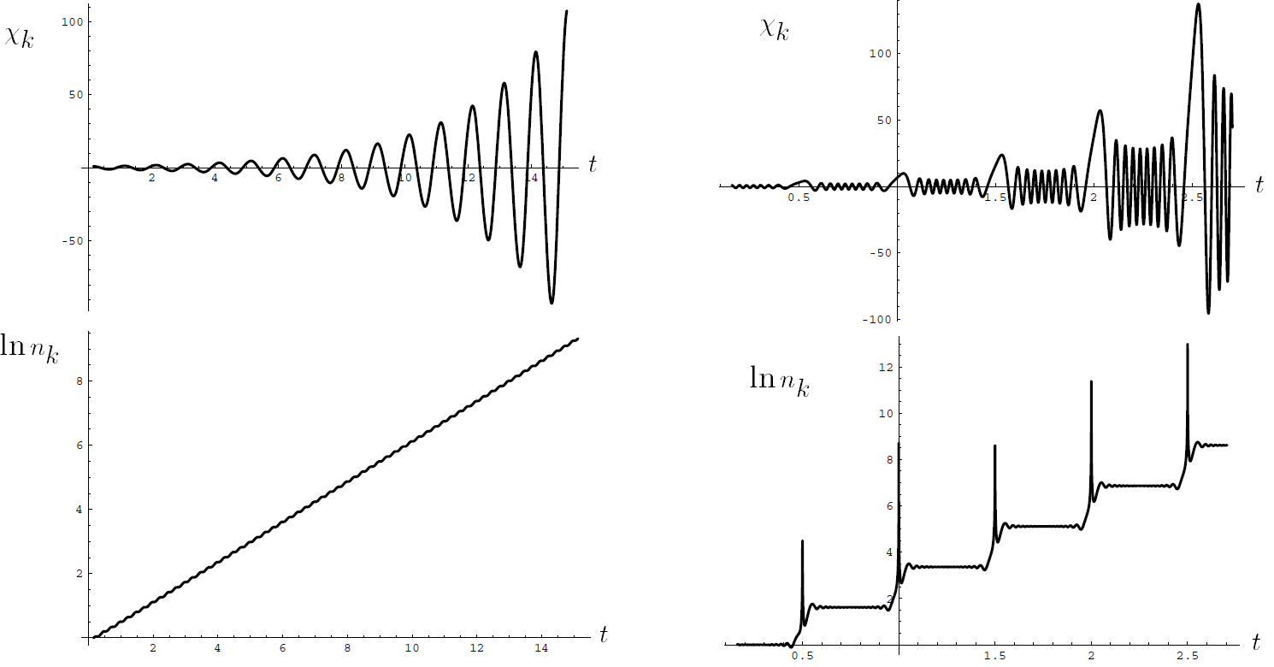



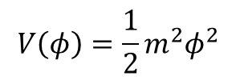
$$V\left(φ\right)=\frac{1}{2}m^{2}φ^{2}$$
$$\sim g^{2}φ^{2}χ^{2}$$
Credit: Kofman, et al, PRD 1997
$$q \sim g^{2}/m^{2}\sim 0.1$$
$$q\sim 200$$
narrow parametric resonance
broad parametric resonance

Slide 18
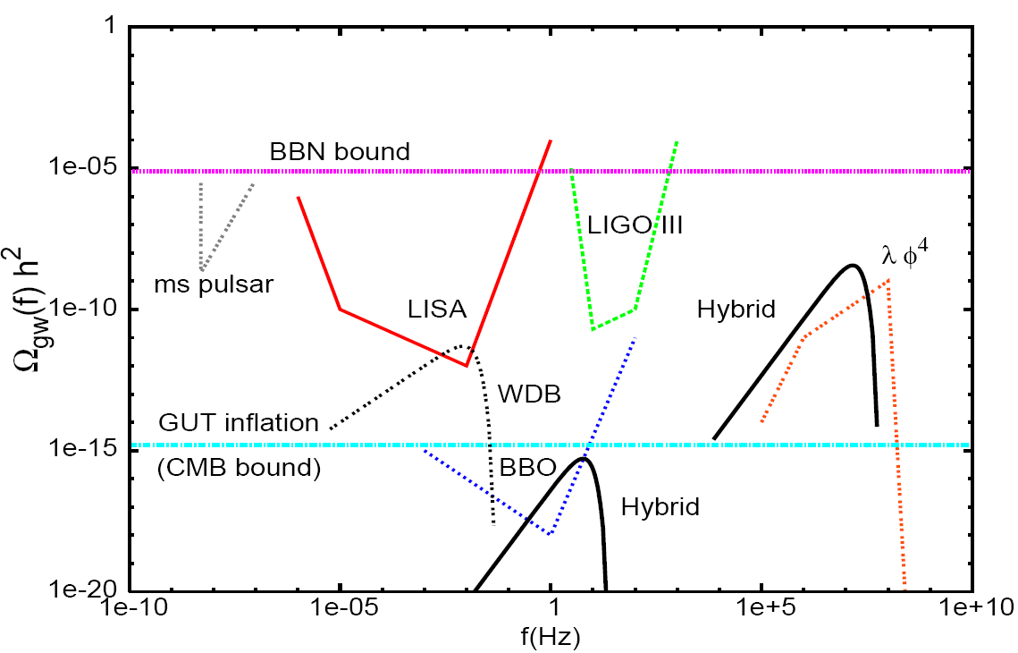


Right: $v={10}^{−2}M_{pl}，g^{2}\sim 0.05$
Left: $v={10}^{−5}M_{pl}，g^{2}\sim {10}^{−14}$
PRD 1997
Credit: J. Garcia-Bellido, D.G. Figueroa, Phys. Rev. Lett. 98 (2007) 061302

Slide 19
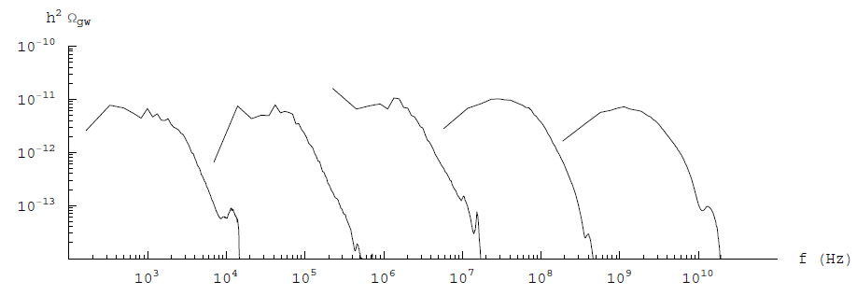
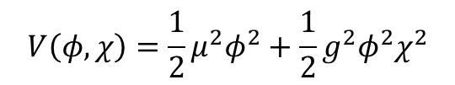


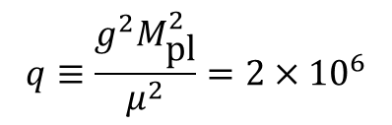
$$V\left(φ,χ\right)=\frac{1}{2}μ^{2}φ^{2}+\frac{1}{2}g^{2}φ^{2}χ^{2}$$
$$q≡\frac{g^{2}M_{\text{pl}}^{2}}{μ^{2}}=2×{10}^{6}$$
Right: $μ={10}^{−6}M_{pl}$
Left: $μ={10}^{−18}M_{pl}$
Credit: R. Easther, J.T. Giblin Jr, E.A. Lim, Phys. Rev. Lett. 99 (2007) 221301

Slide 20
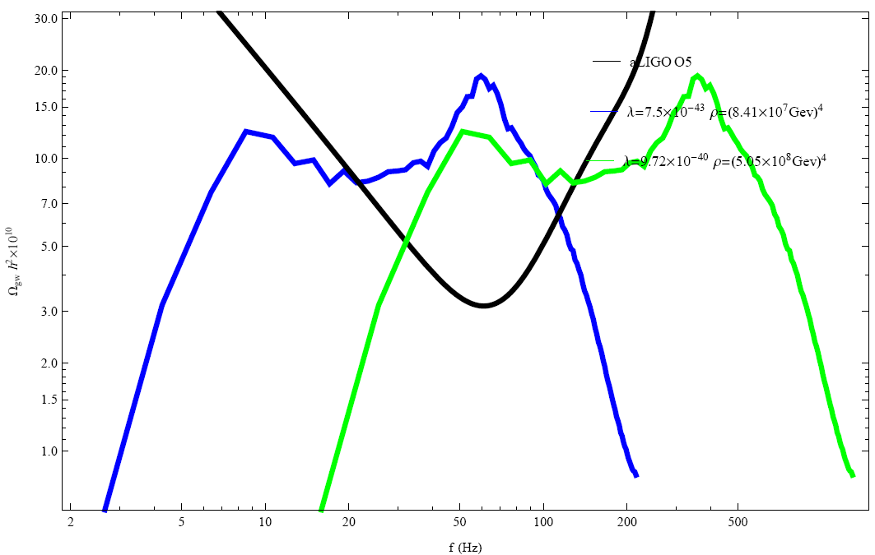

Gravitational Waves from Oscillons with Cuspy Potentials
$$V\left(φ\right)=λM_{\text{pl}}^{4−p}{\left|φ\right|}^{p}, p=1,2/3, 2/5$$
J. Liu, Z.K. Guo, R.G. Cai, G. Shiu, Phys. Rev. Lett. 120 (2018) 031301

Slide 21
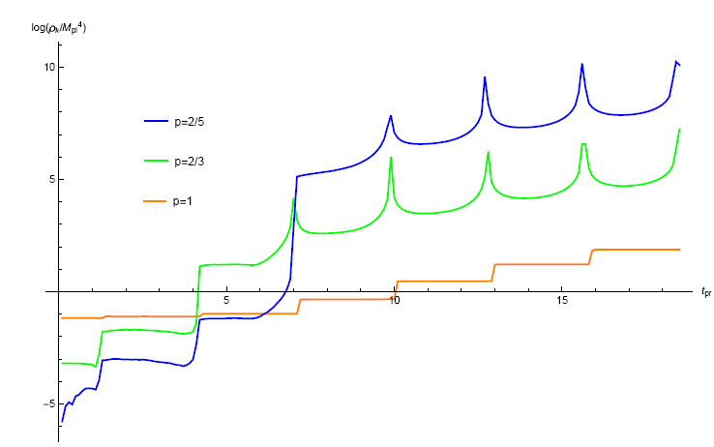
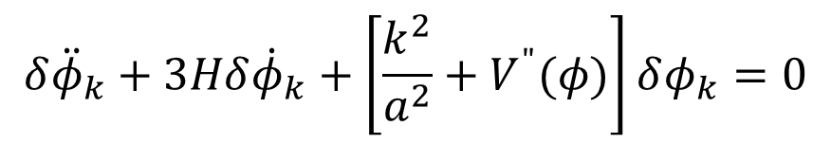
Silverstein et al, arXiv:0803.3085, arXiv:0808.0706
Planck Collaboration, arXiv:1502.02114
Brandenberger et al, arXiv:1502.06135
$$δ{\ddot{φ}}_{k}+3Hδ{\dot{φ}}_{k}+\left[\frac{k^{2}}{a^{2}}+V^{"}(φ)\right]δφ_{k}=0$$

Slide 22
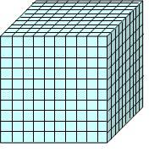
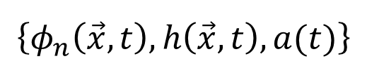








Lattice simulation
$$L$$
$$L$$
$$L$$
Staggered
leapfrog
algorithm
$$t_{0}$$
$$t_{1}$$
$$t_{e}$$
$$\left\{φ_{n}\left(\vec{x},t\right),h\left(\vec{x},t\right),a(t)\right\}$$
$$N^{3}=256×256×256$$
$$L=H^{−1}$$

Slide 23
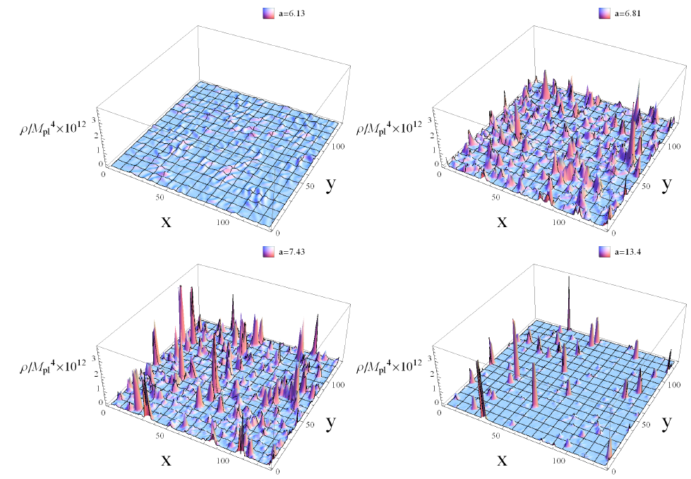

Slide 24
Thanks！

