Slide 1
Hadron Exotics and Production at High Energy
王伟
上海交通大学
2017年3月 合肥
中国科学技术大学交叉学科理论物理研究中心

Slide 2

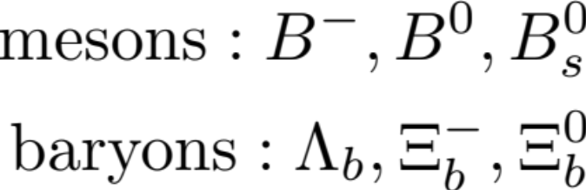
重夸克物理: B物理
Bound states of b and light quarks
Heaviest stable bound states in QCD (>5.3GeV)
Rich spectrum, many decay channels
Important source of information about CP violation, CKM parameters and new physics

Slide 3
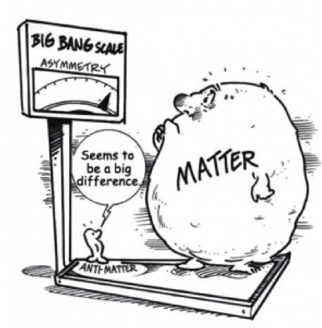
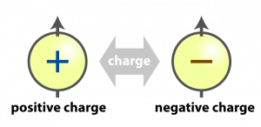
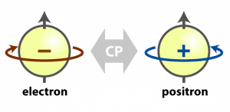
物质与反物质不对称
C:物质－反物质变换
CP
微观粒子物理中需要C和CP破坏！

Slide 4
粒子系统中的CP不对称
In Kaon system, the CP asymmetry (CPA) can reach roughly 0.2%
In D decays, CPA at 1% is often argued to be New physics.
Direct CPA in B decays:
A_{cp}(B→K⁺π⁻)=(-8.2±0.6)%;
A_{cp}(B→π⁺π⁻) = (31±5)%
In B decays, sin(2β) =67.2%! Large mixing CPA
B physics➔ Ideal Platform to study CPA

Slide 5
Content
引言
奇异强子物理
产生机制与有效理论
结论

Slide 6
Mass Origin
Gauge boson: Higgs Mechanism
Quarks and Leptons: Yukawa Coupling
Matter in this world:
p/n: 1GeV u/d: a few MeV
strong interaction: important to understand
but difficult...

Slide 7
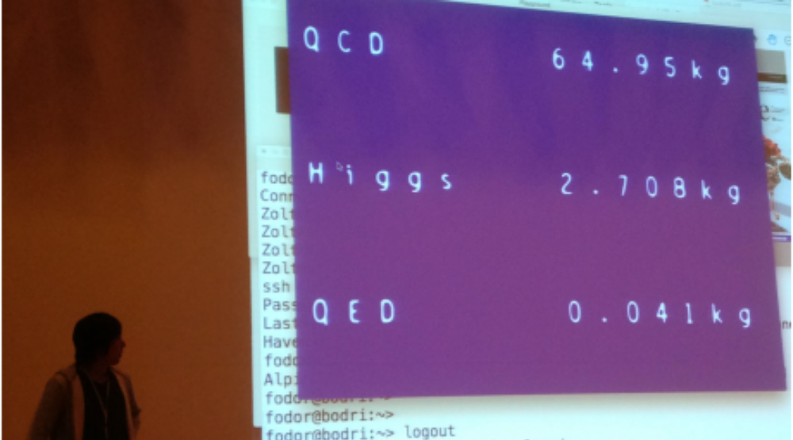
Fodor at Menu2016

Slide 8
What is hadron made of?
Quark model:
6 quarks
6 antiquarks
u^{+2/3}
c^{+2/3}
t^{+2/3}
u^{-2/3}
c^{-2/3}
t^{-2/3}
s^{+1/3}
b^{+1/3}
d^{-1/3}
s^{-1/3}
b^{-1/3}
d^{+1/3}
Baryons: qqq
Mesons: q
q
u^{+2/3}
u^{+2/3}
p:
u^{+2/3}
d^{-1/3}
π⁺ :
d^{+1//3}
u^{-2/3}
u^{-2/3}
u^{-2/3}
p:
π⁻ :
d^{+1/3}
d^{-1/3}

Slide 9
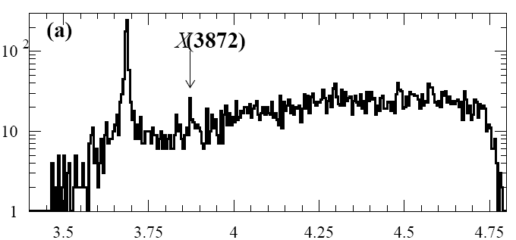
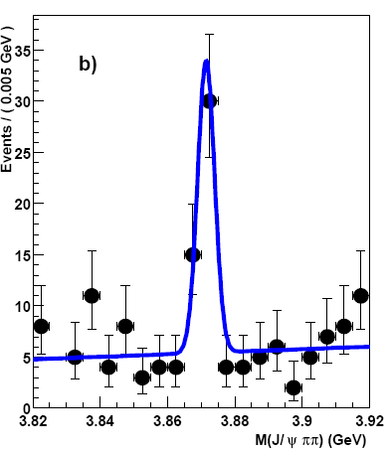
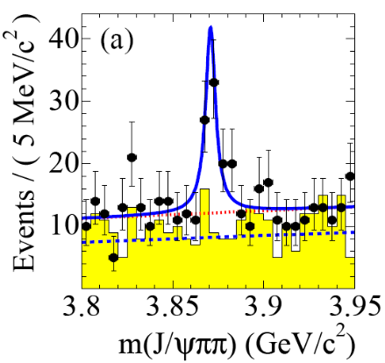


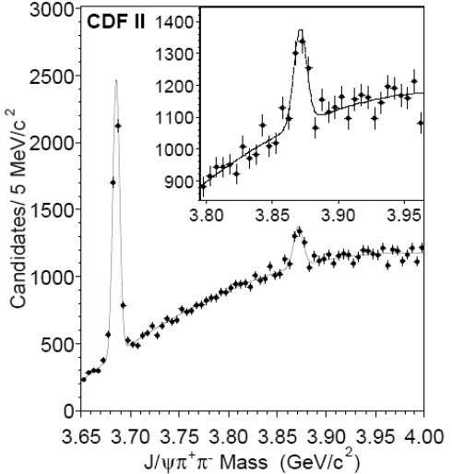
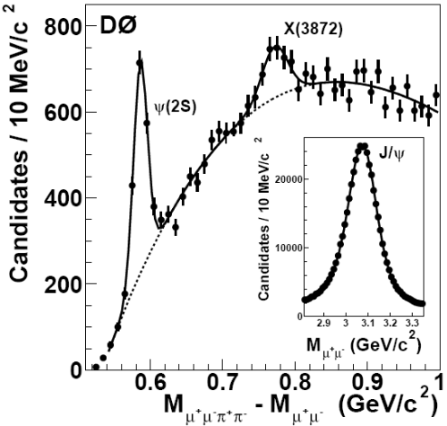


X(3872) observation
PRL91,262001,2003
PRD71,071103,2005
PRD73,011101,2006
first
X(3872) first seen
in B →K J/ψπ⁺π–
10σ
Tevatron: in pp collisions
prompt production
B decays (16.1±4.9±1.0)%
similar to ψ(2S)
─
M(J/ψπ⁺π–)
close to D⁰D^{*0} threshold
(not clear below or above)
M_{X} = 3871.68±0.17 MeV
M_{X} – M_{DD*}
= (–0.12±0.24) MeV
surprisingly narrow:
Γ_{tot} < 1.2 MeV at 90% CL
M(ππ) tends to kinematic limit Large Isospin violation!
PRL93,072001,2004
PRL93,162002,2004

Slide 10
X(3872)
X(3872)→J/ψ γ observation fixes C_{X}= +1
confirms that in the X→J/ψ ππ decay (ππ)=ρ
Γ(X→J ψ γ) / Γ(X→J/ψ π⁺π–) = 0.14 ± 0.05 small
X → J/ψ ω observation
Br (X → J/ψ ω) / Br (X→J/ψ π⁺π–) = 1.0 ± 0.4 ± 0.3
large isospin violation
CDF 790fb⁻¹: PRL98, 132002(2007)
X → J/ψ ππ angular analysis J^{PC} = 1⁺⁺ or 2^{–+}
LHCb 1fb⁻¹ 1302.6269 J^{PC} = 1⁺⁺
LHCb 3fb⁻¹ 1504.06339 S-wave: X → J/ψ ρ

Slide 11

Hadron Exotics
X(3872)
CP
Z(4430)
1307
Belle citation count
850
505
Phys.Rev.Lett.91 262001 (2003)
till 22.03.2017

Slide 12
Zc(3900)
BES: PRL 110, 252001
Belle: PRL 110, 252002

Slide 13
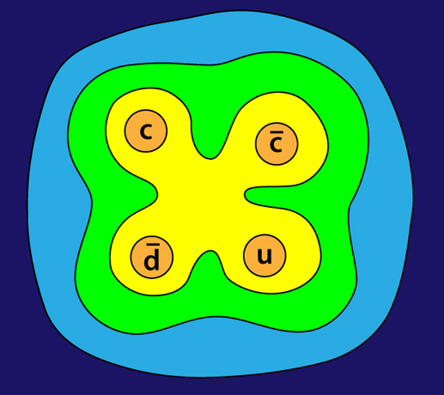
Zc(3900) is exotic!
Z_{c}→J/ψp➔ Z_{c} state contains a cc quark pair
charge = ± 1 ➔ Z_{c} contains additional light quarks
“minimal” quark configuration : Four-quark states!
Z_{c}⁺=
BES和Belle发现“四夸克物质”被美国物理学会主编的《物理》杂志评为2013年国际物理领域十大重要进展之一，并位列首位

Slide 14
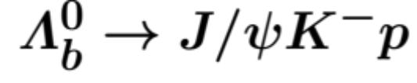
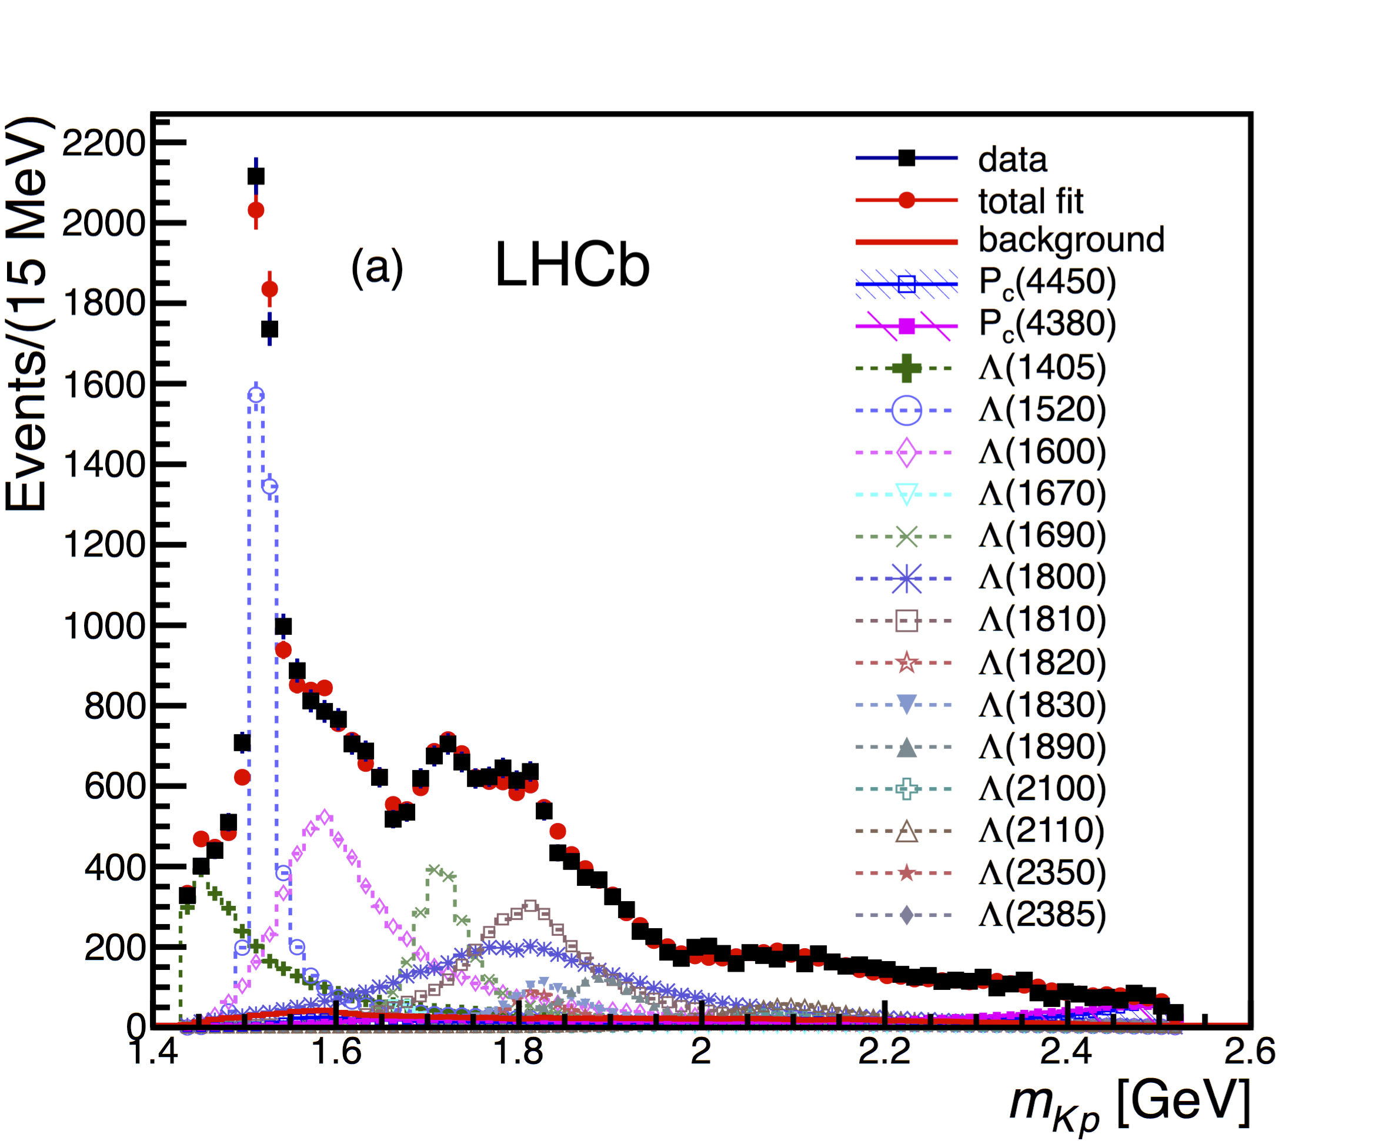
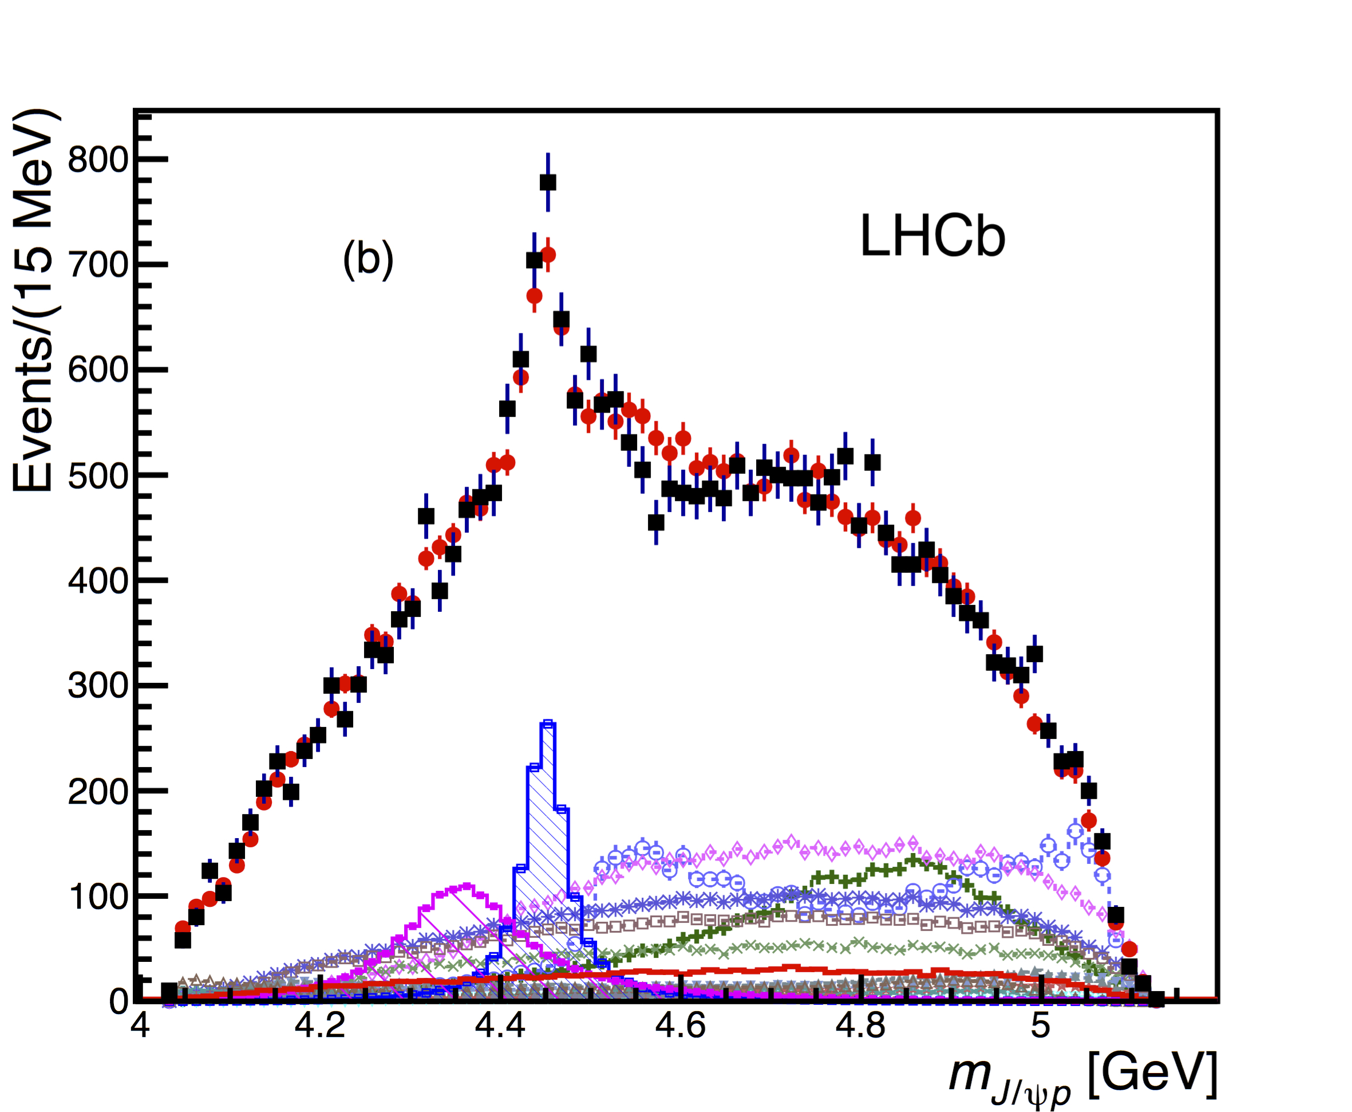
奇异重子
2015年，LHCb发现了两个五夸克态候选者：P_{c}(4380) & P_{c}(4450)
LHCb: PRL 115,072001

Slide 15
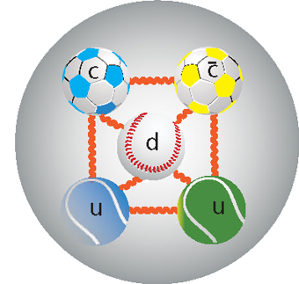
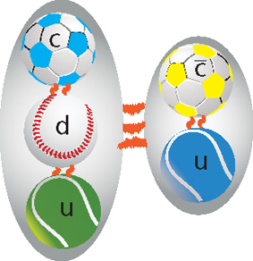
奇异重子
2015年，LHCb发现了两个五夸克态候选者：P_{c}(4380) & P_{c}(4450)
LHCb: PRL 115,072001
LHCb发现“五夸克物质”被英国物理学会主编的《Physics World》杂志评为2015年国际物理领域十大重要进展之一

Slide 16
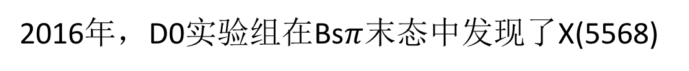
X(5568)
2016年，D0实验组在Bs$π$末态中发现了X(5568)
D0: 1602.07588,PRL117,022003
如果该粒子被确认：
这将是首次发现具有四种不同味道的强子！

Slide 17
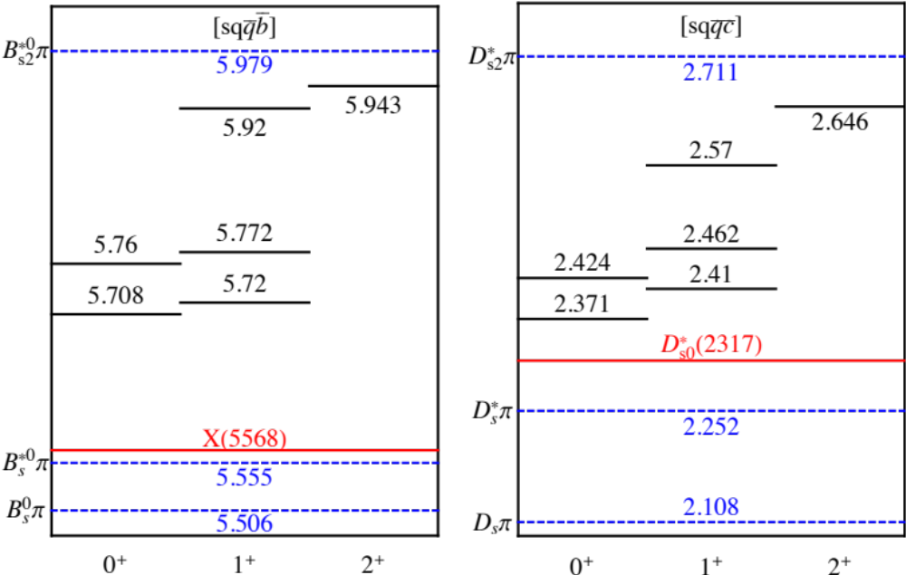
X(5568)
D0: 1602.07588 (24th February)
在四夸克态模型下，计算了X(busd)的质量谱;
计算表明，如果X存在，其质量应该比实验值高约150MeV!
对X(5568)的存在提出了质疑！
W.Wang, R.L.Zhu, Chin.Phys.C 40,093101 (2016)1602.08806; 39 citations
29th February (关于X(5568)的第三篇文章)
1608.00435: LHCb gives negative results on existence of X(5568)!

Slide 18







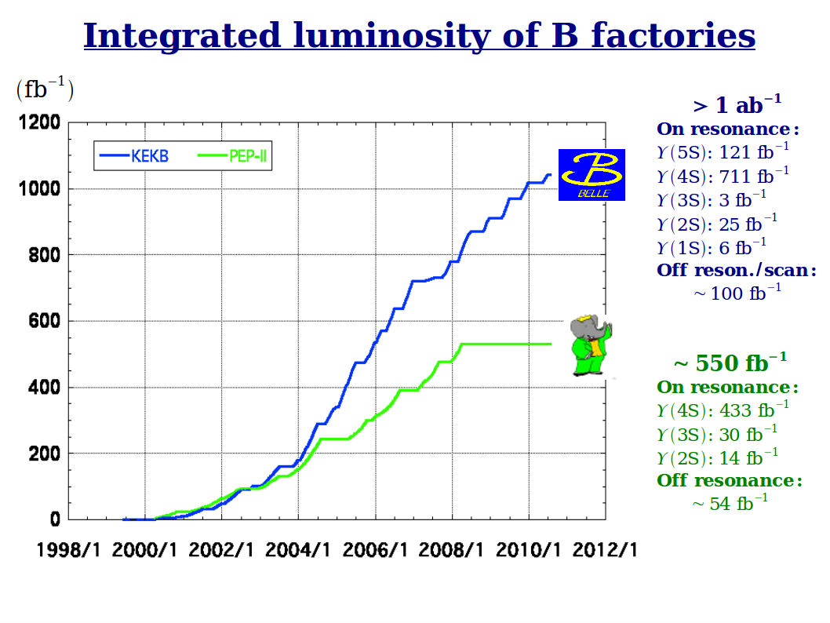
High Energy Hadron Physics Machine

Slide 19
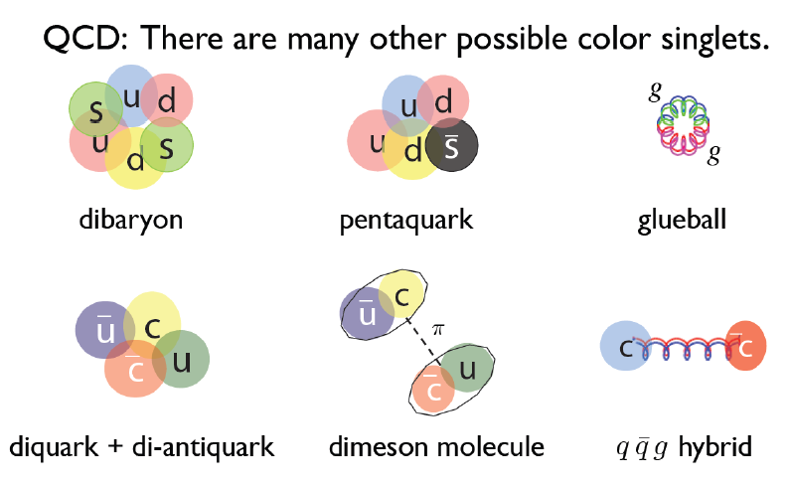
Hadron Exotics: Theory Overview

Slide 20
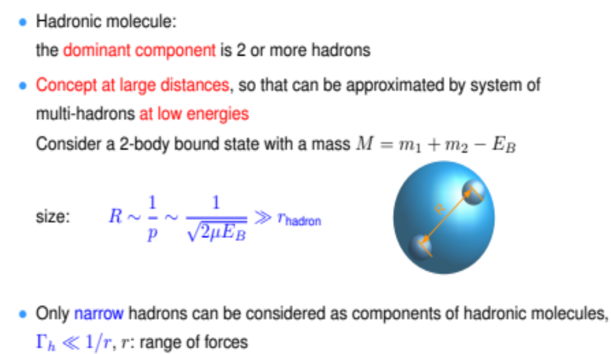
Hadron Exotics: Molecule

Slide 21

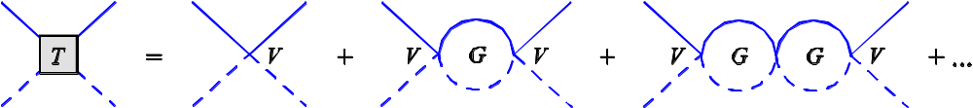
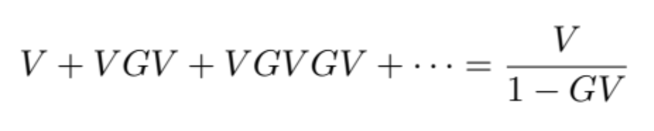
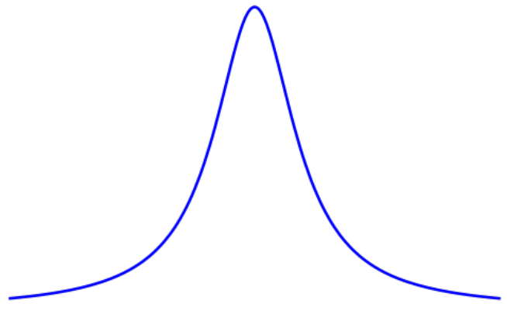
Hadron Molecules
Summing all order contributions:
1-GV＝0
s=s₀
Mass pole corresponds to a resonance structure
→ Hadron Molecule

Slide 22
Many (model-dependent) studies on hadron structure.
how about high energy process?

Slide 23
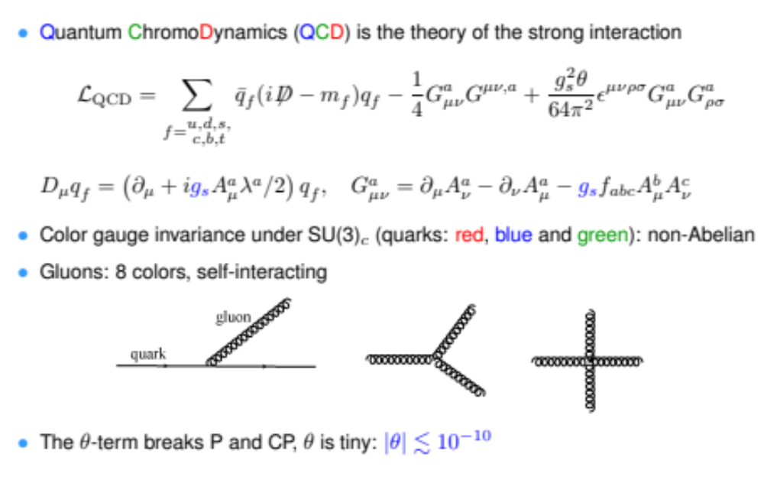
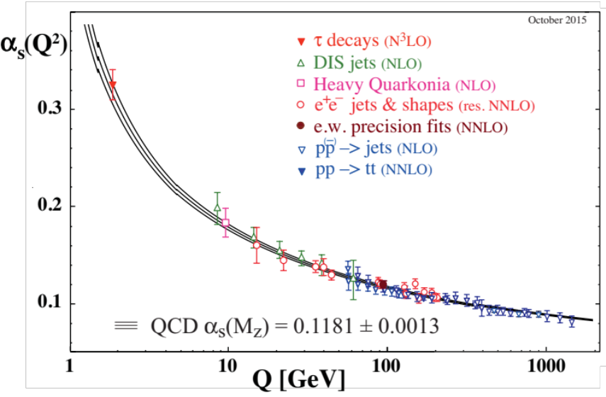
QCD

Slide 24
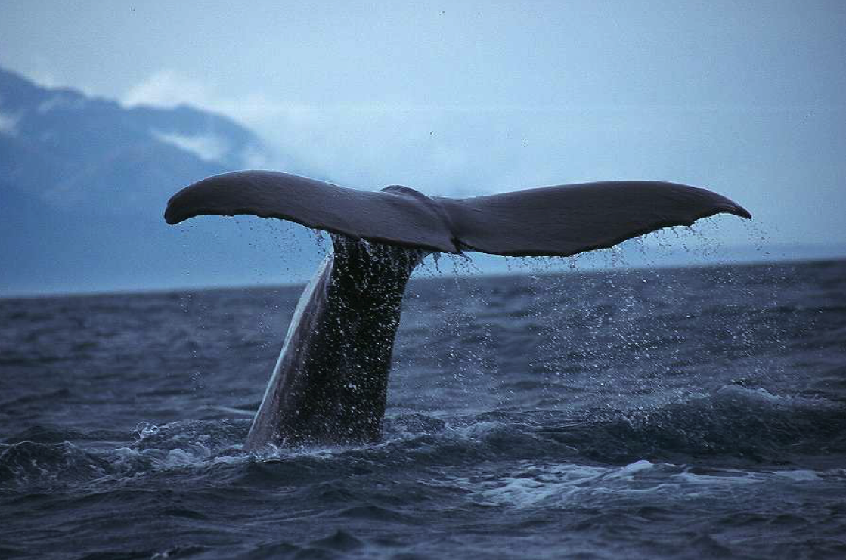
Where is the tail?
Many studies on hadron structure,
but how about high energy process?

Slide 25
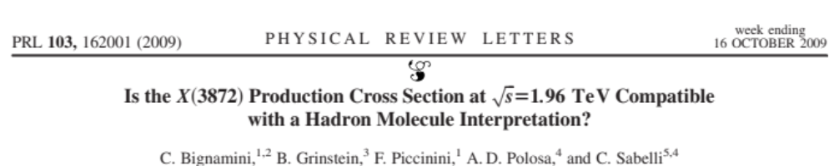
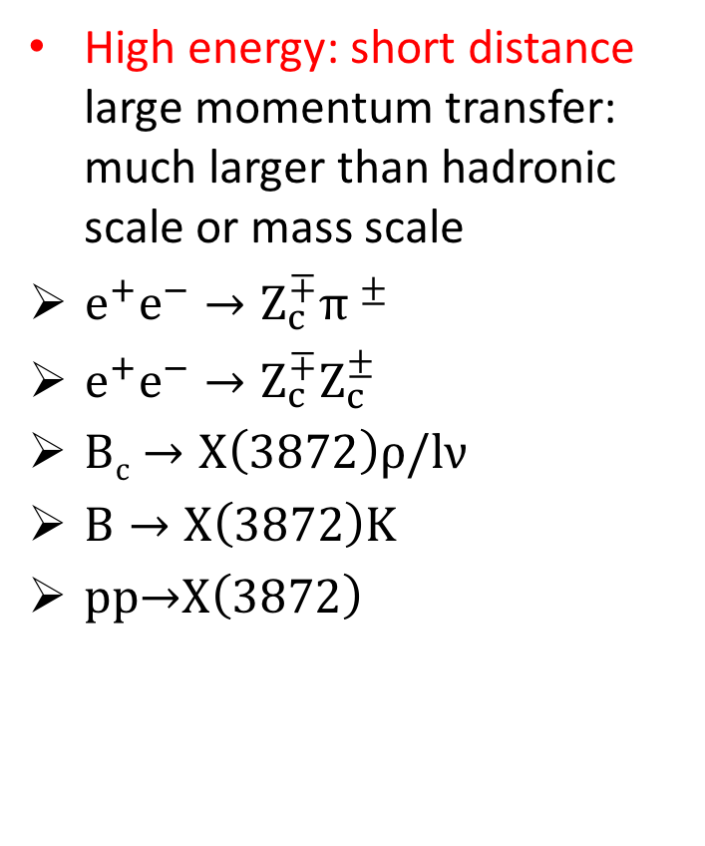
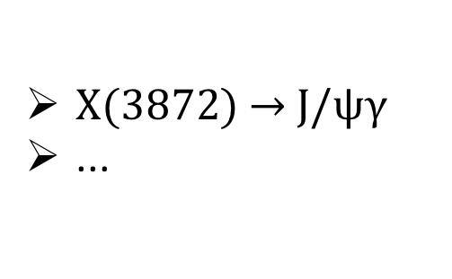
高能过程中的产生
  High energy: short distance large momentum transfer: much larger than hadronic scale or mass scale
  $e^{+}e^{−}→{Z_{c}^{∓}π }^{±}$
  $e^{+}e^{−}→Z_{c}^{∓}Z_{c}^{±}$
  $Bc→X\left(3872\right)ρ/lν$
  $B→X\left(3872\right)K$
  $\text{pp}\text{→}\text{X}\left(\text{3872}\right)$
Low energy: long distance
$\text{X}\text{(3872) → }\text{J}\text{/}\text{ψγ}$
...

Slide 26
Guo, Meißner, WW,
``On the constituent counting rules for hard exclusive processes involving multiquark states,'’
Chin.Phys.C41, 053108 (2017)
[arXiv:1607.04020 [hep-ph]]

Slide 27
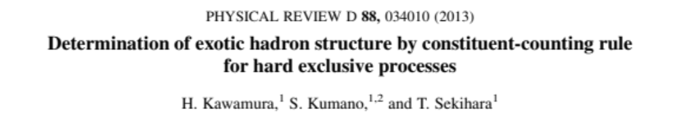
Constituent Scaling Rule?
Kawamura, Kumano, Sekihara,1307.0362
Kawamura, Kumano,1313.1596
Blitz, Lebed, 1503.04802
Brodsky, Lebed, 1505.00803
Chang, Kumano, Sekihara, 1512.00647

Slide 28
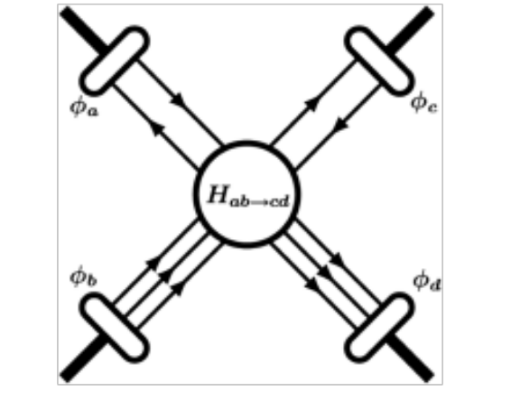




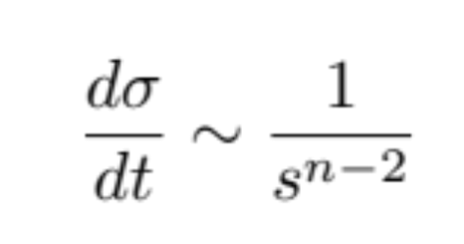
Constituent Scaling Rule?
  s: square of collision energy
  n_{i}: valence component in object i
Constituent Scaling Rule for Cross Section:
  tree-level
Very clean and straightforward!

Slide 29
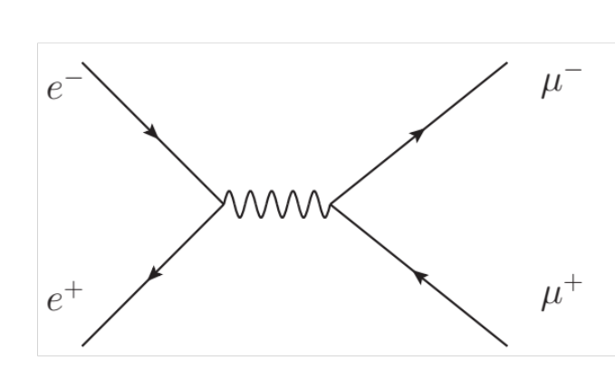
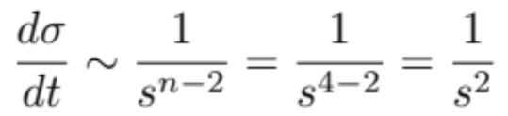
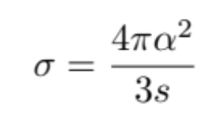

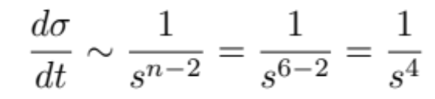
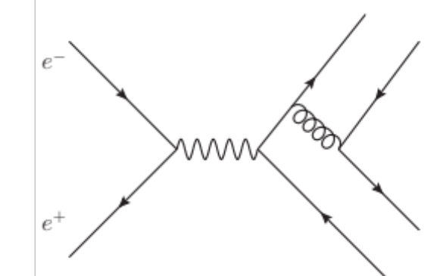
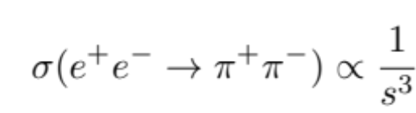





Constituent Scaling Rule?
  $$e^{+}e^{−}→μ^{+}μ^{−}$$
  $$scaling rule:$$
  $$QED:$$
  $$e^{+}e^{−}→π^{+}π^{−}$$
  $$scaling rule:$$
  $$pQCD:$$

Slide 30



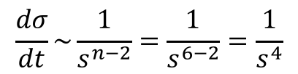
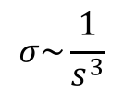
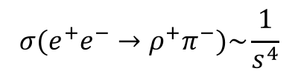

  产生机制：$e^{+}e^{−}→ρ^{+}π^{−}$
  $$e^{+}e^{−}→ρ^{+}π^{−}$$
  $$scaling rule:$$
$$\frac{dσ}{dt}\sim \frac{1}{s^{n−2}}=\frac{1}{s^{6−2}}=\frac{1}{s^{4}}$$
$$σ\sim \frac{1}{s^{3}}$$
  $$pQCD:$$
$$σ(e^{+}e^{−}→ρ^{+}π^{−})\sim \frac{1}{s^{4}}$$

Slide 31
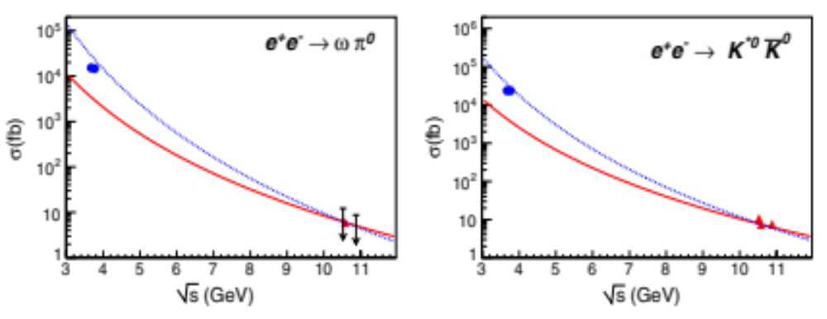
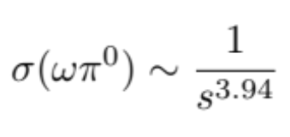
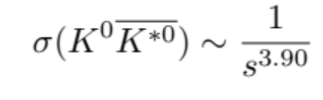

产生机制：$e^{+}e^{−}→ρ^{+}π^{−}$
CLEOc 3.67 GeV:
Phys.Rev.Lett.94,012005(2005);
Belle 10.52, 10.58, 10.876 GeV:
Phys.Rev. D88 (2013) 052019
Solid line: 1/s³ dependence (scaling rule)
dashed line: 1/s⁴ dependence
For more results, see:
BES:Phys. Rev. D 70, 112007 (2004)
Babar:Phys.Rev.D 74, 111103 (2006)
Lu, WW, Wang:
PRD 74, 094020(2007)

Slide 32
Effective Field Theory: Factorization

Slide 33
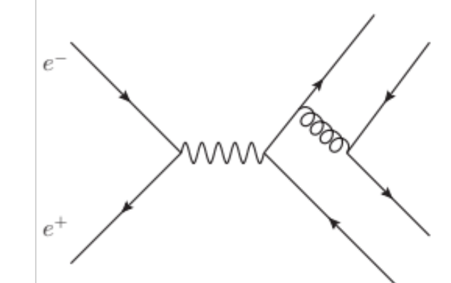


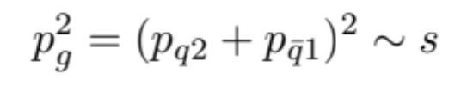

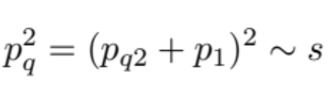

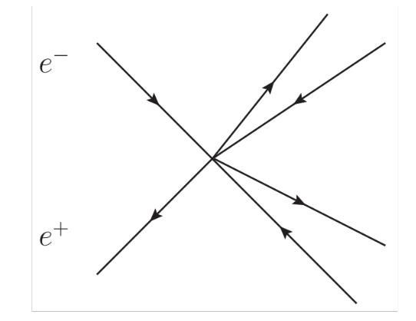
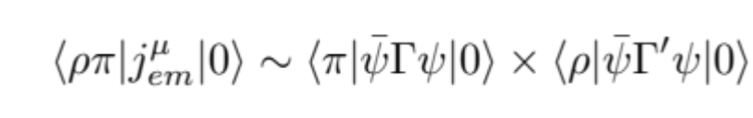
Effective Field Theory
Integrating out

Slide 34






Naïve power counting
$$V=ρ^{0},ω,ϕ$$
$$V=ρ^{0},ω,ϕ$$
$n=n_{a}\text{+}n_{b}$+$n_{c}$+$n_{d}=5$

Slide 35





Effective Field Theory: factorization
能标
$$V=ρ^{0},ω,ϕ$$
QED interaction
结构复杂度
尽管矢量粒子$ρ^{0}$的低能结构是两个夸克，
在高能标下，它的产生由展开幂次最低的光子场算符决定

Slide 36
$${\text{Z}}_{\text{c}}^{\text{±}}$$
BES: PRL 110, 252001
Belle: PRL 110, 252002
tetraquark vs hadronic molecules?
debate?

Slide 37
Constituent Scaling Rule?
Kawamura, Kumano, Sekihara,1307.0362
Kawamura, Kumano,1313.1596
Blitz, Lebed, 1503.04802
Brodsky, Lebed, 1505.00803
Chang, Kumano, Sekihara, 1512.00647

Slide 38


$$e^{+}{e^{−}→\text{Z}}_{\text{c}}^{\text{±}}π^{∓}$$
Brodsky, Lebed: Phys.Rev.D91.114025
Guo, Meissner, WW:

Slide 39



$$e^{+}{e^{−}→\text{Z}}_{\text{c}}^{\text{±}}π^{∓}$$
Suppressed by 1/mc², but irrelevant with s
能标
Off-shell
QCD interaction
结构复杂度

Slide 40



$$B_{c}→X(3872)$$
能标
QCD interaction
结构复杂度

Slide 41



$$B_{c}→X(3872)$$
Ratio of semileptonic and nonleptonic decays:
WW, Q.Zhao, 1512.03123

Slide 42



Concept Clarification: Mixing
  Factorization in EFT:
Mixing
QCD interaction

Slide 43

Summary
奇异强子的研究取得了很大的进展
Constituent scaling rule is violated!
对于含hidden味道的强子，低能结构与高能产生场算符并不一定完全一样
$一些高能$情况下的产生：有效理论
QCD interaction
谢谢大家！

