Slide 1
Mott physics, sign structure, and high-temperature superconductivity
Zheng-Yu Weng
IAS, Tsinghua University
Hefei, USTC ICTS --- 2013.11.29
Notes:
Landau’s Fermi liquid theory has dominated the CMP for over 60 years; It is the basis for the modern quantum many-body theory; A beautiful application of Feynman’s path-integral approach in CMP; BCS theory: over 56 years; High-Tc cuprates: great challenge to these theories/paradigms; past 27 years have seen a great effort in understanding the high-Tc problem, especially in the point of view of doped Mott insulators; this talk is trying to provide a consistent picture based on one of the sustained effort; many important concepts will be touched upon: Mott physics, electron fractionalization; emergent physics; emergent gauge theory; …

Slide 2
Outline
Introduction to basic experimental phenomenology of high-T_{c} cuprates
High-T_{c} cuprates as doped Mott insulators /doped antiferromagnets
Basic principles: Mott physics and sign structure
Nontrivial examples:
(1) one-hole case
(2) finite doping and global phase diagram
(3) ground state wavefunction
Summary and conclusion

Slide 3
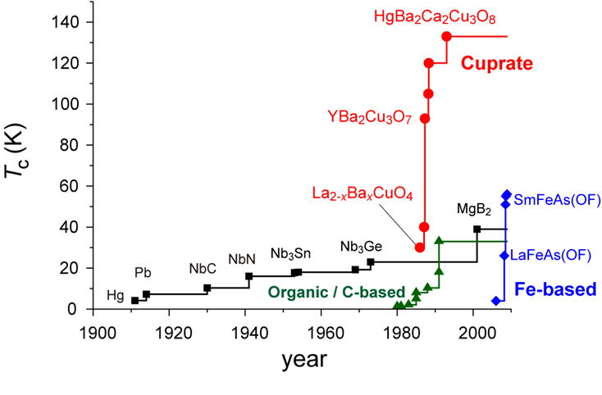
High-T_{c} superconductors

Slide 4
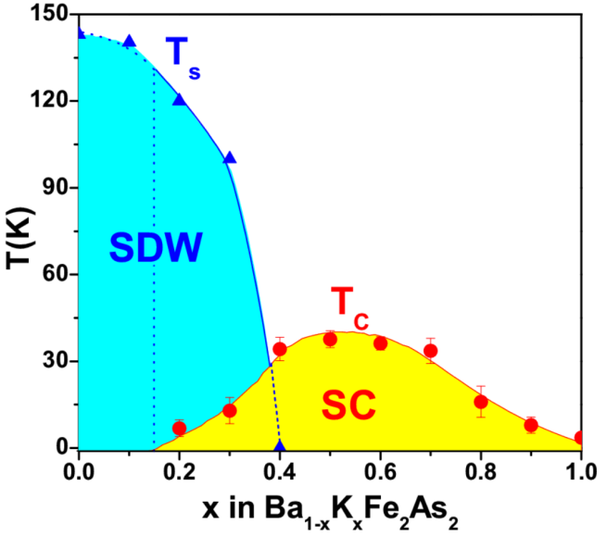
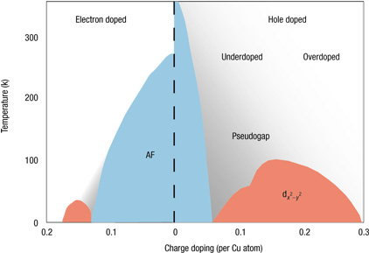
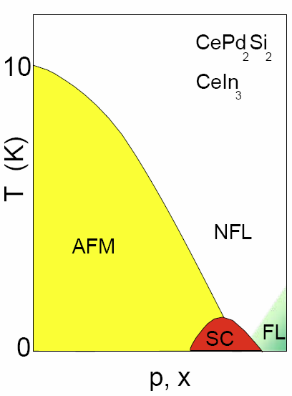
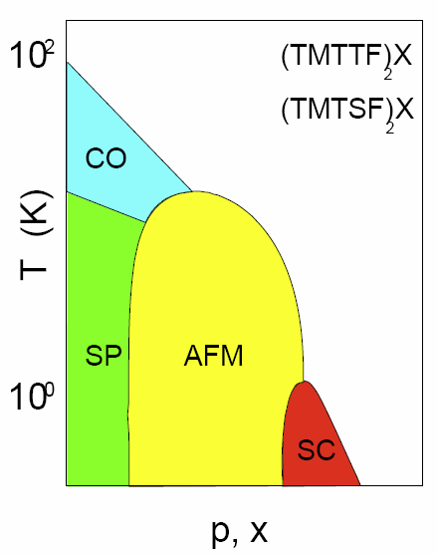
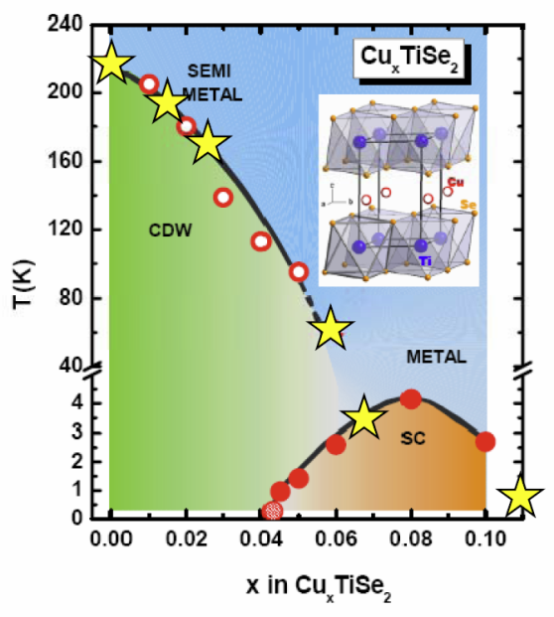
Are the cuprates any special besides high Tc?
cuprates
iron pnictides
heavy fermion
organic metal
CDW

Slide 5
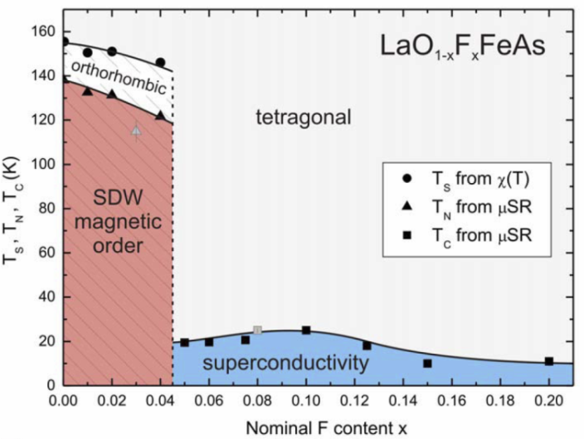
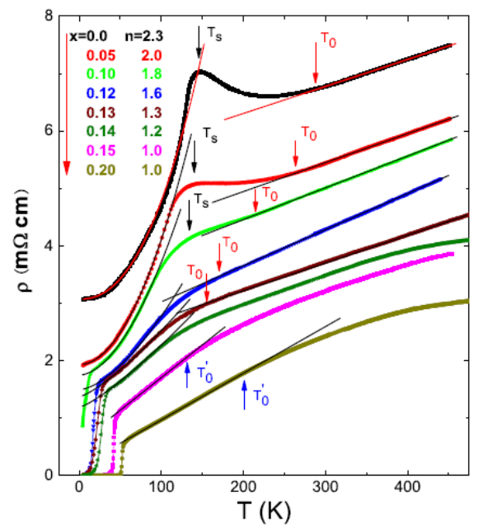
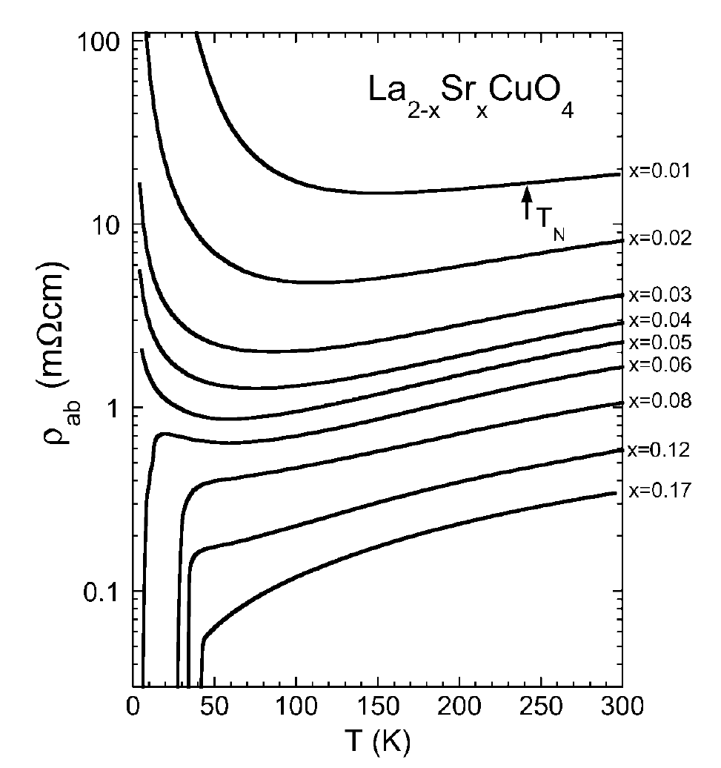

Slide 6
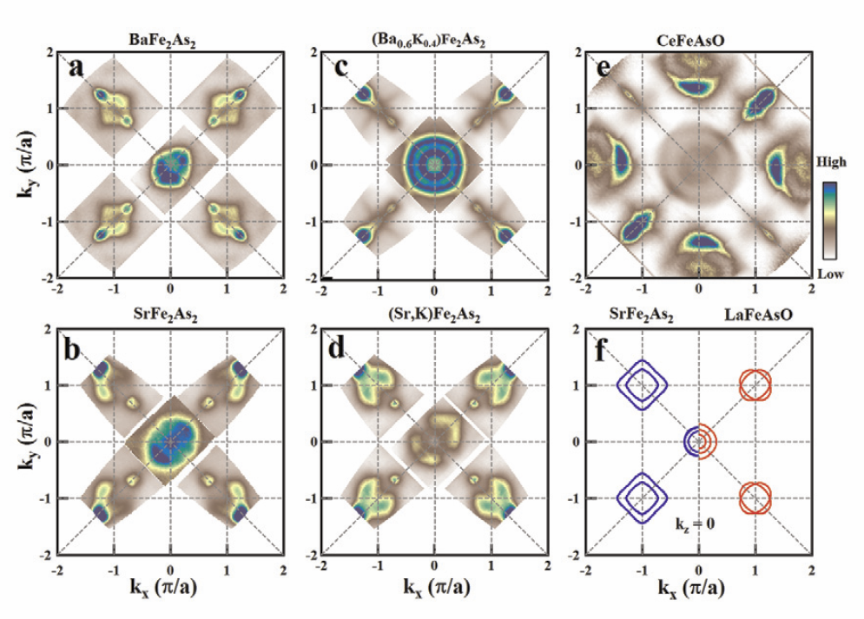

Slide 7
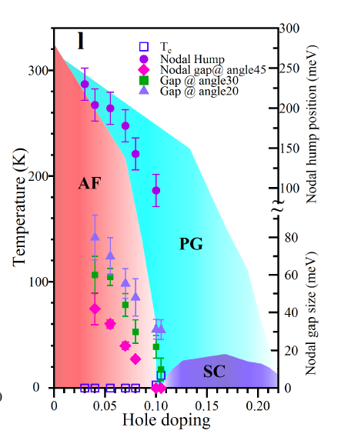
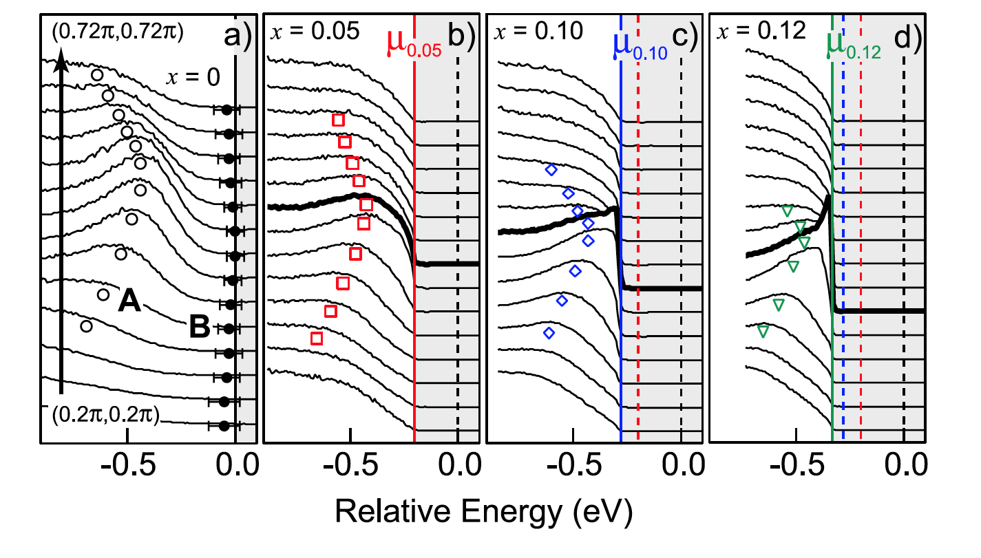
charge localization

Slide 8
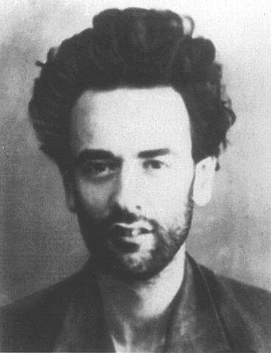
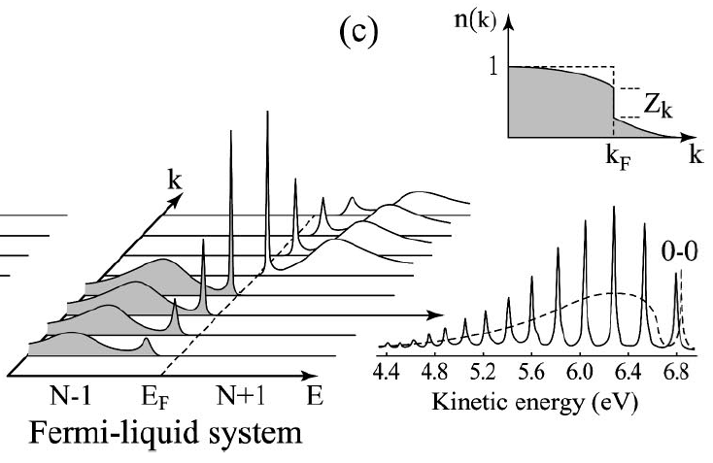
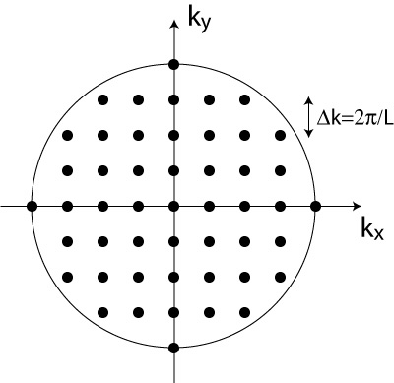

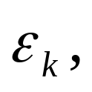
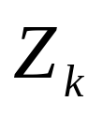
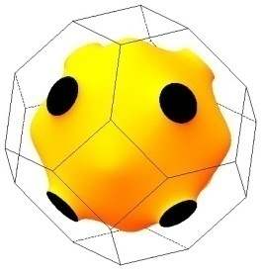

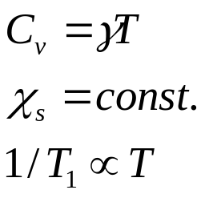


Landau paradigm
ARPES
Fermi sea
Fermi surface of copper
typical Fermi liquid behavior:
Fermi degenerate temperature
Sommerfeld constant
Pauli susceptibility
Korringa behavior

Slide 9
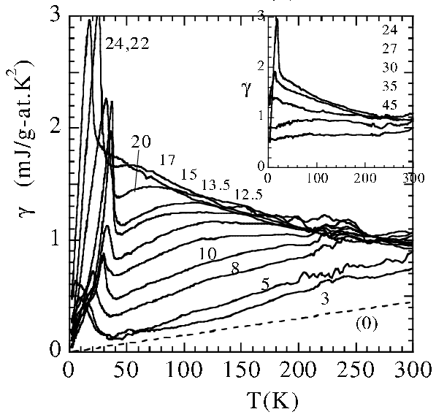
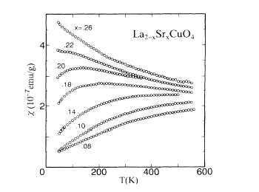
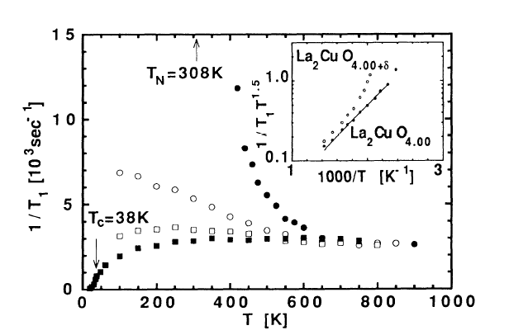
La_{2-x}Sr_{x}CuO₄
Spin susceptibility (T. Nakano, et al. (1994))
Specific heat (Loram et al. 2001)
Fermi liquid behavior:
Sommerfeld constant
Pauli susceptibility
Korringa behavior
NMR spin-lattice relaxation rate (T. Imai et al. (1993))

Slide 10
Cuprate phase diagram
T
~ J/k_{B}
Strange metal: maximal scattering
T₀
strong AF correlations
T_{N}
T*
strong SC fluctuations
T_{v}
T_{c}
FL?
0
x
QCP
AFM
d-wave superconducting order

Slide 11
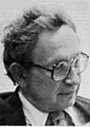
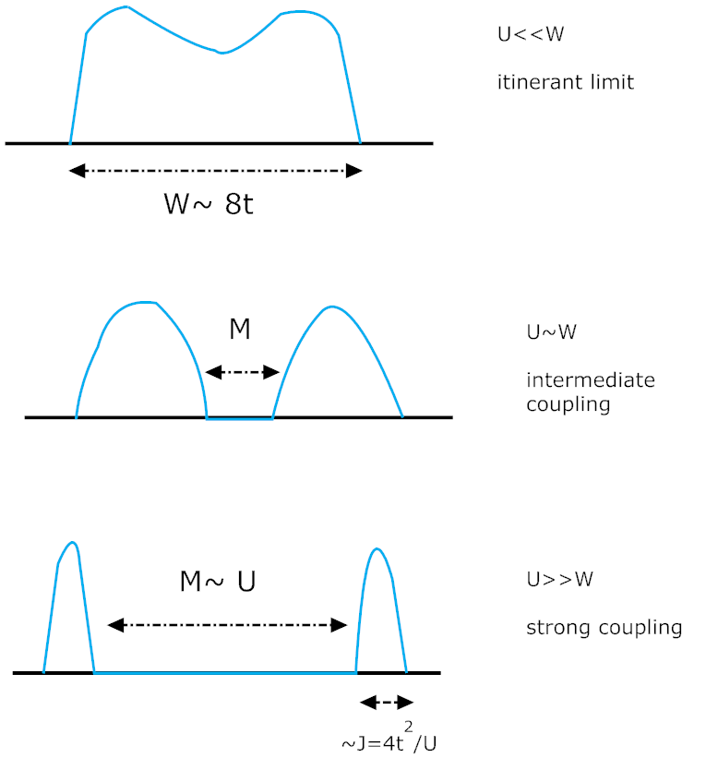
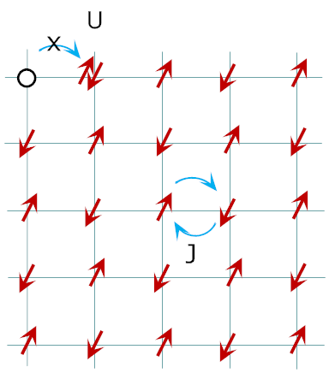
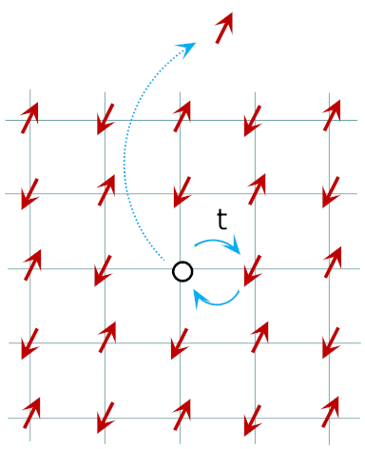

Cuprates = doped Mott Insulator
Anderson, Science 1987
Mott insulator
doped Mott insulator
Heisenberg model
t-J model
one-band large-U Hubbard model

Slide 12
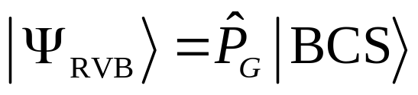
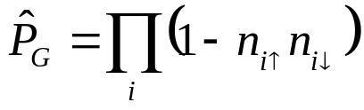
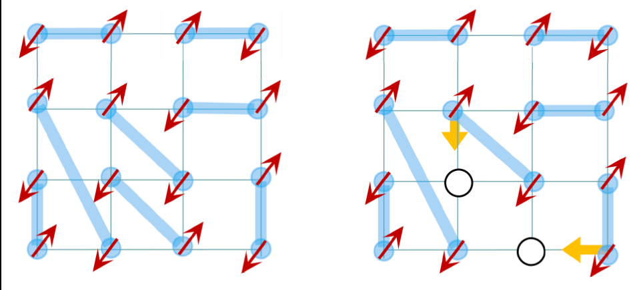
Anderson’s RVB theory
Science, 235, 1196 (1987)
Gutzwiller projection
d-wave and pseudogap:
Zhang, Gross, Rice, Shiba
(1988)
Kotliar, Liu (1988)
……
Review:
Half-filling:
Mott-RVB insulator
doping:
Superconductor
Anderson, et al., J. Phys.:
Condens. Mater (2004)

Slide 13
Understanding of Mott physics

Slide 14
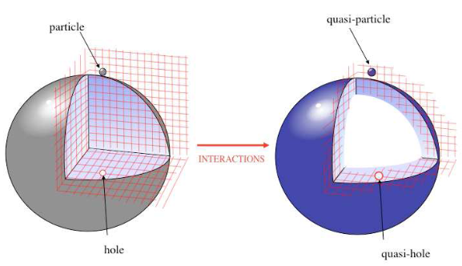

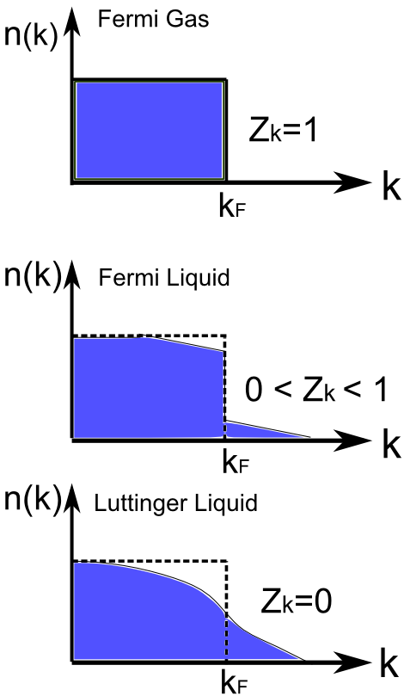
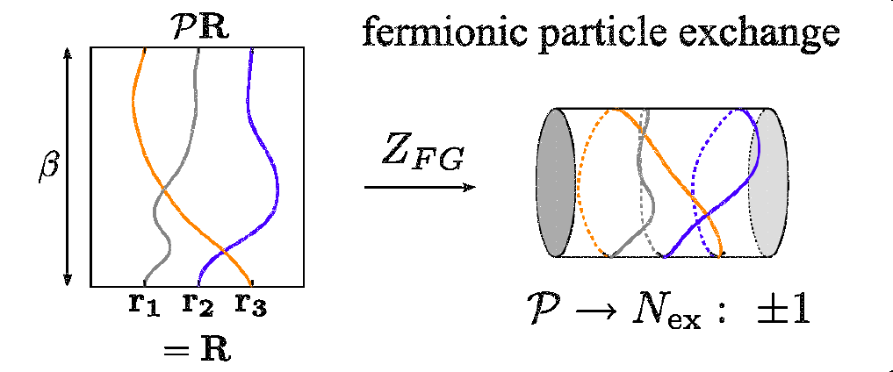
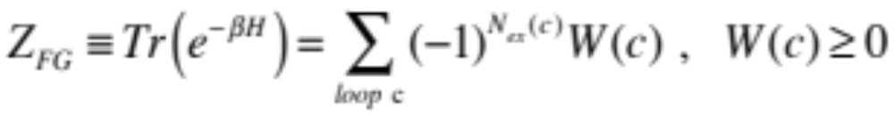
Statistical sign structure for Fermion systems
Fermion signs
Landau Fermi Liquid

Slide 15
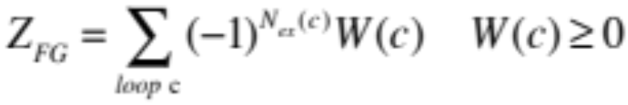

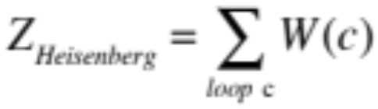
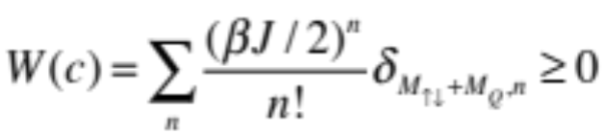
（1）Fermi liquid: Fermion signs
（2）Bose condensation:
Off Diagonal Long Rang Order (ODLRO)
compensating the Fermion signs
Cooper pairing in SC state
CDW (“exciton” condensation)
SDW (weak coupling)
normal state: Fermi liquid
Antiferromagnetic order (strong coupling)
Complete disappearance of Fermion signs!

Slide 16
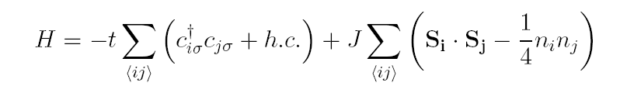
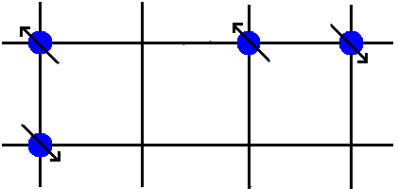

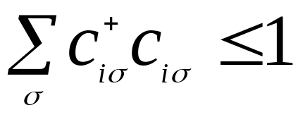


A minimal model for doped Mott insulators: t-J model
hopping superexchange

Slide 17
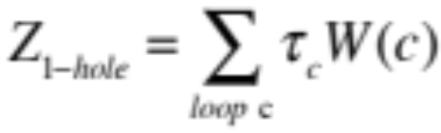
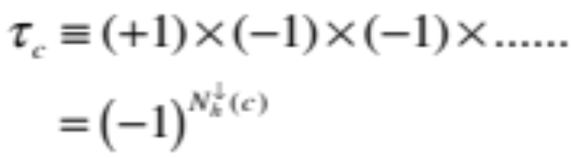
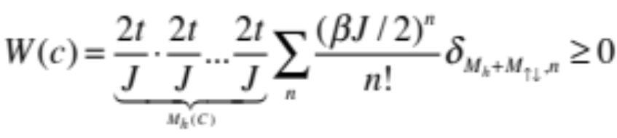
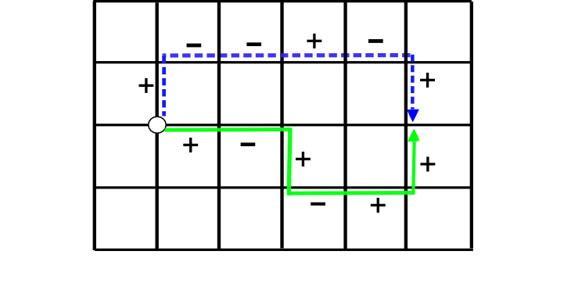


Single-hole doped Heiserberg model:
＋
－
Phase string effect
D.N. Sheng, Y.C. Chen, ZYW, PRL (1996)；K. Wu, ZYW, J, Zaanen, PRB (2008)

Slide 18
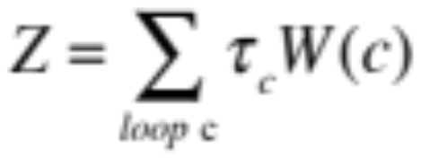


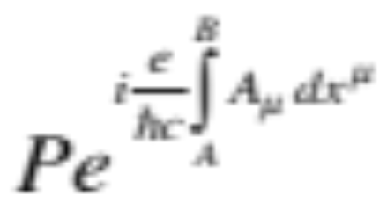
Emergent gauge force in doped Mott insulators!
Mutual Chern-Simons gauge theory ZYW et al (1997) (1998)
Kou, Qi, ZYW PRB (2005); Ye, Tian, Qi, ZYW, PRL (2011); Nucl. Phys. B (2012)
Nonintegrable phase factor:
B
“An intrinsic and complete description of electromagnetism”
A
“Gauge symmetry dictates the form of the fundamental forces in nature”
C. N. Yang (1974) , Wu and Yang (1975)

Slide 19
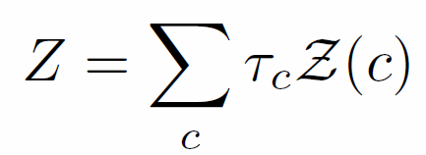
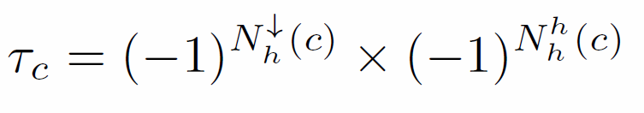

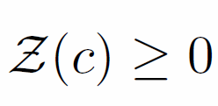
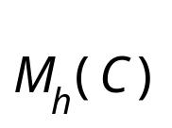
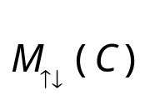




Exact sign structure of the t-J model
at arbitrary doping, dimensions, temperature
= total steps of hole hoppings
= total number of spin exchange processes
= total number of opposite spin encounters
Wu, Weng, Zaanen, PRB (2008)

Slide 20
For a given path c:
+
-
+
-
+
+
+
-
+
+
-
-
-
(-)
+
(-)³
-
-
-
-
+
+
-
+
-
+
+
K. Wu, ZYW, J. Zaanen, PRB (2008)

Slide 21


Removing the phase string: σt-J model
σ
no phase string effect!

Slide 22

New guiding principles:
Mott physics = phase string sign structure replacing the Fermion signs
Strong correlations = charge and spin are long-range entangled
Sign structure + restricted Hilbert space = unique fractionalization
“smooth” paths good for
mean-field treatment
singular quantum phase
interference

Slide 23
Consequences of
the sign structure

Slide 24

Global phase diagram
T
T₀
“strange metal”
pseudogap
AF
SC
FL？
δ
localization
AF = long-range
RVB

Slide 25


DMRG numerical study
Z. Zhu, H-C Jiang, Y. Qi, C.S. Tian, ZYW, Scientific Report 3, 2586 (2013）；
Z. Zhu, et al. (2013); ……
t-J ladder systems

Slide 26


Effect of phase string effect
no phase string effect
Self-localization of the hole!
σ

Slide 27


Momentum distribution
Quasiparticle picture restored!
without phase string effect

Slide 28



localization-delocalization transition
t’
t

Slide 29

T
Global phase diagram
T₀
“strange metal”
pseudogap
AF
SC
FL
δ
localization
AF = long-range
RVB
AF
spin liquid
doping
localization
SC

Slide 30
Delocalization and superconductivity
+
-
+
-
-
+
+
-
-
-
+
-
+
-
-
-
-
+
+
+
-
+
+
+
-
-
+
localization/AFLRO
delocalization/spin liquid
AF
spin liquid
doping
localization
SC

Slide 31

Non-BCS elementary excitation in SC state
+
-
-
+
+
+
-
-
-
-
+
+
-
-
-
-
+
+
+
-
+
-
+
-
spin-roton
+
-
+
-
-
+
Superconducting transition
-
-
spinon confinement-deconfinement transition
+
spinon-vortex
+
-
T_{c} formula Mei and ZYW (2010)

Slide 32



Spin-rotons
neutron
Raman A_{1g}
J.W. Mei & ZYW, PRB (2010)
164 K

Slide 33

Global phase diagram
charge-spin long-range entanglement by phase string effect
T
T₀
“strange metal”
pseudogap
AF
SC
FL
δ
localization
AF = long-range
RVB

Slide 34





Slide 35






T
T₀
strange metal
(Curie-Weiss metal)
T₀
uniform susceptibility
pseudogap
AF
SC
non-FL
0
x
bosonic RVB
resistivity

Slide 36








Example III : “Parent” ground state
ZYW, New J. Phys. (2011)
l_{h}
i_{u}
j_{d}
short-ranged

Slide 37


Global phase diagram
charge-spin long-range entanglement by phase string effect
T
T₀
“strange metal”
pseudogap
AF
SC
FL*
δ
localization
AF = long-range
RVB

Slide 38
Summary
Cuprates are doped Mott insulators with strong Coulomb interaction
New organizing principles of Mott physics:
An altered fermion sign structure due to large-U
Consequences:
(1) Intrinsic charge localization in a lightly doped antiferromagnet
(2) Charge delocalization (superconductivity) arises by destroying
the AFLRO
(3) Localization-delocalization is the underlying driving force for the
T=0 phase diagram of the underdoped cuprates
(4) Non-BCS-like ground state wavefunction

Slide 39
Thank you
For your attention!

Slide 40
Example III : “Parent” ground state
ZYW, New J. Phys. (2011)
l_{h}
i_{u}
j_{d}
AFM state:
Superconducting state:
emergent (ghost) spin liquid
short-ranged

Slide 41








Electron fractionalization form

