Slide 1
RHIC & LHC create pure glue matter
0.Early proposals for two phase transitions and two timescales in RHICs:
Svetitsky&Yaffe, Pisarski&Wilczek, Raha&Sinha, Shuryak et al…
1. CGC Gluon Supersaturation – Overoccupied, BEC
2. fast Gluon Equilibration – slow quark saturation
3. First Transition is 1.Order Phase Trans. in Yang-Mills gauge theory
4. Pure Gauge Theory Nf =0 vs.“physical” Nf 2+1QCD: Nf fct of time !
5. Second ‘Transition’: hadronization from 2+1Nf Quark-Gluon Plasma?
6. GlueBall-Hagedornstates decay in 2b-cascade: high mult pp pA - AA?
GB-HS, hadron ratios, <pt> vs. Multiplicity Flow & Ridge in pp, pA
Dileptons, Photons, Centauros,… vs. Multiplicity in pp, pA… +AA?
Horst Stoecker, GSI Helmholtzzentrum f. Heavy Ion Research, CCNU Wuhan, USTC,
Judah M. Eisenberg Professor Laureatus, ITP & FIAS, Goethe Univ. Frankfurt

Slide 2
Acknowledgements
Transport colleagues: Zhou, Seizel, Xu, Zhuang, C. Greiner...
Hagedorn dynamics: Beitel, Gallmeister, C. Greiner...
FIAS: Schramm, Dietrich, Struckmeier, Vasak, ...
Early phase e-m probes colleagues: Raha, Sinha, Gorenstein, Vovchenko, Satarov, Mishustin, A. Srivastava, Csernai ...
Lattice colleagues: Fodor, Borsanyi, Szabo, Karsch, Philipsen...
Experimentalists: Giubellino, Harris, Oeschler, PBM, Masc..

Slide 3
Traditional picture of QCD matter in Heavy Ion Collisions
Initial Color Glass Condensate Glasma thermalizes fast equilibration of Gluons and Light flavor quarks high pressure, entropy hydrodynamic expansion flow as excellent probe of QCD matter.
Hadronization@T=155MeV: crossing of 2+1 flavor QCD.
Hadronic yields and v_n at RHIC and LHC measured ->FIT !
Comparison of HRG, T= 155 MeV, with LHC data
test of our understanding of QCD matter.

Slide 4


Jet Suppression scheme and Heavy Quarks in
Hot SU(3) Matter – whats the “medium”?
hadrons
e⁻, J/
partons
1)
production
2)
medium energy loss
3)
fragmentation
4)
decay
Initial momentum distributions for partons
Parton energy loss
Fragmentation functions of partons into hadrons
Decay of heavy mesons to single e⁻ and J/Psi.
… Courtesy Magdalena Djordjevic

Slide 5
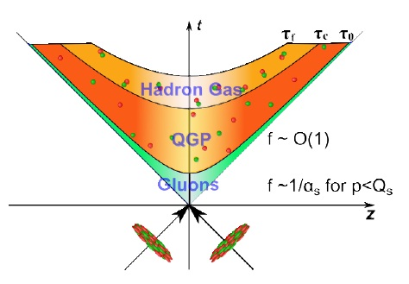
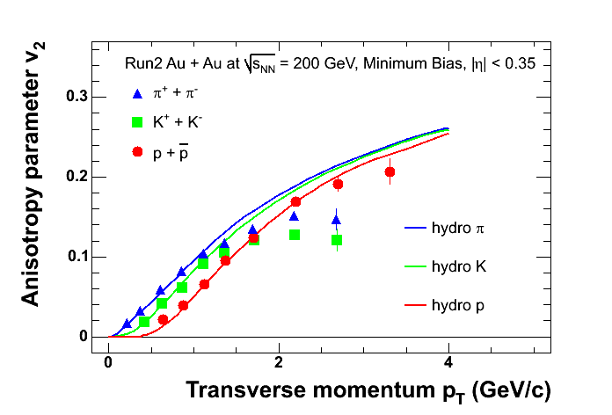
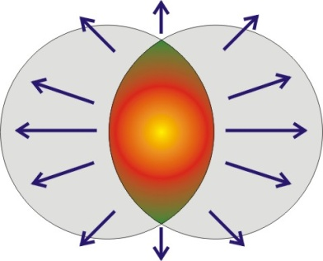
Introduction: Fast thermalization required for Hydro
how can a system evolve
to thermal equilibrium
in such a very short time?
?
?
Initially: very far from equilibrium !
2+1QCD Hydro-Onset time < 1fm/c ?

Slide 6
The early eighties: predictions of QCD phase structure
1. two different phase transitions:
Svetitsky&Yaffe: F.O.P.T. in pure gauge YM theory:
“glueplasma – GlueBall fluid” – no quarks!
Pisarski&Wilczek: chiral massless quarks
F.O.PT QGP-Hadrons, but crossing if quark mass nonzero
2. - two chemical saturation eq. timescales in RHICs:
Raha/Sinha; Shuryak; T. Biro, B. Mueller, X.Y. Wang Transport Theory
Fast chemical saturation: pure glue! But Slow saturation: quarks !
Search for pure gauge YM F.O.P.T. at early times in colliders?
=> Early pp, pA: Glue <=> GlueBall: new QCD phase structure?

Slide 7
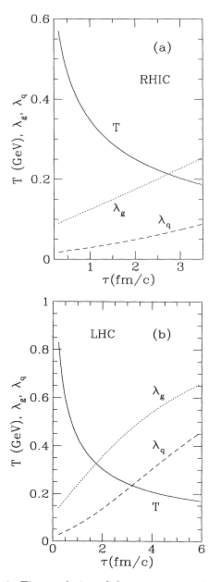
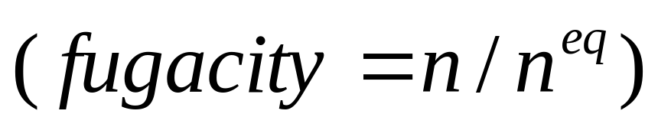
Time evolution of fugacity
of gluons and quarks (g, q)
from pQCD-based rate eq.
T. S. Biró, B. Mueller, X. Wang,
BMW , PRC48,1275 (1993)
Fast gluon saturation,
slow quark saturation

Slide 8
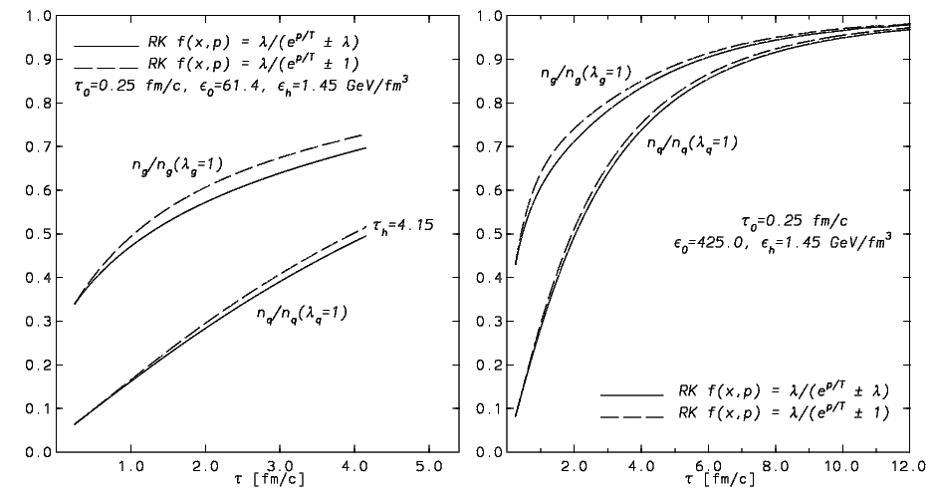
LHC
Fast gluon saturation,
slow quark saturation
Fast gluon saturation,
slow quark saturation
RHIC
Rate equation calculation
D.M. Elliott, D.H. Rischke,Nucl.Phys. A671,583 (2000)

Slide 9
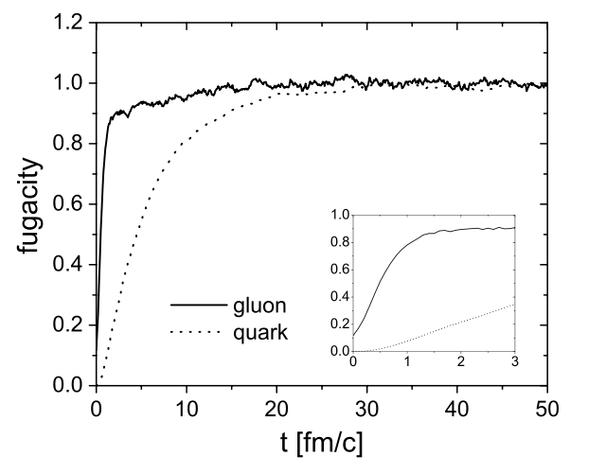
Time evolution of fugacity(g,q) - analog to Nf (t)
BAMPS Box calculation
Z.Xu, C.Greiner,
PRC71,064901(2005)
fugacity ~ ½ flavor number Nf:
Nf(t)
2
1
0.2
0.1
Fast gluon saturation,
slow quark saturation
t/fm/c

Slide 10
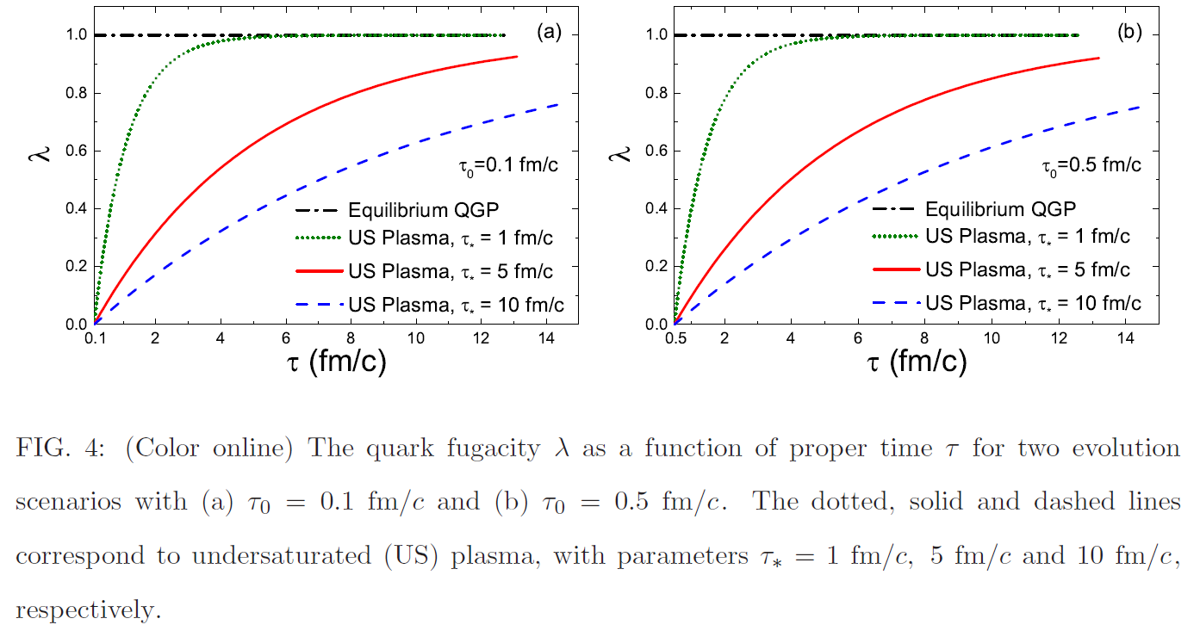

Slide 11

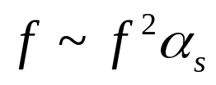
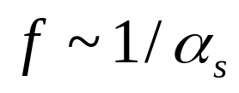

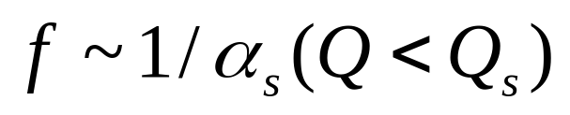
Introducing the Color Glass Condensate
CGC=effective field theory for hadrons at high energy limit
●
high energy
(time dilation)
fluctuation(sea partons) lifetime
internal interaction time scales
small x ( )l
gluon number increase at small x with increasing energy
●
gluon fusion
Saturation
●
Saturation momentum Qs(~GeV)
this feature can be inherited by initial
Glasma through indirect way

Slide 12
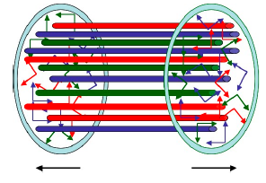
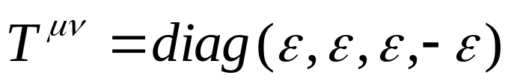
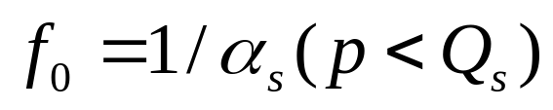
Introducing the Glasma
Glasma = non-equilibrium state in between CGC and QGP
●
using CGC as initial states for nuclei
highly anisotyopic initial glasma fields
(won't last longer than 1/Qs)
●
Instabilities -->wide range of unstable modes (up to Qs) grow exponentially untill saturation density
redistribute momentum ---> isotropization
free up quanta from classical field
initial condition amenable
for kinetic theory

Slide 13
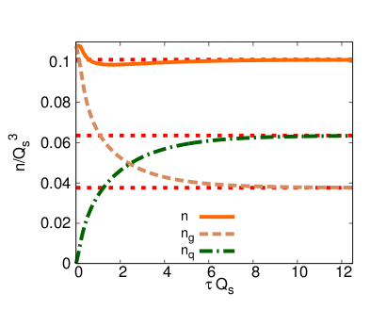
begin time evolution with
Glasma initial condition,
Use diffusion approximation
for Boltzmann equation
Fast gluon saturation,
slow quark saturation
Jean-Paul Blaizot, Bin Wu, Li Yan, Nucl.Phys. A930,139(2014)

Slide 14


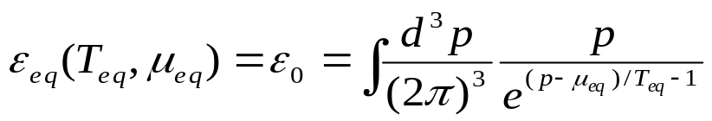

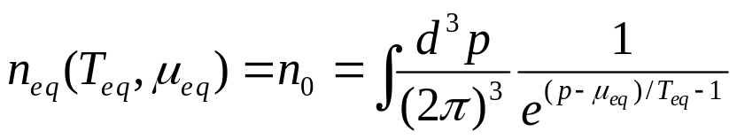

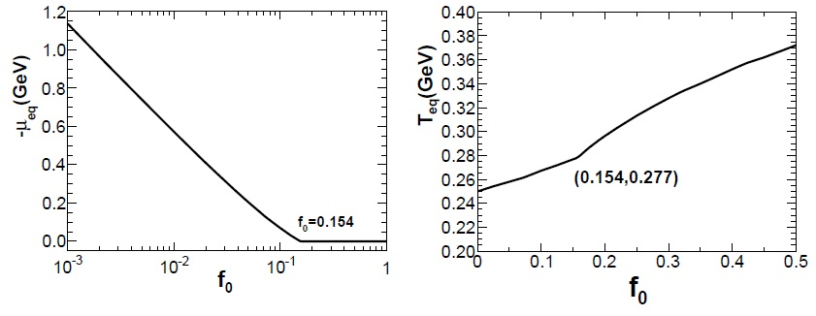
Introducing: Overpopulation
Overpopulation = the system contain more gluons than can
be accommodated by a Bose-Einstein distribution
initially:
expected final:
even for ,
still highly overpopulated

Slide 15
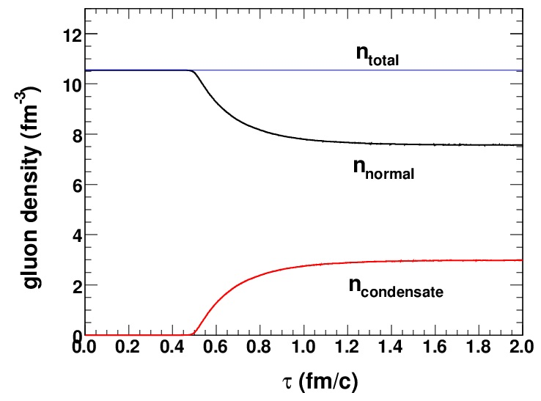
Kai Zhou, Zhe Xu, Pengfei Zhuang, Carsten Greiner,

Slide 16
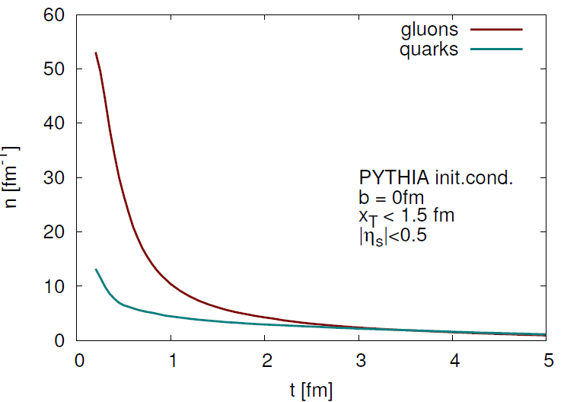
Gluon yields & quark yields F. Senzel, Z. Xu, C. Greiner BAMPS
Gluons
quarks

Slide 17
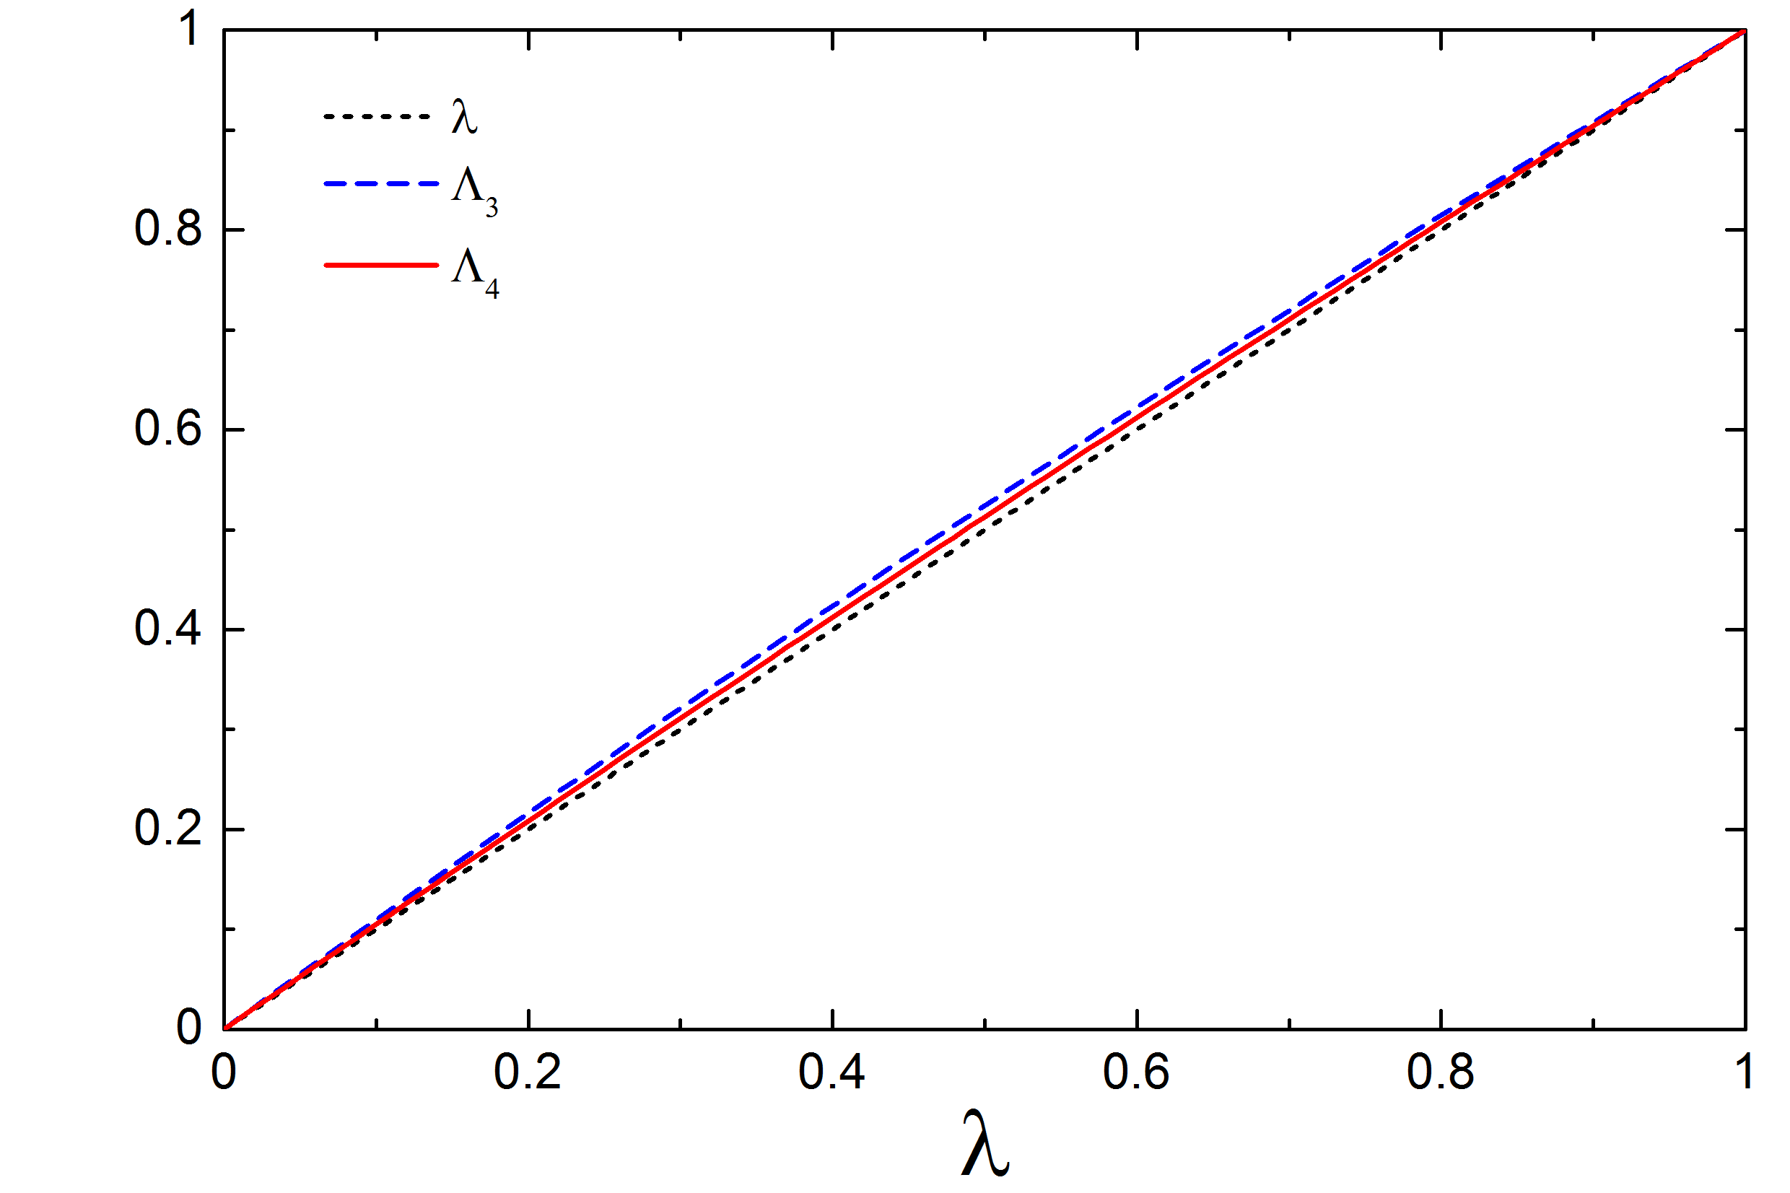

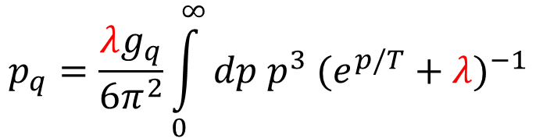



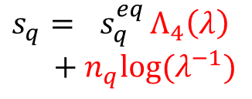

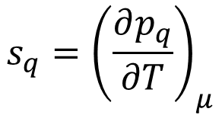


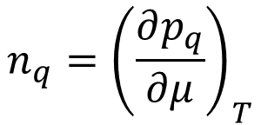
Thermodynamics of chemically Under-Saturated US QGP
Equation of state: $ε=3p$ (ideal gas of massless quarks and gluons)
(anti-)quarks are chemically Under-Saturated: (anti-)quark fugacity $e^{μ/T}=λ<1$
$$p_{q}=\frac{λg_{q}}{6π^{2}}\int_{0}^{∞}{dp p^{3} ({e^{p/T}+λ)}^{−1}}$$
$$n_{q}={\left(\frac{∂p_{q}}{∂μ}\right)}_{T}$$
$$s_{q}={\left(\frac{∂p_{q}}{∂T}\right)}_{μ}$$
quarks
gluons
number density:
$$n_{q}={ n}_{q}^{eq}Λ_{3}(λ)$$
$$n_{g}=n_{g}^{eq}$$
pressure:
$$p_{q}={ p}_{q}^{eq}Λ_{4}(λ)$$
$$p_{g}=p_{g}^{eq}$$
energy density:
$$ε_{q}={3p}_{q}^{eq}Λ_{4}(λ)$$
$$ε_{g}={3p}_{g}^{eq}$$
entropy density:
$$s_{q}={ s}_{q}^{eq}Λ_{4}\left(λ\right)$$
$+ n_{q}log⁡(λ^{−1})$
$$ε_{g}={3p}_{g}^{eq}$$

Slide 18
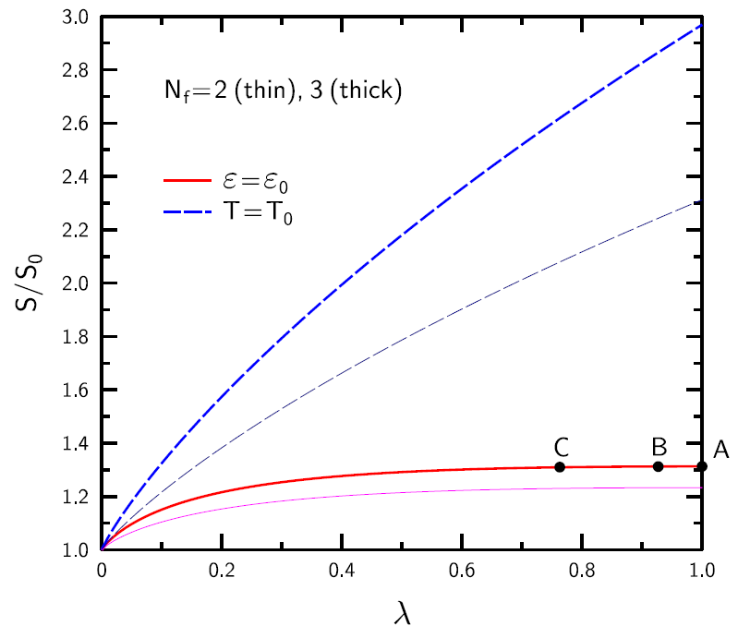
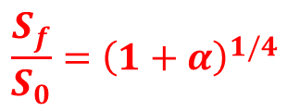

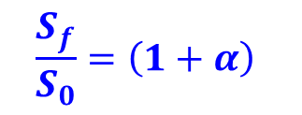



Chemical equilibration of US Plasma in homogeneous box
Initial state: pure gluon plasma ($λ=0)$
Final state: QGP ($λ=1)$
Equilibration process depends on boundary conditions
Entropy production: $\frac{S}{S_{0}}={\left(\frac{T}{T_{0}}\right)}^{3}\left(1+αΛ_{4}−βΛ_{3}ln⁡λ\right)$,$α=0.656N_{f}$, $β=0.156N_{f}$
Isothermal ($T=T_{0})$
$$\frac{S_{f}}{S_{0}}=\left(1+α\right)$$
Isoergic ($ε=ε_{0})$
$$\frac{S_{f}}{S_{0}}={\left(1+α\right)}^{1/4}$$

Slide 19
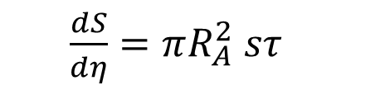

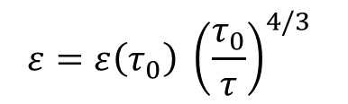

Bjorken evolution of US Plasma
Pure glue initial state: $λ=0$ at $τ=τ_{0}$
quark suppression $λ\left(τ\right)=1−\exp\left(\frac{τ_{0}−τ}{τ_{∗}}\right), τ_{∗}=1, 5, 10$fm/c saturation time
$$ε=ε\left(τ_{0}\right) {\left(\frac{τ_{0}}{τ}\right)}^{4/3}$$
Energy conservation
Temperature: $T=T_{0}{\left(\frac{τ_{0}}{τ}\right)}^{1/3}{\left(1+αΛ_{4}\right)}^{−1/4}$
Entropy density: $s=s_{0}{\left(\frac{T}{T_{0}}\right)}^{3}\left(1+αΛ_{4}−βΛ_{3}ln⁡λ\right)$
$\frac{dS}{dη}=πR_{A}^{2} sτ$
Freezeout: $T_{f}=156$ MeV, $\frac{dS(τ_{f})}{dη}=6.3{\left.\frac{dN_{π}}{dy}\right|}_{y=η}=πR_{A}^{2} s(τ_{f})τ_{f}$
$$T_{0}, { τ}_{f}$$

Slide 20
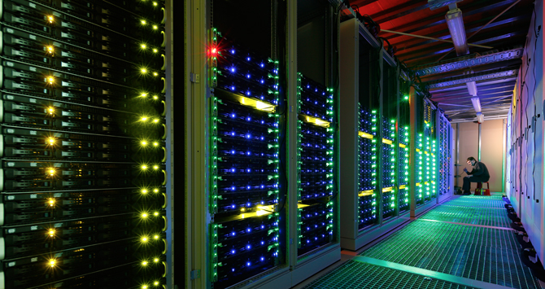
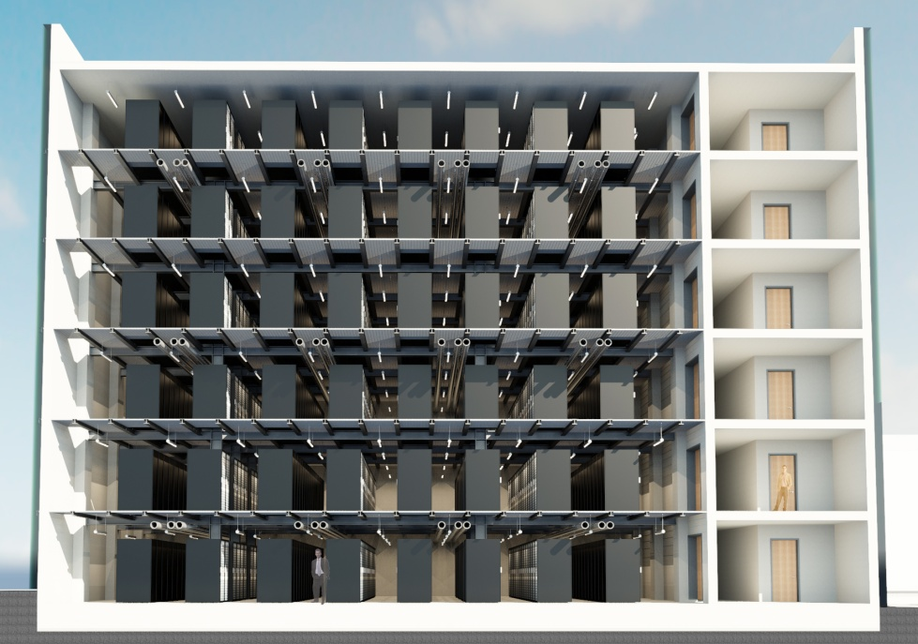
Extreme Computing Challenges !!!
=> the FAIR Tier 0 GreenCube Data Center
***No. 1*** Green500: Nov. 2014
5.27 GFlops/Watt - World Record
L-CSC GSI Darmstadt PUE <1.07
powerefficient Supercomputer
AMD FirePro GPU, Intel Xeon CPU
Tier-0 data center: FAIR GreenCube
Helmholtz funding 770 Racks 2.2m
12 M€ building cost
7 M€ initial HPC installation
Completion of CC in Q4/2015
Max cooling power 12 MW
Fully redundand (N+1)

Slide 21
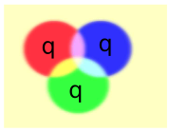
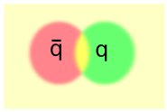
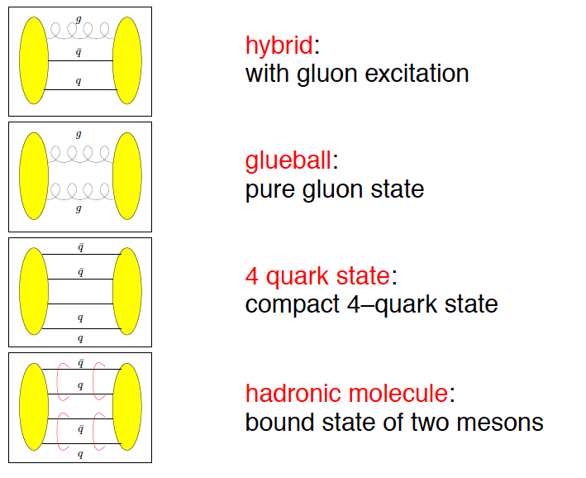
Beyond standard quark configurations
QCD allows much more than what we have observed:
Exotica
Baryons
Mesons
may have J^{PC} not allowed for qq
_
Courtesy C. Hanhart

Slide 22
Lattice QCD vs pure YM: glueballs

Slide 23
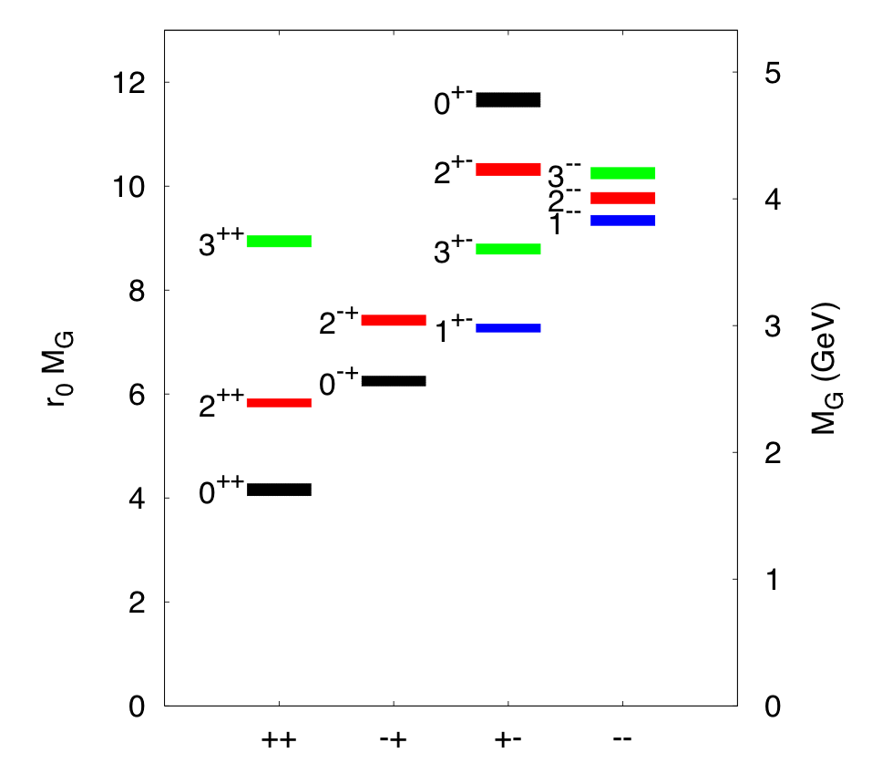
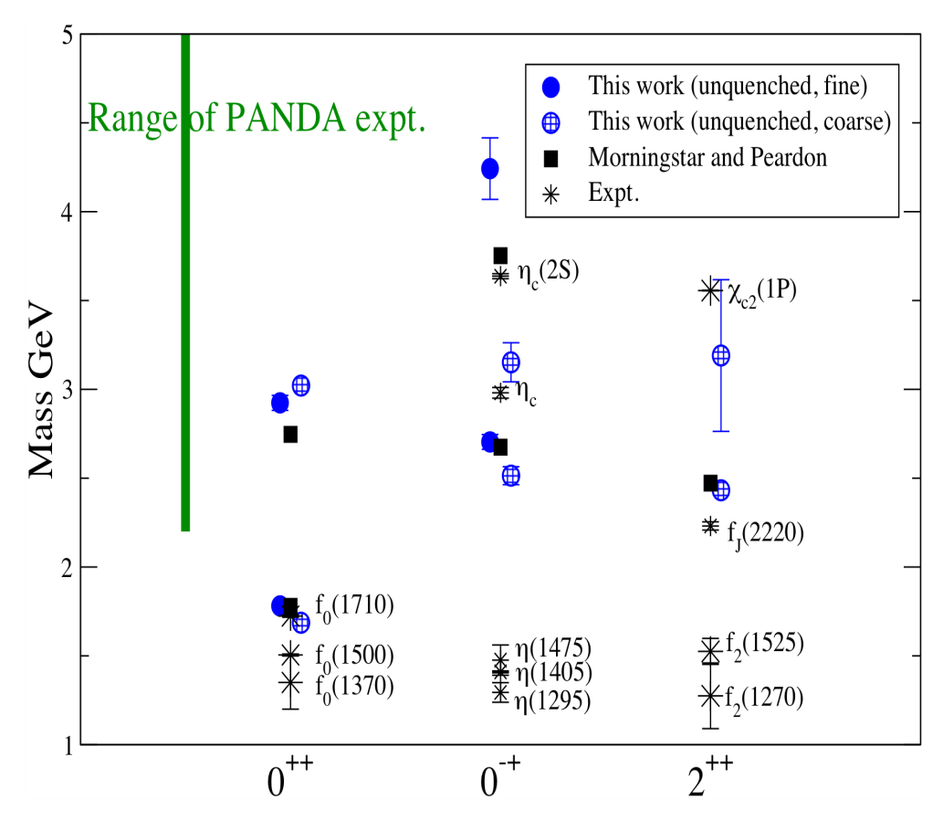
Glueball spectrum
Quenched results:
Morningstar-Peardon
Phys.Rev. D73 014516 (‘06)
First unquenched results:
pion mass 360 MeV
UKQCD coll. PRD82 (‘10) 34501

Slide 24
New Start on Old ideas !

Slide 25
Pure YM gauge theory on the lattice:
a hot glue plasma
a 1. Order PhaseTransition,
and a warm Glueball Fluid ! ?

Slide 26
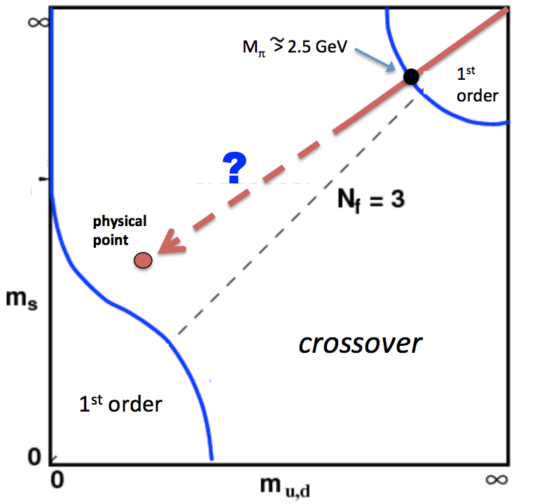
SU(3)_color Lattice Gauge Theory
Columbia Plot: Order of Phase Transition depends on quark masses
pure gauge: glue only!
t=0.1fm/c : No Quarks !
LHC & RHIC: high mult. pp & AA events
Quenched QCD glue + GlueBalls
few heavy Quarks
T_cp =250 MeV

Slide 27
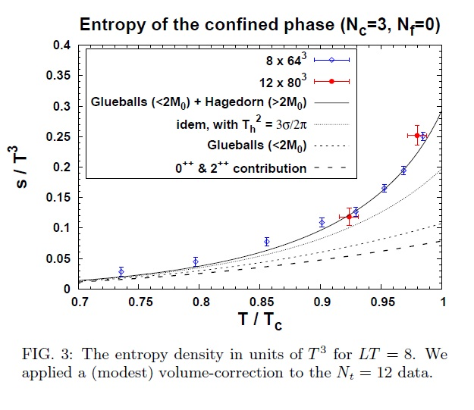
Pure LGT thermal GlueBall-matter observed at RHIC and LHC !?
Harvey Meyer, Univ. Mainz

Slide 28
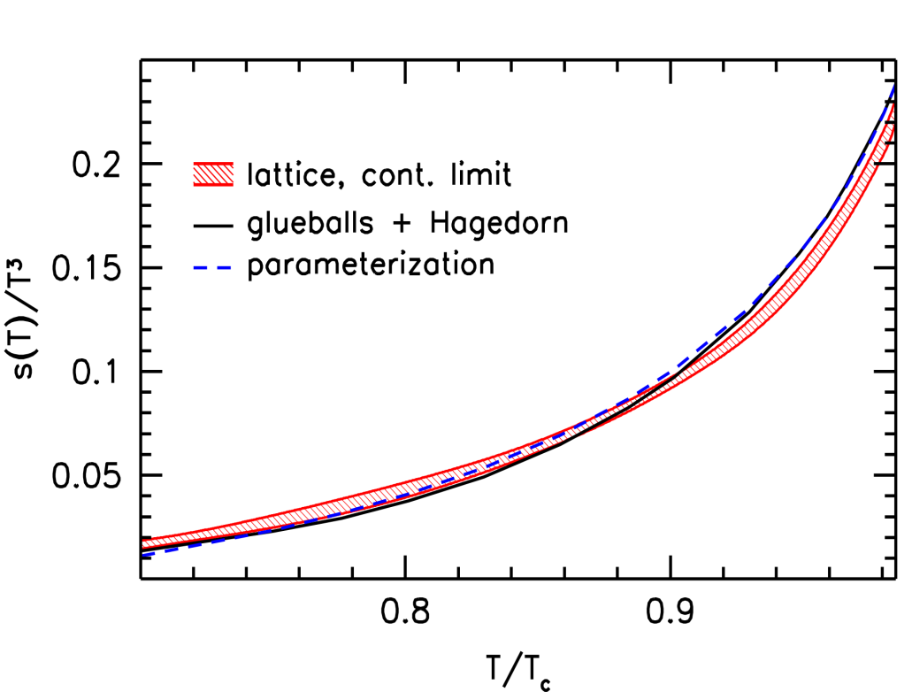
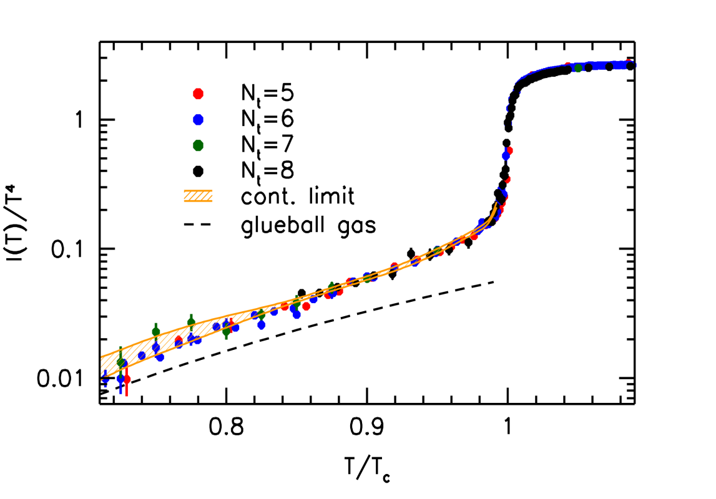
Lattice Gauge Thermodynamics of the GlueBall-matter fluid
Pure YM gauge: Glue Plasma
Glueball-Hagedorn-States
Glueball-Hagedorn-States
12 Glueballs
Wuppertal-Budapest (W.-B.)Collaboration: JHEP 1207 56 (‘12)
High precision continuum result for the quenched equation of state.
Low temperature behavior and phase transition described by Hagedorn-GlueBall spectrum.
W.-B. use 12 GlueBall states (Morningstar-Peardon) plus Hagedorn-GB towers
(as proposed by Harvey Meyer).

Slide 29
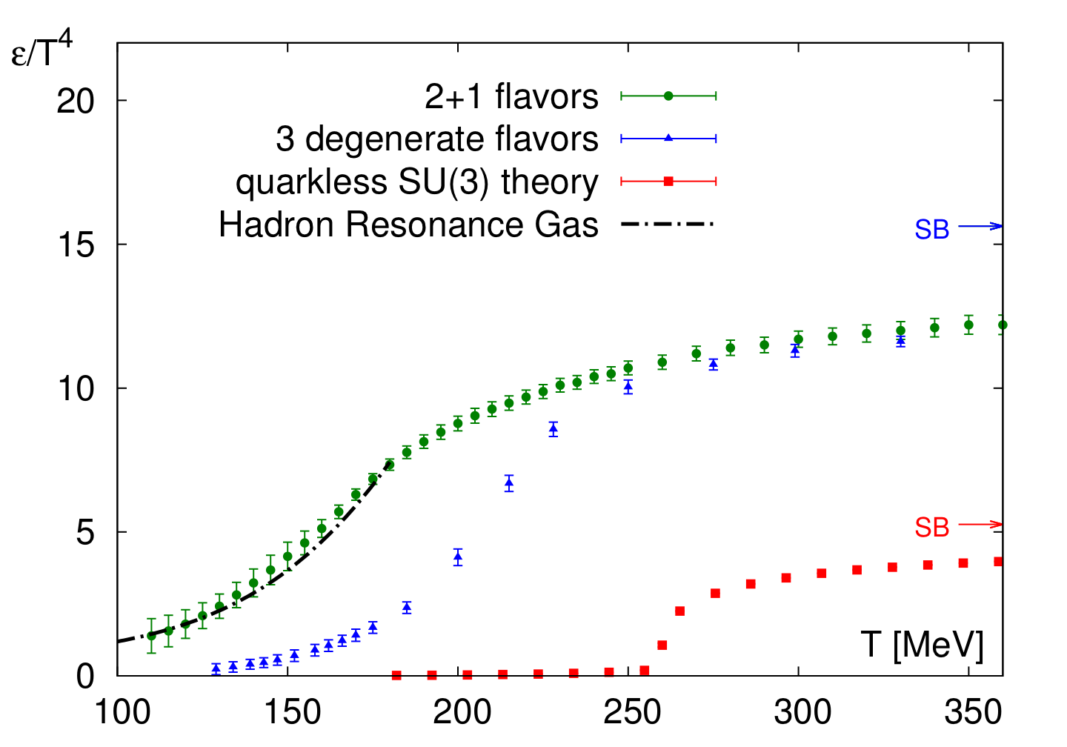
Pure YM LGT vs. 2+1 flavor Lattice QCD
Energy density (EoS) DIFFERENT for different quark masses
Energy density from
Sz. Borsanyi et al., W.P.
Wuppertal-Budapest coll
JHEP 1011, 2010,077;
PLB730, 2014, 99
“physical point” 2+1
T_c.o. = 155 MeV
N_f = 3, m_{u,d} = m_{s}
T_c.o. = 220 MeV
pure gauge YM
T_c = 270 MeV
Quenched: W.B. coll.
JHEP 1207, 2012, 056
1. O.P.Transition from glue-plasma to GlueBall-Hagedorn St.
HagedornStates decay

Slide 30
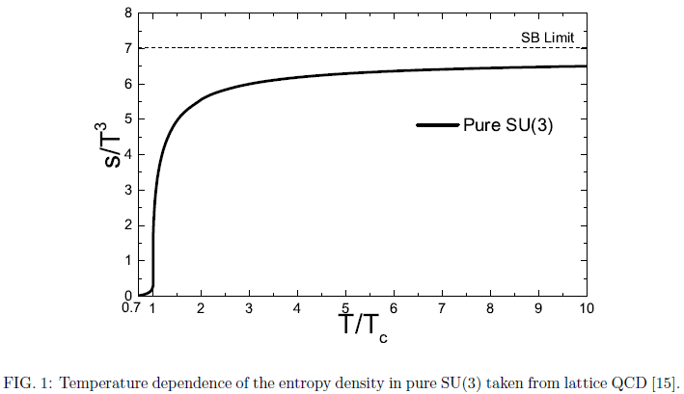
Glue plasma from pure lattice gauge theory, Bosanyi et al
V. Vovchenko et al

Slide 31
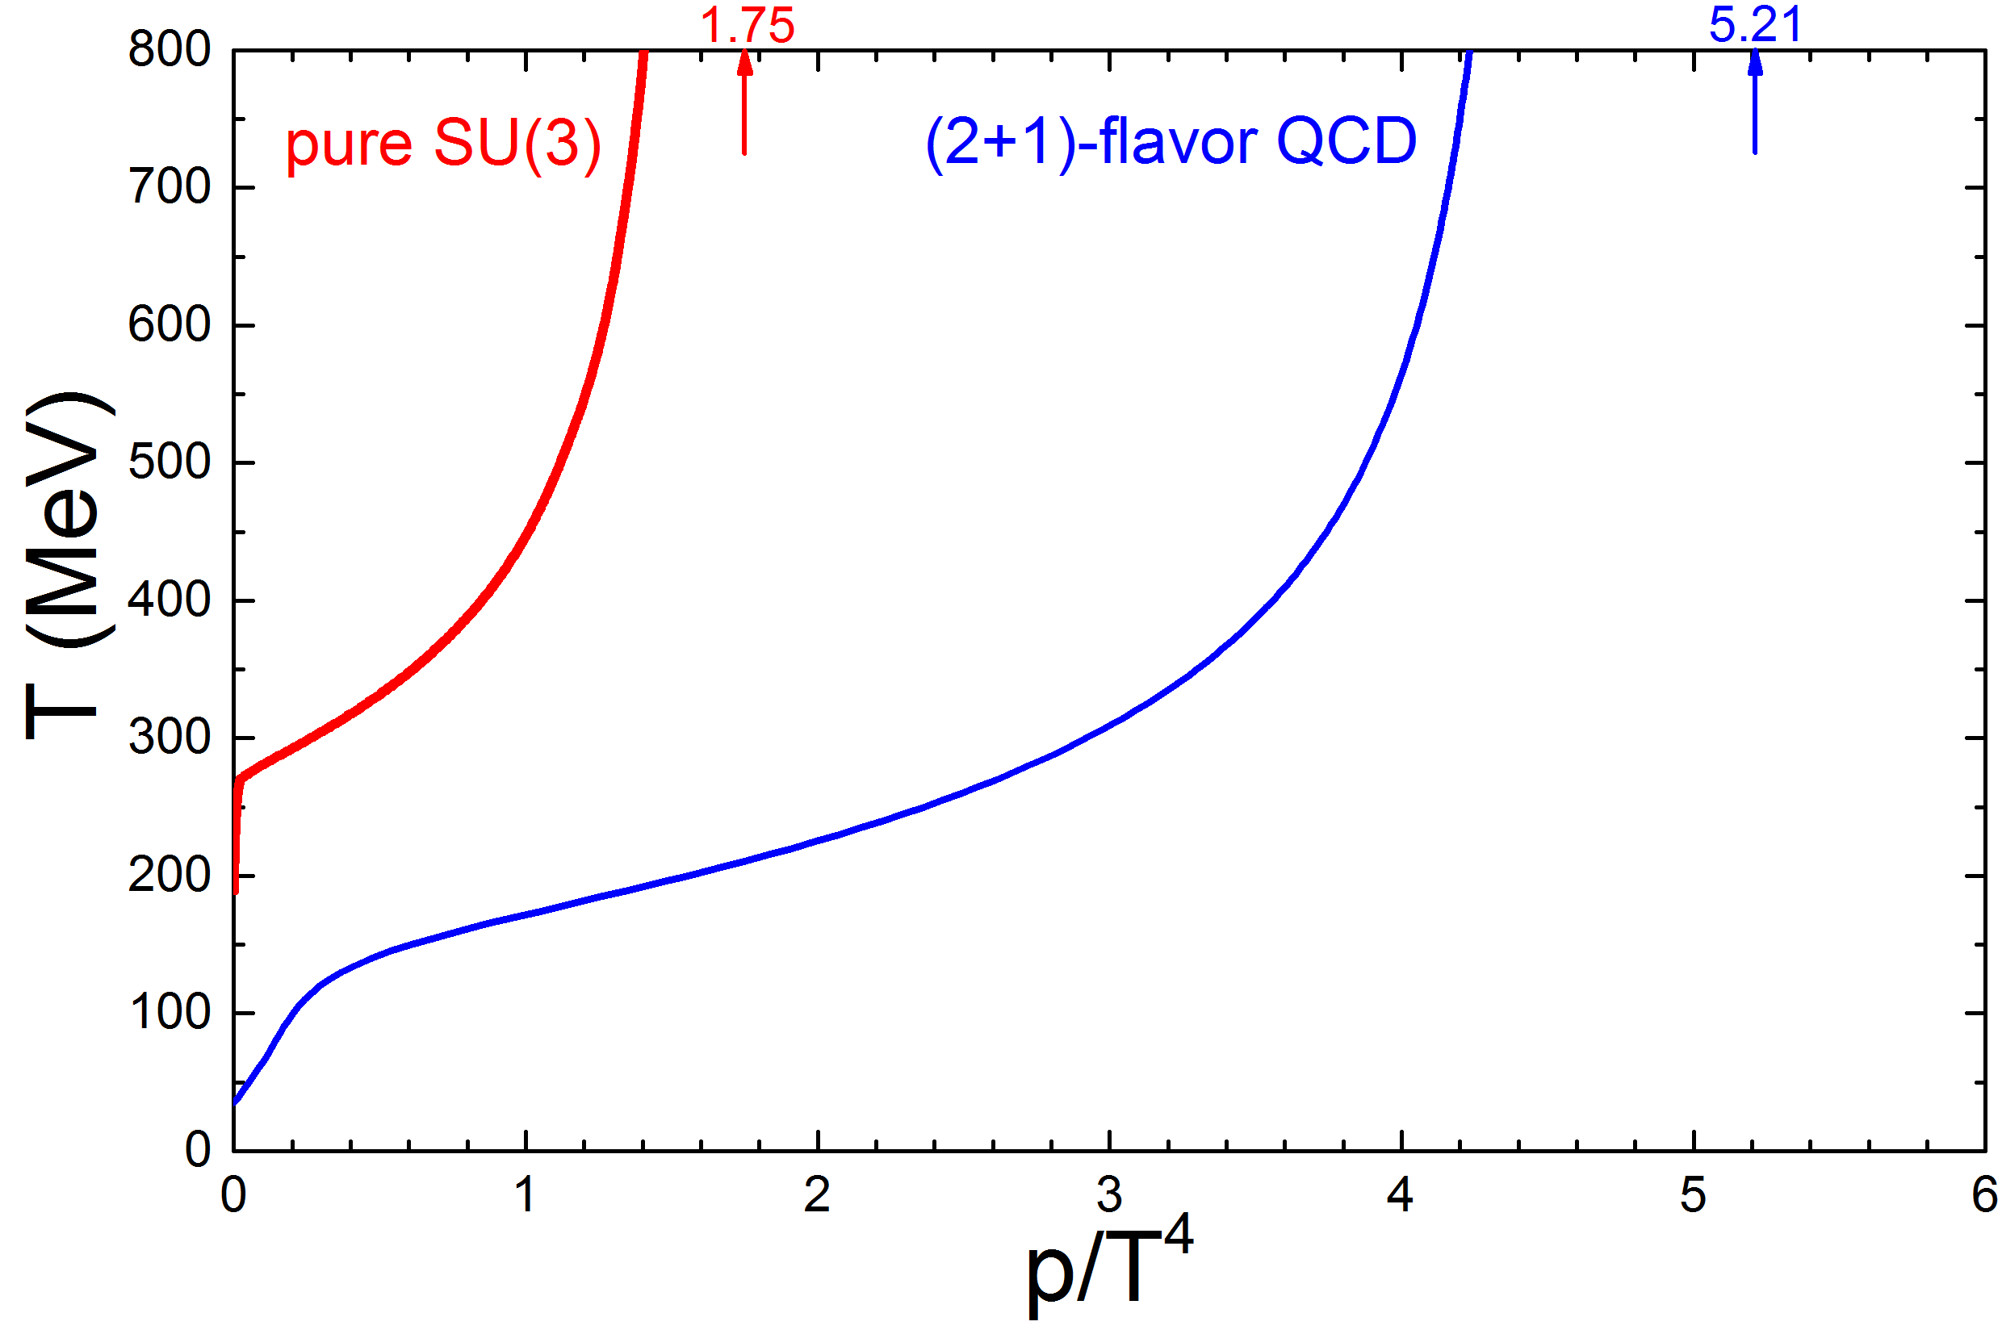
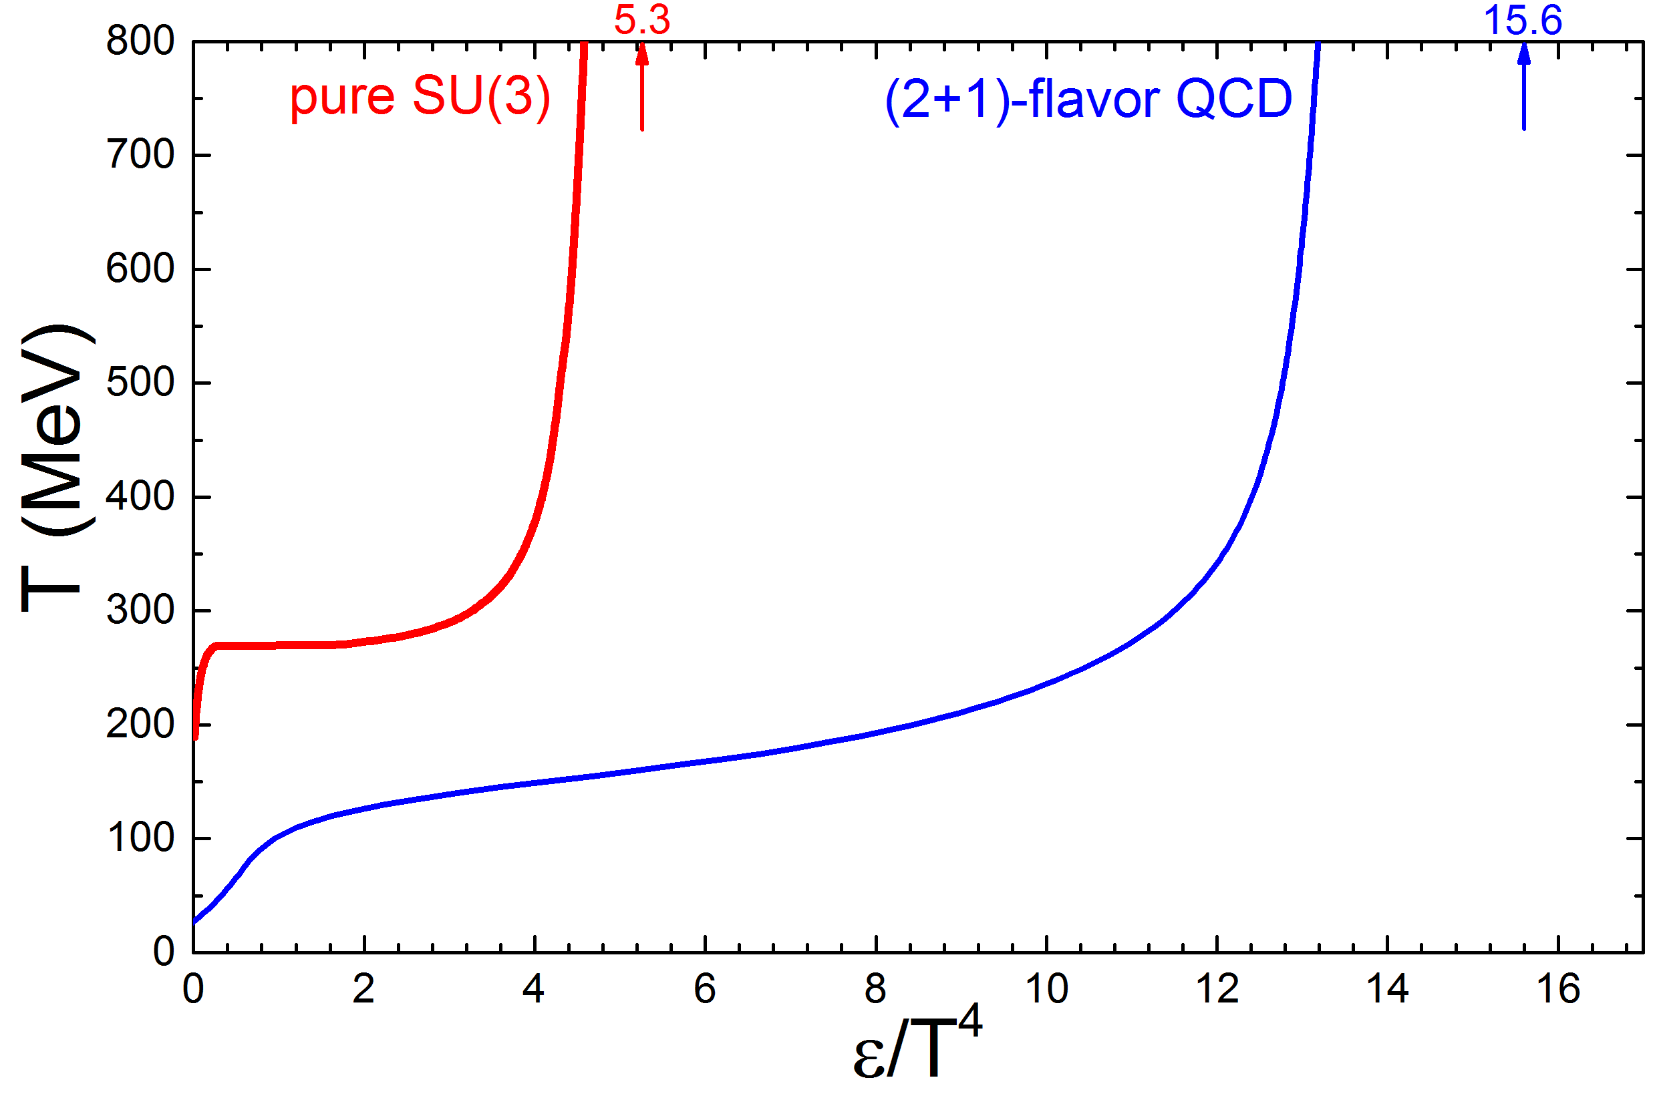
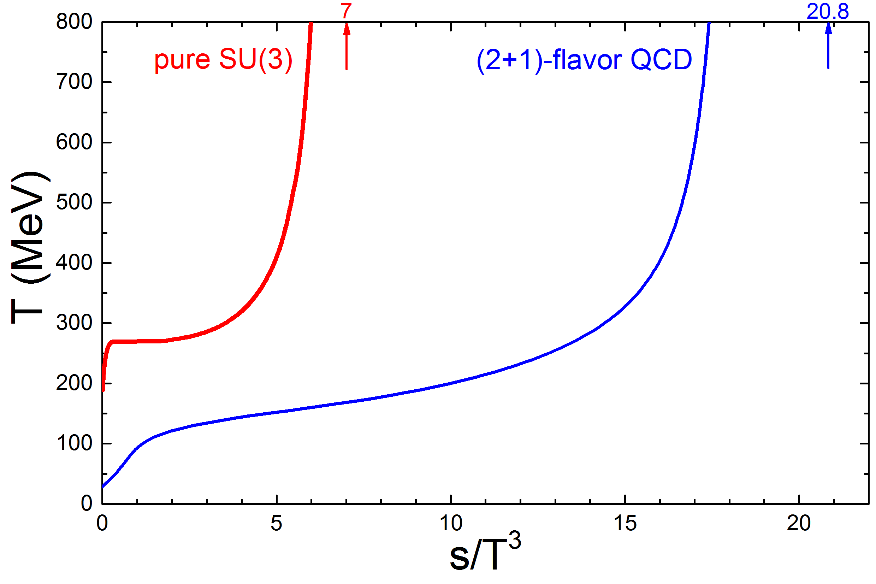
pressure
energy density
entropy density

Slide 32
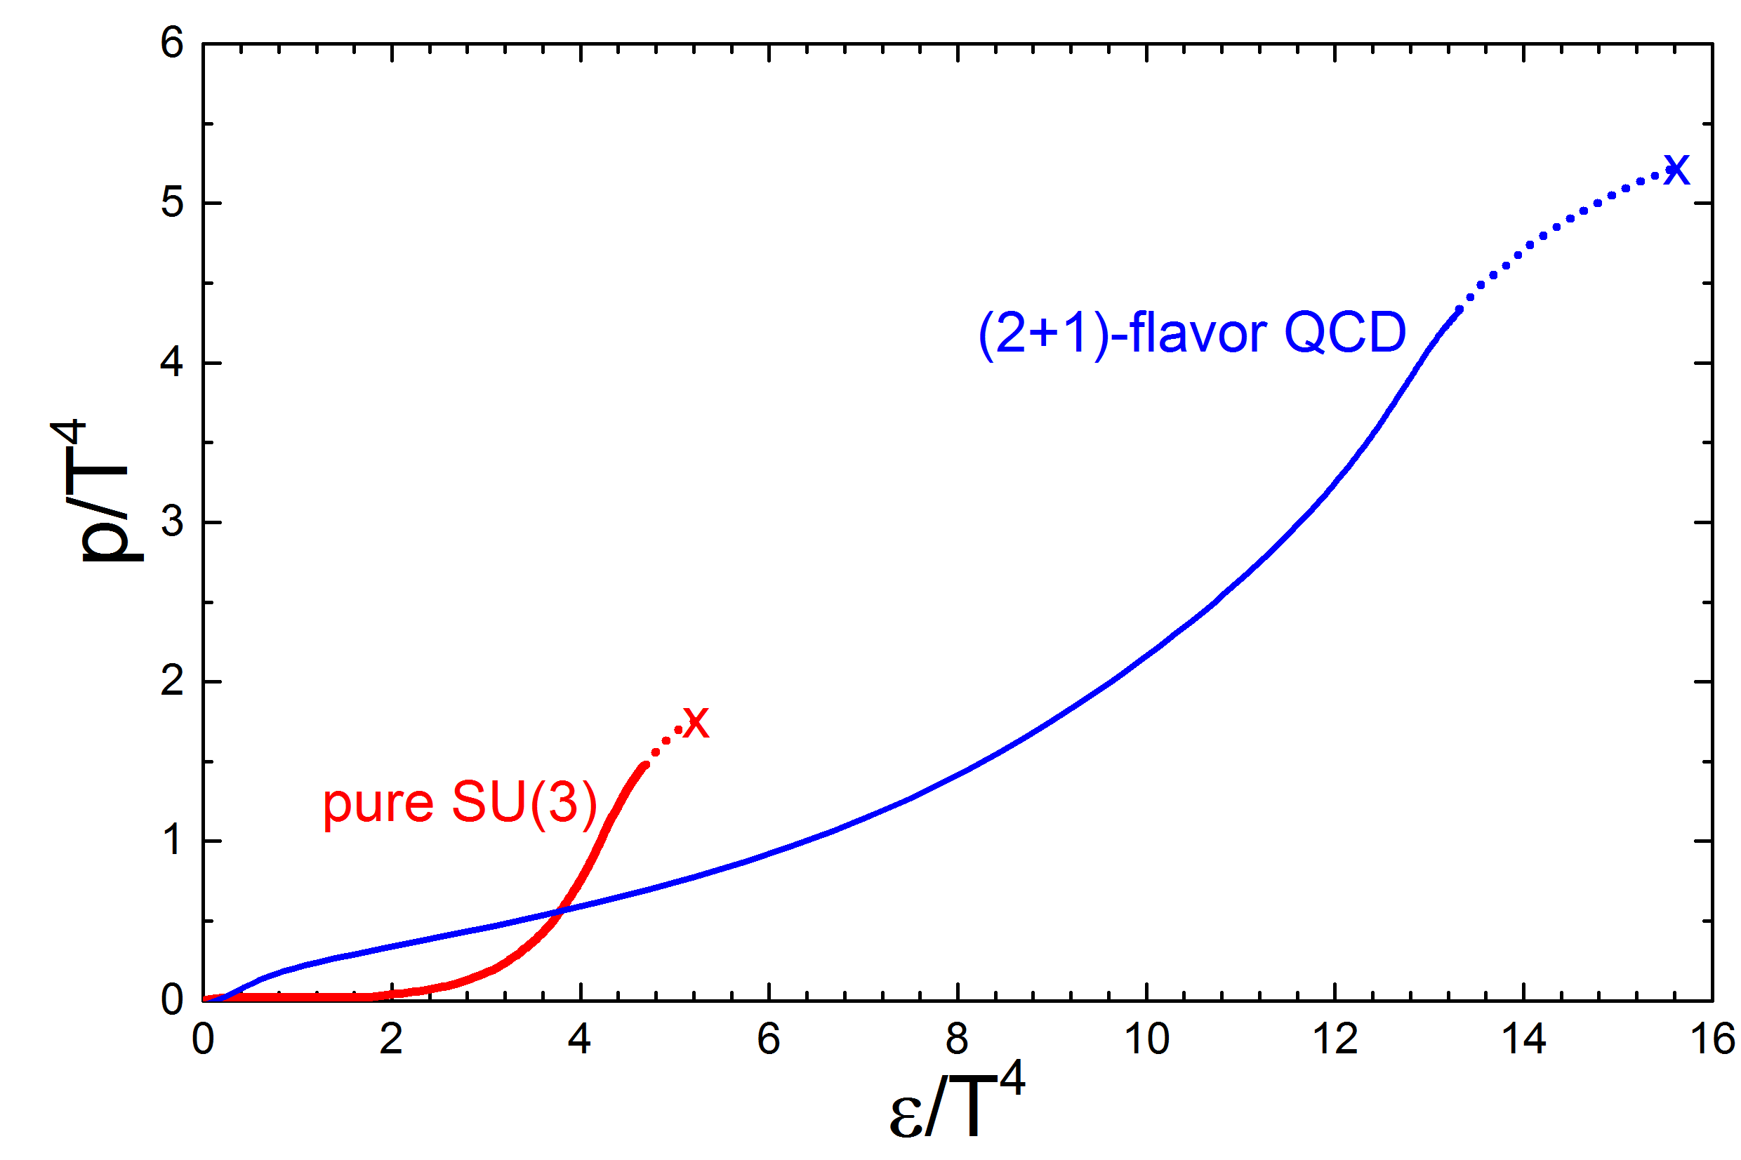
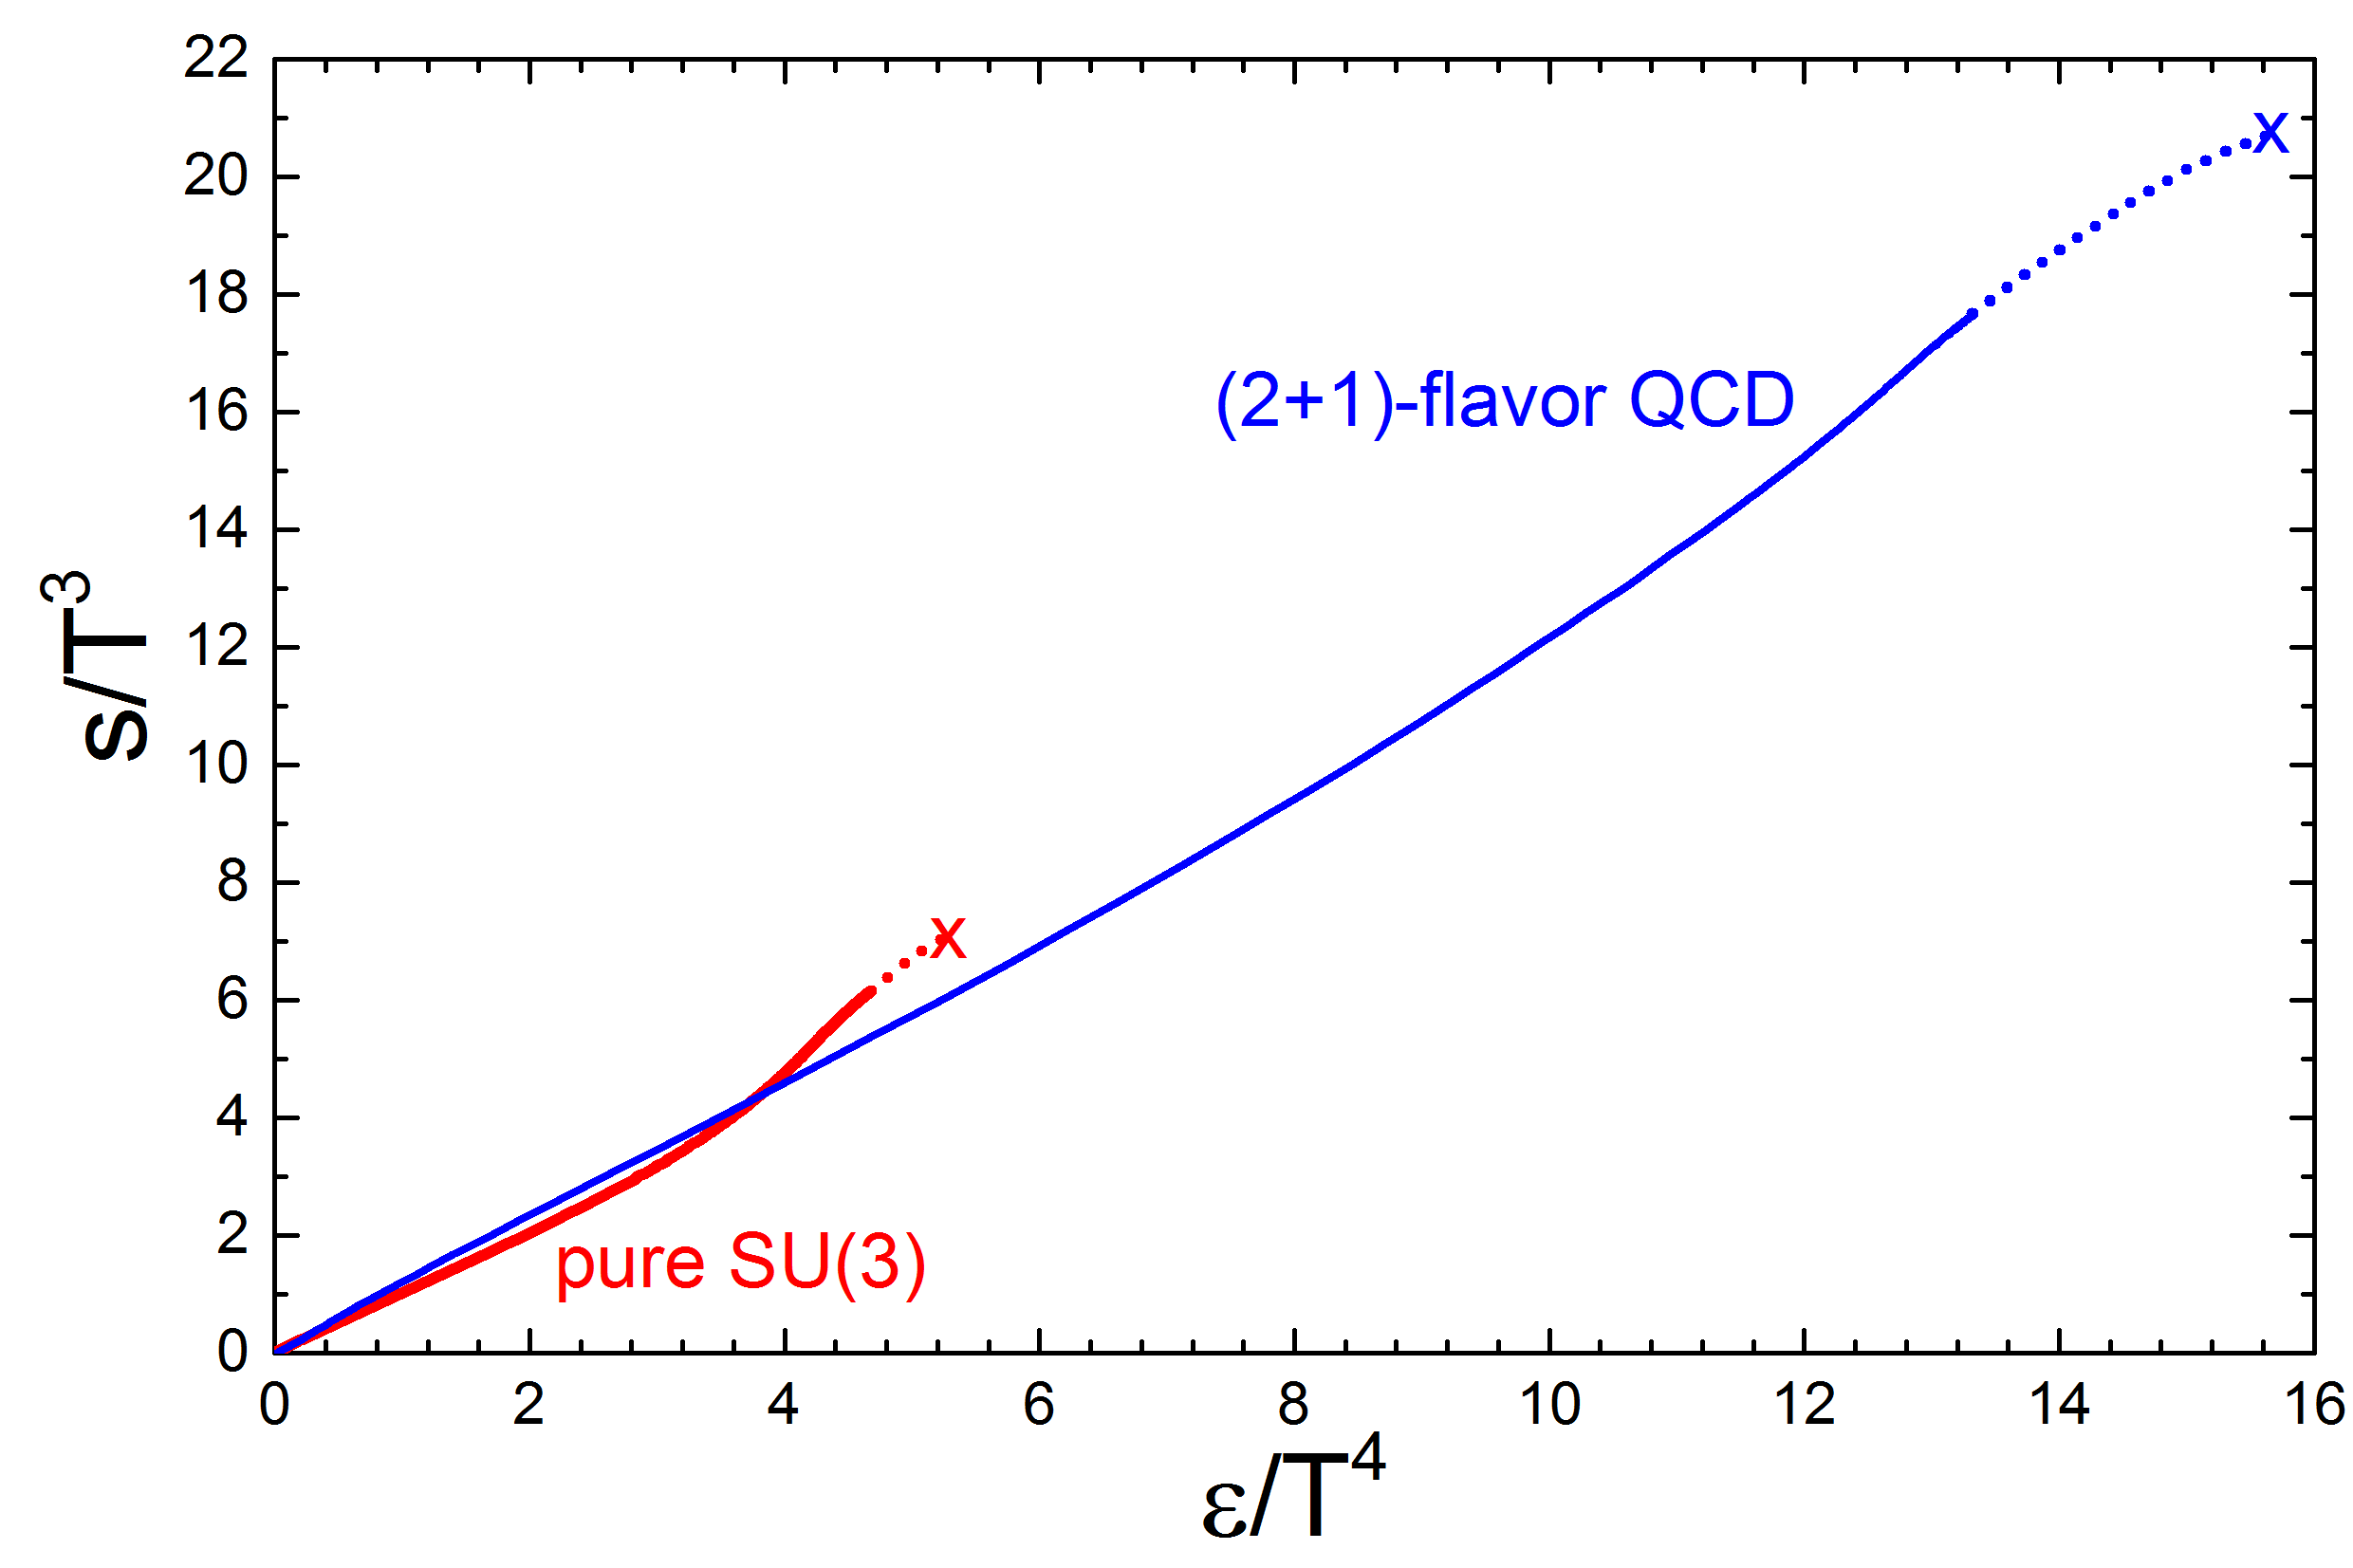
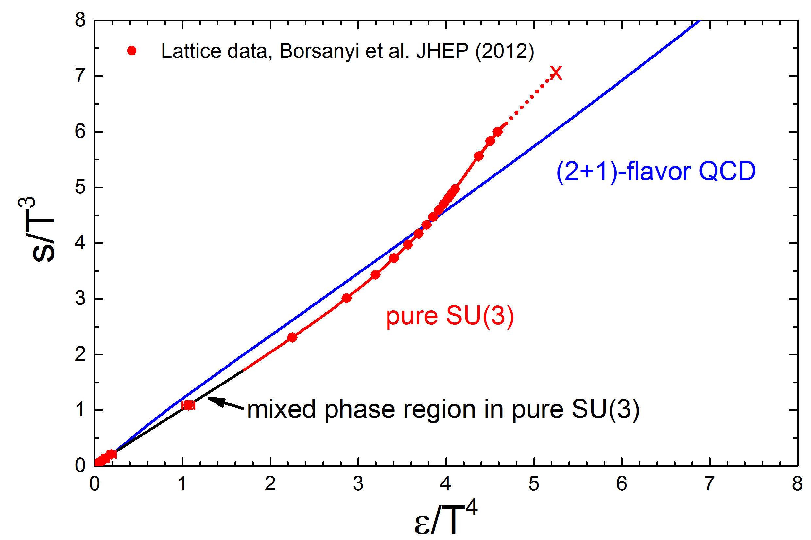
pressure vs.
energy density
entropy density vs.
energy density

Slide 33
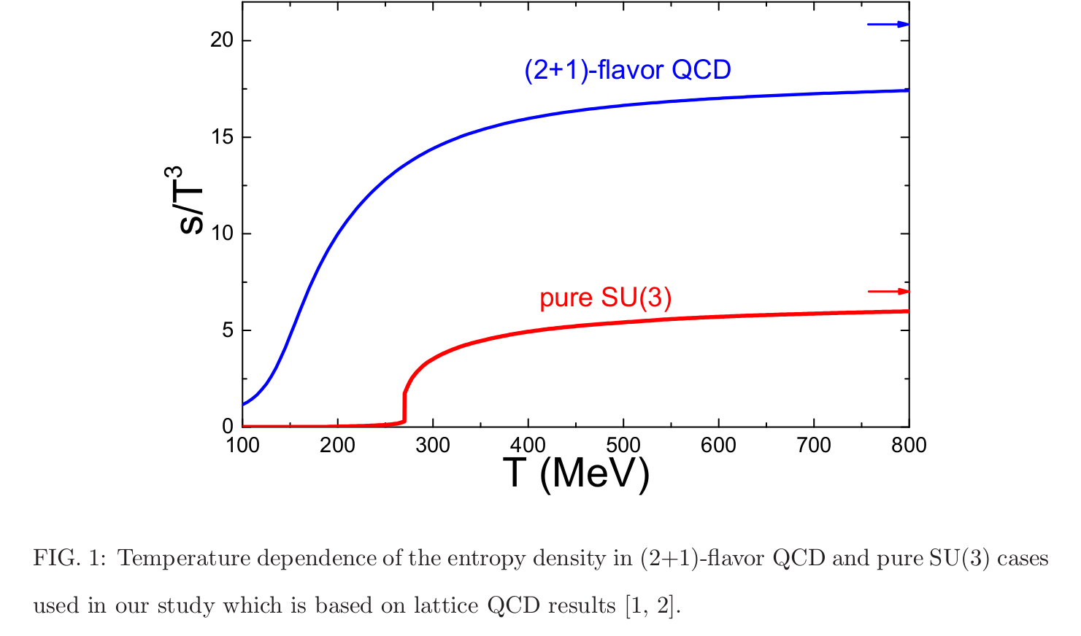
crossing from Hadronfluid to
2+1 Nf quark gluon plasma
Borsanyi et al, W.B. collaboration
F.O.P.T. from GlueBall fluid to pure glue plasma, Borsanyi et al
V. Vovchenko et al

Slide 34


Slide 35
Time evolution of high multiplicity pp AA
at RHIC and LHC in pure YM scenario

Slide 36
Alternate Scenario: pure gauge matter in pp, pA – AA ?
Initial Color Glass Condensate Glasma thermalizes fast equilibration of Gluons, slow equil. of quarks high pressure, entropy gluon plasma fast hydrodynamic expansion of gluon plasma.
1. Order Phase Transition at T_c = 270 MeV of flavorless QCD.
Transition from glue plasma in GlueBall fluid
Glueball-Hagedornstates mix with quarks, decay into Hadrons

Slide 37

Eff.Nf(t)
0.0
0.1
0.2
0.3
0.6
0.9
GlueBalls decay
Eff. Nf(t): 0 0.1 0.2 0.3 0.6 1.2 ...
Eff. Nf(t) is U.S. – parameter : Nf = 2+1 ~ fugacity = 1

Slide 38

Hadronization
of GlueBalls
- HagedornStates
Hadronization of
GlueBall-Hagedorn
Hadronic Gas?

Slide 39


$ε=λ_{q}{ ε}_{QGP}+\left(1−λ_{q}\right) ε_{YM}$

Slide 40


Slide 41


$p=λ_{q}{ p}_{QGP}+\left(1−λ_{q}\right) p_{YM}$

Slide 42


$s=λ_{q}{ s}_{QGP}+\left(1−λ_{q}\right) s_{YM}$

Slide 43



pressure
energy density
entropy density

Slide 44

Time evolution T(t) of pp vs AA collisions at RHIC
Pure YM
L~ 0
L~0.3
L~0.5
L~0.7
L~0.9
L~ 0
L~0.3
L~0.5
L~0.7
L~0.9
2+1 flavors
V. Vovchenko et al.

Slide 45



Slide 46


Slide 47


Slide 48
SU(3)_color Lattice Gauge Theory
Columbia Plot: Order of Phase Transition depends on quark masses
pure gauge: glue only!
t=0.1fm/c : No Quarks !
LHC/FCC: time evol. high mult. pp & AA
Quenched QCD: glue +GlueBalls
t=1fm/c
few heavy Quarks
T_cp =250 MeV
2fm/c: Quarkdensity
is not yet equilibrated
3fm/c Hadronization?
4fm/c Freeze Out ?

Slide 49
„Time dependence“ in Columbia plot: N_f (t)
pp (& AA?) initial: Color Glass Condensate t=0.1fm/c:
glue thermalizes fast ~ pure glue-plasma: N_f (t=0.1)=0.1
Pure Yang Mills Lattice gauge theory:
1. Order Phase Transition @ T_c = 270MeV
From glue plasma to GlueBall fluid
Expansion
Expansion to critical point
T_cp =240 MeV t~2 fm/c
more and more quarks produced
N_f (t=2fm/c) ~ 0.6
GlueBalls, Hagedorn States Mix
Sequential 2-body decays of Glueball-Hagedorn States can well explain the observed hadron yield ratios.

Slide 50
Identification of Glueballs
Lightest Glueball predicted near two states of same Q.N..
“Over population” Predict 2, see 3 states
Glueballs should decay in a flavor-blind fashion.
Production Mechanisms:
Certain are expected to by Glue-rich, others are
Glue-poor. Where do you see them?
Proton-antiproton
Central Production
J/ψ decays

Slide 51
Holographic vs. lattice glueball spectra and decays
Slides from
Seiji Terashima, YITP, Kyoto, Koji Hashimoto, Riken, Chung-I Tan arXiv:0709.2208

Slide 52
Glueball Decay in Holographic QCD
Seiji Terashima (YITP, Kyoto)
Based on the work (arXiv:0709.2208)
in collaboration with Koji Hashimoto (Riken)
and Chung-I Tan (Brown)
2007 Dec. 18 at NCTS

Slide 53


Holographic vs. lattice glueball spectra
Seiji Terashima,YITP,Kyoto, Koji Hashimoto,Riken, Chung-I Tan,Brown, arXiv:0709.2208
Holographic
Pure gauge Lattice SU(3)
Morningstar-Peardon
Brower-Mathur-Tan, 2000
dropped

Slide 54
Adding quarks in AdS/CFT: holographic QCD slide courtesy Terashima et al
Adding Nf flavors → adding another kind of D-branes as probe.
Here, we add Nf pairs of D8-brane and anti-D8-brane.
This model has spontaneously broken chiral symmetry,
so there is massless pion.
Let us consider gravity dual, i.e. the D8-branes in the Witten’s background.
(D8-brane and anti-D8-brane are connected and
become smooth curved D8-branes as a result of the curved background.)
The D8-brane action is
Karch-Katz
Myers et.al.
Sakai-Sugimoto
where F is the field strength of the 9-dim. gauge fields on the Nf D8-branes.

Slide 55



Generic feature of holographic glueball decay slide courtesy Terashima et al
Glueballs are obviously flavor-blind.
Thus couplings to mesons are universal against flavors.
From the D8-brane action,
we see that
(1) No glueball interaction involving more than two pions. because
Decay of any glueball to 4 is suppressed. Prediction of the holographic QCD! => this is signature of Centaro events !?
(2) Direct couplings of a glueball with more than five meson are suppressed. (implies “vector meson dominance”): No
These are from “Holographic gauge” choice

Slide 56



But no mixing between lightest glueball and meson slide courtesy S.Terashima et al
Scalar mesons = transverse scalar of D8-branes, denoted by y, which is essentially τ.
Terms linear in y in the D8-action is:
All of these vanish for the lightest glueball.
No mixing with mesons at order
This is very important to distinguish the glueball and meson.

Slide 57
Decay of lightest scalar glueball
Terashima et al

Slide 58





Lightest glueball mass is
We have
Thus NO 2 ρ-meson decay in holographic QCD
(In the experiment, M=1507MeV, mρ=775MeV)
We will use
Slide courtesy S.Terashima eta al arXiv:0709.2208

Slide 59


Possible decay process (from kinematics)
Branching ratio for f0(1500):
(a) 35%
(b)+(c) 49%
(d) 7 %

Slide 60
Quote S.Terashima et al:
First attempt in computing decays of glueballs to
mesons using a holographic QCD (Sakai-Sugimoto model).
The holographic QCD is, in principle, equivalent to QCD.
We therefore expect that the holographic approach should provide
interesting information on strong coupling physics of QCD.
Explicit couplings between the lightest glueball and the mesons are given,
and the associated decay products/widths are calculated.
Our results are consistent with the experimental data of the decay for the f0(1500)
which is thought to be the best candidate of a glueball in the hadronic spectrum.
We have shown that there is no mixing with the mesons at the leading order.
Decay of any glueball to 4 is suppressed.
This is a prediction of the holographic QCD!

Slide 61
End of input from
“Glueball Decay in Holographic QCD”
Seiji Terashima (YITP, Kyoto)
Based on the work (arXiv:0709.2208)
in collaboration with Koji Hashimoto (Riken)
and Chung-I Tan (Brown)
2007 Dec. 18 at NCTS

Slide 62
Bootstrap (Max Beitel, Kai Gallmeister, Carsten Greiner)
Assumption: only 2-body (detailed balance!)
Bootstrap equation
Total decay width (via detailed balance)
cf. S. Frautschi, PRD 3 (1971) 2821
C. Hamer, S. Frautschi, PRD 4 (1971) 2125

Slide 63
GlueBalls & Hagedorn-States: exponentially increasing Mass-Spectra, Width
Bootstrap (Max Beitel, Kai Gallmeister, Carsten Greiner)
GlueBalls+HagedornStates
p-Baryon-HagedornStates
T quite independent of charges

Slide 64

Hadrons created in Cascade of binary decays of GlueBall-Hagedorn states
Max Beitel, Kai Gallmeister, Carsten Greiner

Slide 65

Slopes of Hadron spectra after binary decay casc. of 4 GeV GlueBall-HagedornState
Spectra/slopes of decay products of each single GB-HagedornStates with a cascade of sequential 2-body decays:
slopes look thermal !!!
slopes equal Hagedorn temperature !
slope independent of mass and radius of GB-Hagedorn State
M.Beitel, K.Gallmeister, C.Greiner, PRC 90 (2014) 045203

Slide 66


Single HS-cascade 2-body decays: yield-ratios vs ALICE
data: ALICE @ LHC
M.Beitel, KGallmeister, C.Greiner, PRC 90 (2014) 045203

Slide 67
How do electromagnetic probes,
i.e. Dileptons and Photons, come out
from pure glue FOPT scenario?
V. Vovchenko, Gorenstein, Satarov, Mishustin,
Csernai, et al.

Slide 68
Eff.Nf(t)
0.0
0.1
0.2
0.3
0.6
0.9
Eff.Nf(t): 0 0.1 0.2 0.3 0.6 0.9 ….

Slide 69


Slide 70


Slide 71



Slide 72



Slide 73

Photons

Slide 74
Signatures for pure glue->glueball scenario:
New event-class in high multiplicity pp & pA at RHIC and LHC

Slide 75
Time dependence in Columbia …. RHIC and LHC as Glueball Factories…
violent pp (& AA) collisions
initial state at LHC:
Color Glass Condensate
t=0.1fm/c: glue thermalizes
pure glue-plasma created
Quenched Lattice SU(3)_c :
T_c =270MeV
glue plasma -> GlueBall fluid
1. Order Phase Transition
Expansion to critical point
T_cp =240 MeV t~1-2 fm/c
GlueBalls + Hagedorn States Mix
more and more quarks produced: T_co =155MeV crossover transition
Observables from Columbia plot
T>T_cp: Zero e.m. radiation
Measure T~270 MeV Dilepton mass
T_c: Flow collapse as barometer
T_cp: Critical Scattering (MG,WG),
Kurtosis , # fluctuations
T_c ~ 2*T_co =>
P_t(pp) ~ 2*p_t(AA)
M_GlueBalls < 2GeV: „No“ Baryons
p/pi ~ 0 : Yield p+pBar << mesons
Lightest GlueBall decays:
- No decays to 2 Omega, no 2 Rho
Glue Flavor blind !
K/pi=1 Yields: Kaons ~ pions

Slide 76
Outlook: Alternative Class of High M events in pp, pA @ LHC – AA?
Initial Color Glass Condensate Glasma thermalizes fast equilibration of gluons, slow equil. of quarks high pressure, entropy in gluon plasma fast hydrodynamic expansion of gluon plasma.
1. Order Phase Transition at T_c = 270 MeV of flavorless QCD.
Transition from glue plasma in GlueBall fluid
Glueballs’ Hagedorn states decay directly into Hadrons

Slide 77



Cosmic Matter in the Laboratory
FAIR–RHIC-LHC
14 billion years
3 K
Creation of heavy elements in SN Explosions
in NS-NS-mergers: NuSTAR RIBs
1 billion years
20 K
Creation of A<60 nuclei in stars
400.000 years
3.000 K
H/He- Atoms form in ion-electron plasma
3 minutes
10⁹ K
Anti-Protons, Neutrons, Hadrons disappear
Create Anti-Baryons, Glueballs PANDA
5 microsec
Temperature
10¹² K
Gluons and quarks disappear CBM
time
Create Gluons, Quarks, Leptons…
Big Bang = Genesis
Notes:
The physics of hadrons and nuclei span a huge range in terms of
age of the universe
size of the universe
while the size of the object stays always in the ballpark of 1 fm (10⁻¹⁵m), the approx. range of the strong force
If we follow the bigbang, we can identify several regions of particular interest
Genesis of Quark
the Freeze-Out
almost Cold Hadrons
and Nuclei
The Genesis of Quarks is a different programme, so I leave it out for further discussions
All the others pose very remarkable questions
What kind of phase transition do exist in strongly interacting fundamental matter (among Quarks and Gluons) leading to the mapping of the phase diagram
The second important question is to understand quantitatively the mass of the proton (and all other hadrons) leading to the investigation of the binding among Quarks and Gluons
Finally the abundance of elements is critically defined by the dynamics of exotic nuclei, making the mapping of exotic nuclei the important challenge for understanding the appearance of our world

Slide 78



Brilliant Anti-proton beams
- Strange & Charm cosmic matter
SIS 100/300
50 MeV
SIS18
p-Linac
30 GeV Protons
HESR
ESR
Cu Target
10⁷ p/s @ 3 GeV
CryRing
High to low Energy pbars :
proton Linac 50 MeV
accelerate p in SIS18/SIS100
produce pbar on target
collect pbar in CR,
inject pbar into HESR
+ back to ESR+CryRing: FLAIR!
FLAIR
PANDA
Accelerating
Cooling
Collecting
Accumulating
Precooling
RESR/CR
100m
G.Boca GSI, Germany & U. Pavia, Italy
Ff slides Courtesy Panda collab., Jim Ritman, FZJ

Slide 79

The PANDA Spectrometer at FAIR
Detector requirements:
4π acceptance
High rate capability:
2x10⁷ s⁻¹ interactions
Efficient event selection
➔Continuous acquisition
Momentum resolution ~1%
Vertex info for D, K⁰_{s}, Y
(cτ = 317 μm for D±)
➔Good tracking
Good PID (γ, e, μ, π, K, p)
➔Cherenkov, ToF, dE/dx
γ-detection 1 MeV – 10 GeV
➔Crystal Calorimeter

Slide 80



Particle production in pp collisions
_
Formation:
_
_
All J^{PC} allowed for (qq) accessible in p p
c.f.
Only J^{PC} = 1⁻⁻ allowed in e⁺e⁻
(to 1st order)

Slide 81



The PANDA Physics Program
Hadron Spectroscopy
Experimental Goals: mass, width & quantum numbers of resonances
Charm Hadrons: charmonia, D-mesons, charm baryons
➔ Understand new XYZ states, Ds(2317) and others
Exotic QCD States: glueballs, hybrids, multi-quarks
Spectroscopy with Antiprotons:
Production of states of all quantum numbers
Resonance scanning with high resolution
Baryon Spectroscopy: excited ss, sss, c baryons
Hadron Structure
Generalized Parton Distributions
➔ Formfactors and structure functions, Lq
Timelike Nucleon Formfactors
Drell-Yan Process
Nuclear Physics
Hypernuclei: Production of double Λ-hypernuclei
➔ γ-spectroscopy of hypernuclei, YY interaction
Hadrons in Nuclear Medium

Slide 82

Search for Heavy Glueballs
Charmed Glueballs
  flavour blind decays
    charmed final states
  only a few charmed mesons around 3 - 4 MeV/c²
    less mixing
Exotic glueballs (oddballs), no mixing!
  m(2⁺⁻) = 4140(50)(200) MeV
  m(0⁺⁻) = 4740(70)(230) MeV
  decay modes φφ, φη, J/ψη, J/ψφ
  Narrow widths predicted
Morningstar & Peardon, PRD60(1999)34509
Morningstar & Peardon, PRD56(1997)4043 QUENCHED Lattice theory
See Also: Wuppertal-Buda coll., HOTQ-RBRC-Bielefeld coll, Owe Pilipsen, Goethe Uni Frankfurt

Slide 83





FAIR Experiments
CBM
APPA
NuSTAR
Super- FRS
PANDA

Slide 84
Yes!
FAIR Council decided Sept. 29, 2015 to add 16 % to the FAIR contruction budget to built the full four scientific pillar modularized start version, in accord with the international convention between the founding nations, signed Oct. 4, 2010
APPA, CBM, NuSTAR, PANDA

Slide 86


Slide 87


Slide 88


Slide 89


Slide 90


Slide 91


Slide 92


