Slide 1
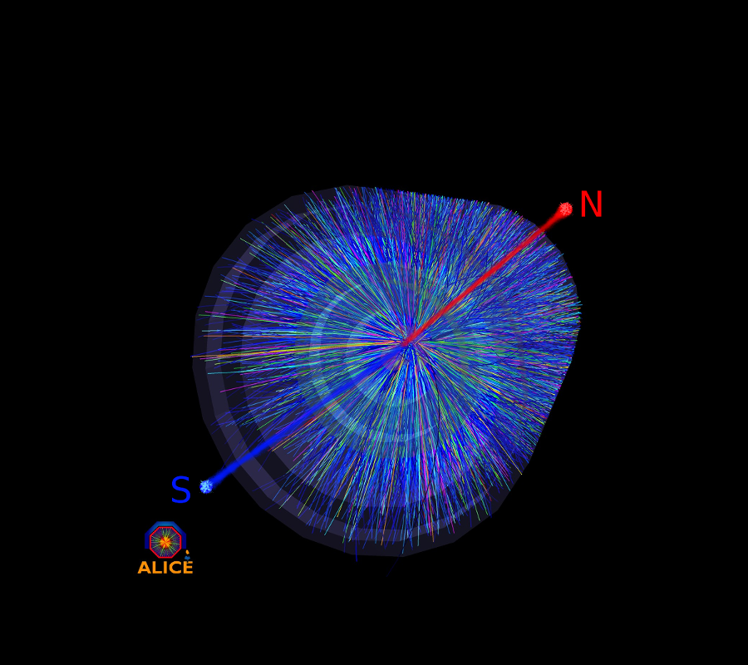

Schwinger pair production of magnetic monopoles
Arttu Rajantie
O. Gould and AR, PRD96 (2017) 076002
O. Gould and AR, PRL119 (2017) 241601
O. Gould, AR and C. Xie, PRD98 (2018) 056022
O. Gould, D.L-J. Ho and A. Rajantie, arXiv:1902.04388
USTC, 30 May 2019

Slide 2
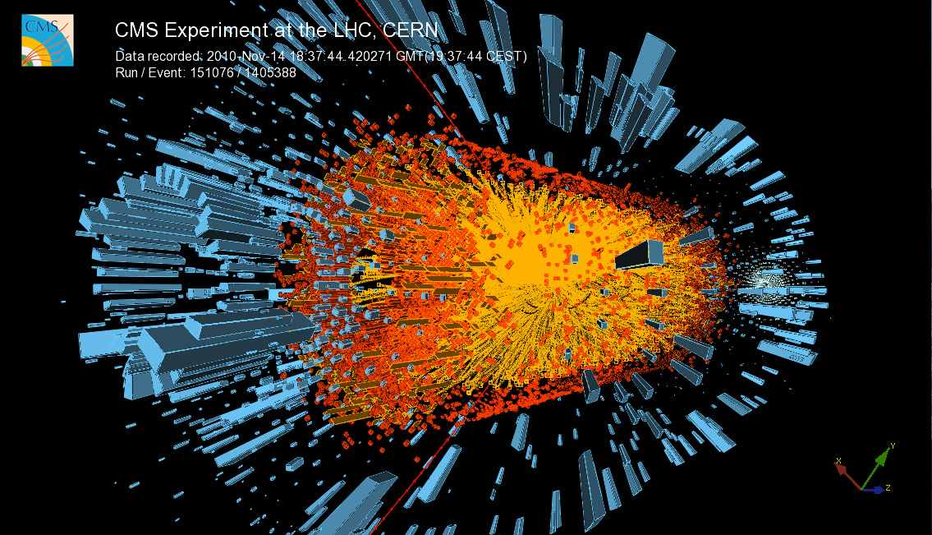
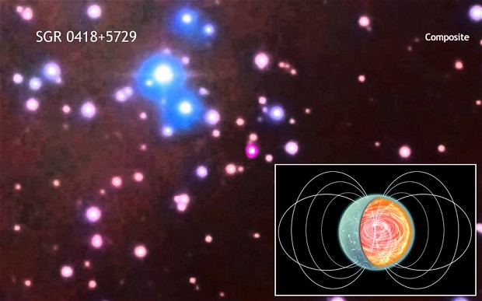
Outline
Magnetic monopoles
Schwinger pair production at zero temperature
Schwinger pair production at non-zero temperature
Schwinger pair production from time-dependent fields
Monopole mass bounds from heavy ion collisions and neutron stars

Slide 3
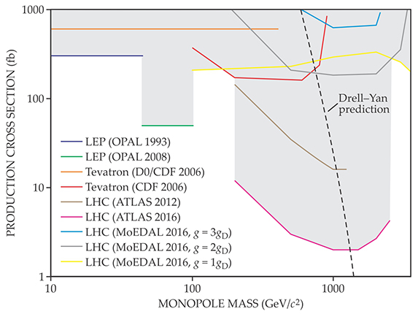
Monopole Searches in Colliders
AR, Physics Today 2016

Slide 4
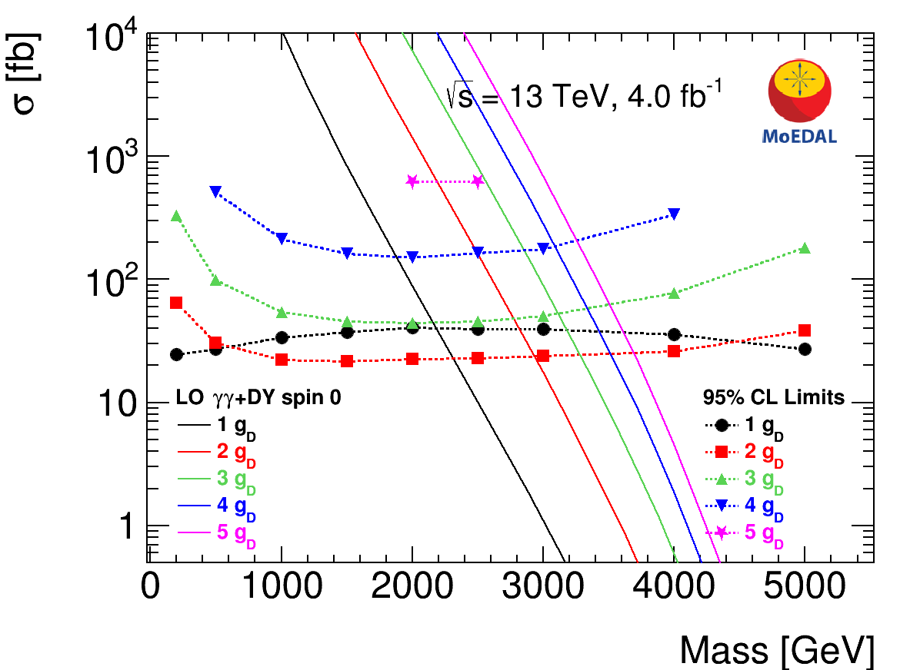
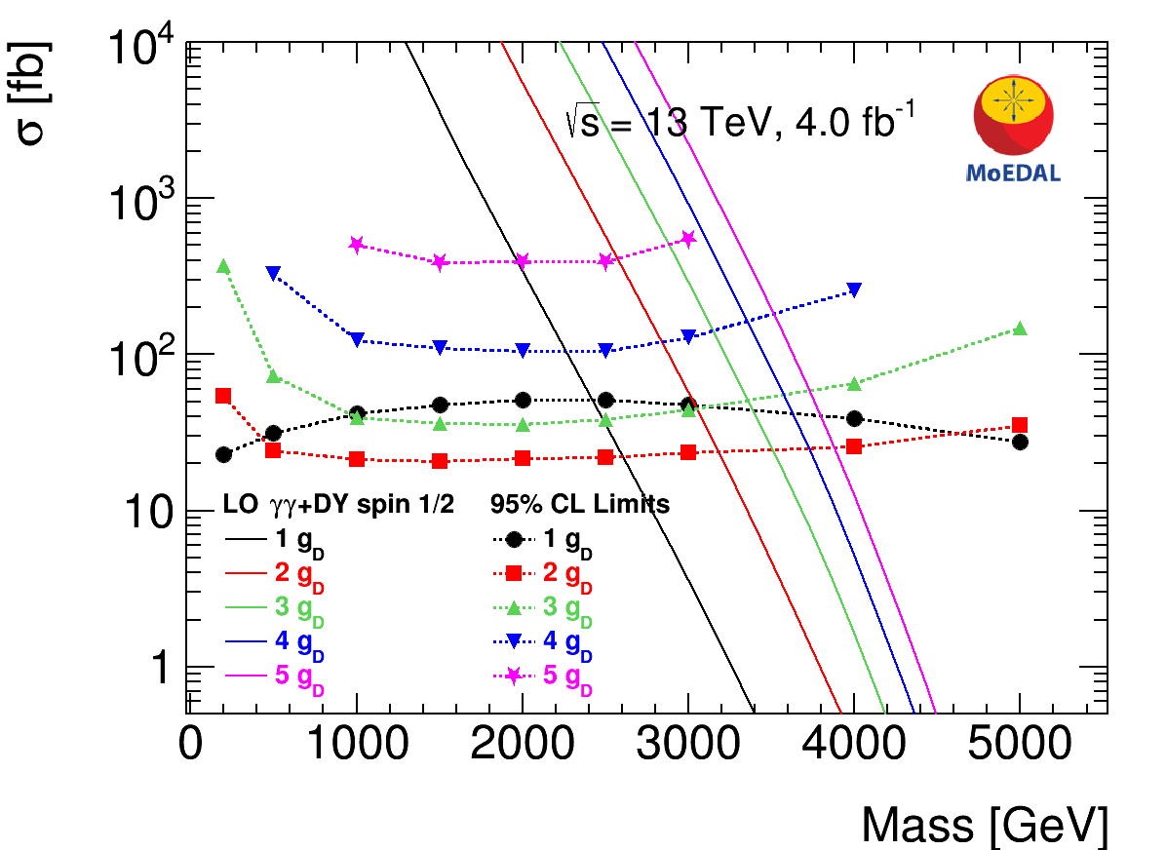
Monopole Searches in Colliders
MoEDAL Collaboration, 2019

Slide 5
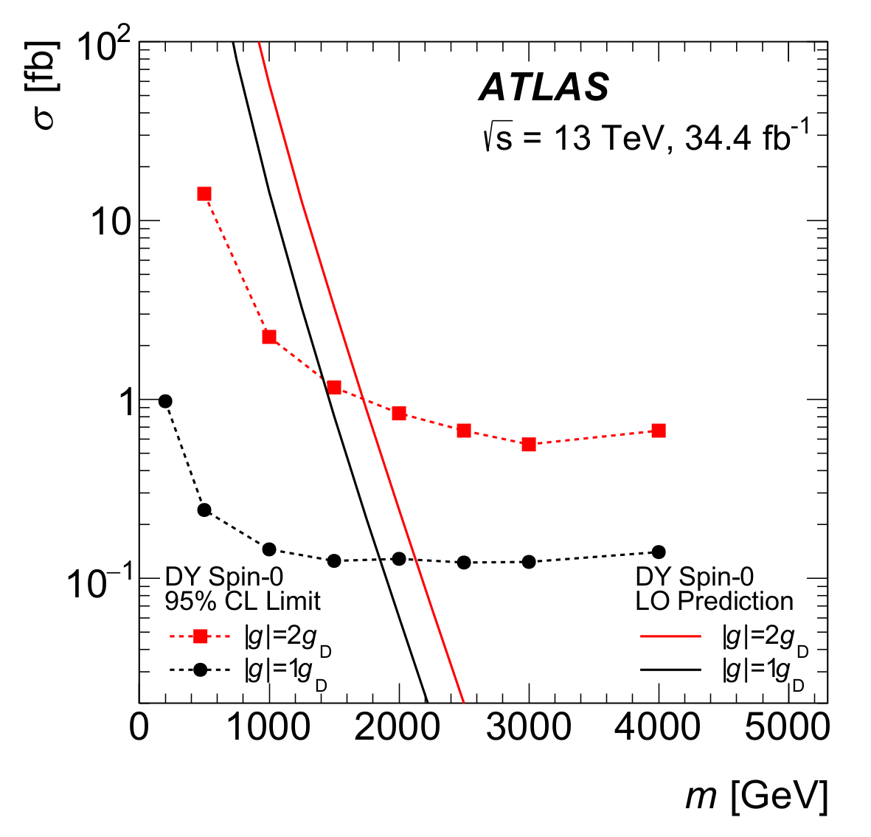
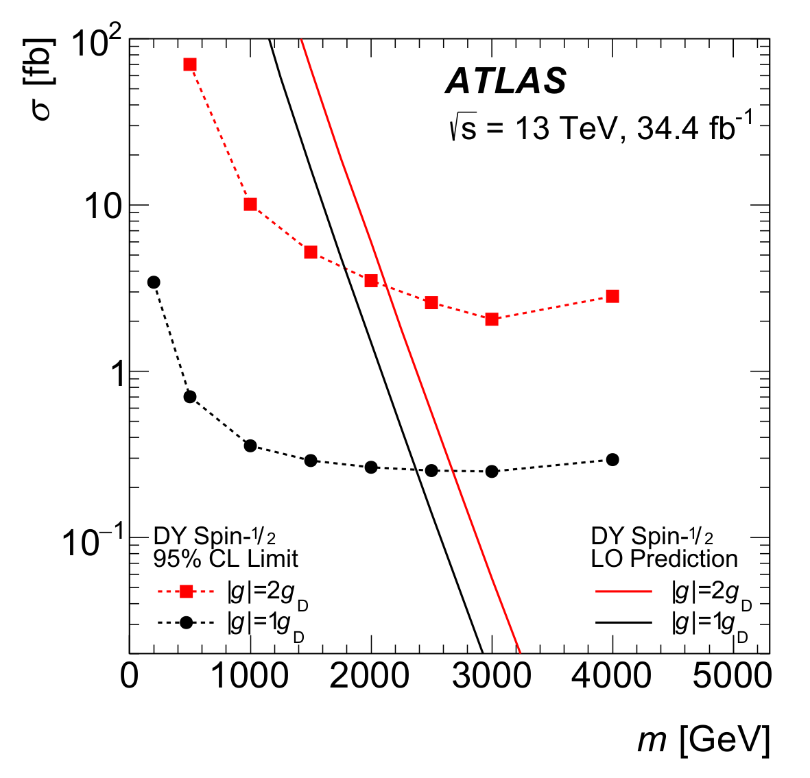
Monopole Searches in Colliders
Upper bounds on production cross section
To obtain a bound on the monopole mass,
one needs to calculate the cross section from theory
ATLAS Collaboration, arXiv:1905.10130

Slide 6
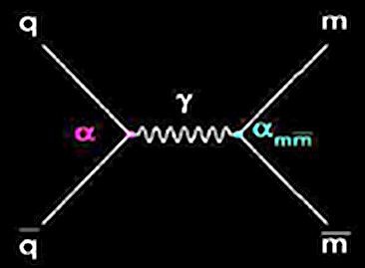
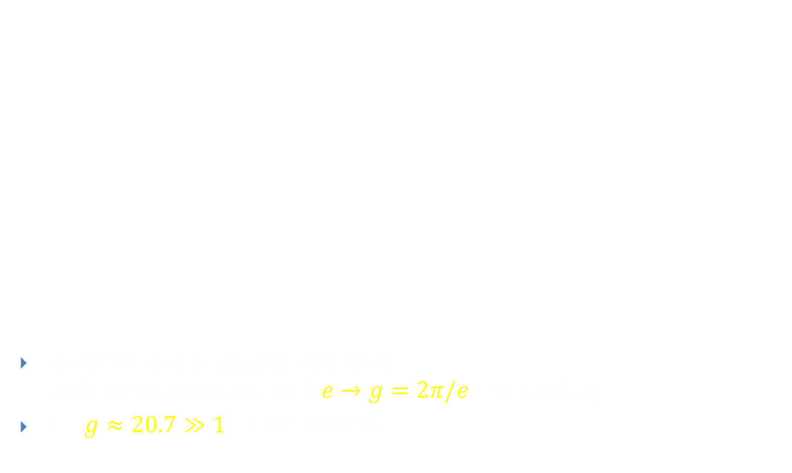
Monopole Searches in Colliders
Searches usually assume tree-level
Drell-Yan cross section with $e→g=2π/e$ (EM duality)
But $g≈20.7≫1$ ⇒ Not reliable!
ATLAS Collaboration, arXiv:1905.10130

Slide 7
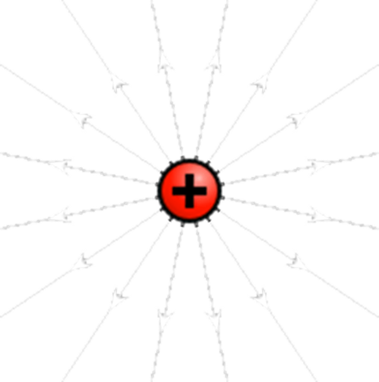
Two Types of Monopoles
Solitonic monopoles (’t Hooft 1974, Polyakov 1974)
  Smooth, semiclassical solutions in a renormalised, weakly coupled theory
Elementary monopoles (e.g. Dirac 1931, Schwinger 1966, Zwanziger 1971)
  New field in the Lagrangian
N

Slide 8


‘t Hooft-Polyakov Monopole
Magnetic monopole in weakly coupled, renormalisable
quantum field theory
Georgi-Glashow model: SU(2)+adjoint Higgs
$Φ≠0$ ⇒ Symmetry breaking $SU(2)→U(1)$
Electrodynamics with magnetic field given by
$$B_{i}=\frac{1}{2}ε_{ijk}\text{Tr}\hat{Φ}\left(F_{jk}^{}−\frac{i}{2e}\left[D_{j},\hat{Φ}\right]\left[D_{k},\hat{Φ}\right]\right)$$

Slide 9
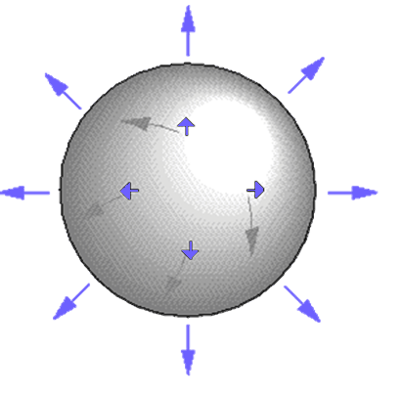
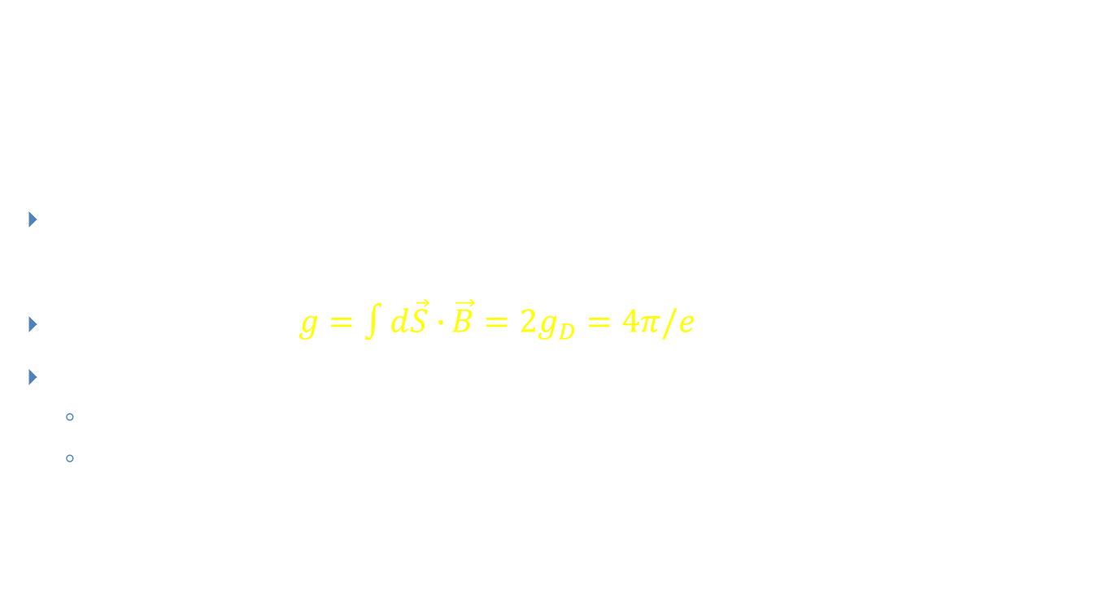
‘t Hooft-Polyakov Monopole
Smooth “hedgehog” solution:
$Φ^{a}∝x_{a}$, $A_{i}^{a}∝ε_{iaj}x_{j}$
Magnetic charge $g=\int{d\vec{S}∙}\vec{B}=2g_{D}=4π/e$
Calculable properties:
  Finite mass $M≈{4πv}/e\sim m/{e^{2}}≫m$
  Non-zero size $R≈1/m≫1/M$

Slide 10
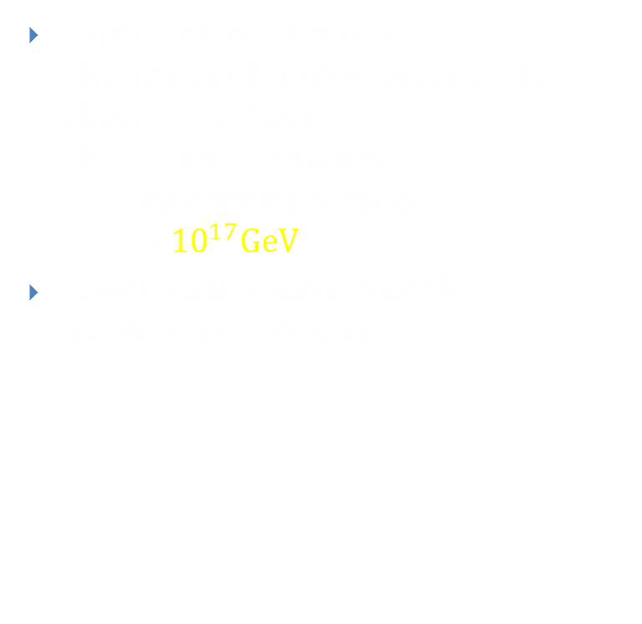
GUT Monopoles
Grand Unified Theory (GUT):
Electroweak & strong forces unified above $∼{10}^{16}GeV$
→ ‘t Hooft-Polyakov monopoles of mass $\sim {10}^{17}GeV$
Lower mass in some models,
maybe even $TeV$-scale?
energy
Theory of Everything
10¹⁹ GeV
Grand Unified Theory
10¹⁶ GeV
Electro- weak Theory
gravity
strong
weak
electromagnetic
10² GeV

Slide 11

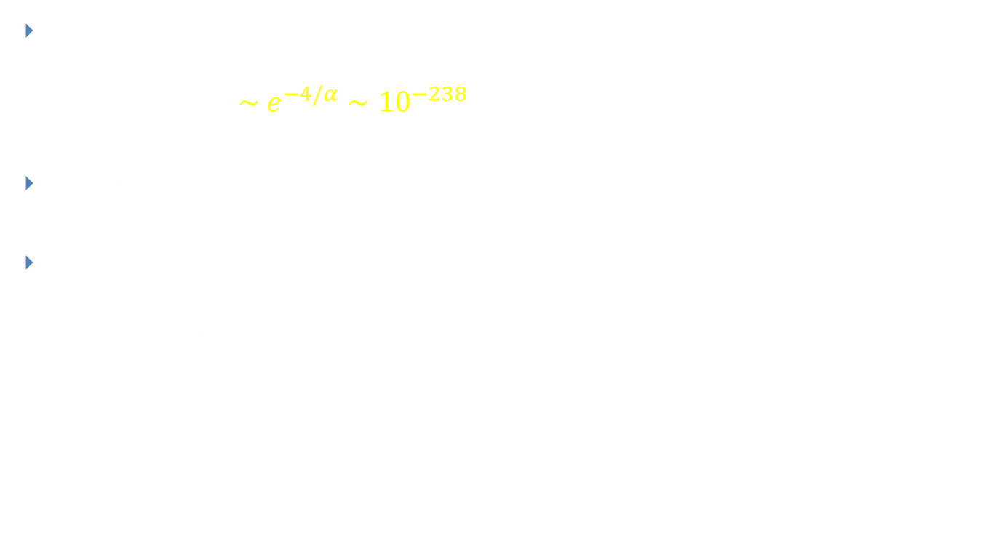
Production Amplitude
Semiclassical argument for solitonic monopoles:
pair production from two-particle collisions
suppressed by $\sim e^{−4/α}∼{10}^{−238}$
(Witten, Drukier&Nussinov)
Confirmed numerically for kinks in 1+1D
(Demidov&Levkov 2011)
Production of solitonic
monopoles may be practically
impossible in two-particle
collisions

Slide 12
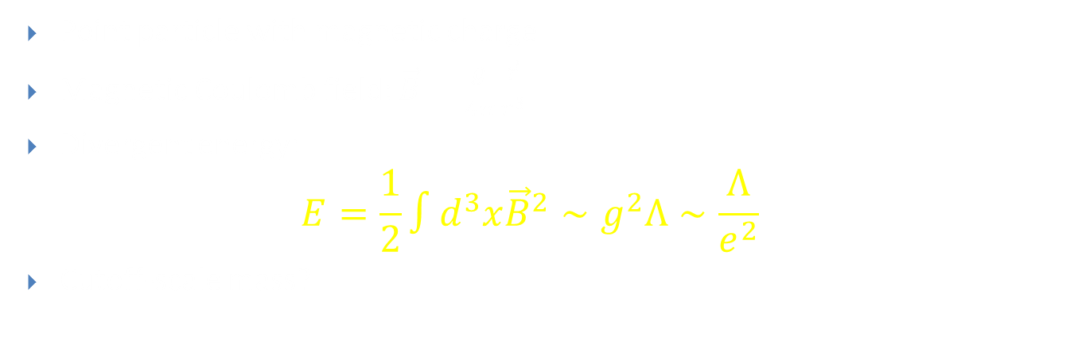
Elementary Monopoles: Classical
N
Point particle with magnetic charge
Magnetic Coulomb field: $\vec{B}=\frac{g}{4π}\frac{\vec{r}}{r^{3}}$
Divergent energy:
$E=\frac{1}{2}∫d^{3}x{\vec{B}}^{2}∼g^{2}Λ∼\frac{Λ}{e^{2}}$
Cutoff-scale mass?

Slide 13

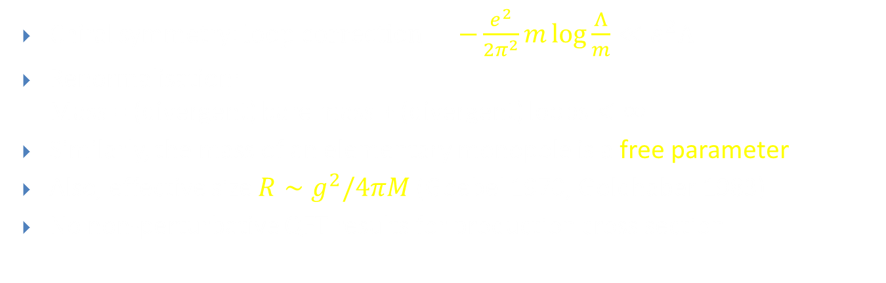
Elementary Monopoles: Quantum
Chiral symmetry: $\text{loop} \text{correction}=−\frac{e^{2}}{2π^{2}}m\log{\frac{Λ}{m}}≪e^{2}Λ$
Renormalisation:
Mass = (divergent) bare mass + (divergent) loops $<∞$
Similarly, the mass of an elementary monopole is a free parameter
Also, effective size $R∼g^{2}/4πM$ (Goebel 1970, Goldhaber 1983)
No non-perturbative QFT results for production cross section

Slide 14
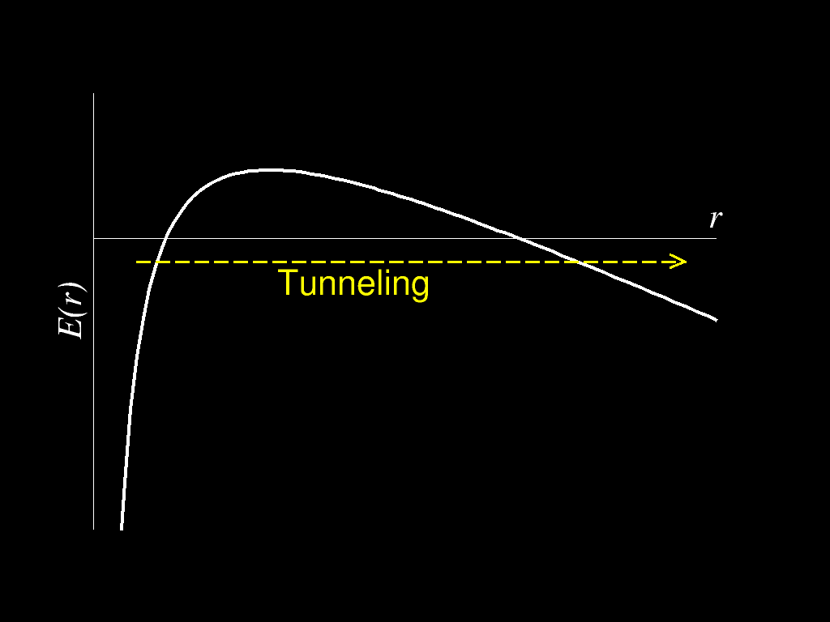
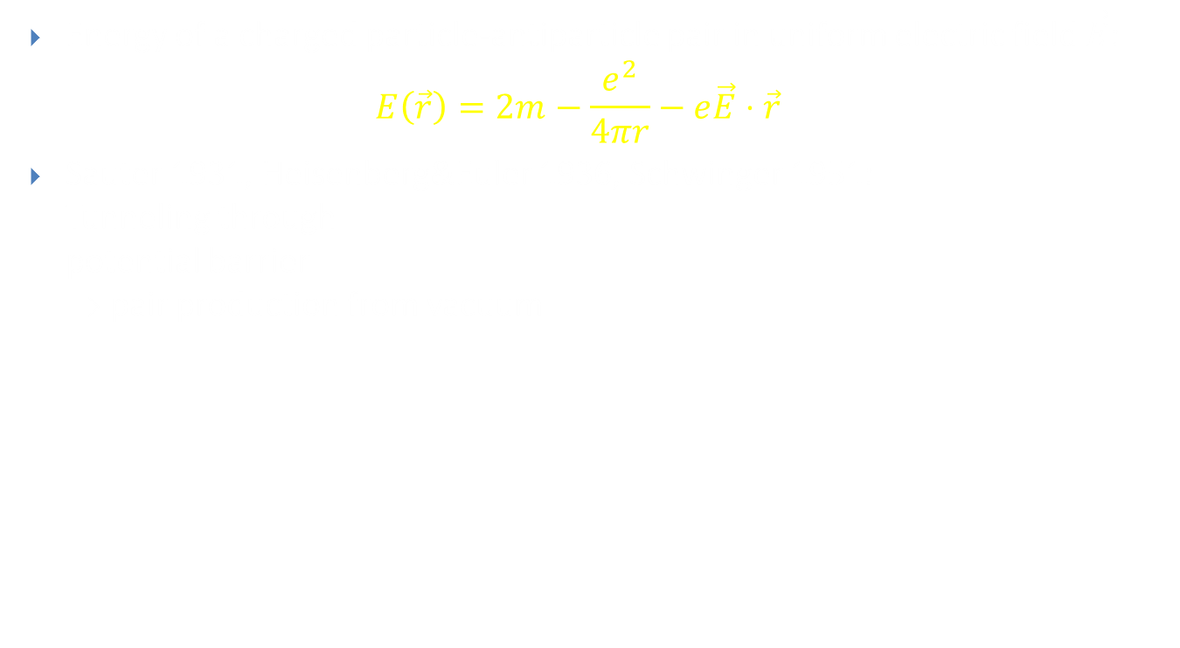
Schwinger Pair Production
Energy of a charged particle-antiparticle pair in uniform electric field $\vec{E}$:
$$E\left(\vec{r}\right)=2m−\frac{e^{2}}{4πr}−e\vec{E}⋅\vec{r}$$
Sauter 1931, Heisenberg&Euler 1936, Schwinger 1951:
Tunneling through
potential barrier
⇒ pair production from vacuum

Slide 15
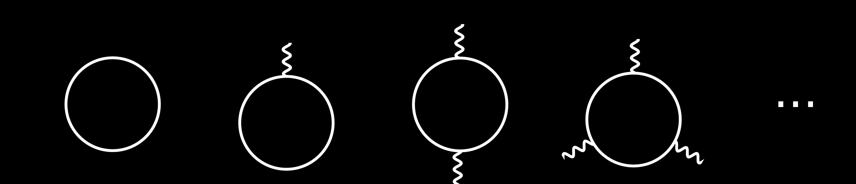
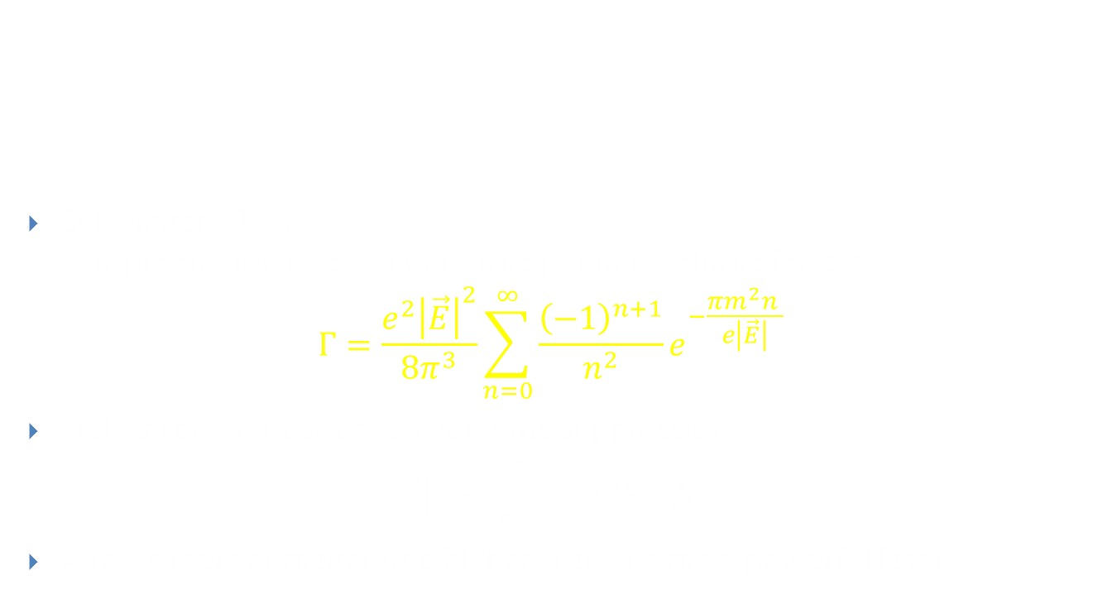
Weak Coupling
Schwinger 1951:
Pair production rate per unit time per unit volume for $e≪1$:
$$Γ=\frac{e^{2}{\left|\vec{E}\right|}^{2}}{8π^{3}}\sum_{n=0}^{∞}{\frac{{\left(−1\right)}^{n+1}}{n^{2}}e^{−\frac{πm^{2}n }{e\left|\vec{E}\right|}}}$$
Field strength needed to overcome suppression:
$\left|\vec{E}\right|≫\frac{m^{2}}{e}∼{10}^{18} V/m$
A few orders of magnitude higher than the most powerful lasers

Slide 16
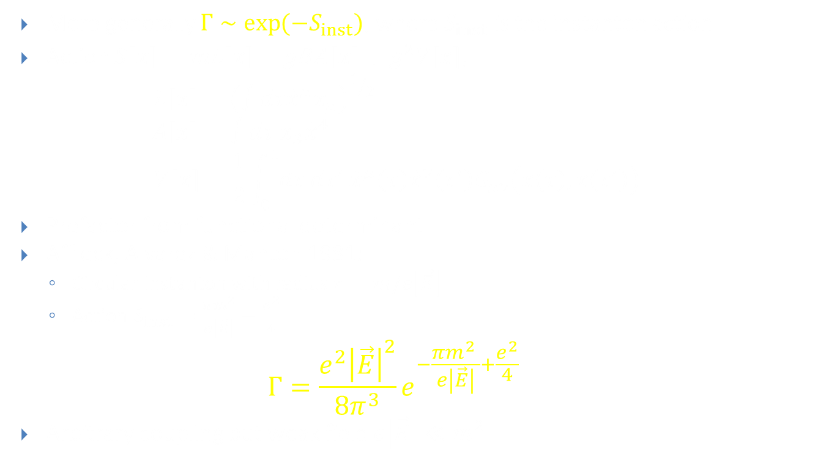
Arbitrary Coupling
More generally $Γ∼\exp{(−S_{inst})}$, where $S_{inst}$ is the instanton action
Action $S\left[x\right]=mL\left[x\right]−gBA\left[x\right]+g^{2}V\left[x\right]$,
$L\left[x\right]={\left(∫dτ{\dot{x}}^{μ}{\dot{x}}_{μ}\right)}^{1/2}$
$A\left[x\right]=∫dτ x_{3}{\dot{x}}^{4}$
$V\left[x\right]=\frac{1}{2}\int_{0}^{1}{dτ dτ^{′}}{\dot{x}}^{μ}\left(τ\right){\dot{x}}^{ν}\left(τ^{′}\right)G_{μν}\left(x\left(τ\right),x\left(τ^{′}\right)\right)$
Prefactor from functional determinant
Affleck, Alvarez & Manton 1981:
  Circular instanton with radius $r=m/e\left|\vec{E}\right|$
  Action $S_{inst}=\frac{πm^{2}}{e\left|\vec{E}\right|}−\frac{e^{2}}{4}$
  $$Γ=\frac{e^{2}{\left|\vec{E}\right|}^{2}}{8π^{3}}e^{−\frac{πm^{2} }{e\left|\vec{E}\right|}+\frac{e^{2}}{4}}$$
Arbitrary coupling but weak field $e\left|\vec{E}\right|≪m^{2}$

Slide 17

Worldline Calculation
Weak field $ε=e\left|\vec{E}\right|/m^{2}≪1$
⇒ Saddle point approximation in $s$ integration
$$Γ=−\frac{2}{𝒱}\sqrt{2πε} Im\int{\frac{𝒟x^{μ}}{L{\left[x\right]}^{1/2}}e^{−\frac{\tilde{S}\left[x\right]}{ε}}}$$
where
$$\tilde{S}\left[x\right]=L\left[x\right]−A\left[x\right]+κV[x]$$
$$L\left[x\right]={\left(∫dτ{\dot{x}}^{μ}{\dot{x}}_{μ}\right)}^{1/2} \\ A\left[x\right]=∫dτ x_{3}{\dot{x}}^{4}$$
$$V\left[x\right]=\frac{1}{2}\int_{0}^{1}{dτ dτ^{′}}{\dot{x}}^{μ}\left(τ\right){\dot{x}}^{ν}(τ^{′})G_{μν}(x(τ),x\left(τ^{′}\right))$$
and $κ=\frac{e^{3}\left|\vec{E}\right|}{m^{2}}=e^{2}ε$

Slide 18

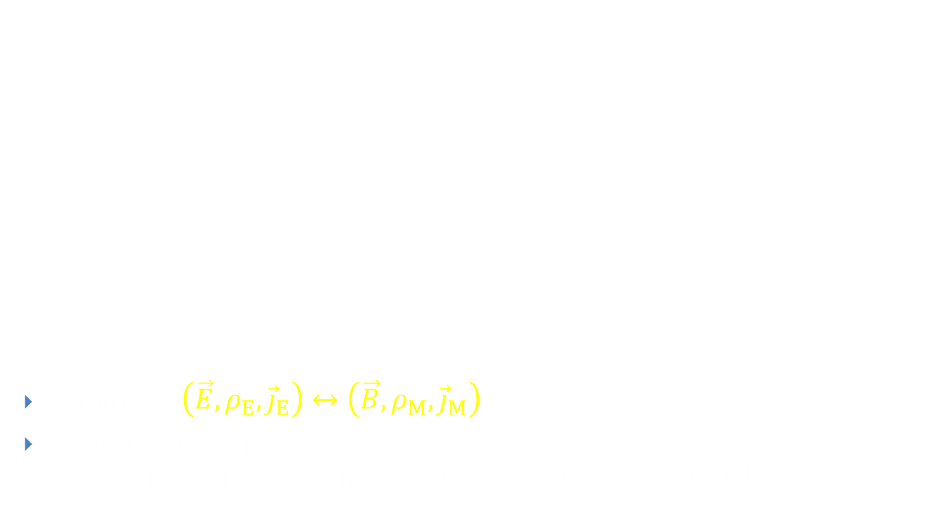
Electric-Magnetic Duality
Symmetry $\left(\vec{E},ρ_{E},{\vec{j}}_{E}\right)↔\left(\vec{B},ρ_{M},{\vec{j}}_{M}\right)$
Dual Schwinger process:
Production of magnetic monopoles by strong magnetic field
$$\vec{∇}⋅\vec{E}=ρ_{E} \\ \vec{∇}⋅\vec{B}=ρ_{M} \\ \vec{∇}×\vec{E}=−\frac{∂\vec{B}}{∂t}+{\vec{j}}_{M} \\ \vec{∇}×\vec{B}=−\frac{∂\vec{B}}{∂t}+{\vec{j}}_{E}$$
N

Slide 19
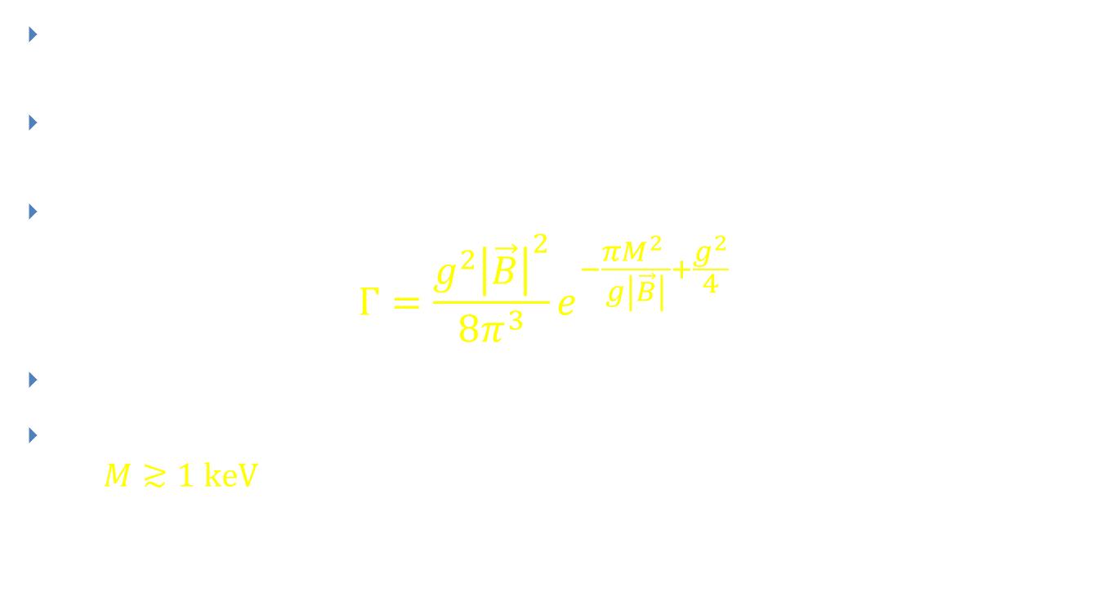
Monopoles from Schwinger Process
Calculation does not require weak coupling:
$g≫1$ is not a problem
Largely independent of microscopic structure of monopoles
(elementary or solitonic)
Pair production rate (constant field, $T=0$): (Gould&AR, PRD2017)
$Γ=\frac{g^{2}{\left|\vec{B}\right|}^{2}}{8π^{3}}e^{−\frac{πM^{2} }{g\left|\vec{B}\right|}+\frac{g^{2}}{4}}$
Pair production needs a strong magnetic field $\left|\vec{B}\right|≳M^{2}/g$
Strongest magnetic fields in lab$\left|\vec{B}\right| \sim 100 T∼{10}^{−13} GeV^{2}$
⇒ $M≳1 keV$

Slide 20
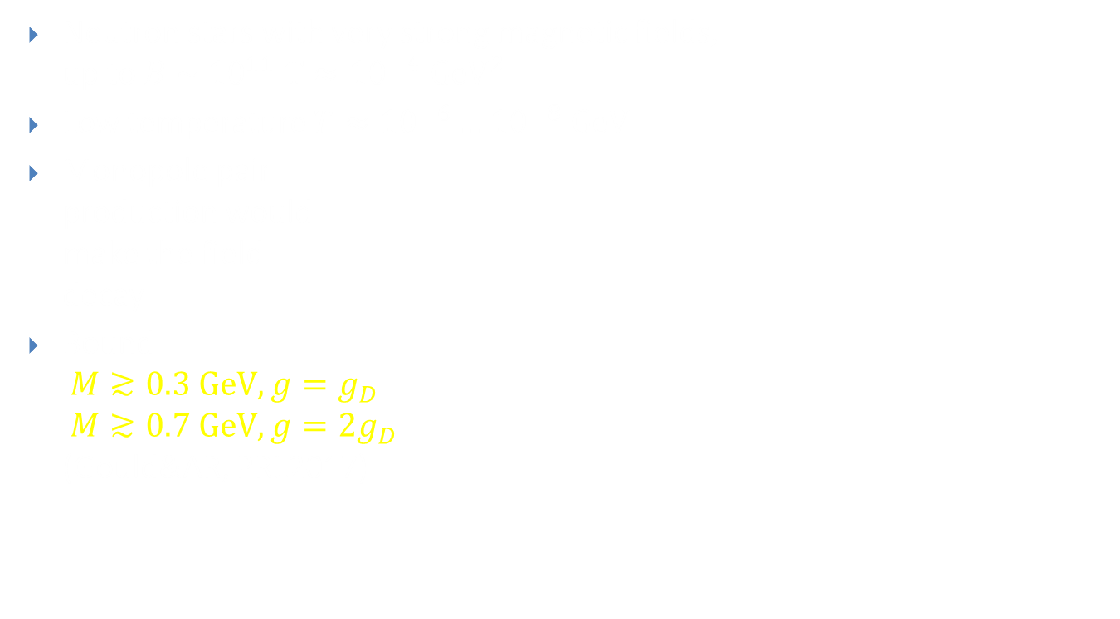
Magnetars
Neutron stars with very strong magnetic fields,
up to $B \sim {10}^{11} T≈{10}^{−4} GeV^{2}$
Low temperature $T≈{10}^{−6}…{10}^{−8} GeV$
Monopole pair
production would
make the field
decay
Bound
$M≳0.3 GeV, g=g_{D}$
$M≳0.7 GeV, g={2g}_{D}$
(Gould&AR, PRL2017)

Slide 21
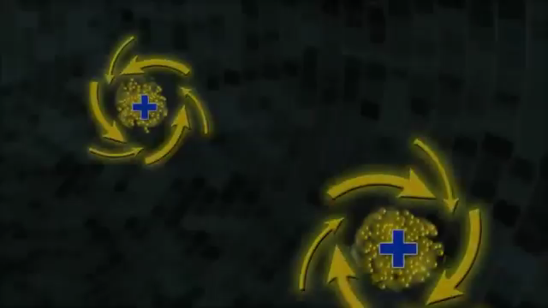
Heavy Ion Collisions
(Video: Brookhaven National Laboratory)

Slide 22
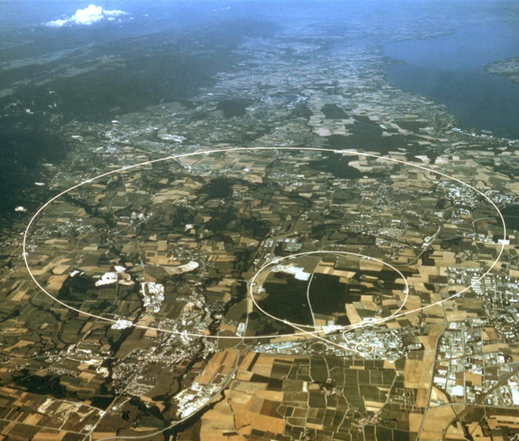

Heavy Ion Collisions at SPS
Monopole search at
CERN Super Proton Synchrotron
(He, PRL 1997)
  $160AGeV$ fixed target Pb beam, $\sqrt{s_{NN}}≈17 GeV$
  No monopoles ⇒
  Production cross section bound
  $σ_{MM}<1.9 nb$
  Rest frame field $B≈0.0097 GeV^{2}$, temperature $T≈0.185 GeV$
High temperature
  Instantons with periodic
  Euclidean time

Slide 23
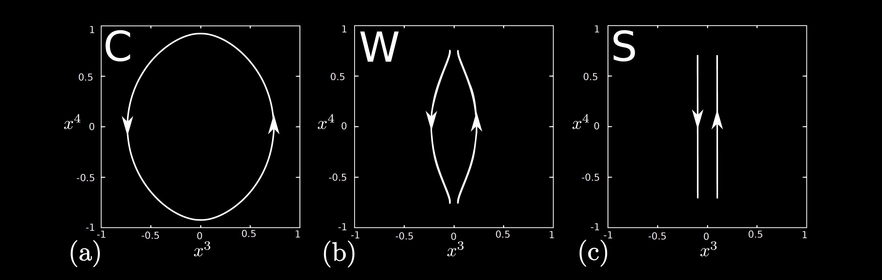
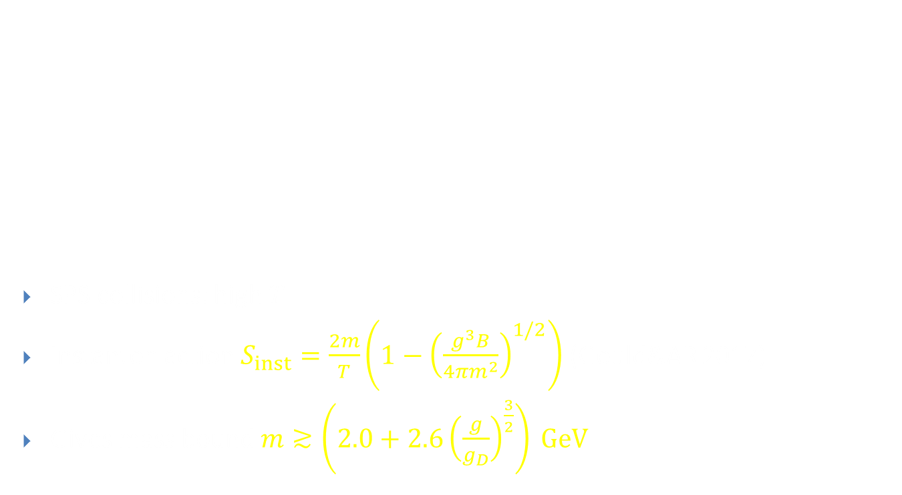



Thermal Schwinger Process
SPS collisions: high $T$
Instanton action $S_{inst}=\frac{2m}{T}\left(1−{\left(\frac{g^{3}B}{4πm^{2}}\right)}^{1/2}\right)$ (Gould&AR 2017)
Gives mass bound $m≳\left(2.0+2.6{\left(\frac{g}{g_{D}}\right)}^{\frac{3}{2}}\right) GeV$
low$T$
intermediate $T$
high $T$

Slide 24
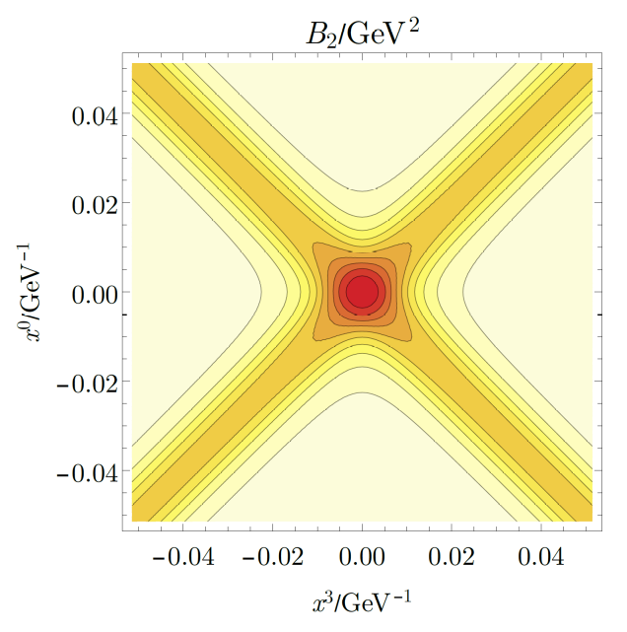
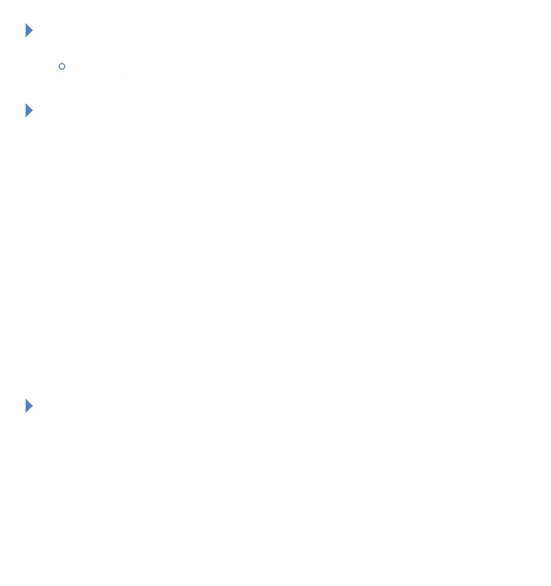

LHC Heavy Ion Collisions
Pb-Pb collisions in Nov 2018
  $\sqrt{s_{NN}}=5.02 TeV$,
Time-dependent field
$$\vec{B}=\frac{B\hat{y}}{2}\left({\left(1+ω^{2}{\left(t−\frac{z}{v}\right)}^{2}\right)}^{−3/2}\right.$$
$$\left.+{\left(1+ω^{2}{\left(t+\frac{z}{v}\right)}^{2}\right)}^{−3/2} \right),$$
where $B≈8.6 GeV^{2}$, $ω≈62 GeV$
Wick rotate to Euclidean space
$${\vec{B}}_{E}=\frac{B\hat{y}}{2i}\left({\left(1+ω^{2}{\left(iτ−\frac{z}{v}\right)}^{2}\right)}^{−3/2}\right.\left.+{\left(1+ω^{2}{\left(iτ+\frac{z}{v}\right)}^{2}\right)}^{−3/2} \right)$$

Slide 25
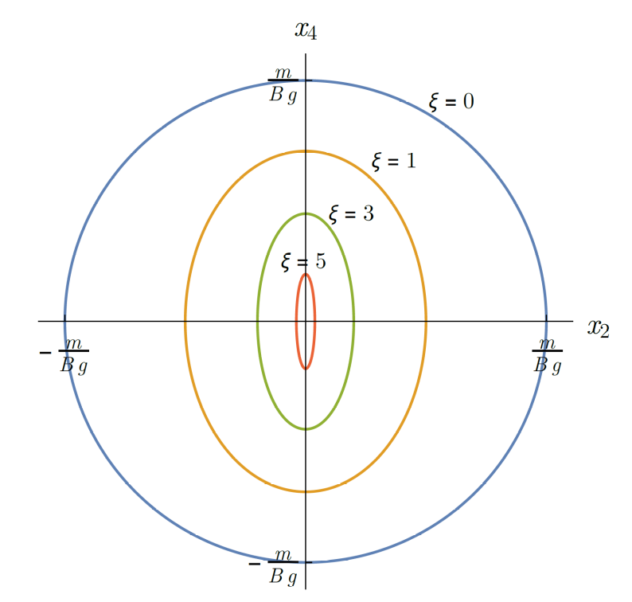

Spacetime Dependence
In LHC heavy-ion collisions, fields are not even approximately constant
Parameterised by
$ξ=\frac{mω}{gB}≈M/(3n GeV)$
  Constant field: $ξ→0$
Need to find worldline instanton
in a time-dependent background
(Gould, Ho & AR, arXiv:1902.04388)
Can be done analytically
to first order in self-interaction,
numerically to all orders

Slide 26
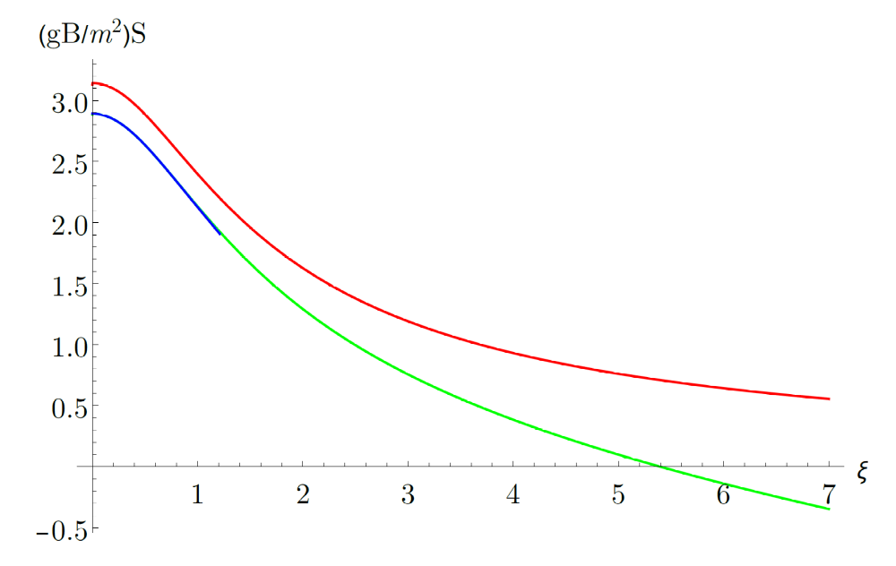
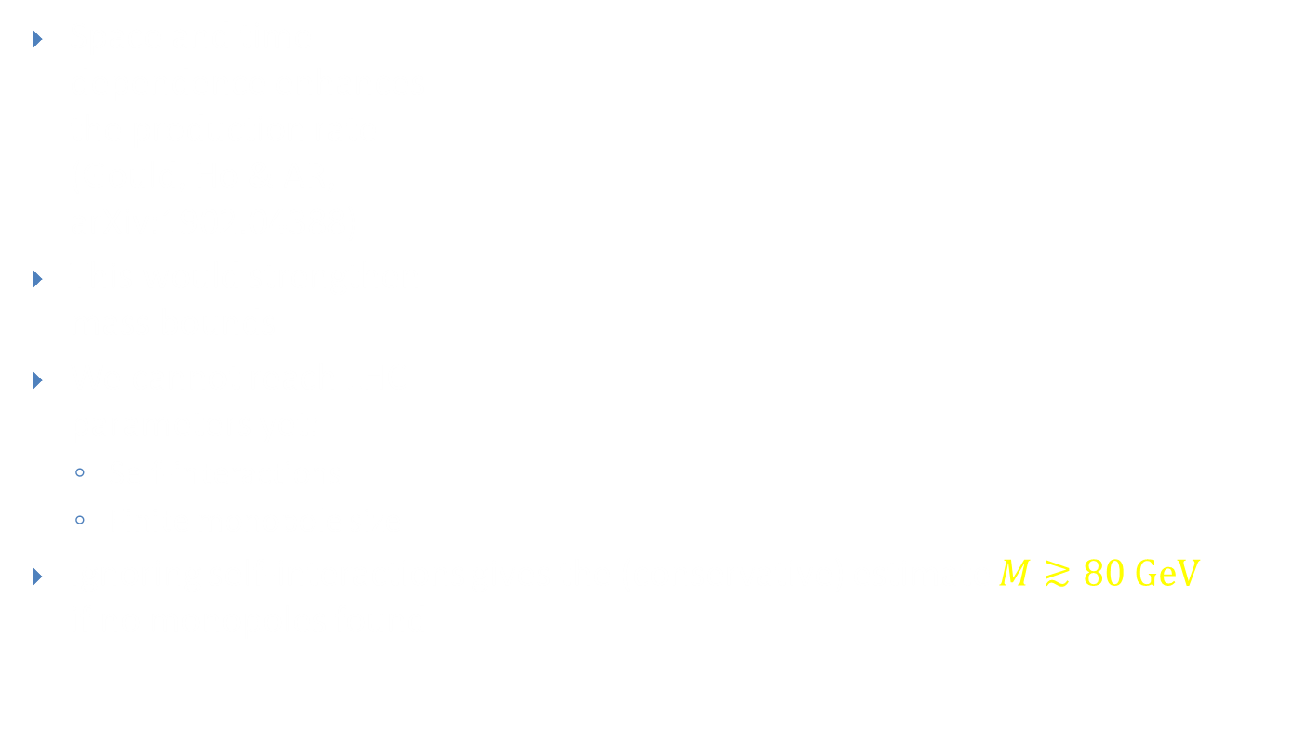


Spacetime Dependence
Space and time
dependence enhances
the production rate
(Gould, Ho & AR,
arXiv:1902.04388)
This would strengthen
mass bounds
We cannot reach LHC
parameters yet:
  Self-interactions
  Finite monopole size
Ignoring self-interactions gives the (conservative) estimate $M≳80 GeV$
if no monopoles found
$$Γ∼exp(−S)$$
Self-interactions:
None
Leading order
All orders
$$ξ≈M/(3nGeV)$$

Slide 27
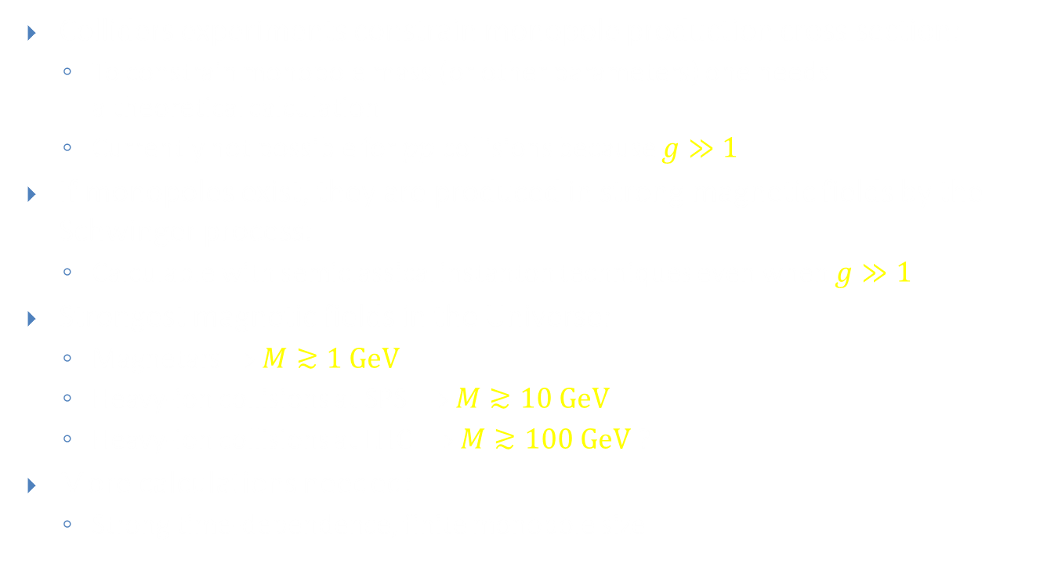
Summary
Colliders experiments constrain monopole production cross section:
  To constrain monopole mass (or other parameters) one needs
  a theoretical calculation
  Currently not possible for $pp$ collisions because $g≫1$
If monopoles exist, they are produced in strong magnetic fields by the Schwinger process:
  Calculable with semiclassical instanton techniques even when $g≫1$
Strongest magnetic fields in the Universe:
  Magnetars ⇒ $M≳1 GeV$
  Heavy-ion collisions at SPS ⇒ $M≳10 GeV$
  Heavy-ion collisions at LHC ⇒ $M≳100 GeV$ ?
More calculations needed:
  Strong time-dependence, finite monopole size

