Slide 1

Anti-Unruh effect And
quantum entanglement
Baocheng Zhang
2019年弦论、场论与宇宙学会议 湖北宜昌

Slide 2
Outline
Unruh and Anti-Unruh effects
Quantum entanglement
Entanglement amplification
Conclusion and future

Slide 3
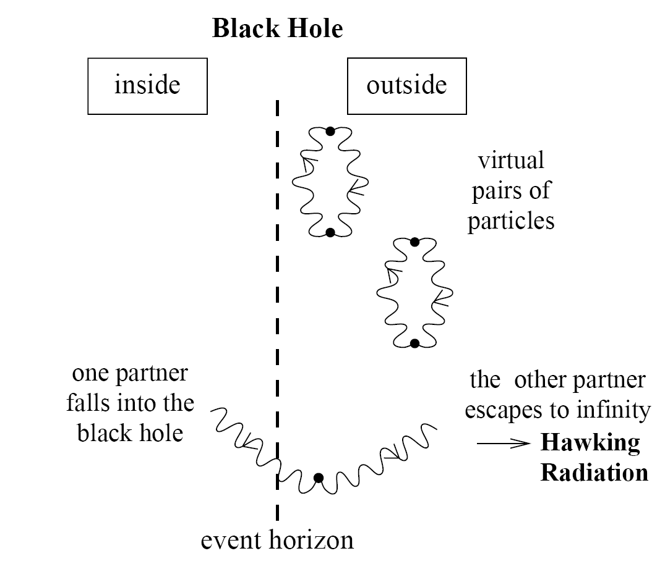

Information loss？
Irrespective of what initial state a black hole starts with before collapsing, it will evolves eventually into a thermal state after being completely exhausted into emitted radiations.
The radiations should be altered
B. Zhang et al, IJMPD 22 (2013) 1341014
The interior should be reinterpreted
B. Zhang, PRD 92 (2015) 081501(R)
B. Zhang, et al, PLB 765 (2017) 226
Is information loss a feature for semi-classical theory? Unruh effect!

Slide 4
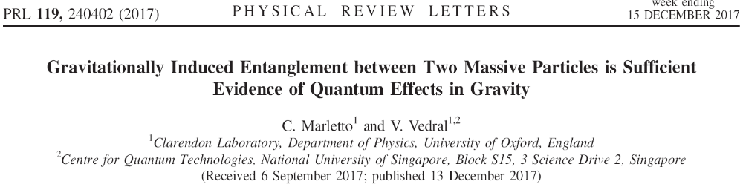
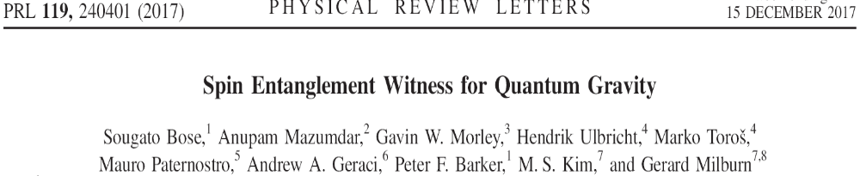
Quantum Gravitational field?
Could acceleration lead to the generation of entanglement? Unruh effect!

Slide 5
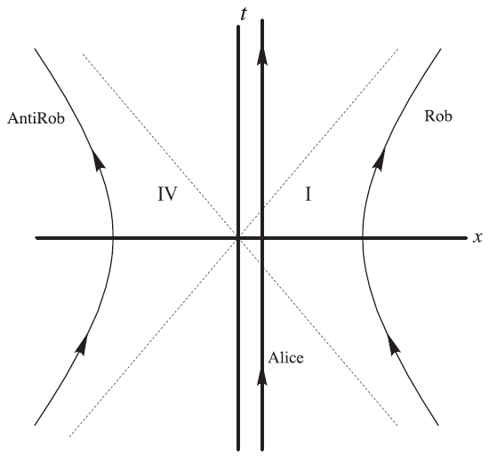



Unruh effect
L. C. B. Crispino, et al, Rev. Mod. Phys. 80 (2008) 787.

Slide 6

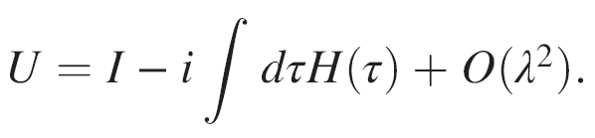
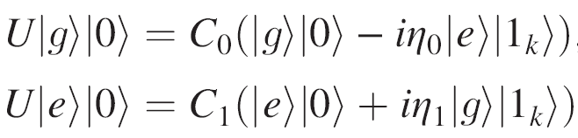






Unruh-DeWitt Detector
(1+1)-dimensional model
The time evolution is determined
The change of the detectors is
L. C. B. Crispino, et al, Rev. Mod. Phys. 80 (2008) 787.

Slide 7
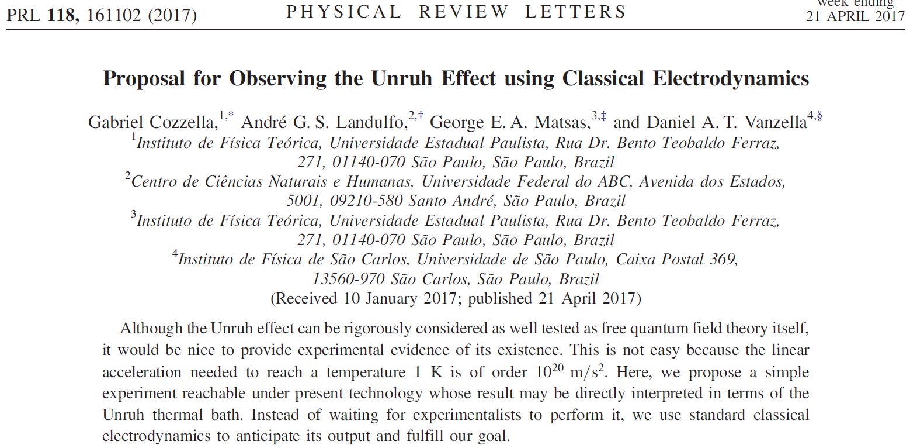
Experimental confirmation?
Question?

Slide 8

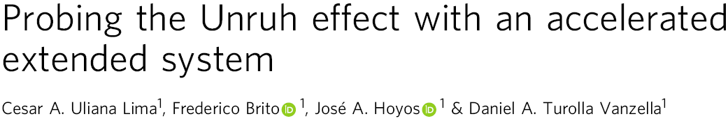
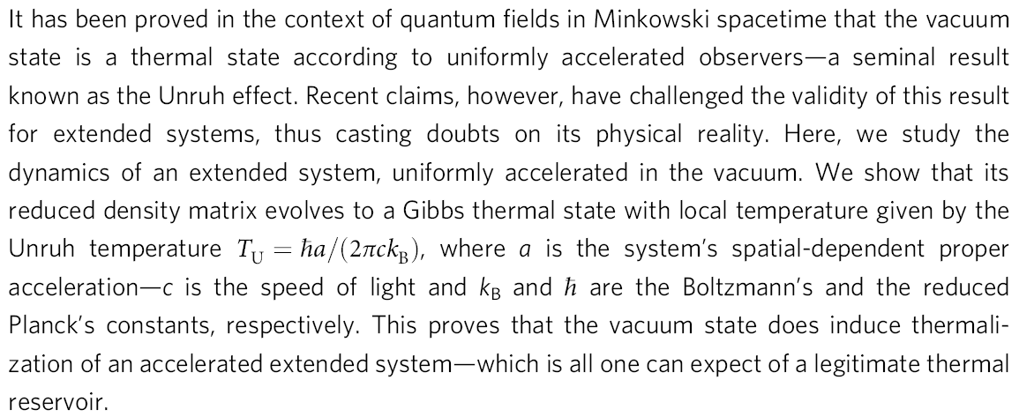
Experimental confirmation?

Slide 9
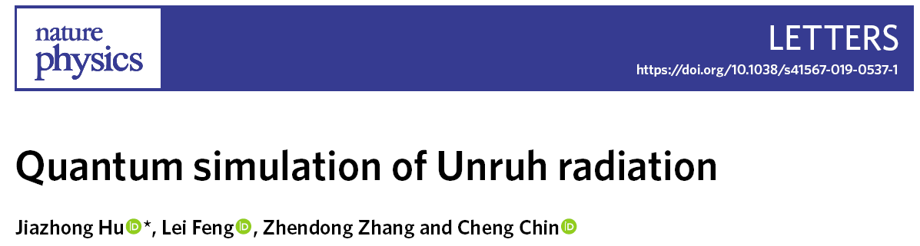


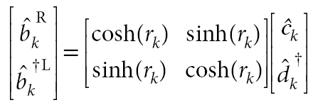
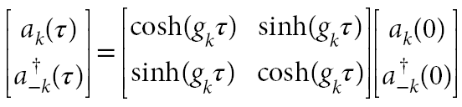


Experimental confirmation?

Slide 10
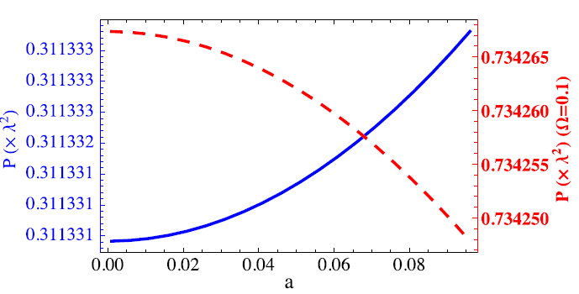
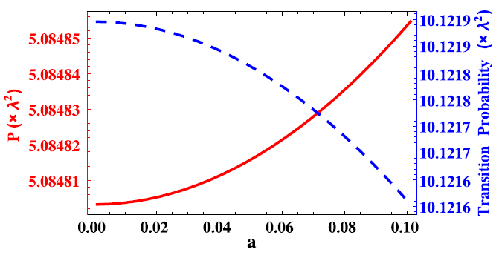
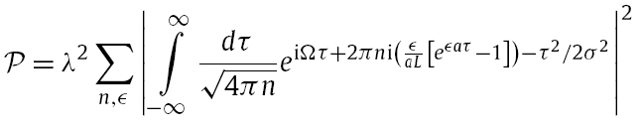
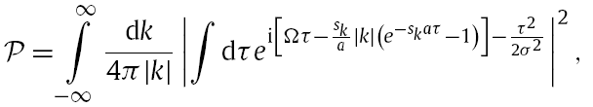
Anti-Unruh effect
A particle detector in uniform acceleration coupled to the vacuum can cool down with increasing acceleration under certain conditions.
W.G.Brenna et al, PLB 757 (2016) 307

Slide 11
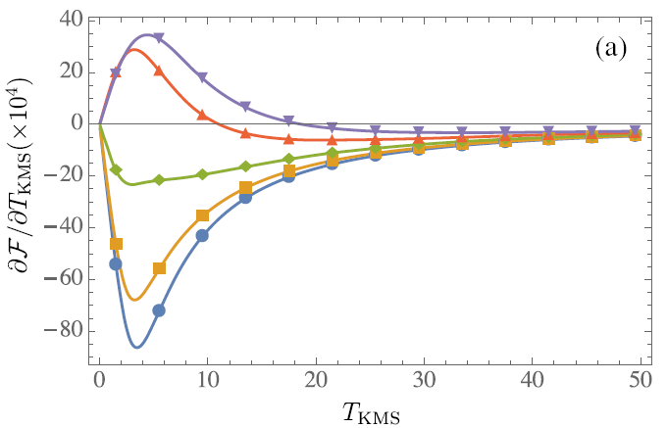
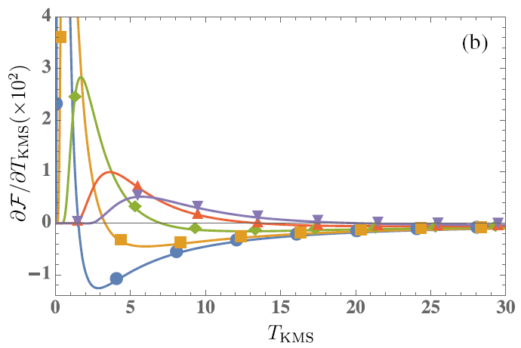





Anti-Unruh effect
Is this unintuitive “cooling” effect just transient behavior?
Can it happen under true stationarity conditions?
L.J.Garay et al, PRD 94 (2016) 104048

Slide 12









Anti-Unruh effect
The coherence for accelerated atoms
Consider an atom with the initial state
After the atom is accelerated
The decoherence factor
means that the atom loss coherence completely
means that the atom remains in the pure state
Taotao Li, et al, Phys. Rev. D 97, 045005 (2018)

Slide 13
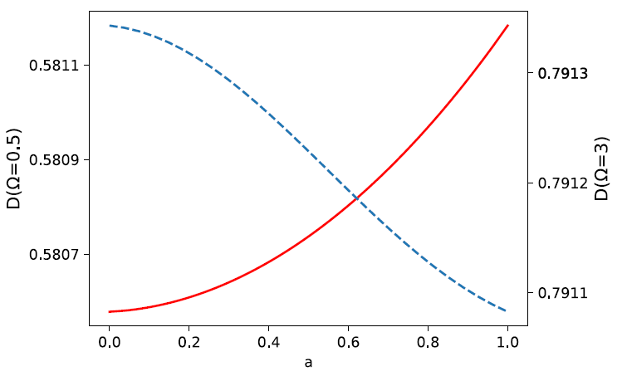
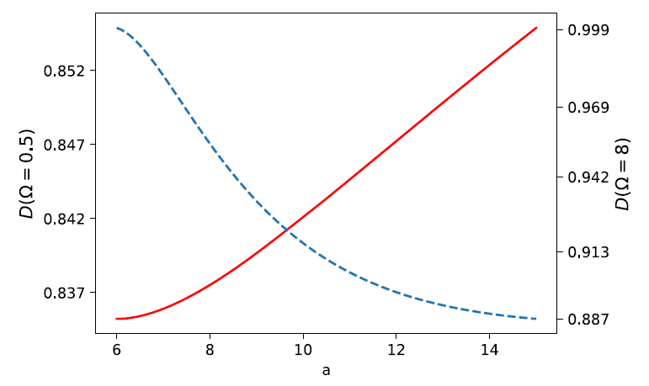
Anti-Unruh effect
The Anti-Unruh effect will lead to the increase of the coherence of the quantum state for accelerated atoms.
Finite interaction time
Infinite interaction time
Taotao Li, et al, Phys. Rev. D 97, 045005 (2018)

Slide 14
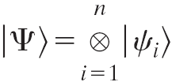
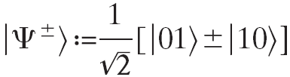
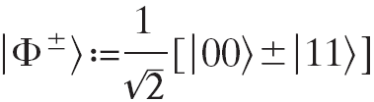
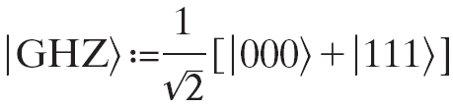
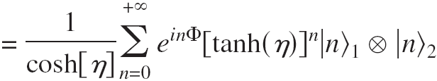

Quantum entanglement
Quantum entangled states that cannot be expressed as
Bell states or EPR pair,
GHZ states,
Two-mode squeezed state

Slide 15







Measure for Entanglement
Logarithmic negativity:
Concurrence:
the i-th eigenvalue of the partial transpose of the bipartite state density matrix

Slide 16

Entanglement Amplification
Consider two atoms with initial states
When one or two of the two atoms are accelerated, how would the initial entangled state be changed?
Note: different from D!

Slide 17
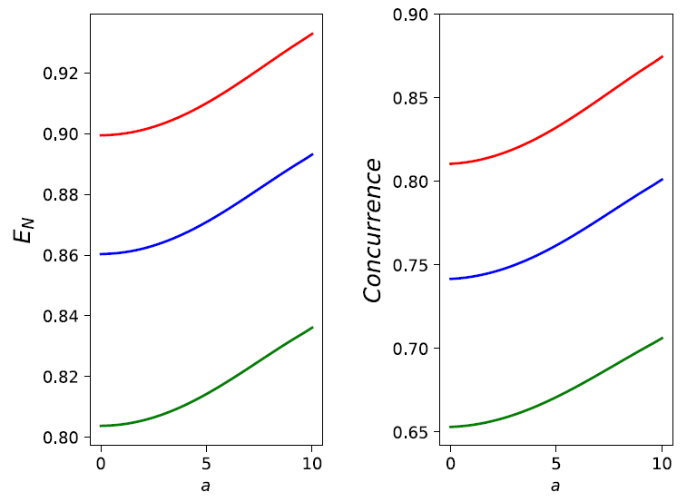
One atom is accelerated
The different lines represent the different initial states
The interaction is finite for the acceleration
Taotao Li, et al, Phys. Rev. D 97, 045005 (2018)

Slide 18
When the initial entanglement
is maximal,
how should it be changed?

Slide 19
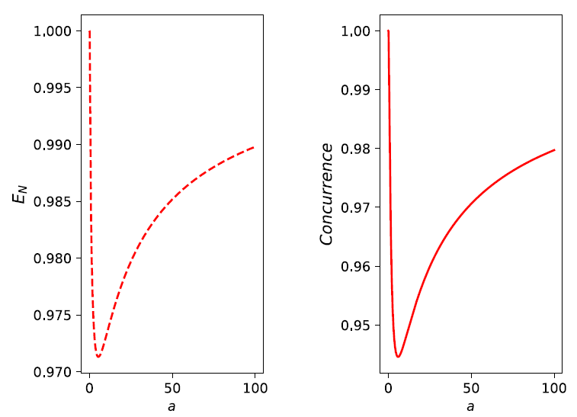
The interaction is infinite for the acceleration
Taotao Li, et al, Phys. Rev. D 97, 045005 (2018)

Slide 20
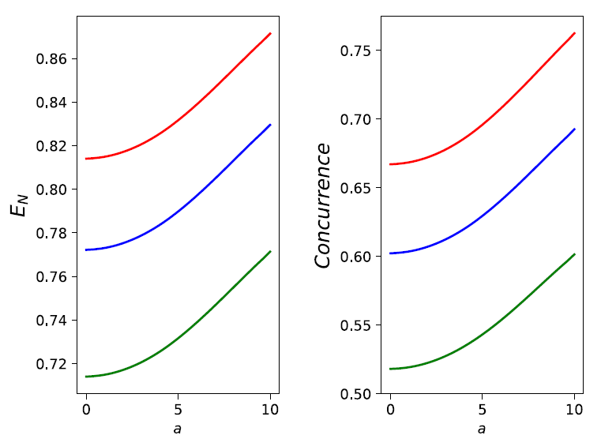
Two atoms are accelerated
The different lines represent the different initial states
The interaction is finite for the acceleration
Taotao Li, et al, Phys. Rev. D 97, 045005 (2018)

Slide 21
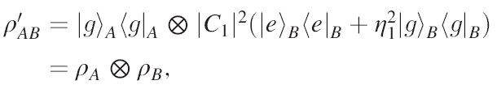
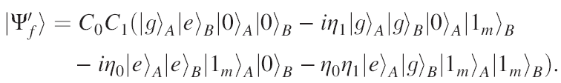

Initial product state
One atom is accelerated
Two atoms are accelerated simultaneously
Acceleration cannot generate entanglement!
Taotao Li, et al, Phys. Rev. D 97, 045005 (2018)

Slide 22
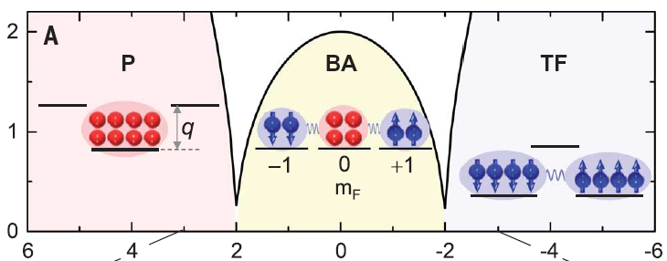
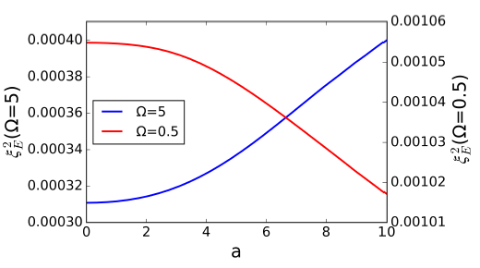

Experimental Possibility？
Yongjie Pan, et al, in progress

Slide 23
Summary and discussion
Anti-Unruh effect can increase the coherence of quantum states.
Anti-Unruh effect can increase the entanglement between different atoms. Phenomenological evidence?
Entanglement can be amplified but cannot created out of nothing.
Does our work means that gravity lead finitely to the decoherence of quantum states? Vacuum?

Slide 24

Thank you!

