Slide 1

Entropy, thermodynamics
And black hole interior
Baocheng Zhang
Based on Phys. Rev. D 92, 081501(R) (2015)
中科大交叉学科理论研究中心 2016.3.3

Slide 2
Outlines
Black hole volume
Entropy in the volume
Vacuum polarization
New thermodynamics

Slide 3
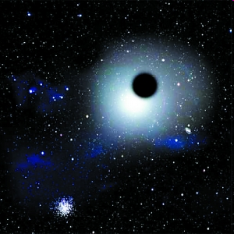
A black hole
A black hole is often defined as an object whose gravity so strong that the light can not escape. This is a classical description.

Slide 4

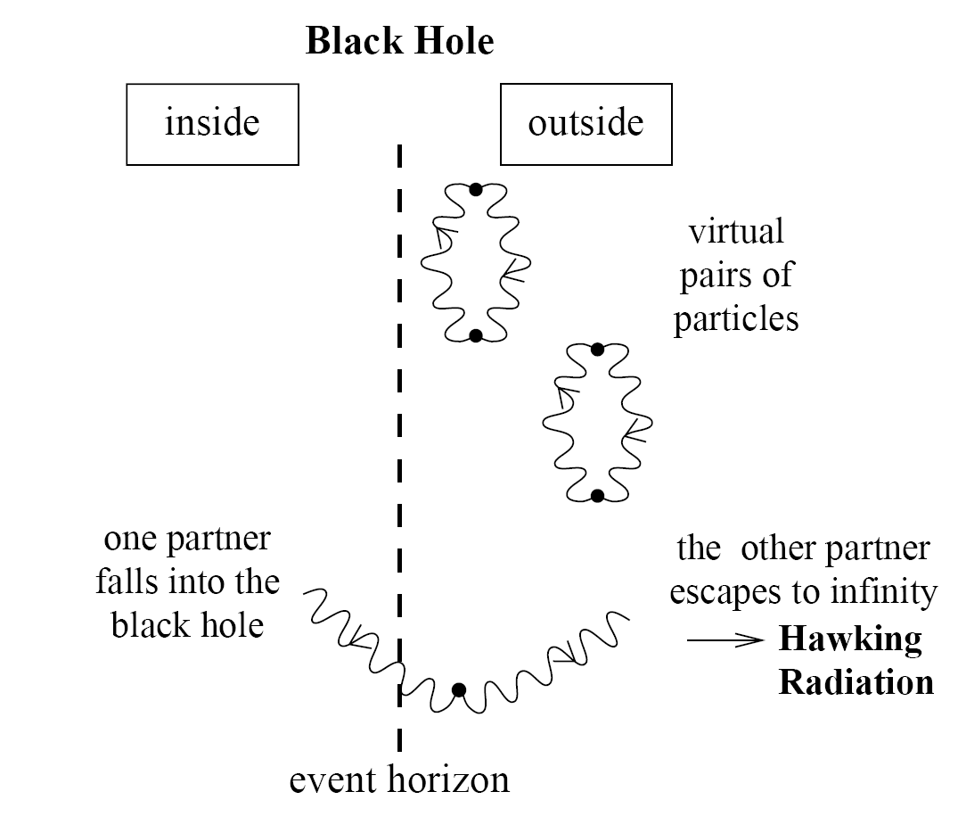

Black hole radiation
Classical black hole
Quantum black hole
Physical explanation
This picture leads to some severe problems!

Slide 5
Black hole information loss
When the black hole become thermal radiation completely, no place for the information about the initial state*. Many focus on this paradox.
At 2000, Parikh and Wilczek discovered that the radiation is non-thermal.
M. K. Parikh and F. Wilczek, Phys. Rev. Lett. 85，5042 (2000).
At 2009, based on the work of Parikh and Wilczek, we showed that the radiation process is consistent with unitarity required by quantum mechanics.
B. Zhang, et al, Phys. Lett. B 675, 98 (2009).
At 2011, we showed our method is applicable to nearly all black holes.
B. Zhang, et al, Annals of Physics 326, 350 (2011).
At 2013, our essay is awarded first prize in the 2013 Essay Competition of the Gravity Research Foundation. B. Zhang, et al, IJMPD 22, 1341014 (2013).
*S. W. Hawking, Phys. Rev. D 14, 2460 (1976)

Slide 6




Black hole entropy
Is it a statistical entropy?
……
Number of microstates
Define a microstate
B. Zhang, et al, GRG 43, 797 (2011)
3D
AdS/CFT
Cardy formulaFT
P. K. Townsend and B. Zhang, PRL 110, 241302 (2013) ;
B. Zhang, PRD 88, 124017 (2013)

Slide 7
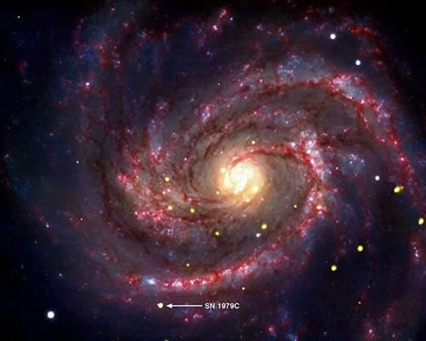
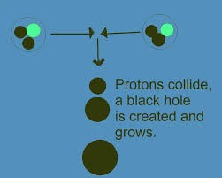
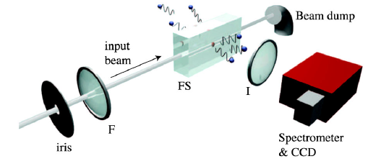
Observation
Astrophysical—Bending of light，GW etc.
(1970- Cygnus X-1 ~10Msun; 2010-SN1979C,~33yr, 20Msun~5Msun)
Large Hadron Collider
Analogue gravity

Slide 8

A potential problem is (a) for information loss paradox, is it lost after evaporation or other time? (b) are there degrees of freedom for the interpretation of entropy? Where?
A plausible result is the interior of a black hole might provide the space for the information or d.o.f?

Slide 9
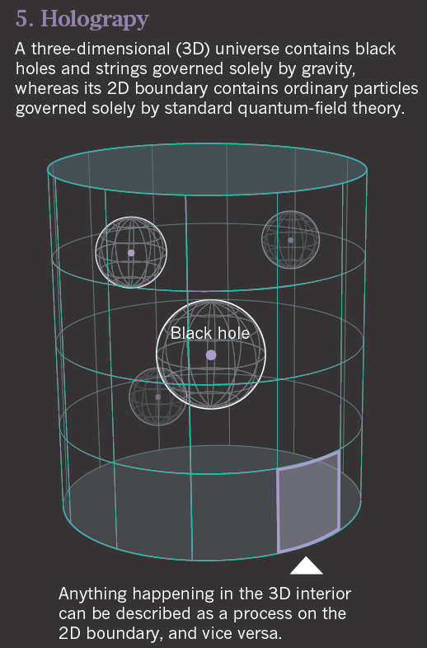
Holographic principle
From Nature 2013

Slide 10
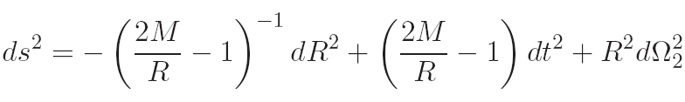



Interior dynamics
Static metric of inside Schwarzschild black holes
Make the change of the coordinates
The interior metric becomes
Compared with the FRW metric
The interior of a Schwarzschild black hole can be considered as a collapsing universe
S. M. Carroll, et al, J. High Energy Phys. 11 (2009) 094

Slide 11
Equilibrium and volume
Black hole radiation can be considered as equilibrium state
Equilibrium means there exists a time-like Killing vector
Mathematically, define a volume
Thermodynamically, exist a volume

Slide 12





Volume of black holes
The volume should be slicing invariant
To avoid the singularity of the horizon, a change has to be made for the Schwarzschild coordinates
The differential spacetime volume
The suggested volume of black holes
Application
M. K. Parikh, Phys. Rev. D 73, 124021 (2006)

Slide 13
Other definition of volume
Kodama volume
Null generator volume
Vector volume
Thermodynamic volume
others
S. A. Hayward, Classical Quantum Gravity 15, 3147 (1998).
W. Ballik and K. Lake, arXiv: 1005.1116
W. Ballik and K. Lake, Phys. Rev. D 88, 104038 (2013)
M. Cvetic, et al, Phys. Rev. D 84, 024037 (2009)

Slide 14


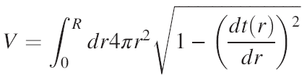
Volume of Collapsing black holes
The volume inside a two-sphere S is the volume of the largest spacelike spherically-symmetric surface bounded by S.
For collapsing black holes,
Parameterization,
The suggested volume expression
The example in flat spacetime

Slide 15








Maximal slicing
Maximization with an auxiliary manifold
Maximal slicing which have vanishing mean extrinsic curvature

Slide 16

CR Volume
The volume for collapsing black holes
For Schwarzschild black holes, it is a very large volume, so is there enough degrees of freedom in such space for the interpretation of BH entropy?

Slide 17



Asymptotic static
The inner metric which is not static
Is it possible to describe quantum states inside?
Thus it makes sense for entropy in the volume

Slide 18






Entropy in the volume
Due to uncertainty relation, one quantum state corresponds to a “cell” of volume, so the number of quantum states in the phase space labeled by
Consider scalar fields, a constraint from Klein-Gordon Eq.
The number of quantum states with energy less than E is

Slide 19
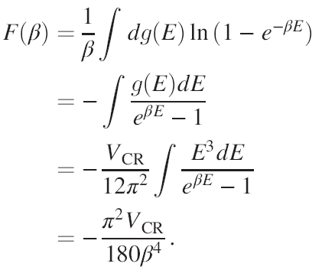

Entropy in the volume
Ignore the exotic feature of CR volume, and the free energy
Then the entropy is obtained as

Slide 20




Entropy in the volume
The volume for Schwarzschild black holes
The loss mass rate and Stefan-Boltzmann law
For a black hole with mass M, we have
Thus the entropy is
It is surprised that the entropy associated with the CR volume is proportional to the surface area!

Slide 21

Then how should we understand such entropy?

Slide 22
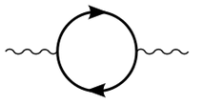
Vacuum polarization
In quantum field, vacuum polarization describes a process in which some virtual particle pairs are created
It is confirmed experimentally by Lamb shift, the anomalous magnetic dipole moment of the electron, Casimir effect, ……
In curved spacetime background, the polarization of the vacuum can be induced by gravitation

Slide 23
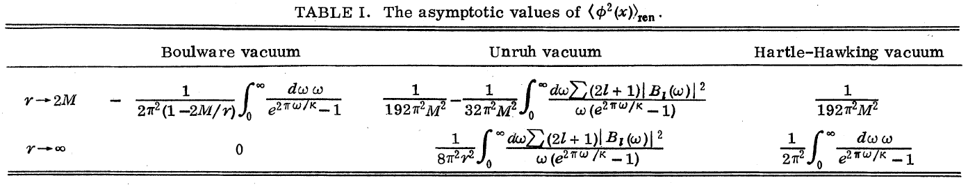
Three kinds of vacuum states
Boulware vacuum
Unruh vacuum
Hartle-Hawking vacuum
P. Candelas, Phys. Rev. D 21, 2185 (1980).

Slide 24
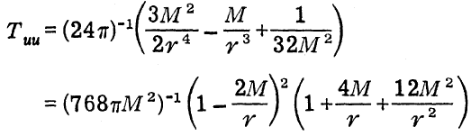



Hawking radiation
The originally obtained black hole radiation by Hawking is through Bogolubov transformations
Vacuum polarization can give Hawking radiation
The resulting temperature
P. C. W. Davies, et al, Phys. Rev. D 13, 2720 (1976); A. Fabbri, et al, Phys. Lett. B 574, 309 (2003)

Slide 25



Physical effect from vacuum polarization
Vacuum polarization near the horizon causes quantum pressure on the horizon
This leads to such term for black hole thermodynamics
Compared with the change from entropy
T. Elster, Phys. Lett. A 94, 205 (1983)

Slide 26


“New” Thermodynamics
First law of black hole thermodynamics
It is remembered that entropy associated with the CR volume also contributes to the thermodynamics.

Slide 27



“New” Thermodynamics
New forms with the CR volume considered
Thus it provides an thermodynamic interpretation
for vacuum polarization near the horizon!

Slide 28
Summary and discussion
The entropy associated with CR volume is proportional to the surface area of the black hole
It cannot interpret BH entropy, but related to the thermodynamics caused by vacuum polarization near EH
These verify further that no enough degrees of freedom inside BH for the interpretation of BH entropy
It reminds us of the recent suggestion that the information should be stored at the horizon by Hawking, et al, which seem relevant to the firewall paradox

Slide 29

Thank you!

