Slide 1

Heisenberg-scaled magnetometer with dipolar spin-1 condensates
2017.12.1@USTC
Su Yi
Institute of Theoretical Physics, CAS
Xing, Wang, Tan, Zhang, and Yi, PRA 93, 043615 (2016)

Slide 2
Outline
Introduction
Dipolar spinor condensates
Our scheme for magnetometer
  Initial state preparation
  Parametrization
  Measurement
  Parameter estimation
  Results
Summary

Slide 3
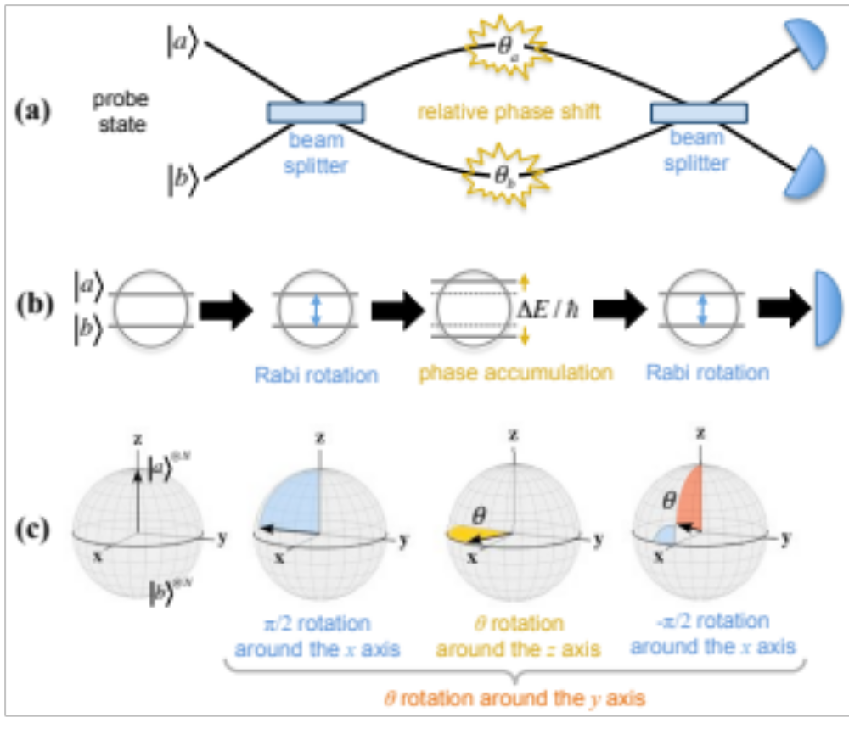
Interferometry

Slide 4


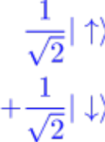
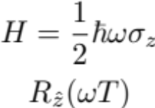
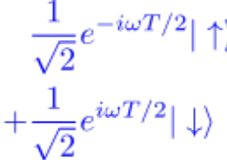




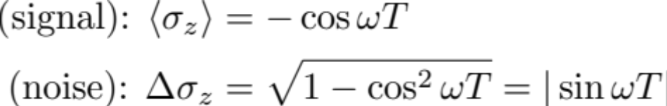
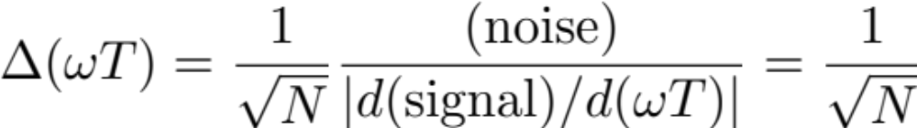
Ramsey interferometry
N independent atoms
Shot-noise limit

Slide 5

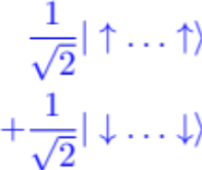
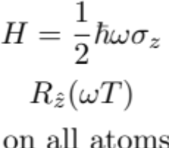
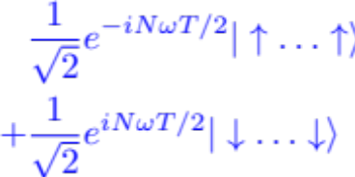


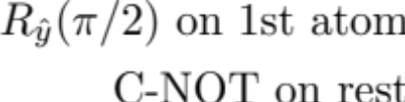
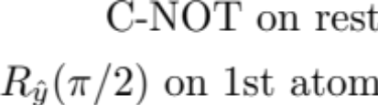
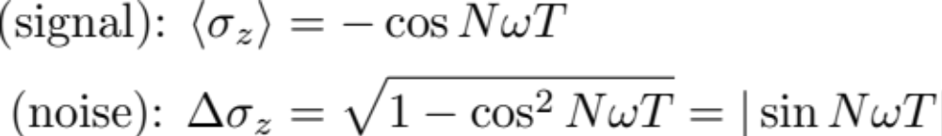
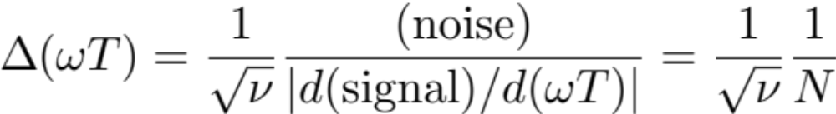

Cat-state Ramsey interferometry
Cat state
N atoms
Fringe pattern with period 2𝝅/N
𝝂 = number of trials
Heisenberg limit
N cat-state atoms

Slide 6
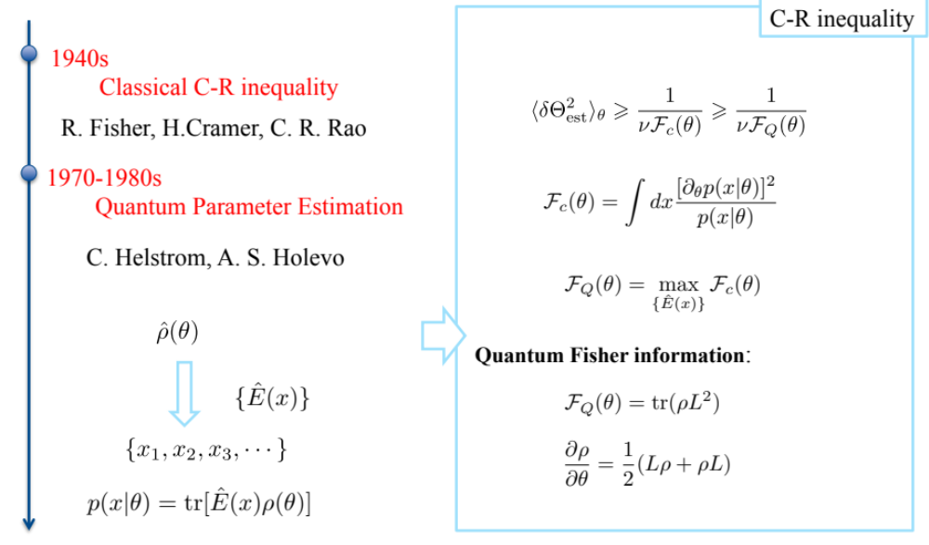
Parameter estimation

Slide 7
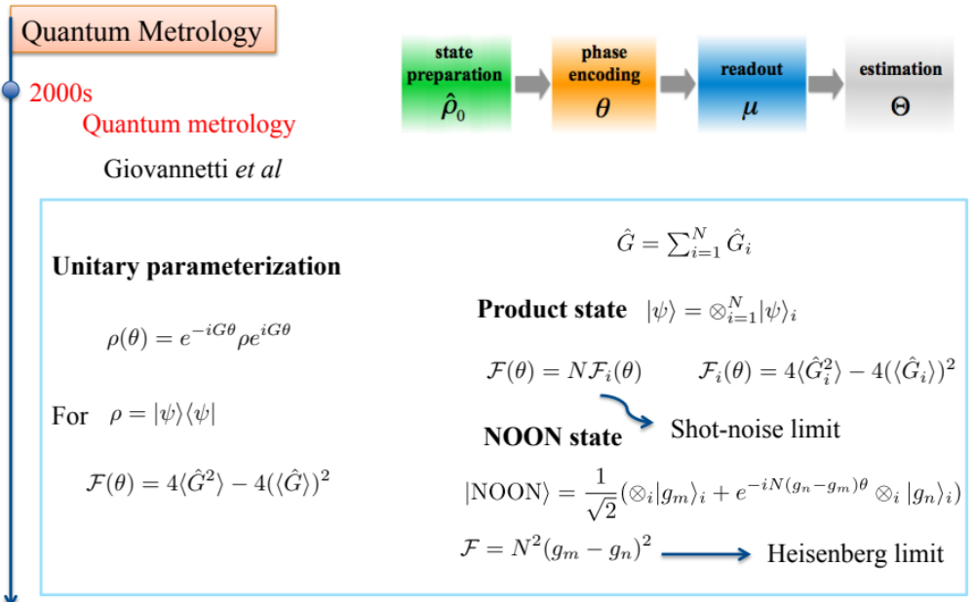
Quantum metrology
V. Giovannetti, et al., Science 306, 1330 (2004); PRL 96, 010401 (2006); Nat. Photon. 5, 222 (2011).

Slide 8
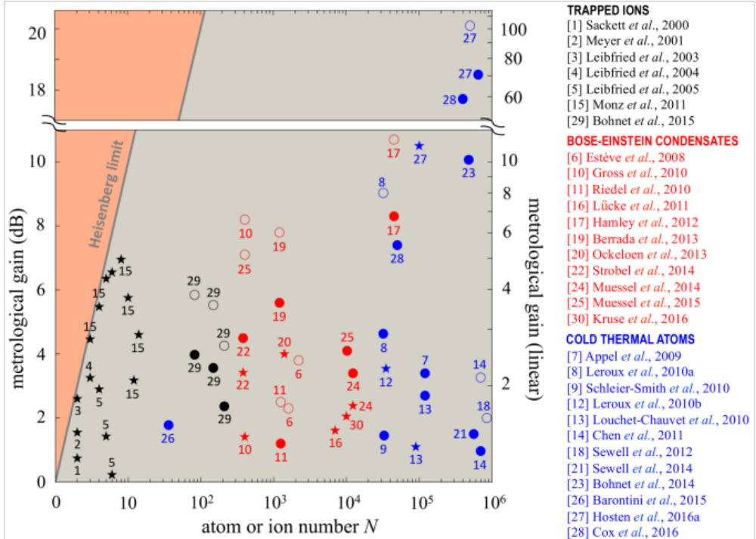
Experimental achievements
L. Pezze et al., arXiv: 1609.01609

Slide 9
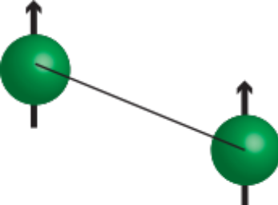

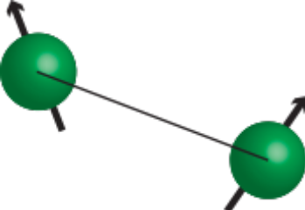



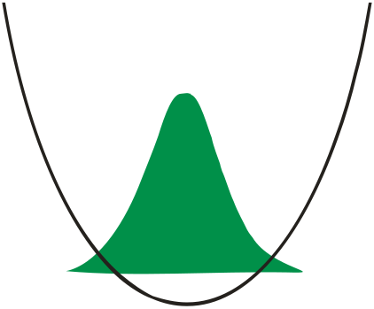

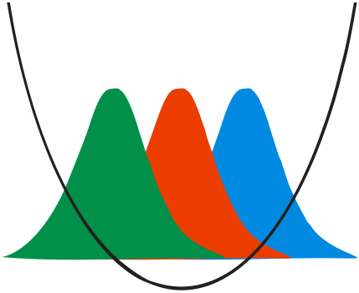

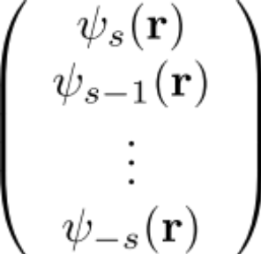

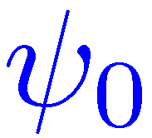
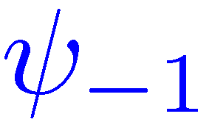

Spinor condensate

Slide 10

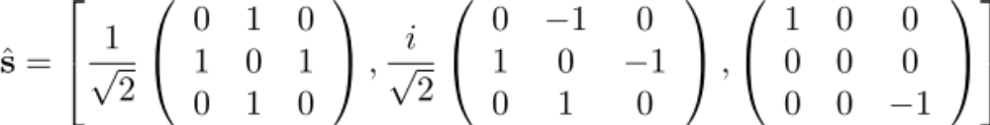

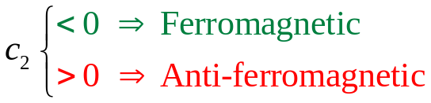
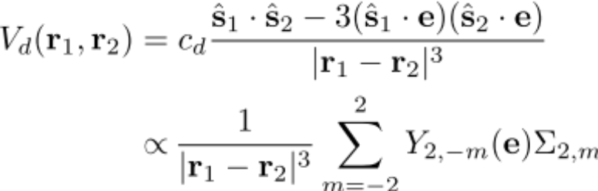
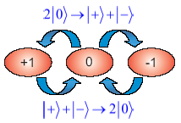
Spinor condensates
contact interactions
dipolar interaction
Σ_{2,m} is a spherical tensor of rank 2 made up from two spin operators
Ho, PRL 81, 742 (1998).
Ohmi et al., J. Phys. Soc. Jpn. 67, 1822 (1998).

Slide 11
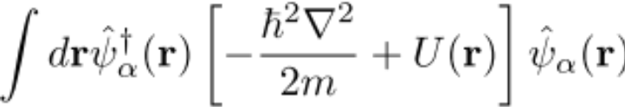
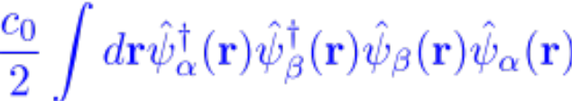
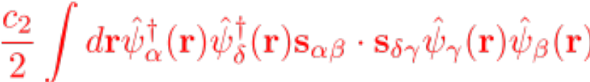
Total Hamiltonian

Slide 12


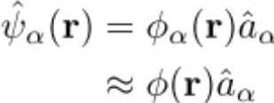
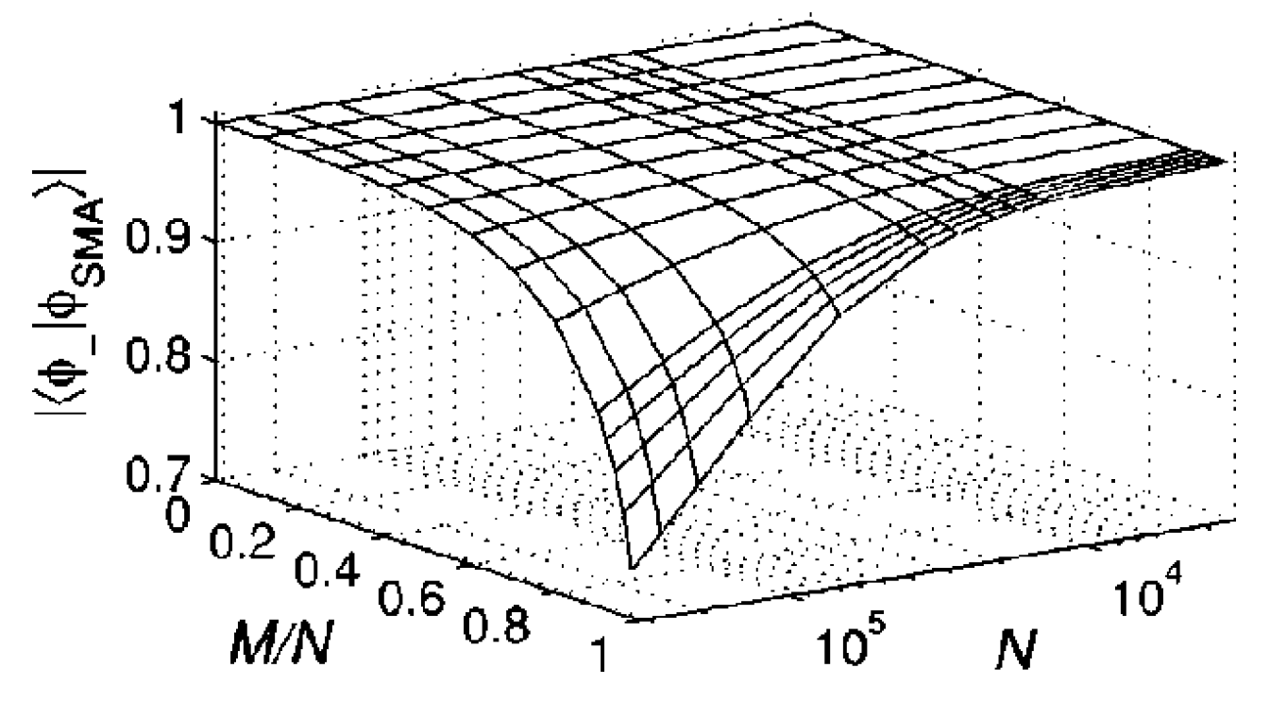

Single-mode approximation (SMA)
spin-independent:
SMA: all spin components share a common spatial mode function
spin-dependent:
Spins and SMA:
Law et al., PRL 81, 5257 (1998).
Yi et al., PRA 66, 011601 (2002).

Slide 13

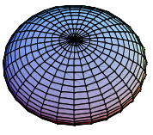
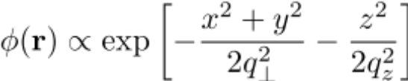

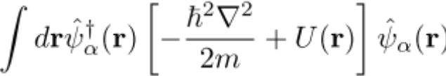





Hamiltonian in SMA
SMA:
Atom number:

Slide 14
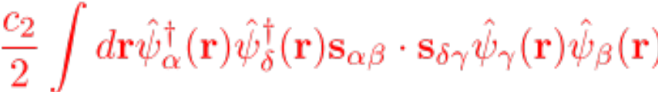

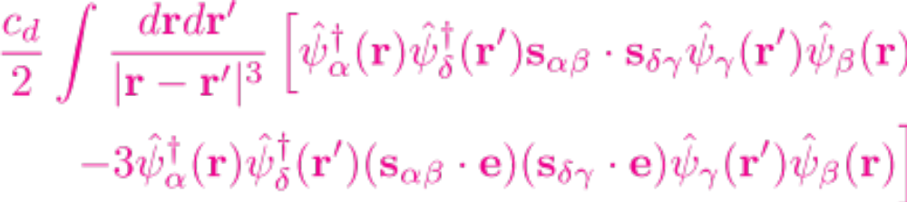

Spin-dependent Hamiltonian
Spin angular momentum:

Slide 15
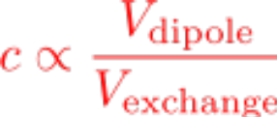


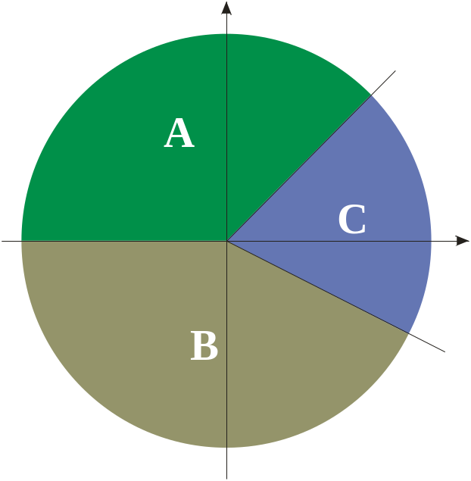




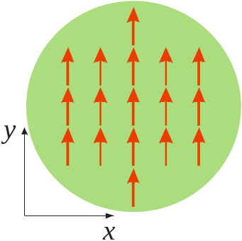
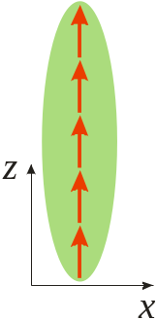

Uniaxial quantum magnet
A: ferromagnetic
B: ferromagnetic
C: anti-ferromagnetic
Yi, You, and Pu, PRL 93, 040403 (2004).

Slide 16



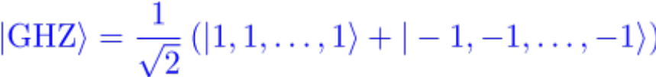



Creating entangled state using spin-1 atom
Pair of entangled atoms:
Pu et al., PRL 85, 3987 (2000).
Duan et al., PRL 85, 3991 (2000).
Many entangled atoms:
You, PRL 90, 030402 (2003).
Zhang and You, PRL 91, 230404 (2004).

Slide 17


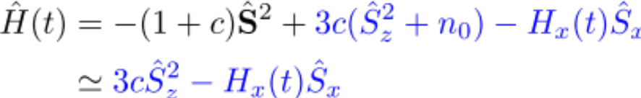

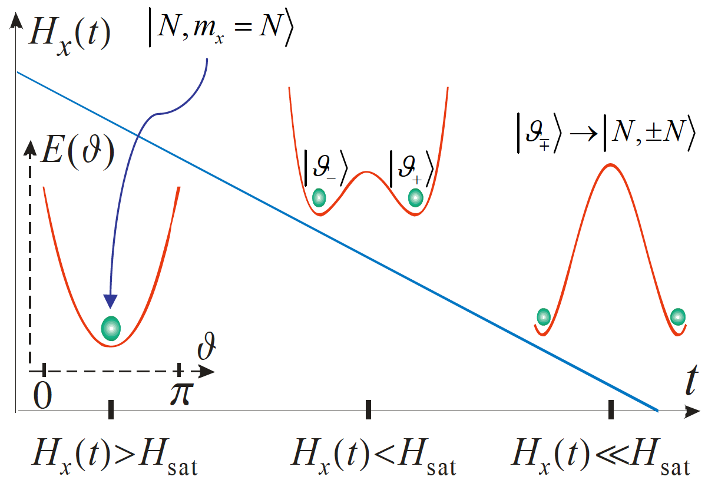
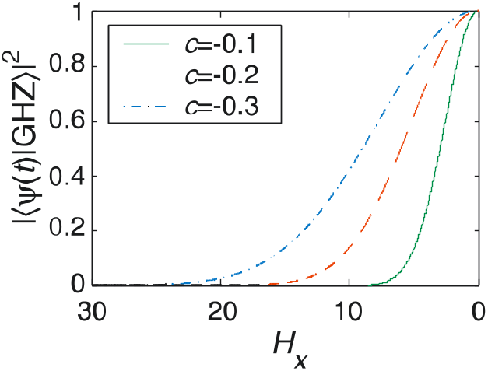
GHZ state with dipolar interaction
Zero H_{x}
Classical case
Large H_{x}
Yi and Pu, PRA 73, 023602 (2006)

Slide 18
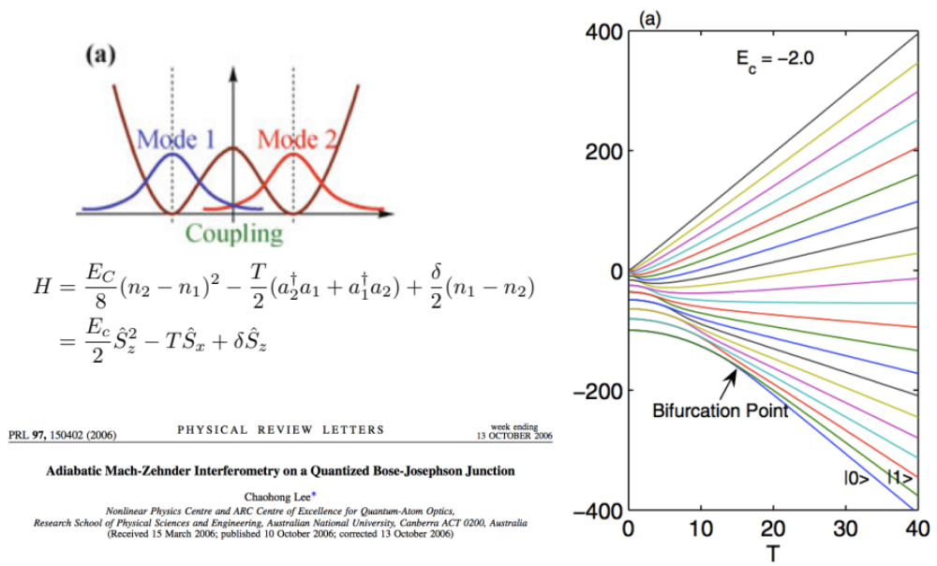
Adiabatic Mach-Zehnder interferometry

Slide 19
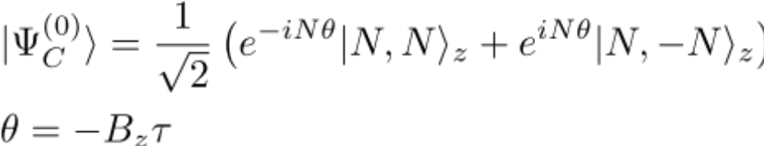

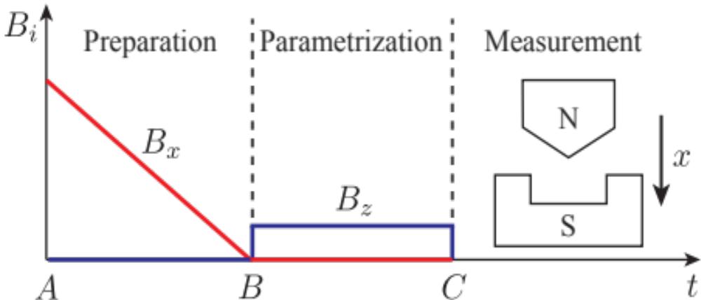
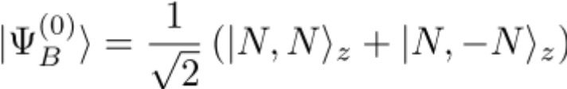
Our scheme

Slide 20
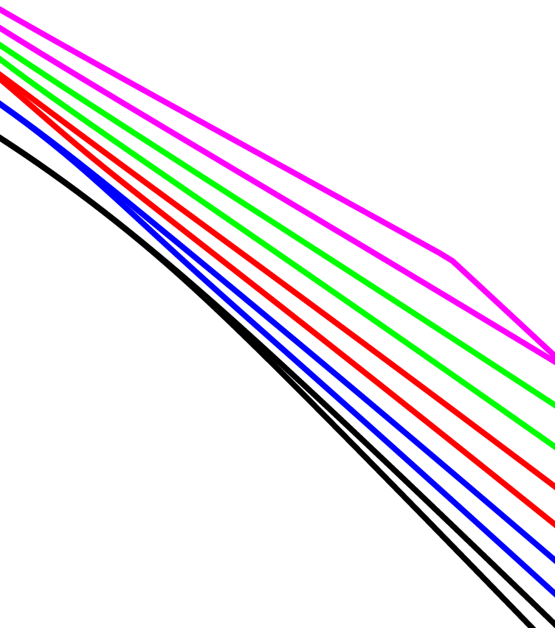

Energy spectrum

Slide 21



Parity operator
Fock state basis:
Definition:
Properties:

Slide 22




Parity of a state
In the basis
In the basis

Slide 23





State preparation
✗

Slide 24




Parametrization

Slide 25










Alternative form of the state

Slide 26




Measurement
Observable to be measured:
Expectation value:
Variance:

Slide 27



Parameter estimation
Estimator:
Variance of the estimator:
Heisenberg limit:

Slide 28




General cases:
Estimator:
Variance:

Slide 29



Fisher information
Reduced Fisher information:
Heisenberg scaled variance:

Slide 30





Parameter specification
Rb87 atom
Units for time:
Initial B-field:
Sweeping rate:
Time required for state preparation:
1.7 s

Slide 31




Fisher information vs N

Slide 32



Fisher information vs sweeping rate

Slide 33







Stray fields
Pulse

Slide 34
Summary
Propose a Heisenberg scaled magnetometer
Find a parity symmetry which ensures that the initial states have a relatively large Fisher information
Better performance with large number of atoms
Accessible with current experimental technique

Slide 35
Thank you for your attention

