Slide 1
A new plane symmetric solution and its application in cosmology
张宏升
上海师范大学
Ref: PLB663 (2008) 291; 670 (2009) 271;
671 (2009) 428; 679 (2009) 81; 700 (2011) 97

Slide 2
Outline
Taub solution
Generalized ADS as the source of Taub
The third brane model

Slide 3
Plane symmetry
A metric which permits 3 Killing vectors: two for translations and one for rotation.
For vacuum case, one can prove there exists the 4th Killing vector, as the Birkhoff theorem in spherical case.

Slide 4
Taub solution

Slide 5
Taub’s theorem
A perfect fluid cannot bound a vacuum in a space with plane symmetry unless the boundary condition of the continuity of the derivatives of the metric tensor is violated.

Slide 6
Dolgov and Khriplovich’s theorem
Any singularity free source with reflective symmetry for plane symmetric vacuum space does not exist.
A.D. Dolgov, I.B. Khriplovich, Gen. Relativ. Gravit. 21 (1989) 13.

Slide 7
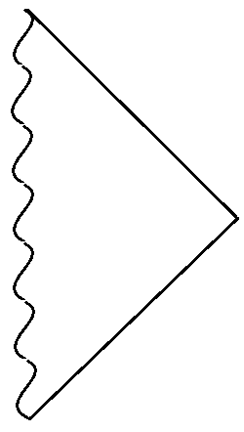
Penrose diagram

Slide 8
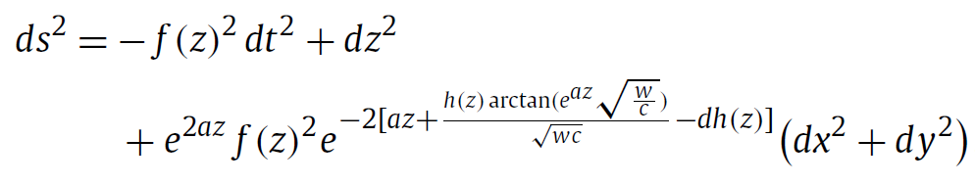
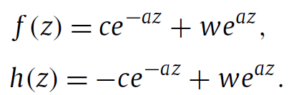
A new plane symmetric solution sourced by a perfect fluid

Slide 9
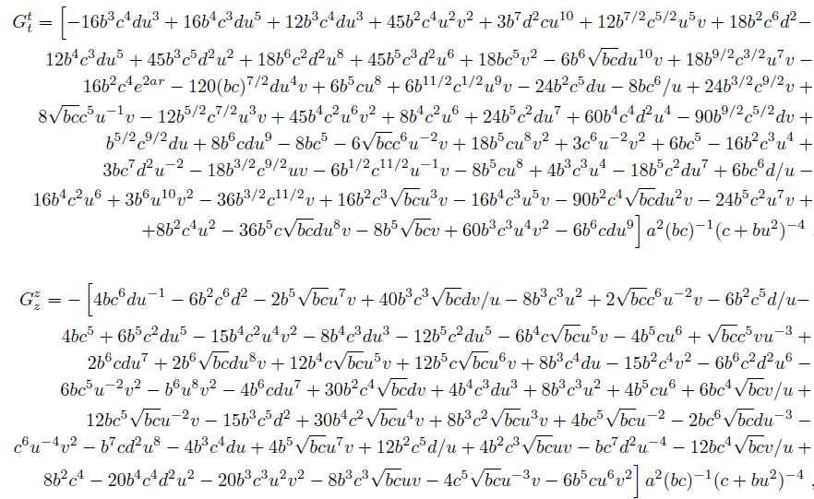
Stress tensor

Slide 10
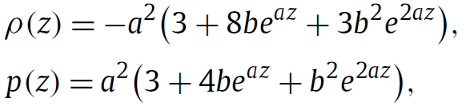
A simplified class

Slide 11
Reduced cases
a=0 Minkowski
b=0 Anti-de Sitter
It can be regarded as a generalization of ADS. Thus we call it GADS

Slide 12
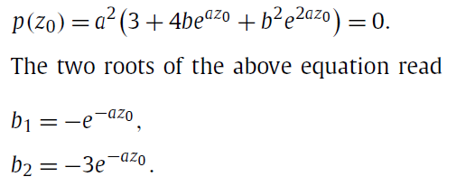
Match to vacuum space
Pressure should vanish on the ground, while density can keep a non-zero number.

Slide 13


Match to Taub
Boundary conditions
1. The metric is continuous
2. The jump condition

Slide 14
Conclusion
This new plane solution is a proper source of Taub space.

Slide 15
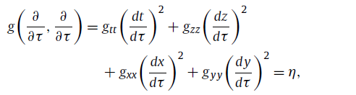
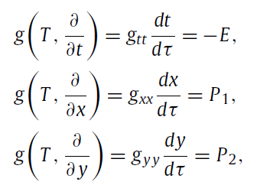
Geodesics
Contraction of the tangent vector

Slide 16
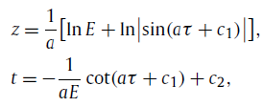


Geodesics along z-direction
3-velocity

Slide 17
Example of global equivalence principle
We can not differentiate gravity or acceleration field.
Reparametrization of time can reach a “constant acceleration” in 1+3 language.

Slide 18
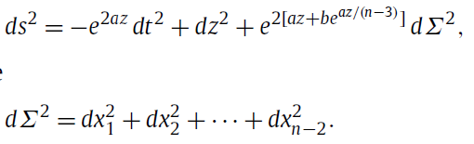
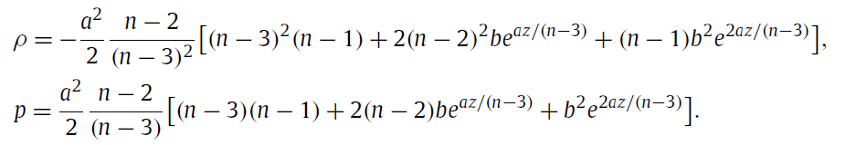
Higher dimensional case

Slide 19


Junction condition

Slide 20
The background of Brane universe
Type I: (A)dS, for example Randall-Sundrum
Type II: Minkowski, for example DGP
The necessary condition for Brane model: the background permits a maximal symmetric 3-space, which serves as our space.

Slide 21
The third brane
The brane in 5d Taub and GADS

Slide 22
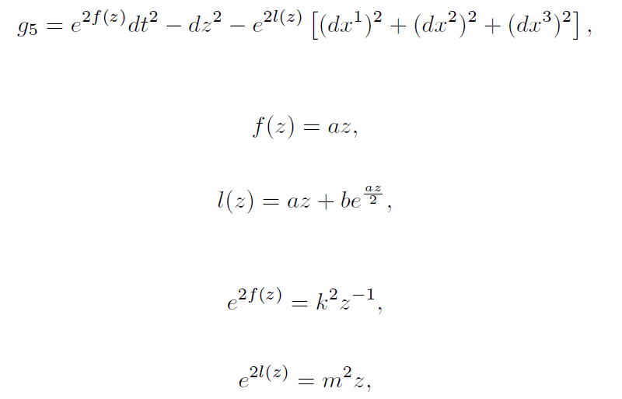
Taub and GADS bulk

Slide 23







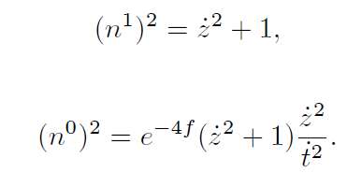
Moving brane in Taub and GADS bulk

Slide 24


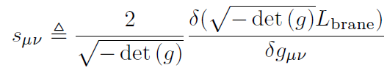
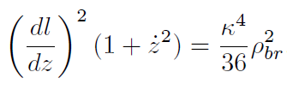

Slide 25
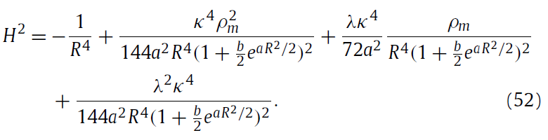
GADS brane

Slide 26
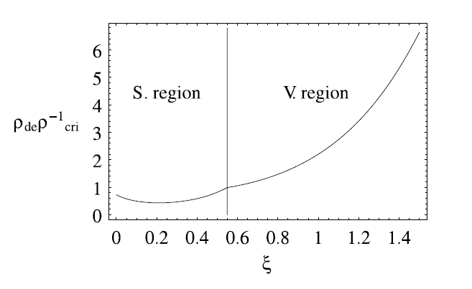
Density evolution

Slide 27
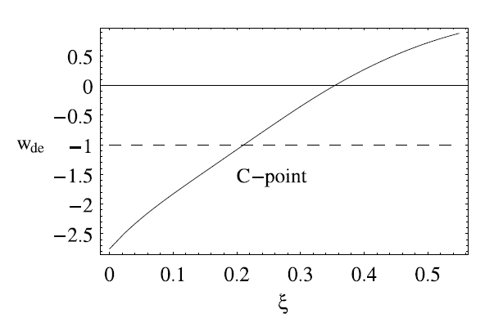
Evolution of W_de

Slide 28
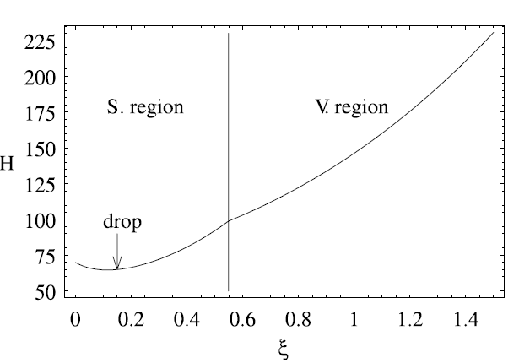
Evolution of H

Slide 29
Thank you for your attention!

