Slide 1
Towards the Physical Vacuum of Cosmic Inflation
Yi Wang, HKUST, 2016-04-07
References:
1507.05193 with Hongliang Jiang;
1601.01179 with Hongliang Jiang and Siyi Zhou
work in progress with Ziwei Wang and Siyi Zhou

Slide 2
What’s wrong with the inflationary vacuum?

Slide 3
What’s wrong with the inflationary vacuum?
-- Nothing is wrong if you don’t care
Inflation is an attractor solution
Bunch-Davies works well (lowest energy state)
Higher energy states diluted

Slide 4
What’s wrong with the inflationary vacuum?
-- Nothing is wrong if you don’t care
Inflation is an attractor solution
Bunch-Davies works well (lowest energy state)
Higher energy states diluted
-- But everything is wrong when you care
Assuming linear order perturbations

Slide 5
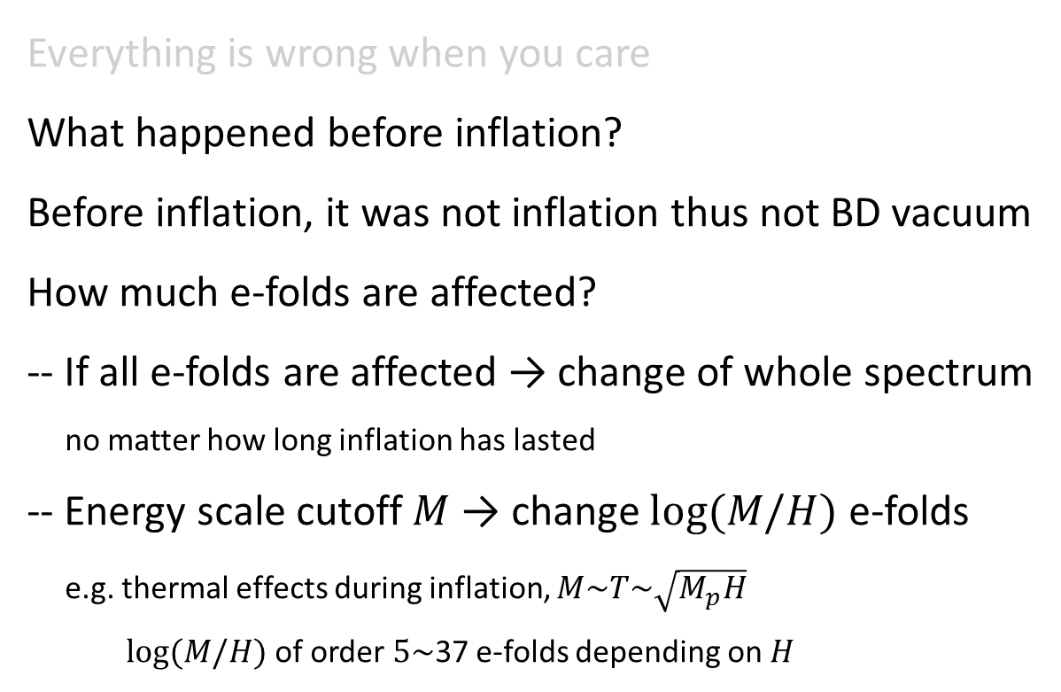
Everything is wrong when you care
What happened before inflation?
Before inflation, it was not inflation thus not BD vacuum
How much e-folds are affected?
-- If all e-folds are affected → change of whole spectrum
no matter how long inflation has lasted
-- Energy scale cutoff $M$ → change $log⁡(M/H)$ e-folds
e.g. thermal effects during inflation, $M\sim T\sim \sqrt{M_{p}H}$
$log⁡(M/H)$ of order $5\sim$37 e-folds depending on $H$

Slide 6
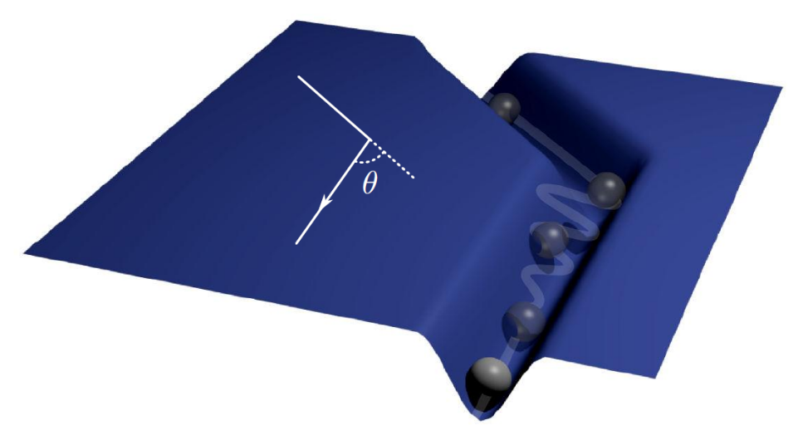
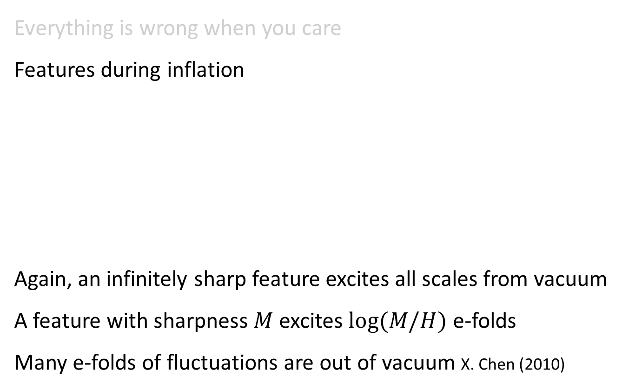
Everything is wrong when you care
Features during inflation
Again, an infinitely sharp feature excites all scales from vacuum
A feature with sharpness $M$ excites $log⁡(M/H)$ e-folds
Many e-folds of fluctuations are out of vacuum X. Chen (2010)

Slide 7
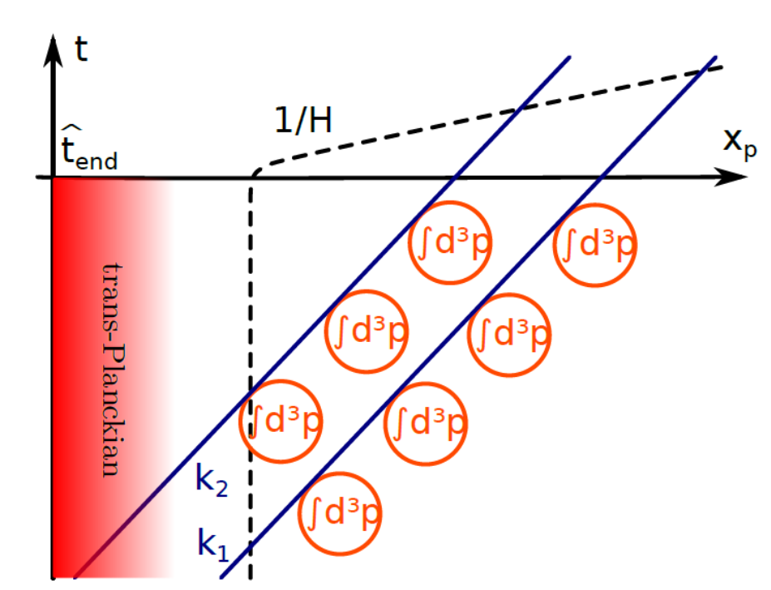
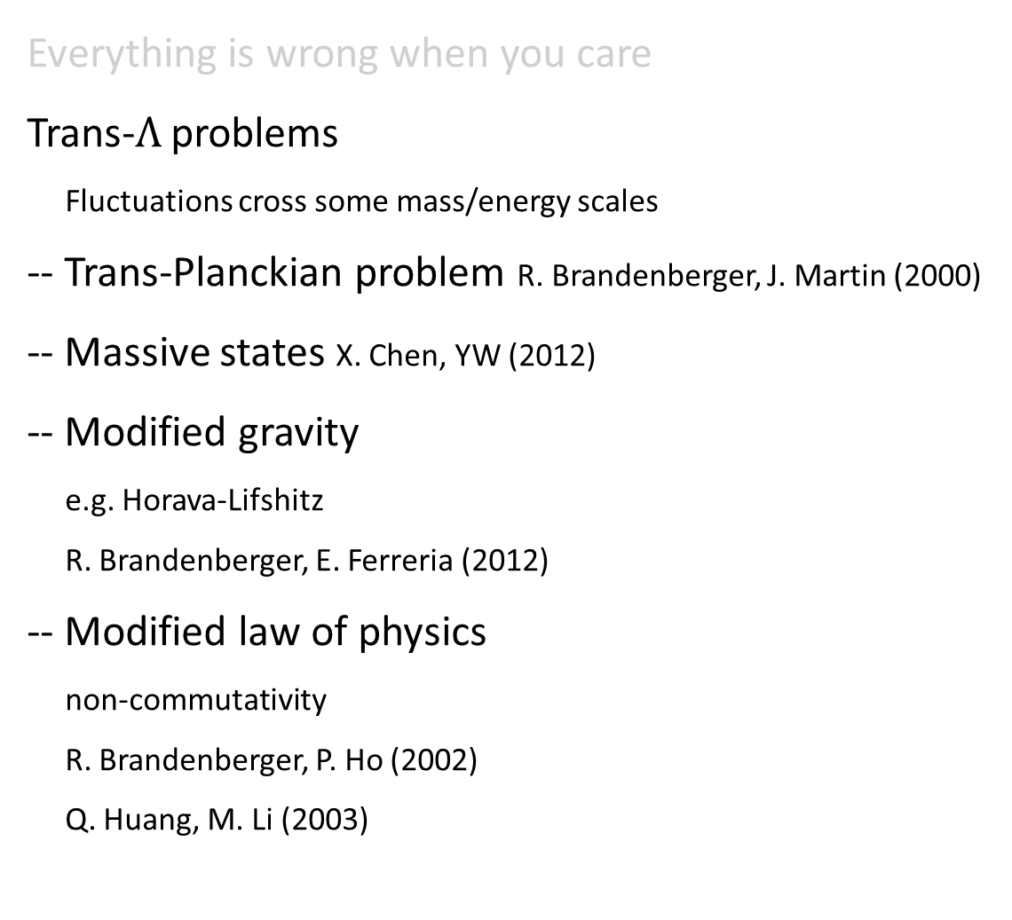
Everything is wrong when you care
Trans-$Λ$ problems
Fluctuations cross some mass/energy scales
-- Trans-Planckian problem R. Brandenberger, J. Martin (2000)
-- Massive states X. Chen, YW (2012)
-- Modified gravity
e.g. Horava-Lifshitz
R. Brandenberger, E. Ferreria (2012)
-- Modified law of physics
non-commutativity
R. Brandenberger, P. Ho (2002)
Q. Huang, M. Li (2003)

Slide 8
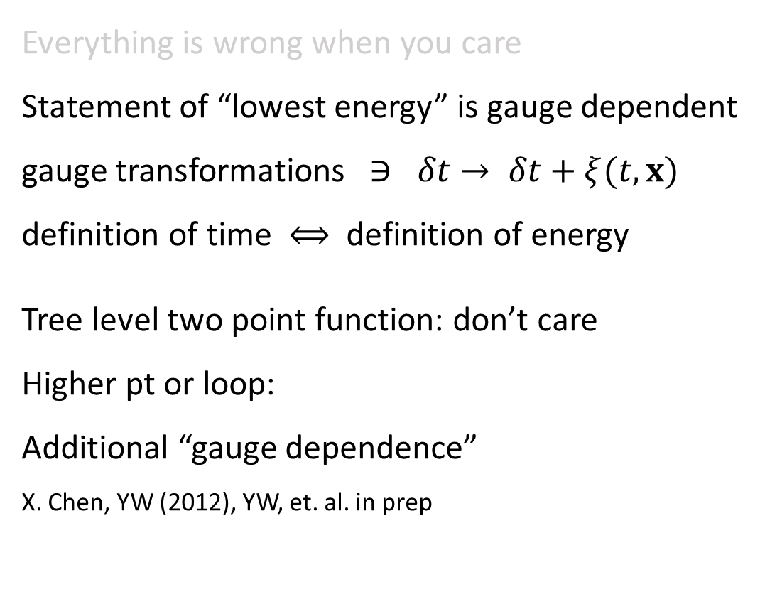
Everything is wrong when you care
Statement of “lowest energy” is gauge dependent
gauge transformations $∋ δt→ δt+ξ(t,x)$
definition of time $⟺$ definition of energy
Tree level two point function: don’t care
Higher pt or loop:
Additional “gauge dependence”
X. Chen, YW (2012), YW, et. al. in prep

Slide 9
How to reconcile the opinions of care/don’t care?
How to determine the physical vacuum of inflation?

Slide 10
Find out the stable state which does not decay

Slide 11


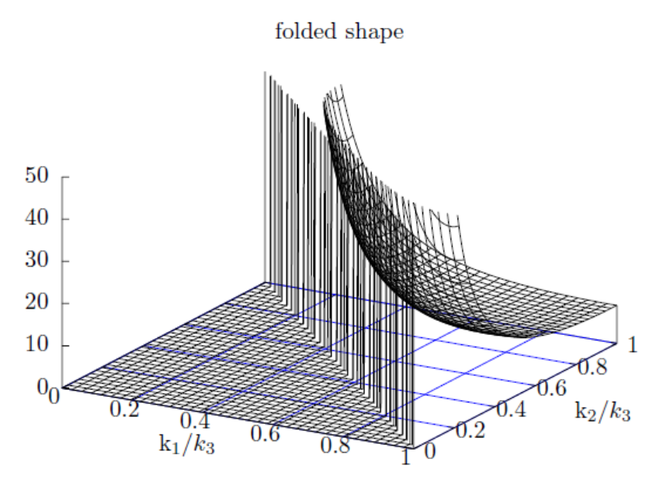
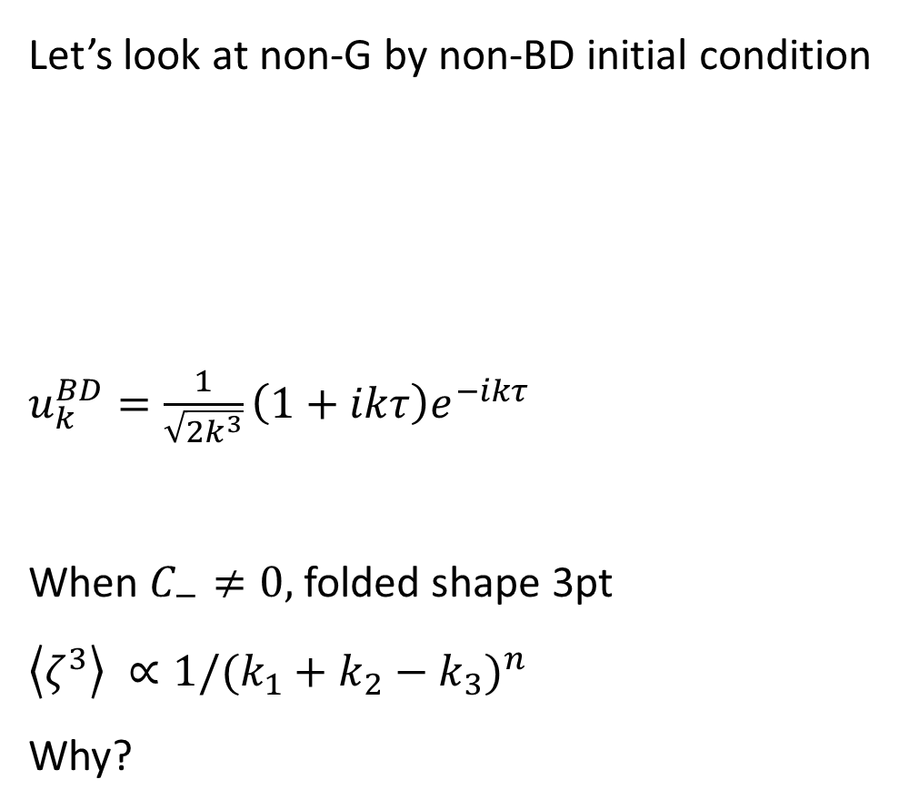
Let’s look at non-G by non-BD initial condition
$u_{k}^{BD}=\frac{1}{\sqrt{2k^{3}}}\left(1+ikτ\right)e^{−ikτ}$
When $C_{−}≠0,$ folded shape 3pt
$\left\langle ζ^{3}\right\rangle ∝1/{(k_{1}+k_{2}−k_{3})}^{n}$
Why?

Slide 12
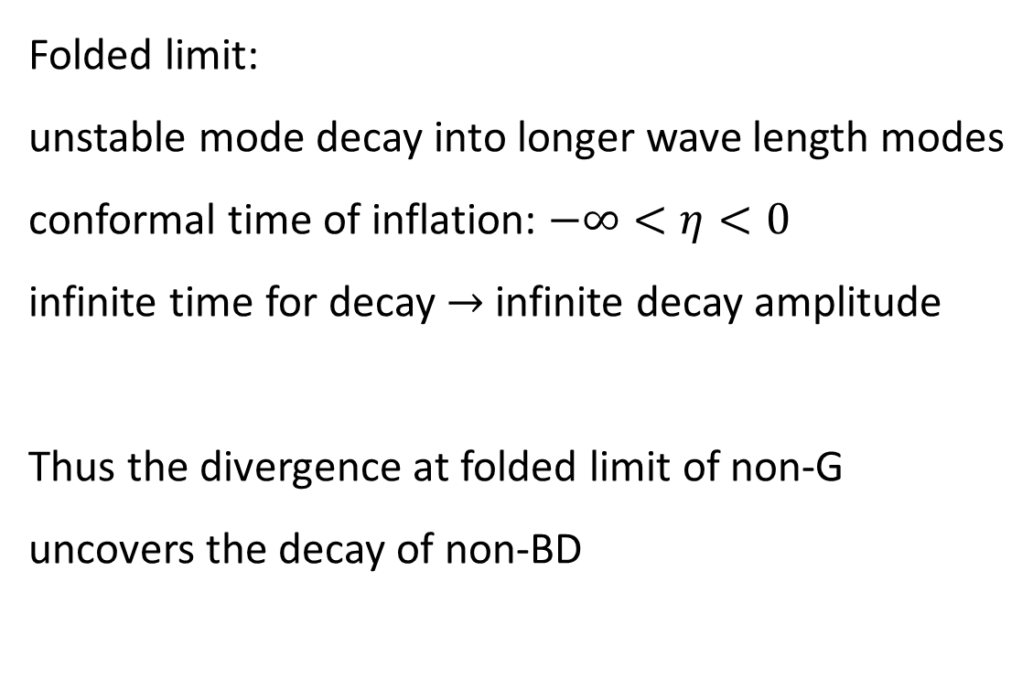
Folded limit:
unstable mode decay into longer wave length modes
conformal time of inflation: $−∞<η<0$
infinite time for decay $→$ infinite decay amplitude
Thus the divergence at folded limit of non-G
uncovers the decay of non-BD

Slide 13
How to make it explicit and quantitative?

Slide 14
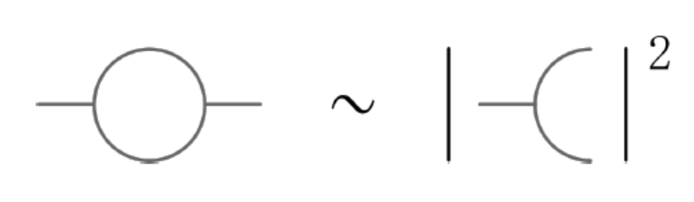
Integrate all the decay products, to see
how much the initial state decayed.
Practically, it is equivalent to one-loop correction
to two point function
Im
(See also Armendariz-Picon 2006)

Slide 15
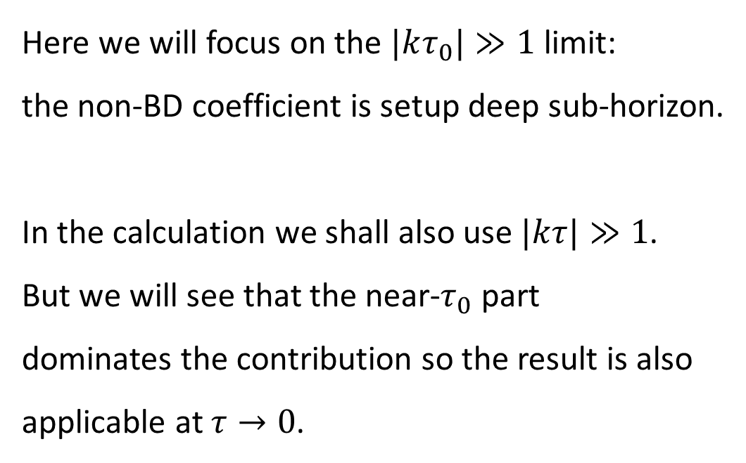
Here we will focus on the $|kτ_{0}|≫1$ limit:
the non-BD coefficient is setup deep sub-horizon.
In the calculation we shall also use $|kτ|≫1$.
But we will see that the near-$τ_{0}$ part
dominates the contribution so the result is also
applicable at $τ→0$.

Slide 16


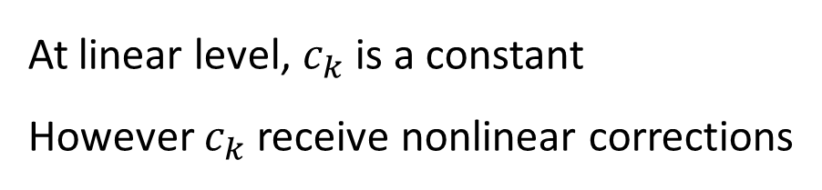
At linear level, $c_{k}$ is a constant
However $c_{k}$ receive nonlinear corrections

Slide 17

At linear level, $c_{k}$ is a constant
However $c_{k}$ receive nonlinear corrections

Slide 18




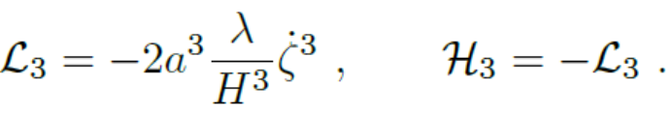
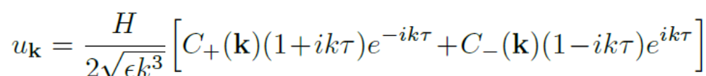

We calculate the corrections in a simple model
with , i.e.
Garraga, Mukhanov (1999)
Chen, Huang, Kachru, Shiu (2006)
up to linear order

Slide 19
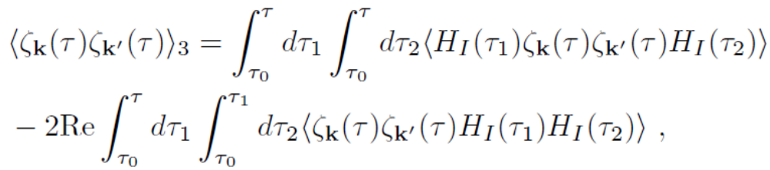
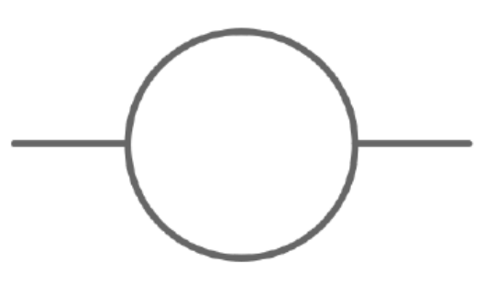



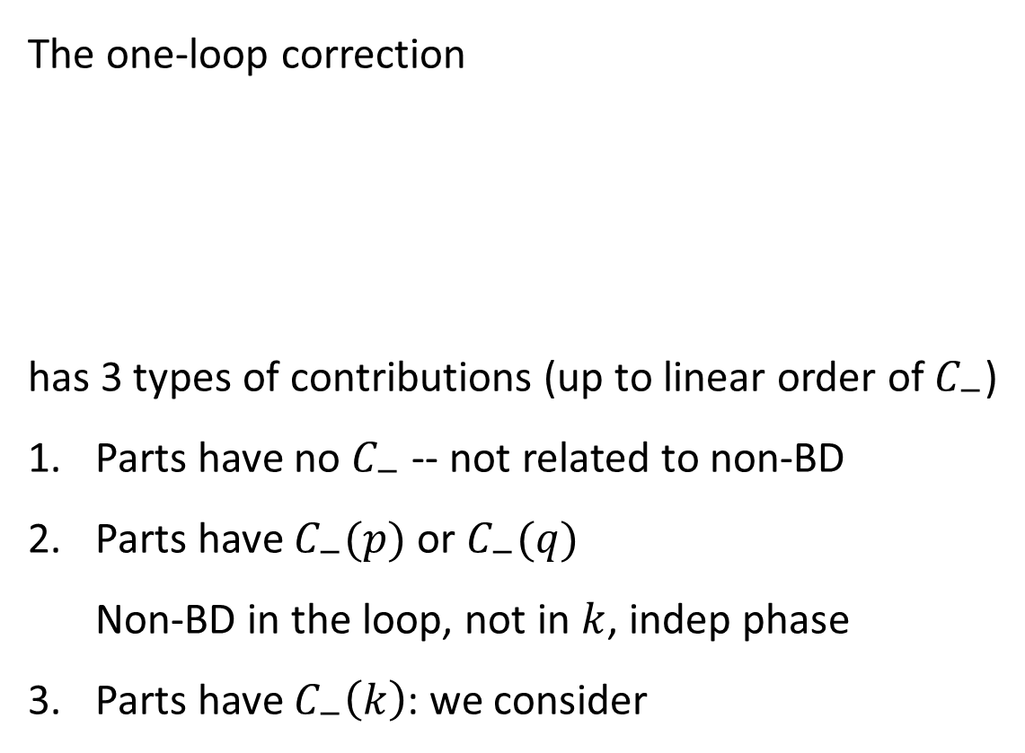
The one-loop correction
has 3 types of contributions (up to linear order of $C_{−}$)
Parts have no $C_{−}$ -- not related to non-BD
Parts have $C_{−}(p)$ or $C_{−}(q)$
  Non-BD in the loop, not in $k$, indep phase
Parts have $C_{−}\left(k\right)$: we consider
$$p$$
$$k$$
$$q$$

Slide 20
The one-loop correction
has 3 types of contributions (up to linear order of $C_{−}$)
Parts have no $C_{−}$ -- not related to non-BD
Parts have $C_{−}(p)$ or $C_{−}(q)$
  Non-BD in the loop, not in $k$, indep phase
Parts have $C_{−}\left(k\right)$: we consider
(may be important for equilibrium cases!)
$$p$$
$$k$$
$$q$$

Slide 21
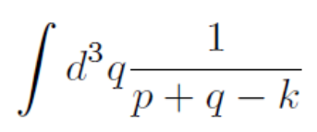
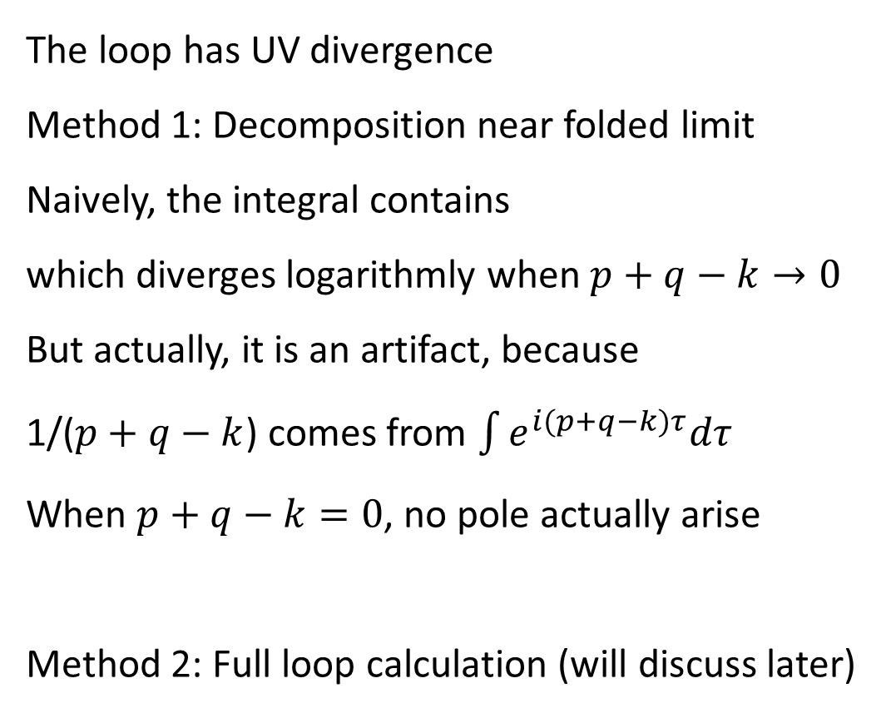



The loop has UV divergence
Method 1: Decomposition near folded limit
Naively, the integral contains
which diverges logarithmly when $p+q−k→0$
But actually, it is an artifact, because
1/($p+q−k$) comes from $\int{e^{i(p+q−k)τ}dτ}$
When $p+q−k=0$, no pole actually arise
Method 2: Full loop calculation (will discuss later)
$$p$$
$$k$$
$$q$$

Slide 22
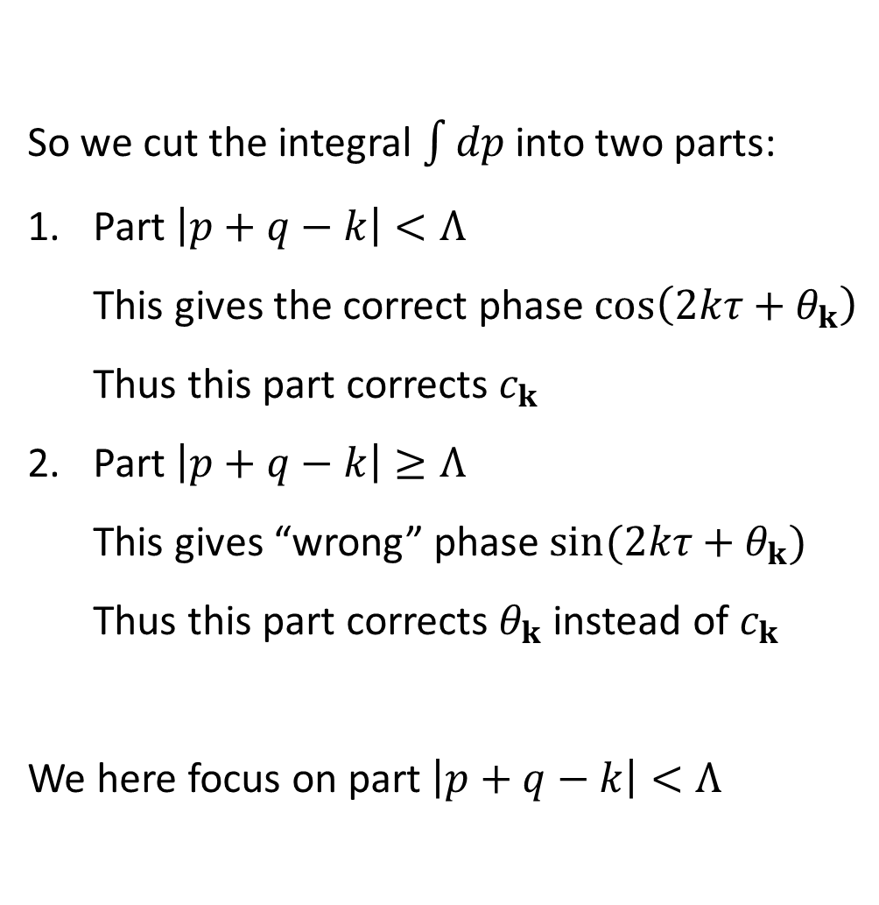
So we cut the integral $\int{dp}$ into two parts:
Part $\left|p+q−k\right|<Λ$
  This gives the correct phase $\cos\left(2kτ+θ_{k}\right)$
  Thus this part corrects $c_{k}$
Part $\left|p+q−k\right|≥Λ$
  This gives “wrong” phase $sin⁡(2kτ+θ_{k})$
  Thus this part corrects $θ_{k}$ instead of $c_{k}$
We here focus on part $\left|p+q−k\right|<Λ$
$$p$$
$$k$$
$$q$$

Slide 23
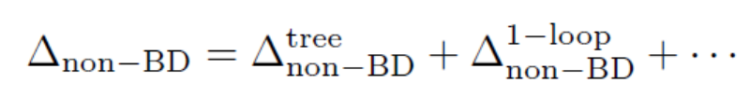
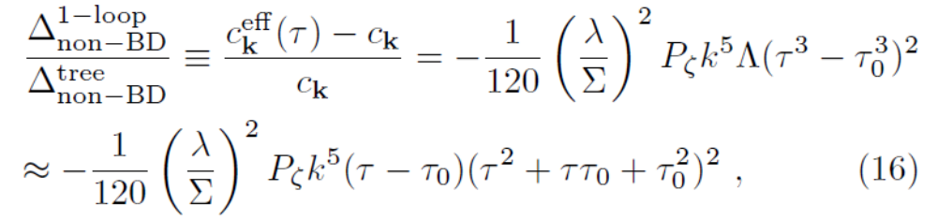

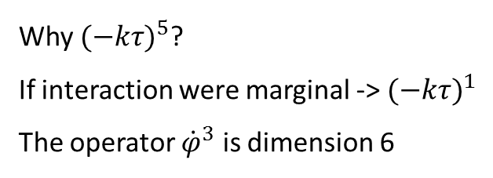
Why ${(−kτ)}^{5}$?
If interaction were marginal -> ${(−kτ)}^{1}$
The operator ${\dot{φ}}^{3}$ is dimension 6
This calculation is up to an order one constant.
The constant is recovered in a precise calculation.

Slide 24
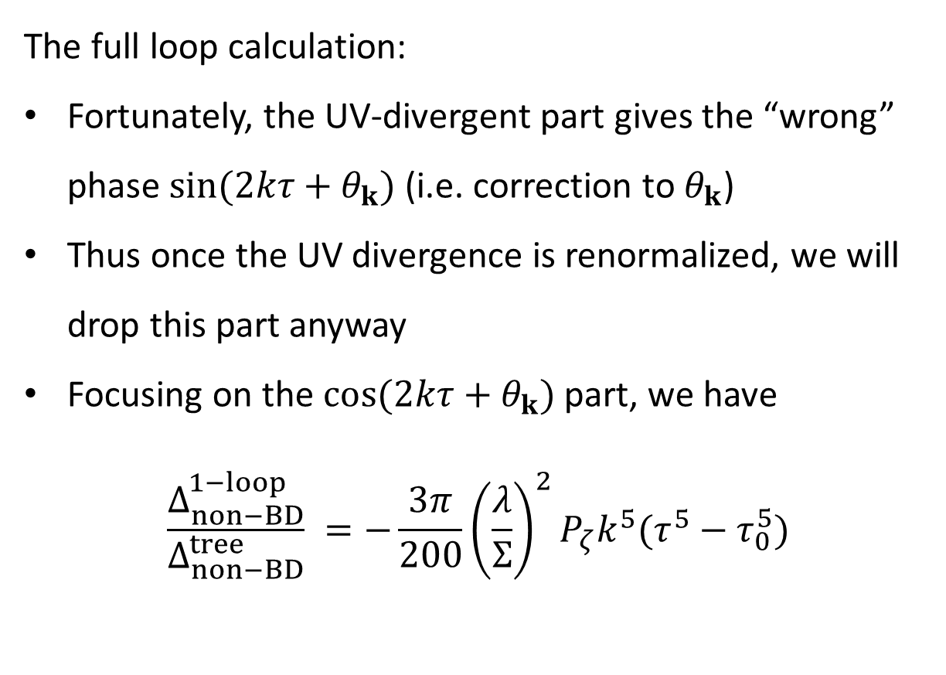
The full loop calculation:
Fortunately, the UV-divergent part gives the “wrong” phase $sin⁡(2kτ+θ_{k})$ (i.e. correction to $θ_{k}$)
Thus once the UV divergence is renormalized, we will drop this part anyway
Focusing on the $cos⁡(2kτ+θ_{k})$ part, we have
$$\frac{Δ_{non−BD}^{1−loop}}{Δ_{non−BD}^{tree}} =−\frac{3π}{200}{\left(\frac{λ}{Σ}\right)}^{2}P_{ζ}k^{5}(τ^{5}−τ_{0}^{5})$$

Slide 25
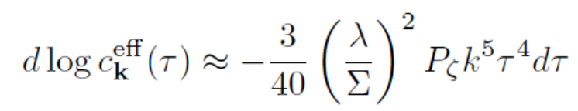

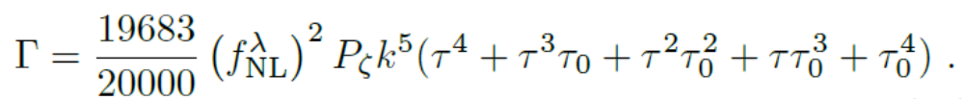


This decay can be resumed using dynamical RG
Burgess, Leblond, Holman, Shandera 2009
$$−3π/40$$
$$19683π/20000$$

Slide 26
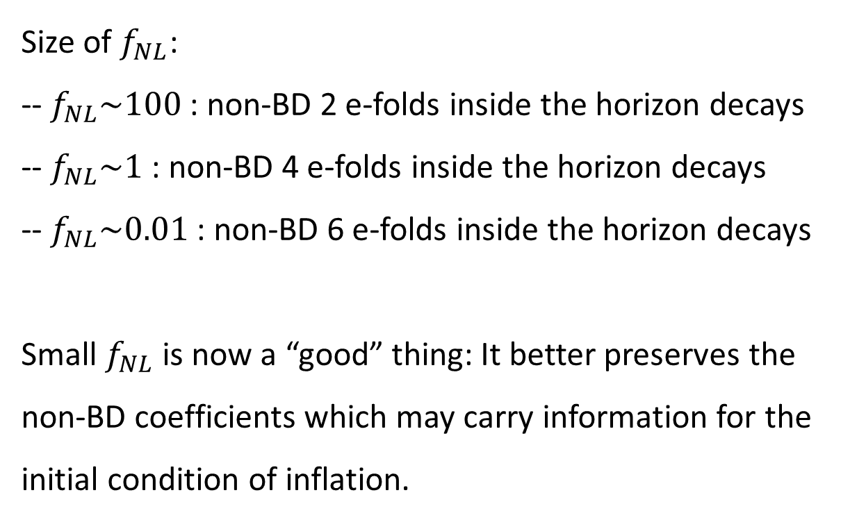
Size of $f_{NL}$:
-- $f_{NL}\sim 100$ : non-BD 2 e-folds inside the horizon decays
-- $f_{NL}\sim 1$ : non-BD 4 e-folds inside the horizon decays
-- $f_{NL}\sim 0.01$ : non-BD 6 e-folds inside the horizon decays
Small $f_{NL}$ is now a “good” thing: It better preserves the
non-BD coefficients which may carry information for the
initial condition of inflation.

Slide 27
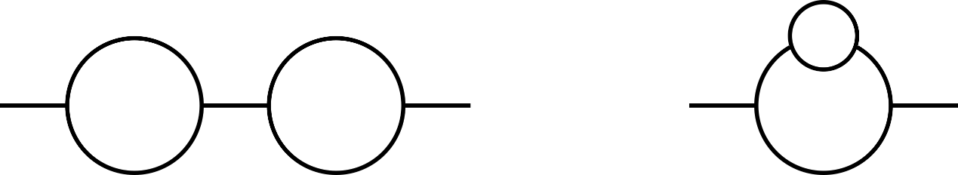
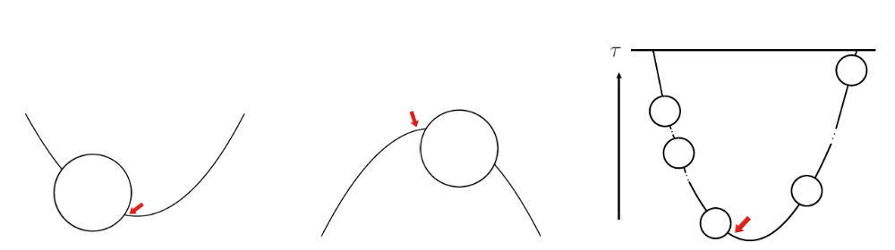
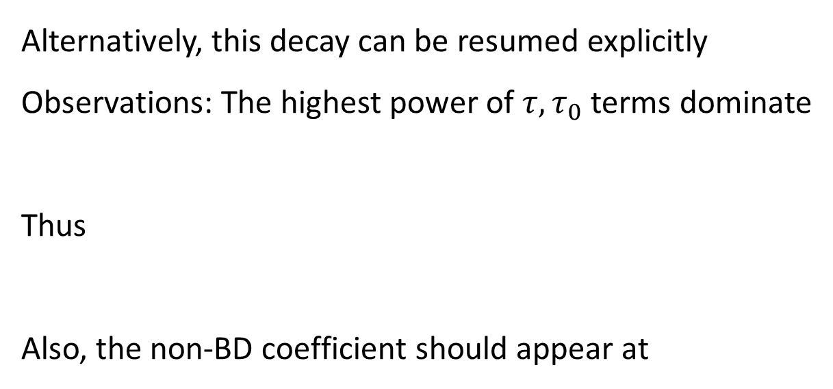

Alternatively, this decay can be resumed explicitly
Observations: The highest power of $τ, τ_{0}$ terms dominate
Thus
Also, the non-BD coefficient should appear at
$$≫$$

Slide 28
The two methods (DRG vs direct resum) agree for most parts,
except a two-loop contribution.
Im
The first loop may contribute imaginary part
even we cut the second loop
This is the part that DRG misses and we are unable to resum.
Fortunately it can be absorbed by choosing the renormalization point.

Slide 29
The 3-point function with decaying non-BD coefficients

Slide 30
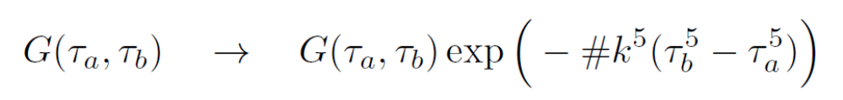
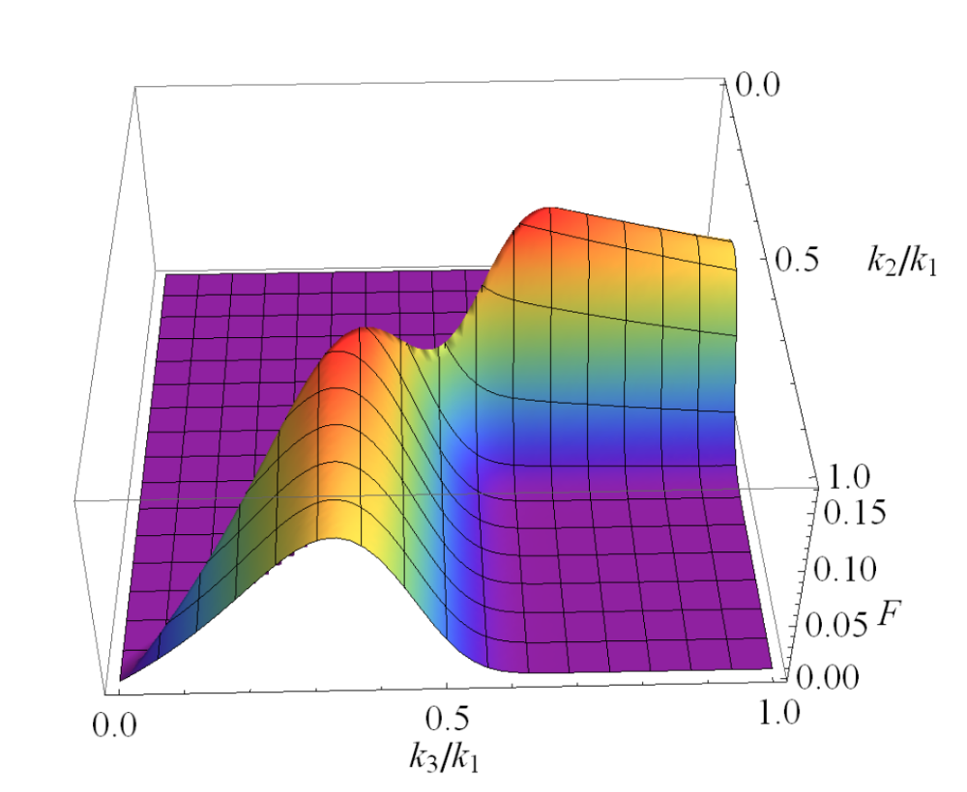
The decaying non-BD shapes
We also did it in two ways:
just replace the propagator
explicitly resum diagrams

Slide 31
Resumming the BD diagrams

Slide 32
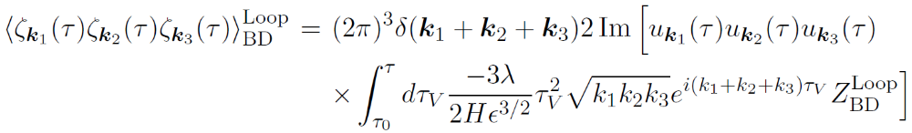


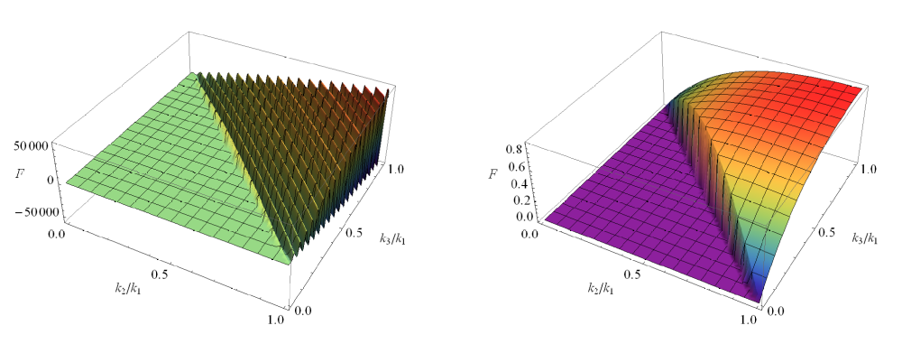
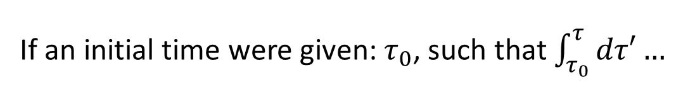
Resumming the BD diagrams
If an initial time were given: $τ_{0}$, such that $\int_{τ_{0}}^{τ}{dτ′}…$
tree
including resummed loops

Slide 33
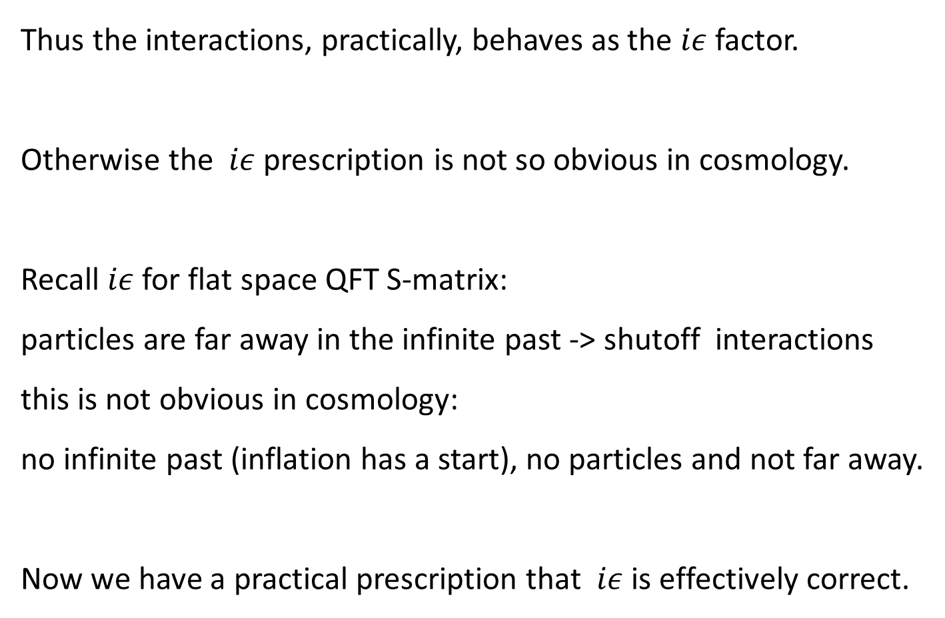
Thus the interactions, practically, behaves as the $iε$ factor.
Otherwise the $iε$ prescription is not so obvious in cosmology.
Recall $iε$ for flat space QFT S-matrix:
particles are far away in the infinite past -> shutoff interactions
this is not obvious in cosmology:
no infinite past (inflation has a start), no particles and not far away.
Now we have a practical prescription that $iε$ is effectively correct.

Slide 34
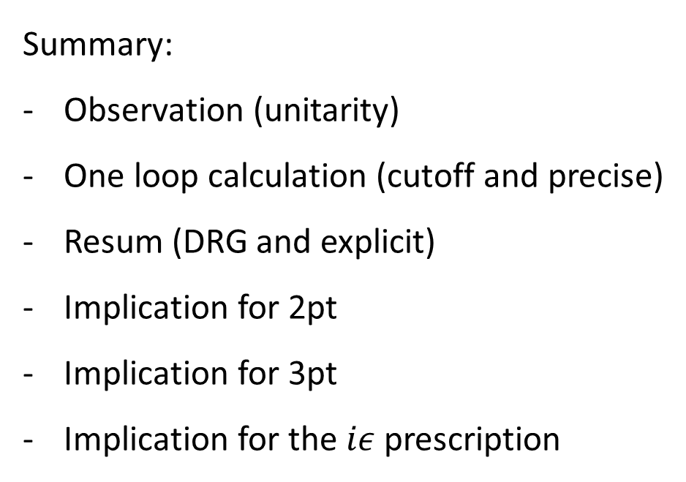
Summary:
Observation (unitarity)
One loop calculation (cutoff and precise)
Resum (DRG and explicit)
Implication for 2pt
Implication for 3pt
Implication for the $iε$ prescription

Slide 35
Thank you!

