Slide 1


Slide 2
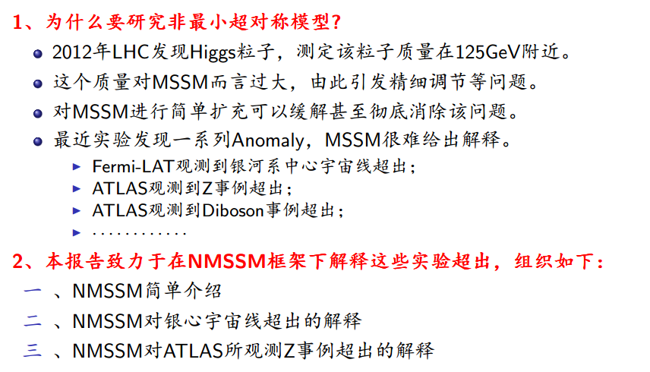
前言

Slide 3
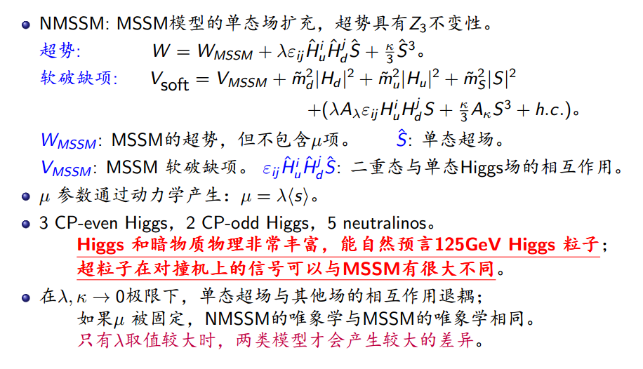
一、NMSSM模型简介

Slide 4
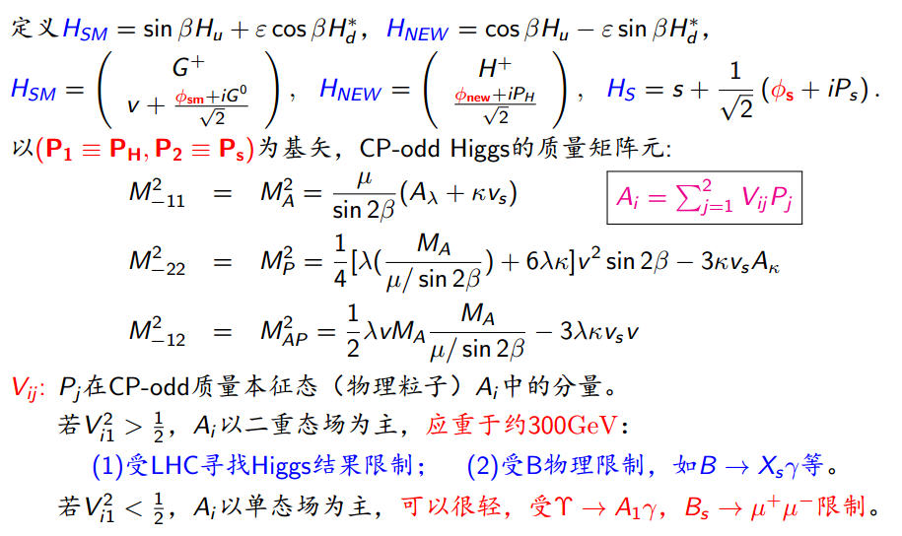
一、NMSSM模型简介

Slide 5
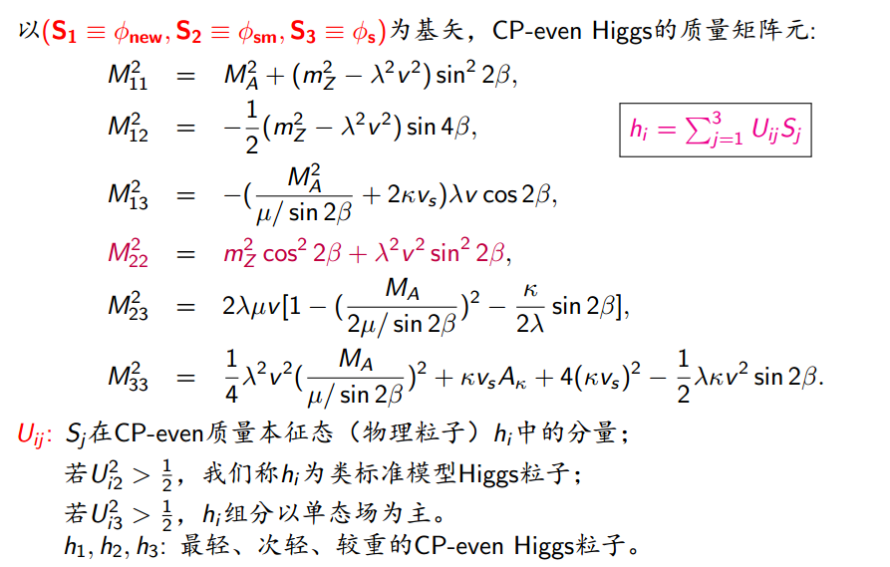
一、NMSSM模型简介

Slide 6
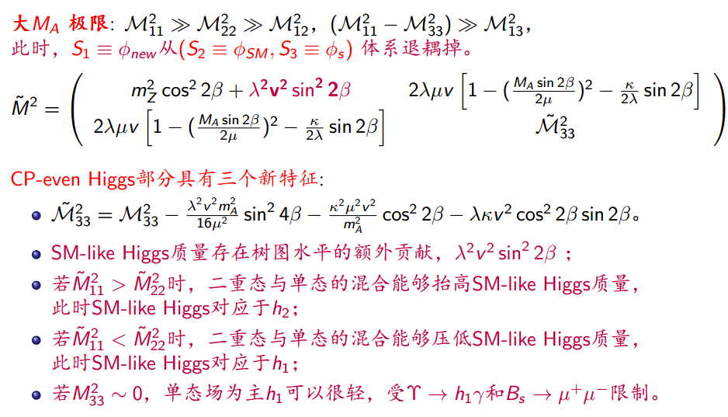
一、NMSSM模型简介

Slide 7
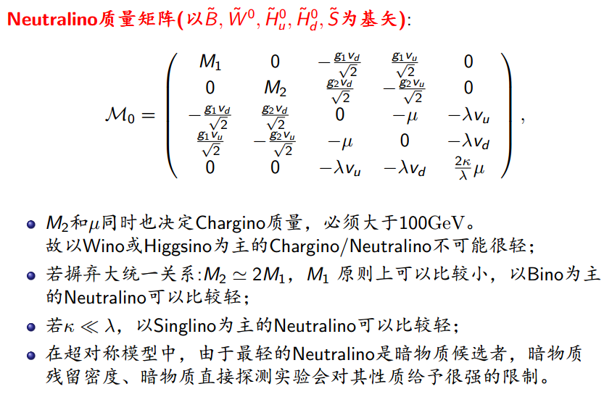
一、NMSSM模型简介

Slide 8
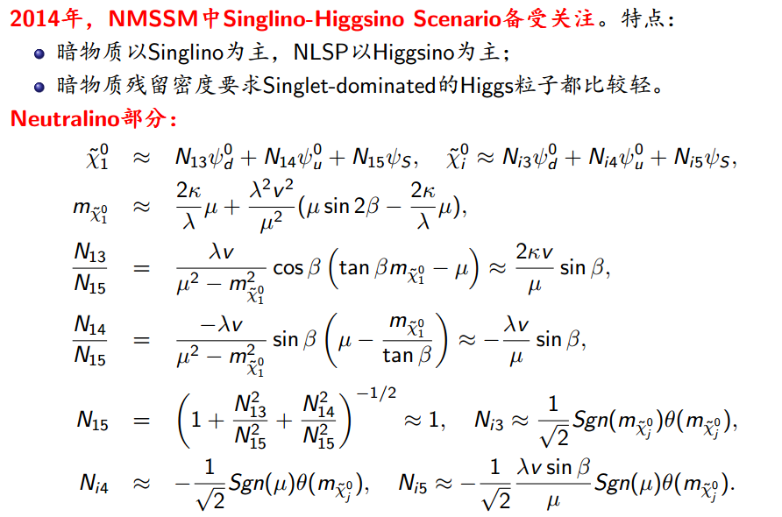
一、NMSSM模型简介

Slide 9
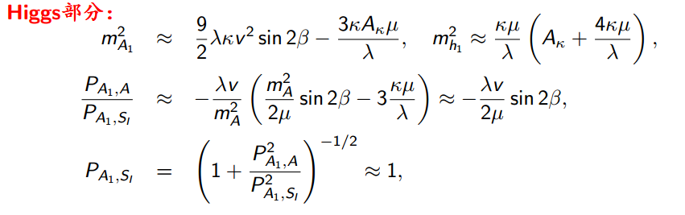
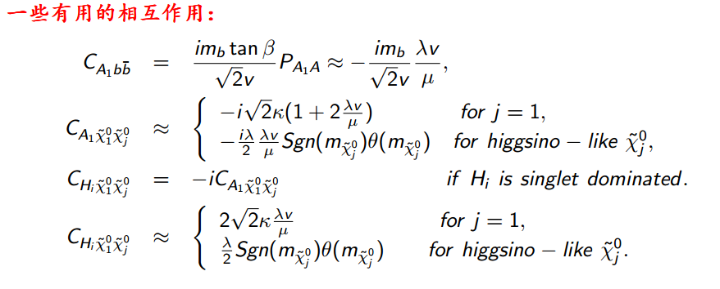
一、NMSSM模型简介

Slide 10
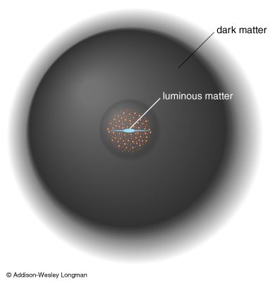
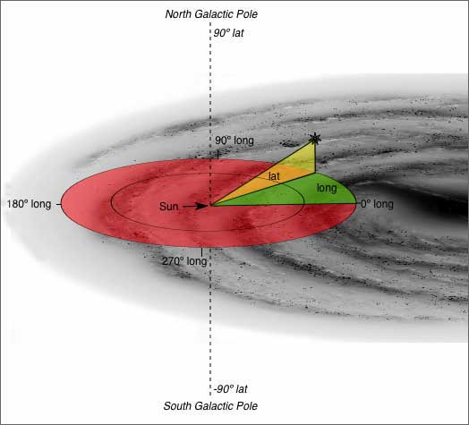
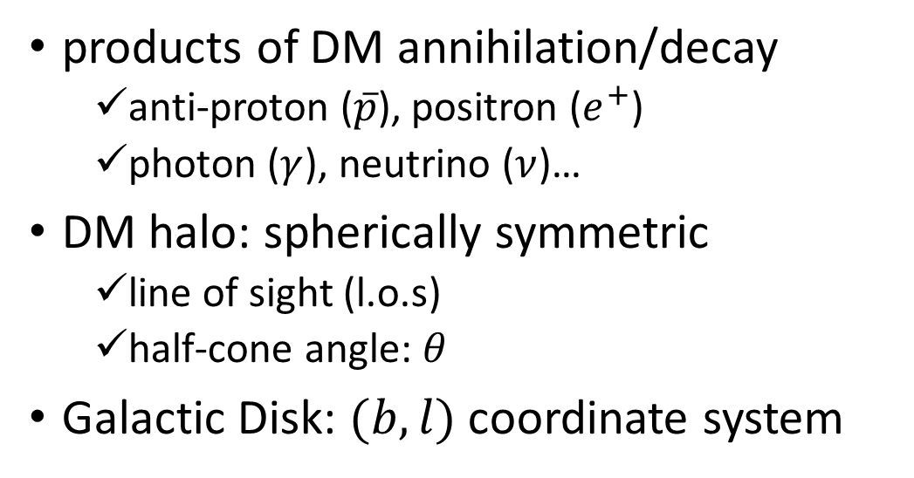
NMSSM对银心宇宙线超出的解释
products of DM annihilation/decay
  anti-proton ($\overline{p}$), positron ($e^{+}$)
  photon ($γ$), neutrino ($ν$)…
DM halo: spherically symmetric
  line of sight (l.o.s)
  half-cone angle: $θ$
Galactic Disk: $(b,l)$ coordinate system

Slide 11
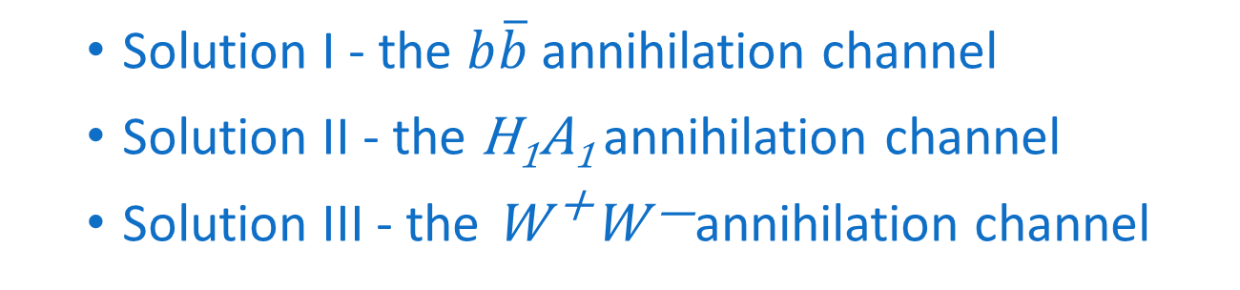
Outline
Introduction
  Fitting the GCE in the NMSSM
  GCE solutions with H₂ being the SM-like Higgs boson
    Solution I - the $b\overline{b}$annihilation channel
    Solution II - the H₁A₁ annihilation channel
    Solution III - the W ⁺W —annihilation channel
  GCE solutions with H₁ being the SM-like Higgs boson
    Solution IV - the H₁A₁ annihilation channel
    Solution V – the H₂A₁ annihilation channel
  Explore the GCE solutions in future experiments
  Summary

Slide 12
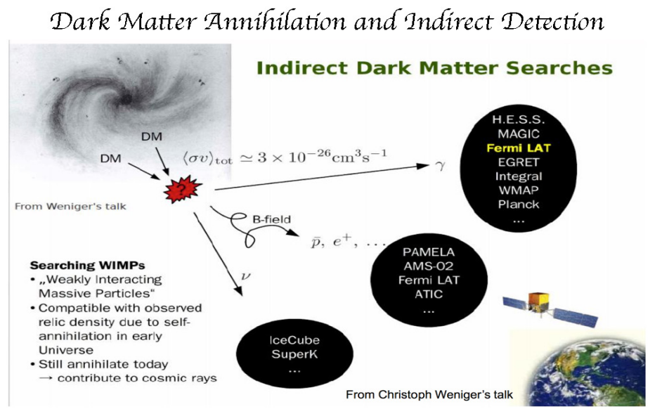
Introduction

Slide 13
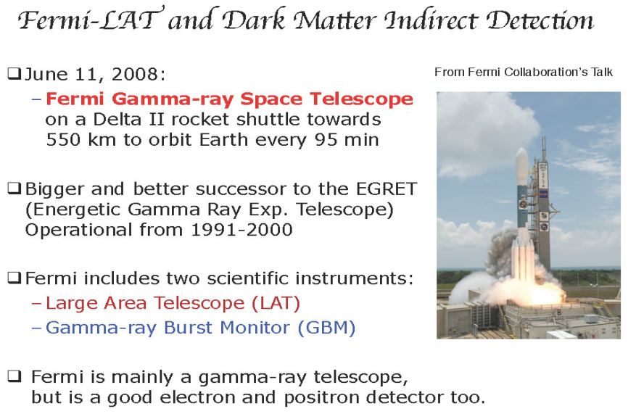
Introduction

Slide 14
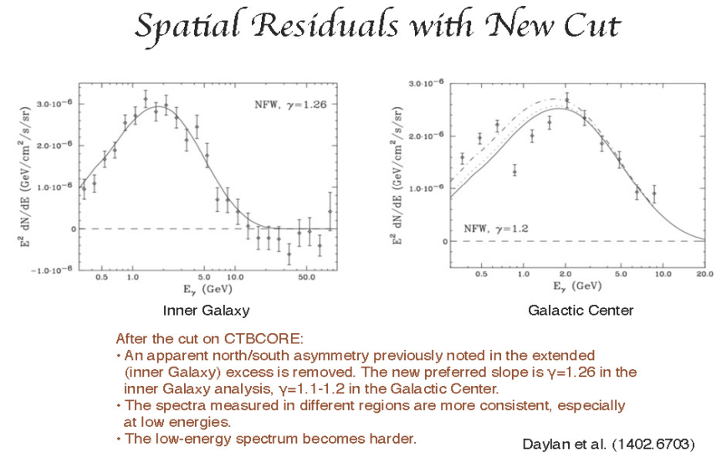
Introduction

Slide 15
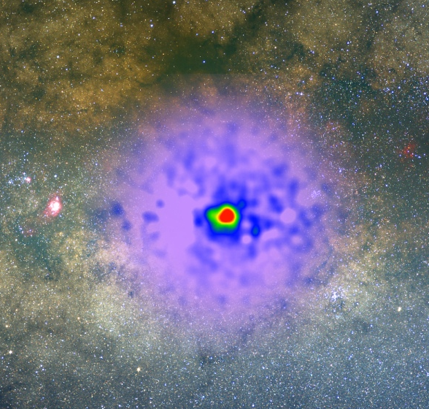
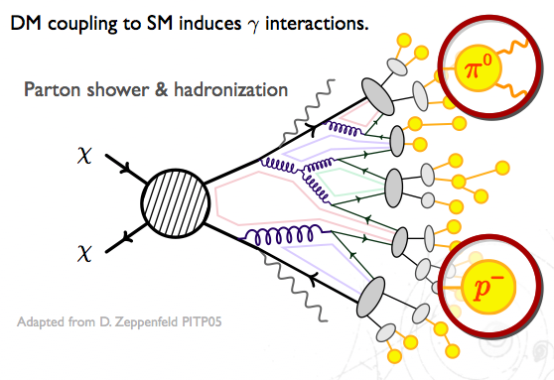
Introduction
Notes:
Fermi lab 发现了GCE超出，该超出比较倾向于用暗物质湮灭来解释。

Slide 16
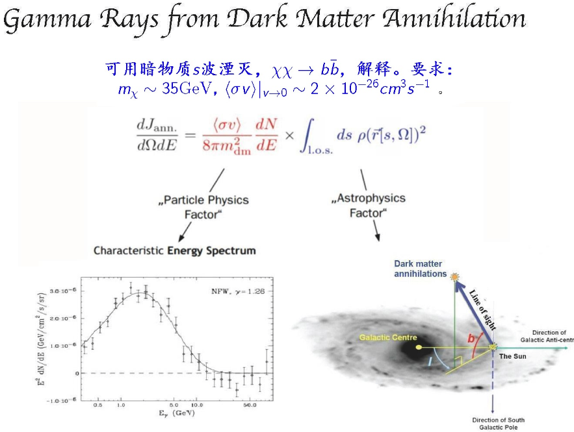
Introduction

Slide 17
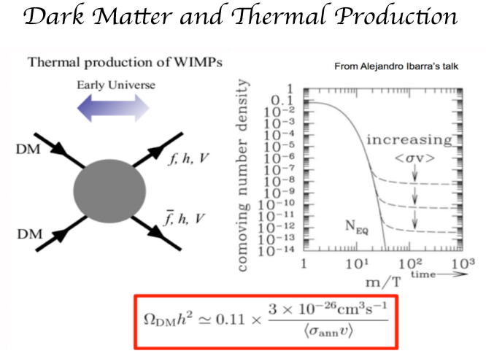
Introduction

Slide 18
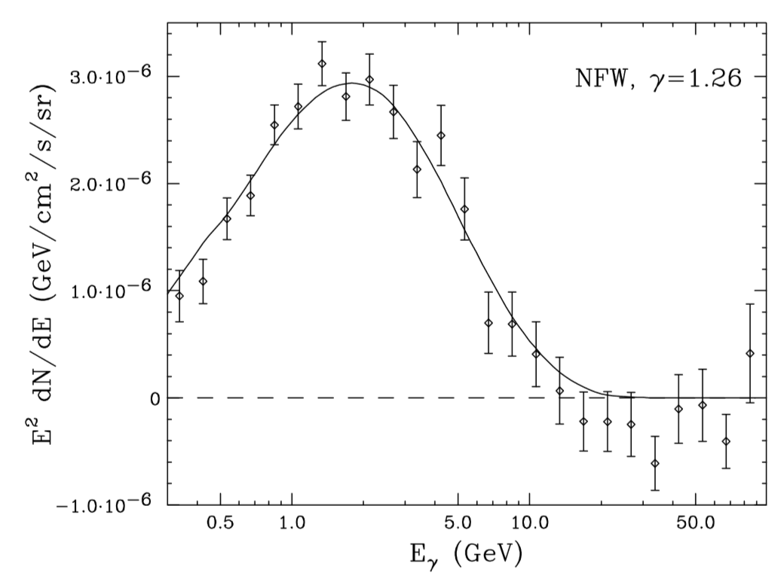
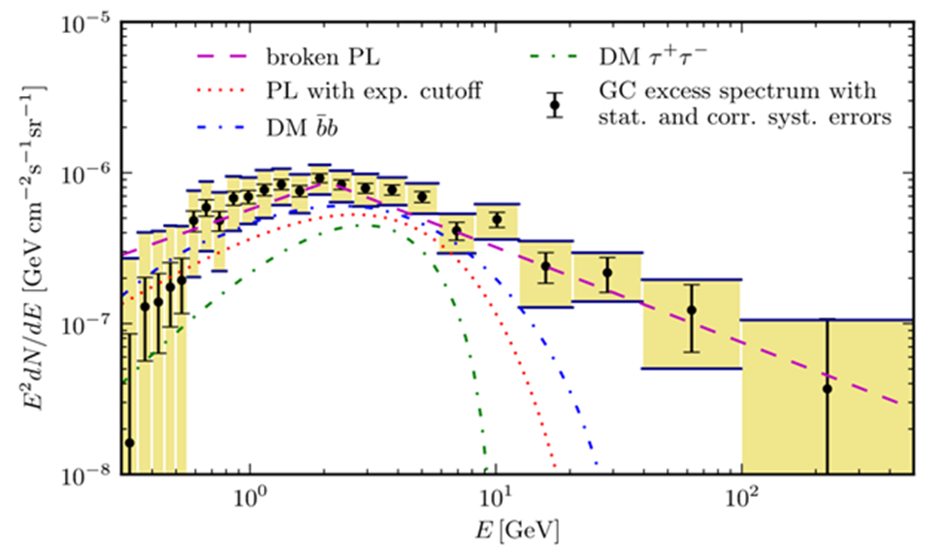
Introduction
arXiv: 1402.6703
arXiv: 1409.0042
重要进展：考虑了宇宙线前景和背景带来的误差。
Notes:
早起的时候，得到的光子谱尾部较短，大家倾向于用35GeV的暗物质湮灭到bb bar或者10GeV的暗物质湮灭到tautau来解释；后来Calore组重新分析背景和前景，得到的光子谱尾部较长，所以除了湮灭到bb bar或者tautau外，其他的湮灭道也能很好的解释，特别是湮灭到Higggs。所以我们又重新详细研究了NMSSM解释GCE的情况。

Slide 19
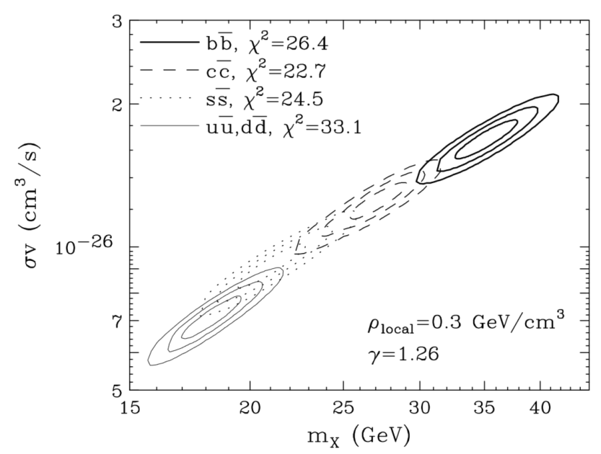
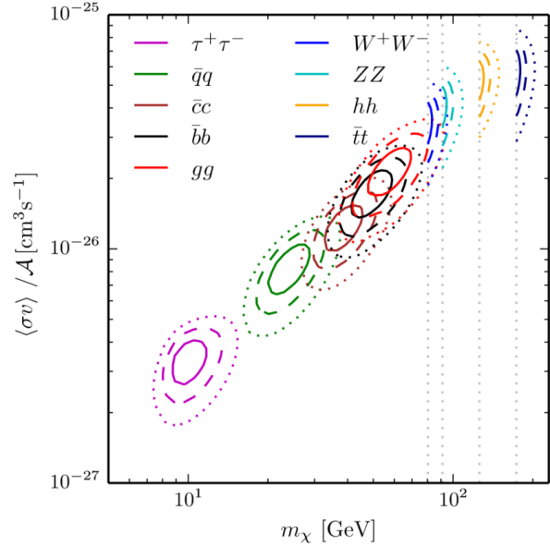
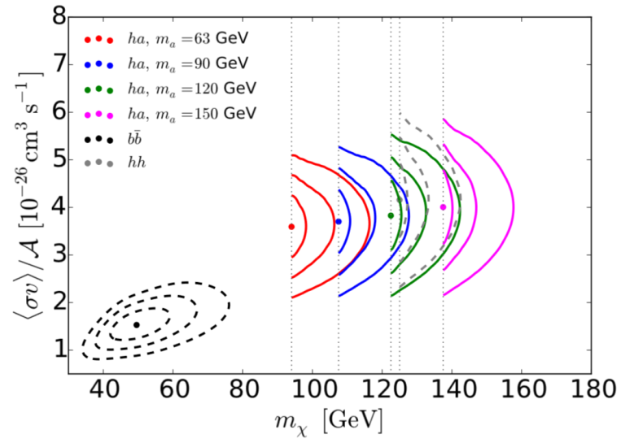
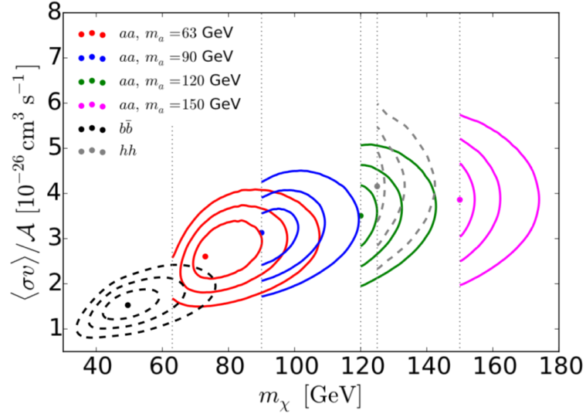
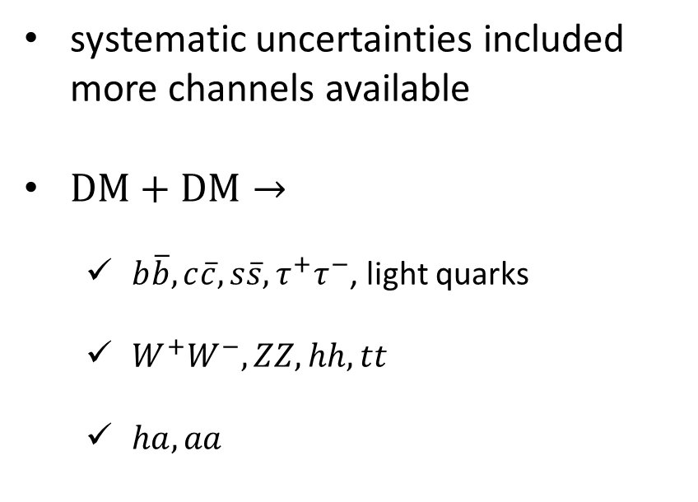
DM annihilation (Simplified model)
Introduction
D. Hooper, 1402.6703
F. Calore, 1411.4647
systematic uncertainties included
more channels available
$DM+DM→$
  $b\overline{b}, c\overline{c}, s\overline{s}, τ^{+}τ^{−}$, light quarks
  $W^{+}W^{−}, ZZ, hh, tt$
  $ha, aa$
T. Gherghetta
1502.07173

Slide 20
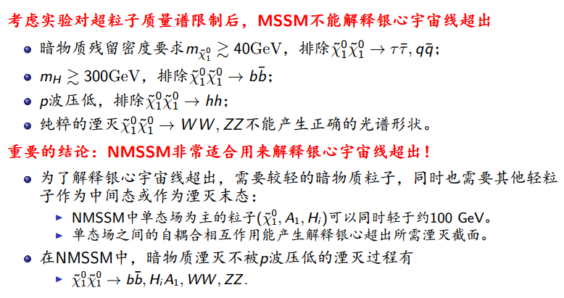
Introduction

Slide 21
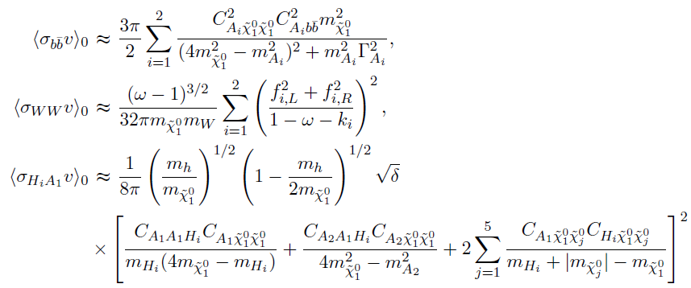
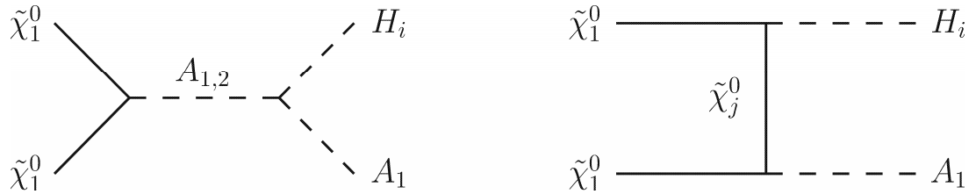
Introduction
The velocity weighted annihilation cross section

Slide 22
Outline
Introduction
  Fitting the GCE in the NMSSM
  GCE solutions with H₂ being the SM-like Higgs boson
    Solution I - the $b\overline{b}$annihilation channel
    Solution II - the H₁A₁ annihilation channel
    Solution III - the W ⁺W —annihilation channel
  GCE solutions with H₁ being the SM-like Higgs boson
    Solution IV - the H₁A₁ annihilation channel
    Solution V – the H₂A₁ annihilation channel
  Explore the GCE solutions in future experiments
  Summary

Slide 23
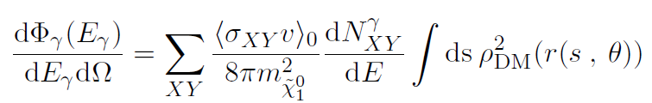
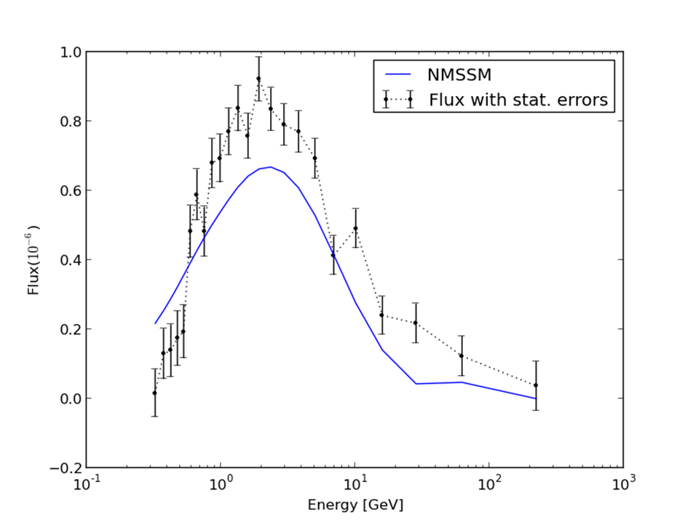
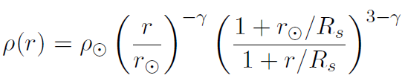
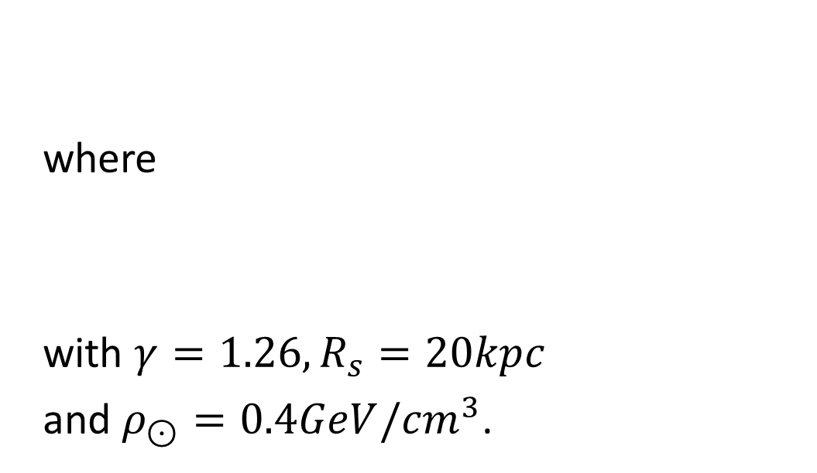
Fitting the GCE in the NMSSM
The flux per unit solid angle at some photon energy $E_{γ}$ is
where
with $γ=1.26, R_{s}=20kpc$
and $ρ_{⊙}=0.4GeV/{cm}^{3}$.
要点：产生光子谱线的形状和高度

Slide 24
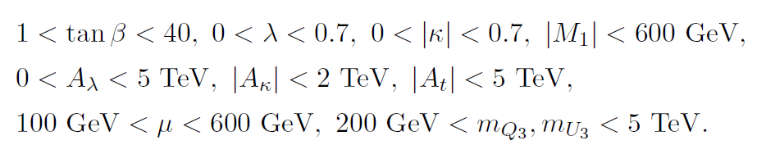
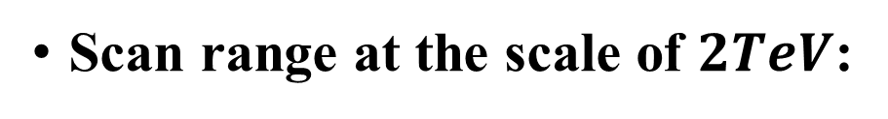
Fitting the GCE in the NMSSM
Scan range at the scale of $2TeV$:
  with $A_{t}=A_{b}, M_{U_{3}}=M_{D_{3}}, M_{U_{1,2}}=M_{D_{1,2}}=2TeV, A_{E}=300GeV$.

Slide 25
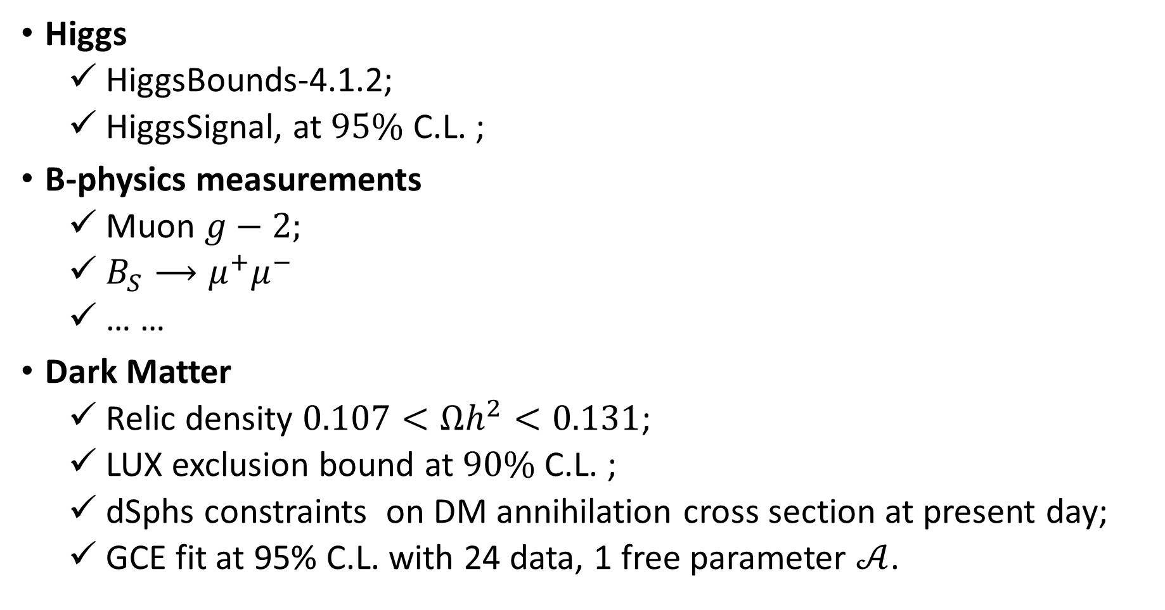
Fitting the GCE in the NMSSM
Higgs
  HiggsBounds-4.1.2;
  HiggsSignal, at $95\%$ C.L. ;
B-physics measurements
  Muon $g−2;$
  $B_{S}⟶μ^{+}μ^{−}$
  … …
Dark Matter
  Relic density $0.107<Ωh^{2}<0.131$;
  LUX exclusion bound at $90\%$ C.L. ;
  dSphs constraints on DM annihilation cross section at present day;
  GCE fit at 95% C.L. with 24 data, 1 free parameter $𝒜$.

Slide 26
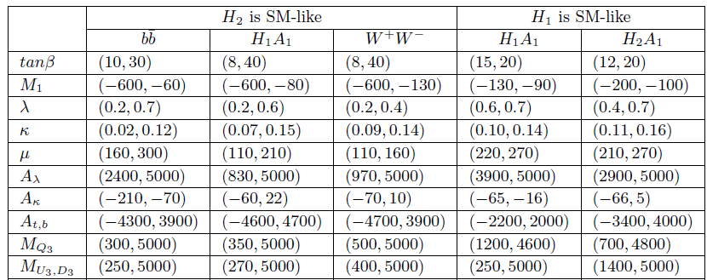
Fitting the GCE in the NMSSM

Slide 27
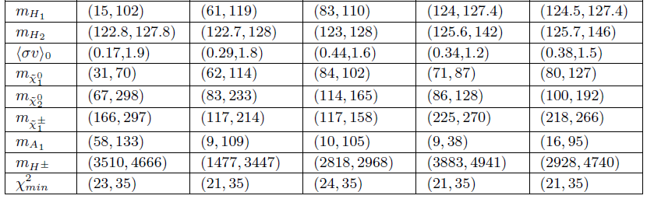

重要特点:
Fitting the GCE in the NMSSM
所有单态场为主的粒子都比较轻 ;
$μ≤300 GeV$.

Slide 28
Outline
Introduction
  Fitting the GCE in the NMSSM
  GCE solutions with H₂ being the SM-like Higgs boson
    Solution I - the $b\overline{b}$annihilation channel
    Solution II - the H₁A₁ annihilation channel
    Solution III - the W ⁺W —annihilation channel
  GCE solutions with H₁ being the SM-like Higgs boson
    Solution IV - the H₁A₁ annihilation channel
    Solution V – the H₂A₁ annihilation channel
  Explore the GCE solutions in future experiments
  Summary

Slide 29
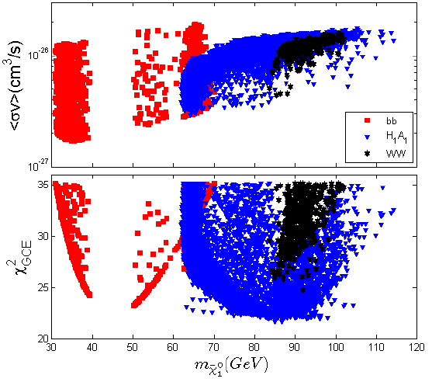

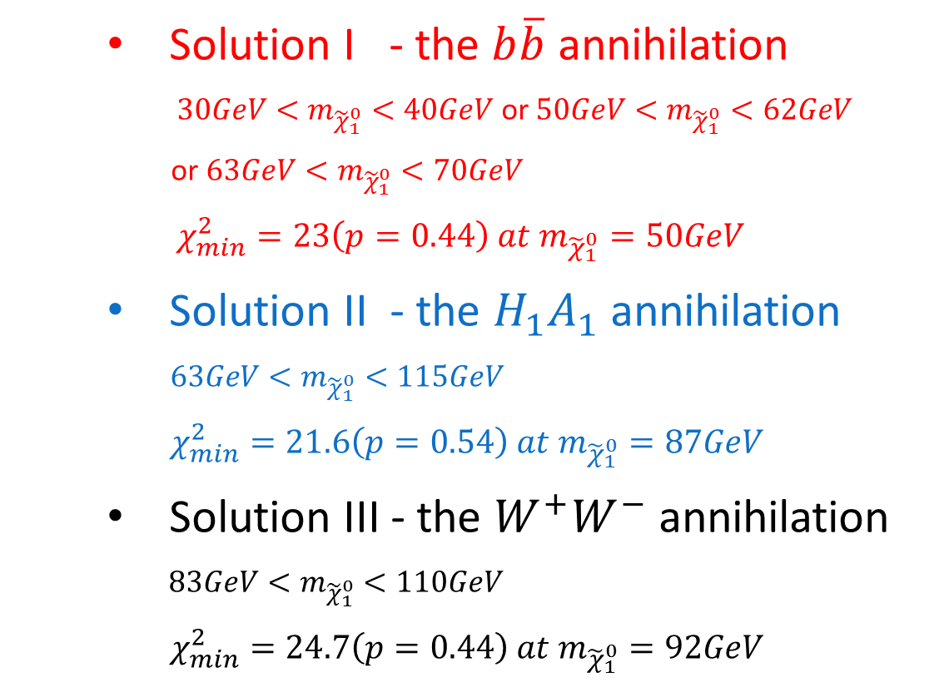
GCE solutions with $H_{2}$ being the SM-like Higgs
    Solution I - the $b\overline{b}$ annihilation
    $30GeV<m_{{\tilde{χ}}_{1}^{0}}<40GeV$ or $50GeV<m_{{\tilde{χ}}_{1}^{0}}<62GeV$
    or $63GeV<m_{{\tilde{χ}}_{1}^{0}}<70GeV$
    $χ_{min}^{2}=23\left(p=0.44\right) at{ m}_{{\tilde{χ}}_{1}^{0}}=50GeV$
    Solution II - the ${H_{1}A}_{1}$ annihilation
    $63GeV<m_{{\tilde{χ}}_{1}^{0}}<115GeV$
    $χ_{min}^{2}=21.6\left(p=0.54\right) at{ m}_{{\tilde{χ}}_{1}^{0}}=87GeV$
    Solution III - the $W^{+}W^{−}$ annihilation
    $83GeV<m_{{\tilde{χ}}_{1}^{0}}<110GeV$
    $χ_{min}^{2}=24.7\left(p=0.44\right) at{ m}_{{\tilde{χ}}_{1}^{0}}=92GeV$

Slide 30
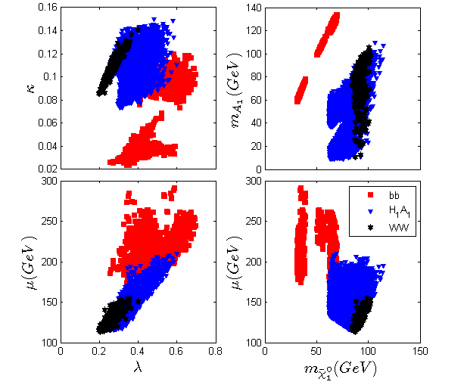

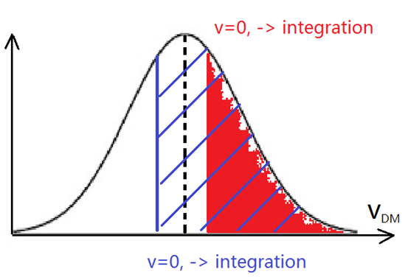
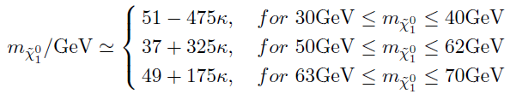

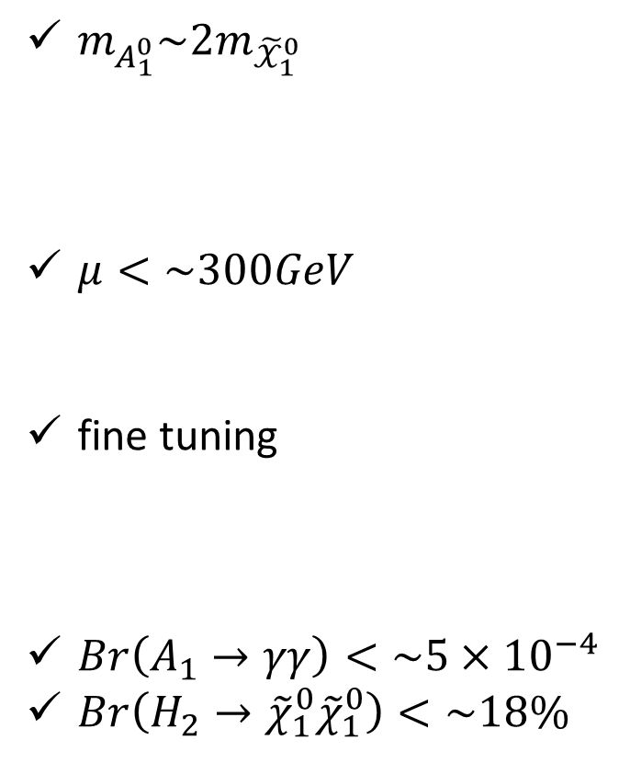
GCE solutions with $H_{2}$ being the SM-like Higgs
Solution I - the $b\overline{b}$ annihilation :
$m_{A_{1}^{0}}\sim 2m_{{\tilde{𝒳}}_{1}^{0}}$
$μ<\sim 300GeV$
fine tuning
$Br\left(A_{1}→γγ\right)<\sim 5×{10}^{−4}$
$Br\left(H_{2}→{\tilde{χ}}_{1}^{0}{\tilde{χ}}_{1}^{0}\right)<\sim 18\%$

Slide 31
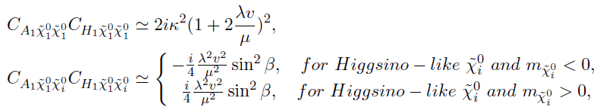

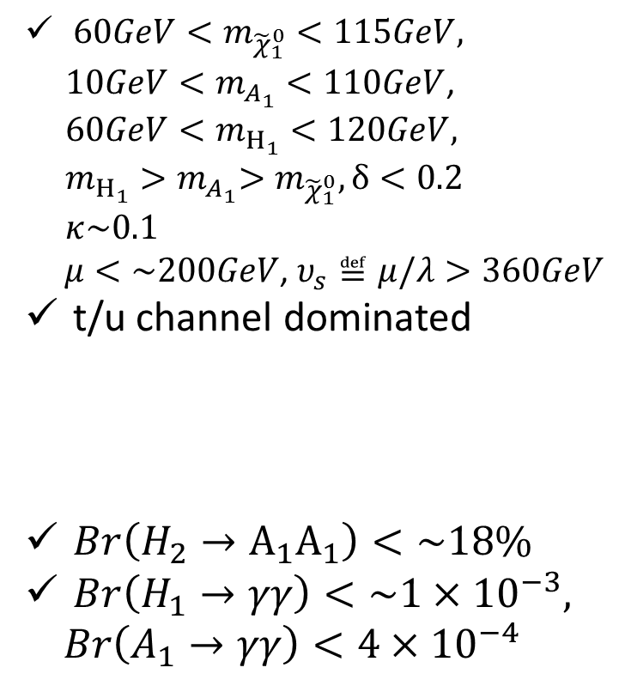
GCE solutions with $H_{2}$ being the SM-like Higgs
Solution II - the ${H_{1}A}_{1}$annihilation :
${60GeV<m}_{{\tilde{χ}}_{1}^{0}}<115GeV,$
${10GeV<m}_{A_{1}^{}}<110GeV$,
${60GeV<m}_{H_{1}^{}}<120GeV,$
$m_{H_{1}^{}}{>m}_{A_{1}^{}}>m_{{\tilde{χ}}_{1}^{0}},δ<0.2$
$κ\sim 0.1$
$μ<\sim 200GeV$, $υ_{s}≝μ/λ>360GeV$
t/u channel dominated
$Br\left(H_{2}→A_{1}A_{1}\right)<\sim 18\%$
$Br\left(H_{1}→γγ\right)<\sim 1×{10}^{−3},$
$Br\left(A_{1}→γγ\right)<4×{10}^{−4}$

Slide 32
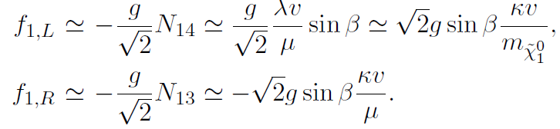
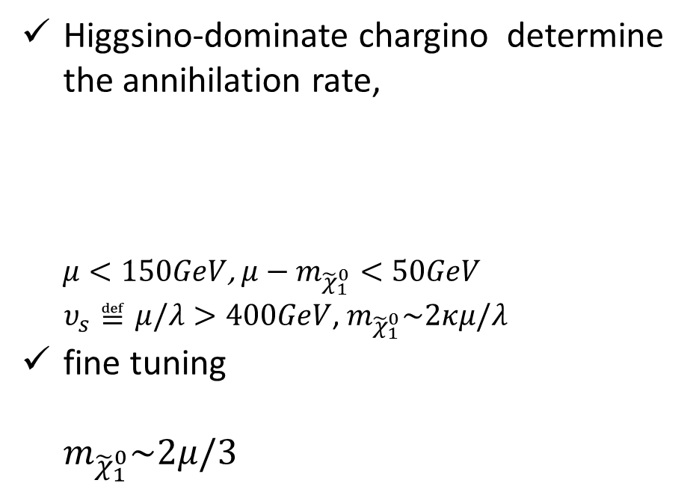
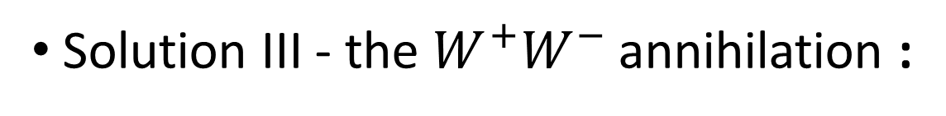
GCE solutions with $H_{2}$ being the SM-like Higgs
Solution III - the $W^{+}W^{−}$ annihilation :
Higgsino-dominate chargino determine the annihilation rate,
$μ<150GeV$, $μ−m_{{\tilde{χ}}_{1}^{0}}<50GeV$
$υ_{s}≝μ/λ>400GeV$, $m_{{\tilde{χ}}_{1}^{0}}\sim 2κμ/λ$
fine tuning
$m_{{\tilde{χ}}_{1}^{0}}\sim 2μ/3$

Slide 33

GCE solutions with $H_{2}$ being the SM-like Higgs
Solution III - the $W^{+}W^{−}$ annihilation :

Slide 34
Outline
Introduction
  Fitting the GCE in the NMSSM
  GCE solutions with H₂ being the SM-like Higgs boson
    Solution I - the $b\overline{b}$annihilation channel
    Solution II - the H₁A₁ annihilation channel
    Solution III - the W ⁺W —annihilation channel
  GCE solutions with H₁ being the SM-like Higgs boson
    Solution IV - the H₁A₁ annihilation channel
    Solution V – the H₂A₁ annihilation channel
  Explore the GCE solutions in future experiments
  Summary

Slide 35



GCE solutions with $H_{1}$ being the SM-like Higgs
    Solution IV - the ${H_{1}A}_{1}$annihilation
    $70GeV<m_{{\tilde{χ}}_{1}^{0}}<87GeV$
    $χ_{min}^{2}=21.4\left(p=0.55\right) at{ m}_{{\tilde{χ}}_{1}^{0}}=81GeV$
    Solution V - the ${H_{2}A}_{1}$ annihilation
    $80GeV<m_{{\tilde{χ}}_{1}^{0}}<130GeV$
    $χ_{min}^{2}=21.6\left(p=0.54\right) at{ m}_{{\tilde{χ}}_{1}^{0}}=85GeV$

Slide 36




GCE solutions with $H_{1}$ being the SM-like Higgs
Solution IV - the ${H_{1}A}_{1}$annihilation :
$δ<0.1$
${71GeV<m}_{{\tilde{χ}}_{1}^{0}}<87GeV,$
${10GeV<m}_{A_{1}^{}}<40GeV$,
${126GeV<m}_{H_{2}^{}}<142GeV,$
$κ\sim 0.1$
$220GeV<μ<270GeV$, $m_{{\tilde{χ}}_{1}^{0}}\sim 2κμ/λ$~80GeV, $λ>0.6$
$υ_{s}≝μ/λ>300GeV$, $\frac{λυ}{μ}<0.6$
t/u channel dominated
$Br\left(H_{1}→A_{1}A_{1}\right)<\sim 24\%$
$Br\left(A_{1}→γγ\right)<5×{10}^{−5}$

Slide 37


GCE solutions with $H_{1}$ being the SM-like Higgs
Solution V - the ${H_{2}A}_{1}$annihilation :
$δ<0.1$
${80GeV<m}_{{\tilde{χ}}_{1}^{0}}<130GeV,$
${18GeV<m}_{A_{1}^{}}<100GeV$,
${125GeV<m}_{H_{2}^{}}<146GeV,$
$μ−m_{{\tilde{χ}}_{1}^{0}}>100GeV$

Slide 38
Outline
Introduction
  Fitting the GCE in the NMSSM
  GCE solutions with H₂ being the SM-like Higgs boson
    Solution I - the $b\overline{b}$annihilation channel
    Solution II - the H₁A₁ annihilation channel
    Solution III - the W ⁺W —annihilation channel
  GCE solutions with H₁ being the SM-like Higgs boson
    Solution IV - the H₁A₁ annihilation channel
    Solution V – the H₂A₁ annihilation channel
  Explore the GCE solutions in future experiments
  Summary

Slide 39





Explore the GCE solutions in future experiments
The main contribution to $σ_{P}^{SI}$ comes from the t-channel process mediated by the CP-even Higgses $H_{1,2}$

Slide 40




Explore the GCE solutions in future experiments
The main contribution to $σ_{P}^{SD}$ comes from the t-channel process mediated by Z

Slide 41


Explore the GCE solutions in future experiments
    This is the $3l+E_{T}^{miss}$ constraints for the $b\overline{b}$ solution when $H_{2}$ being the SM-like Higgs and ${30GeV<m}_{{\tilde{χ}}_{1}^{0}}<40GeV$.
The solutions with $H_{1}$ being the SM-like Higgs have similar features.
The $W^{+}W^{−}$solutions with $H_{2}$ being the SM-like Higgs receive no constraints from this experiment.

Slide 42
Outline
Introduction
  Fitting the GCE in the NMSSM
  GCE solutions with H₂ being the SM-like Higgs boson
    Solution I - the $b\overline{b}$annihilation channel
    Solution II - the H₁A₁ annihilation channel
    Solution III - the W ⁺W —annihilation channel
  GCE solutions with H₁ being the SM-like Higgs boson
    Solution IV - the H₁A₁ annihilation channel
    Solution V – the H₂A₁ annihilation channel
  Explore the GCE solutions in future experiments
  Summary

Slide 43

Summary
With $H_{2}$ being the SM-like Higgs
  Pure DM annihilation channel $b\overline{b}$ and $W^{+}W^{−}$ and mixed channel $H_{1}A_{1}$ can provide
  a good fit to the GCE spectrum;
  The annihilation channel $H_{1}A_{1}$ provide a better explanation than $b\overline{b}$ and $W^{+}W^{−};$
  The constants of $σ_{P}^{SI}$ in the future XENON-1T and LUX can cover most of them, while
  the constants of $σ_{P}^{SD}$ will test nearly all of them.
With $H_{1}$ being the SM-like Higgs
  It is more difficult to find GCE solutions than $H_{2}$ scenario, and the two solutions ${ H}_{1}A_{1}$ and $H_{2}A_{1}$can be pure or mixed.
  ${125GeV<m}_{H_{2}^{}}<142GeV,210GeV<μ<270GeV$,
  Both $σ_{P}^{SI}$ and $σ_{P}^{SD}$ detection in future XENON-1T can cover all the parameter space.

Slide 44

Summary

Slide 45

NMSSM对ATLAS所观测Z事例超出的解释

Slide 46
Outline
Introduction
  EXCESS in ATLAS leptonic-Z search
  Confronted with other limits
Explanation I in SUSY
  Our Scenario
  MC Tools
  Result
Explanation II in SUSY

Slide 47


Introduction : ATLAS Z EXCESS
arXiv:1503.03290

Slide 48


Introduction : ATLAS Z EXCESS
general gauge mediation models
arXiv:1503.03290

Slide 49

Introduction : ATLAS Z EXCESS
Event selection

Slide 50

Introduction : ATLAS Z EXCESS
Event selection

Slide 51


Introduction : ATLAS Z EXCESS
Result

Slide 52




Introduction : CMS Result
CMS search for the leptonic-Z + jets + ${E_{T}^{}}^{miss}$
No Access in the on-Z SRs
$$N_{jets}≥2$$
$$N_{jets}≥3$$

Slide 53




Introduction : CMS Result
Search for process:
$$P_{T}\left(l_{1}\right)>20GeV$$
$$P_{T}\left(l_{2}\right)>20GeV$$
SFOS：$l_{1}, l_{2}$
$m\left(l_{1},l_{2}\right)∈$ (81GeV, 101GeV)
LEPTON
$jet$($P_{T}>40GeV$, $\left|η\right|<3.0)$ > 1
$${E_{T}^{}}^{miss}>100GeV$$
Six bins
JET+${E_{T}^{}}^{miss}$

Slide 54

Introduction : Constraints
0 lepton, 2~6 jets
1. arXiv:1405.7875,
0 lepton + 2~6 jets + MET；
2. ATLAS-CONF-2013-047，
0 lepton + 2~6 jets + MET；
3. arXiv:1308.1841,
0 lepton + > 6 jets + MET。

Slide 55


Introduction: Constraints
CheckMATE

Slide 56

Introduction : Constraints
Validation

Slide 57

Introduction : Constraints
Validation

Slide 58
Outline
Introduction
  EXCESS in ATLAS leptonic-Z search
  Confronted with other limits
Explanation I in SUSY
  Our Scenario
  MC Tools
  Result
Explanation II in SUSY

Slide 59


Explanation I in SUSY : Our Scenario
Neutralino同轻夸克相互作用由其Gaugino成分决定；
Neutralino同Z玻色子作用由其Higgsino成分决定；
Neutralino同Higgs粒子作用中，Gaugino和Higgsino成分都起作用。

Slide 60






Explanation I in SUSY : Our Scenario
LSP singlino-dominated neutralino
NLSP bino-dominate neutralino
$M_{2},μ_{eff}>m_{\tilde{g}}$
  So that, BR( $\tilde{g}→{{\tilde{χ}}_{2}^{0}}^{} j j$ ) > BR( $\tilde{g}→{{\tilde{χ}}_{1}^{0}}^{} j j$ )
  So that, forbid $\tilde{g}→{{\tilde{χ}}_{i}^{±}}^{} j j$
$m_{\tilde{t}},m_{\tilde{b}}≫m_{\tilde{q}}>m_{\tilde{g}}$
(or $m_{\tilde{t}},m_{\tilde{b}},m_{\tilde{q}}>m_{\tilde{g}}$ and $m_{\tilde{g}}<m_{{{\tilde{χ}}_{2}^{0}}^{}}+2m_{t}$ in $m_{\tilde{g}}\sim m_{{{\tilde{χ}}_{2}^{0}}^{}}$)
  So that, BR( $\tilde{g}→{{\tilde{χ}}_{2}^{0}}^{} \overline{q} q$ ) > BR( $\tilde{g}→{{\tilde{χ}}_{2}^{0}}^{} \overline{t} t$ )[low efficiency]
$m_{Z}<m_{{{\tilde{χ}}_{2}^{0}}^{}}−m_{{{\tilde{χ}}_{1}^{0}}^{}}≤m_{h}$ ( or specified SUSY parameters)
  So that, BR(${{\tilde{χ}}_{2}^{0}}^{}→Z{{\tilde{χ}}_{1}^{0}}^{}$)~100%
$$\tilde{B}$$
$$\tilde{S}$$
$$\tilde{B}$$
$$\tilde{S}$$

Slide 61
Explanation I in SUSY : MC Tools
Tool of Simulation
  MadGraph: events generated
  Pythia: parton shower and hadronization
  Delphes: simulate behavior of ATLAS and CMS
  CheckMATE: tuned Delphes + Analysis Tools
Tool of Spectrum：NMSSMTools
Tool of Cross Section：Prospino

Slide 62

Explanation I in SUSY : Result

Slide 63


Explanation I in SUSY : Result

Slide 64


Explanation I in SUSY : Result

Slide 65


Explanation I in SUSY : Result

Slide 66

Explanation I in SUSY : Result
Without CMS limit, NMSSM can explain the ATLAS Z-peaked
excess at $1σ$ level, and the central value of the ATLAS excess can
be achieved easily.
With CMS limit, NMSSM can explain the ATLAS Z-peaked excess
at $1.2σ$ away(11 Events).
Gluino mass is limited in a narrow region to explain the ATLAS excess,
and the mass splittings of SUSY particles are usually less than 150 GeV.

Slide 67
Outline
Introduction
  EXCESS in ATLAS leptonic-Z search
  Confronted with other limits
Explanation I in SUSY
  Our Scenario
  MC Tools
  Result
Explanation II in SUSY

Slide 68


Explanation II in SUSY : Result
1. 利用Squark对产生过程来解释；
2. LSP以Singlino为主，NLSP以Bino为主；
3. 其他 Neutralino 比 Squark 重。

Slide 69


Explanation II in SUSY : Result

Slide 70



Explanation II in SUSY : Result

Slide 71
Explanation II in SUSY : Result
若只考虑ATLAS限制，当Squark轻于800GeV时，可重复
出ATLAS实验中心值；
进一步考虑CMS限制后，当Squark轻于750GeV时，可对
ATLAS实验贡献10个以上事例；
当Squark轻于1.3TeV时，对ATLAS实验可贡献6个以上事例；
产生的各种分布与实验数据较好地吻合；
与Gluino对产生过程相比，Squark质量有更大的取值范围来
解释ATLAS实验，同时超粒子谱可以有较大的质量劈裂。

Slide 72

Explanation II in SUSY : Discussion
现有研究表明，在简单情形下会存在很小的参数空间，SUSY可在1$σ$范围解释ATLAS实验；而我们只能在1.2$σ$层次解释。原因何在？
    选取的超对称参数空间不同，这会影响动力学分布；
    涉及到蒙卡模拟，通常会有20%左右的误差；
    对CMS实验限制处理不同，我们考虑6个Signal region；
强调：更复杂的SUSY情形，可能会有效避开CMS限制，更好的解释ATLAS实验。
寻找这样参数空间对计算条件有很高的要求！

Slide 73

WE ARE JUST ON THE WAY
Thank you.

