Slide 1
Primordial black holes from ultra-slow-roll inflation
Yungui Gong
龚云贵
School of Physics
Huazhong University of Science and Technology
ICTS-USTC，2017.11.10

Slide 2
Outline
Observational constraints on the mass of PBHs
The generic feature of inflation for the production of PBHs
Ultra-slow-roll inflation
Model building
Conclusions
Gao, Gong and Li, 1405.6451; Gong, 1707.09578;
Yi and Gong, 1712.07478

Slide 3
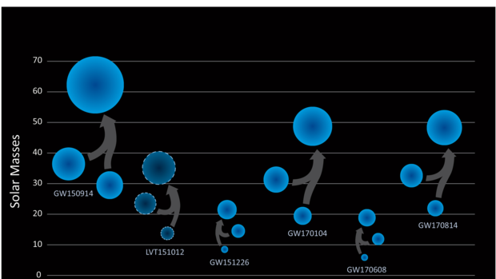
Motivation
GWs: detection of binary black hole merger
PBHs: Primordial black holes as dark matter?
GW150914：PRL 116, 061102; GW151226: PRL 116, 241103; GW170104: PRL 118, 221101; GW170608: ApJ 851, L35; GW170814: PRL 119, 141101;
Bird etal., PRL 116, 201301; Sasaki etal., PRL 117, 061101;

Slide 4

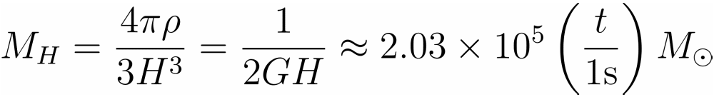

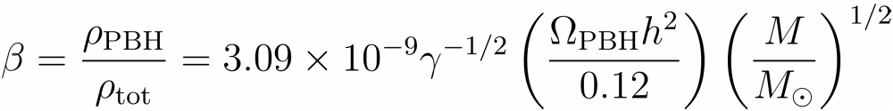
The PBHs
PBHs: PBH forms in the radiation era as a result of gravitational collapse of density perturbations generated during inflation
The mass
Suppose that the mass of PBHs is of the same order of the horizon mass
The fraction of the mass of the Universe in PBHs at the formation of PBHs

Slide 5
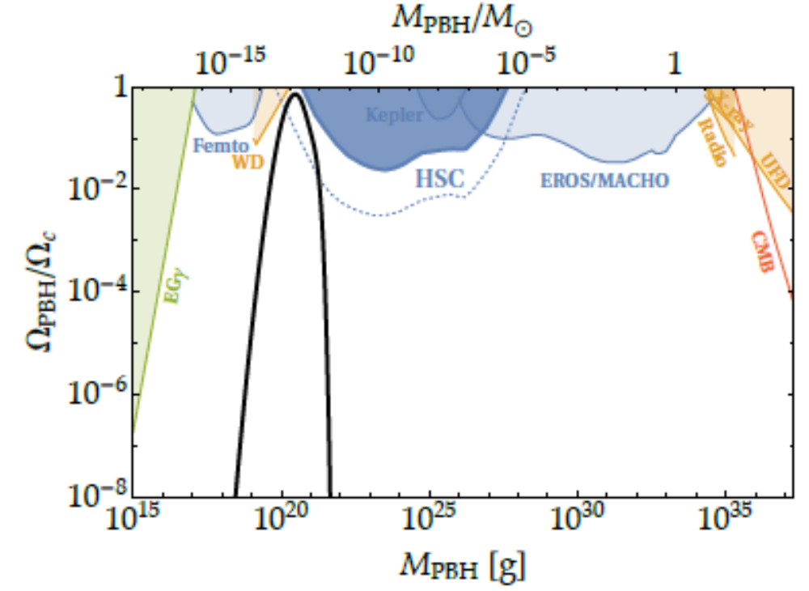
Observational constraints
Inomata etal. PRD 96 (17) 043504

Slide 6







The Constraints
The mass window
  Hawking radiation by now
  MACHO (Massive Astrophysical Compact Halo Object)
  Astrophysical constraints (femtolensing, millilensing, microlensing etc)
  -distortion
Carr, APJ 201 (75) 1
Exclude
EROS-2 Collaboration 07, AA 469, 387
Exclude
Exclude
Kohri etal. 14, PRD 90, 083514
Gould 92; Nemiroff etal. 01; Wilkinson etal. 01; Dalcanton etal. 94; Allsman etal. 01; Tisserand etal. 07; Carr etal. 10; Griest etal. 13

Slide 7





The mass window for PBHs
Allowed mass window
Particular constraints
  Microlensing constraints
  Extended mass functions
Kuhnel etal. 17, 1705.10361;
Kovetz, 1705.09182;
Ali-Haimoud etal., 1709.06576
Width
Inomata etal. PRD 96 (17) 043504
Allowed mass
All observations combined: PBHs can only constitute of order 10% of the dark matter
Carr etal. PRD 96 (17) 023514

Slide 8
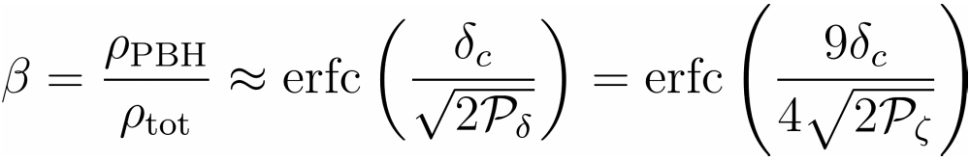


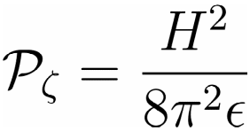
The production of PBHs
The energy density
Need an enhancement on the primordial power spectrum: at small scales
Carr, APJ 201 (75) 1

Slide 9
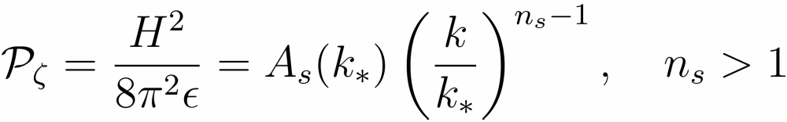
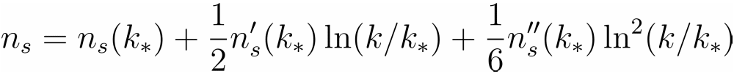
The production mechanism
Blue spectrum
Running index
Designer inflation
Parametric Resonance
Waterfall scenario
Enhancement: Power spectrum peaks on some scales

Slide 10
Inflationary models
Two-field hybrid model of inflation
Axion inflation
Single field double inflation
Single field inflation
Garcia-Bellido, Linde, Wands, PRD 54 (96) 6040;
Inomata etal. PRD 95 (17) 123510; PRD 96 (17) 043504
Garcia-Bellido, Peloso, Unal, JCAP 1612 (16) 031
Yokoyama, PRD 58 (98) 083510
Saito, Yokoyama & Nagata, JCAP 06(2008)024
Kannike, Marzola, Raidal, Veermae, JCAP 1709 (17) 020
Garcia-Bellido, Morales, Phys. Dark Univ. 18 (17) 47;
Ezquiaga, Garcia-Bellido, Morales, 1705.04861

Slide 11
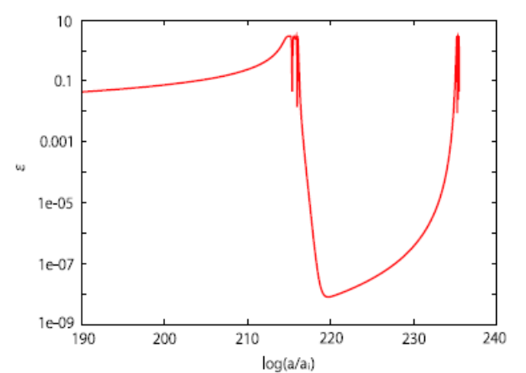
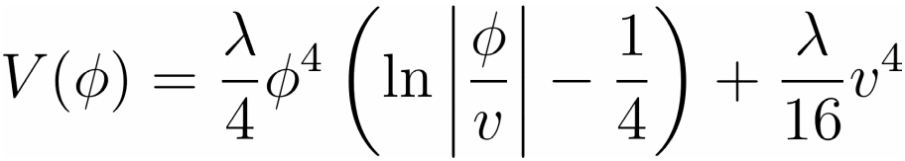
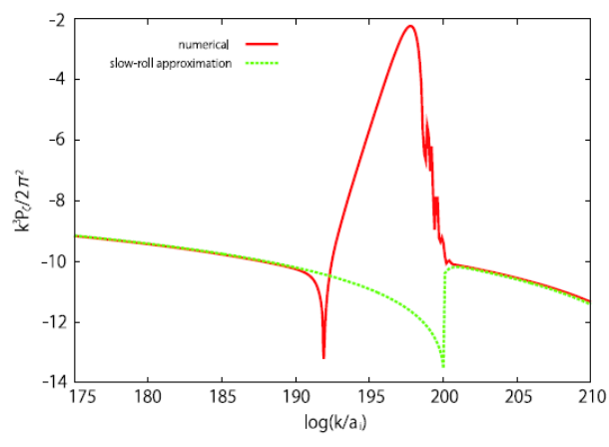




Double inflation
Single field double inflation: Coleman-Weinberg potential
Chaotic inflation + New inflation
Initial condition?
Yokoyama, PRD 58 (98) 083510
Saito, Yokoyama & Nagata, JCAP 06(2008)024

Slide 12
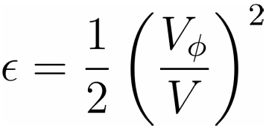
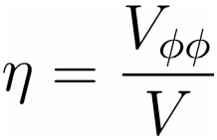
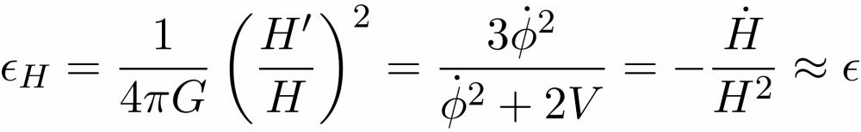
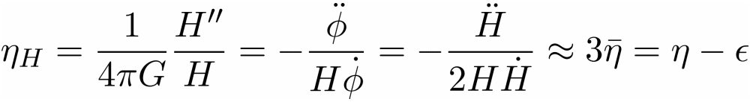
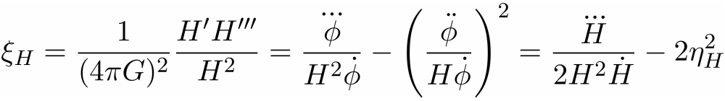
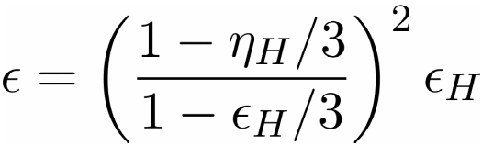
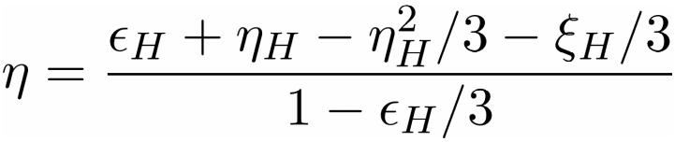
Some notations
Slow-roll parameters
Liddle, Parsons, Barrow,
PRD 50 (94) 7222
Notes:
The notation of the slow-roll parameters

Slide 13

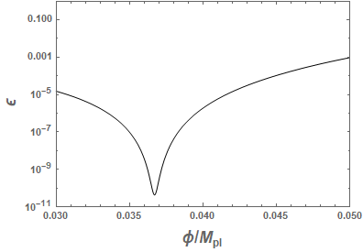
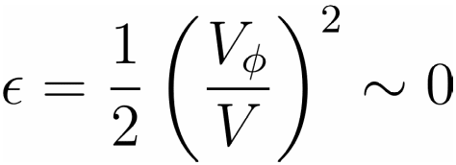
The enhancement
Very small at small scales
Slow-roll inflation
Motivation and Goal: Decrease by 7 orders of magnitude

Slide 14

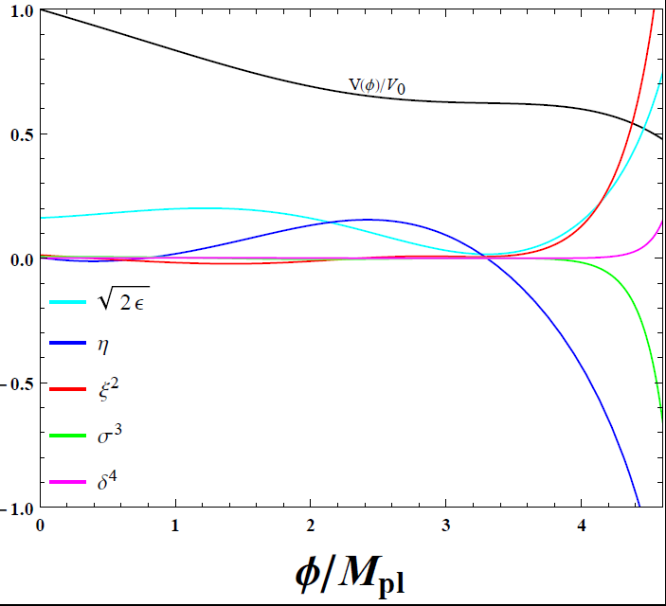
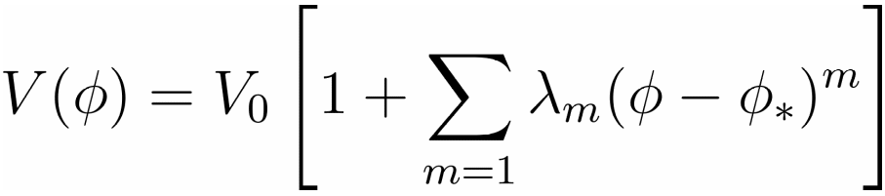

The Challenges
Slow-roll inflation
Very small slow-roll parameter
increases monotonically till
Gao, Gong and Li, 1405.6451

Slide 15

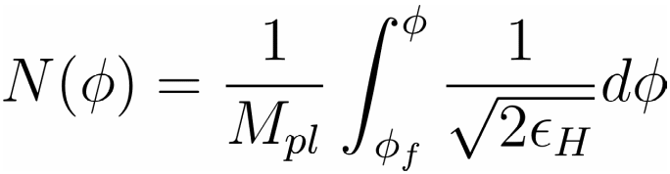
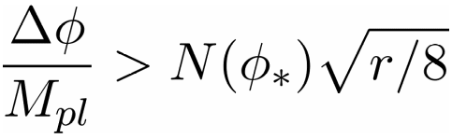


Modified Lyth bound
Lyth bound
Smaller field excursion: breakdown of Lyth bound
Slow-roll Results
Numerical Results

Slide 16
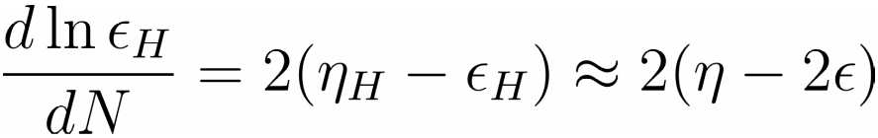
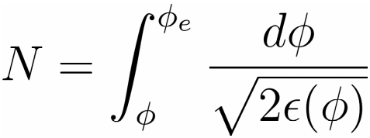


The challenges
Breakdown of slow-roll inflation
Large contribution to N
Ruin of the featureless and smooth over the observational scales, leads to big distortion
N can be much larger than 60
Planck15, AA 594 (16) A20

Slide 17
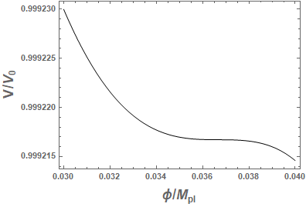

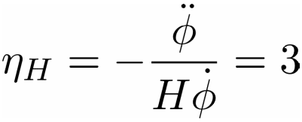

The generic feature
Small requires very flat potential, inflection point
Ultra-slow-roll inflation
Break-down of slow-roll
Tsamis, Woodard, PRD 69 (04) 084005

Slide 18


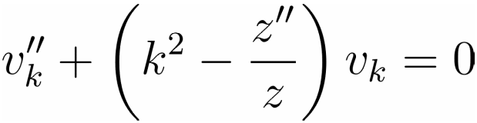
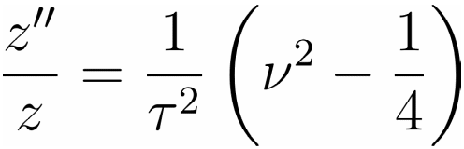

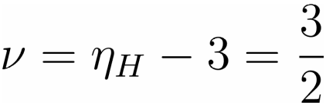
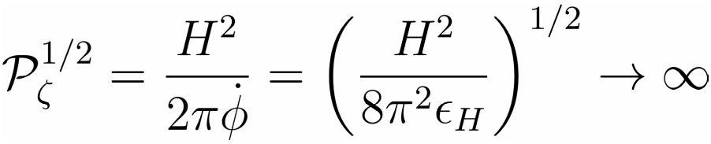
Ultra-slow-roll inflation
The field rolls faster
Mukhanov-Sasaki Equation
The contribution to N during ultra-slow-roll inflation (inflection point) becomes smaller
Dimopoulos, 1707.05644
Slow-roll
Kinney, PRD 72 (05) 023515

Slide 19

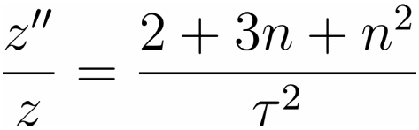
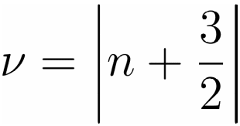
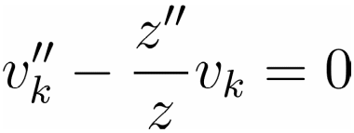
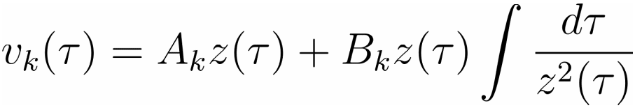
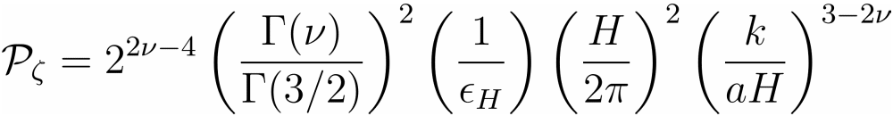

Constant-roll inflation
Constant-roll inflation
No freezing out on Super-horizon scale
Power spectrum
growing mode?
Martin, Motohashi, Suyama PRD 87 (13) 023514
Motohashi, Starobinsky, Yokoyama, JCAP 1509 (15) 018

Slide 20
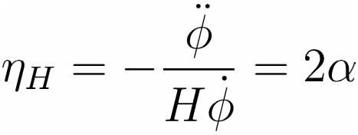






Constant-roll inflation1
The model
Power-law inflation
Exit problem

Slide 21
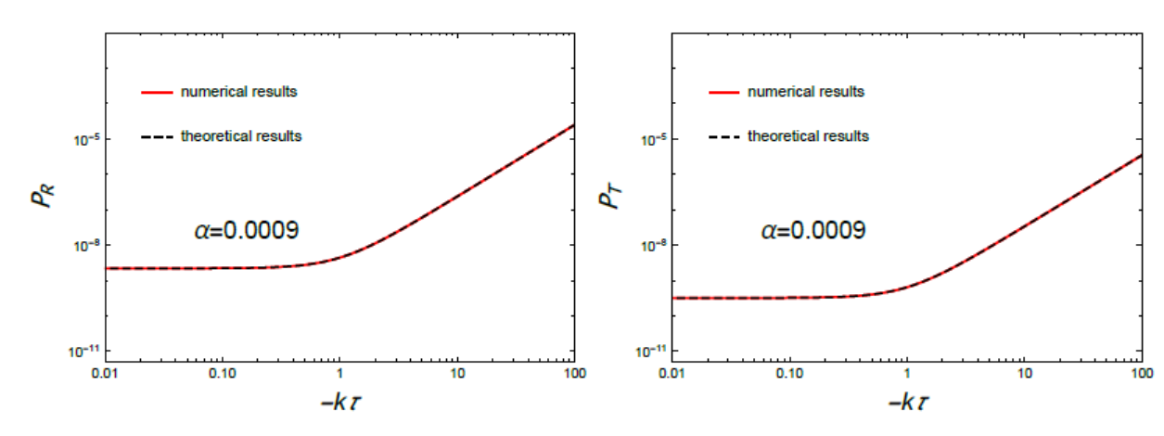

Constant-roll inflation2
Validity of analytical approximation
Slow-roll inflation
Yi and Gong, 1712.07478

Slide 22
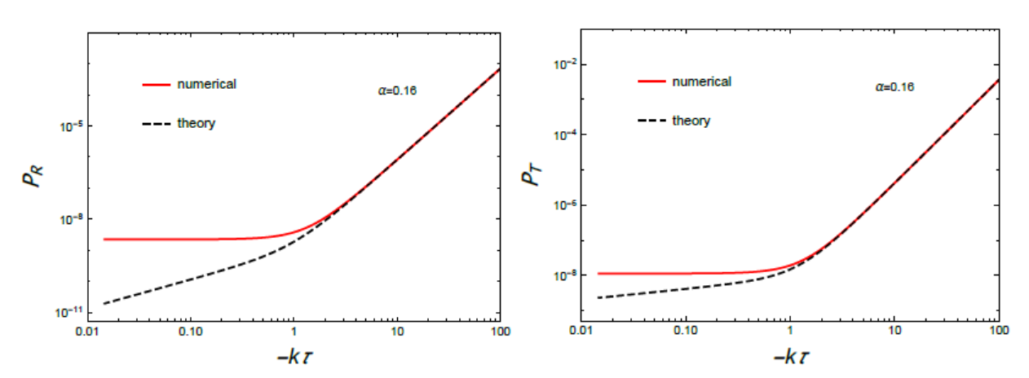
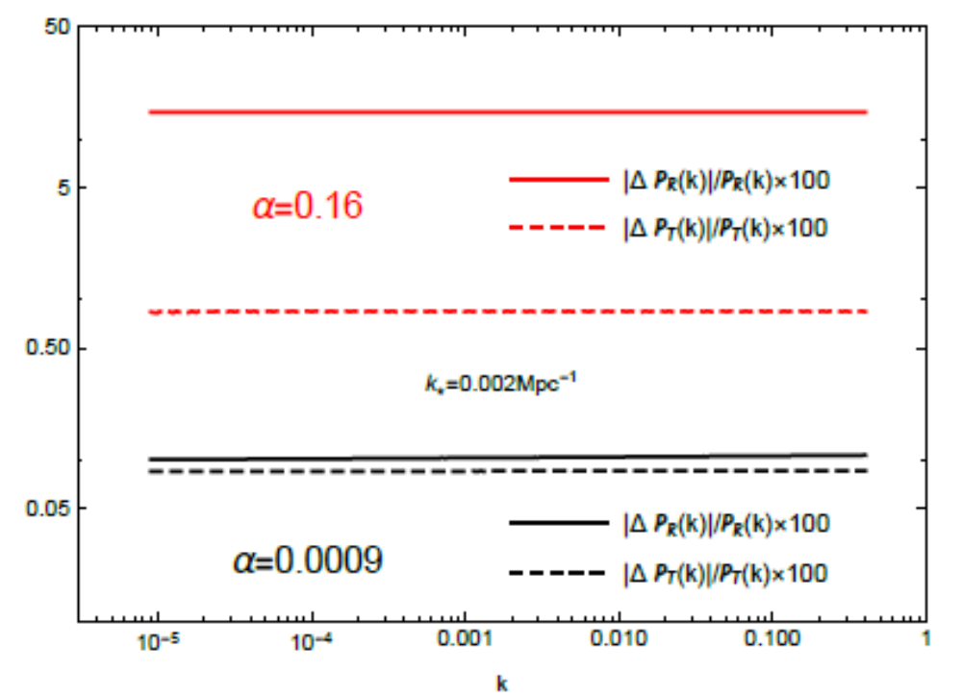
Constant-roll inflation3
Validity of analytical approximation
Chongchitnan & Efstathiou, JCAP 0701
Yi and Gong, 1712.07478

Slide 23
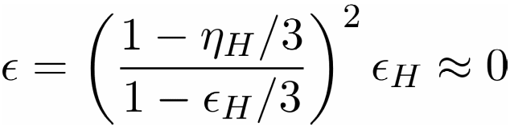
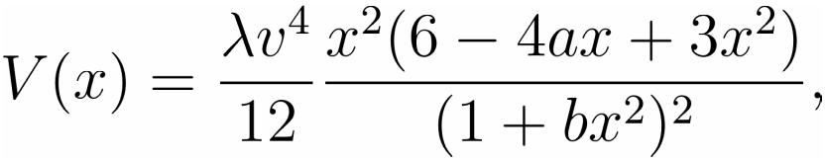
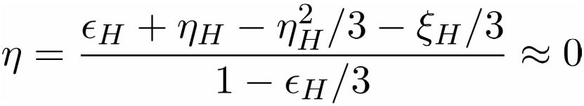
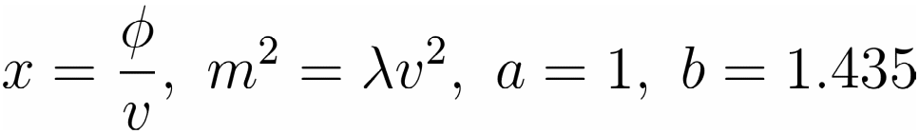


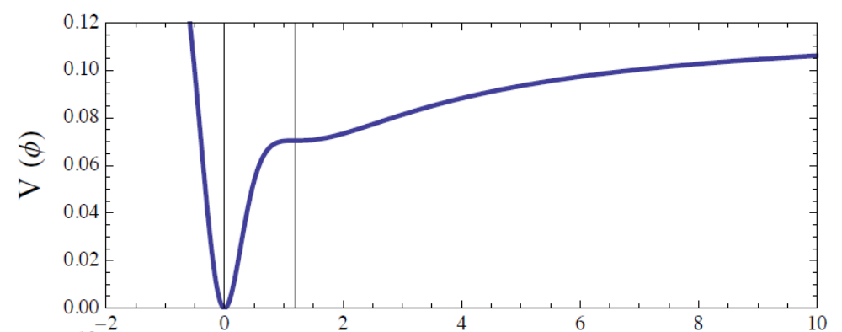
Inflection point inflation
Toy model
Inflection point
Garcia-Bellido, Morales, Phys. Dark Univ. 18 (17) 47

Slide 24
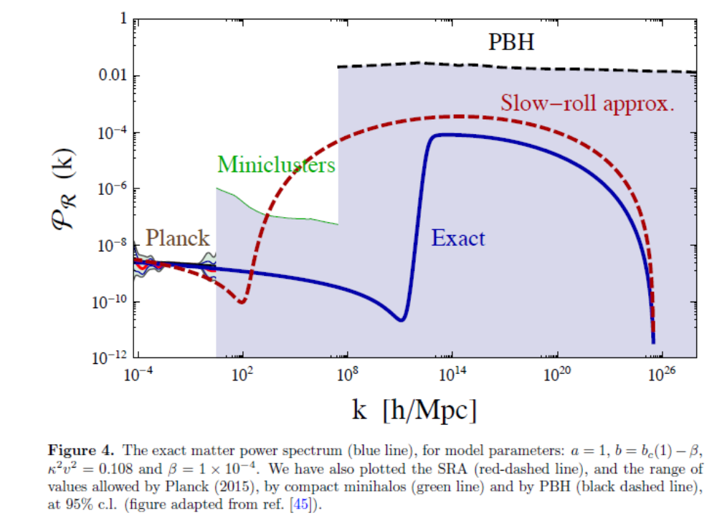
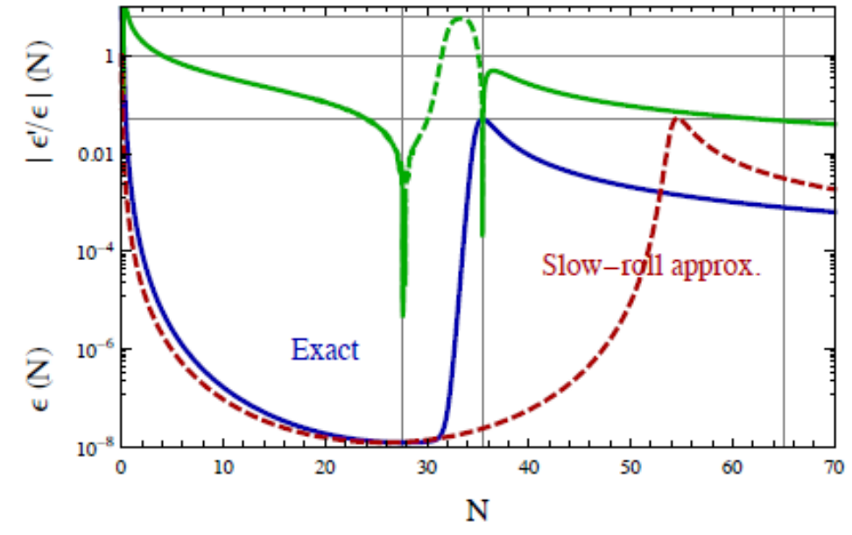
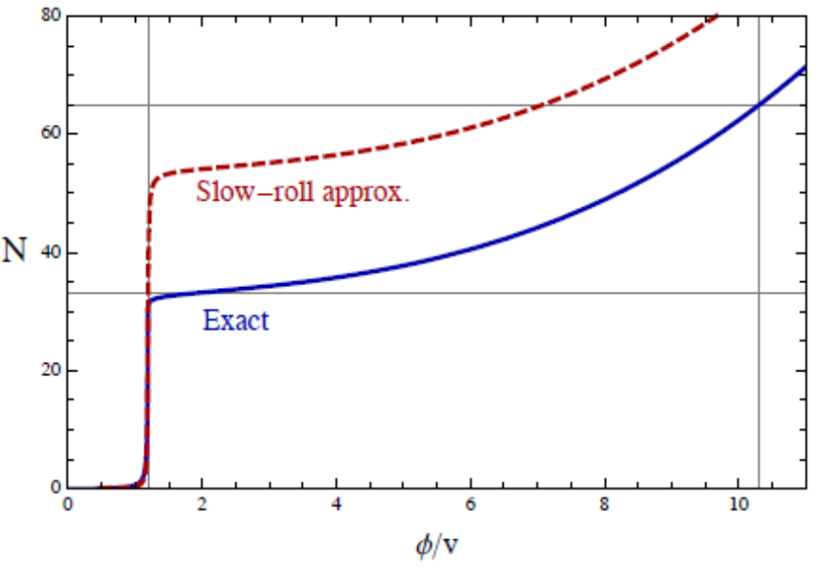
The toy model
The change of

Slide 25
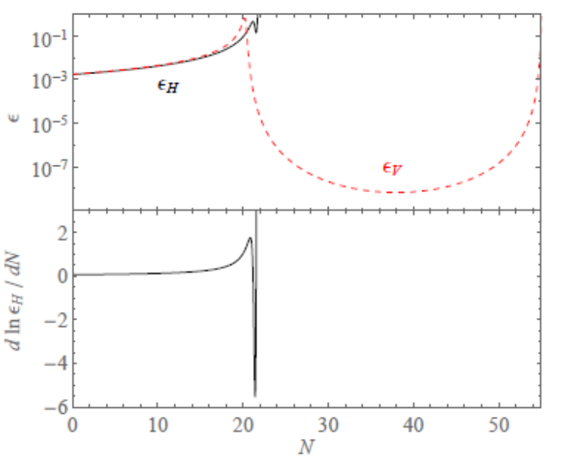
The criticism
Breakdown of slow-roll approximation
Inflation ends before reaching the inflection point
Not enough enhancement of the amplitude
Needs to apply the formalism for ultra-slow-roll inflation
Overshot from standard inflation, large suppression of the amplitude
Germani, Phys. Dark Univ. 18 (17) 6
Motohashi, Hu, PRD 96 (17) 063503

Slide 26






Critical Higgs Inflation
The Higgs inflation
Ezquiaga, Garcia-Bellido, Morales, 1705.04861

Slide 27



The model
Polynomial potential
Lyth bound
Gao, Gong, Li, PRD 91 (15) 063509

Slide 28


The model
Polynomial potential

Slide 29



The model parameters
The parameters: determined by observational data
Specify
Planck15: AA 594 (16) A20

Slide 30


Inflection point
Slow-roll parameters
Inflection point

Slide 31






Ultra-slow-roll Inflation
Inflation
Ensure the reach of inflection point
Inflection point
Notes:
Around the inflection point, delta N is around 40

Slide 32

The power spectrum
Numerical solution
Gong, 1707.09578
Peak value

Slide 33






The other constraint
The distortion
Inomata etal. PRD 95 (17) 123510;
Nakama etal., PRD 95 (17) 121302
Notes:
CMB distortion

Slide 34


Conclusions
The large enhancement on the power spectrum at small scales is possible from ultra-slow-roll inflation
To reach the ultra-slow-roll inflation, it is required that for a brief time before the scalar field reaches the inflection point
Although and , inflation does not end near the inflection point
The scalar field is not trapped in the ultra-slow-roll inflation because of the inflection point
Notes:
Propose the model and procedure for model building

Slide 35
Thank You

