Slide 1


QGP viscosity at RHIC and LHC energies
Huichao Song 宋慧超
Supported by DOE
Seminar at the Interdisciplinary Center for Theoretical Study, USTC
11/22/2011

Slide 2
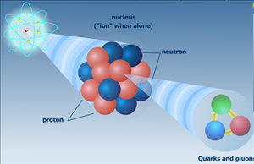
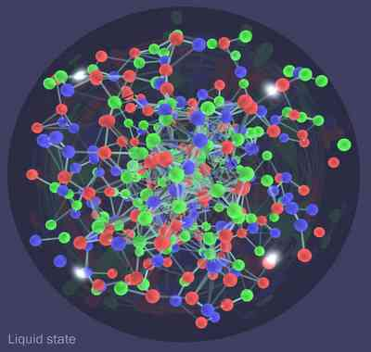
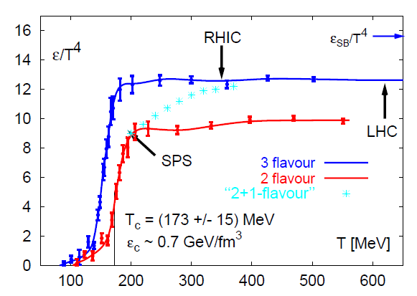
Quark and Gluons: confined in proton and neutrons through strong forces described by QCD
QGP (quark gluon plasma): deconfinement phase of QCD matter
EOS (lattice QCD)

Slide 3
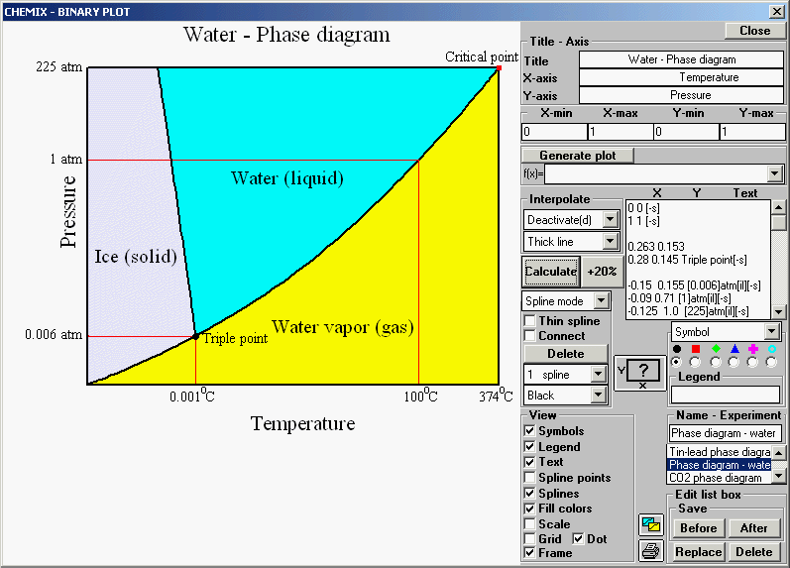
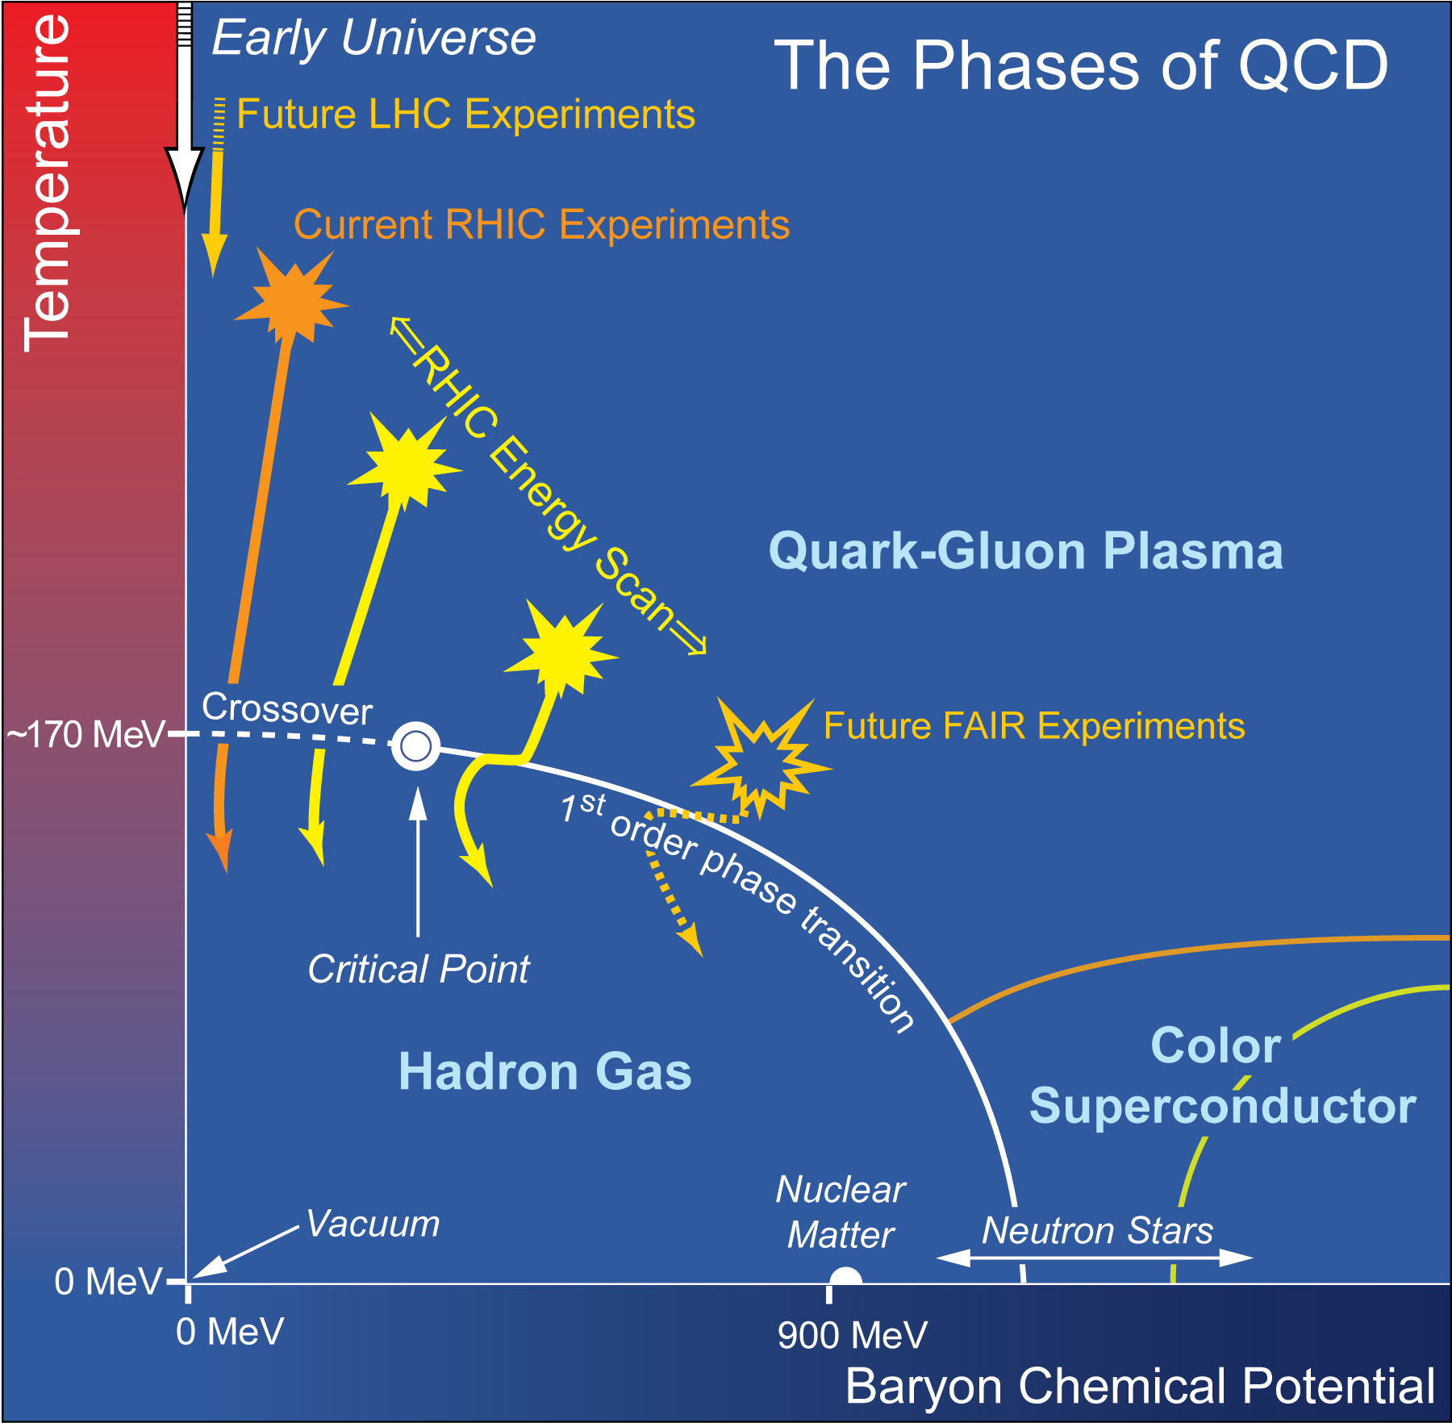
QCD Phase diagram
Water: Phase diagram
QGP

Slide 4
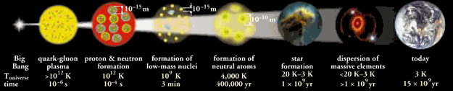
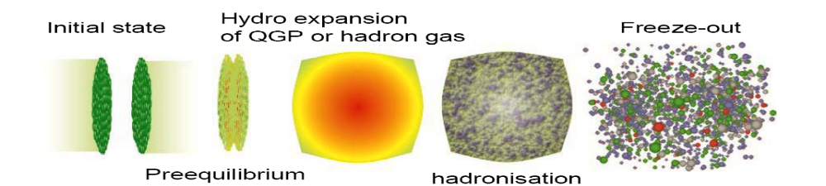
big bang: the very early history of the universe
QGP
Hadrons
nuclei
atom
little bang: the different stage for a relativistic heavy ion collisions
Hadron
Gas
QGP
S.Bass

Slide 5
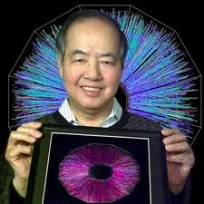
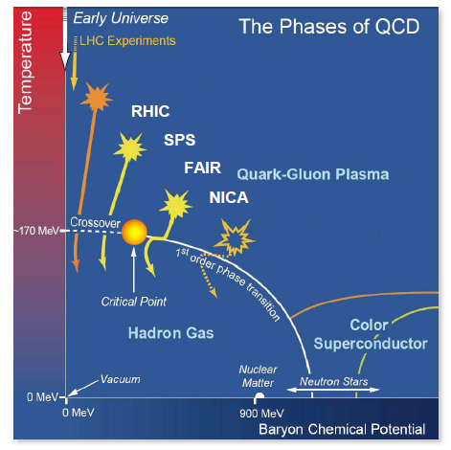
A brief history of relativistic heavy ion physics
1974: Workshop on “BeV/nucleon collisions of heavy
ions”
We should investigate.... phenomena by distributing energy of high nucleon density of a relatively large volume” ---T.D.Lee
1984: SPS starts, (end 2003)
1986: AGS stars, (end 2000)
2000: RHIC starts
2010: LHC starts
Future: FAIR & NICA

Slide 6
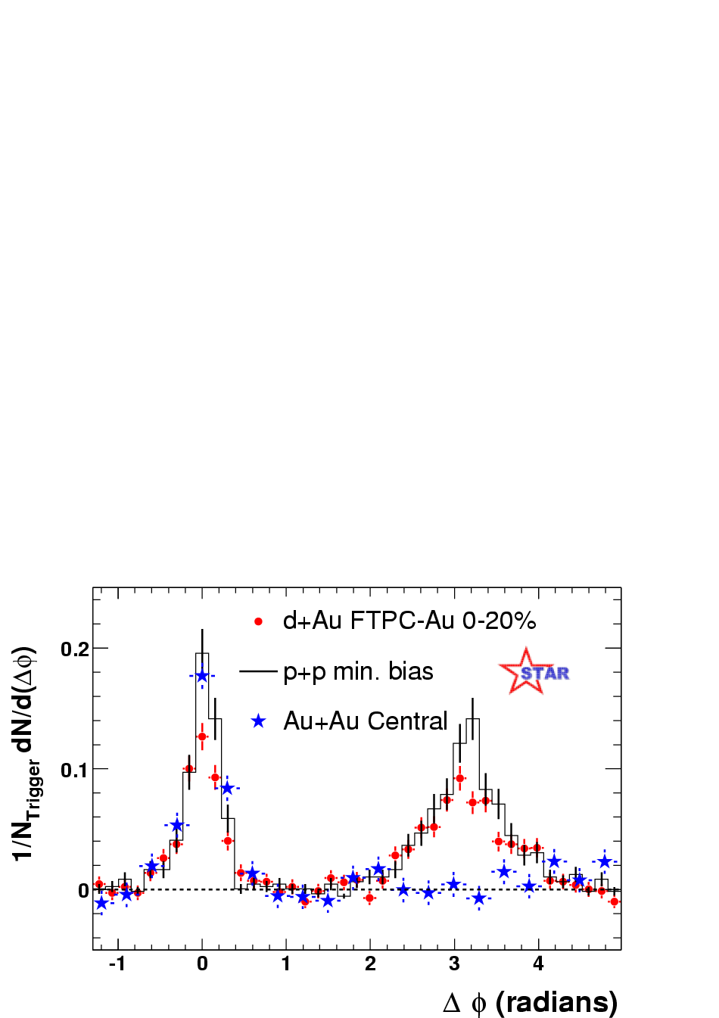
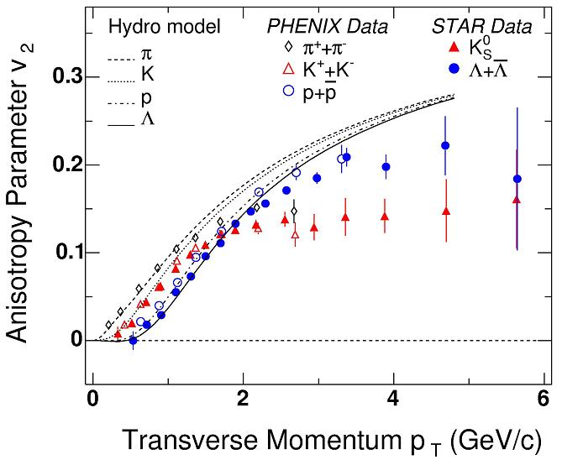
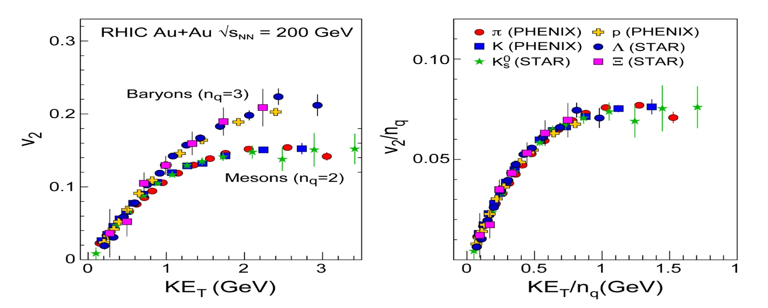
The QGP was discovered
RHIC (2000-- )

Slide 7
Future science at the relativistic heavy ion collider
the next phase … will focus on detailed investigations of the QGP, “both to quantify its properties and to understand precisely how they emerge from the fundamental properties of QCD”
--The frontiers of nuclear science, a long range plan
-What is the mechanism of the unexpectedly fast thermal equilibrium?
-What is the initial temperature and thermal evolution of the produced matter?
-What is the energy density and equation of state of the medium?
-What is the viscosity of the produced matter?
-Is there direct evidence for deconfinement, color screening, and a partonic nature of the hot dense medium? What is the screening length?
-Is the chiral symmetry restored by QCD?
-How does the new form of matter hadronize at the phase transition?
http://www.bnl.gov/physics/rhiciiscience/

Slide 8
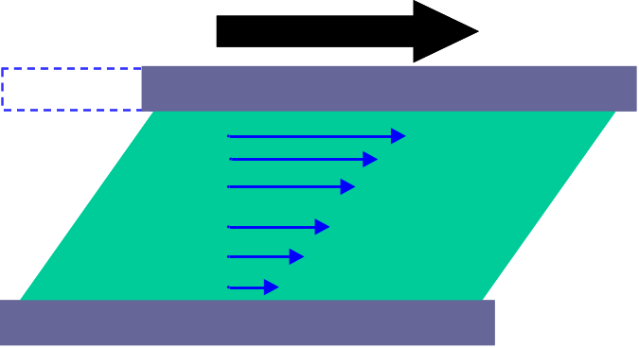
The fluid nature of the QGP &
its viscosity
shear viscosity
bulk viscosity

Slide 9
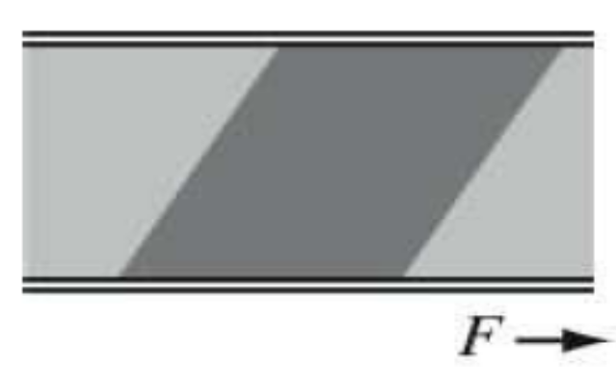
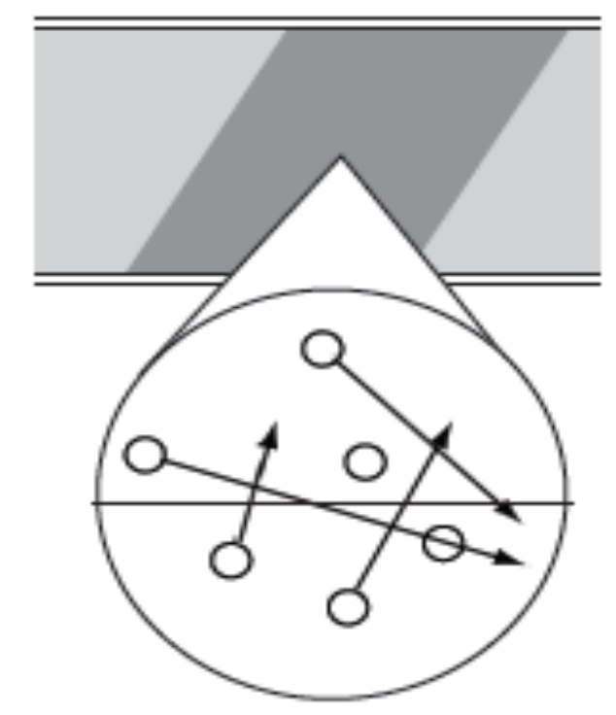
Lower bound for from quantum mechanics
Quantum mechanics excludes the possibility of an absolutely ideal fluid:
Example: shear viscosity of a dilute gas
F
y
Shear viscosity - classical definition:
u
Shear viscosity - microscopic view:
the ability of momentum transfer
uncertainty principle:

Slide 10
The QGP shear viscosity
Kubo formula:
Kinetic theory:
-Weakly coupled QCD prediction:
P.Arnold,G.Moore,&Y.Yaffe, 00,03
-Strongly coupled AdS/CFT prediction:
AdS/CFT correspondence: gauge/gravity duality
4d gauge theory at strong coupling 5d gravity at weak coupling
N=4 SYM
Type IIB superstring theory on
D.T. Son, et,al. 05
(not related to real QCD)
To extract the QGP viscosity from experimental data, we need viscous hydrodynamics

Slide 11
Ideal hydrodynamics
hydro
S.Bass
Conservation laws:
ideal hydro: local equilibrium
- 4 equations
- 5 unknowns
Input: “EOS”
Notes:
Introduction
11

Slide 12
Viscous hydrodynamics
hydro
S.Bass
Conservation laws:
ideal hydro: local equilibrium
viscous hydro: near equilibrium
shear pressure tensor
bulk pressure:
Notes:
Introduction
12

Slide 13
Viscous hydrodynamics
hydro
S.Bass
Conservation laws:
- Israel-Stewart eqns.
Notes:
Introduction
13

Slide 14
Viscous hydrodynamics
hydro
S.Bass
Conservation laws:
- Israel-Stewart eqns.
Input: “EOS”
initial and final conditions
Bjorken appro. : reduces (3+1)-d hydro to (2+1)-d hydro
Notes:
Introduction
14

Slide 15
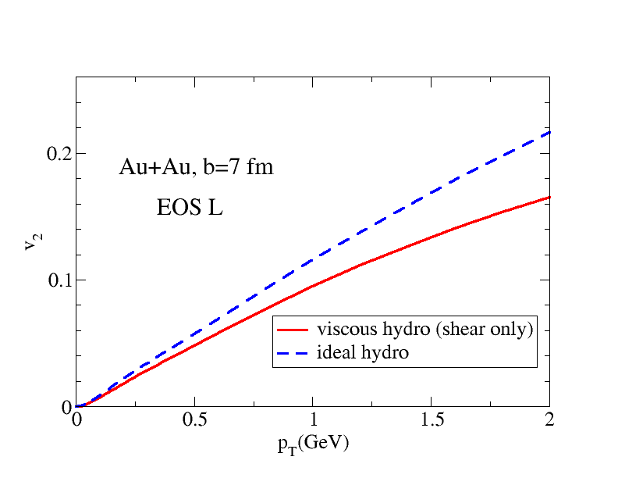
Viscous hydro: Shear viscosity & elliptic flow V2
H. Song and U. Heinz, PRC08
Elliptic flow v2
20-25% v2 suppression
-V2 can be used to extract the QGP shear viscosity

Slide 16
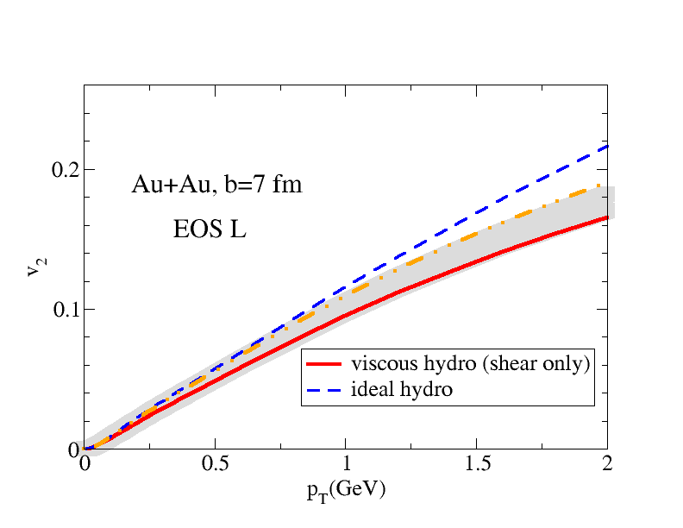
Shear viscosity & elliptic flow V2
Elliptic flow v2
20-25% v2 suppression
-V2 can be used to extract the QGP shear viscosity
-For an acurrate extraction of QGP viscosity, one needs very precise V2 (experimental data & theoretical results)

Slide 17
Shear viscosity & elliptic flow V2
Elliptic flow v2
20-25% v2 suppression
Example: If v2 is increased by 10%, one need to increase by in order to describe the same exp. data
-10% uncertainties in V2 translate into 50% uncertainties for the extracted value of
-V2 can be used to extract the QGP shear viscosity
-For an acurrate extraction of QGP viscosity, one needs very precise V2 (experimental data & theoretical results)

Slide 18


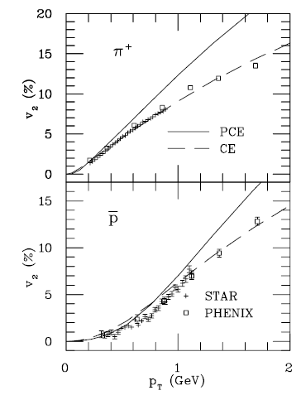
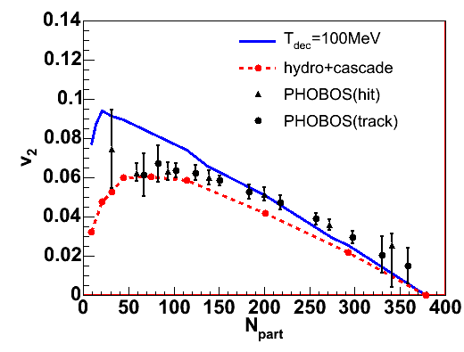
Hadronic effects on elliptic flow V2
Partially Chemical equil.
hadronic dissipative effects
Ideal hydro
~30%
~30-50%
P. Huovinen 07
T. Hirano 06
-These two HRG effects are not included in early viscous hydro calculations
viscous hydro + hadron cascade (URQMD) hybrid approach
URQMD includes the partially chemical equilibrium nature & hadronic dissipative effects

Slide 19
Hadron
Gas
QGP
Initial conditions viscous hydro final conditions
Hadron
Gas
QGP
Initial conditions viscous hydro hadron cascade

Slide 20
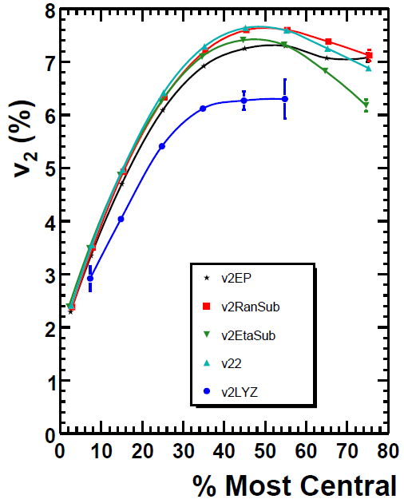
Extracting QGP viscosity from RHIC data
EXP.
V2 from different exp methods are affected by non-flow and fluctuations
~20%
STAR DATA
~20% uncertainties in EXP V2
~100% uncertainties for the
extracted QGP viscosity

Slide 21
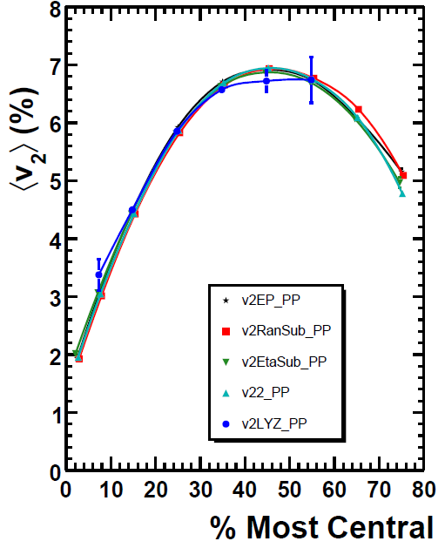
Extracting QGP viscosity from RHIC data
EXP.
Corrected v2:
Ollitrault, Poskanzer & Voloshin, PRC09
with assumptions on fluctuations and non flow, all corrected v2 in participant / reaction plan converge to unique curves
Corrected V2
greatly reduces uncertainties from
EXP data for the extracted

Slide 22
Extracting QGP viscosity from RHIC data
Theoretical Modeling
Viscous Hydro + URQMD
-initial conditions
-initial conditions
-EoS: s95p-PCE Huovinen & Petreczky10
-chemical composition of HRG
Song, Bass
& Heinz, PRC2011
-viscosity of HRG
-bulk viscosity: <20%
Song & Heinz,
PRC 09

Slide 23
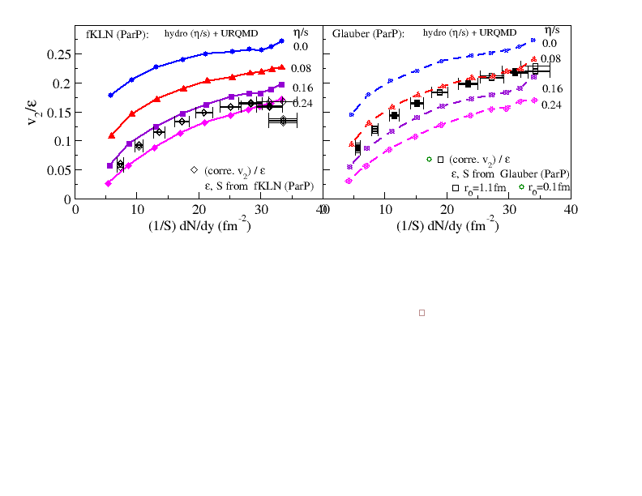
QGP viscosity from
MC-KLN
MC-Glauber
(Part. Plan)
(Part. Plan)
for MC-KLN initial conditions
for MC-Glauber initial conditions
H. Song, S. Bass, U. Heinz, T. Hirano, and C. Shen, PRL2011

Slide 24
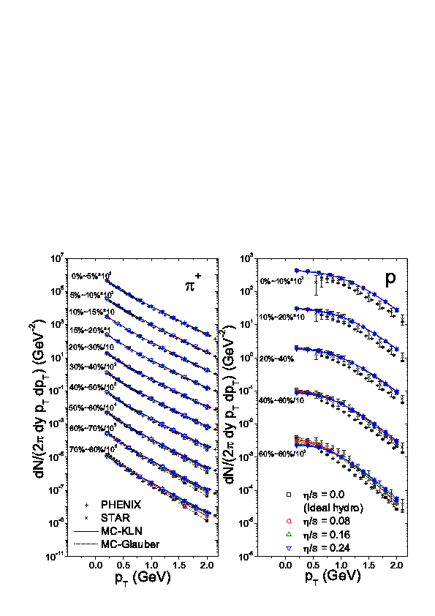
H. Song, S. Bass, U. Heinz, T. Hirano, and C. Shen,PRC2011
-a nice fit for both pion and proton spectra, insensitive to QGP viscosity

Slide 25
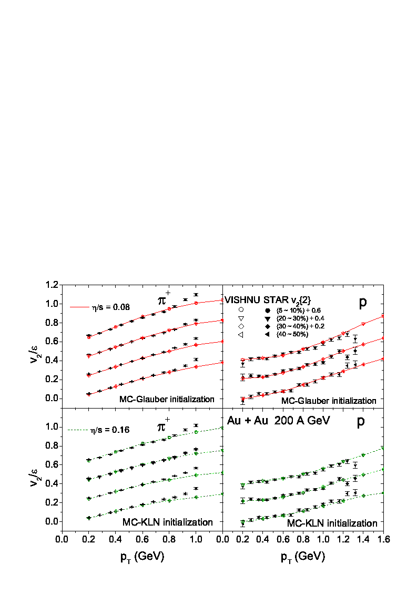
H.Song, S. Bass , U. Heinz, T. Hirano, and C. Shen, PRC2011
5-10%
20-30%
20-30%
30-40%
30-40%
40-50%
40-50%
Glauber
Glauber
5-10%
20-30%
20-30%
30-40%
30-40%
40-50%
40-50%
KLN
KLN
-fluctuating effects is reduced by comparing theory & EXP.
-hit the lower-bound of extracted from (non flow effects)
for Glauber initial condi.
for KLN initial condi.

Slide 26
QGP viscosity at RHIC & LHC energies
-- H. Song, S. Bass, U. Heinz, PRC2011

Slide 27
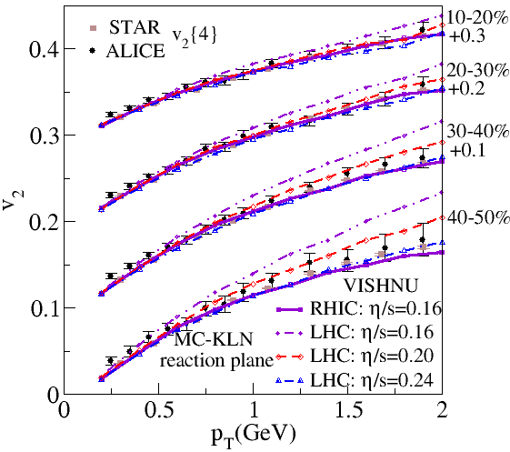
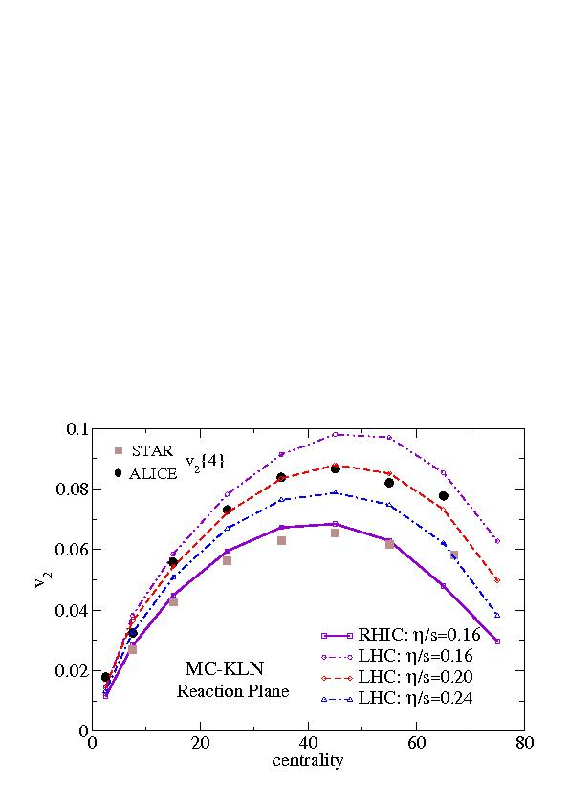
V2(PT) at RHIC and LHC
Song, Bass & Heinz, PRC 2011
RHIC:
Assuming const.
LHC:
This is not aim for extracting QGP viscosity at LHC energy with reliable uncertainty estimates

Slide 28
QGP viscosity from RHIC data
-- past, current and future

Slide 29
Viscous Hydrodynamics Modeling -- a brief history
Causal Viscous hydrodynamics: I-S formulism
W. Israel and J. M. Stewart, Ann. Phys. (N.Y.) ibid. 118, 341 (1979).
Viscous hydrodynamics in 1+1, 2+1 & 3+1-d for RHIC physics
A.Muronga, Phys. Rev. Lett. 88, 062302 (2002); Phys. Rev.C 69, 034903 (2004).
U. Heinz, H. Song and A. K. Chaudhuri, Phys. Rev. C73, 034904 (2006).
Numerical Simulations and implication to RHIC
H. Song and U. Heinz, Phys. Lett. B 658, 279 (2008) ; Phys. Rev.C77, 064901 (2008)
P. Romatschke and U. Romatschke, Phys. Rev. Lett. 99, 172301 (2007).
K. Dusling and D. Teaney, Phys. Rev. C 77, 034905 (2008)
D. Molnar and P. Huovinen, J. Phys. G 35, 104125 (2008).
Viscous hydro + hadron cascade hybrid model
H. Song , S. Bass and U. Heinz, Phys. Rev. C83, 024912 (2011)
Extracting QGP viscosity from RHIC data
M.Luzum and P. Romatschke, Phys. Rev. C78, 034915 (2008).
H.Song, S. Bass, U. Heinz, T. Hirano and C. Shen, Phys. Rev. Lett. 106, 192301(2011).
H. Song, S. Bass, U. Heinz, T. Hirano and C. Shen, Phys. Rev. C83, 054910(2011).

Slide 30
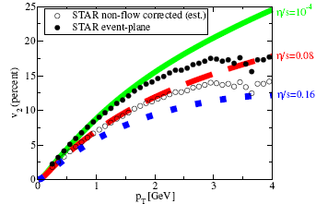

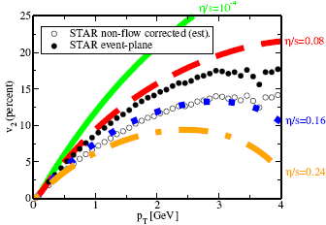

Viscous hydro & QGP viscosity (2008)
viscous hydro
(uncertainties in )
-initial conditions: CGC vs. Glauber ~100%
-EoS: ?%
-chemical composition of HRG : ?%
-viscosity of HRG : ?%
-bulk viscosity: ?%
Glauber
CGC
Luzum & Romatschke, PRC 2008

Slide 31
Viscous hydro & QGP viscosity (2008)
viscous hydro
(uncertainties in )
-initial conditions: CGC vs. Glauber ~100%
-EoS: EOS Q, vs. EOS L ~25%
-chemical composition of HRG : (PCE vs. CE) ~100%
-viscosity of HRG (or equil. HRG vs. non-equil. HRG) : ~100-150%
-bulk viscosity: ?%
Glauber
CGC
Luzum & Romatschke, PRC 2008

Slide 32
viscous hydro + URQMD & QGP viscosity (2010)
viscous hydro + URQMD
-initial conditions
-EoS: s95p-PCE (Huovinen & Petreczky 10)
-chemical composition of HRG
Song, Bass, Heinz,
PRC2011
-dissipative effects of HRG
-bulk viscosity: <20% Song & Heinz, PRC 09
This field is experiencing fast development !

Slide 33
viscous hydro + URQMD & QGP viscosity (2010)
viscous hydro + URQMD
elliptic flow data
-initial conditions
-non-flow & fluctuations :
-EoS: s95p-PCE (Huovinen & Petreczky 10)
Corrected integrated V2 in participant (reaction) plan for theoretical comparison
-chemical composition of HRG
Song, Bass, Heinz,
PRC2011
-dissipative effects of HRG
-bulk viscosity: <20% Song & Heinz, PRC 09
Ollitrault, Poskanzer & Voloshin, 09
This field is experiencing fast development !

Slide 34
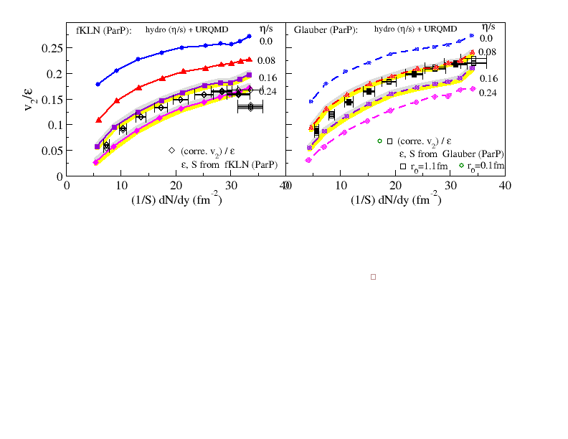
viscous hydro + URQMD & QGP viscosity (2010)
viscous hydro + URQMD
elliptic flow data
-initial conditions
-non-flow & fluctuations :
-EoS: s95p-PCE (Huovinen & Petreczky 10)
Corrected integrated V2 in participant (reaction) plan for theoretical comparision
-chemical composition of HRG
Song, Bass, Heinz,
PRC2011
-dissipative effects of HRG
-bulk viscosity: <20% Song & Heinz, PRC 09
Ollitrault, Poskanzer & Voloshin, 09
MC-KLN
MC-Glauber
viscous hydro + URQMD

Slide 35
The near future
More precise QGP viscosity
-uncertainties from Glauber and KLN initialization:
-- need other probe or tools to pin down the initial conditions
-uncertainties from initial flow, bulk viscosity, e-b-e hydro:
-- extract QGP viscosity from more observables:
1) uncertainties from exp data? 2) may sensitive to other hydro inputs
MC-KLN
MC-Glauber

Slide 36
Photons
HBT
V2
Spectra
Other free inputs in the hybrid model

Slide 37
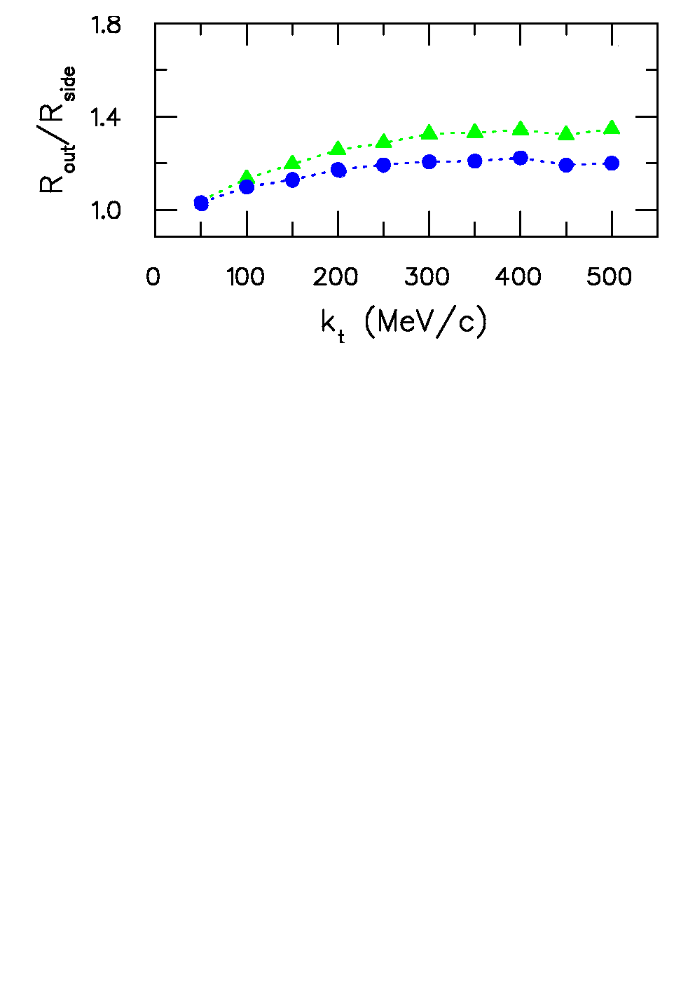
HBT radii
S. Pratt QM09
without viscosity
with viscosity
- is sensitive to the QGP viscosity
- However, viscosity is only one of the many ingredients that affect HBT radii (Pratt QM09)
- HBT HELPS to constrain the QGP viscosity, together with other observables (V2 …)

Slide 38
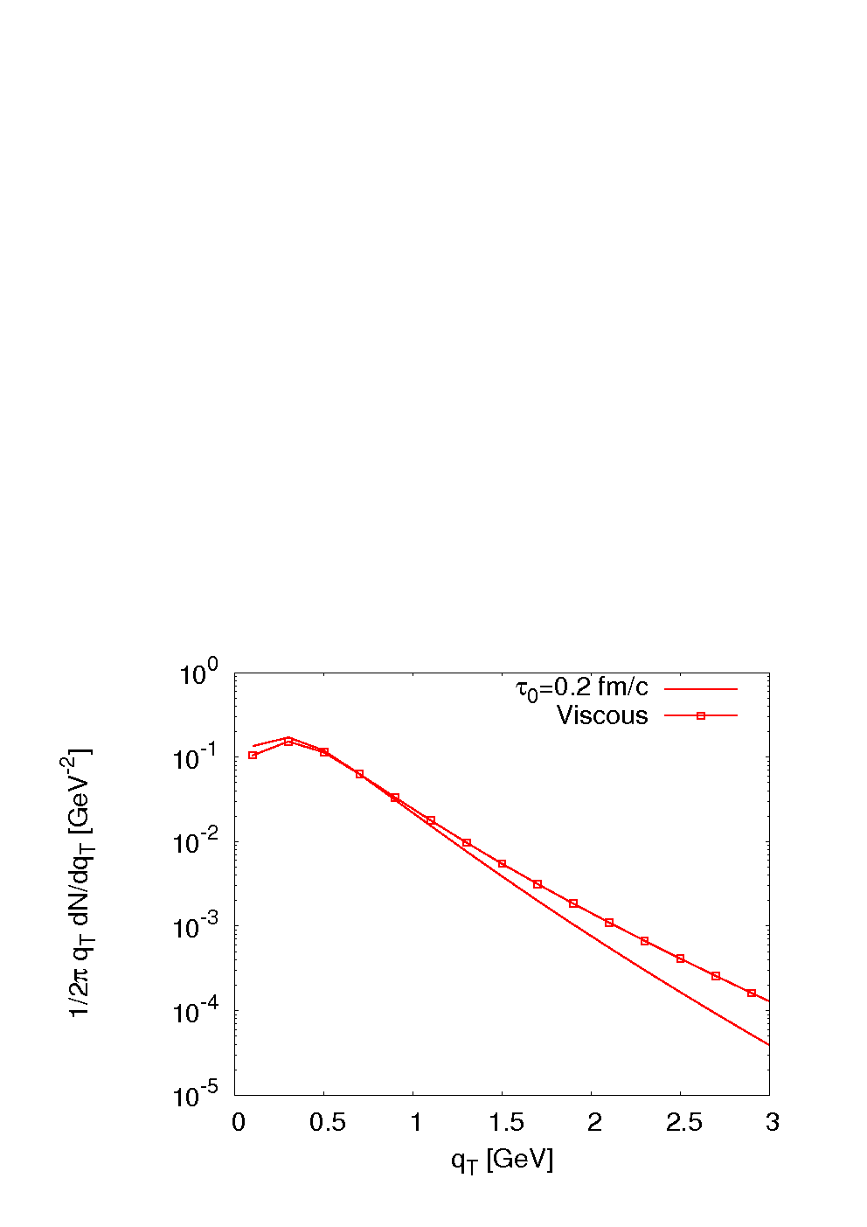
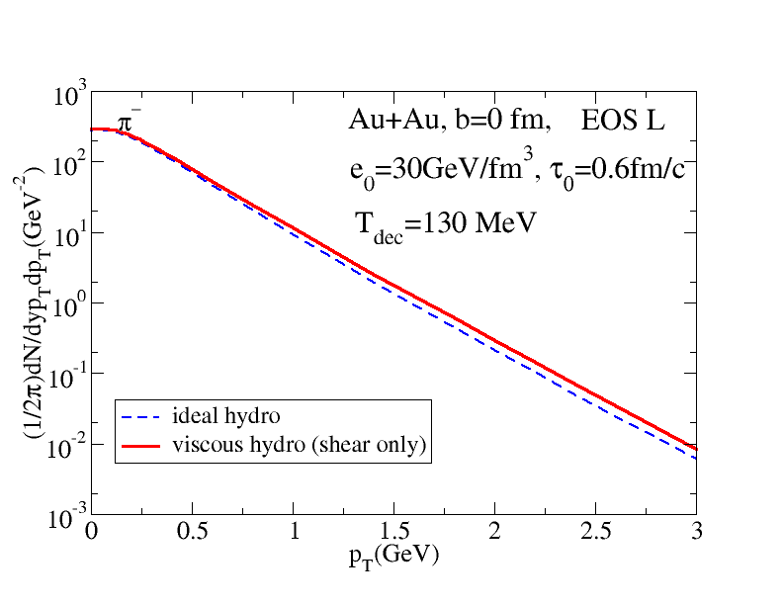
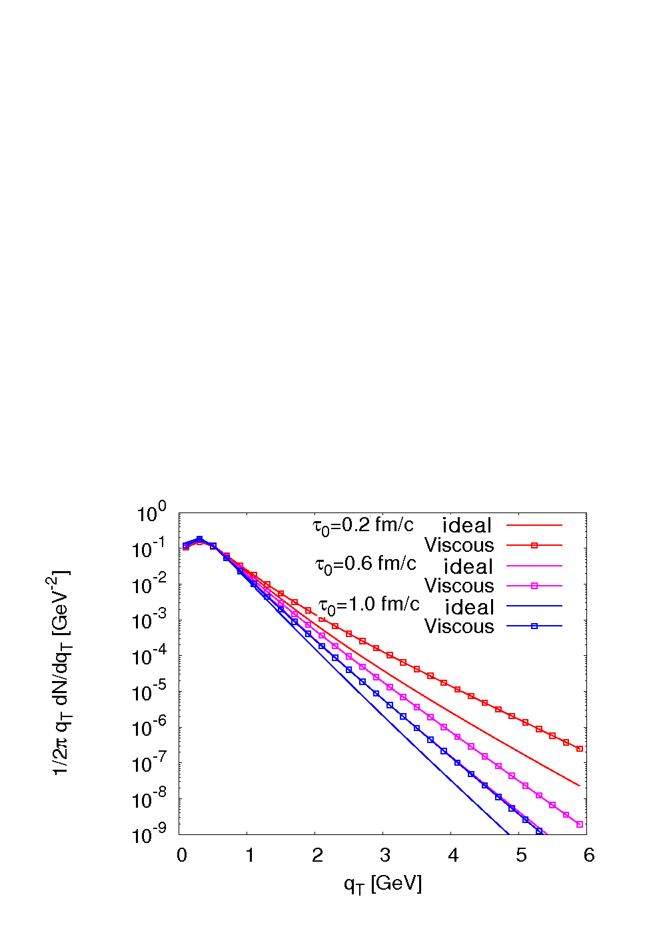
EM probes: Photons
Photon spectra
Pion spectra
K. Dusling, 0903
-Viscous hardening of PT-spectra is stronger for photons than hadrons
-However, earlier thermalization also leads to harder photon spectra (Dusling 0903)
-Photon spectra MAY HELP to constrain the 2-d range of QGP viscosity & thermalization time, together with other observables (V2 …)

Slide 39
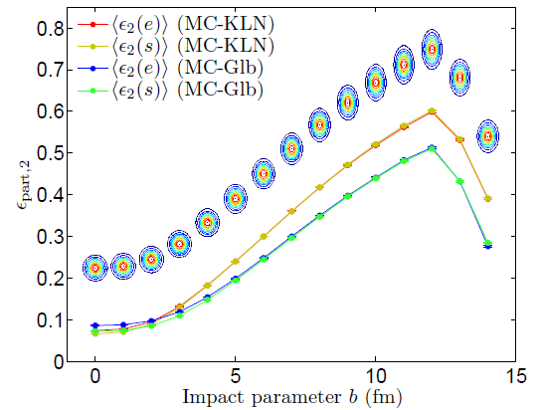
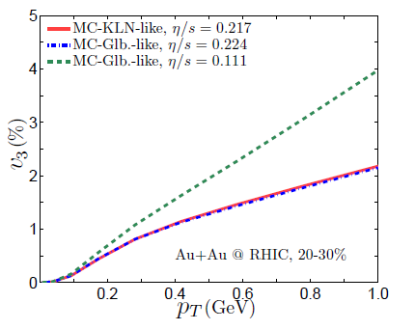
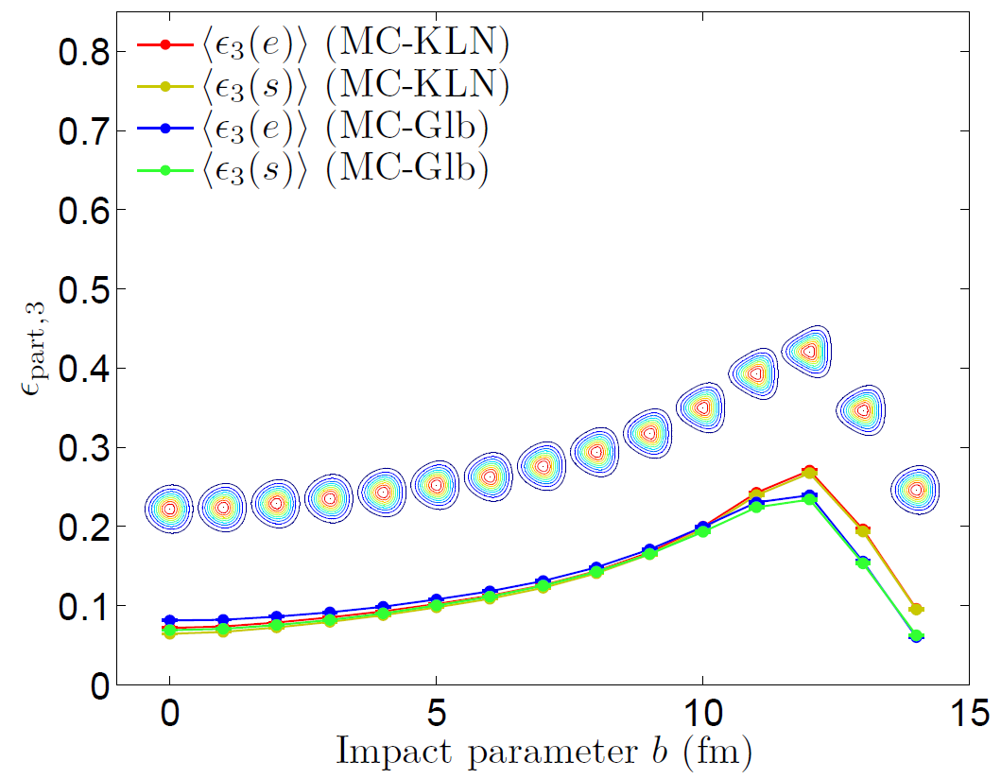
Triangular flow & QGP viscosity
MC-KLN
MC-Glauber
Zhi & Heinz, preliminary results
-triangular flow is sensitive to QGP shear viscosity
-triangular flow can help us to eliminate the uncertainties from KLN and Glauber

Slide 40
A short summary
- is sensitive to
Extraction from elliptic flow data using viscous hydro + UrQMD indicates:
-Relatively larger uncertainties are from initial geometry
MC-Glauber: MC-KLN:
-Relatively smaller uncertainties are from
initial flow, bulk viscosity, single short hydro vs. e-by-e simulations …
-other possible observables may help to reduce these uncertainties ,
photons, HBT radii, triangular flow …

Slide 41
Thank You

Slide 42
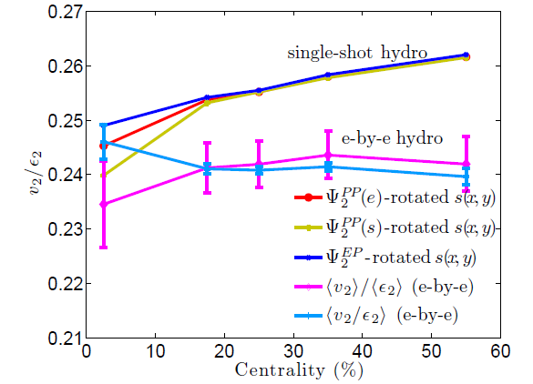
e-b-e hydro vs. single shot hydro
Zhi & Heinz, preliminary results
Event-by-event hydro produces 5% less v2/ecc than single-shot hydro with smooth averaged initial profile
each of them shifts v2 by a few percent
initial flow, bulk viscosity and e-b-e hydro:
cancelation among them
for MC-KLN initial conditions
for MC-Glauber initial conditions

