Slide 1


Deep Underground Xenon Observatory in China: the PandaX Experiment
刘江来
上海交通大学
Member of Collaboration

Slide 2
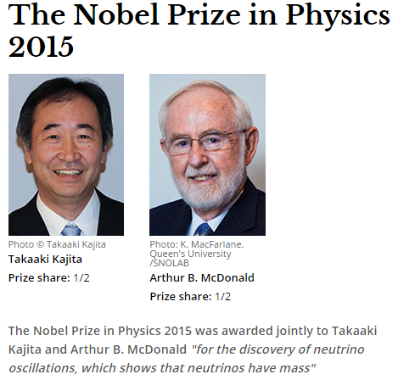

Three days ago …
梶田隆章

Slide 3
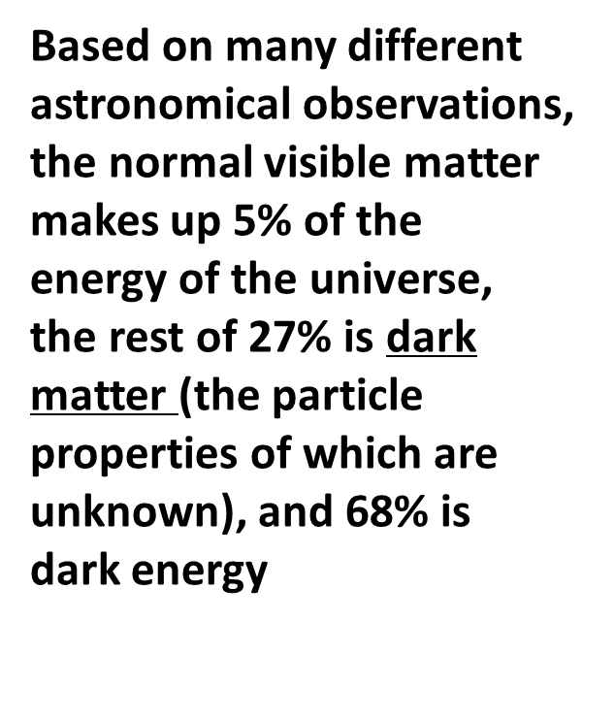
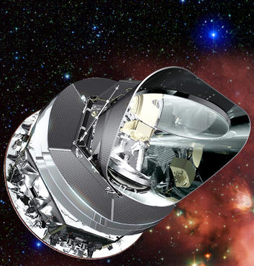
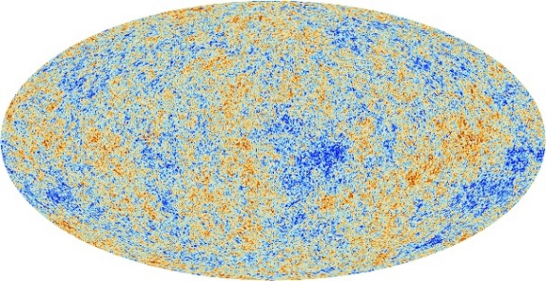
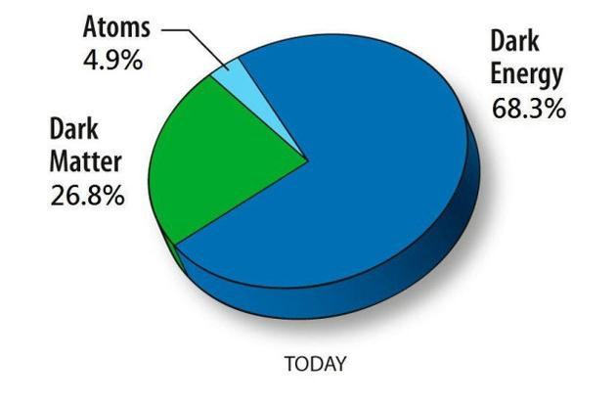
Existence of dark matter

Slide 4
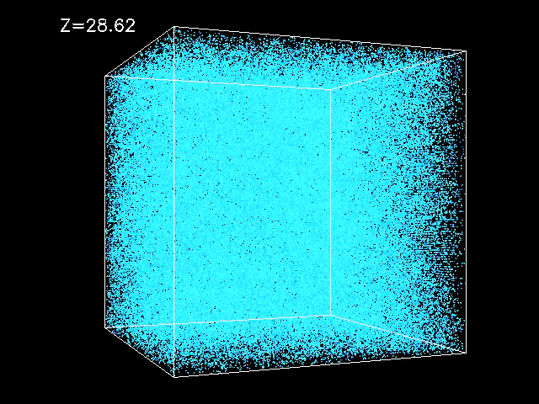
Neutrinos = dark matter?
Today’s Universe is very lumpy: the large structure formation maps to the tiny density fluctuation 13.7 billion years ago
Neutrinos, moving way too fast, do not generate the observed large structure
We need much more dark matter than just the neutrinos!

Slide 5
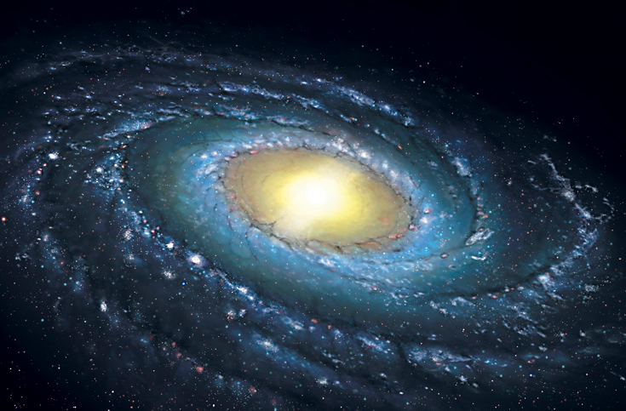
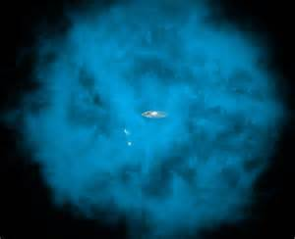
Standard halo
Local density around us: 0.3(0.1) GeV/cm³

Slide 6
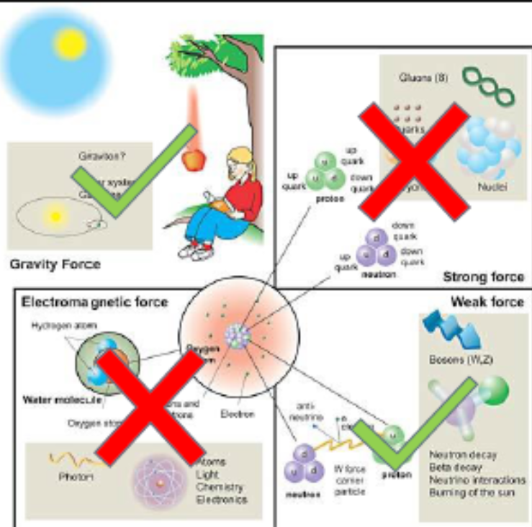
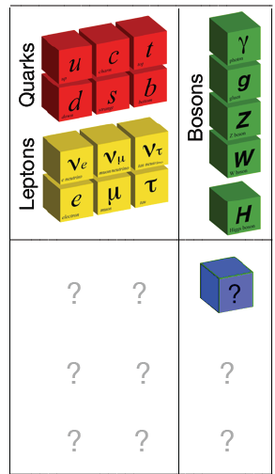
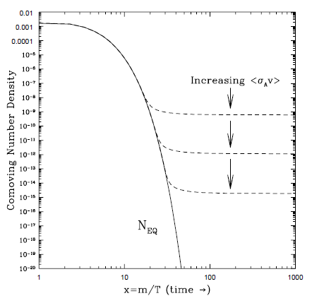
Particle nature: known knowns
No EM and strong interactions
Very long lived (half-life longer than the age of the Universe)
Not part of the Standard Model
Most popular: weakly-interacting-massive-particle (WIMPs)
“WIMP miracle”

Slide 7
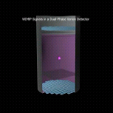
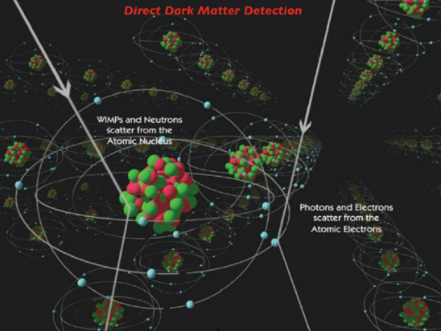
Dark matter: direct detection
Solar system moves in the Galaxy (DM halo) with a speed of 220 km/s
DM direct detection: wait for DM interacting atomic nucleus in the detector, and detect its recoil

Slide 8
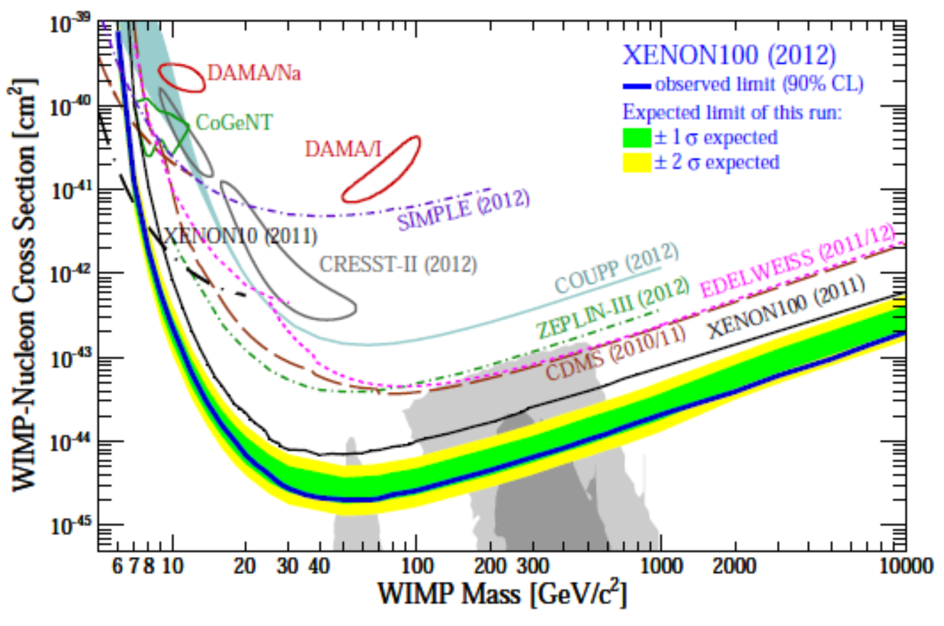
Dark matter “gold rush”
  COUPP, PICASSO, XENON,CoGENT,DEAP/CLEAN, ZEPLIN, DRIFT, LUX, KIMS, XMASS, CDMS, WARP, EDELWEISS, MIMAC…
E.g. XENON100 2012 results
Sensitivity are approaching
<1 evt/100kg/year
“WIMP miracle” (SUSY)

Slide 9
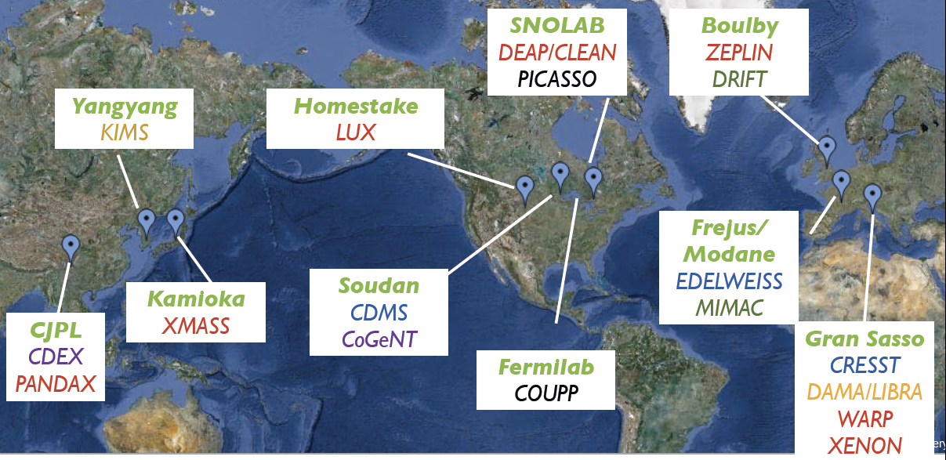
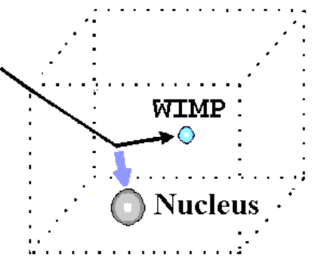
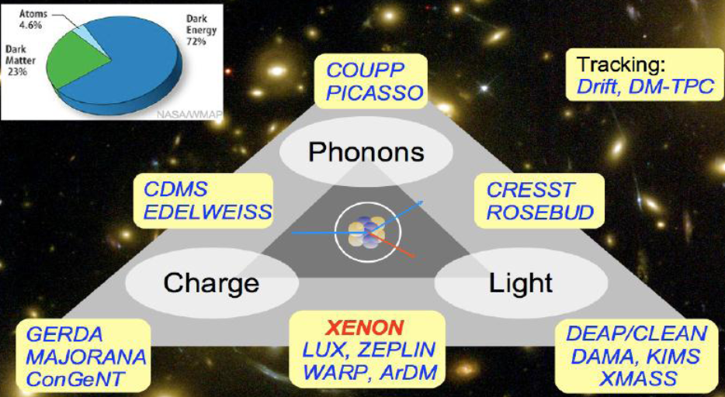
Dark matter “gold rush”
CDEX
PandaX

Slide 10
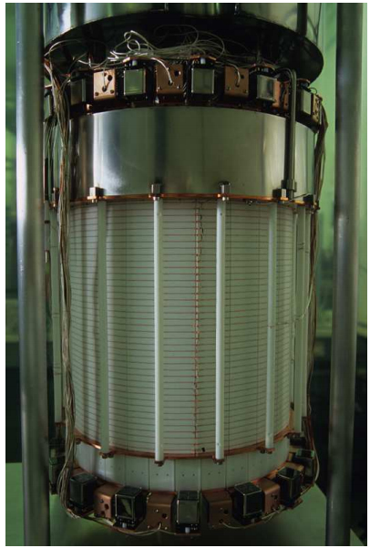
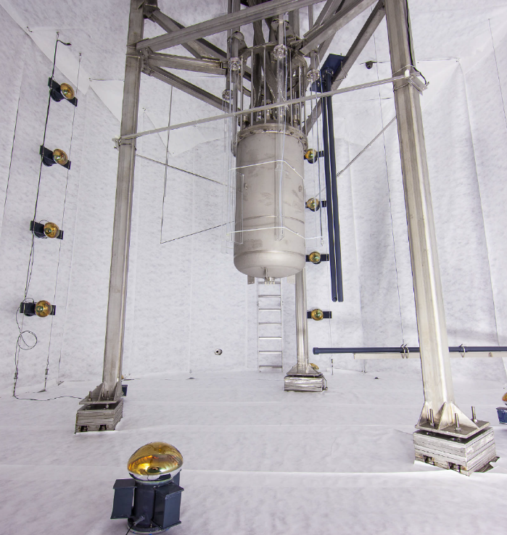
Xenon experiments
Xe advantages
Low radioactive isotopes
Good scintillation yield
Powerful self-shielding
Relatively easy to scale up
“easy” cryogenics
Dual phase TPC for signal reconstruction
Good background discrimination
...
XENON100, 60 kg, completed 2012, Gran Sasso
XENON1T in preparation
LUX, 250 kg, running, Sanford Lab
LZ(multi-ton) in preparation

Slide 11
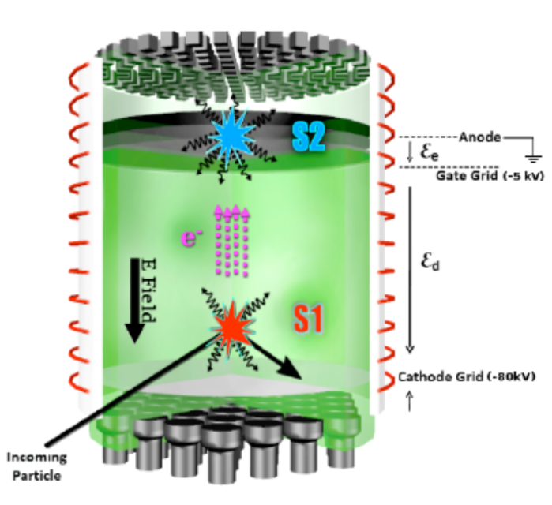
Dual phase xenon detector
Dark matter: nuclear recoil (NR)
γ background: electron recoil (ER)
Drift time
S2
S1
Drift time
S2
S1
(S2/S1)_{NR}<<(S2/S1)_{ER}
Multi-site scattering background (ER or NR)
S1
S2

Slide 12
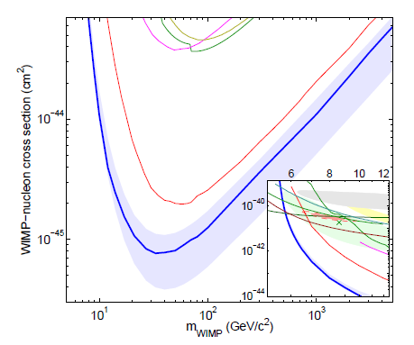
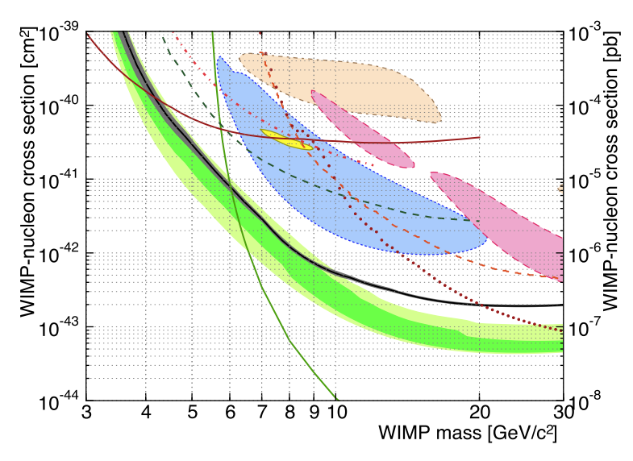
Direct detection: global situation
LUX 2013，PRL 112, 091303 (2014)
SuperCDMS, PRL 112, 241302 (2014)
Many experiments utilizing different technologies
Quite some contradictory claims
Quite some high sensitivity null results
Xenon experiments carve into the “mainstream” supersymmetry theory predictions, still say no

Slide 13
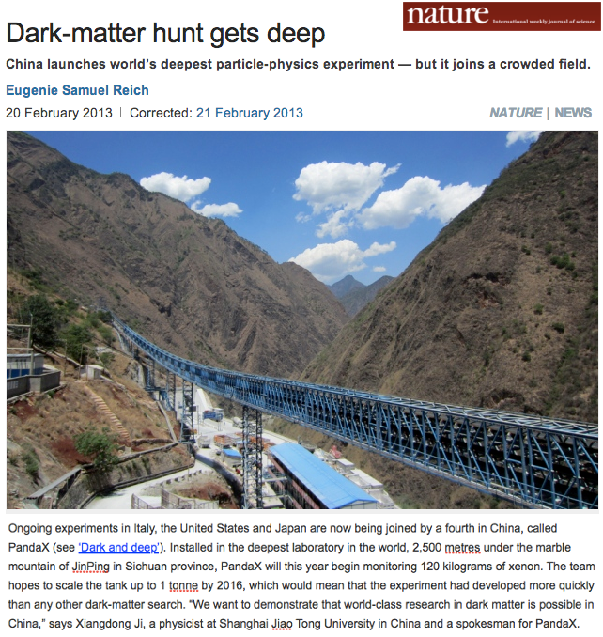
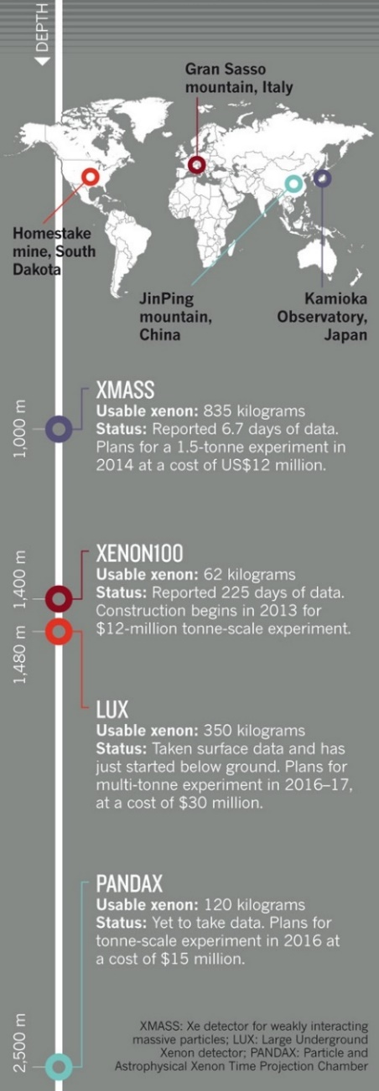
DM-rush in Jin-Ping, China (CJPL)

Slide 14
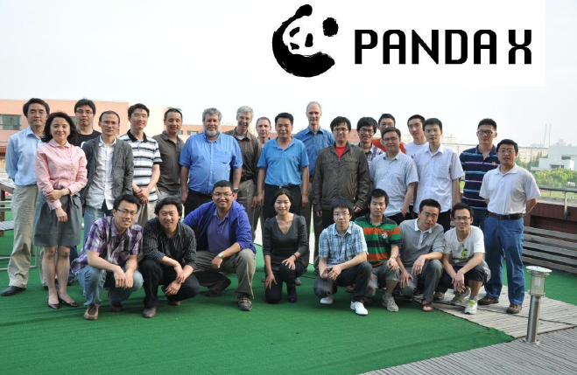


PandaX collaboration
Started in 2009
Shanghai Jiao Tong University (2009-)
Peking University (2009-)
Shangdong University (2009-)
Shanghai Institute of Applied Physics, CAS (2009-)
University of Science & Technology (2015-)
China Institute of Atomic Energy (2015-)
Yalong Hydropower (2009-)
University of Maryland (2009-)
University of Michigan (2011-2015)
~40 people

Slide 15
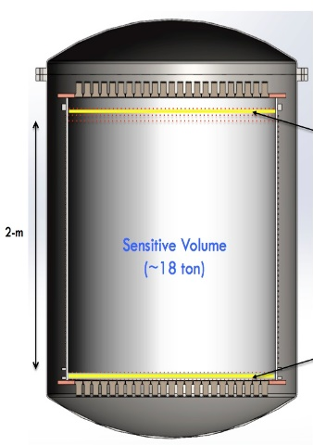
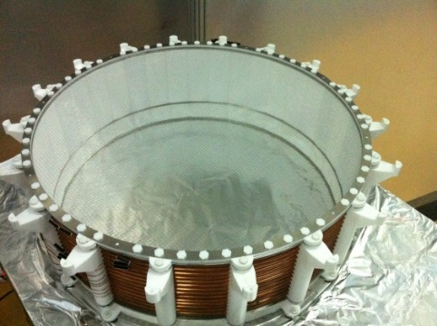
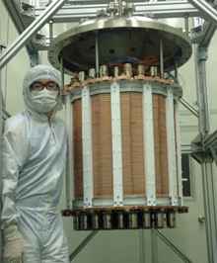
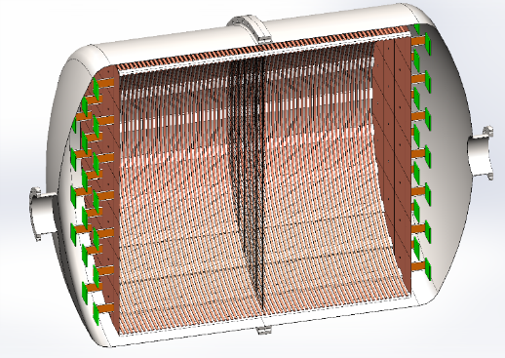
PandaX experiment
PandaX＝Particle and Astrophysical Xenon Experiments
Phase I: 120 kg DM
2009-2014
Phase II: 500 kg DM
2014-2017
Phase III: 200 kg to 1 ton ¹³⁶Xe 0vDBD
2016-2020
Phase IV: 20 ton DM
2020-2025

Slide 16
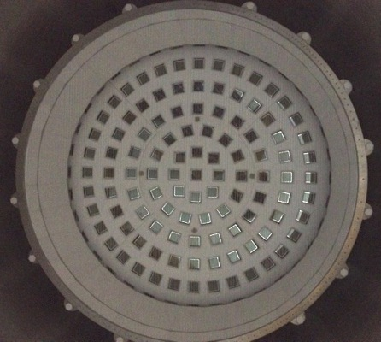
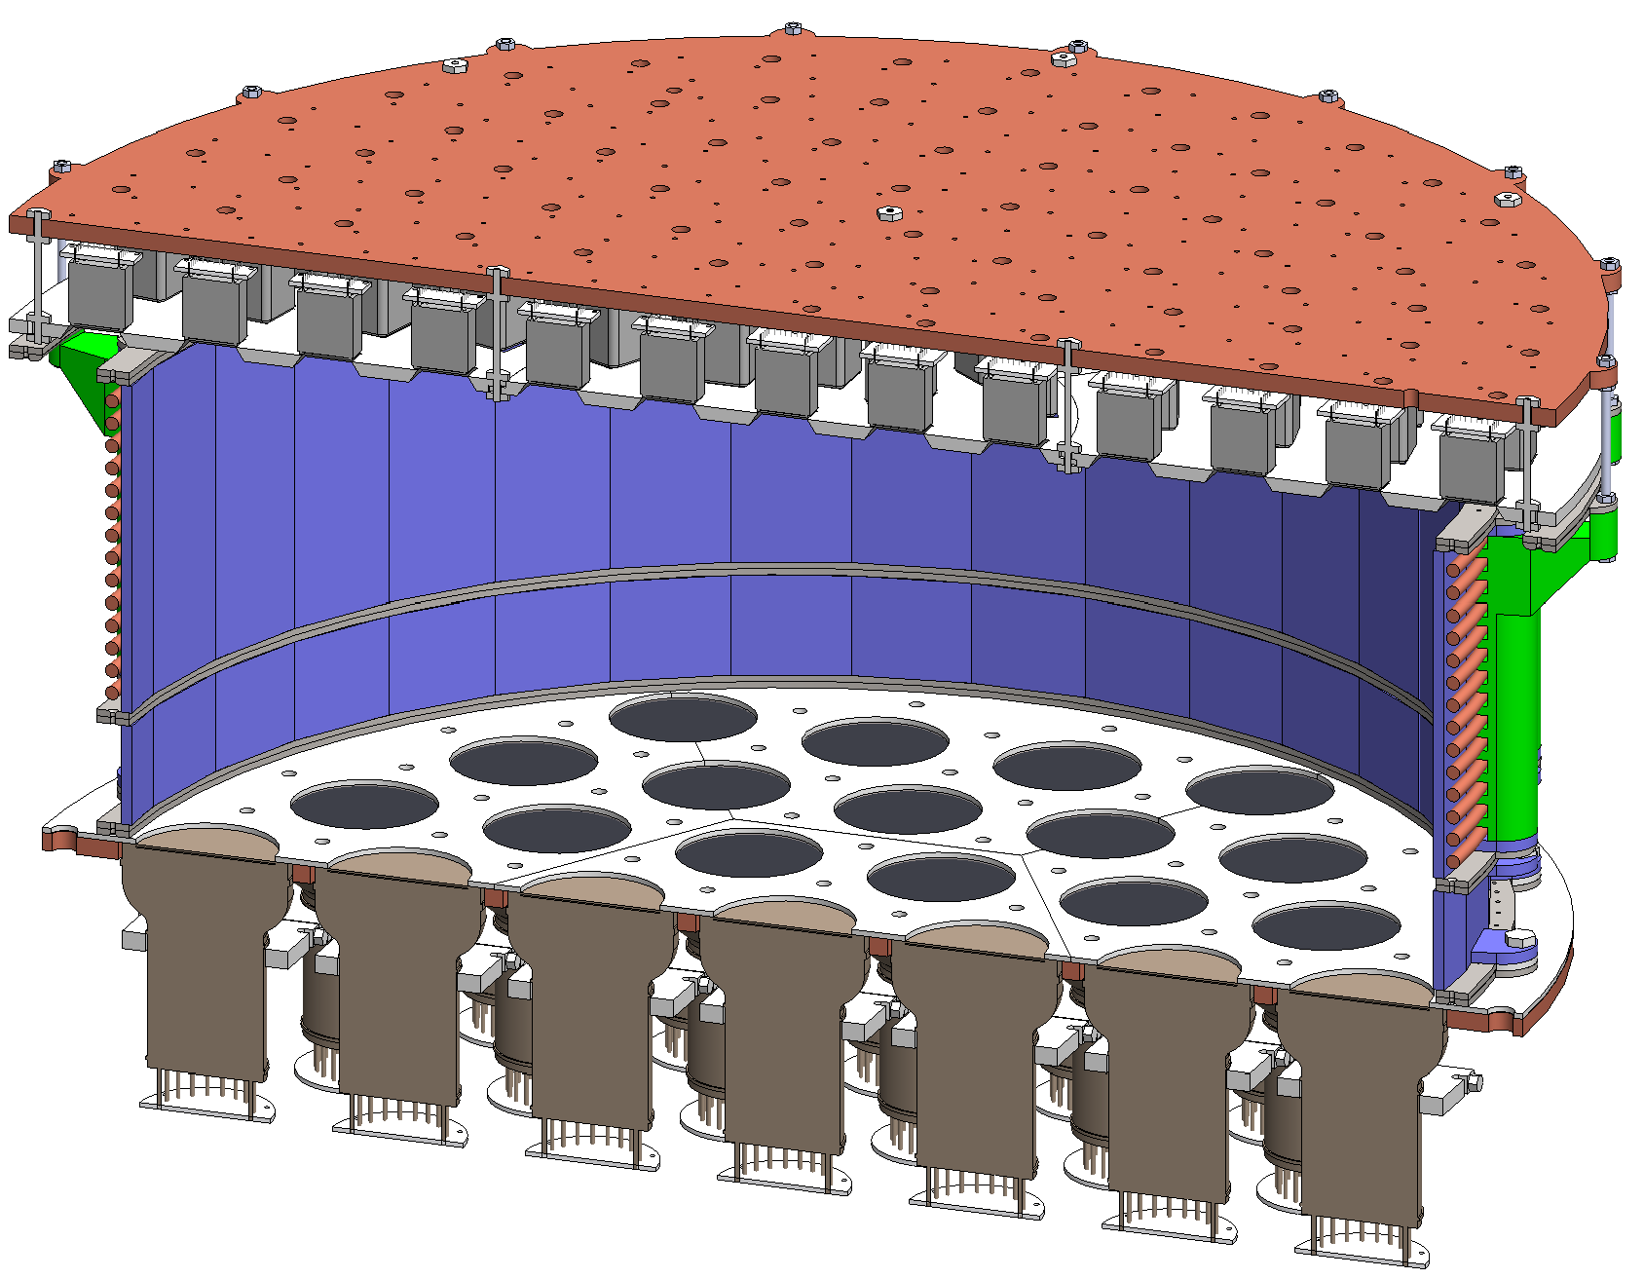

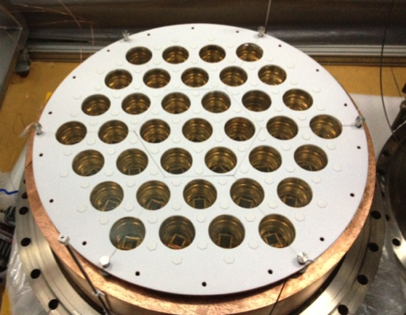
PandaX-I TPC
Total Xe mass: 450 kg
Sensitive target Xe mass: 120 kg
Top: 143 R8520 PMTs
Shaping rings
15 cm
60 cm
Electrodes
Below-cathode: 5 cm LXe
LXe “Skin”:
7.5 cm
Bottom: 37 R11410 PMTs
Teflon reflector
Key design goal: high light collection efficiency

Slide 17
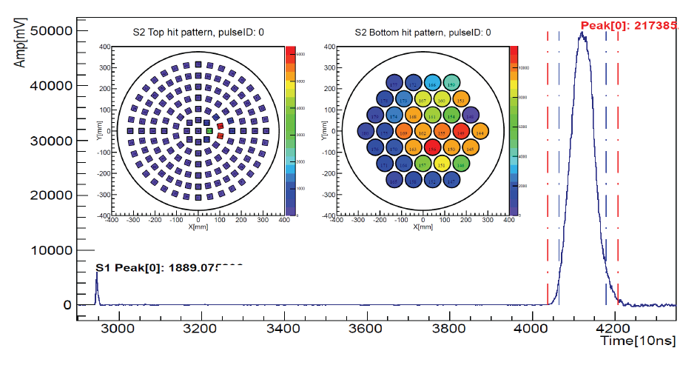
A typical “signal”
Horizontal position reconstructed from S2 hit pattern: either charge center or neural network method
Vertical position reconstructed from S1-S2 separation
Electron drift 1.7 mm/us

Slide 18
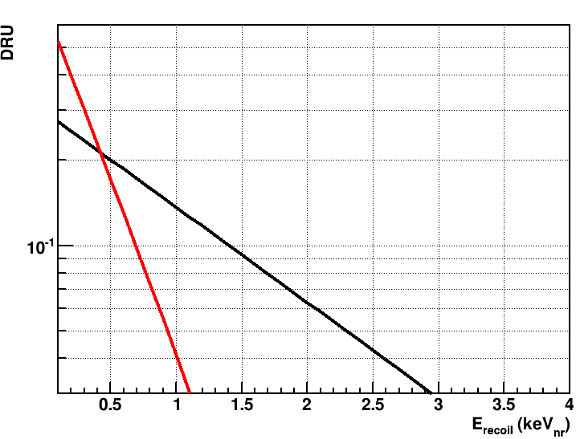
Why more lights?
Cross section 5E-43cm²
5 GeV/c² DM
10 GeV/c² DM
The lower mass of DM particle, the smaller recoil energy, the smaller amount of light
Light yield is the key for low threshold to probe low mass DM

Slide 19
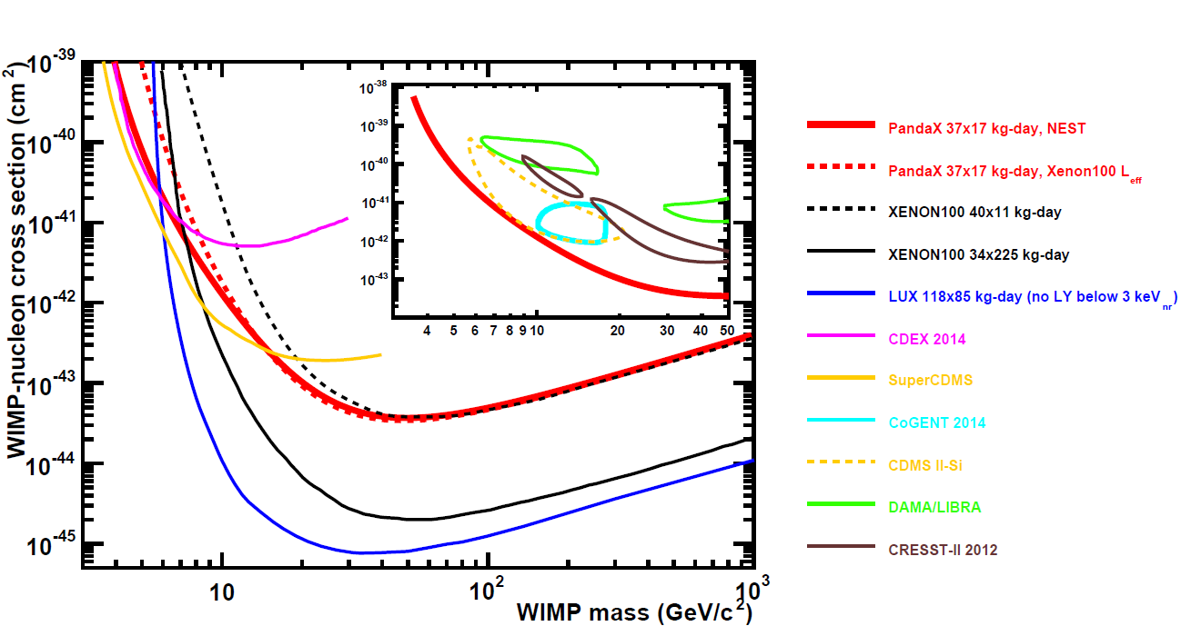
PandaX-I first data: 34x17 kg-day
Sci China-Phys Mech Astron, 2014, 57(11): 2024-2030
Disfavor all previously positive signals
At low mass region, our results more constraining than XENON100 first results with similar exposure

Slide 20
PandaX-I full exposure run
arXiv:1505.00771, accepted by Phys. Rev. D
80.1 live-day × fiducial mass 54 kg (x7 exposure)
Calibrations with much larger statistics (ER/NR)
Updated energy modeling at low recoil energy and improved treatment to low mass WIMPs
Better understanding/modeling of background
Blinded analysis: FV and energy acceptance defined blindly using FoM based on background expectation and exposure
Likelihood approach to final results

Slide 21
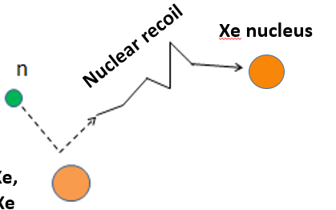
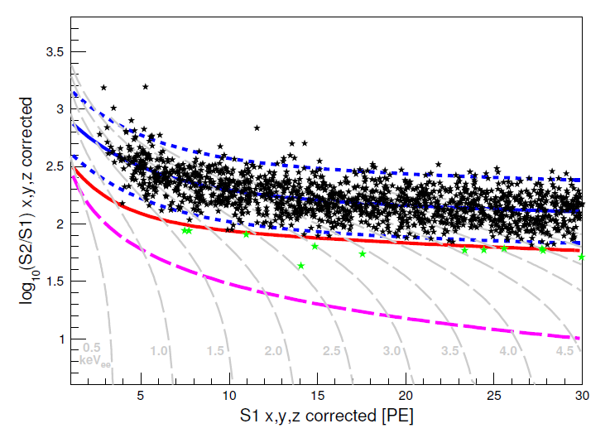
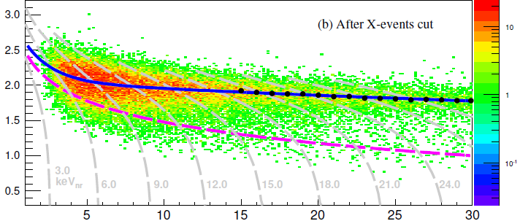
ER/NR calibration
γ
Electron recoil
electron
Gamma events (electron recoil)
Neutron events (NR signal)
Median of NR (ER rejection 99.5%)

Slide 22
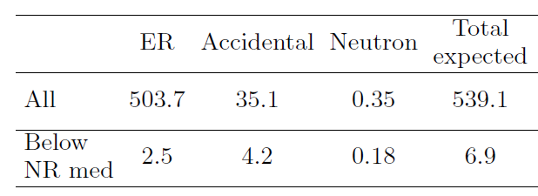
Backgrounds
ER background (external/internal): data driven
Accidental background: data driven
Neutron background (NR): MC based/loosely bound by data

Slide 23
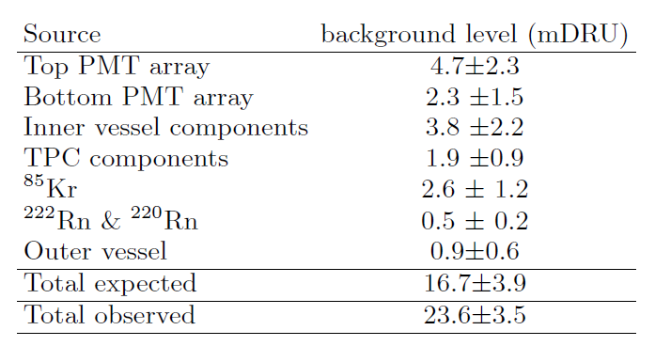
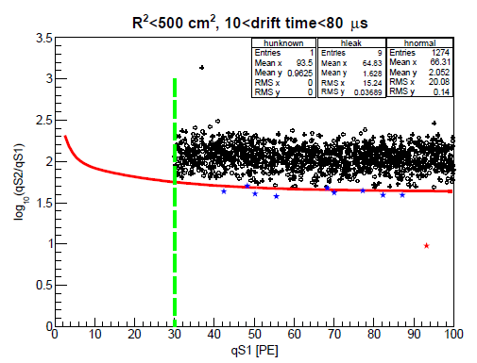
ER background
Blinded region
“High energy” region

Slide 24
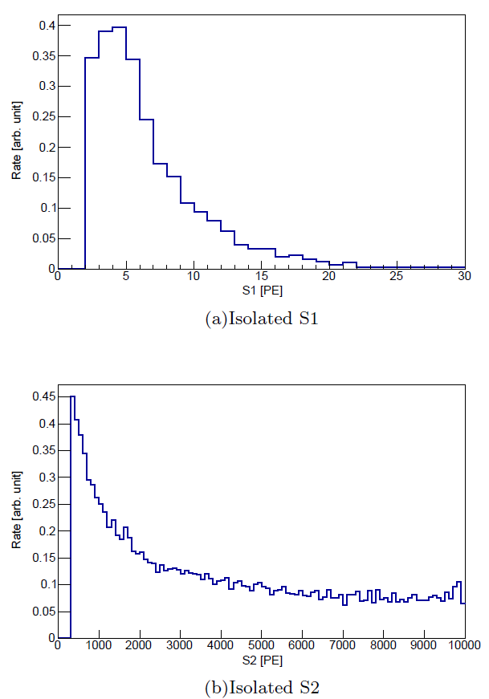
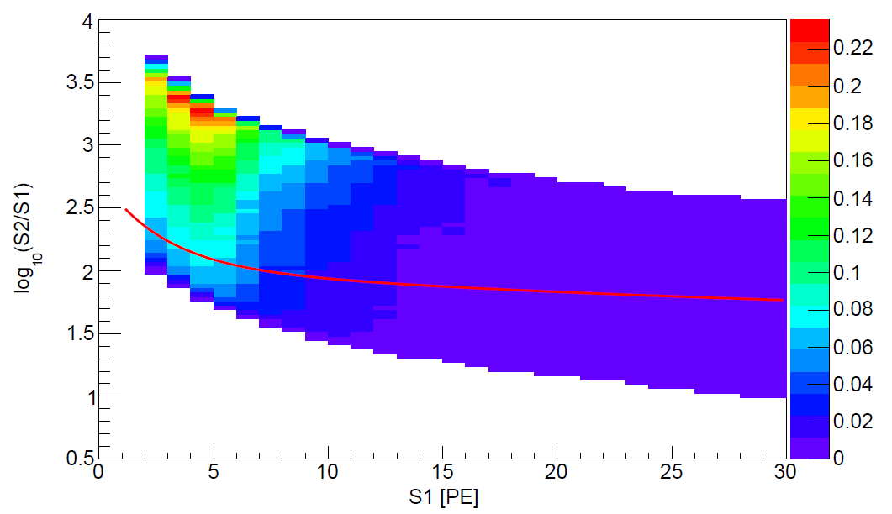
Accidental background
Isolated S1 and S2 events in random coincidence
~240/day, physical low energy events depositing energy close to anode
S2
NR median
~23 Hz, originated from electrodes, PMTs, and interactions in “chargeless regions”
Accidental distribution: some do leak below the NR median
S1
300 PE S2 cut to suppress accidental

Slide 25
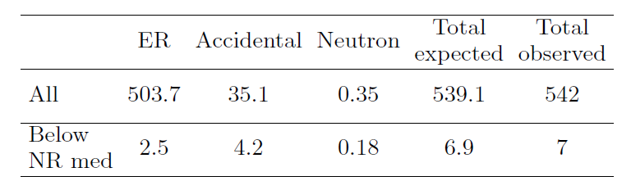
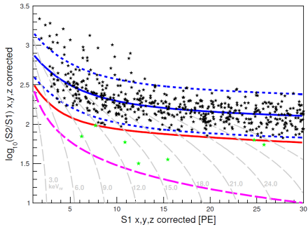
Blinded cut selection
Fiducial volume and S1 cut determined blindly by maximizing the counting sensitivity based on the background expectation below the NR median

Slide 26
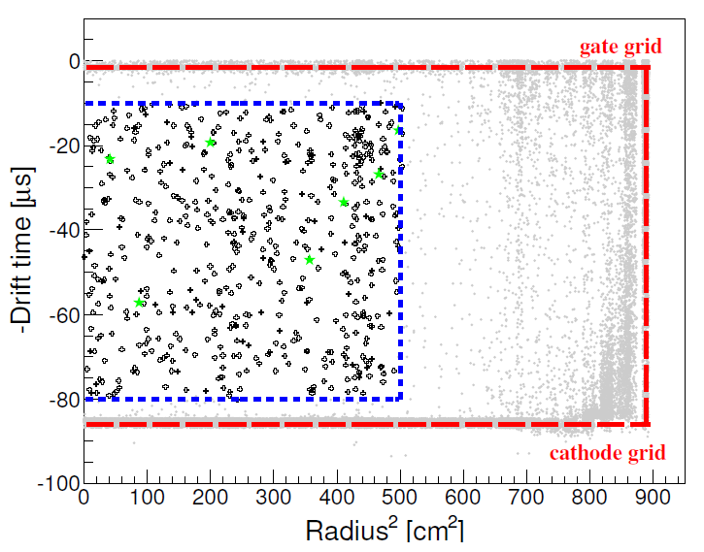
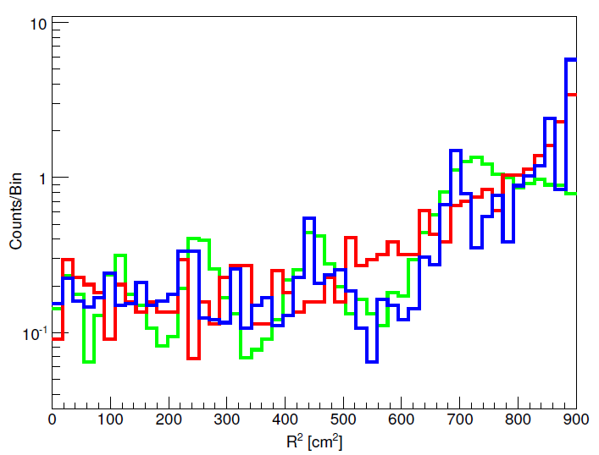
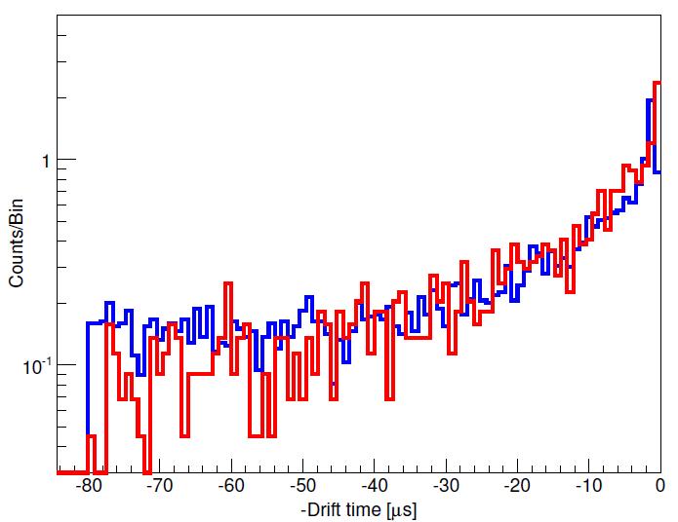
Unblinded vertex distribution
Data template
Data CoG
MC
Data
MC
Data/MC agree well!

Slide 27
Search for dark matter!
Accidental backgrounds
ER median and ± 2σ
7 events found in the DM search region, however consistent with background expectation
NR median
300 PE S2 cut

Slide 28
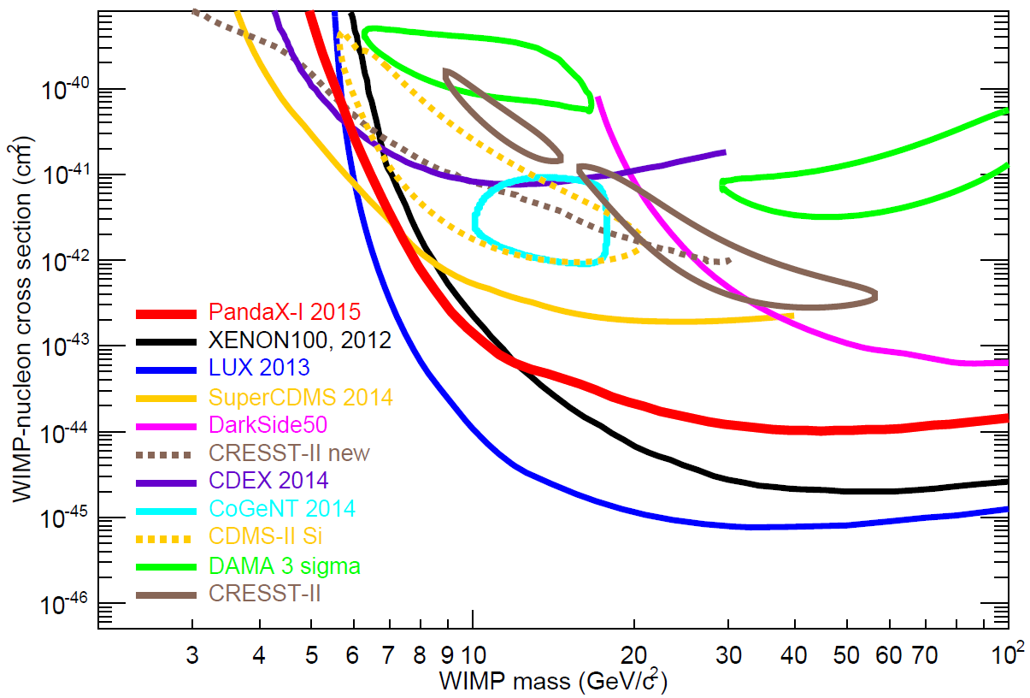
DM limits
Full exposure results with an improved analysis confirmed the finding from the first results, disfavoring all positive WIMP claims
Tighter bound than superCDMS above WIMP mass of 7 GeV/c²
Best reported* WIMP limits below 5.5 GeV/c² in xenon community
Profile likelihood fit using DM and background distribution.
*LUX chose a cutoff below 3 keV_{nr}, whereas we used the NEST model all the way.

Slide 29
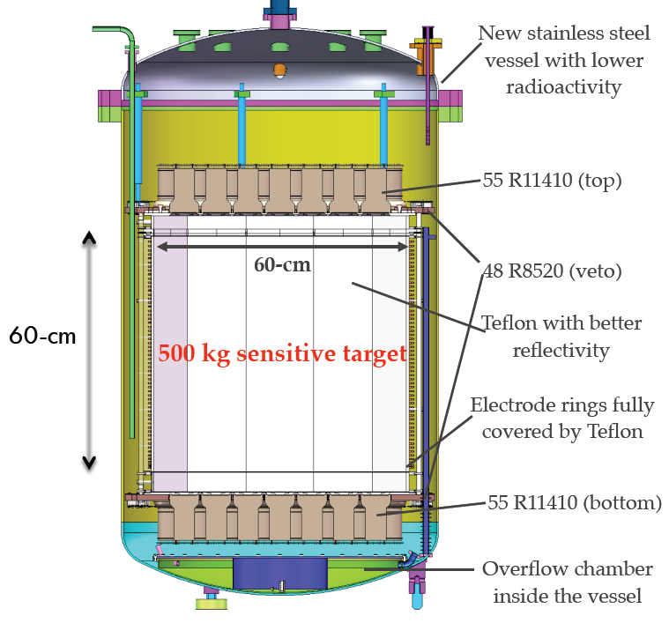


PandaX-II: 500 kg LXe target
Started construction June 2014
Completed detector assembly in CJPL Mar 2015
Presently under commissioning
Expect to start dark matter data taking in 2015
Expected running time for physics: 2 years

Slide 30

PandaX-II: projected sensitivity
PandaX-II sensitivity assumes:
300 kg x 365 day
4.4 PE/keV_{ee} (@122 keV)
S1 range: [3, 47] PE
ER rejection 99.75%
NR acceptance 35%
<3.7 background events
PandaX-II covers significant region in the SUSY WIMP parameter space.

Slide 31



PandaX: future plans
  PandaX-III: High ¹³⁶Xe Gas 0νDBD, 200 kg, modularized to 1-ton
  PandaX-IV: 20-ton LXe DM
“Chase DM to ν-floor”

Slide 32


Future PandaX in CJPL-II
Water purification
Electronics/slow control
Clean hut
Counting room/office
Crane
Water pool
Low background counting
Distillation tower
PandaX-III & PandaX-IV
Xe storage
CJPL-II expansion ongoing (civil ready 2016)

Slide 33

0νDBD
Normal double-β decay: rare but allowed 2nd order standard model process
Zero-neutrino double-β decay:
Neutrino is Majorana (anti-matter disappearance mystery)
Neutrino absolute mass
Lepton number violation

Slide 34

Return of 1920’s

Slide 35

Road map
Current limit
100 kg-ish
Inverted
Hierarchy
Ton-scale
Ton scale experiment could nail this if neutrino is IV

Slide 36

Forerunners
Key considerations:
Energy resolution
Scalability
Background level
No perfect technology yet …

Slide 37

High pressure ¹³⁶Xe
0νDBD signal: two electrons emitting from the same vertex with a summed energy at the Q value
HP xenon:
  Excellent energy resolution
  Tracking ability: at 10 atm, 2-beta track length about 30 cm with two Bragg peaks, discrimination with gamma background⇒ smoking gun for discovery
γ bkg
0νDBD

Slide 38

Detector concepts
Electronics & DAQ
Xenon gas system
Dia. 1.5m
Len. 2m
HP Vessel
Frontend ASICs
Readout plane
Water shield
Drift chamber
200 kg, modularized to ton-scale
Cathode

Slide 39











PandaX-III collaboration

Slide 40
Ending
Art McDonald: Once you have the detector in operation and you're sitting there observing a burst of light represented on your display screen you have the ability to observe particles that come directly from the core of the sun. They're telling you what's happing there right now in terms of the nuclear reactions that are powering it, you are able to make measurements of the fundamental properties of the neutrinos themselves and it's a great experience to look at this data and realise that you are seeing things that are extremely fundamental in their nature.
当你的探测器运行的时候，你在屏幕前静静的等待来自于太阳中心的粒子闯入探测器中发出的着微弱的光，它们在向你诉说给予我们能量的核反应的故事。你可以测量这些中微子，并通过分析它们得到自然界中深奥的秘密，这是一个无比美妙的经历！

Slide 41




Koshiba
Davis
Target: proton decay
Discovered: supernova neutrinos
Target: solar neutrino
Discovery: solar neutrino oscillation
2002
Kajita
McDonald
Target: study background of proton decay
Discovered: atmospheric neutrino oscillation
2015
These might only be the beginning!

Slide 42
谢谢！

Slide 43



Unbinned likelihood function
Expected shape of ER background
same as that in ⁶⁰Co calibration!

