Slide 1

Electroweak vacuum instability and spacetime curvature
Arttu Rajantie
USTC, Hefei, China
12 April 2018
In collaboration with:
Daniel Figueroa, Matti Herranen, Tommi Markkanen,
Sami Nurmi, Stephen Stopyra, Francisco Torrenti

Slide 2
Based on:
Herranen, Markkanen, Nurmi & AR, PRL113 (2014) 211102
Herranen, Markkanen, Nurmi & AR, PRL115 (2015) 241301
AR & Stopyra, PRD95 (2017) 025008
AR & Stopyra, PRD97 (2018) 025012
Figueroa, AR & Torrenti, arXiv:1709.00398
Markkanen, Nurmi, AR & Stopyra, arXiv:1804.02020

Slide 3
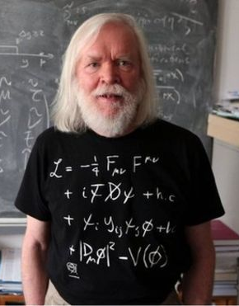

The Standard Model
Six leptons, six quarks,
three gauge fields
+ Higgs scalar $φ$
19 parameters –
all have been measured
All renormalisable terms
allowed by symmetries
in Minkowski space

Slide 4
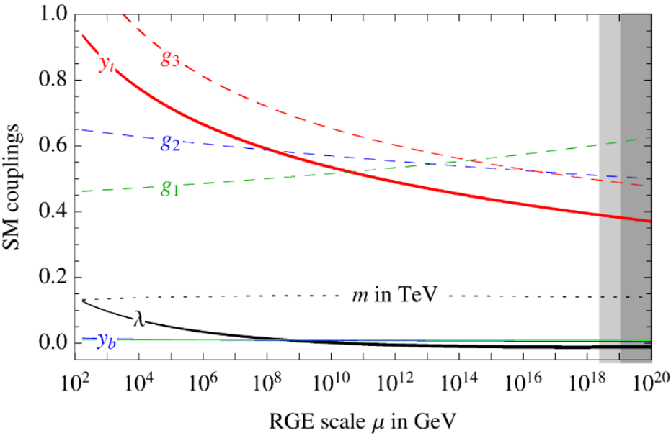

The Standard Model
Six leptons, six quarks,
three gauge fields
+ Higgs scalar $φ$
19 parameters –
all have been measured
All renormalisable terms
allowed by symmetries
in Minkowski space
Can be extrapolated all the
way to the Planck scale
(Buttazzo et al 2013)

Slide 5
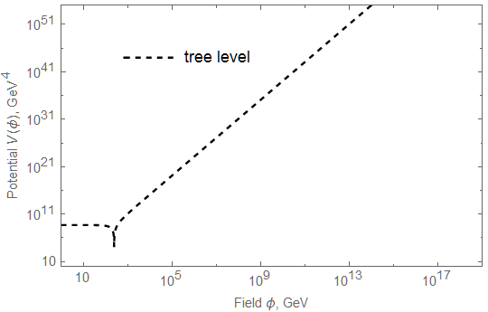
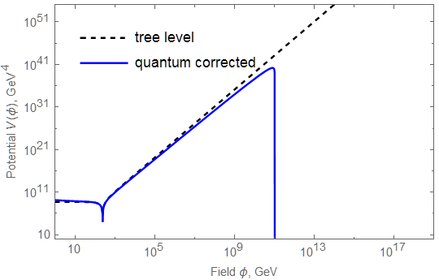

Vacuum Instability
Higgs effective potential
$V\left(φ\right)≈λ\left(φ\right)φ^{4}$
Becomes negative
at $φ>φ_{c}≈{10}^{10}GeV$
True vacuum at
Planck scale?
Current vacuum
metastable against
quantum tunneling

Slide 6
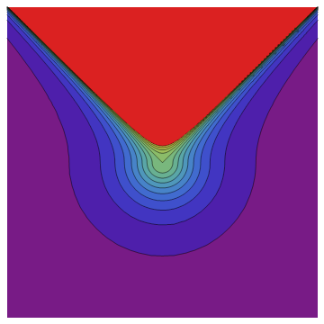

Tunneling Rate
Bubble nucleation rate:
$Γ∼e^{−B}$, where
$B=$action of the
“bounce” solution (Coleman 1977)
Solve Euclidean eqs of motion
Constant $λ<0$:
$φ\left(r\right)=\sqrt{\frac{2}{|λ|}}\frac{2R}{r^{2}+R^{2}}$
Action $B=\frac{8π^{2}}{3\left|λ\right|}$

Slide 7
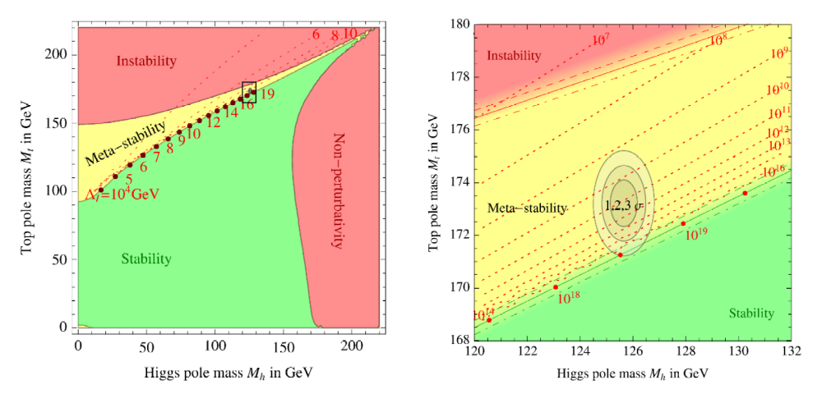

Instability Bounds
Vacuum lifetime $\sim \exp\left(B\right)∼\exp\left(\frac{8π^{2}}{3\left|λ\right|}\right)$
Longer than the age of the Universe
(Buttazzo et al. 2013)

Slide 8
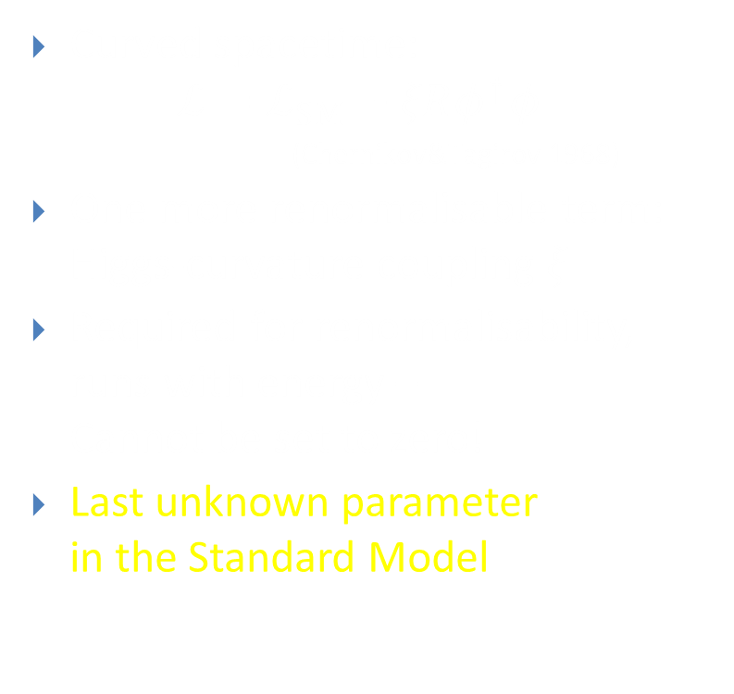

Higgs-Curvature Coupling
Curved spacetime:
$$ℒ=ℒ_{SM}+ξRφ^{†}φ$$
$\text{(}\text{Chernikov}\text{\&}\text{Tagirov} \text{1968}\text{)}$
One more renormalisable term:
Higgs-curvature coupling $ξ$
Required for renormalisability,
runs with energy –
Cannot be set to zero!
Last unknown parameter
in the Standard Model
$$+ξRφ^{2}$$

Slide 9
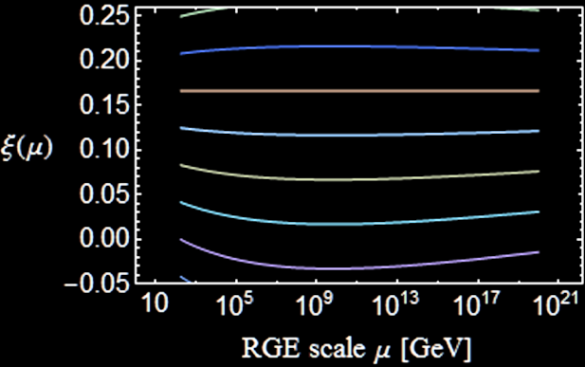


Running $ξ$
$$μ\frac{dξ}{dμ}=\left(ξ−\frac{1}{6}\right)\frac{12λ+6y_{t}^{2}−\frac{3}{2}g^{′2}−\frac{9}{2}g^{2}}{16π^{2}}$$
Becomes negative
if $ξ_{EW}=0$
Conformal value
$ξ=1/6$
RG invariant at 1 loop

Slide 10


Measuring $ξ$
Curved spacetime:
$$ℒ=ℒ_{SM}+ξRφ^{†}φ$$
Ricci scalar $R$ very small today – Difficult to measure
Colliders: Suppresses Higgs couplings (Atkins&Calmet 2012)
  LHC Bound $\left|ξ\right|≲2.6×{10}^{15}$
  Future (?) ILC: $\left|ξ\right|≲4×{10}^{14}$
In contrast, $R$ can be high in
  True vacuum
  Early universe

Slide 11

Vacuum Instability Including Gravity
Tunneling rate: $Γ∼e^{−B}$, where
$B=$action of the Euclidean “bounce” solution (Coleman 1977)
Coupled field and Einstein equations
Perturbative gravitational correction (Isidori et al 2007)
$ΔB=\frac{32π^{2}}{45M_{Pl}^{2}ρ^{2}{\left|λ\right|}^{2}}$, where $ρ=$ radius of the instanton
AR & Stopyra, PRL(2017):
Full numerical solution including $ξ$

Slide 12
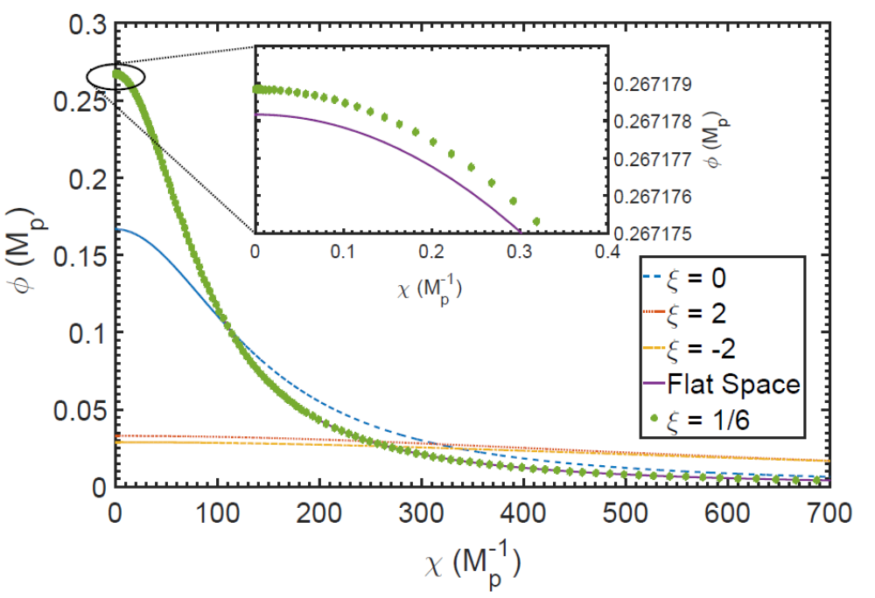

Vacuum Instability and $ξ$
radius
AR & Stopyra, PRD(2017)

Slide 13
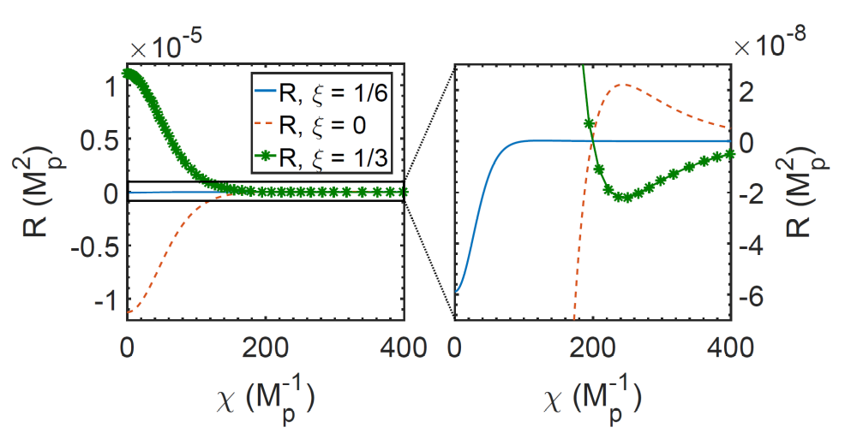

Vacuum Instability and $ξ$
High spacetime curvature inside the bubble:
Sign depends on $ξ−1/6$
radius
radius
AR & Stopyra, PRD(2017)

Slide 14
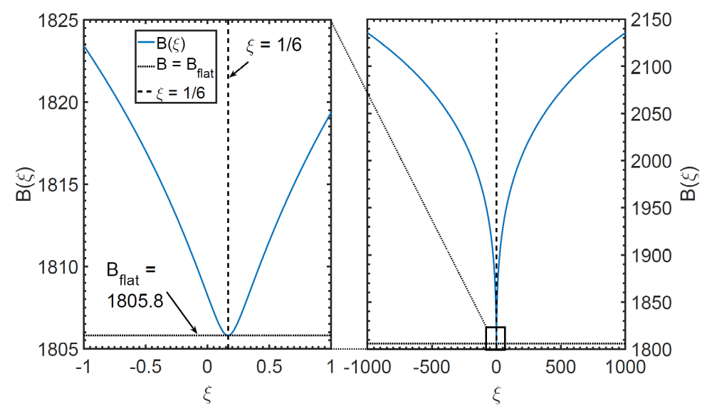

Vacuum Instability and $ξ$
Tunneling rate $Γ∼e^{−B}$: Larger $\left|ξ\right|$  more stable vacuum
Perturbative $ΔB=\frac{32π^{2}{\left(1−6ξ\right)}^{2}}{45M_{Pl}^{2}ρ^{2}λ^{2}}$ (Salvio et al, arXiv:1608:02555)
AR & Stopyra, PRD(2017)

Slide 15
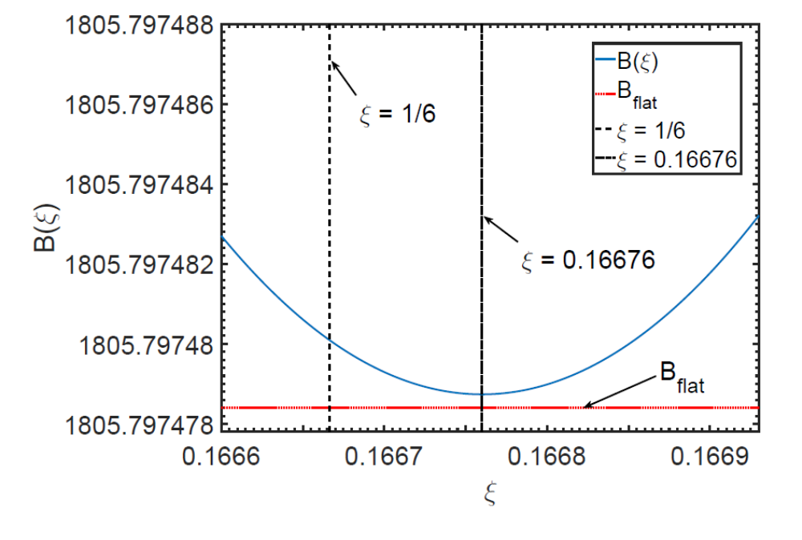

Vacuum Instability Today
Fastest at $ξ≈1/6$, where almost the same as Minkowski
AR & Stopyra, PRD(2017)

Slide 16
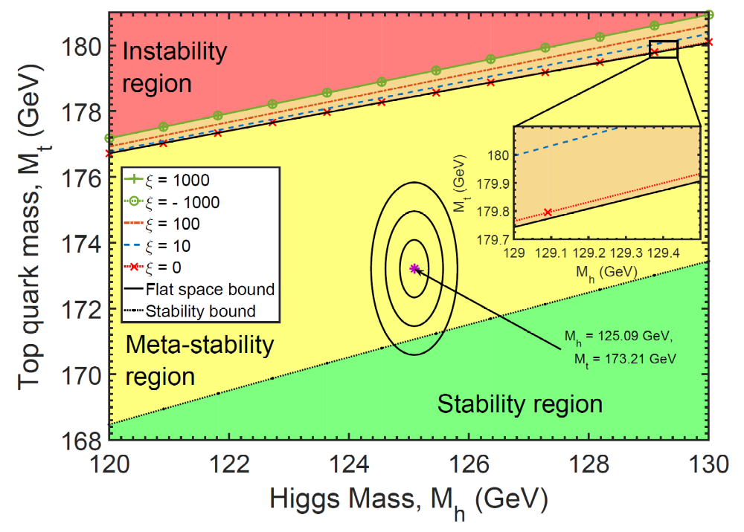
Effect on Stability
AR & Stopyra, PRL(2017)

Slide 17

Early Universe
Assume:
  Light, subdominant Higgs
  Inflaton decoupled from the Higgs
Effective Higgs mass term $m_{eff}^{2}(t)=m_{H}^{2}+ξR(t)$
Ricci scalar in FRW spacetime:
$$R=6\left(\frac{{\dot{a}}^{2}}{a^{2}}+\frac{\ddot{a}}{a}\right)=3\left(1−3w\right)H^{2}$$
  Radiation dominated $w=1/3$ $R=0$
  Matter dominated $w=0$ $R=3H^{2}$
  Inflation / de Sitter $w=−1$ $R=12H^{2}$

Slide 18

Higgs Fluctuations from Inflation
Inflation: $H≲9×{10}^{13} GeV$ (Planck+BICEP2 2015)
Equilibrium field distribution (Starobinsky&Yokoyama 1994)
$P\left(φ\right)∝exp\left[−\frac{8π^{2}}{3H^{4}}V\left(φ\right)\right]$
Tree-level potential
$V\left(φ\right)=λ{\left(φ^{2}−v^{2}\right)}^{2}$
Nearly scale-invariant
fluctuations with
amplitude $φ∼λ^{−1/4}H$
Higgs fluctuations

Slide 19

Higgs Fluctuations from Inflation
Equilibrium $P\left(φ\right)∝exp\left[−\frac{8π^{2}}{3H^{4}}V\left(φ\right)\right]$
Running $λ$:
Fluctuations take the
Higgs over the barrier
if $H≳φ_{c}≈{10}^{10}GeV$
(Espinosa et al. 2008;
Lebedev&Westphal 2013;
Kobakhidze&Spencer-Smith 2013;
Fairbairn&Hogan 2014;
Hook et al. 2014)
Does this imply
$H≲{10}^{10}GeV$ ?
Higgs fluctuations

Slide 20

Higgs During Inflation
Inflation: Constant $R=12H^{2}$
Effective mass term
$$m_{eff}^{2}=m_{H}^{2}+ξR=m_{H}^{2}+12ξH^{2}$$
Tree level: (Espinosa et al 2008)
  $ξ>0$: Increases barrier height
  Makes the low-energy vacuum more stable
  $ξ<0$: Decreases barrier height
  Makes the low energy vacuum less stable
$H$ contributes to loop corrections:
For $H≫φ$, $V\left(φ\right)≈λ\left(H\right)φ^{4}$  No barrier! (HMNR 2014)

Slide 21
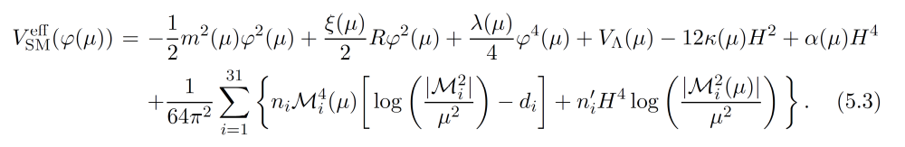
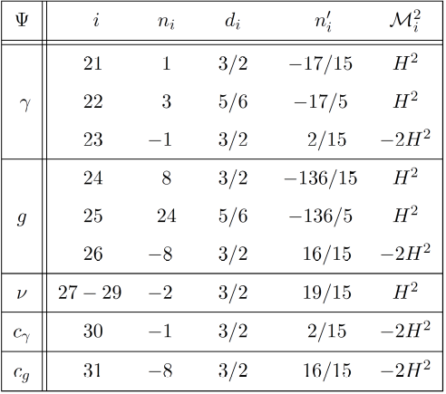
Potential in Curved Spacetime
One-loop computation:
(MNRS 2018)

Slide 22

Potential in Curved Spacetime
One-loop computation for $ξ=0$ (in units of $μ_{inst}≈{10}^{10} GeV$)
(MNRS 2018)

Slide 23


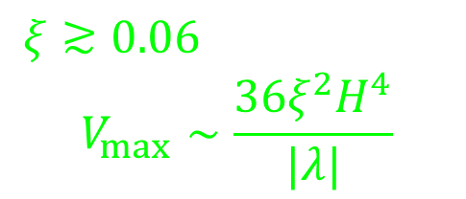

(De-)Stabilising the Potential
$$ξ≳0.06$$
$$V_{max}∼\frac{36ξ^{2}H^{4}}{|λ|}$$
$$V\left(φ\right)$$
Minkowski
$$φ$$
$$ξ≲0.02$$

Slide 24

(De)Stabilising the Potential
If $H≳{10}^{10}GeV$ and there is no new physics,
vacuum stability during inflation requires $ξ≳0.06$
(MNRS 2018)

Slide 25

De Sitter Tunnelling
Analytic continuation: De Sitter  Sphere

Slide 26
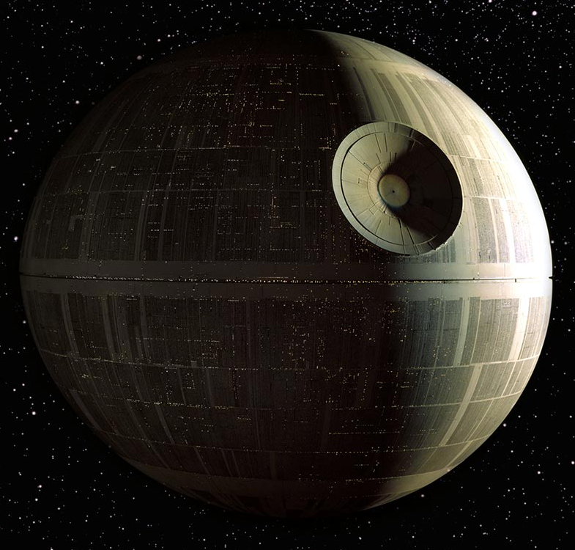
De Sitter Tunnelling
Analytic continuation: De Sitter  Sphere

Slide 27
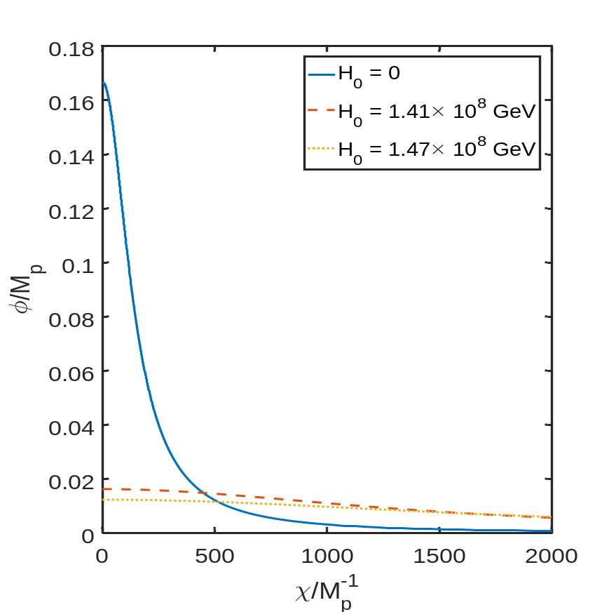

De Sitter Tunnelling
When $H∼R$,
significant difference
from Minkowski
High $H$:
Hawking-Moss instanton
=classical excitation
radius
(AR&Stopyra, PRD 2018)

Slide 28
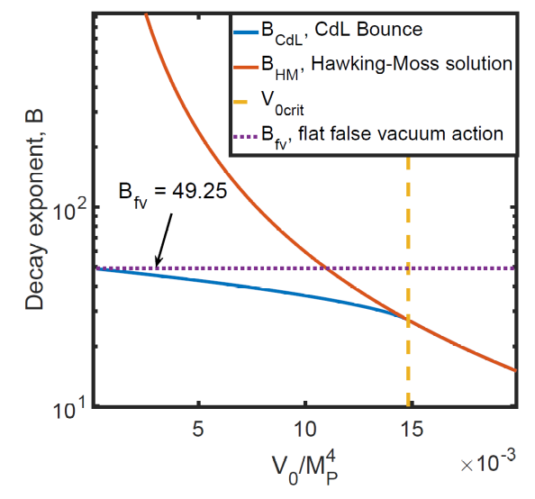
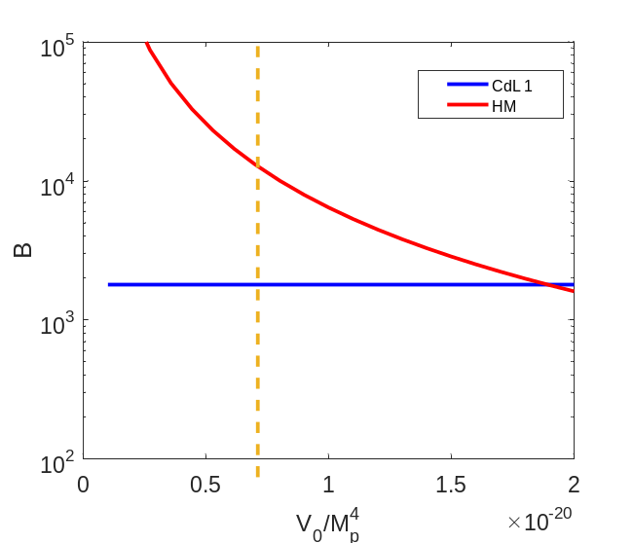
Instanton Actions
Polynomial potential
Standard Model potential
(AR&Stopyra, PRD 2018)

Slide 29
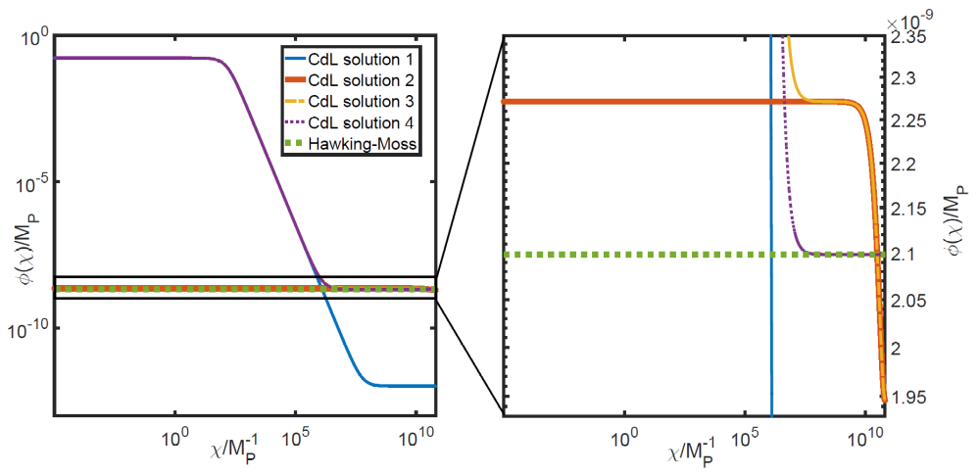
Multiple Solutions
(AR&Stopyra, PRD 2018)

Slide 30

End of Inflation
Reheating: Inflation ($R=12H^{2}$) → rad dom ($R=0$)
$$R\left(t\right)=\frac{2m_{φ}^{2}φ^{2}− {\dot{φ}}^{2}}{M_{Pl}^{2}}$$
Effective Higgs mass $m_{eff}^{2}=m_{H}^{2}+ξR$ oscillates:
  “Geometric preheating” (Bassett&Liberati 1998, Tsujikawa et al. 1999)
  $R$ goes negative: If $ξ>0$, Higgs becomes tachyonic (HMNR 2015)
Higgs variance at horizon scale:
${\left\langle φ^{2}\right\rangle }_{H}∼\frac{2}{3\sqrt{3}ξ}{\left(\frac{H}{2π}\right)}^{2}e^{\frac{2\sqrt{ξ}χ_{ini}}{M_{Pl}}}∼\frac{H^{2}}{ξ}e^{2\sqrt{ξ}}$

Slide 31
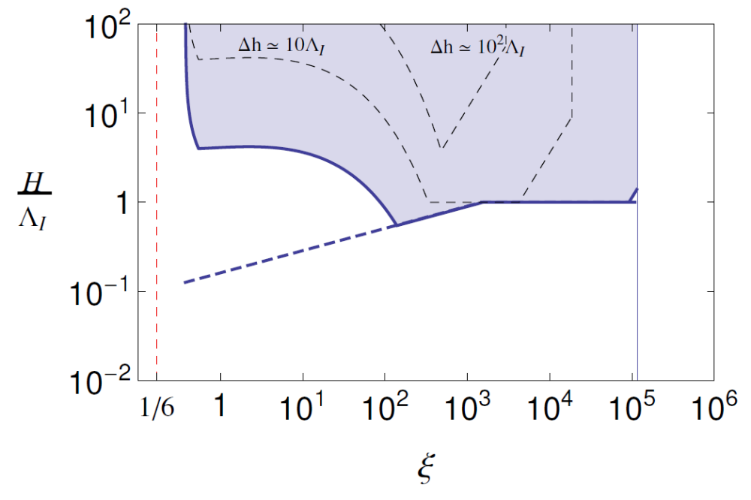
Vacuum Decay at the End of Inflation
Not enough
growth
Instability!
?
Becomes
nonlinear
Field backreaction
(HMNR 2015)

Slide 32
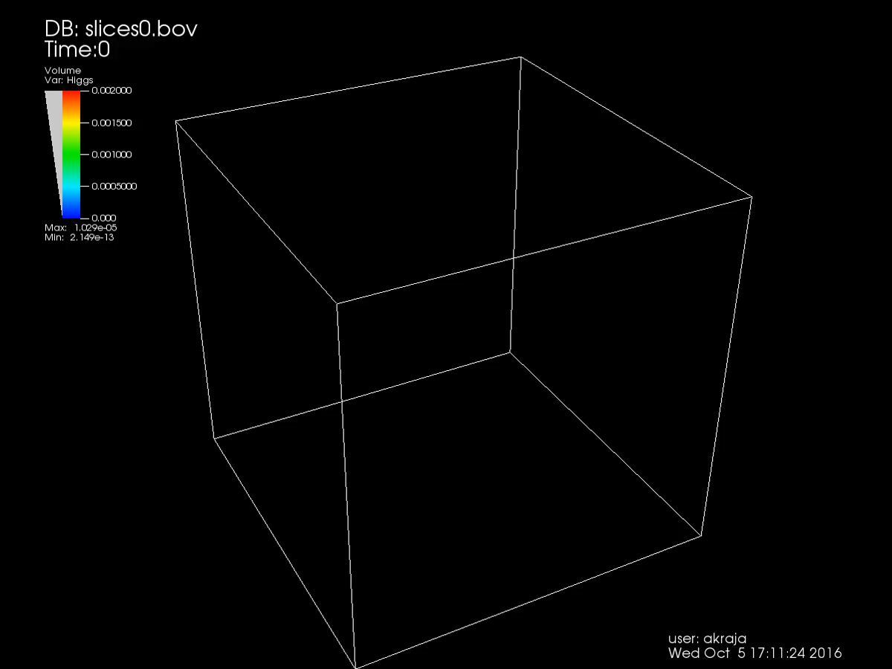

Detailed Calculations
Ema et al,
arXiv:1602:00483
  Lattice simulation
  $ξ≲10$
Kohri et al, arXiv:1602.02100
  Linearised calculation
  $ξ≲40$
Figueroa, AR & Torrenti,
arXiv:1709.00398
  Lattice simulations

Slide 33
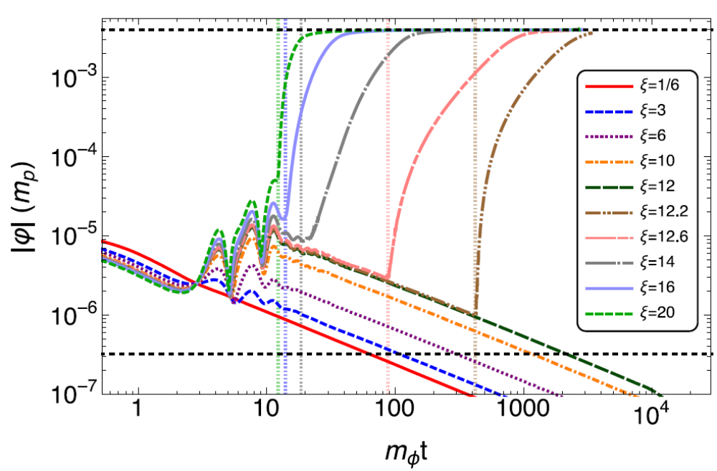

Lattice Simulations
$V\left(χ\right)=\frac{1}{2}m^{2}χ^{2}$, $M_{top}=172.12 GeV$
true
vacuum
Figueroa, AR & Torrenti, arXiv:1709.00398

Slide 34
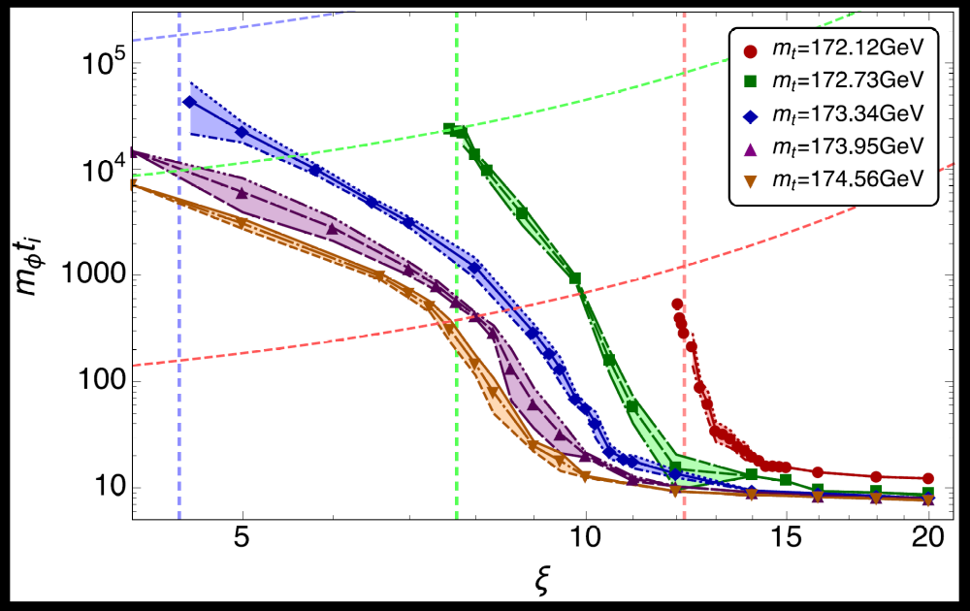

Instability Time
Stability depends on top mass and speed of reheating
$M_{top}=173.34 GeV:$ vacuum decay before $mt=100$if $ξ≳9$
Figueroa, AR & Torrenti, arXiv:1709.00398

Slide 35

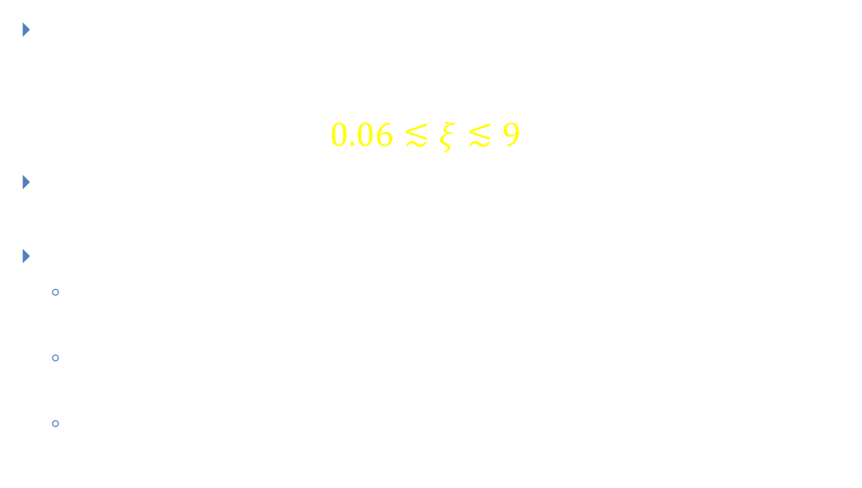
Constraints on $ξ$
Minimal scenario:
Standard Model + $m^{2}χ^{2}$ chaotic inflation,
no direct coupling to inflaton
$$0.06≲ξ≲9$$
15 orders of magnitude stronger than the LHC bound
$\left|ξ\right|≲2.6×{10}^{15}$
Caveats:
  Assumes no direct coupling to inflaton
  – Would still need $|ξ|≲O(1)$
  Assumes no new physics
  – Could stabilise potential altogether
  Assumes high scale inflation
  – Need $H≳{10}^{9} GeV$

