Slide 1

Spatial noncommutativity
And black hole
thermodynamics
Baocheng Zhang
Based on Phys. Lett. B 765, 226 (2017)
Collaborated with Li You
中科大交叉学科理论研究中心 2017.3.16

Slide 2
Outlines
Black hole volume and entropy
Noncommutative black holes
Infinite volume of NBH
Implication for infinite volume

Slide 3
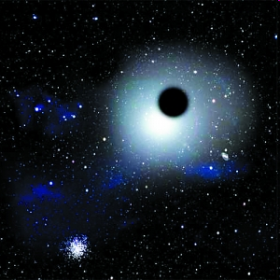
A black hole
A black hole is often defined as an object whose gravity so strong that the light can not escape. This is a classical description.

Slide 4

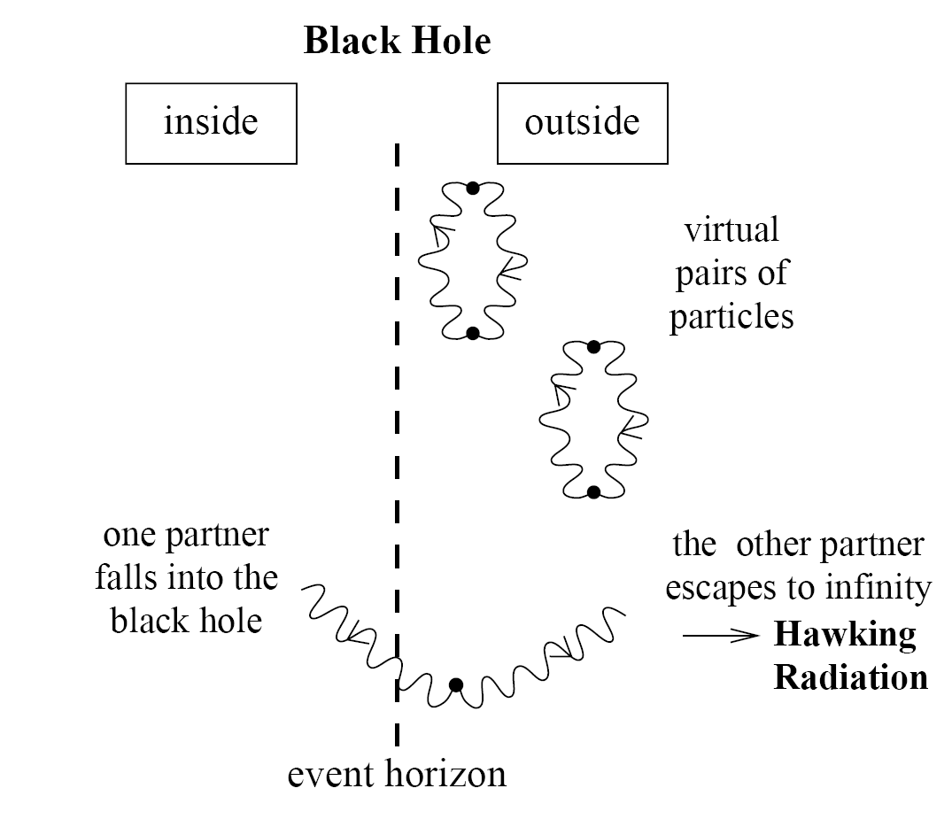

Black hole radiation
Classical black hole
Quantum black hole
Physical explanation
This picture leads to some severe problems!

Slide 5
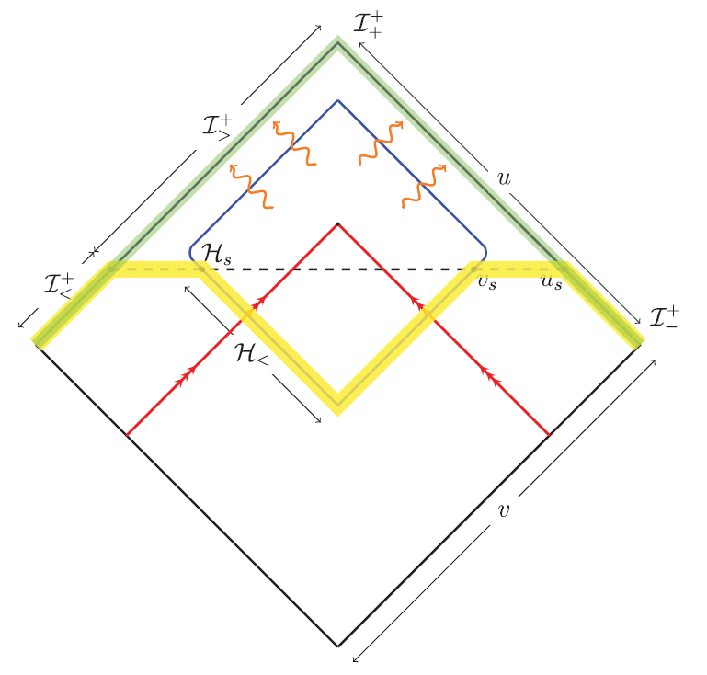
When the radiation could begin
In semi-classical limit, the formation process is essentially complete long before the evaporation turn on.
Hawking, Perry, and Strominger, PRL 116, 231301 (2016)

Slide 6

A potential problem is that when a black hole forms but the radiation does not begin, what state the black hole should stay in? No-hair theorem classically?
A plausible thought is whether the black hole have interior which can be called volume.

Slide 7


Black hole interior
There exists a transformation that tranfers the inside metric of a Schwarzschild BH into that similar to collapsing universe
That black hole radiation can be considered as equilibrium state implies that a volume can exist thermodynamically and mathematically.
FRW metric
S. M. Carroll, et al, J. High Energy Phys. 11 (2009) 094

Slide 8





Volume of black holes
The volume should be slicing invariant
To avoid the singularity of the horizon, a change has to be made for the Schwarzschild coordinates
The differential spacetime volume
The suggested volume of black holes
Application
M. K. Parikh, Phys. Rev. D 73, 124021 (2006) and others

Slide 9


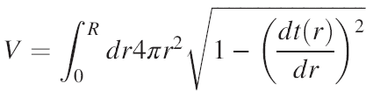
Volume of Collapsing black holes
The volume inside a two-sphere S is the volume of the largest spacelike spherically-symmetric surface bounded by S.
For collapsing black holes,
Parameterization,
The suggested volume expression
The example in flat spacetime
M. Christodoulou and C. Rovelli, Phys. Rev. D 91, 064046 (2015)

Slide 10









Maximal slicing
Maximization with an auxiliary manifold
Maximal slicing which have vanishing mean extrinsic curvature
The volume for collapsing black holes (CR volume)
B. Zhang, Phys. Rev. D 92, 081501(R) (2015)

Slide 11



Asymptotic static
The inner metric which is not static
Is it possible to describe quantum states inside?
Thus it makes sense for entropy in the volume
B. Zhang, Phys. Rev. D 92, 081501(R) (2015)

Slide 12







Entropy in the volume
Due to uncertainty relation, one quantum state corresponds to a “cell” of volume, so the number of quantum states in the phase space labeled by
With the standard statistical method, we obtains the entropy
With CR volume and estimation for the time v from the law of Stefan-Boltzmann, the final form for the entropy
This is related to vacuum polarization near horizon!
B. Zhang, Phys. Rev. D 92, 081501(R) (2015)

Slide 13



Final stage of evaporation
The earlier estimation depends on Stefan-Boltzmann law
It was shown that SB law holds so long as the mass of black hole is much greater than Planck mass.
Thus need to investigate the final stage of evaporation, which can be described well in the noncommutative spacetime.

Slide 14
A simple history
1930s, Heisenberg put forward this thought at first.
Then, Peierls tried to applied it to Landau energy level.
In 1947, Snyder constructed the first example explicitly.
In 1947 later, Yang extended Snyder’s work.
In 1948, Moyal found the Moyal product.
Until 1980s, SNC was again paid attention due to France’s Mathematicians Connes et al.
In 1986, Witten linked SNC with string theory.
In 1989, Seiberg-Witten map was put forward. Since then, SNC entered into different fields of physics, including black hole, condensed matter, high-energy physics, QM, et al.

Slide 15
There are many proposals for how this may be achieved, none of which are entirely conclusive. Of course, much of the issue concerns the magnitude of the effects of noncommutativity, and the hope is that there exist physical processes for which the effective scale of noncommutativity lies within the present day experimental energy range.

Slide 16

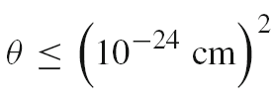
Violations of Lorentz invariance and causality
In some estimates for violations of Lorentz invariance, the NC parameter is constrained in the range
Similarly, for those with violation of causality,
Phys. Rev. Lett. 87, 141601 (2001).
Int. J. Mod. Phys. A 23, 1637–1677 (2008)

Slide 17
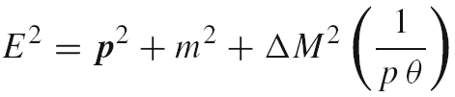



Dispersion relations
Modified dispersion relation due to NC
NC parameter is constrained by observational data from blazars or cosmic microwave background radiation
J. High Energy Phys. 0401, 037 (2004); Phys. Rev. D 79, 063004 (2009).

Slide 18
Coherent representation
Unlike the Moyal product which encodes the NC information in the definition of calculation, the present discussion writes the NC information into the coherent state which makes many cases more convenient to incorporate NC into themselves, for example, the black hole that will be discussed below.
A. Smailagic, et al, J. Phys. A 36, L517 (2003); J. Phys. A 36 L467 (2003).

Slide 19







Noncommutativity in gravity
Einstein field equation,
Solving this equation with matter of mass M, but its position Dirac-delta function is replaced everywhere with a Gaussian distribution, and thus, one can choose the mass density of a static, spherically symmetric, smeared, particle-like gravitational source as,
This shows that the energy-momentum tensor is taken as
S. Ansoldi, et al, PLB 645, 261 (2007).

Slide 20
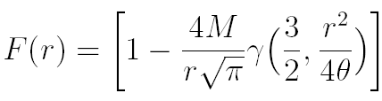

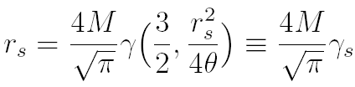

NC black holes
Solving the Einstein equation with the description above,
The horizon is calculated at
Compared with the Schwarzschild black holes,
which is the commutative limit of the NC solution.
S. Ansoldi, et al, PLB 645, 261 (2007).

Slide 21
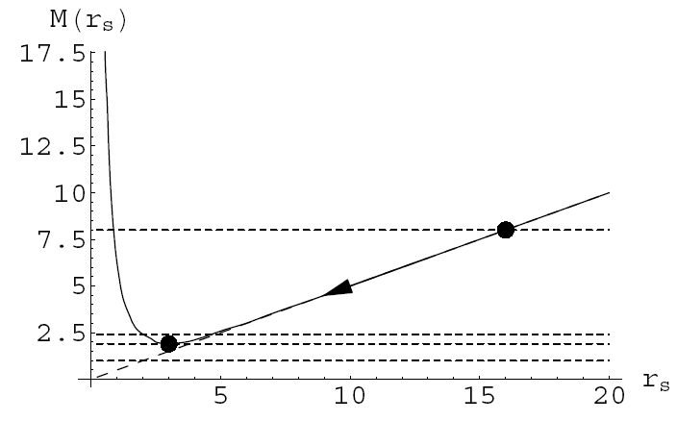


Mass in evaporation
The ending point occurs in
Y. S. Myung, et al, JHEP 02, 012 (2007).

Slide 22
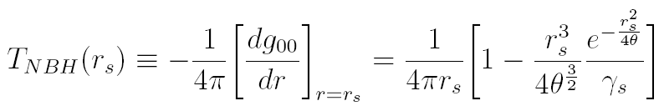
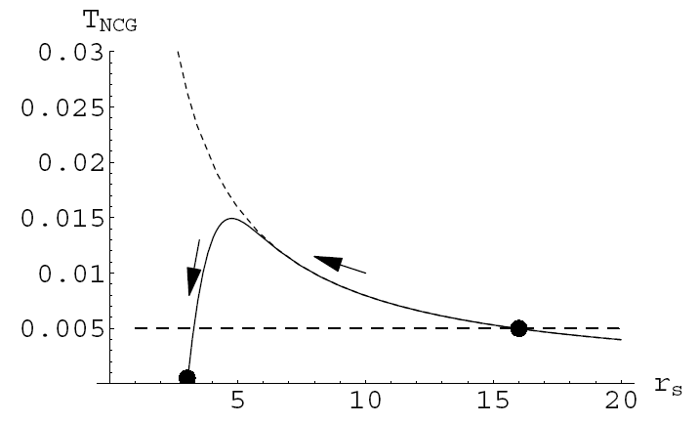


Temperature in evaporation
The turning point occurs in
Y. S. Myung, et al, JHEP 02, 012 (2007).

Slide 23
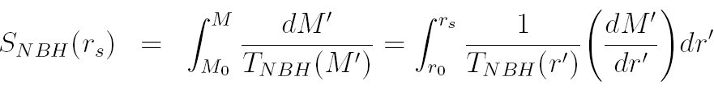
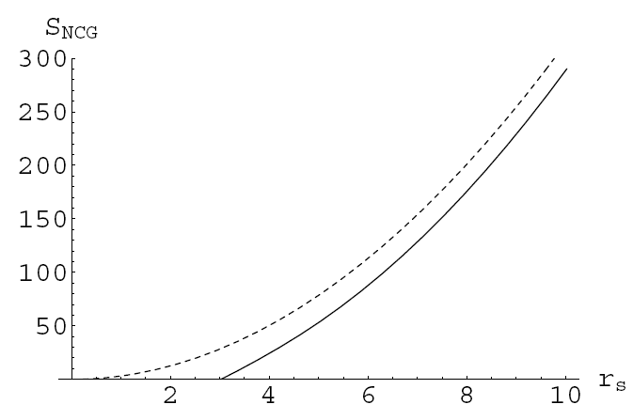
Entropy in evaporation
No conflict for NC black holes in the end.
Y. S. Myung, et al, JHEP 02, 012 (2007).

Slide 24
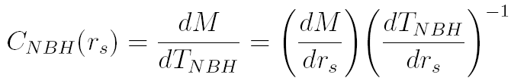
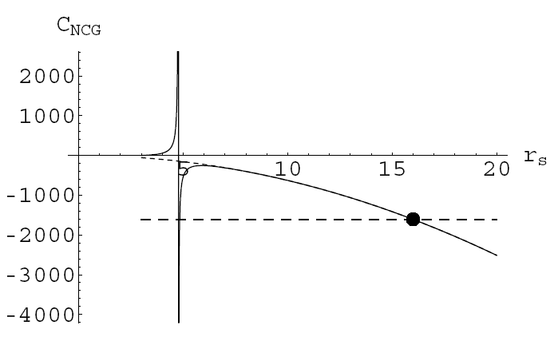
Heat capacity in evaporation
That has a second-order phase transition.
Y. S. Myung, et al, JHEP 02, 012 (2007).

Slide 25
NC black holes
All those above showed that NC black hole can provide a nice description for the final stage of evaporation, and in what follows, I will see what changes it can bring for the discussion of black hole volume.

Slide 26



NC black hole volume
Start with Eddington-Finkelstein coordinates,
but with the noncommutative expression
It is found that the maximum lies at
The volume associated with NC spacetime

Slide 27




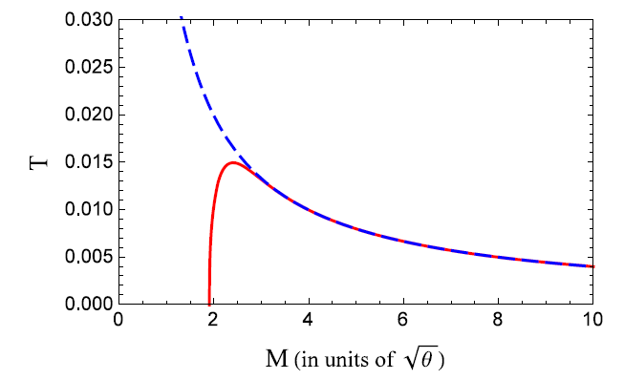
NC black hole entropy
Since only spatial NC is considered, the statistics in phase space is similar to earlier ones,
Standard statistical method gives the entropy
In what follows, we divide the evaporation into two stages

Slide 28
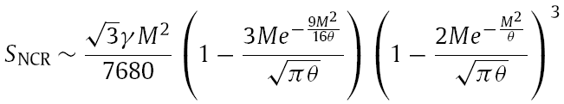

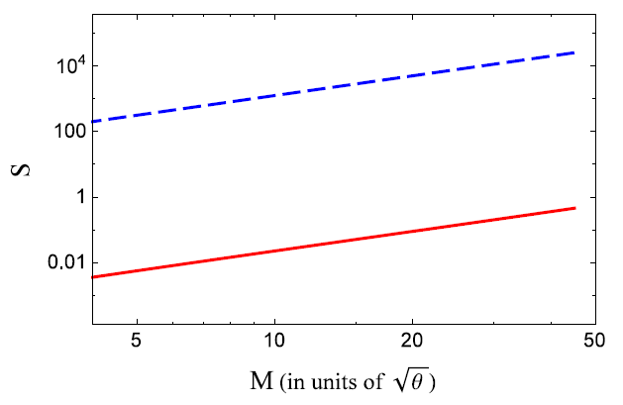
First stage of evaporation
Still the entropy associated with NC volume cannot interpret NCBH entropy!

Slide 29

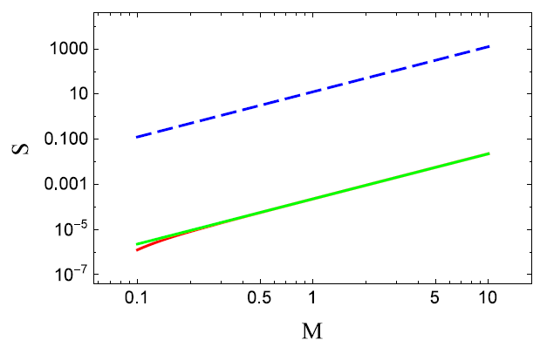
First stage of evaporation
Back reaction is considered with Vaidya metric, and the volume is modified
The entropy is presented in the picture
Back reaction doesn’t change the earlier conclusion!

Slide 30
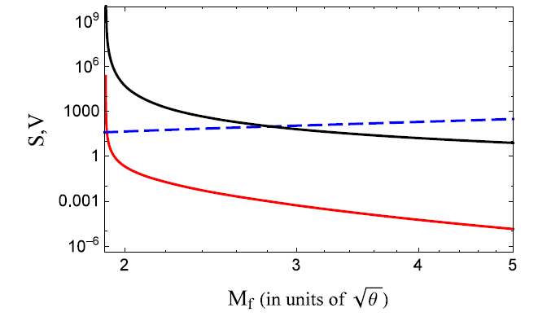



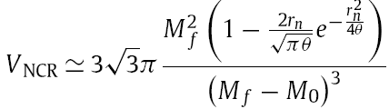

Second stage of evaporation
With the modified parameters

Slide 31
Conclusion and Discussion
The entropy associated with NC CR volume is proportional to the surface area of the black hole, but still cannot interpret BH entropy statistically.
The effect of radiation back reaction is found to be insufficient to change the above conclusion.
Infinite volume wrapped by finite surface is presented, which implies that the statistical interpretation for BH entropy can be independent of the volume.
Information cannot store inside the black hole, and unitarity can be held only through the leaking through Hawking radiation.
B. Zhang and Li You, Phys. Lett. B 765, 226 (2017)

Slide 32
Future
Whether quantum systems are influenced by gravity can be observable in present experiments on earth.
Quantum and gravity; quantum and classical physics

Slide 33

Thank you!

